Slide 1


Slide 2
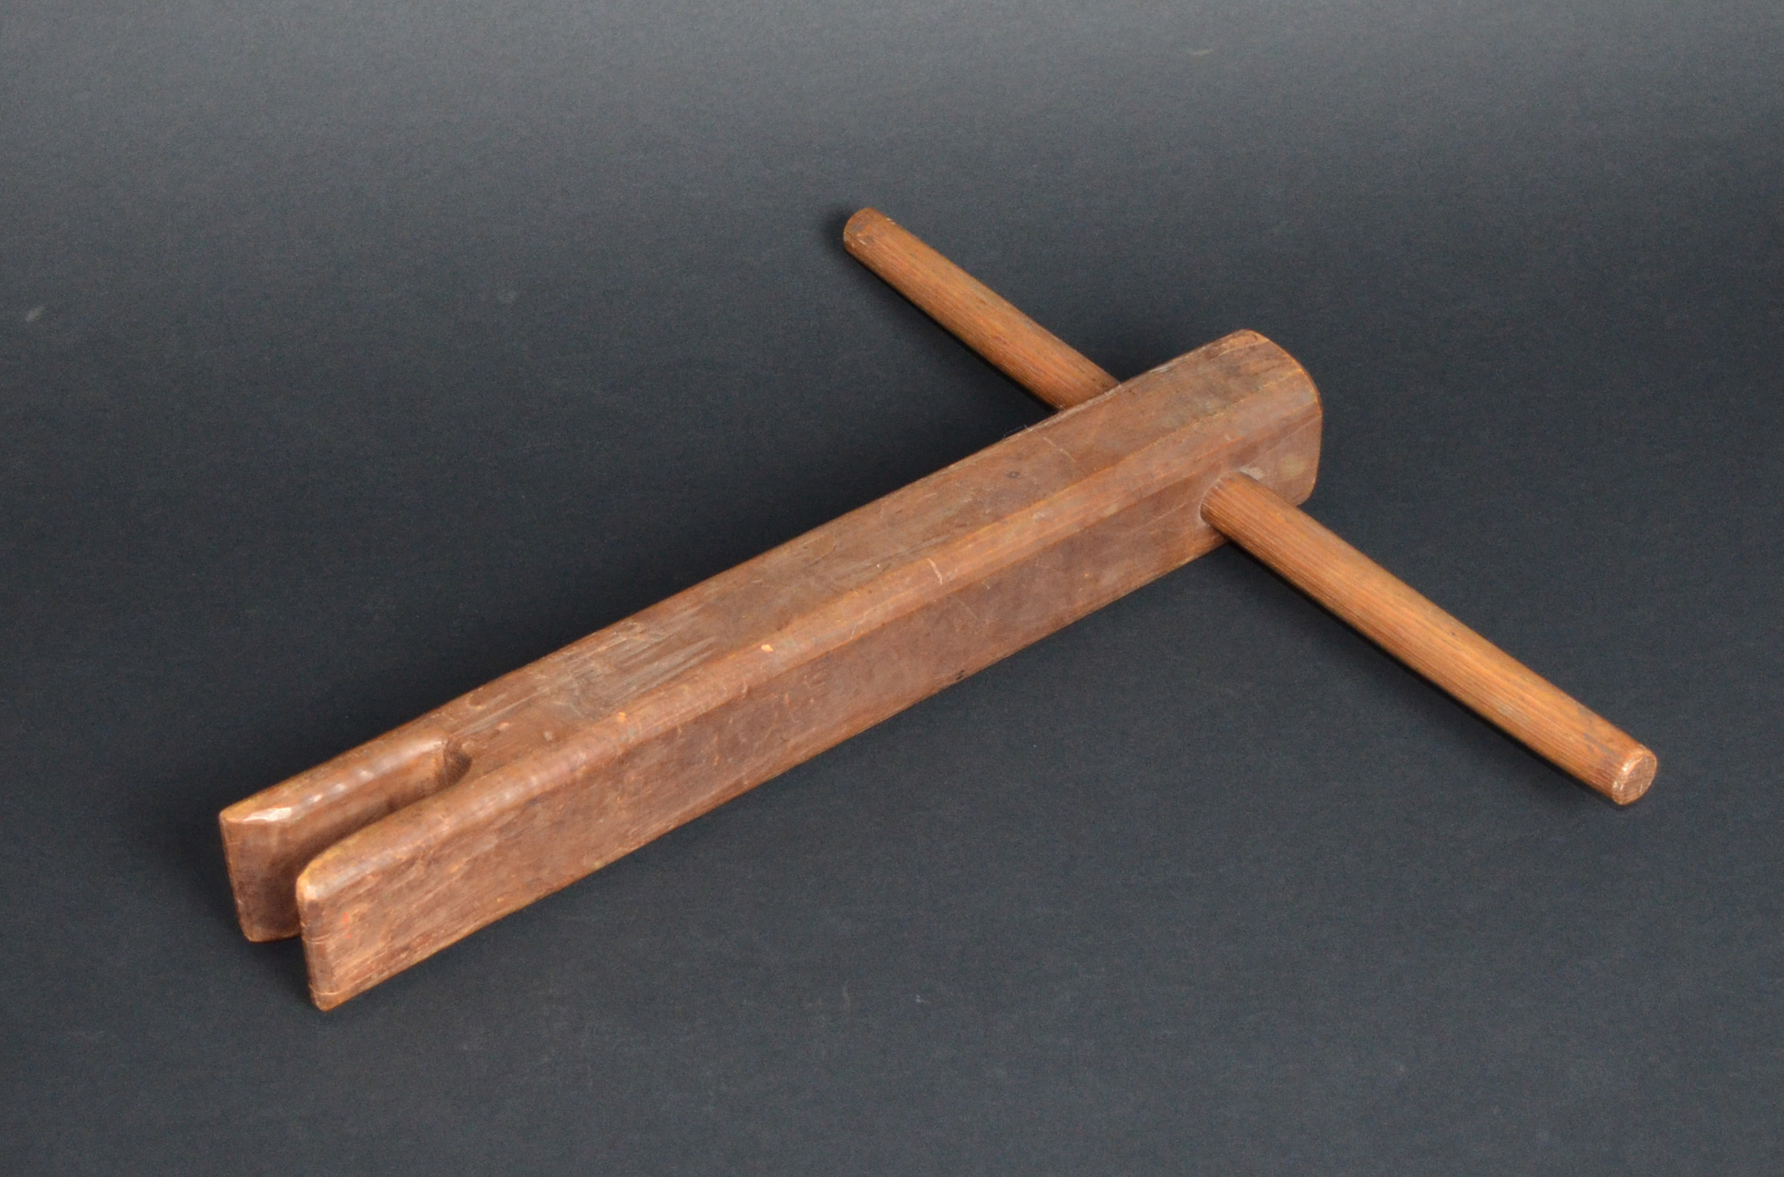
MYTH:
The phrase “sleep tight” began as a reminder to tighten the ropes on a bed.
Old fashioned mattresses, like the one slept on by John Jay, were held on their frames by ropes woven between the frame of the bed. A bed key, like this one, was used to tighten the ropes.
In the early 19th century, the word “tight” had a slightly different meaning than it does today. When someone said “sleep tight,” they just meant “sleep well” or “sleep soundly.”
Bed Key
19th century
Wood
JJ.1969.5

Slide 3
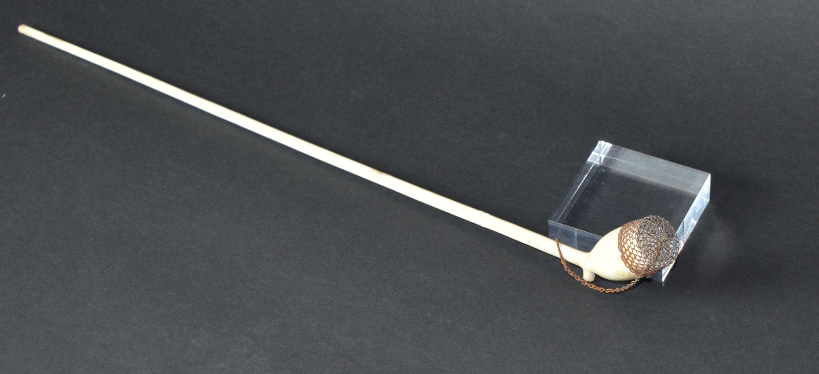
MYTH:
Men would break off the stem of a clay pipe to not spread germs when sharing it, or once tobacco residue had built up to an intolerable level.
Actually, the only reason most clay pipes like these are found in pieces at historic and archeological sites is because they are extremely fragile, and since they were so easy to break, they often did.
Clay Pipe
Goedewaagen Gouda (Netherlands)
c.1760-1830
Clay, metal
JJ.1965.325.1

Slide 4
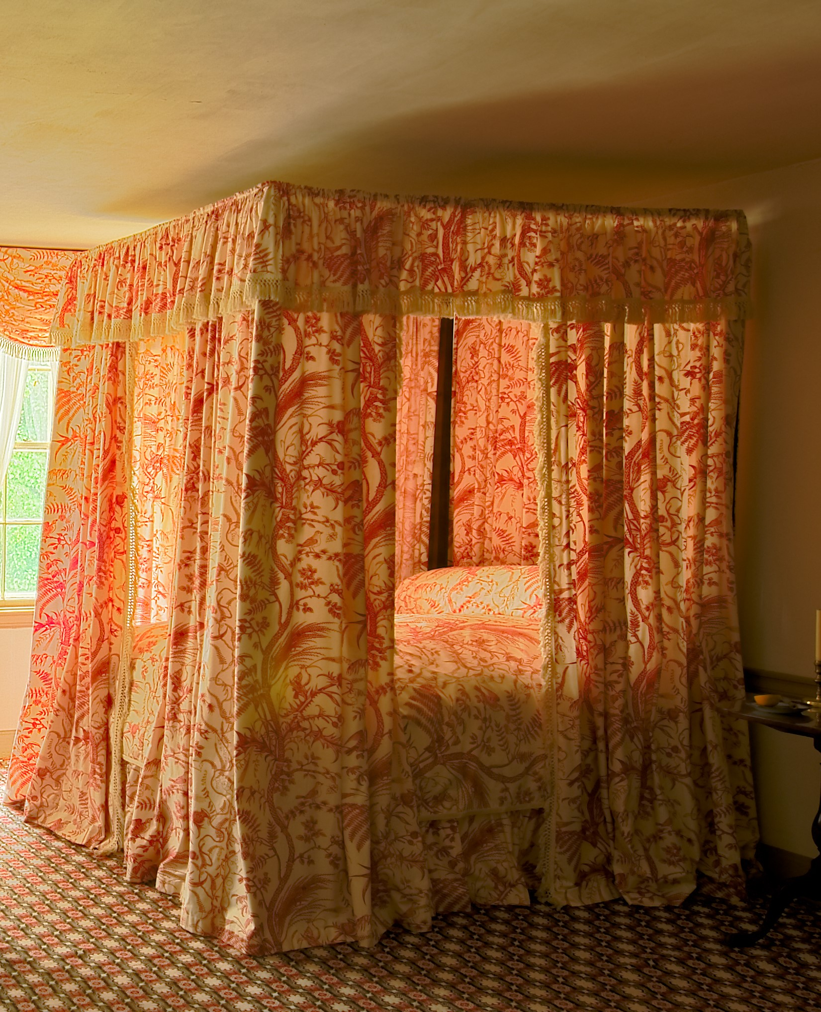
MYTH:
People “back then” were shorter than they are today.
Another common myth is that people slept sitting up.
Both these myths stem from the perception that antique beds often appear to be shorter than modern beds; however, it is an optical illusion. John’s bed, and most others from the period are approximately the same size as beds today. The combination of the canopy, fabric hanging from the top, and the puffy feather mattress just makes beds from the period appear much shorter than they are.
John Jay’s Bed
c.1780
Wood, linen
JJ.1958.112

Slide 5
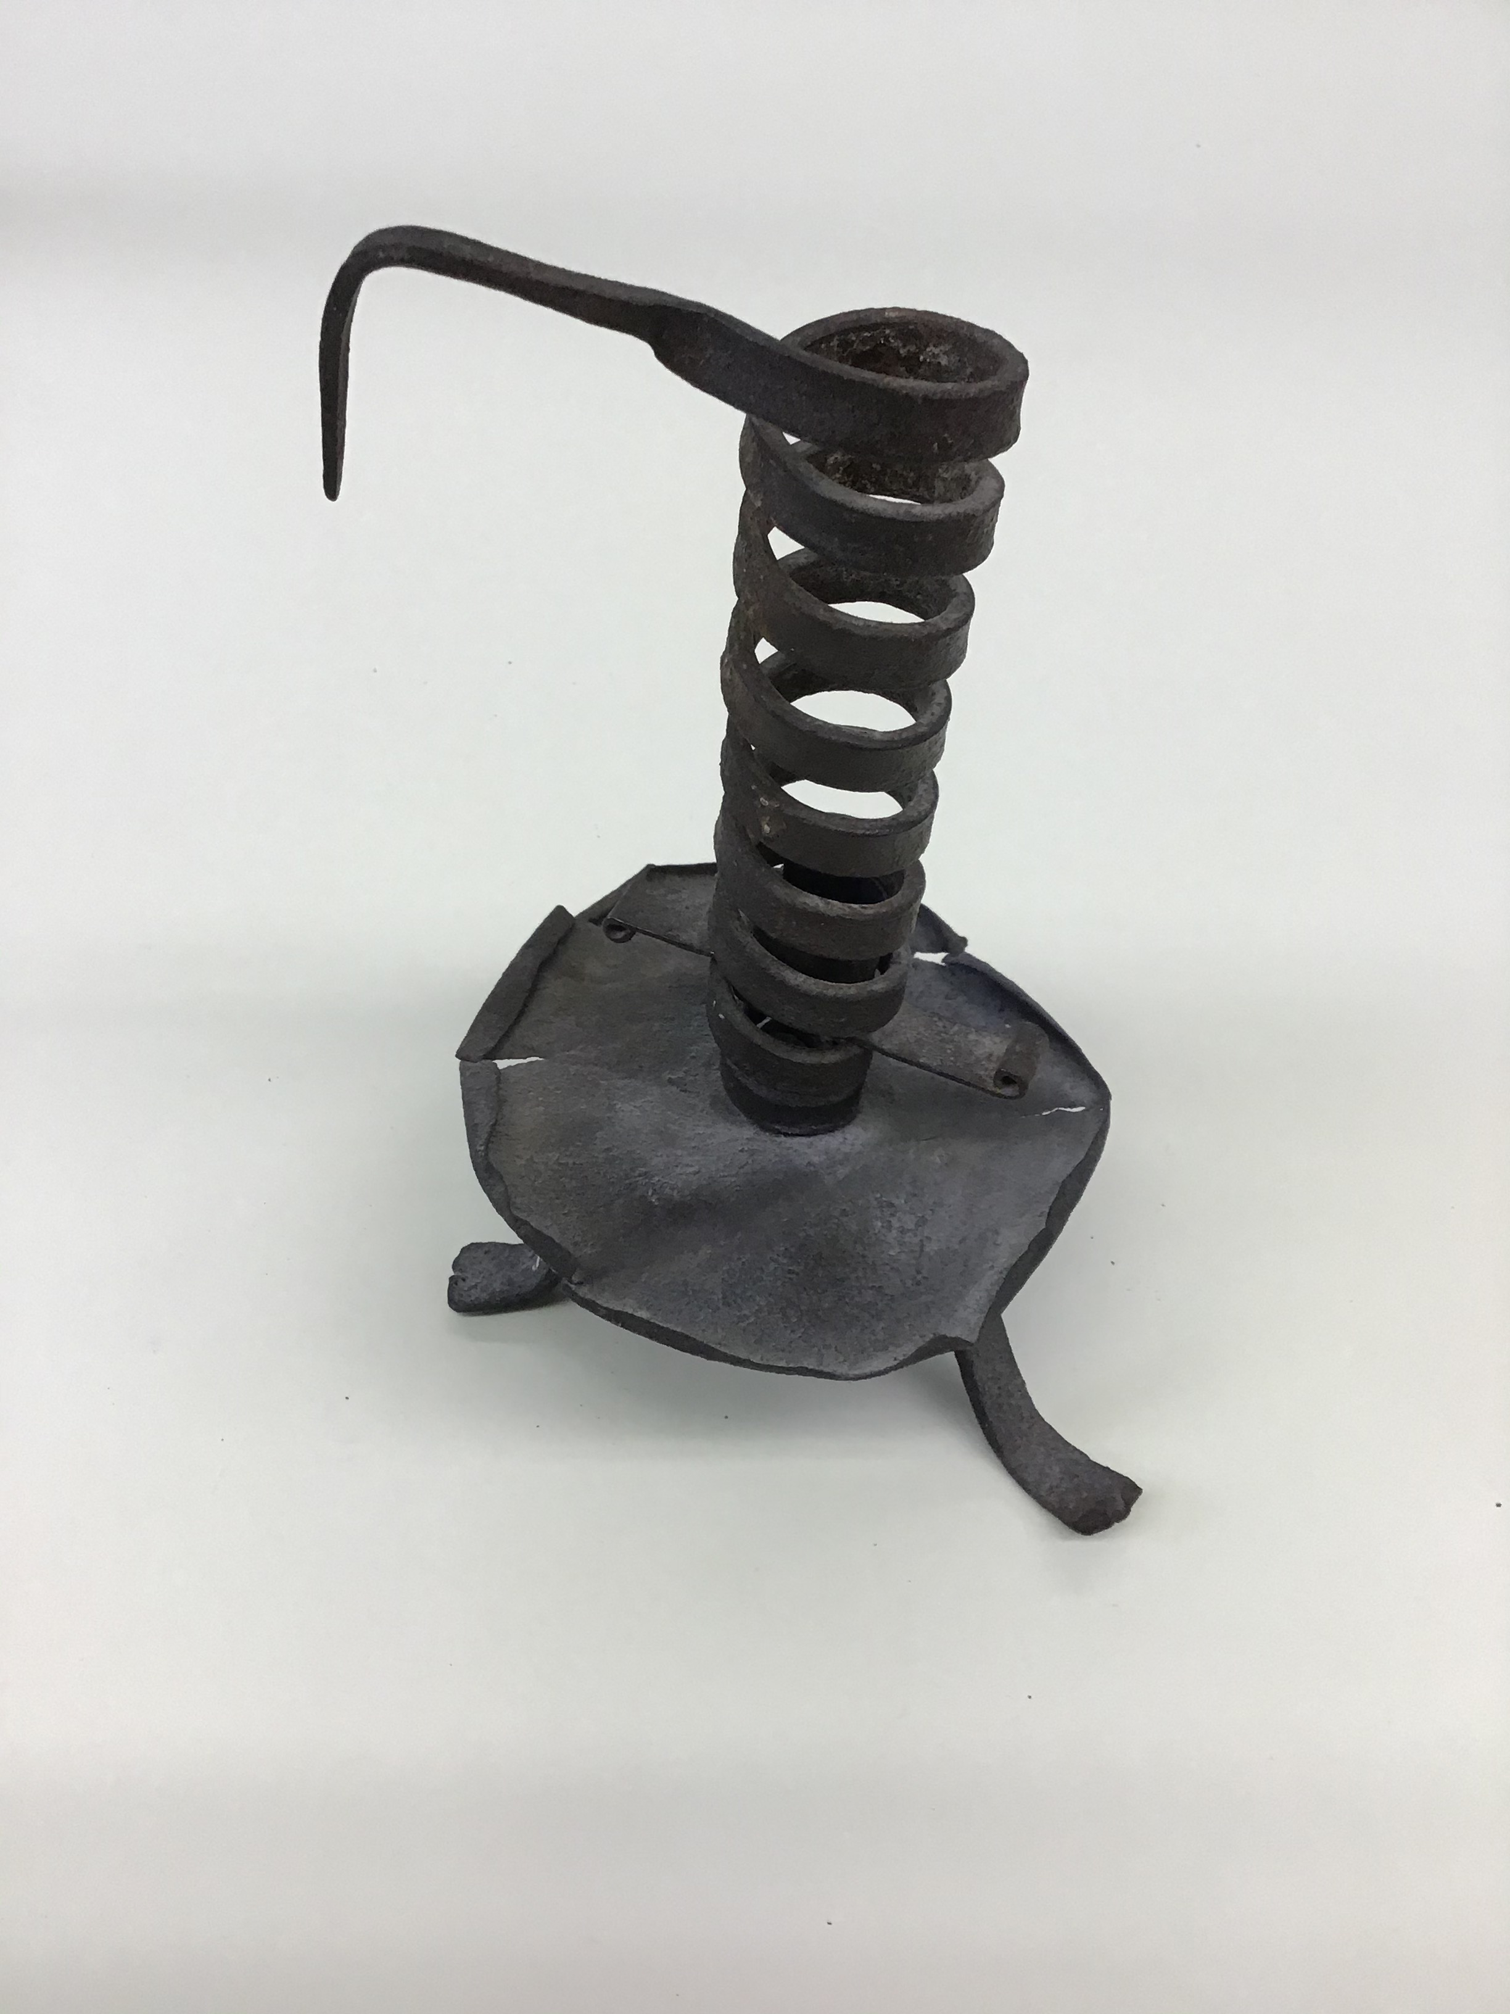
MYTH:
A candle’s height could be adjusted to alter burn time, and therefore effect the amount of time a suitor would be able to stay courting.
Although the spiral design of this candle holder was used to adjust a candle’s height and burn time, it was not invented for courting customs. In truth, these spiral candlesticks were simply a practical design for holding all types of candles, and the adjustable mechanism allowed people to use as much of the candle as possible.
Courting Candle
19th century
Iron
JJ.1962.83

Slide 6
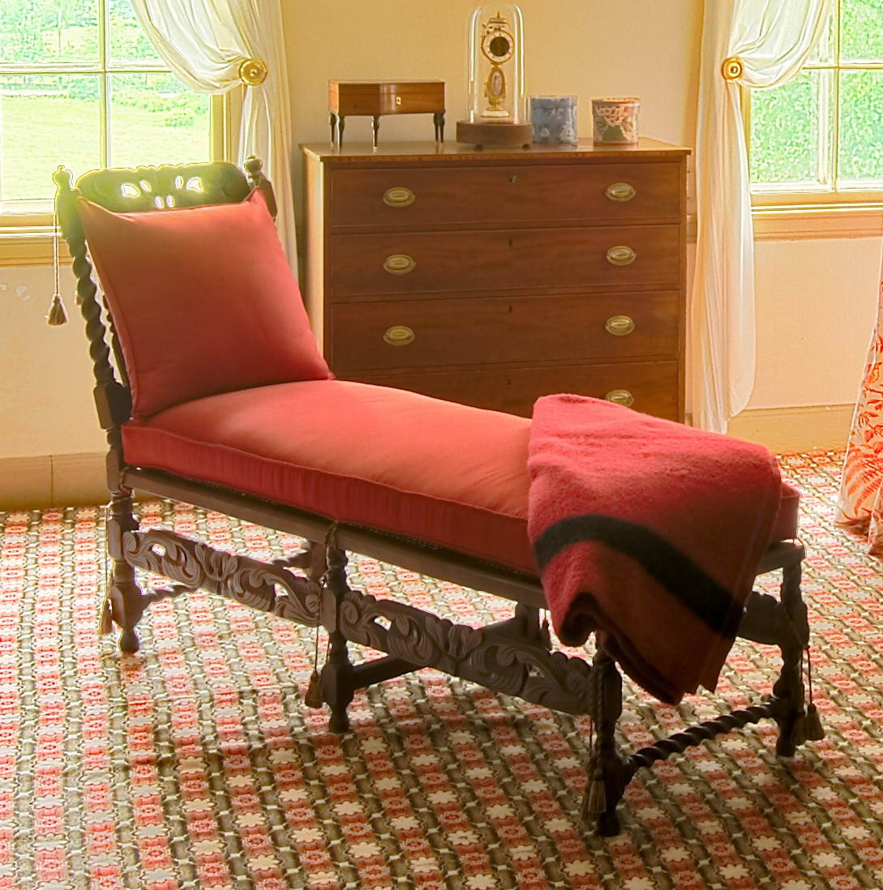
MYTH:
This piece of furniture was invented during the Victorian era and is called a “fainting couch” because women would need a place to catch themselves should their tight corsets cause a fainting spell.
Another common myth is that these were called “daybeds” and were used as a casual resting place during the day, as it was considered improper to nap in one’s bed during the day.
In truth, daybeds have been around since ancient Egypt. While they would have been a convenient place to rest if a woman felt faint or ill from her tight corset, in reality they were just designed as a fashionable piece of furniture.
Fainting Couch or Day Bed
19th century
Walnut, maple
JJ.1958.622

Slide 7
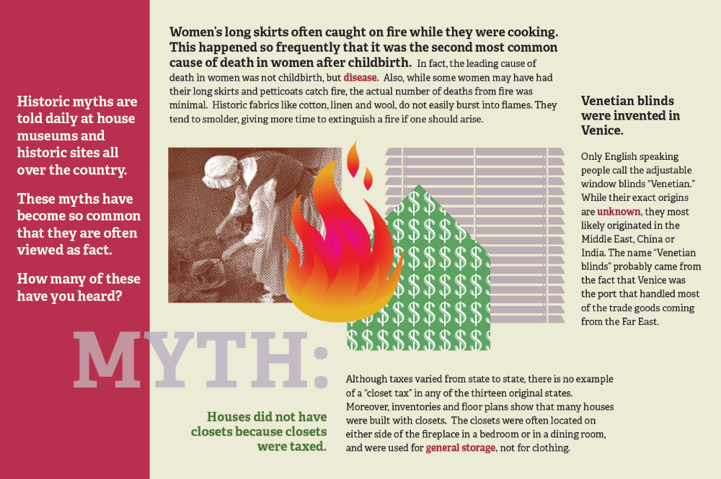

Slide 8
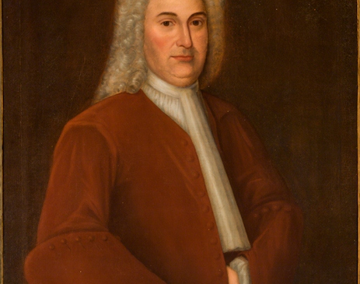
MYTH:
Artists charged more to paint hands, as they are more difficult to execute accurately.
Many people believe that during the 18th century, men who posed for portraits often did so with one hand inside their jacket pocket for this reason. While hands are challenging for artists, the hand-in-jacket look was simply a striking, and dignified, stance for someone to take for a portrait.
Portrait of Auguste Jay (1665-1751)
Attributed to Evert Duyckinck III
c. 1697
Oil on canvas
JJ.1982.89

Slide 9
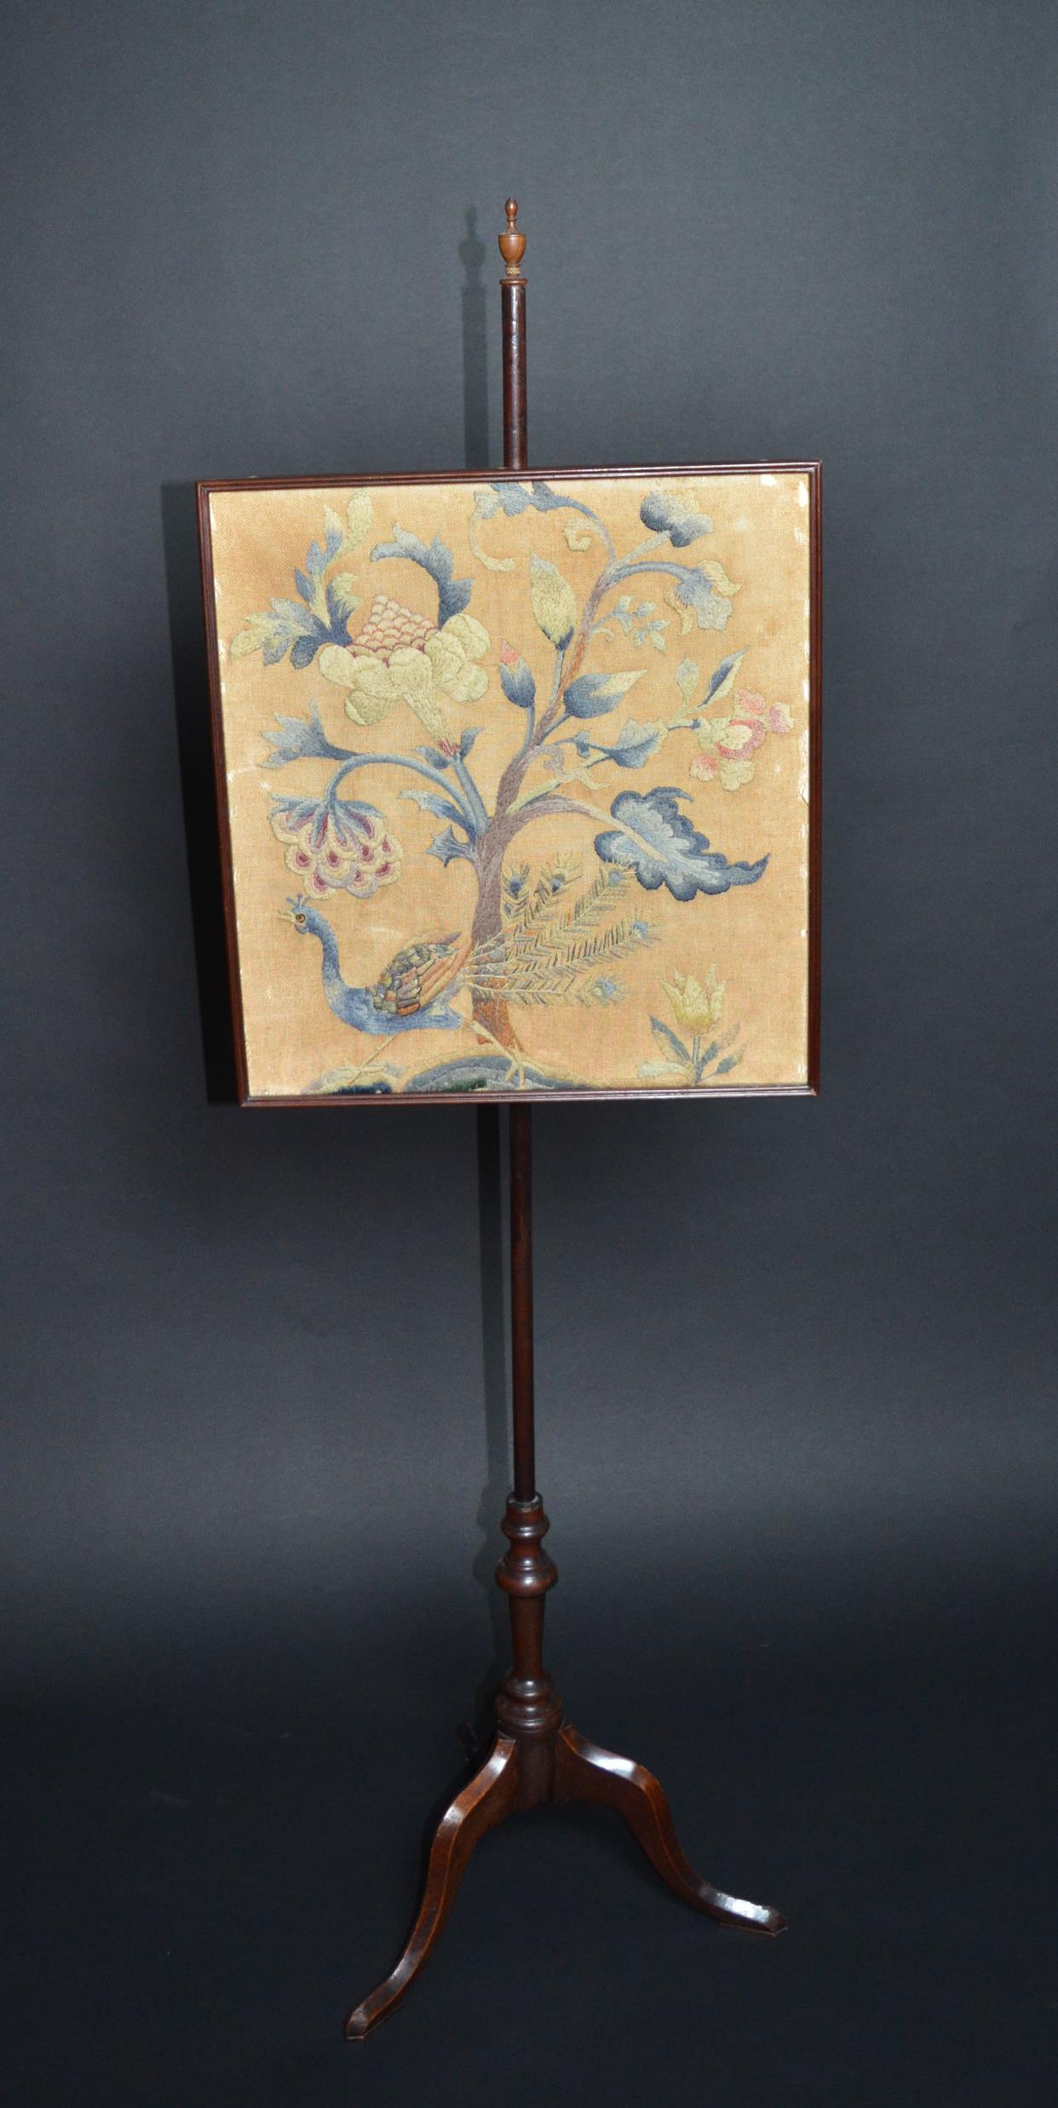
MYTH:
Fire screens were designed to protect a woman’s makeup, made of wax, from melting.
This was probably not the case as women only wore makeup on very rare occasions during the Colonial era; they would not have worried much about it melting off from day-to-day. In fact, fire screens like this were made as a barrier between them and the fire so they could be more comfortable, and not overwhelmed by the fire’s direct heat.
Fire Screen
c. 1750
Wool, silk, cotton, mahogany, brass
JJ.1964.166

Slide 10
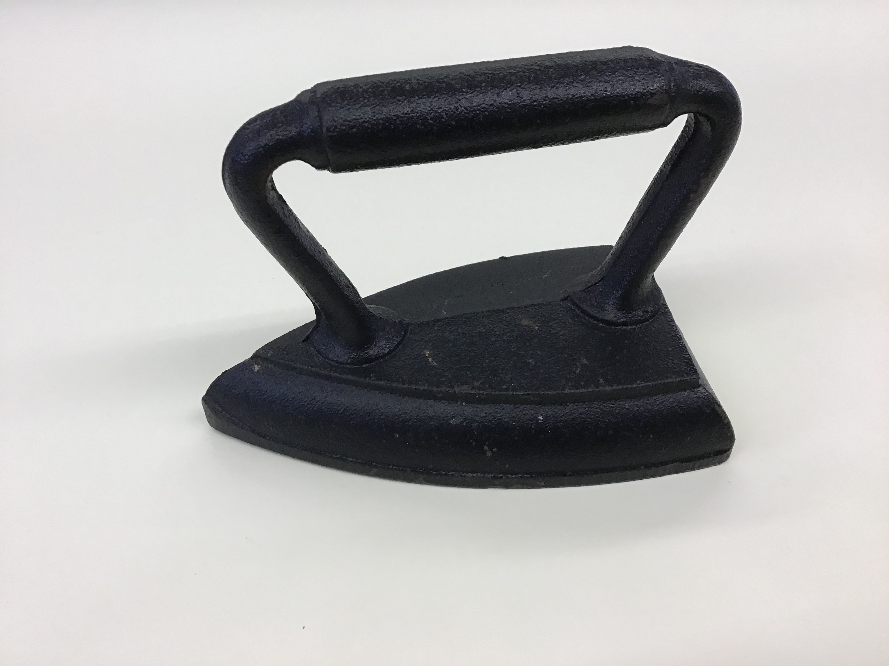
MYTH:
The phrase “too many irons in the fire” has its origin in the early chore of ironing clothes.
The myth refers to early 19th century laundresses. While working, they would be using one iron, and have at least one other heating up on the stove or by the fire. The myth suggested that too many irons heating up at once might cause a fire.
In truth, historians believe the saying likely originated in the blacksmith trade. Smiths would often keep more than one iron heating up at any given time to increase their productivity. An iron left on the fire too long could be damaged to the point of being useless.
Iron
Early 20th century
Iron, wood
JJ.1968.49

Slide 11
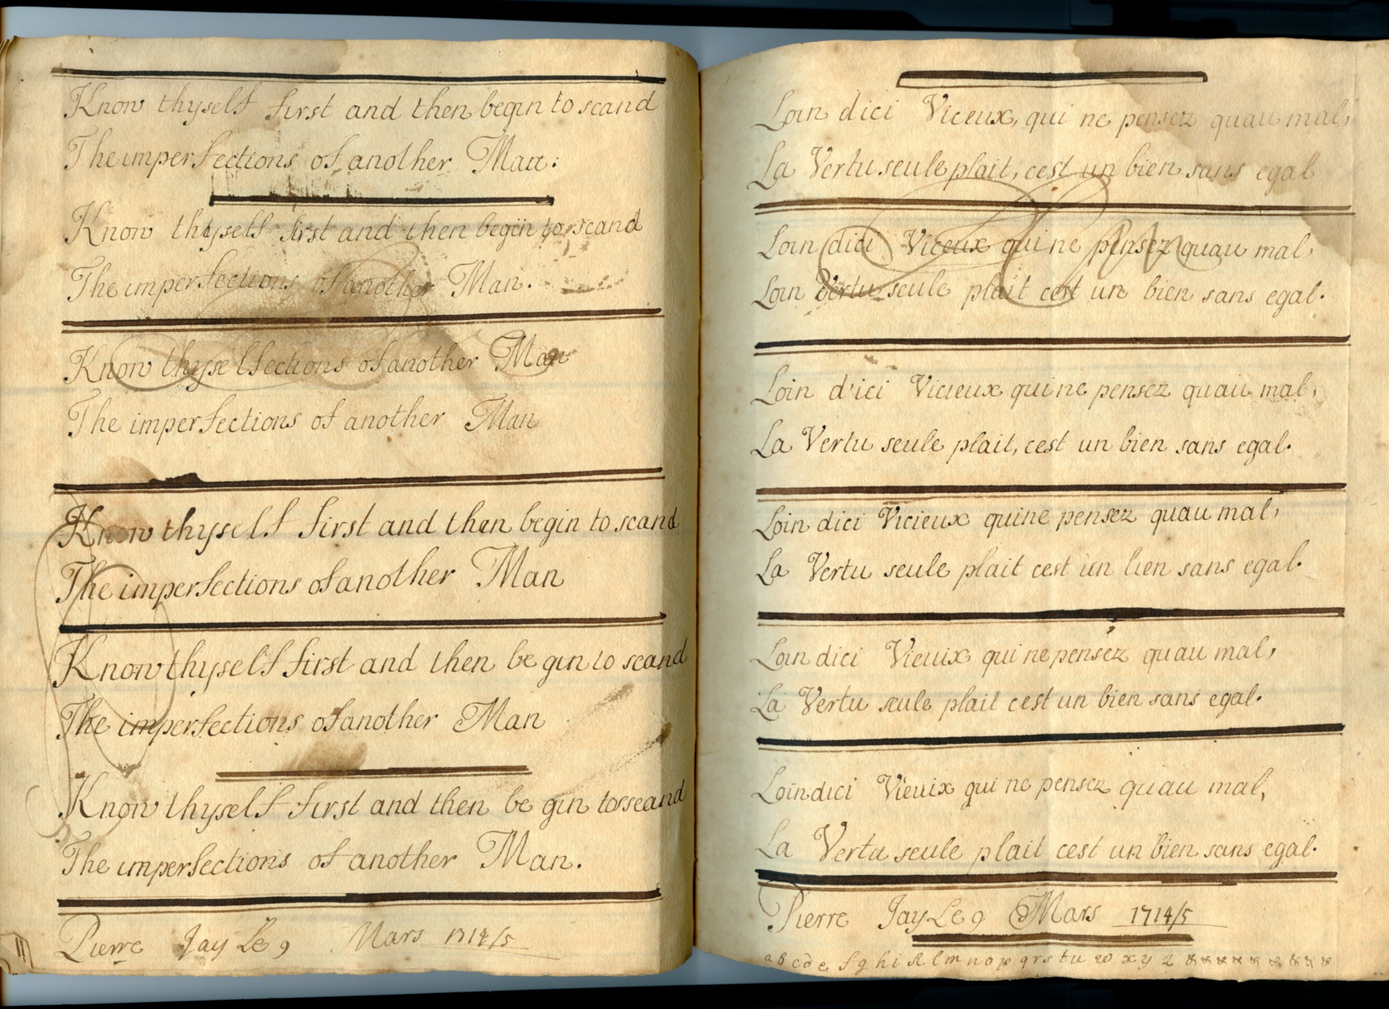
MYTH:
There is no J Street in Washington, D.C. because L’Enfant didn’t like John Jay.
This legend centers on the original planning of Washington D.C. by Major Pierre Charles L’Enfant, and the naming of the city’s streets. The myth states that there is no J street in Washington D.C. because L’Enfant was displeased with the Jay Treaty, which greatly favored Great Britain over the interests of the United States and France. The original plans for city, which did not include a building for the Supreme Court, provide additional evidence for suspected animosity between Jay and L’Enfant.
In fact, L’Enfant worked on the project from 1790-1792, yet Jay did not depart for negotiations of the Jay Treaty until 1794. The explanation for the missing J street lies in the Latin alphabet, on which the English language is based. The letter “J” didn’t appear until the Middle Ages, when it was sometimes used as a substitute for the letter “I.” During L’Enfant and Jay’s lifetime, the letters “I” and “J” were interchangeable in written English, although they sounded different when spoken.
The penmanship practice books of Peter Jay, John Jay’s father, show that the alphabet simply went “G, H, J, K;” the letter “I” is completely left out.
Peter Jay’s Penmanship Book
C. 1714
Paper, Ink
JJ.1978.46

Slide 12
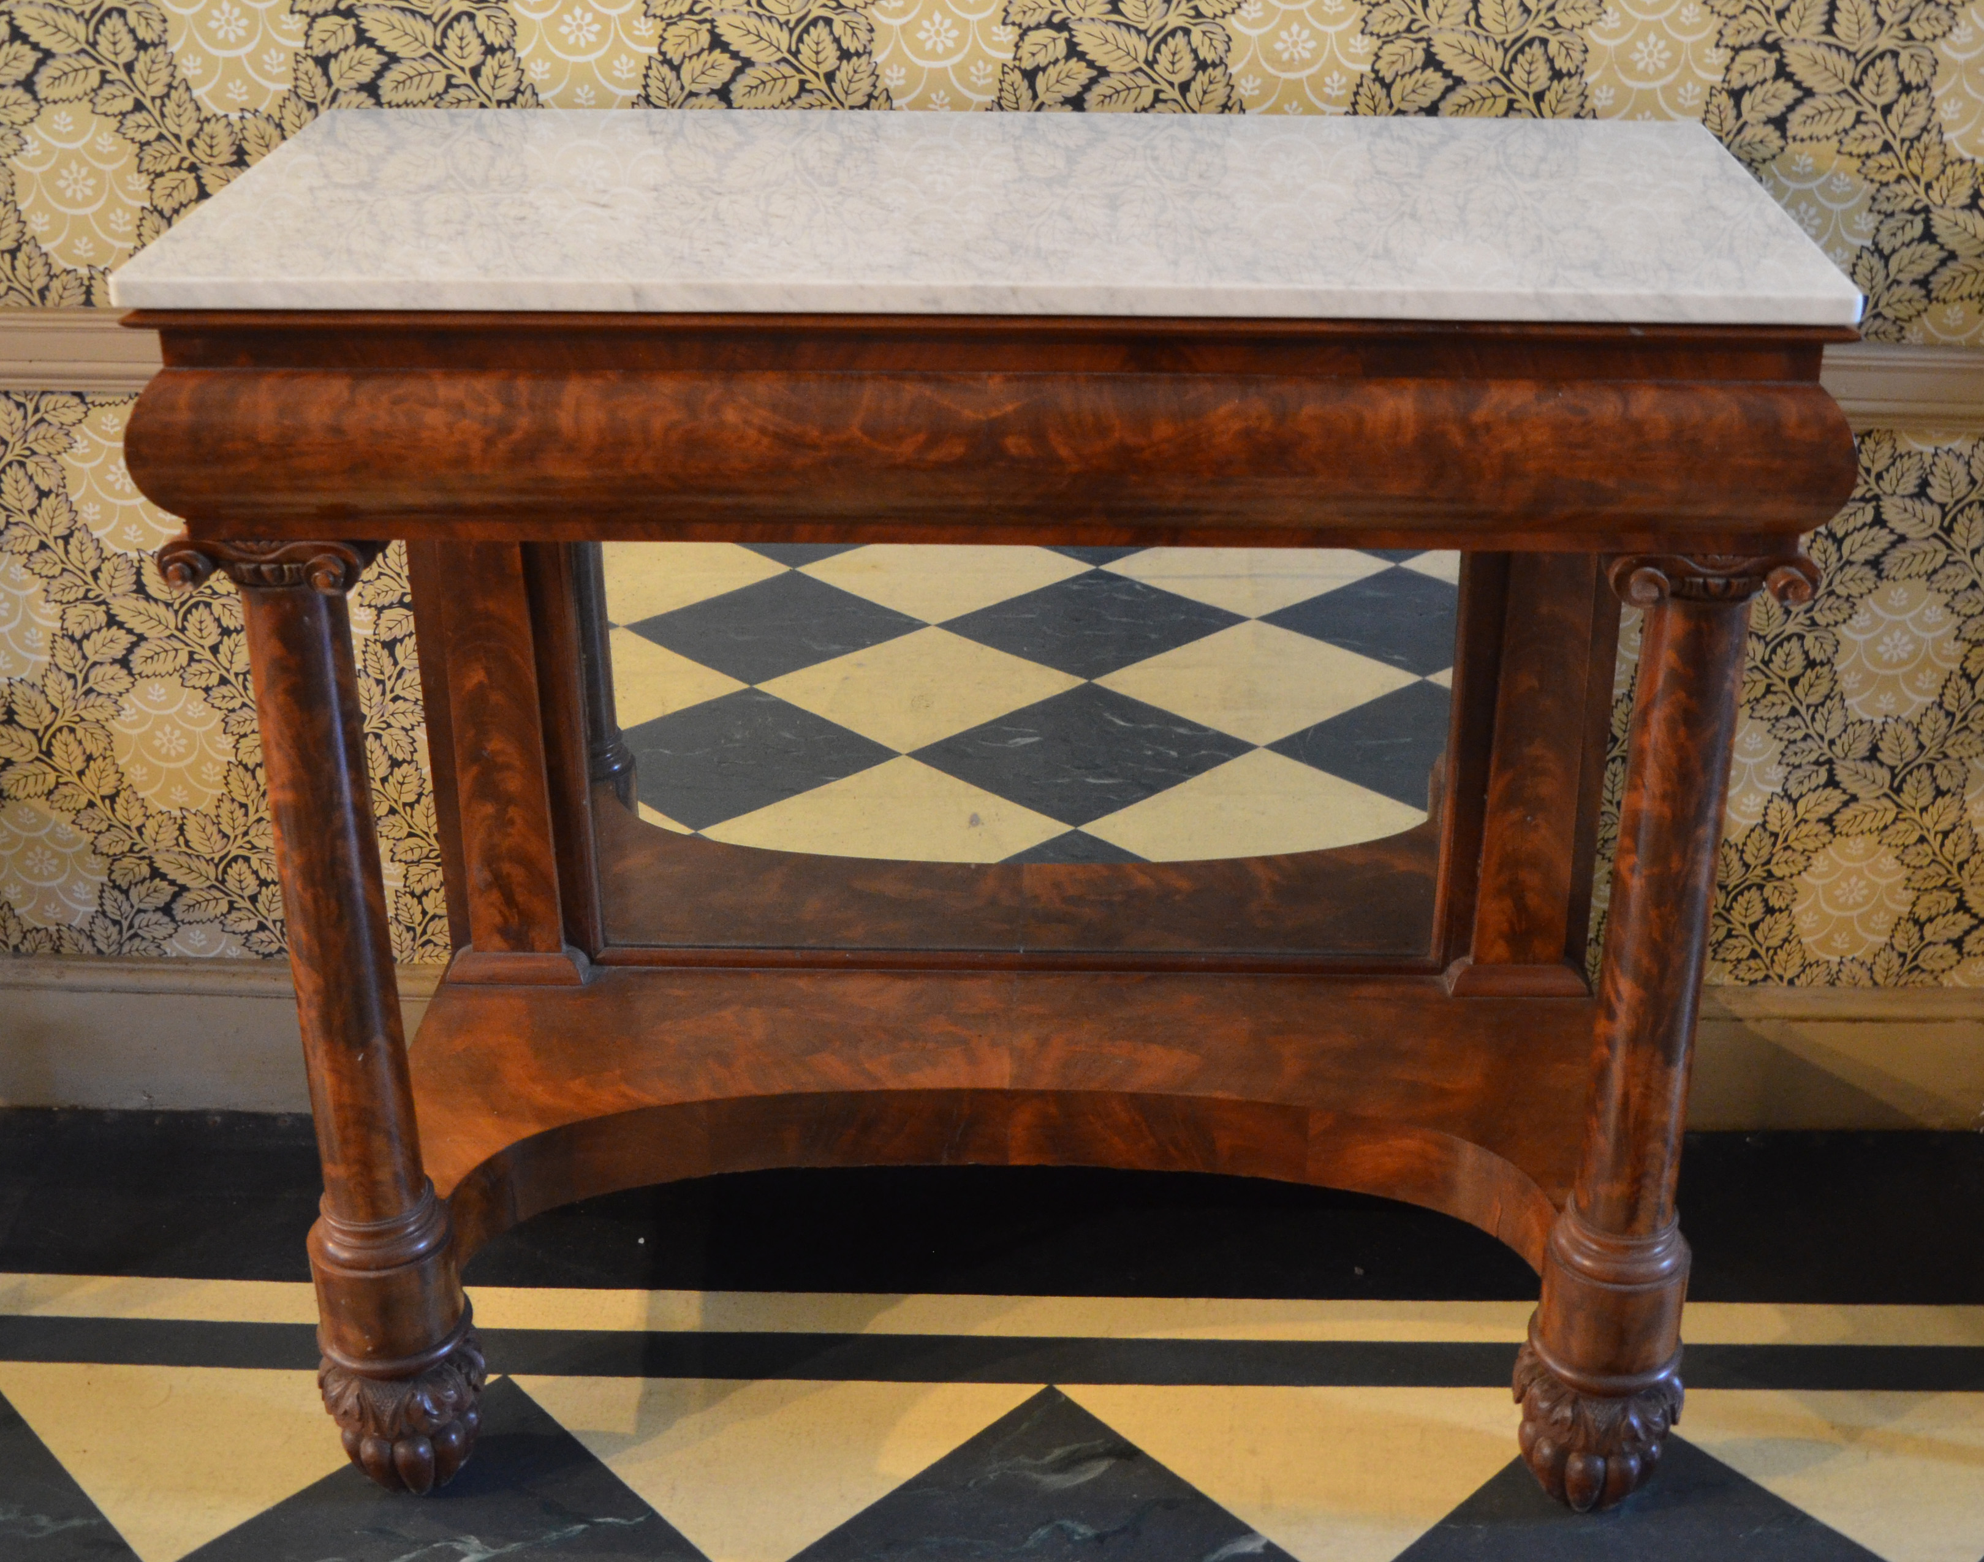
MYTH:
The lower mirror on a pier table is there so that women could make sure their ankles were not showing.
In fact, this style of furniture is called a “pier table” because it was designed to be placed in between windows in a parlor or dining room, a space known as the pier. The mirror underneath is designed to reflect light to make the room brighter. Try it yourself: stand in front of the table and note that it is impossible to see your ankles in the mirror while standing up.
Pier Table
c.1810-1820
Glass, rose wood, marble
JJ.1958.125

Slide 13
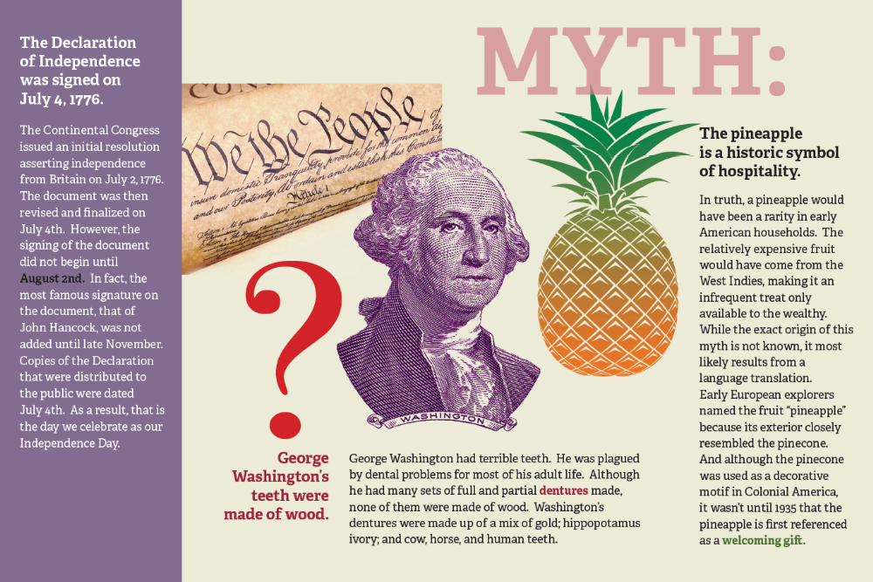

Slide 14
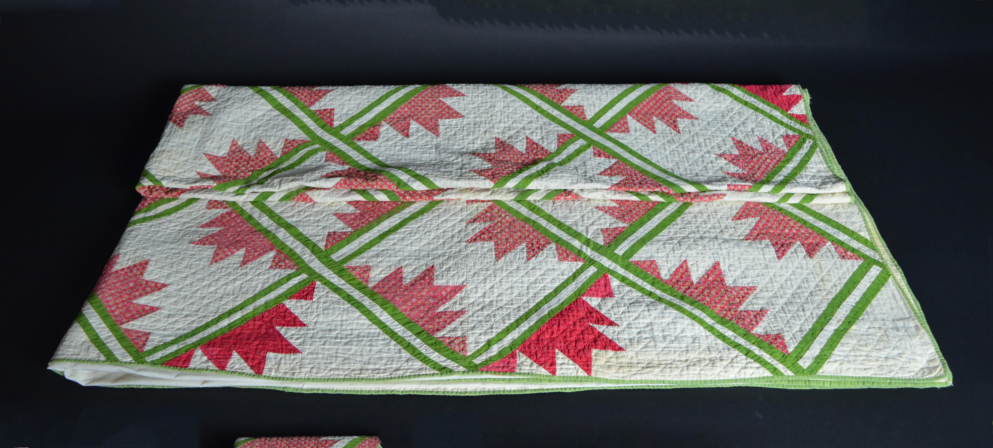
MYTH:
Hidden messages sewn into the patterns of quilts provided runaway slaves directions along the Underground Railroad.
This quilt contains a great example of a pattern often associated with the Underground Railroad. According to legend, the “bear paw” design either indicated that runaway slaves should follow a mountain trail to keep them hidden from view or suggested they follow an actual bear’s trail which would lead them to water and food. Scholars have found no historical evidence of any uniform pattern, or symbol, stitched into quilts that could be translated into directions, or messages to runaway slaves.
Quilt
Late 19th – early 20th century
Cotton
JJ.1999.71

Slide 15
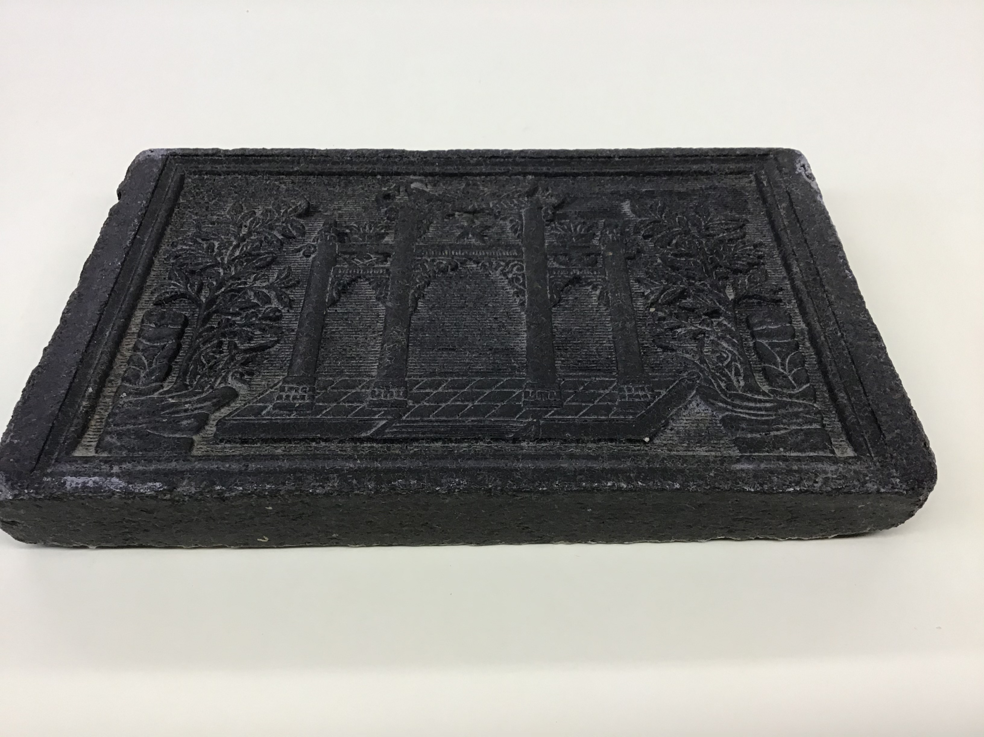
MYTH:
Tea was shipped to, and stored in, the colonies in the form of tightly packed bricks.
While it is true that some tea was transported in bricks like this, that was primarily in China where tea was used as a form of currency. During John Jay’s time, most Americans had their tea shipped and stored in the more common “loose leaf” form familiar to us today. While tea was still packed tightly for shipping from China to the British Colonies, it was not in the compact brick form, but loose enough that the customer could break it up and store as they pleased.
Tea Brick
18th century reproduction
Tea (compressed)
RTJJNA

Slide 16
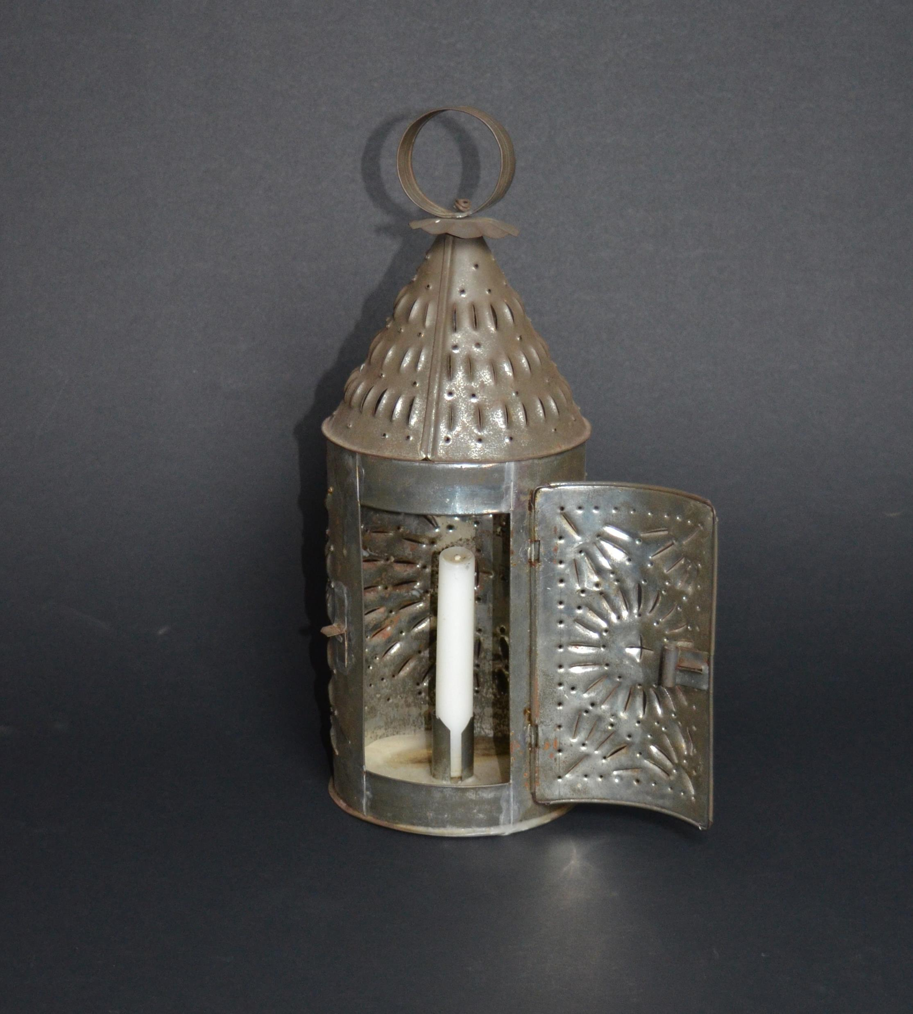
MYTH:
You could tell who was walking around at night by the pattern of light emitted by their tin-punched lantern.
Lanterns with punched patterns, like this one, were thought to be unique to individual families in the Colonial era. Historians have performed experiments that prove it would be impossible to distinguish one light pattern from another at any kind of distance.
Tin-Punched Lantern
18th century reproduction
Tin
RTJJ.1991.41

Slide 17
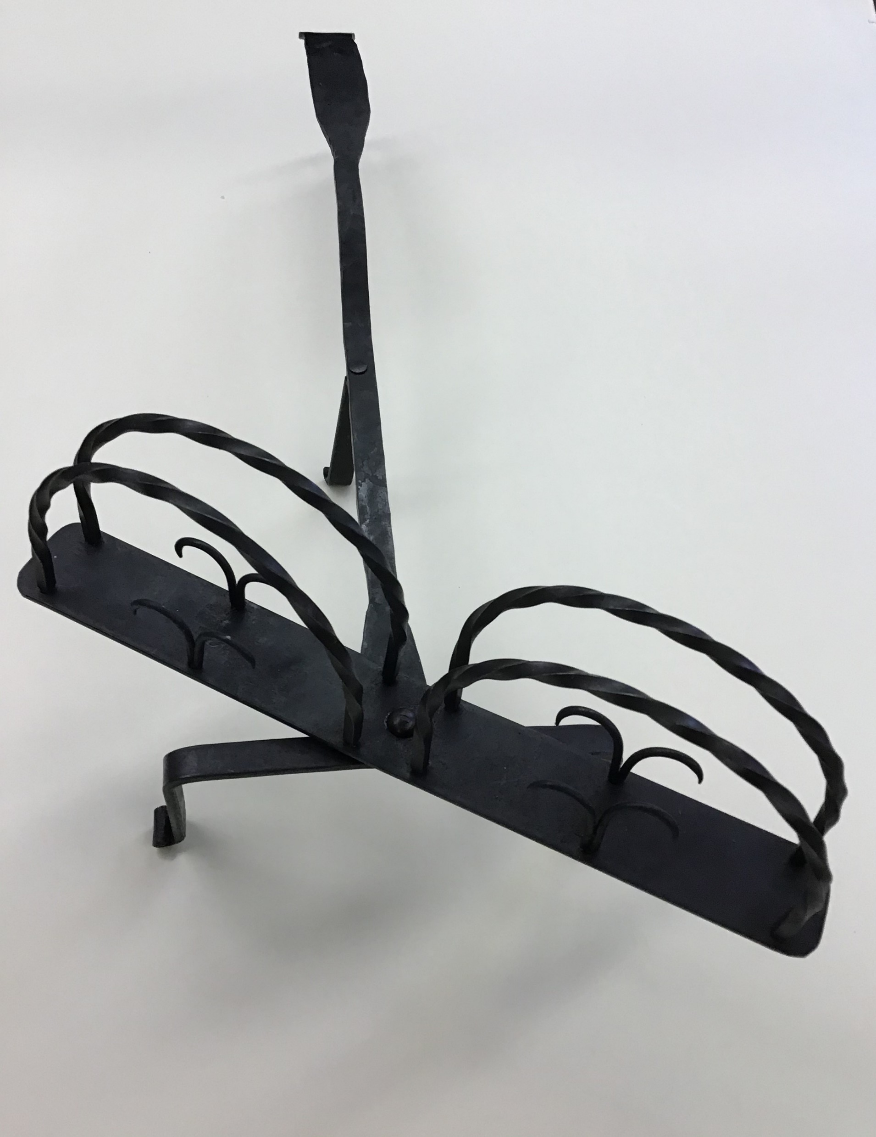
MYTH:
This device got its name “toaster” because people would turn it, to brown both sides of their bread, with their toe.
This is perhaps the most obvious myth of all! Of course the word “toaster” comes from the fact that the device makes bread lightly burned and crispy, or toasted. People would usually turn their toasters using a fireplace tool, so they wouldn’t burn their fingers or toes.
Toaster
c. 1800-1840
Iron, paint
JJ.1995.38

Slide 18
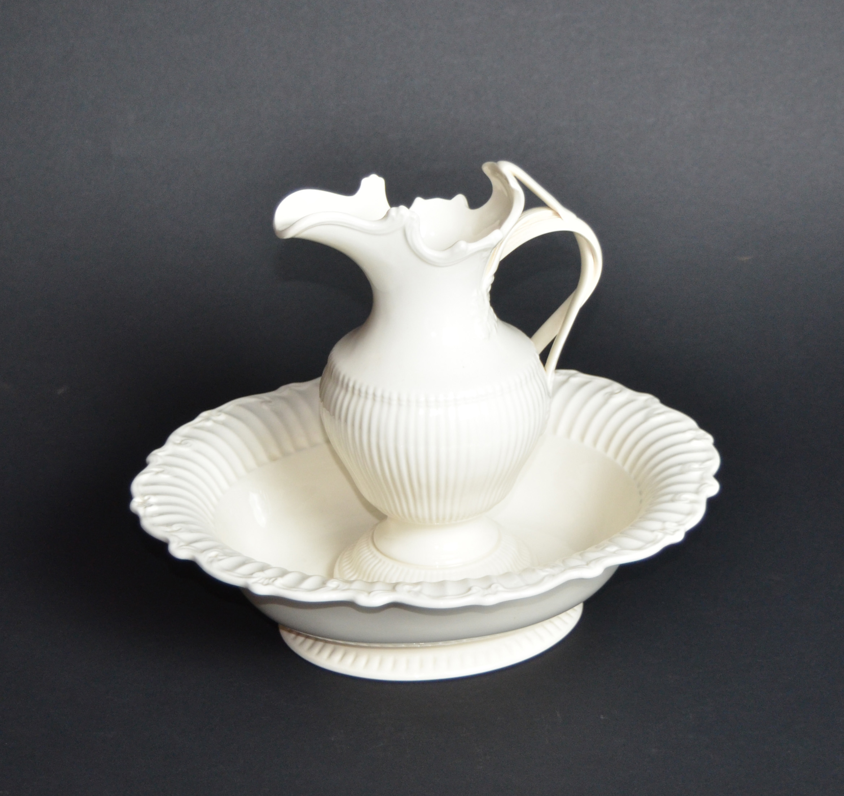
FACT:
People who lived during John Jay’s time only bathed a few times a year.
People during the Revolutionary era only filled a tub with water, sat in it, and washed their entire body a few times a year. However, their version of “bathing” daily would have involved the use of a wash basin like this one. They would have used it to wash their hands and face, and would clean the rest of their bodies with a sponge.
Wash Basin
18th century reproduction
Ceramic
RTJJ.1997.4.1&.2

Slide 19
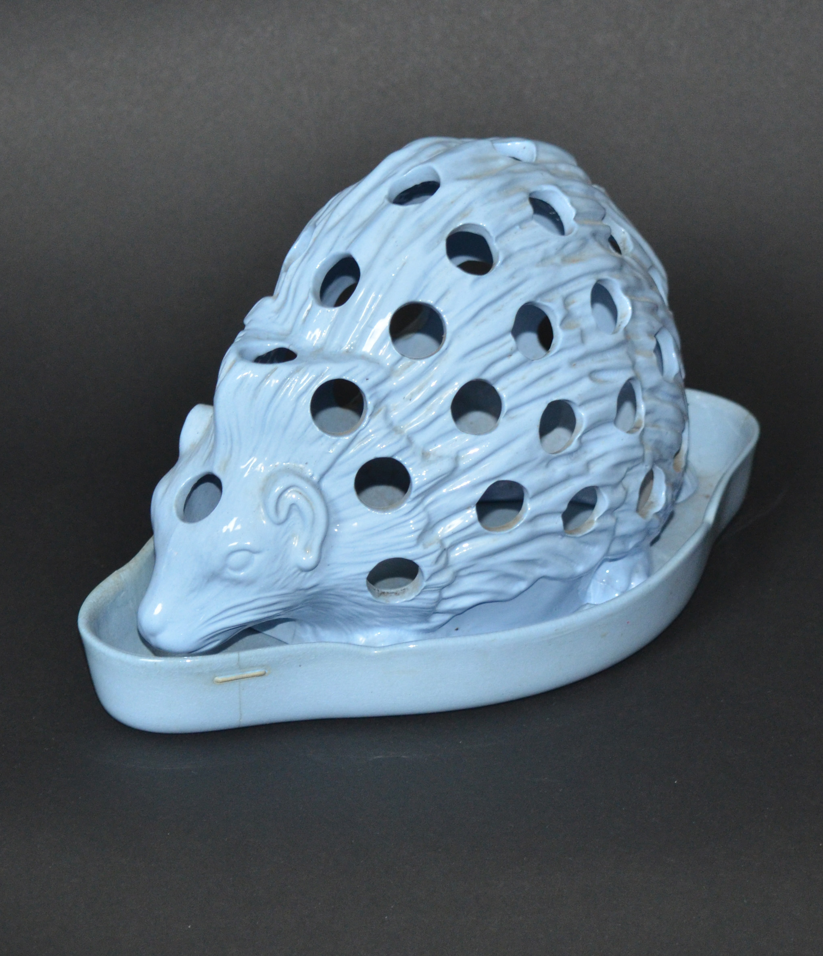
WE STILL MAKE MYTH-STAKES
Although not stemming from a history myth, this object had been misidentified by museum staff for the last 50 years. We originally thought this was a spill holder. Spills were small, reed-like pieces of wood that would be used to transfer fire from one place to another, such as from the fireplace to a candle. While doing some research for our Connecting to Collections program series, we discovered that it is in fact a bulb pot. The hedgehog’s body and the tray below would hold soil; crocus or other bulbs would be planted and forced to bloom through the holes. We essentially created our own history myth.
Bulb Pot
Josiah Wedgwood
1771
Earthenware
JJ.1968.215

