Slide 1



.Net Havoc
Abusing ASP.net Mechanics &
Overriding Properties of Server-Side Web Controls
Shay Chen, CTO
@sectooladdict
Hacktics ASC, Ernst & Young
September 12th, 2013

Slide 2

About
Formerly a boutique company that provided information security services since 2004.
As of 01/01/2011, Ernst & Young acquired Hacktics professional services practice, and the group joined EY as one of the firm’s advanced security centers (ASC).

Slide 3
Abusing ASP.net Mechanics
Identify Hidden Server Controls
Enumerate Control Type
Inject / Override Control Properties
Cached Viewstate / Validation Mining
Web Control Event Execution

Slide 4

Introducing
SCIP!
Server Control Invisibility Purge
A project based on a research by Niv Sela and Shay Chen,
ZAP Extension Implementation by Alex Mor.

Slide 5
Property Injection / Property Override
Fingerprint visible & hidden control types
Override server side control properties
Access additional data sources in the backend databases and systems
Execute application attacks while bypassing ASP.net security mechanisms

Slide 6
Event Execution Exploits (EodSec)
Elevate privileges by executing controls/events of high-privileged users
Exploit vulnerable code stored in dormant events
Corrupt the application data
Exceed logical restrictions
Etc

Slide 7
Risk Factors
Hidden Server Control Identification
Server Control Type Fingerprinting
Server Control Property Manipulation
Server Control Property Injection
Execution of Dormant Server Controls
Cached Viewstate Reuse

Slide 8
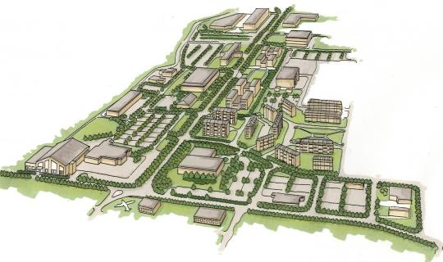
The Attack Surface of ASP.net / Mono

Slide 9
Security Features in ASP.net/Mono
Event Validation
Digital Signatures / MAC
  Limit to List, Manipulation Prevention
Security Filter (XSS)
Sandbox
Built-in Regular Expressions
Etc

Slide 10
Attack Surface Analysis: Entry Points
Purpose: Locating Code to Abuse
  Web Pages
  Web Service Methods
  Global Modules (Filters, Handlers, Etc)
  …
  *Events of Server Web Controls*

Slide 11
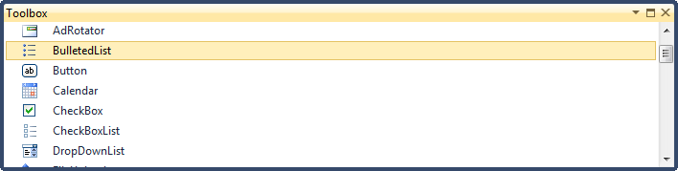
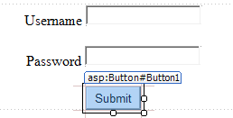
Server-Side Web Controls
Rendered into HTML/JS code
Include server side implementation
Core Controls and Custom Controls (e.g. ascx)

Slide 12
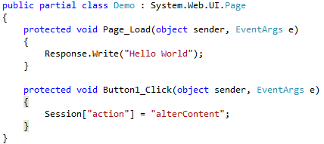
Server-Side Control Events
A triggered server-side code segment, containing optional functionality (PostBack/CallBack in ASP.Net)
Client triggering mechanism rely on EVENTTARGET, EVENTARGUMENT and VIEWSTATE
Sample Server Side Implementation (C#, ASP.Net):
  aspx:
  .aspx.cs:

Slide 13

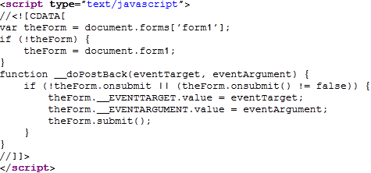
Client-Side Implementation of Events
Sample client-side implementation (ASP.Net postback):

Slide 14
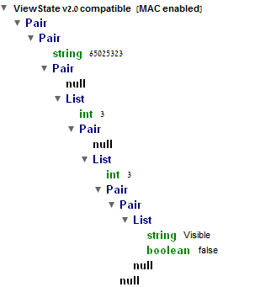
The Structure of the Viewstate Field
Viewstate HTML Structure:
Serialized into Base64*
Signed (MAC), clear-text or encrypted

Slide 15

Event Validation Drill Down
Independent Events (e.g. buttons with usesubmitbehavior=false, etc)
Programmatic vs. Declarative

Slide 16
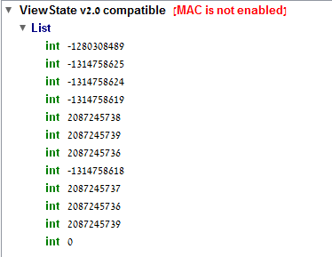

The Event Validation Mechanism
Name/Value HashCode Formula
if ([ControlValue] == null) return GetStringHashCode([ControlName]); else return GetStringHashCode([ControlName]) ^ GetStringHashCode([ControlValue]);
The EventValidation Field
MachineKey and MAC
Control Name/Value Verification, Prior to Event Execution
Include viewstate hashcode
Included in the HTML:
<-Viewstate
Hashcode
<-Control Hashcodes

Slide 17
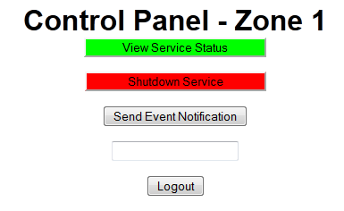
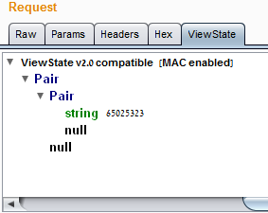
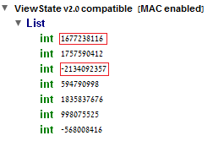
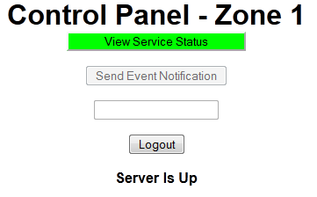
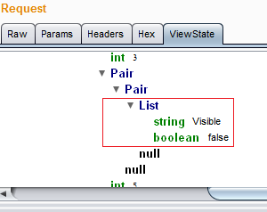
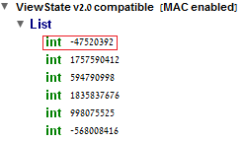
Evidence of Hidden Controls & Type
Visible/Enabled Controls:
Invisible / Disabled Controls (Properties in Viewstate):
EventValidation
(Viewstate Decoder):
EventValidation
(Viewstate Decoder):

Slide 18

Server Controls / Props: Application Building Blocks

Slide 19
Fingerprinting Server Controls
Control Viewstate Presence
  Collection of Properties for Each Control
  Boolean, Numeric, Text, etc
  Properties reloaded from the viewstate
Rule of Thumb – Properties in Viewstate
  Programmatic value manipulation
  Significant In-Design Modifications

Slide 20
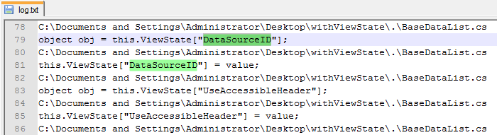
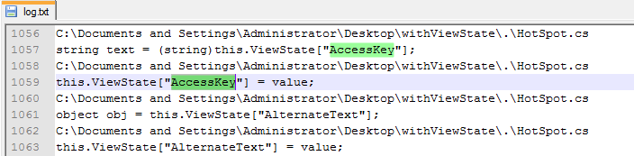
Mapping Viewstate Reloaded Props

Slide 21
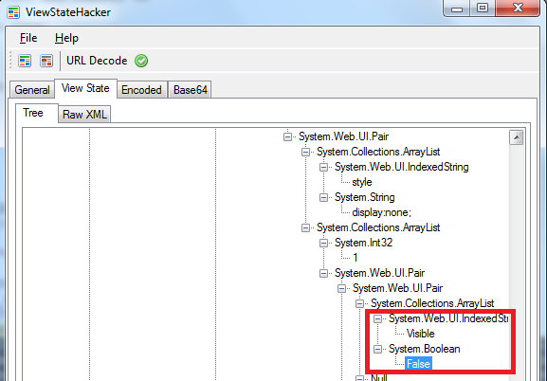
Demo I:
Altering Server Side Properties

Slide 22
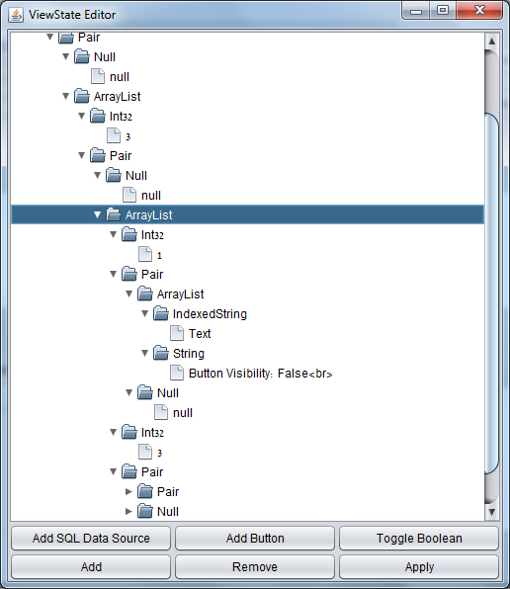

Slide 23
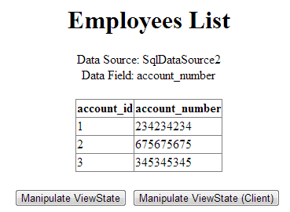
Demo II:
Inject / Override the GridView sqlDataSource and key fields

Slide 24
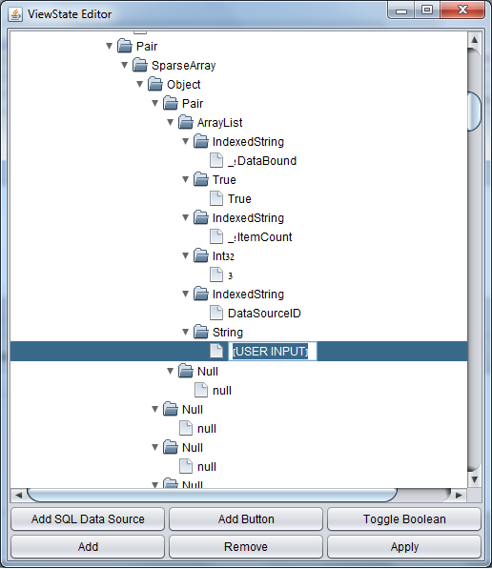

Slide 25
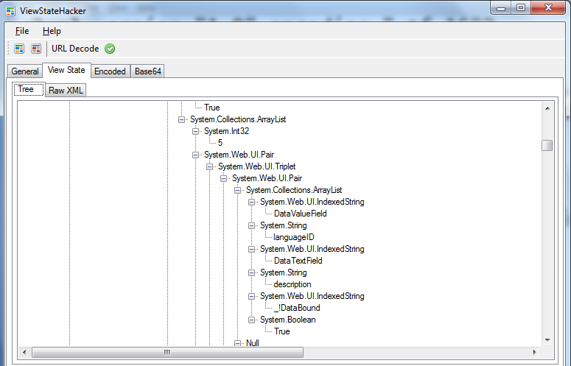
Demo III:
Executing Application Attacks via Viewstate

Slide 26
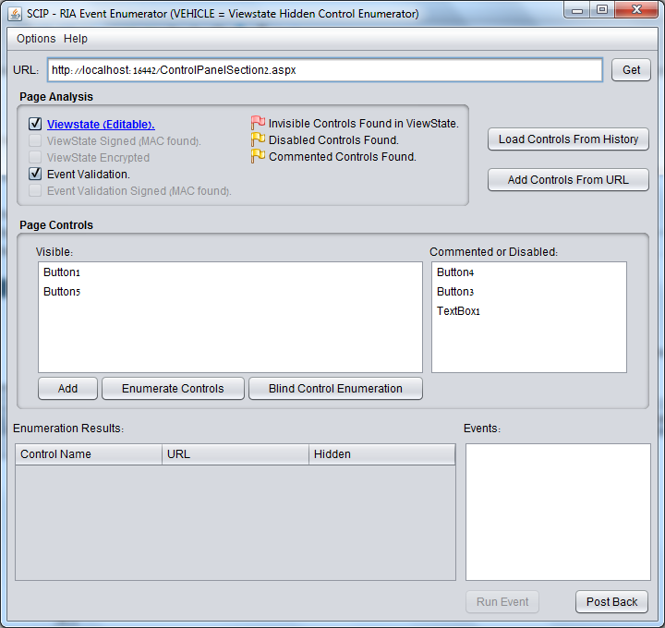

Slide 27
Overriding Control Properties
Reusing Valid Viewstates
  MAC Compatibility
  Mining Sources
  Structure Similarity
Reconstructing Unsigned Viewstates
  Structure and Order of Properties
  Insertion of Value Pair Blocks

Slide 28

Hidden Web Controls:
Archetypes

Slide 29

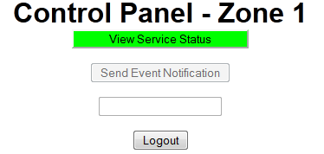
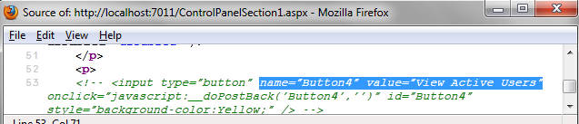
Dormant Server Web Controls, 1 of 3
Commented Out Controls
  Commented out using HTML comments (<!-- -->)
  Rendered inside an HTML comment, but the server code is still active.

Slide 30
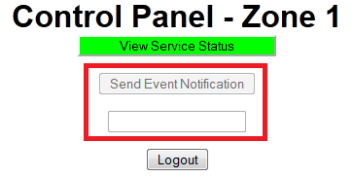
Dormant Server Web Controls, 2 of 3
Disabled Controls
  The control enabled property is set to false (Server)
  Rendered with the disabled="disabled" HTML property
  Rendered without an input postback method

Slide 31
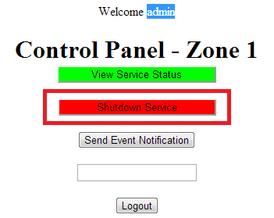
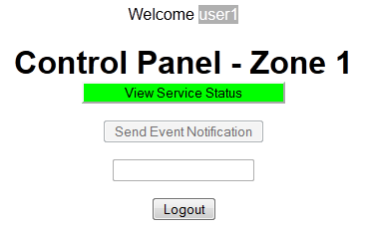
Dormant Server Web Controls, 3 of 3
Invisible Controls
  The control visible property is set to false
  Not rendered in the presentation layer, but the code is still active

Slide 32
Dormant Events of Web Controls
Dormant Events of Visible Controls
  Declarative: Optional events of controls with multiple events
  Programmatic: Optional event listeners registered in the code level for controls with at least one active event

Slide 33

Dormant & Invisible Control Execution

Slide 34
Commented Control Event Execution
Prerequisites (ASP.Net) - Commented Out Controls:
  Comment server control using HTML comments
  Event code does not include privilege validation
Process
  “uncomment” the HTML control and execute the event, or send the appropriate values directly.
Advantages
  Exploit works despite the Viewstate MAC AND EventValidation.

Slide 35
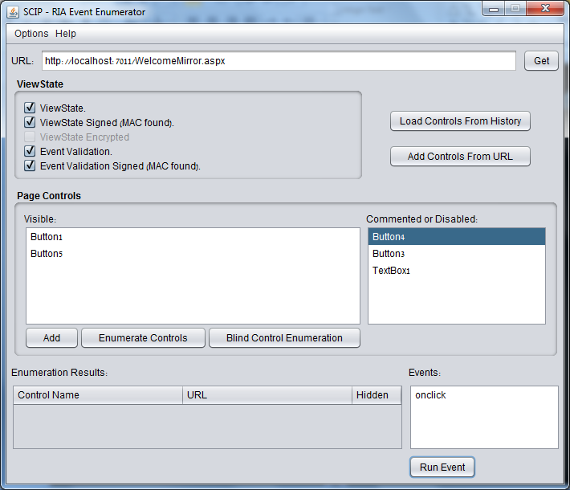
Commented Control Execution, Cont.

Slide 36
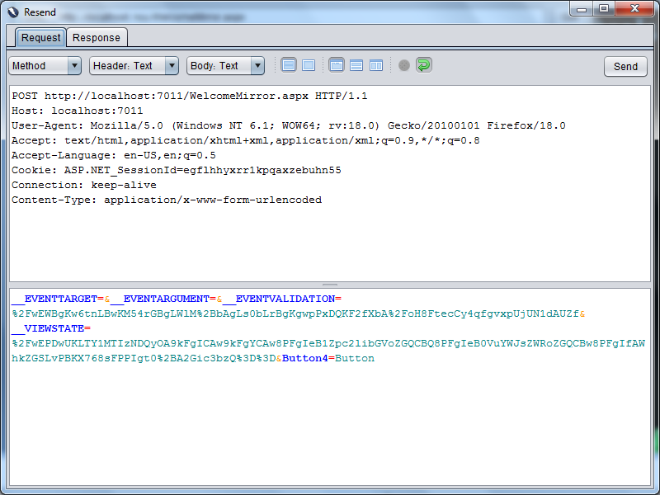
Commented Control Execution, Cont.

Slide 37
Disabled Control Event Execution
Prerequisites (ASP.Net / Mono) - Disabled Controls:
  The control “enabled” server property is set to FALSE
  Event code does not include privilege validation
Process
  ASP.Net/Mono: Forge a postback / callback call, or send the appropriate values directly.
  Mono: delete the viewstate (!)
Advantages
  Exploit works despite an active Viewstate MAC AND EventValidation.

Slide 38
Forging a Disabled Control Event
Forging a PostBack / CallBack Method Call
Why does it work?
  ASP.Net: Temporarily disabled controls are a feature
  Mono: EventValidation’ Viewstate hash-code issue
How does it work?
  The control name is exposed in the disabled control
  Use an interception proxy to “inject” postback calls into HTML control events, or craft requests manually.

Slide 39
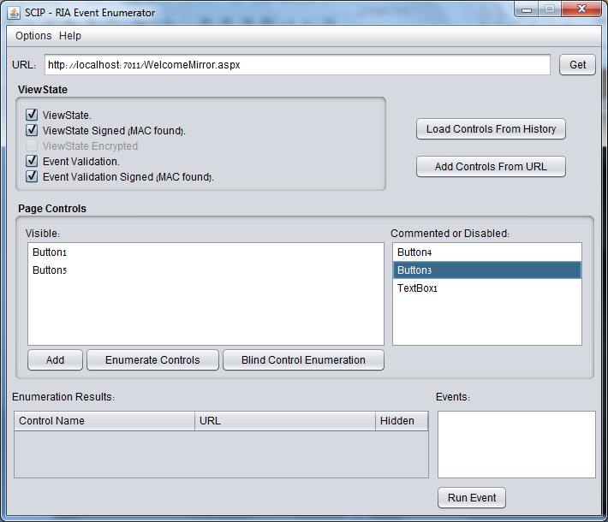
Disabled Control Execution, Cont.

Slide 40


Invisible Control Event Execution 1/4
Prerequisites (ASP.Net / Mono) - Invisible Controls:
  (I) Either the ViewstateMAC OR the EventValidation features must be turned off
  (II) The control “visible” server property is set to FALSE
  (III) Event code does not include privilege validation

Slide 41
Invisible Control Event Execution 2/4
EventValidation is OFF
  No event validation = ANY event can be executed, regardless of MAC
Process
  Craft a request with valid EVENTTARGET value OR
  Inject a custom Postback/Callback call to the response HTML, and target the event of the invisible control
<%@ Page Language="C#" AutoEventWireup="true" EnableEventValidation=“false" EnableViewStateMac=“true“ …%>

Slide 42
Invisible Control Event Execution 3/4
EventValidation is ON , Viewstate MAC is OFF
  Forge valid viewstate / eventvalidation fields (no MAC)
Process
  Craft a request using SCIP or other eventvalidation editors
<%@ Page Language="C#" AutoEventWireup="true" EnableEventValidation="true" EnableViewStateMac=“false“ …%>

Slide 43
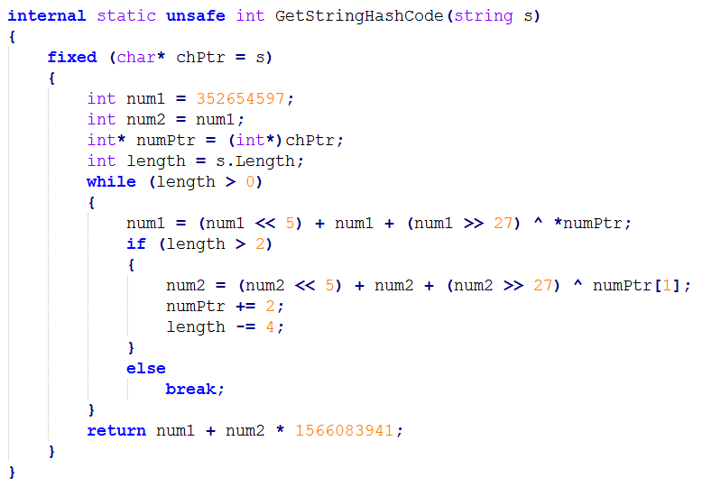
Invisible Control Event Execution 4/4
Hashcode Generation

Slide 44
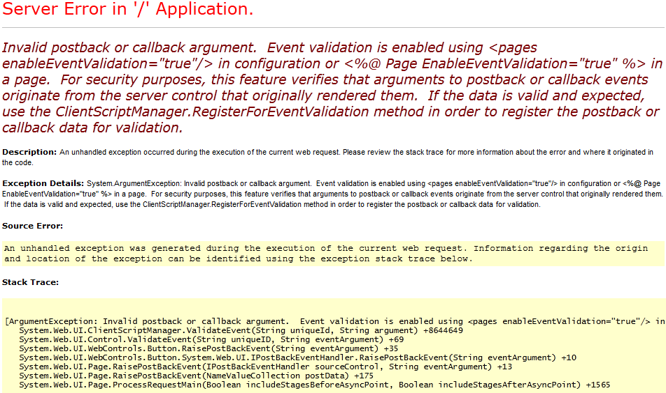
Error-Based Control Enumeration
Accessing invalid control names will NOT raise exceptions
Accessing protected will - if the EventValidation is ON

Slide 45
Blind Control Enumeration
Basic Blind Differentiation Formula:
ValidControlEvent = False; OriginalResponse = getResponse(“Page1.aspx?param=value”); VerificationResponse = getResponse(“Page1.aspx?param=value”); ConfirmationResponse = getResponse(“Page1.aspx?param=value”); InconsistentContent = VerificationResponse - ReflectedValues - TimestampTokens; ClearResponse = OriginalRespone - ReflectedValues - InconsistentContent - TimestampTokens; EventExecResponse = getResponse(“Page1.aspx?param=value&EVENTTARGET=…”); EventExecResponse = OriginalRespone - ReflectedValues - InconsistentContent - TimestampTokens; If (Diff (ClearResponse, EventExecResponse ) > 0) ValidControlEvent = True;

Slide 46
Control Naming Conventions
Default: [ControlType][Number]
  Button1, Button2, TextBox1, TextBox2 …
Default II (v1.1-v3.5/Master): ctl[ID]$[contentScope]$...
  ctl00$MainContent$txtName, ctl00$Content$cmdSubmit
Legacy: [ControlTypeShortCut][Number]
  txt1, txt2, btn1, btn2, cmd1, cmd2, lst1, lst2 …
Custom Legacy: [ControlTypeShortCut][Logic]
  txtUsername, txtPassword, btnSubmit, cmdAddUser …
Plain: [Logic]
  user, pass, submit, delete
Title Match: [Title]
  Username, Password, Origin, Email, Update

Slide 47
Hidden/Optional Event Execution 1/2
Prerequisites – Multiple Dormant Events of Controls:
  Control assigned with multiple events.
  (Calendar control, Custom Controls, etc)
Process:
  Fuzz the eventargument field, in addition to eventtarget
  Eventargument variation can execute different server events (for example - V[value] vs. [value])
Advanced:
  Core Events vs. Custom Events
  Example: Click, Command, onSelectionChanged, OnVisibleMonthChanged, Etc

Slide 48
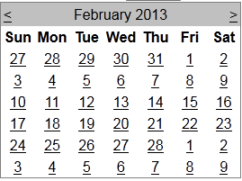
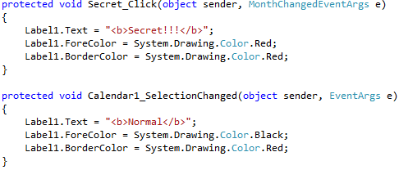
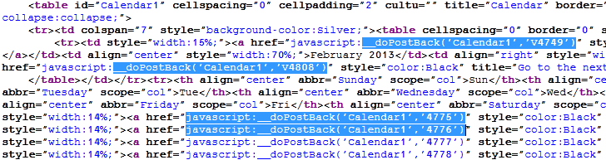
Hidden/Optional Event Execution 2/2

Slide 49
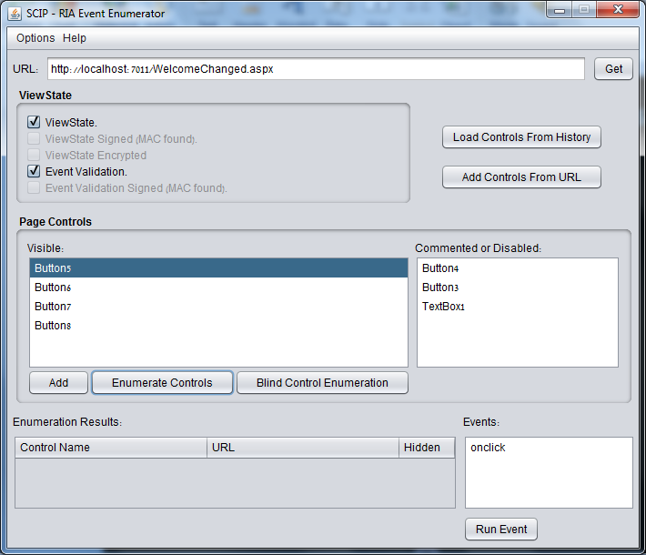
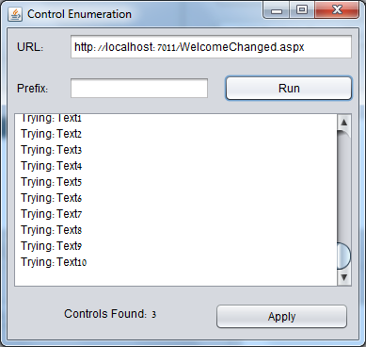
Invisible Control Execution, Cont.

Slide 50
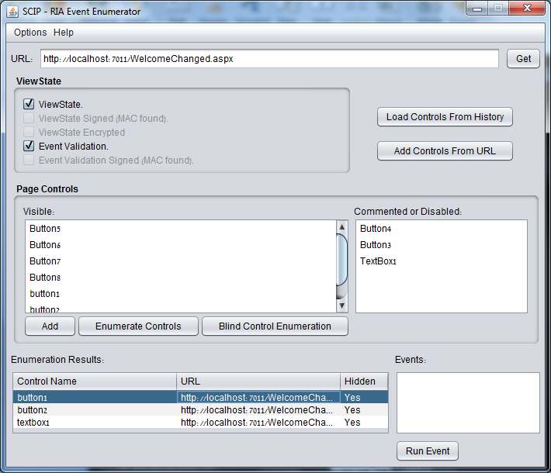
Invisible Control Execution, Cont.

Slide 51
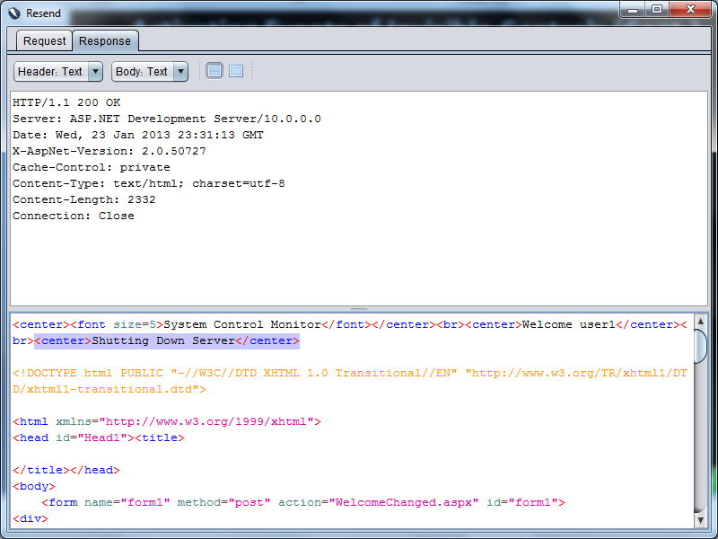
Invisible Control Execution, Cont.

Slide 52

Advanced Event Execution Methods
Executing Events of Invisible Controls
DESPITE
EventValidation and Viewstate MAC

Slide 53
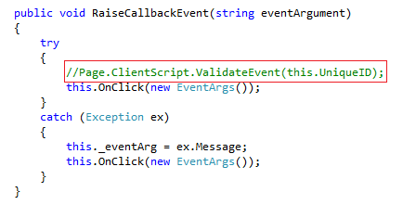
Missing CallBack Code Validation
Prerequisites – Improper CallBack Implementation
  Event validation not performed manually in CallBack code
  Relies on the CALLBACKID and CALLBACKPARAM
Process:
  Ignore Event Validation when Forging Event Call
Advantage:
  Works despite of Viewstate MAC & EventValidation.

Slide 54
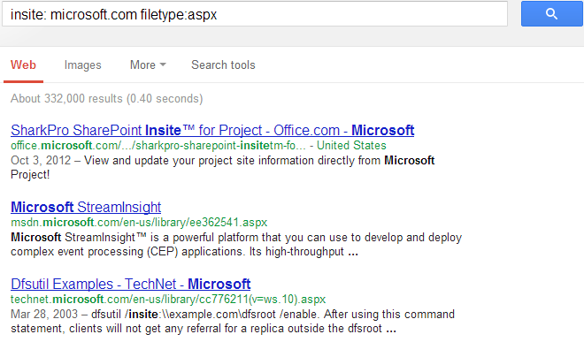
Mining Cached Viewstate Values 1/2
Prerequisites – Reusing Signed Cached Values
  Obtain control names from cached / indexed content: search engines, proxies, browser cache of privileged users
Process:
  Reuse the cached VIEWSTATE, EVENTTARGET, EVENTARGUMENT and EVENTVALIDATION

Slide 55

Mining Cached Viewstate Values 2/2
Advantages
  Exploit works DESPITE the Viewstate MAC AND EventValidation
Shared Hosting Attack Model:
  Can bypass Viewstate MAC and EventValidation
  Scenarios for Shared / Isolated Application Pool

Slide 56

Risk Mitigation

Slide 57
Secure Coding Guidelines
Preventing Event Execution & Property Override
Do NOT use the Disabled property for security purposes
Do NOT rely on HTML comments to hide controls
Remove unnecessary dormant events from all layers: HTML, Design (e.g. aspx), CodeBehind (e.g. aspx.cs)
Implement code-level privilege validation in each event
Enforce digital signatures (Viewstate MAC)
Activate event validation mechanisms (EventValidation)
Disable cache / Prevent indexing in pages with sensitive controls!
Customize the platform error messages
Replace the Machine Key (to prevent cache reuse)

Slide 58
Event Level Privilege Validation
Explicit Privilege Validation in Event Code
Enable Event Validation / MAC
protected void Button1_Click(object sender, EventArgs e) { if (((String)Session["user"]).Equals("admin")) { ... } }
<%@ Page Language="C#" AutoEventWireup="true" EnableEventValidation="true" EnableViewStateMac="true“ …%>

Slide 59
Disable Cache & Prevent Indexing
Disable Browser/Proxy Cache (Sample Code)
Restrict SE access in robots.txt (Sample Config)
  http://www.robotstxt.org/robotstxt.html
Restrict SE caching/crawling via meta tags
  http://www.robotstxt.org/meta.html
HttpContext.Current.Response.Cache.SetExpires(DateTime.UtcNow.AddDays(-1)); HttpContext.Current.Response.Cache.SetValidUntilExpires(false); HttpContext.Current.Response.Cache.SetRevalidation(HttpCacheRevalidation.AllCaches); HttpContext.Current.Response.Cache.SetCacheability(HttpCacheability.NoCache); HttpContext.Current.Response.Cache.SetNoStore();
User-agent: * Disallow: /

Slide 60
Summary

Slide 61


Dormant Control Execution Summary
Event Validation AND Viewstate MAC are ON | ONLY Viewstate MAC is ON | ONLY Event Validation Is ON | Control / Event Type
 |  |  | Commented
 |  |  | Disabled
 |  |  | Invisible
 |  |  | Optional

Slide 62
Advanced Invisible Control Execution
Execute Control Events DESPITE MAC/Validation
  Reuse cached / indexed ViewState and EventValidation fields of the same Page
  Abuse insecure callback implementations
  Abuse MachineKey in Shared Hosting Model

Slide 63

The RIA SCIP Project
Homepage: http://code.google.com/p/ria-scip/
OWASP ZAP extension (v2.0+), requires Java 1.7
Included in ZAP’s Marketplace
Currently focused at ASP.net

Slide 64
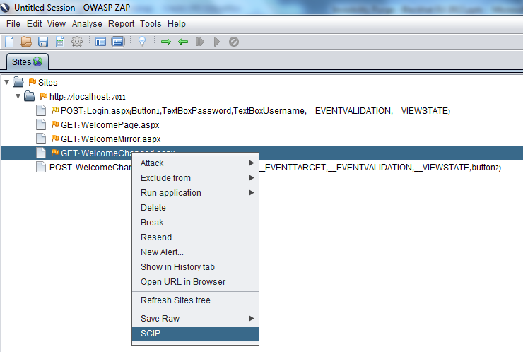
Activating SCIP in ZAP

Slide 65
The RIA SCIP Project, Cont.
Current Features
  Passively identifies traces of Invisible Controls
  Error-based invisible control name enumeration
  Blind-based invisible control name enumeration (NEW!)
  Disabled/commented control event execution
  Invisible control event execution
  Viewstate manipulation for manual parameter tampering, when MAC is OFF (NEW!), Control Injection Templates
  Manual execution of target events
Upcoming Features
  Cached viewstate scraping / comparison / reuse (déjà vu)
  Control type fingerprinting & exploitation

Slide 66
Additional Resources
déjà vu (cache analysis) ZAP Extension: https://github.com/hacktics/deja-vu
Woanware Viewstate Hacker: http://www.woanware.co.uk/application/viewstatehacker.html
OWASP ZAP: https://code.google.com/p/zaproxy/
James Jardine blog posts: http://www.jardinesoftware.net/

Slide 67
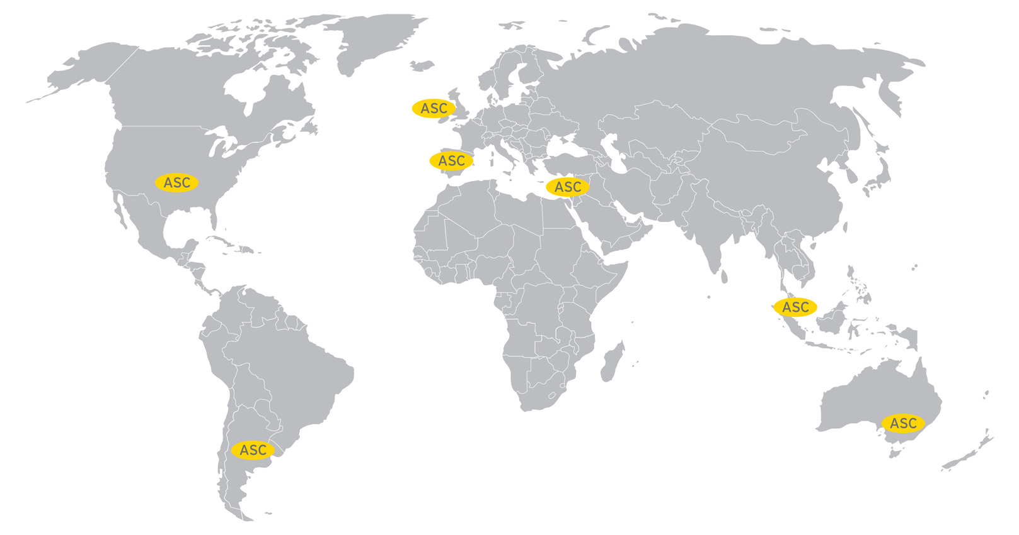
EY Advanced Security Centers
Americas
  Hacktics IL
  Houston
  New York
  Buenos Aires
EMEIA
  Dublin
  Barcelona
Asia Pacific
  Singapore
  Melbourne

Slide 68
Questions?
Shay Chen (@sectooladdict)
Niv Sela (@nivselatwit)
Alex Mor (@nashcontrol)

