Slide 1
OWASP Top 10 – 2010
The Top 10 Most Critical Web Application Security Risks
Dave Wichers
COO, Aspect Security
OWASP Board Member dave.wichers@aspectsecurity.com dave.wichers@owasp.org

Slide 2
What’s Changed?
It’s About Risks, Not Just Vulnerabilities
OWASP Top 10 Risk Rating Methodology
2 Risks Added, 2 Dropped
New title is: “The Top 10 Most Critical Web Application Security Risks”
Based on the OWASP Risk Rating Methodology, used to prioritize Top 10
Added: A6 – Security Misconfiguration
Was A10 in 2004 Top 10: Insecure Configuration Management
Added: A10 – Unvalidated Redirects and Forwards
Relatively common and VERY dangerous flaw that is not well known
Removed: A3 – Malicious File Execution
Primarily a PHP flaw that is dropping in prevalence
Removed: A6 – Information Leakage and Improper Error Handling
A very prevalent flaw, that does not introduce much risk (normally)

Slide 3
Mapping from 2007 to 2010 Top 10
OWASP Top 10 – 2007 (Previous) | OWASP Top 10 – 2010 (New)
A2 – Injection Flaws | A1 – Injection
A1 – Cross Site Scripting (XSS) | A2 – Cross Site Scripting (XSS)
A7 – Broken Authentication and Session Management | A3 – Broken Authentication and Session Management
A4 – Insecure Direct Object Reference | A4 – Insecure Direct Object References
A5 – Cross Site Request Forgery (CSRF) | A5 – Cross Site Request Forgery (CSRF)
<was T10 2004 A10 – Insecure Configuration Management> | A6 – Security Misconfiguration (NEW)
A8 – Insecure Cryptographic Storage | A7 – Insecure Cryptographic Storage
A10 – Failure to Restrict URL Access | A8 – Failure to Restrict URL Access
A9 – Insecure Communications | A9 – Insufficient Transport Layer Protection
<not in T10 2007> | A10 – Unvalidated Redirects and Forwards (NEW)
A3 – Malicious File Execution | <dropped from T10 2010>
A6 – Information Leakage and Improper Error Handling | <dropped from T10 2010>
=
=
+
=
+
-
-

Slide 4
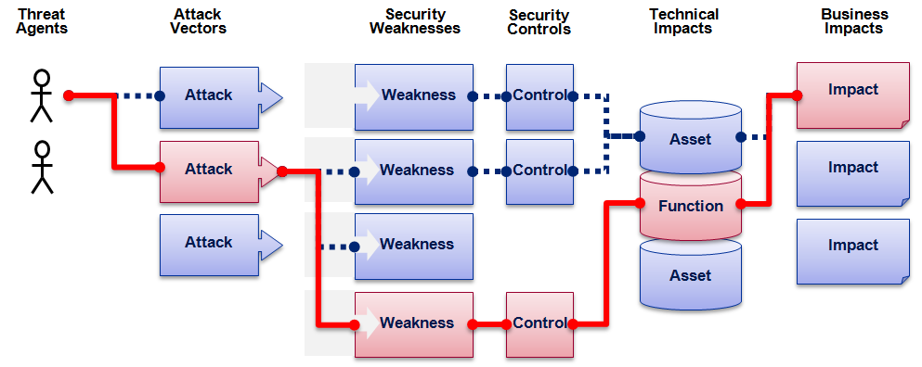

OWASP Top 10 Risk Rating Methodology
Threat Agent | Attack Vector | Weakness Prevalence | Weakness Detectability | Technical Impact | Business Impact
? | Easy | Widespread | Easy | Severe | ?
 | Average | Common | Average | Moderate
 | Difficult | Uncommon | Difficult | Minor
 | 1 | 2 | 2 | 1
 |  | 1.66 | * | 1
1
2
3
Injection Example
1.66 weighted risk rating

Slide 5

OWASP Top Ten (2010 Edition)
A1: Injection
A10: Unvalidated Redirects and Forwards
A7: Failure to Restrict URL Access
A6: Security Misconfiguration
A5: Cross Site Request Forgery (CSRF)
A4: Insecure Direct Object References
A3: Broken Authentication and Session Management
A2: Cross-Site Scripting (XSS)
A8: Insecure Cryptographic Storage
A9: Insufficient Transport Layer Protection
http://www.owasp.org/index.php/Top_10
Notes:
The red ones are the new ones.

Slide 6
A1 – Injection
Injection means…
Tricking an application into including unintended commands in the data sent to an interpreter
Interpreters…
Take strings and interpret them as commands
SQL, OS Shell, LDAP, XPath, Hibernate, etc…
SQL injection is still quite common
Many applications still susceptible (really don’t know why)
Even though it’s usually very simple to avoid
Typical Impact
Usually severe. Entire database can usually be read or modified
May also allow full database schema, or account access, or even OS level access

Slide 7
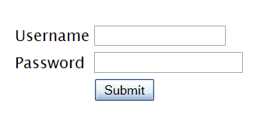
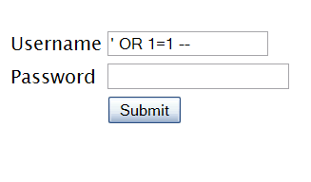

SQL Injection – Illustrated
"SELECT * FROM accounts WHERE acct=‘’ OR 1=1--’"
Account Summary
Acct:5424-6066-2134-4334
Acct:4128-7574-3921-0192
Acct:5424-9383-2039-4029
Acct:4128-0004-1234-0293
Account:
Account:
SKU:
DB Table 

SKU:
HTTP response 

HTTP request
Finance
SQL query
Transactions
Accounts
Administration
Communication
Knowledge Mgmt
E-Commerce
Bus. Functions
Databases
Legacy Systems
Web Services
Directories
Billing
Application Layer
Human Resrcs
APPLICATION
ATTACK
Custom Code
1. Application presents a form to the attacker
2. Attacker sends an attack in the form data
App Server
3. Application forwards attack to the database in a SQL query
Web Server
Hardened OS
4. Database runs query containing attack and sends encrypted results back to application
Network Layer
Firewall
Firewall
5. Application decrypts data as normal and sends results to the user

Slide 8
A1 – Avoiding Injection Flaws
Recommendations
  Avoid the interpreter entirely, or
  Use an interface that supports bind variables (e.g., prepared statements, or stored procedures),
    Bind variables allow the interpreter to distinguish between code and data
  Encode all user input before passing it to the interpreter
  Always perform ‘white list’ input validation on all user supplied input
  Always minimize database privileges to reduce the impact of a flaw
References
  For more details, read the new http://www.owasp.org/index.php/SQL_Injection_Prevention_Cheat_Sheet

Slide 9
A2 – Cross-Site Scripting (XSS)
Occurs any time…
Raw data from attacker is sent to an innocent user’s browser
Raw data…
Stored in database
Reflected from web input (form field, hidden field, URL, etc…)
Sent directly into rich JavaScript client
Virtually every web application has this problem
Try this in your browser – javascript:alert(document.cookie)
Typical Impact
Steal user’s session, steal sensitive data, rewrite web page, redirect user to phishing or malware site
Most Severe: Install XSS proxy which allows attacker to observe and direct all user’s behavior on vulnerable site and force user to other sites

Slide 10
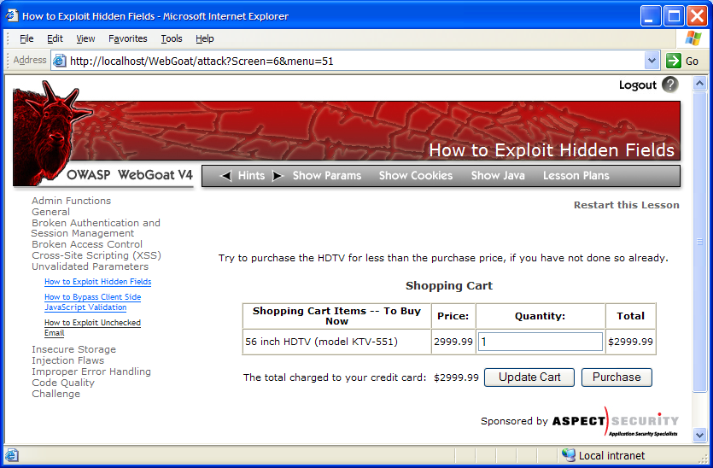

Cross-Site Scripting Illustrated
1
Attacker sets the trap – update my profile
Application with stored XSS vulnerability
Attacker enters a malicious script into a web page that stores the data on the server
2
Victim views page – sees attacker profile
Finance
Transactions
Accounts
Administration
Communication
Knowledge Mgmt
E-Commerce
Bus. Functions
Custom Code
Script runs inside victim’s browser with full access to the DOM and cookies
3
Script silently sends attacker Victim’s session cookie

Slide 11
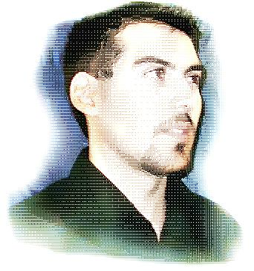
A2 – Avoiding XSS Flaws
Recommendations
  Eliminate Flaw
    Don’t include user supplied input in the output page
  Defend Against the Flaw
    Primary Recommendation: Output encode all user supplied input (Use OWASP’s ESAPI to output encode:
    http://www.owasp.org/index.php/ESAPI
    Perform ‘white list’ input validation on all user input to be included in page
    For large chunks of user supplied HTML, use OWASP’s AntiSamy to sanitize this HTML to make it safe
    See: http://www.owasp.org/index.php/AntiSamy
References
  For how to output encode properly, read the new http://www.owasp.org/index.php/XSS_(Cross Site Scripting) Prevention Cheat Sheet
(AntiSamy)

Slide 12
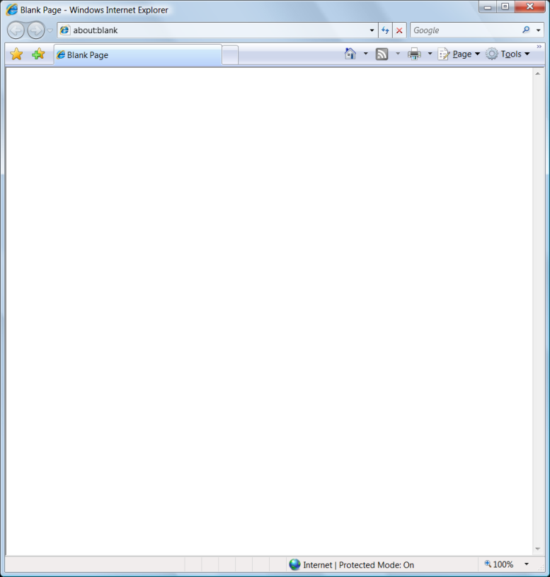
Safe Escaping Schemes in Various HTML Execution Contexts
#1: ( &, <, >, " ) → &entity; ( ', / ) → &#xHH;
ESAPI: encodeForHTML()
HTML Element Content
(e.g., <div> some text to display </div> )
#2: All non-alphanumeric < 256 → &#xHH
ESAPI: encodeForHTMLAttribute()
HTML Attribute Values
(e.g., <input name='person' type='TEXT' value='defaultValue'> )
#3: All non-alphanumeric < 256 → \xHH
ESAPI: encodeForJavaScript()
JavaScript Data
(e.g., <script> some javascript </script> )
#4: All non-alphanumeric < 256 → \HH
ESAPI: encodeForCSS()
HTML Style Property Values
(e.g., .pdiv a:hover {color: red; text-decoration: underline} )
#5: All non-alphanumeric < 256 → %HH
ESAPI: encodeForURL()
URI Attribute Values
(e.g., <a href="javascript:toggle('lesson')" )
ALL other contexts CANNOT include Untrusted Data
Recommendation: Only allow #1 and #2 and disallow all others
See: www.owasp.org/index.php/XSS_(Cross_Site_Scripting)_Prevention_Cheat_Sheet for more details

Slide 13
A3 – Broken Authentication and Session Management
HTTP is a “stateless” protocol
Means credentials have to go with every request
Should use SSL for everything requiring authentication
Session management flaws
SESSION ID used to track state since HTTP doesn’t
and it is just as good as credentials to an attacker
SESSION ID is typically exposed on the network, in browser, in logs, …
Beware the side-doors
Change my password, remember my password, forgot my password, secret question, logout, email address, etc…
Typical Impact
User accounts compromised or user sessions hijacked

Slide 14
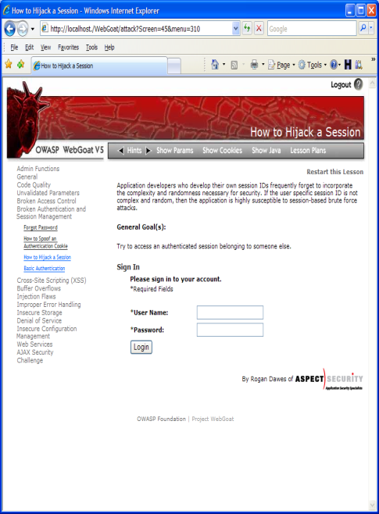
Broken Authentication Illustrated
1
User sends credentials
Finance
Transactions
Accounts
Administration
Communication
Knowledge Mgmt
E-Commerce
www.boi.com?JSESSIONID=9FA1DB9EA...
Bus. Functions
Site uses URL rewriting
(i.e., put session in URL)
2
Custom Code
3
User clicks on a link to http://www.hacker.com in a forum
Hacker checks referer logs on www.hacker.com
and finds user’s JSESSIONID
4
5
Hacker uses JSESSIONID and takes over victim’s account

Slide 15
A3 – Avoiding Broken Authentication and Session Management
Verify your architecture
  Authentication should be simple, centralized, and standardized
  Use the standard session id provided by your container
  Be sure SSL protects both credentials and session id at all times
Verify the implementation
  Forget automated analysis approaches
  Check your SSL certificate
  Examine all the authentication-related functions
  Verify that logoff actually destroys the session
  Use OWASP’s WebScarab to test the implementation
Follow the guidance from
  http://www.owasp.org/index.php/Authentication_Cheat_Sheet

Slide 16
A4 – Insecure Direct Object References
How do you protect access to your data?
This is part of enforcing proper “Authorization”, along with
A7 – Failure to Restrict URL Access
A common mistake …
Only listing the ‘authorized’ objects for the current user, or
Hiding the object references in hidden fields
This is called presentation layer access control, and doesn’t work
Attacker simply tampers with parameter value
Typical Impact
Users are able to access unauthorized files or data
… and then not enforcing these restrictions on the server side

Slide 17
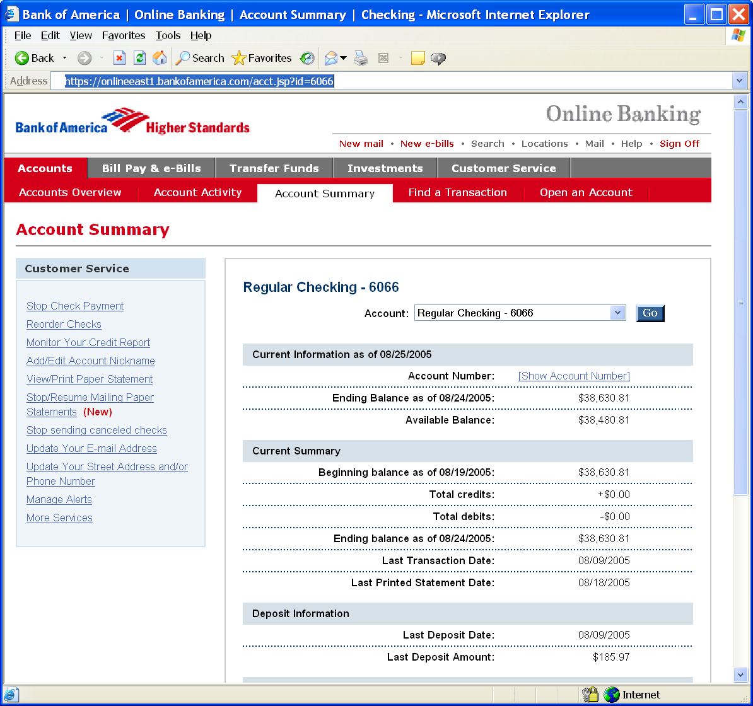
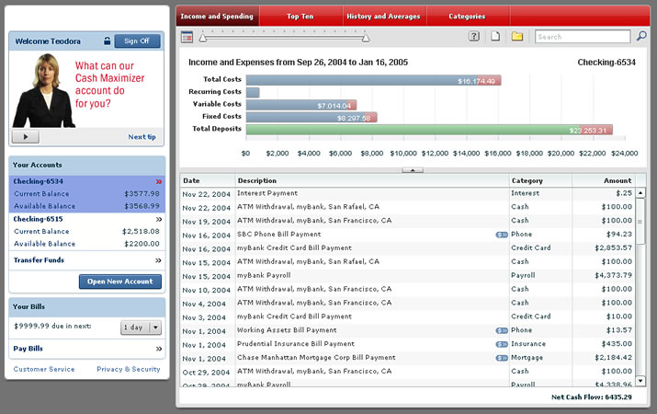
Insecure Direct Object References Illustrated
Attacker notices his acct parameter is 6065
?acct=6065
He modifies it to a nearby number
?acct=6066
Attacker views the victim’s account information
https://www.onlinebank.com/user?acct=6065

Slide 18
A4 – Avoiding Insecure Direct Object References
Eliminate the direct object reference
  Replace them with a temporary mapping value (e.g. 1, 2, 3)
  ESAPI provides support for numeric & random mappings
    IntegerAccessReferenceMap & RandomAccessReferenceMap
Validate the direct object reference
  Verify the parameter value is properly formatted
  Verify the user is allowed to access the target object
    Query constraints work great!
  Verify the requested mode of access is allowed to the target object (e.g., read, write, delete)
http://app?file=Report123.xls
Access
Reference
Map
Report123.xls
http://app?file=1
http://app?id=9182374
Acct:9182374
http://app?id=7d3J93

Slide 19
A5 – Cross Site Request Forgery (CSRF)
Cross Site Request Forgery
An attack where the victim’s browser is tricked into issuing a command to a vulnerable web application
Vulnerability is caused by browsers automatically including user authentication data (session ID, IP address, Windows domain credentials, …) with each request
Imagine…
What if a hacker could steer your mouse and get you to click on links in your online banking application?
What could they make you do?
Typical Impact
Initiate transactions (transfer funds, logout user, close account)
Access sensitive data
Change account details

Slide 20
CSRF Vulnerability Pattern
The Problem
  Web browsers automatically include most credentials with each request
  Even for requests caused by a form, script, or image on another site
All sites relying solely on automatic
credentials are vulnerable!
  (almost all sites are this way)
Automatically Provided Credentials
  Session cookie
  Basic authentication header
  IP address
  Client side SSL certificates
  Windows domain authentication

Slide 21
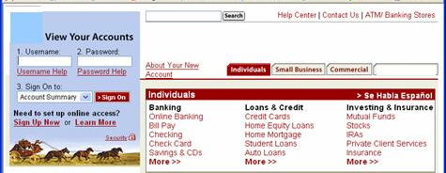
CSRF Illustrated
Attacker sets the trap on some website on the internet
(or simply via an e-mail)
1
Application with CSRF vulnerability
Hidden <img> tag contains attack against vulnerable site
Finance
Transactions
Accounts
Administration
Communication
Knowledge Mgmt
E-Commerce
Bus. Functions
2
While logged into vulnerable site,
victim views attacker site
Custom Code
3
Vulnerable site sees legitimate request from victim and performs the action requested
<img> tag loaded by browser – sends GET request (including credentials) to vulnerable site

Slide 22
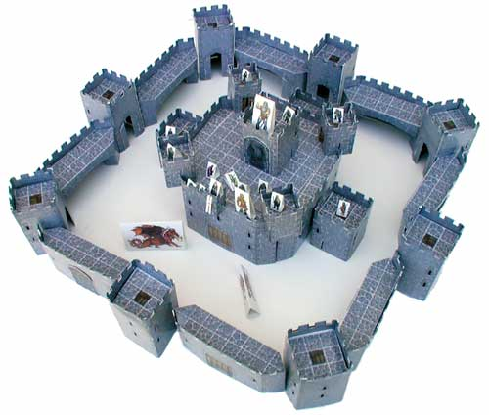
A5 – Avoiding CSRF Flaws
Add a secret, not automatically submitted, token to ALL sensitive requests
  This makes it impossible for the attacker to spoof the request
    (unless there’s an XSS hole in your application)
  Tokens should be cryptographically strong or random
Options
  Store a single token in the session and add it to all forms and links
    Hidden Field: <input name="token" value="687965fdfaew87agrde" type="hidden"/>
    Single use URL: /accounts/687965fdfaew87agrde
    Form Token: /accounts?auth=687965fdfaew87agrde …
  Beware exposing the token in a referer header
    Hidden fields are recommended
  Can have a unique token for each function
    Use a hash of function name, session id, and a secret
  Can require secondary authentication for sensitive functions (e.g., eTrade)
Don’t allow attackers to store attacks on your site
  Properly encode all input on the way out
  This renders all links/requests inert in most interpreters
See the new: www.owasp.org/index.php/CSRF_Prevention_Cheat_Sheet
for more details

Slide 23
A6 – Security Misconfiguration
Web applications rely on a secure foundation
Everywhere from the OS up through the App Server
Don’t forget all the libraries you are using!!
Is your source code a secret?
Think of all the places your source code goes
Security should not require secret source code
CM must extend to all parts of the application
All credentials should change in production
Typical Impact
Install backdoor through missing OS or server patch
XSS flaw exploits due to missing application framework patches
Unauthorized access to default accounts, application functionality or data, or unused but accessible functionality due to poor server configuration

Slide 24
Security Misconfiguration Illustrated
Finance
Database
Transactions
Accounts
Administration
Communication
Knowledge Mgmt
E-Commerce
Bus. Functions
Custom Code
App Configuration
Framework
Development
App Server
Web Server
QA Servers
Insider
Hardened OS
Test Servers
Source Control

Slide 25
A6 – Avoiding Security Misconfiguration
Verify your system’s configuration management
  Secure configuration “hardening” guideline
    Automation is REALLY USEFUL here
  Must cover entire platform and application
  Keep up with patches for ALL components
    This includes software libraries, not just OS and Server applications
  Analyze security effects of changes
Can you “dump” the application configuration
  Build reporting into your process
  If you can’t verify it, it isn’t secure
Verify the implementation
  Scanning finds generic configuration and missing patch problems

Slide 26
A7 – Insecure Cryptographic Storage
Storing sensitive data insecurely
Failure to identify all sensitive data
Failure to identify all the places that this sensitive data gets stored
Databases, files, directories, log files, backups, etc.
Failure to properly protect this data in every location
Typical Impact
Attackers access or modify confidential or private information
Attackers extract secrets to use in additional attacks
Company embarrassment, customer dissatisfaction, and loss of trust
Expense of cleaning up the incident, such as forensics, sending apology letters, reissuing thousands of credit cards, providing identity theft insurance
Business gets sued and/or fined
e.g, credit cards, health care records, financial data (yours or your customers)

Slide 27
Insecure Cryptographic Storage Illustrated
Victim enters credit card number in form
1
Finance
Transactions
Accounts
Administration
Communication
Knowledge Mgmt
E-Commerce
Bus. Functions
Custom Code
Log files
4
Malicious insider steals 4 million credit card numbers
Error handler logs CC details because merchant gateway is unavailable
2
Logs are accessible to all members of IT staff for debugging purposes
3

Slide 28
A7 – Avoiding Insecure Cryptographic Storage
Verify your architecture
  Identify all sensitive data
  Identify all the places that data is stored
  Ensure threat model accounts for possible attacks
  Use encryption to counter the threats, don’t just ‘encrypt’ the data
Protect with appropriate mechanisms
  File encryption, database encryption, data element encryption
Use the mechanisms correctly
  Use standard strong algorithms
  Generate, distribute, and protect keys properly
  Be prepared for key change
Verify the implementation
  A standard strong algorithm is used, and it’s the proper algorithm for this situation
  All keys, certificates, and passwords are properly stored and protected
  Safe key distribution and an effective plan for key change are in place
  Analyze encryption code for common flaws

Slide 29
A8 – Failure to Restrict URL Access
How do you protect access to URLs (pages)?
This is part of enforcing proper “authorization”, along with
A4 – Insecure Direct Object References
A common mistake …
Displaying only authorized links and menu choices
This is called presentation layer access control, and doesn’t work
Attacker simply forges direct access to ‘unauthorized’ pages
Typical Impact
Attackers invoke functions and services they’re not authorized for
Access other user’s accounts and data
Perform privileged actions

Slide 30
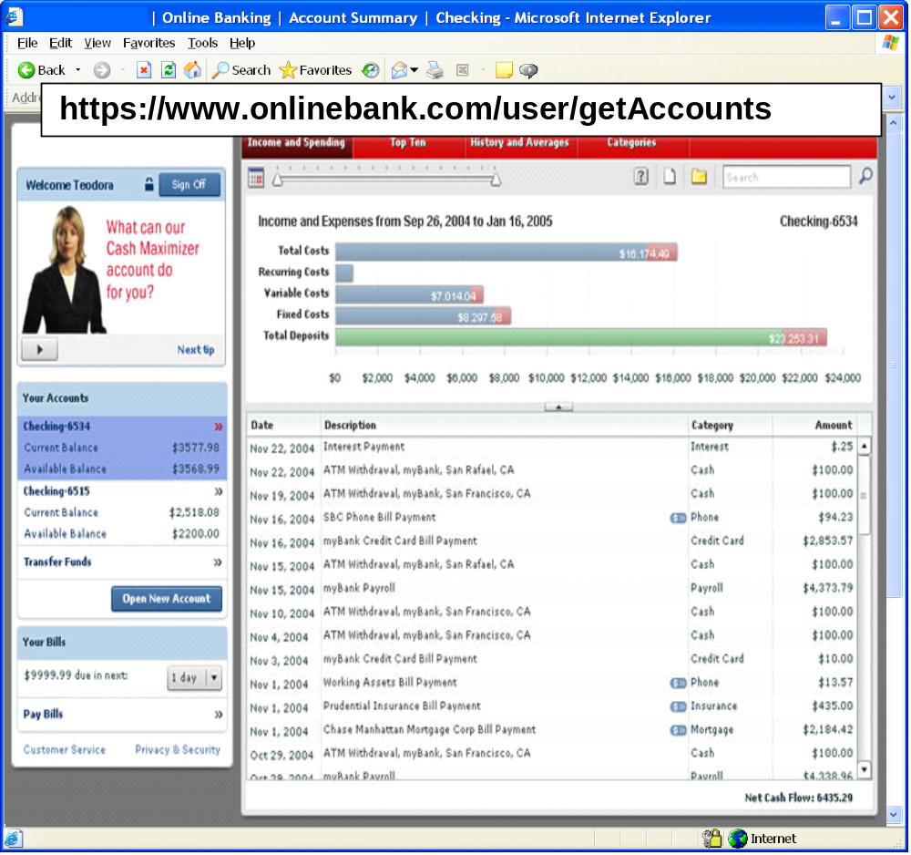
Failure to Restrict URL Access Illustrated
Attacker notices the URL indicates his role
/user/getAccounts
He modifies it to another directory (role)
/admin/getAccounts, or
/manager/getAccounts
Attacker views more accounts than just their own

Slide 31
A8 – Avoiding URL Access Control Flaws
For each URL, a site needs to do 3 things
  Restrict access to authenticated users (if not public)
  Enforce any user or role based permissions (if private)
  Completely disallow requests to unauthorized page types (e.g., config files, log files, source files, etc.)
Verify your architecture
  Use a simple, positive model at every layer
  Be sure you actually have a mechanism at every layer
Verify the implementation
  Forget automated analysis approaches
  Verify that each URL in your application is protected by either
    An external filter, like Java EE web.xml or a commercial product
    Or internal checks in YOUR code – Use ESAPI’s isAuthorizedForURL() method
  Verify the server configuration disallows requests to unauthorized file types
  Use WebScarab or your browser to forge unauthorized requests

Slide 32
A9 – Insufficient Transport Layer Protection
Transmitting sensitive data insecurely
Failure to identify all sensitive data
Failure to identify all the places that this sensitive data is sent
On the web, to backend databases, to business partners, internal communications
Failure to properly protect this data in every location
Typical Impact
Attackers access or modify confidential or private information
e.g, credit cards, health care records, financial data (yours or your customers)
Attackers extract secrets to use in additional attacks
Company embarrassment, customer dissatisfaction, and loss of trust
Expense of cleaning up the incident
Business gets sued and/or fined

Slide 33


Insufficient Transport Layer Protection Illustrated
Business Partners
External Victim
Custom Code
Backend Systems
Employees
1
2
External attacker steals credentials and data off network
Internal attacker steals credentials and data from internal network
External Attacker
Internal Attacker

Slide 34
A9 – Avoiding Insufficient Transport Layer Protection
Protect with appropriate mechanisms
  Use TLS on all connections with sensitive data
  Individually encrypt messages before transmission
    E.g., XML-Encryption
  Sign messages before transmission
    E.g., XML-Signature
Use the mechanisms correctly
  Use standard strong algorithms (disable old SSL algorithms)
  Manage keys/certificates properly
  Verify SSL certificates before using them
  Use proven mechanisms when sufficient
    E.g., SSL vs. XML-Encryption
See: http://www.owasp.org/index.php/Transport_Layer_Protection_Cheat
_Sheet for more details

Slide 35
A10 – Unvalidated Redirects and Forwards
Web application redirects are very common
And frequently include user supplied parameters in the destination URL
If they aren’t validated, attacker can send victim to a site of their choice
Forwards (aka Transfer in .NET) are common too
They internally send the request to a new page in the same application
Sometimes parameters define the target page
If not validated, attacker may be able to use unvalidated forward to bypass authentication or authorization checks
Typical Impact
Redirect victim to phishing or malware site
Attacker’s request is forwarded past security checks, allowing unauthorized function or data access

Slide 36

Unvalidated Redirect Illustrated
1
Attacker sends attack to victim via email or webpage
From: Internal Revenue Service
Subject: Your Unclaimed Tax Refund
Our records show you have an unclaimed federal tax refund. Please click here to initiate your claim.
3
Application redirects victim to attacker’s site
2
Victim clicks link containing unvalidated parameter
Finance
Transactions
Accounts
Administration
Communication
Knowledge Mgmt
E-Commerce
Bus. Functions
Custom Code
Request sent to vulnerable site, including attacker’s destination site as parameter. Redirect sends victim to attacker site
Evil Site
4
Evil site installs malware on victim, or phish’s for private information
http://www.irs.gov/taxrefund/claim.jsp?year=2006& … &dest=www.evilsite.com

Slide 37
Unvalidated Forward Illustrated
1
Attacker sends attack to vulnerable page they have access to
Request sent to vulnerable page which user does have access to. Redirect sends user directly to private page, bypassing access control.
public void sensitiveMethod( HttpServletRequest request, HttpServletResponse response) {
try {
// Do sensitive stuff here.
...
  }
  catch ( ...
2
Application authorizes request, which continues to vulnerable page
Filter
3
Forwarding page fails to validate parameter, sending attacker to unauthorized page, bypassing access control
public void doPost( HttpServletRequest request, HttpServletResponse response) {
try {
String target = request.getParameter( "dest" ) );
  ...
  request.getRequestDispatcher( target ).forward(request, response);
  }
  catch ( ...

Slide 38
A10 – Avoiding Unvalidated Redirects and Forwards
There are a number of options
  Avoid using redirects and forwards as much as you can
  If used, don’t involve user parameters in defining the target URL
  If you ‘must’ involve user parameters, then either
    Validate each parameter to ensure its valid and authorized for the current user, or
    (preferred) – Use server side mapping to translate choice provided to user with actual target page
  Defense in depth: For redirects, validate the target URL after it is calculated to make sure it goes to an authorized external site
  ESAPI can do this for you!!
    See: SecurityWrapperResponse.sendRedirect( URL )
    http://owasp-esapi-java.googlecode.com/svn/trunk_doc/org/owasp/esapi/filters/
    SecurityWrapperResponse.html#sendRedirect(java.lang.String)
Some thoughts about protecting Forwards
  Ideally, you’d call the access controller to make sure the user is authorized before you perform the forward (with ESAPI, this is easy)
  With an external filter, like Siteminder, this is not very practical
  Next best is to make sure that users who can access the original page are ALL authorized to access the target page.

Slide 39
Summary: How do you address these problems?
Develop Secure Code
  Follow the best practices in OWASP’s Guide to Building Secure Web Applications
    http://www.owasp.org/index.php/Guide
  Use OWASP’s Application Security Verification Standard as a guide to what an application needs to be secure
    http://www.owasp.org/index.php/ASVS
  Use standard security components that are a fit for your organization
    Use OWASP’s ESAPI as a basis for your standard components
    http://www.owasp.org/index.php/ESAPI
Review Your Applications
  Have an expert team review your applications
  Review your applications yourselves following OWASP Guidelines
    OWASP Code Review Guide:
    http://www.owasp.org/index.php/Code_Review_Guide
    OWASP Testing Guide:
    http://www.owasp.org/index.php/Testing_Guide

Slide 40
OWASP (ESAPI)
Custom Enterprise Web Application
Authenticator
User
AccessController
AccessReferenceMap
Validator
Encoder
HTTPUtilities
Encryptor
EncryptedProperties
Randomizer
Logger
IntrusionDetector
OWASP Enterprise Security API
Exception Handling
SecurityConfiguration
Your Existing Enterprise Services or Libraries
  ESAPI Homepage: http://www.owasp.org/index.php/ESAPI

Slide 41

Acknowledgements
We’d like to thank the Primary Project Contributors
  Aspect Security for sponsoring the project
  Jeff Williams (Author who conceived of and launched Top 10 in 2003)
  Dave Wichers (Author and current project lead)
Organizations that contributed vulnerability statistics
  Aspect Security
  MITRE
  Softtek
  WhiteHat Security
A host of reviewers and contributors, including:
  Mike Boberski, Juan Carlos Calderon, Michael Coates, Jeremiah Grossman, Jim Manico, Paul Petefish, Eric Sheridan, Neil Smithline, Andrew van der Stock, Colin Watson, OWASP Denmark and Sweden Chapters

