Slide 1

Welcome!
While you wait, here’s a few things you can do to make this a great learning experience!
Keep your distractions to a minimum and be present.
Participate! You have valuable Experience so don’t be afraid to share it.
Have a notebook handy. Feel free to take any notes and ask questions.
We will begin shortly!

Slide 2
Introductions
Today’s Presenter Today’s Co-host
name of Name of
Presenter Co-host
Let’s get started!
Picture
of
Presenter
Picture
of
Producer

Slide 3
Agenda
Learning objectives.
Best practices explanations with discussion activities.
Summary.
Wrap up.
Here is what you can expect during this training.

Slide 4
Best Practices to Manage Conflict
Session 1

Slide 5

Learning Objectives
Recall the best practices to manage conflict.
Identify the practices to manage a conflict.

Slide 6









What do you remember?
Agreement
Investigate
Strategies
In the chat, write what you remember about any of these pictures. You’ll have 1 minute.
Approach
Evaluate
Voice
Decide
Awareness
Implement

Slide 7

Conflict Management Style
Let’s take a poll!
What was your conflict management style?
(If there was a tie between two or more, select the one you identify with the most.)

Slide 8
Best Practices
1. Awareness
2. Approach
3. Investigate
Be aware of conflict
Take a considerate and rational
approach to conflict.
Investigate the situation
Eyes and ears open.
Don’t turn a blind eye.
Stay calm.
Ensure to take a considerate, rational and impartial approach.
Watch language and body language.
Remain neutral.
Focus on facts.
Find out what has happened, who is involved, how people are feeling, and what the issues are.
Don’t prejudge or jump to conclusions.

Slide 9

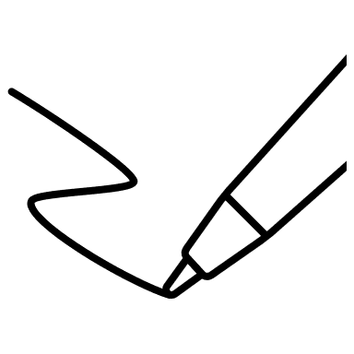
Reflection Time!
Think
and
Write

Slide 10
Think and Write!
For 3 minutes, think and write about a time when …
You had to use the “awareness”, “approach”, and/or “investigate” practices.
Don’t forget!
A couple volunteers will be asked to share their applications.

Slide 11
Best Practices
4. Decide
5. Voice
6. Agreement
Decide how to tackle
the conflict.
Let everyone have their say.
Identify options and agree
on a way forward.
Decide appropriate action.
Is this a serious matter or relatively trivial?
Could it become more serious?
Everyone has the chance to explain point of view and concerns.
A way that is acceptable to all, even if not preferred option for all parties.

Slide 12



Breakout and Discuss!

Slide 13
Discuss!
Scenario
An employee, Ben, informs you that there is tension between him and Jerry, another employee. Ben needs Jerry’s help on a project, but Jerry is not being very responsive.
How would you manage this conflict with “decide”, “voice”, and “agreement”?
Don’t forget:
- 7 minutes of discussion.
Recorder will report back key points.
Given one-minute warning before time is up to finish any discussion.

Slide 14
Best Practices
7. Implement
8. Evaluate
9. Strategies
Implement what has
been agreed.
Evaluate how things
are going.
Consider preventative strategies for the future.
Make decision clear to everyone.
Everyone takes a personal responsibility for any actions agreed.
Don’t assume that the issue has been finally resolved.
Keep an eye on the situation.
Evaluate how well the solution is working.
Think about the lesson that can be learned from the conflict and how it was handled.
What could be done better next time?

Slide 15
Summary
Aware
Approach
Investigate
Decide
Voice
Agree
Implement
Evaluate
Strategies
Let’s review the 9 best practices to manage conflict.

Slide 16

Put it all Together
Keep these questions in mind as you watch.
What practices were used?
Was the conflict managed well?
Did it have a resolution?

Slide 17
Watch, Find, and Write!
Keep these questions in mind as you watch.
What practices were used?
Was the conflict managed well?
Did it have a resolution?
YouTube Video of Conflict

Slide 18
Chat it up
Wrap up!
What are your key takeaways from today?

Slide 19

Thank You for completing this course!
Feel free to ask any questions. Have a great day!

