Slide 1
HCC Upswing is Here to Help!
A User’s Guide to Our Asynchronous Tutoring Site

Slide 2
What Tutors Do
What Tutors Don’t Do
English tutors do…
make notes and comments throughout your paper to help you know what needs to be improved or corrected and how to make the necessary changes.
ask questions to help you think through your ideas and provide you with resources to help you become a better reader and writer.
STEM tutors do…
help you see where you became lost on a problem.
solve similar problems that you can apply to your own work.
explain concepts about which you are confused.
Content tutors do…
ask questions to help you think through your ideas.
explain concepts about which you are confused.
provide you with resources to help you understand content subject matter.
English tutors don’t…
grade (evaluate) your work.
correct your work.
edit your work (change your words).
give you topic ideas for your work.
STEM tutors don’t…
grade your work.
solve problems for you.
Content tutors don’t…
grade your work.
correct your work.

Slide 3
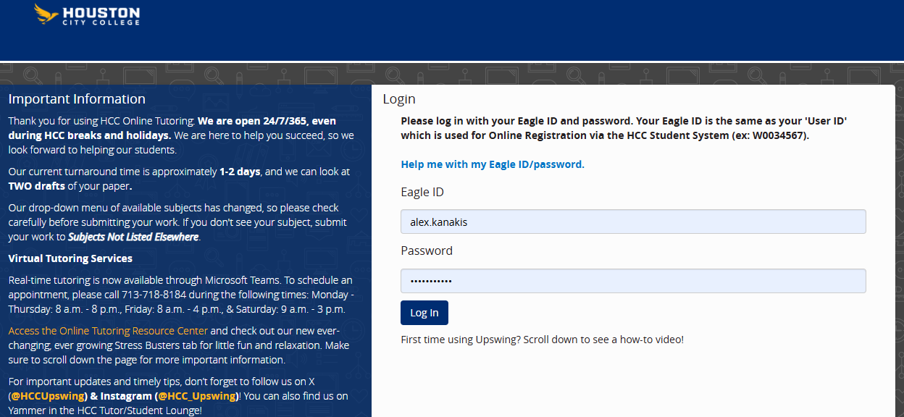
The HCC Upswing Login Page

Slide 4
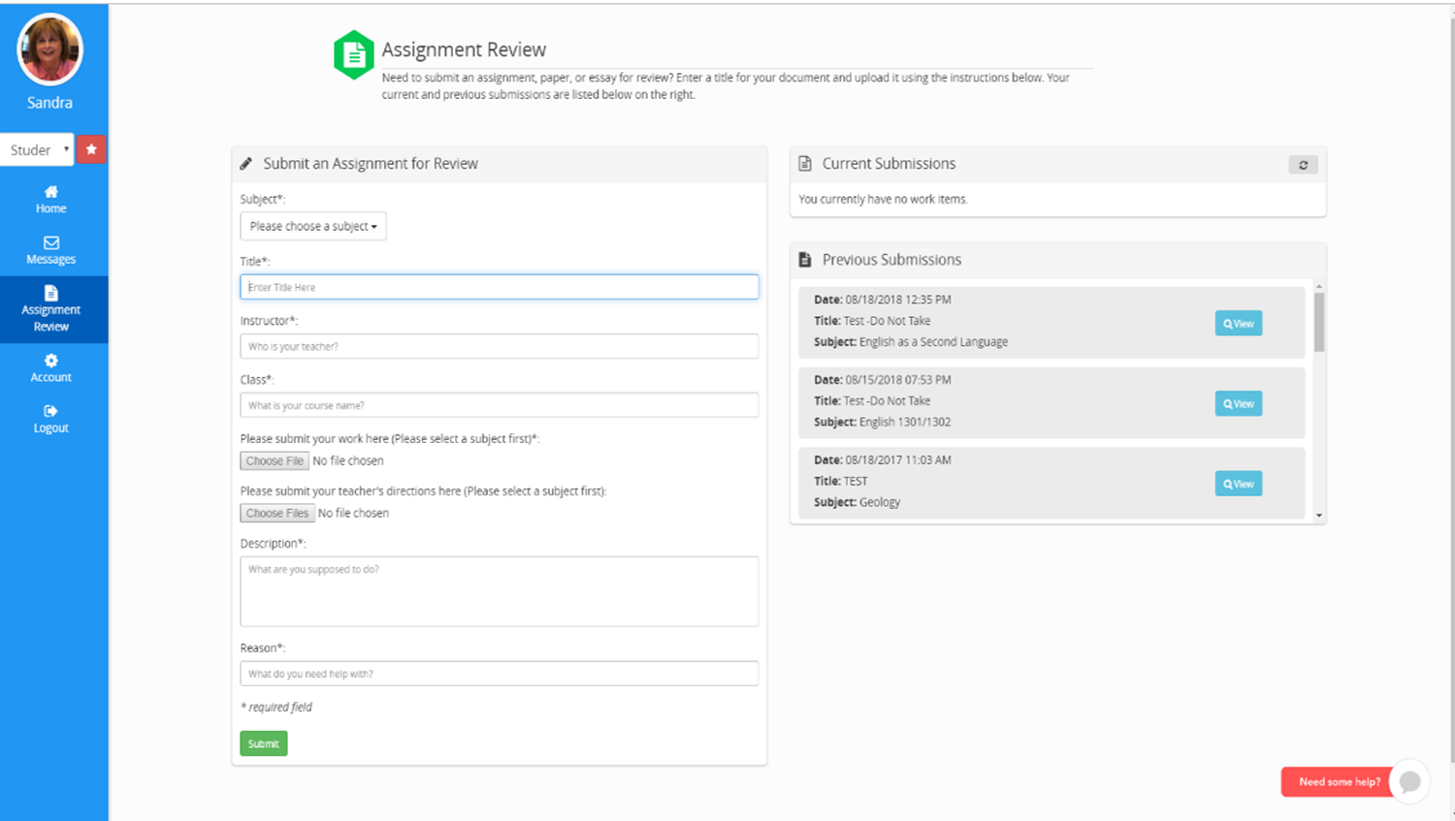
Once You Log In, You Can Submit Your Assignment

Slide 5
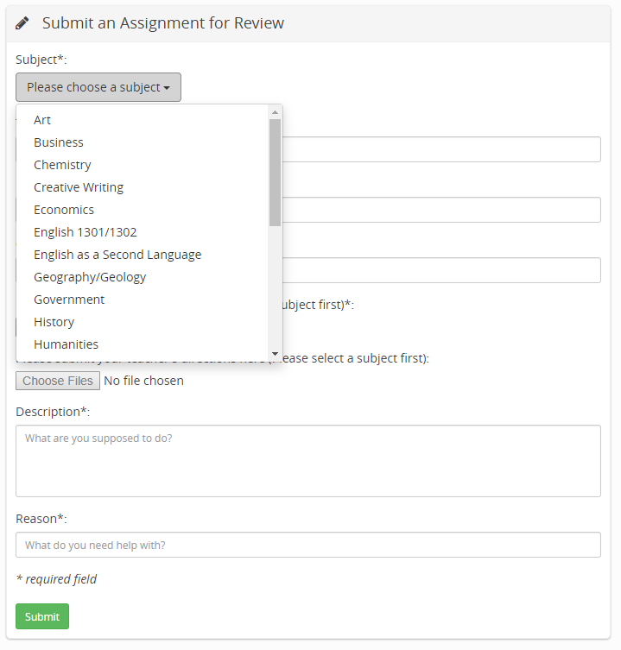

Slide 6
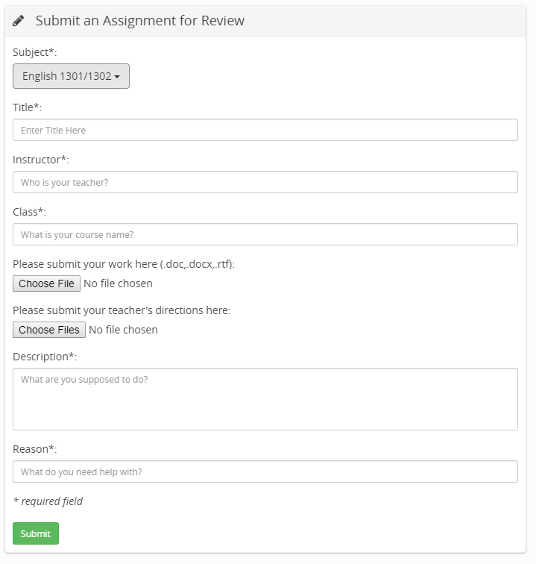

Slide 7
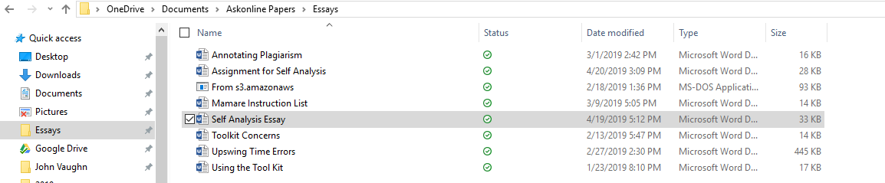

Slide 8
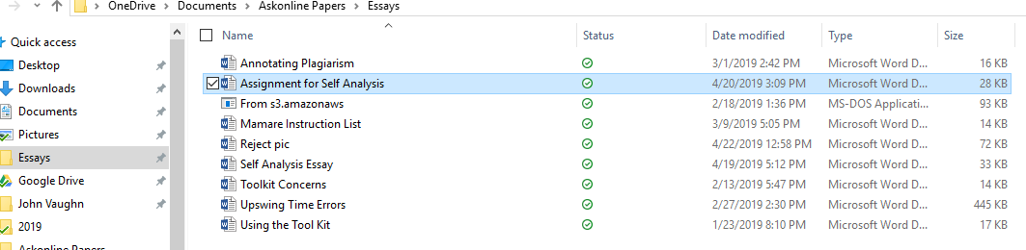

Slide 9
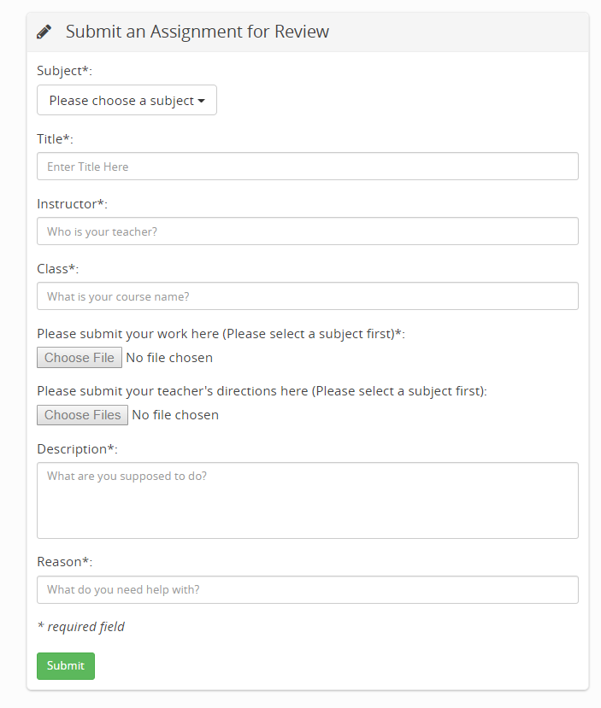
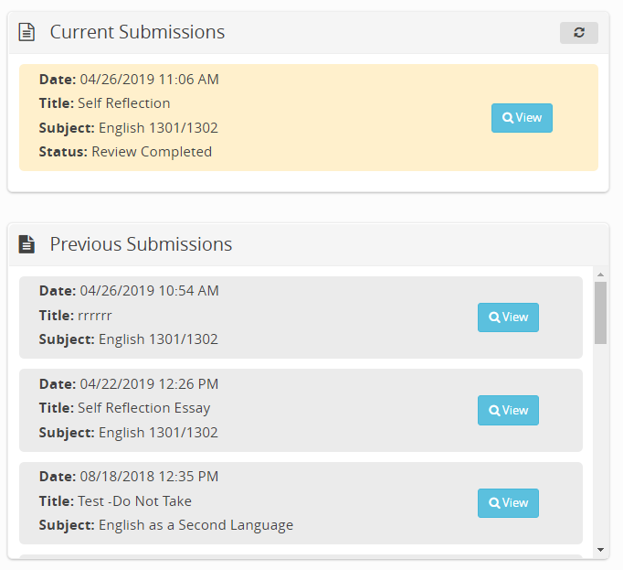

Slide 10
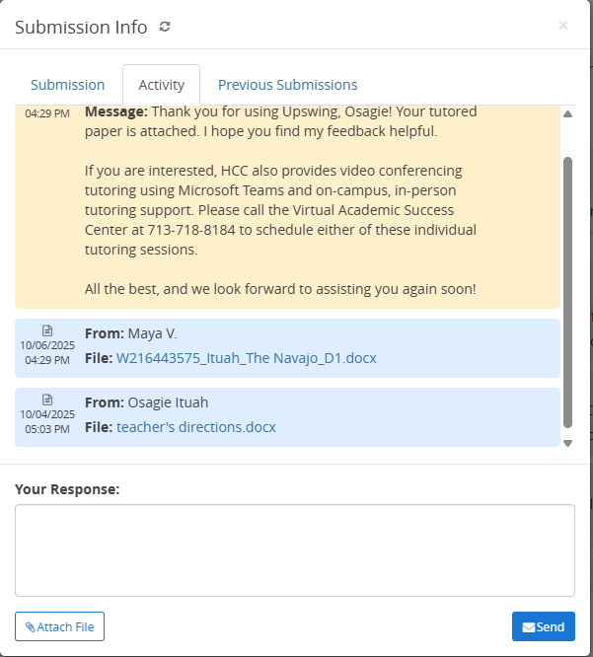

Slide 11
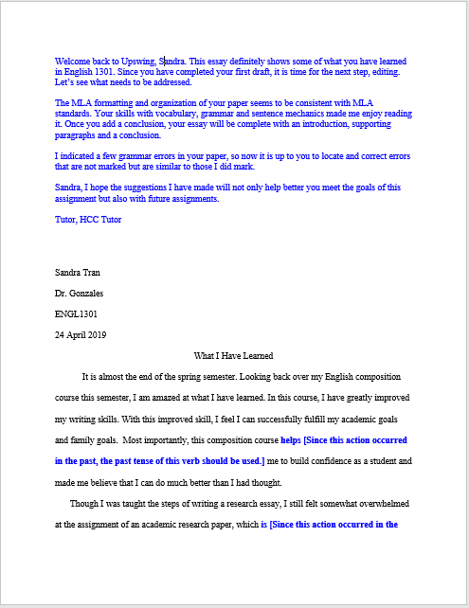

Slide 12
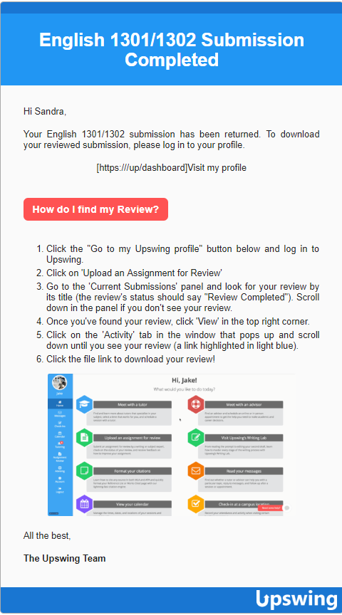
How will I know when my paper is ready?
Once your paper has been reviewed, you will receive a notice via your HCC email account.

Slide 13
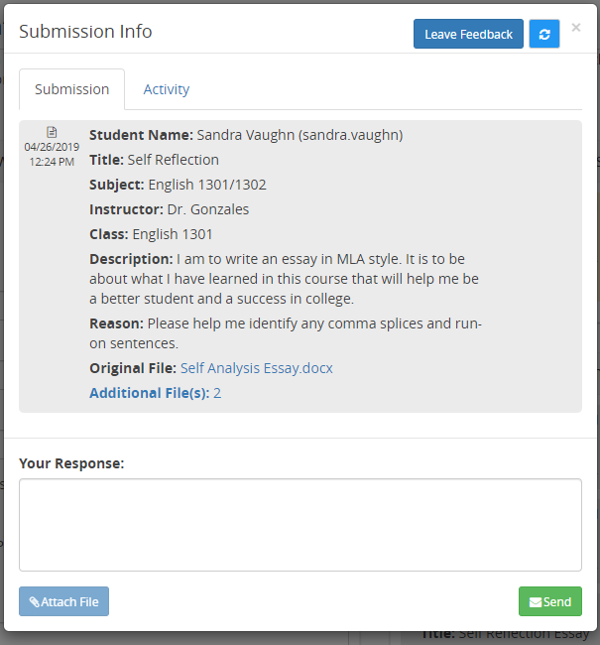
Example of a Rejected Submission
Sandra, your essay is being rejected because earlier today you submitted the same assignment. Once you have edited it using the tutor’s suggestions, please feel free to submit your second draft.

Slide 14
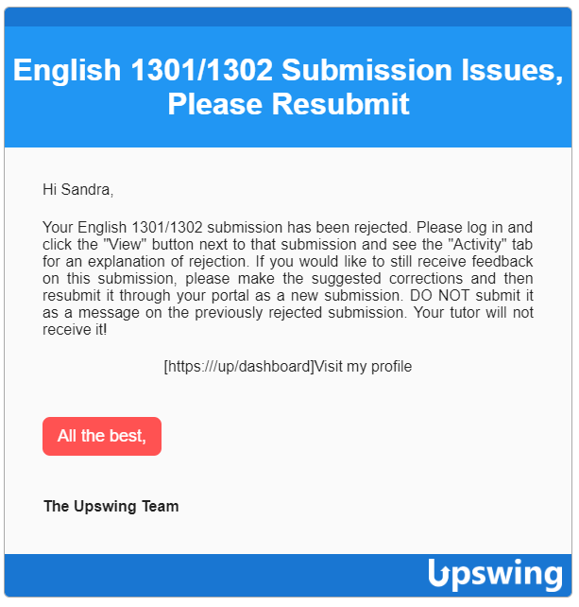
If a tutor has rejected your essay, you will also receive a message via your HCC email account.

Slide 15
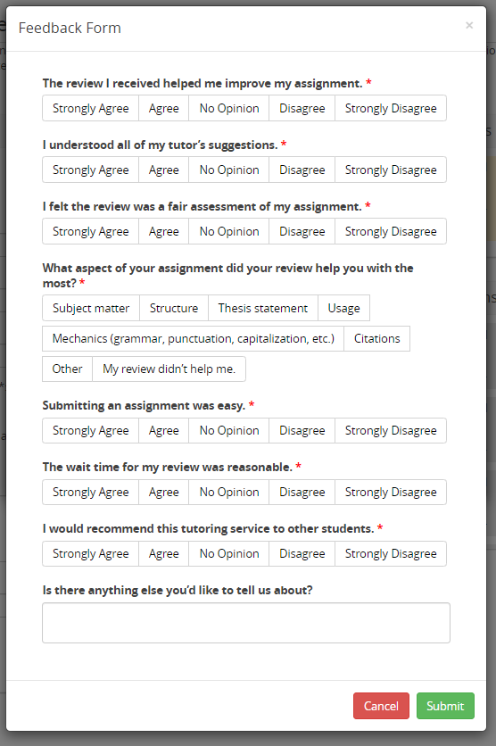
You will also receive a Feedback Form to complete if you wish!

Slide 16
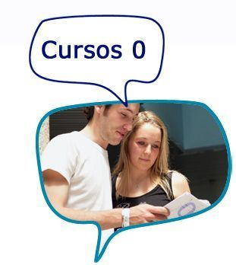
Thanks for tutoring my paper, but…
what do I do now?

Slide 17
Once you receive your paper from the online tutor…
Take the time to read the comments at the top of your paper. Remember that these are merely suggestions to help you meet the assignment goals. If they contradict the instructor’s directions, your teacher's directions come first. These suggestions are based on the information you supply about the assignment.
Read through your paper, noting the comments made within the body of your paper.

Slide 18
What do I do with these information comments?
Recurring grammar errors (i.e., verb tense) are indicated only two or three times. Once this type of grammar error has been marked a couple of times, you can assume that it appears throughout the assignment. Therefore, once the indicated errors have been addressed, you need to locate and correct similar unmarked errors. This procedure helps you focus on these errors so you can avoid them in re-writes and future assignments.

Slide 19
What do I do with these information comments?
Comments and questions added within the body of the essay are intended to help you become aware of ideas that are unclear. For example, the thesis statement might be incomplete, a topic sentence may not support the thesis statement, a point may need to be explained, or a detail may be off-topic. We use in-text comments because it is a conversation we are having with you. Be sure to read the comments and address the issues.
Comments are used to help you expand your ideas and better communicate with the reader, so do not think that a tutor is just being critical.
Again, if any suggestions we provide contradict your instructor’s directions, be sure to follow your instructor’s guidelines.

Slide 20
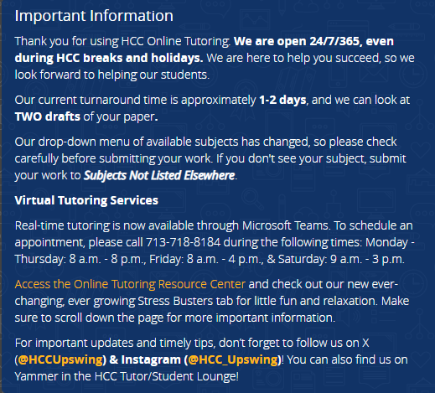
I don’t understand how to correct this error. I still need help!
If you do not understand how to correct an error, we have a Resource Center that provides helpful web links, templates, and handouts.
The web link for this is https://library.hccs.edu/tutoring or just go to our login page and click on “Access the Online Tutoring Resource Center.”
You do not have to be logged in to Upswing to access the Resource Center.

Slide 21
Why is some of my work highlighted in pink or green?
Plagiarism is not only against learning institutions’ policies, but also against the law. If an HCC tutor reviews your paper, and it shows signs of being plagiarized, it will be tutored, but pink highlighting will be used where you have used a source’s exact wording without providing an in-text citation and quotations around the plagiarized work. The tutor will then follow that with the URL leading to the website from which the plagiarized work was taken. If the tutor suspects plagiarism but cannot locate the source, the suspected plagiarized work will be highlighted in green and the tutor will explain why it is suspicious. Our Resource Center will help you correct this problem.
Keep in mind that your instructor wants to see what you can do, not what a reference source can do.

Slide 22

Remember that when we all do our jobs, you will be successful!

Slide 23
Thank You

