Slide 1
Infection Prevention and Control
HEALTH AND SAFETY AND
VOLUNTEER iNDUCTION
Notes:
The infection, prevention and control guidance in this session has been updated in light of the coronavirus (COVID-19) pandemic.
Learning Objectives
Identify ways that are consistent with legislation, policies and procedures for maintaining our own and others’ health and safety
Define the meaning of hazard, risk and risk assessment
Recognise common hazards
Your own health and safety is very important.
During this pandemic, you must take care of yourself and stay at home if:
You exhibit any symptoms of the coronavirus
Anyone you live with is unwell or shows symptoms of the coronavirus
You are an individual who is 'shielded'
If any of the above applies to you, follow Government guidelines and do not attend the place where you volunteer.

Slide 2
INFECTION PREVENTION

Slide 3
Coronavirus Information
It is important to remember that, as a volunteer, it is not your role to deal directly with health and safety issues. It is, however, your duty to know when and how to report any potential concerns.
As long as you are well, you can attend your volunteering role, but you must listen to the health and care professionals you work with and follow their explicit directions.
If you are unsure about your role or have any questions or difficulty understanding the content of this session, please contact your volunteer coordinator for support.
Notes:
This session has been designed to give you an awareness of the subject Health and Safety.

Slide 4
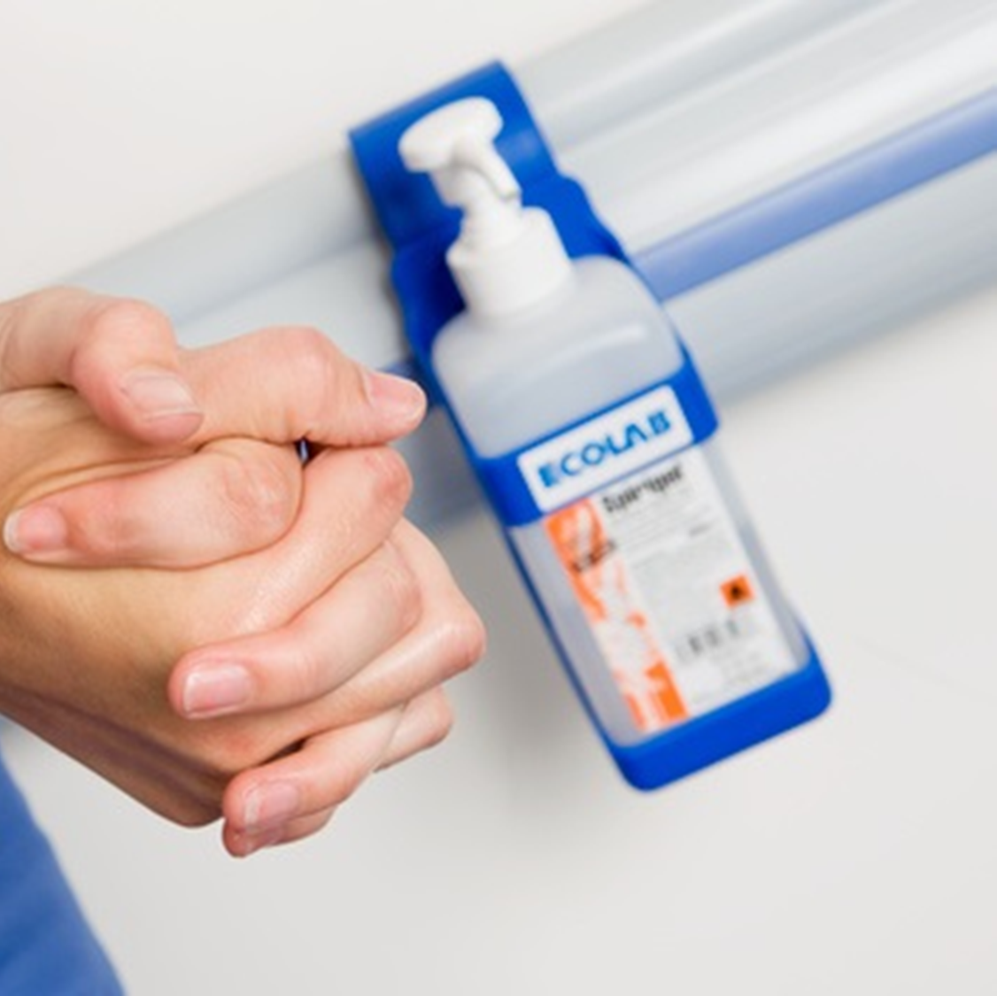
Hand Hygiene
Infection and infectious diseases in humans are caused when harmful germs enter the body and grow.
Infectious diseases can spread from person to person. As with all illnesses, prevention is better than cure.
You have an important role to play in preventing the spread of infections.
It is your responsibility to keep up to date with your own vaccinations in line with the UK vaccination schedule as it is your duty as an individual to avoid spreading infection.
If you are carrying germs, you can transmit them to the people you support directly or you can transfer them from other people or equipment.
This can be minimised by following good hand washing procedures, good personal hygiene habits and staying at home if you are ill.
Notes:
Infection and infectious diseases in humans are caused when harmful germs enter the body and grow. These germs are so small that they can only be seen using a microscope.
Infectious diseases, unlike other diseases such as heart disease and diabetes, can spread from person to person. As with all illnesses, prevention is better than cure.
You have an important role to play in preventing the spread of infections.
It is your responsibility to keep up to date with your own vaccinations in line with the UK vaccination schedule as it is your duty as an individual to avoid spreading infection. If you are carrying germs, you can transmit them to the people you support directly or you can transfer them from other people or equipment. This can be minimised by following good hand washing procedures, good personal hygiene habits and staying at home if you are ill.

Slide 5
EFFECTIVE HANDWASHING
Soap and water
Hand sanitisers
Ensuring you are aware of and follow the guidelines in your organisation for hand hygiene
Regular and correct hand washing is vital to help prevent spread of the coronavirus and other diseases (COVID-19).
One of the most effective measures in the prevention of transmission of infection is improving hand hygiene. Hand hygiene can be performed using

Slide 6
Handwashing technique

Slide 7
Personal Protective Equipment (PPE)
PPE is designed to protect healthcare workers from exposure to potentially infectious material.
Make sure you know and use the appropriate PPE for the situation.
PPE equipment includes:
Gloves
Aprons/gowns
Masks
Protective eyewear
This is not an exhaustive list. It is your responsibility to use PPE in line with local policy and the requirements of your role. If your role involves the use of PPE, your organisation will provide additional training and support specific to the activity.

Slide 8
Personal Protective Equipment (PPE)
In light of the coronavirus (COVID-19) pandemic, if you are working in a healthcare environment, all healthcare professionals and volunteers may be required to wear PPE when in contact with patients.
As a volunteer you will be advised of the precautions you have to take before you carry out your volunteer role.
Notes:
In light of the coronavirus (COVID-19) pandemic, if you are working in a healthcare environment, all healthcare professionals and volunteers may be required to wear PPE when in contact with patients.
As a volunteer you will be advised of the precautions you have to take.
Your volunteer coordinator, or the healthcare staff you are working with, will advise you on whether you should wear PPE before you carry out your volunteer role.
We also recommend that you refer to national guidance on delivering care. You can view this guidance by selecting this link.

Slide 9
Sharps
Volunteers should not be involved in the handling/use of/disposable of sharps.
Sharps include needles, cutters etc.
Notes:
Non-verbal communication includes body language, such as gestures, facial expressions, eye contact and posture.
Communication is:
55% from non-verbal/body language
38% from the tone of voice
7% from the spoken word
In other words:
What you say is less important than how you say it
People can be persuaded by attitude and appearance
Non-verbal communication is particularly important when dealing with emotional issues.

Slide 10
Management of sharps injuries:
Encourage it to bleed
Wash it
Dry and cover it
Seek medical advice
Report it
Ensure you know and follow your organisation’s policy on the management of sharps injuries
If a sharps injury occurs to someone else, help them to seek medical advice.
If you come across any sharps, you should immediately inform a responsible member of staff. Do not touch or attempt to dispose of them.
A sharps injury is an incident which causes a sharp instrument to penetrate the skin. Sharps injuries can result in the transmission of blood-borne viruses such as Hepatitis B, Hepatitis C and HIV.
If a sharp injury occurs to you:

Slide 11
Health and safety

Slide 12
Why is Health and Safety Important?
Health and safety is usually tailored to a number of approaches and there are key tasks that should not be carried out without special training.
Notes:
As health and safety is usually tailored to a number of approaches, dependent on which area in the organisation you volunteer for, there may be elements of the session that are not applicable to you. In particular, there are key tasks relating to health and safety that should not be carried out without special training.
If you are unsure of whether it applies to you, then please consult your volunteer coordinator.

Slide 13
How can your organisation ensure that it is committed to delivering services safely?
Health and Safety audits/inspections,
Staff and
Volunteer training
Policies
Guidelines and procedures
Safe work equipment and facilities
Risk assessments,
Fire precautions,
Safety signs
Employer’s liability insurance
Some examples of the procedures and provisions in place across organisations:

Slide 14
WHAT CAN WE DO TO KEEP SAFE?
Wear any personal protective equipment (PPE) that is required
Follow policies and procedures
Report unsafe activities
Report unsafe situations or conditions
Report accidents and near misses.

Slide 15
The legal stuff
The law aims to:
Prevent people getting injured or suffering illness caused through work
Encourage high standards of health and safety
The law says:
You have a right to a safe workplace
Your organisation must keep you safe
You also have responsibility for your own safety

Slide 16
All organisations have legal responsibility under the Health and Safety at Work etc. Act 1974 and Management of Health and Safety at Work Regulations 1999 to ensure the health, safety and welfare at work of their employees and volunteers.
There is health and safety legislation that relates to different workplaces. It's important to know how this legislation applies to you.

Slide 17
Some of the legislation that may apply to you as a volunteer include:
Health and Safety at Work etc. Act (1974)
Management of Health and Safety at Work Regulations (1999)
Manual Handling Operations (1992) (amended 2002)
Display Screen Equipment Regulations (1992) (amended by the Health and Safety (Miscellaneous Amendments) Regulations (2002)
Personal Protective Equipment at Work Regulations (1992)
Control of Substances Hazardous to Health Regulations (COSHH) (2002)

Slide 18
Control of Substances Hazardous to Health (COSHH) Regulations 2002
These regulations help protect people against hazardous substances.
Examples include cleaning products such as bleach, dust, fumes and waste products.
Hazardous substances are usually indicated by hazard signs, such as the diamonds you can see on the picture to the left.
COSHH assessments should be available. These contain information about how to work safely with hazardous substances.

Slide 19
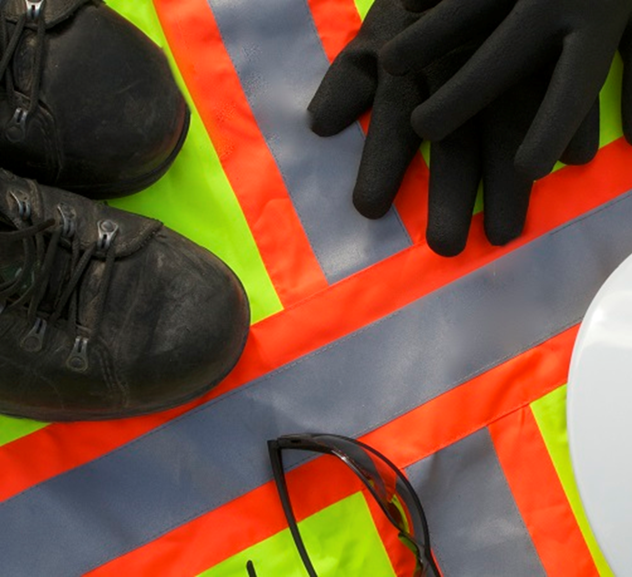
Personal Protective Equipment at Work Regulations (1992)
Organisations have duties concerning the provision and use of personal protective equipment (PPE).
PPE is equipment that will protect the user against health or safety risks.
It can include items such as safety helmets, gloves, eye protection, high-visibility clothing, safety footwear and safety harnesses.

Slide 20
Responsibilities
If an organisation fails to meet its responsibilities and comply with health and safety legislation, it can have serious consequences. These include:
Prosecution, notices, fines and imprisonment
Claims and complaints
Damage to reputation, credibility and morale

Slide 21
You and your organisation have certain responsibilities in relation to the Health and Safety at Work Act.
Volunteer
No person shall intentionally or recklessly interfere with or misuse anything provided in the interests of health and safety. Volunteers should:
Take responsibility for their own health and safety and that of others who may be affected by their acts or omissions
Co-operate with their organisation on health and safety issues
Be familiar with and follow policies, procedures and instructions
Report any accidents, damage, unsafe acts or conditions, near misses, or loss as soon as reasonably possible
Ensure that they immediately report any condition which may affect their ability to volunteer safely
Ensure that they attend any related training courses provided for them
Organisation
It shall be the duty of every employer to ensure, so far as is reasonably practicable, the health, safety and welfare at work of all his/her employees

Slide 22
Risks and hazards
What do we mean by risks and hazards?
Hazard
A hazard is anything with the potential to cause harm, for example:
Uneven or wet floors
Cables stretched across walkways
Hazardous materials such as cleaning products
Risk
Risk is the likelihood and consequences of that harm occurring.
Significant risk is capable of creating a real risk to health and safety.
Safe
Safe is about being protected from, or not exposed to, danger or risk.

Slide 23
Risk assessments
In order to identify hazards that have the potential to cause harm and ensure that the associated risks are well controlled, you should:
Know about the hazards and risks in your organisation
Make sure the risks stay controlled
Risk is a part of everyday life:
You can’t eliminate them all
You can identify the significant risks that affect you
You should know what to do to manage them responsibly

Slide 24
There are five steps to carrying out a risk assessment:
Identify the hazards
Decide who might be harmed and how
Evaluate the risks and decide on precautions
Record your findings and implement them
Review your assessment and update if necessary
Notes:
This is a brief overview of risk assessment. As a volunteer you would not normally be responsible for undertaking formal risk assessments. If, however, there is an expectation that this will be your responsibility, you should seek further advice from your organisation.

Slide 25
Slips, trips and falls
Slips, trips and falls can happen anywhere. They are the biggest cause of serious injuries to others. To prevent slips, trips and falls:
Wear sensible, suitable footwear
Clean up and report spillages
Remove and report obstructions
Keep walkways and work areas clear and well lit
Plan cleaning schedules appropriately

Slide 26
Adverse events
Action or lack of action that leads to unexpected, unintended and preventable harm.
Incidents
Specific negative events. Incidents are described as events which need investigation as they caused severe harm or damage to either the person receiving care or the organisation.
Errors
Not doing something as it should have been done, for example, through bad planning or being forgetful.
Near misses
Situations where an action could have harmed the individual but, either by chance or purpose, was prevented.
Unfortunately, people can't always be protected from harm and mistakes do happen.
Mistakes are seen as adverse events, incidents, errors or near misses.
Notes:
Unfortunately, people can't always be protected from harm. All volunteer workplaces involve people collaborating towards the well-being of those needing care or support. Mistakes happen through things like lack of knowledge, poor communication or not sharing information, stress, negligence or being distracted. Mistakes are seen as adverse events, incidents, errors or near misses.

Slide 27
Incidents and near misses should be reported
To prevent/minimise risks and incidents
To learn from mistakes and make the appropriate change to prevent it from happening again
For a safer working environment
To comply with legislation
To comply with the organisation’s policies
To maintain a record of events and actions
To identify trends
To encourage openness and fairness
Refer to your local policies and procedures for reporting procedures

Slide 28
Moving and assisting
The regulations define moving and handling as:
“Any transporting or supporting of a load (including the lifting, putting down, pushing, pulling, carrying or moving thereof) by hand or bodily force.”
As a volunteer, you should only be expected to assist people rather than be responsible for actual handling tasks, for example, using specialist equipment to help get someone out of bed. So here we will refer to moving and assisting.
We are all at risk from moving and assisting injuries.

Slide 29
MANAGING RISK
First - You must avoid harmful manual assisting operations, so far as it is reasonably practicable.
Second - Assess the manual assisting operations that cannot be avoided.
Third - Reduce the risk of injury so far as it is reasonably practicable.
In order to help manage any risks from manual assisting, you must follow these steps:

Slide 30
Both the organisation and individual volunteers are responsible for ensuring they take steps to minimise injuries.
Organisation's responsibilities:
Implement relevant policies and guidelines
Undertake risk assessments
Provide training and guidance
Provide specialist equipment to support safer moving If appropriate

Slide 31
Volunteer's responsibilities
Follow prescribed safe systems of volunteering
Be aware of, and understand your organisation's moving and handling policy
Use equipment provided properly
Do not misuse or interfere with equipment provided for your safety
Tell your organisation if you identify hazardous handling activities or any defects in equipment
Ensure your activities don’t put others at risk
It is important to be able to identify situations where you should not carry out specific tasks, unless you have had specialist training. If in doubt, ask your volunteer coordinator.

Slide 32
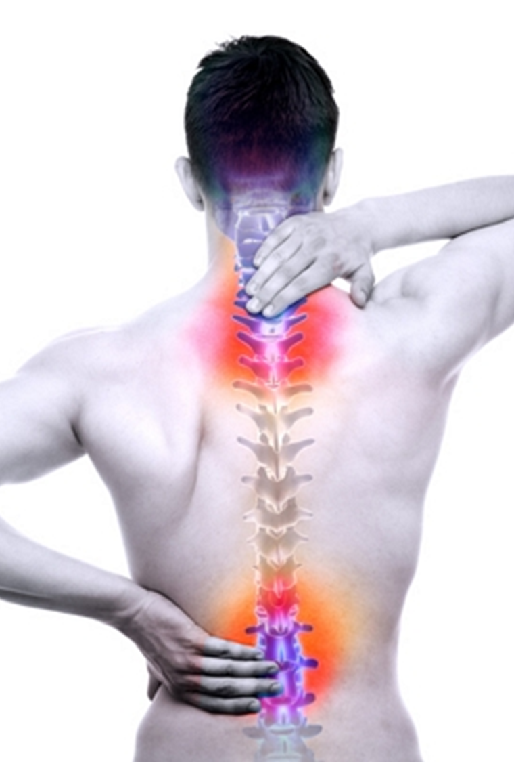
Common Injuries and Healthy Back Care
Common injuries
Musculoskeletal disorders to the back and limbs include:
Damage to:
Joints
Muscles
Tendons and ligaments
Intervertebral discs
Repetitive strain injury (RSI)
Hernias
Abrasions/bruises
Wear and tear
Fractures

Slide 33
Promoting healthy back care
Key activities include:
Always ensure a good posture
Try to use a chair with a backrest. Change how you sit every few minutes
Stay active and exercise. Particularly strengthen abdominal and back muscles
Maintain a healthy weight
Quit smoking
Reduce stress

Slide 34
The ergonomic approach to the assessment of risk involves fitting the job to the person, rather than the person to the job.
Notes:
TILE – Acronym for Task, Individual capability, Load, Environment

Slide 35
Session Summary
Your organisation's policies, guidelines and procedures in relation to health, safety and welfare should be readily available
Any issues around health and safety should be reported/discussed with your volunteer coordinator
What can we all do to keep safe?
Wash your hands regularly
Wear any personal protective equipment (PPE) that is required
Follow policies and procedures
Report unsafe activities
Report unsafe situations or conditions - make them safe if you can without putting yourself at risk
Report accidents and near misses

Slide 36
Thank you!

Slide 37
The content of this training was developed by NHS England, E-Learning for Healthcare and has been adapted by Bradford Teaching Hospitals NHS Foundation Trust, to provide an accessible format, ensuring that all volunteers have the same basic learning when they start in their role.

