Slide 1
FIRE SAFETY
VOLUNTEER iNDUCTION
Notes:
By the end of this session you will be able to:
Define the characteristics of fire, smoke and toxic fumes
Identify the main fire hazards in your volunteering environment
Describe the actions required when discovering a fire in your volunteering environment, including how to raise alarm, what action to take when an alarm is raised, evacuation procedures and associated escape routes
Describe basic fire safety and fire safety protocols
Explain how to practice and promote fire prevention

Slide 2
The ELEMENTS OF FIRE
What is fire?
It is a chemical reaction producing smoke, heat and flames
Produces dangerous toxic gases
May cause disorientation
May damage property
May cause injury or death

Slide 3
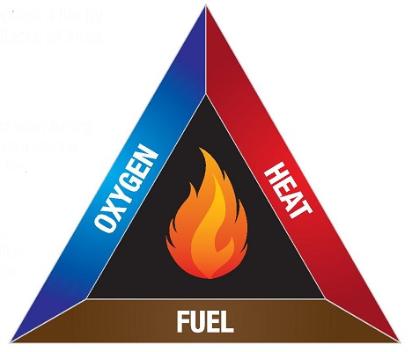
The elements of fire
A fire needs three elements:
Oxygen
Heat
Fuel
Take one of these elements away and the fire will be extinguished.

Slide 4
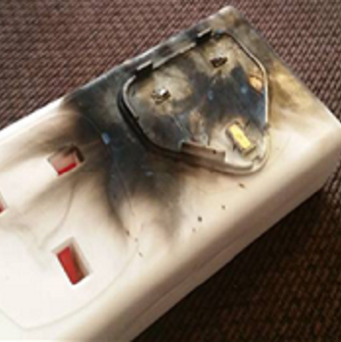
The elements of fire
One of the biggest cause of fires in organisations is electricity.
Therefore, you must:
Turn off equipment when not in use
Report faulty equipment to a member of staff
Avoid using extension cables
Ensure electric cables are not trapped or pinched
Ensure vents on electric equipment are not obstructed

Slide 5
Risk assessment
Fire regulations say that all organisations should:
Carry out regular and timely fire risk assessments
Ensure that their staff and volunteers know where the fire exits are and that they are familiar with the evacuation protocol
Ensure that their staff and volunteers familiarise themselves with the organisation’s fire safety policy and fire risk assessment
Notes:
As part of your induction, you will be informed by your volunteer coordinator of any particular risks in the area where you are volunteering which could include:
What fire hazards have been identified and what are the preventive measures?
What actions have been taken to remove or reduce the chance of fire occurring?
Who is at risk? Consider the most vulnerable people
What should people do in the case of a fire?
What is the emergency plan for your location?

Slide 6
Reducing the risk of fire
Fire doors
Fire ALARM
Fire signage
Emergency escape lighting
Keep fire doors closed, they must NOT be wedged open
Fire alarms alert people when smoke or heat is detected
Fire signs are designed and used to meet fire safety needs and help ensure you comply with current legislation. Legislation states that "all premises should clearly mark emergency exits and escape routes“.
Emergency escape lighting is part of an emergency lighting system that provides illumination for the safety of people leaving a location.

Slide 7
Reducing the risk of fire
What can be done to reduce the risk of fire?
Fire fighting equipment
Fire fighting equipment is available to use at the scene of a fire.
There are a number of different kinds of extinguisher available depending on the location.
Evacuation procedures
You will be given information about local fire evacuation procedures on your induction.
Each organisation will have a specific evacuation plan.
Notes:
Fire fighting equipment:
As a volunteer it is not your role to use fire extinguishers. Most organisations will have designated Fire Marshalls who will be trained in the proper use of fire extinguishers. Make sure you know who your Fire Marshall is.

Slide 8
IN THE EVENT OF A FIRE
If you see a fire, smell smoke or suspect a fire - raise the alarm
Do not tackle the fire
Close doors and windows if it’s safe to do so
Follow local evacuation procedures. Trained staff will deal with any vulnerable people
Exit the building as quickly as possible
Do not stop to collect personal belongings
Do not use standard lifts
Meet well away from the building at an agreed assembly point
Do not return to the building until told it is safe to do so
Follow any instructions from fire marshals/wardens and the emergency services
Whilst volunteering, what should you do if you smell smoke, see flames or hear a fire alarm?
Each organisation's procedure will vary slightly but you should follow these general guidelines:
If you smell smoke:
If you hear a fire alarm:

Slide 9
As a volunteer, what are your responsibilities in relation to fire safety?
As a volunteer you should:
Understand and comply with your organisation's fire safety policy
Comply with the no smoking policy, ensure cigarette ends are put out properly and disposed of safely
Keep fire doors closed to stop the spread of fire, heat or smoke
Know what to do if you discover a fire or hear a fire alarm
Know what phone number to call in the case of a fire
Be familiar with your building's evacuation routes
Know where the fire extinguishers are in case you need to direct members of the fire brigade
Report any ideas for reducing the risk of fire in your area

Slide 10
Key points
A fire needs three elements to stay alight: oxygen, heat and fuel
The most common cause of fire in organisations is electricity
Protective measures should be taken to reduce the risk of fire, such as keeping fire doors closed and reducing fire hazards
All staff and volunteers should familiarise themselves with the organisation’s procedure in the event of a fire
All staff and volunteers should be acquainted with the location of fire exits and the evacuation protocol for their working area
Regular and timely fire risk assessments should be carried out by trained staff

Slide 11
Thank you!

Slide 12
The content of this training was developed by NHS England, E-Learning for Healthcare and has been adapted by Bradford Teaching Hospitals NHS Foundation Trust, to provide an accessible format, ensuring that all volunteers have the same basic learning when they start in their role.

