Slide 1
Bringing volunteers back on site safely
Alan Bigham, Programme Manager
Volunteering in NHSScotland
30 September 2020
Notes:
Title slide 1

Slide 2
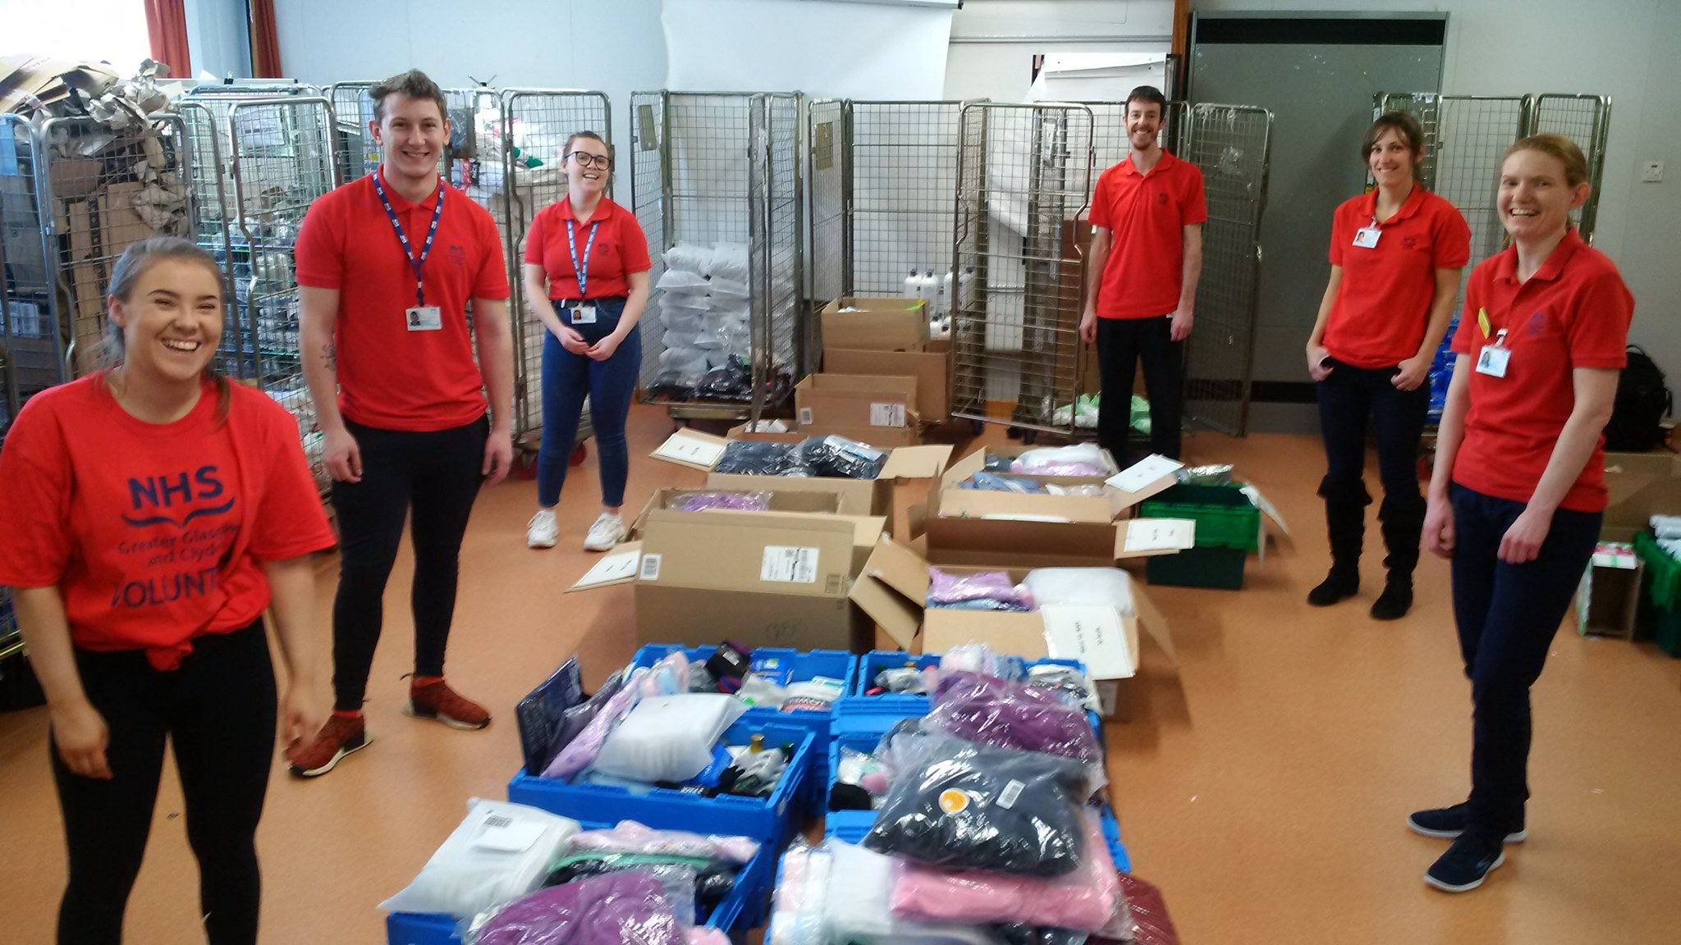
Volunteering in NHS boards
Paused entirely
Very limited roles (e.g. gardening)
Limited roles, e.g. wayfinding, some wards
Open to recruitment (focus directed in response to COVID-19)

Slide 3
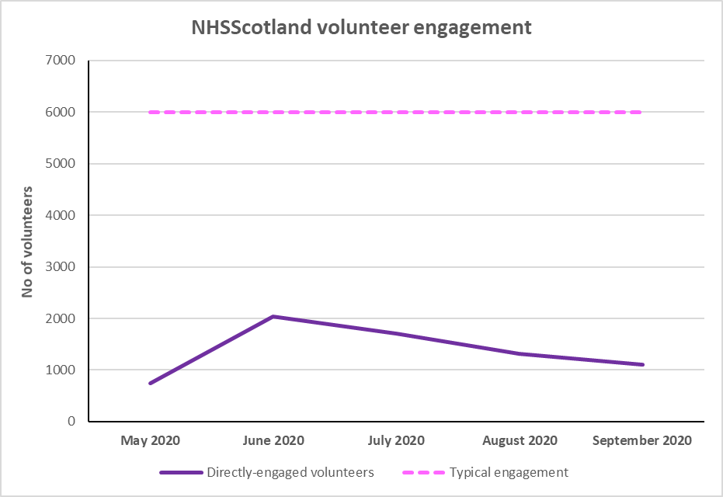
Impact of COVID-19 on NHS Boards

Slide 4
Shared practice and guidance
COVID-19 Age tool
Phased return
Staggered rotas
Health Protection Scotland guidance (inc distancing and PPE)
Face coverings and masks
Symptom reporting and contact tracing
Travel
https://www.hisengage.scot/COVID-volunteering

Slide 5
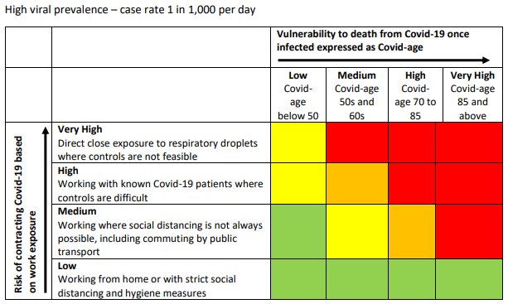
COVID-19 Age Tool
‘Covid age’
Risk factors
Age
Ethnicity
Health factors
Sex
Viral prevalence (‘risk appetite’)
Clinical judgment

