Slide 1
An introduction to the Engage programme
Salisbury foundation trust
Rubina THIEBAUT

Slide 2
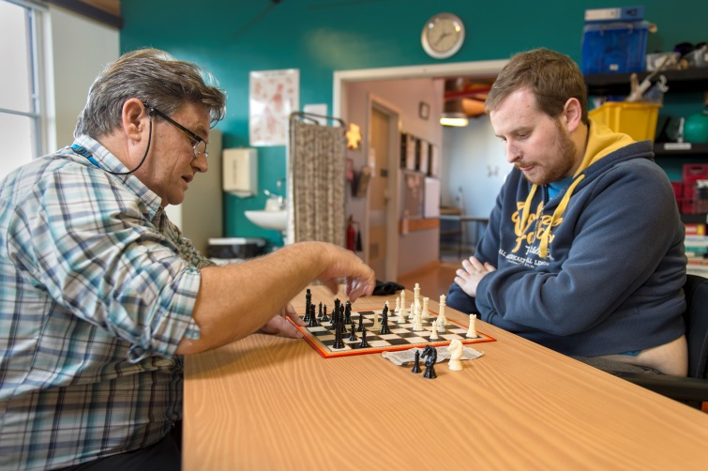
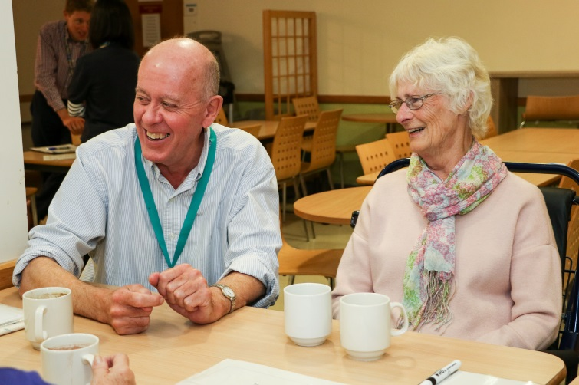
Objectives for today
How Engage began
The need for intervention
The background of Engage
Research
Rolling Engage out to other trusts
https://youtu.be/WM4nCTiFh3A

Slide 3
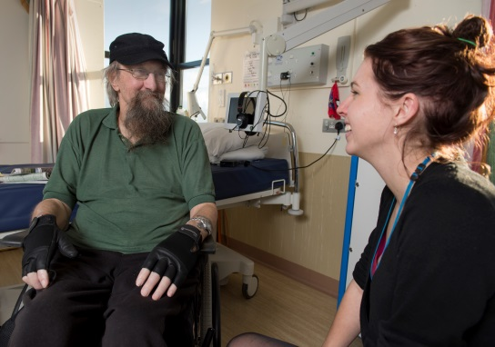
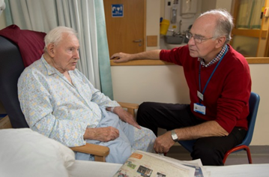
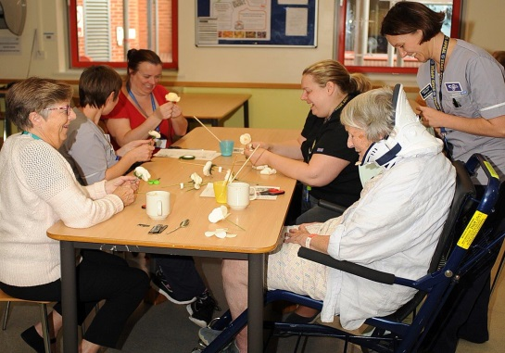
How engage began
It all began with Dr Nigel North, consultant Clinical Psychologist; it’s personal.
As an inpatient at Salisbury hospital, Nigel's mother became increasingly frustrated with the lack of social support given from the healthcare professionals.
This led to Nigel discovering the need for extra cognitive support for older adults within the hospital environment.

Slide 4
Need for intervention
It was clear that it was not just Nigel’s mother who was feeling this was in hospital and this led to Nigel setting up the Engage Programme as an intervention.
It has been estimated that around 85% of hospital beds are taken up by the over 65’s (Oliver,2016).
It is estimated that 1 in 6 adults over 80 have Dementia(Alzheimer’s Society, 2019).
Estimations suggest that there are 35.6 million people living with Dementia worldwide (Briggs et al., 2016).

Slide 5
Background of engage
2010
Trials on Redlynch & Farley Wards
Presentation to Trust board, after 6-7 months trial period
Engage initially funded via the Psychology Department's Budget
2011
Won SDH's Service Improvement Award
Engage presented at a conference for cognitive and social stimulation in July 2011
2012
Engage presented at the NHS Innovations for Older Adult Care and Dementia Partnership
Received 'Highly Commended' in SDH's Equality & Diversity Award
2013
Our first sale of the Engage 'package' - to Poole Hospital
Finalist in the Innovation Categorgy at the National HSJ Awards (from 1100 entries)
Referred to as a 'beacon of good practice' in the National Dementia Audit
2014
Engage featured in several newspapers
Nigel North interviewed by BBC Wiltshire and SPIRE FM
Significant interest received from other NHS Trusts
Receiving referrals from all general hospital wards
2015
Our second sale of the Engage 'package' - to Port Talbot Hospital
2016
Won the Queen's Award for Voluntary Service
Engage Coordinator, Antointette Broomfield & Volunteer, Mike Pointer attended the Queen's Garden Party
Fundraising by Engage Volunteers raised £1,500 for the purchase of iPads to use with patients
Presented Engage at SDH's Hospital Round
2017
Links made with AGE UK Salisbury: Sarah Homer delivered teaching to Age UK Volunteers
2018
Joint 3rd Place Winner of the Wiltshire Life Awards for 'Community Group Award'
Nigel won Wiltshire Life's 'Lifetime Achievement Award'
Engage entered Waitrose's Community Nomination Scheme - awarded £349 by our local community
Presented Engage at SDH's Hospital Round
2019
Awarded grant funding of £75,000 from Helpforce
Recruitment drive
Scaling to other NHS Trusts
Engage Working Party
Senior Convened Steering Group

Slide 6
Research
There have been two rounds of research carried out on the effectiveness of the Engage Programme during its 10 years of running.
Conclusions drawn:
Anxiety and depression scores were lower in those that had received intervention from volunteers.
There was no statistical significance in the amount of interventions the patients had received, meaning even a few visits could make the positive difference in the anxiety and depression scores.

Slide 7
Rolling out engage
There have been two attempts previously to roll out the Engage Programme, one at Port Talbot and the other at Poole Hospital.
Although the programme was well received at both hospitals, the programme did ultimately fail.
This failure boiled down to one critical point – an Engage Programme Coordinator was not put in place.
This brings us up to date and our current partnership with Helpforce.

Slide 8
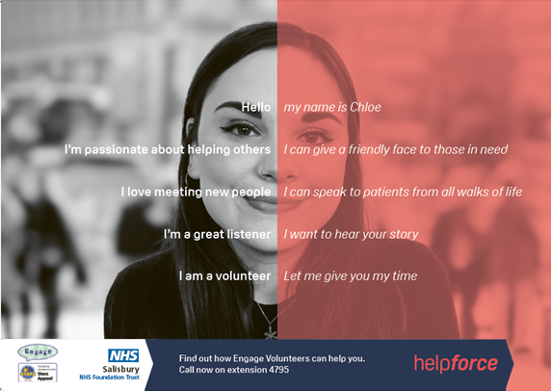
HELPFORCE volunteer innovators programme

Slide 9
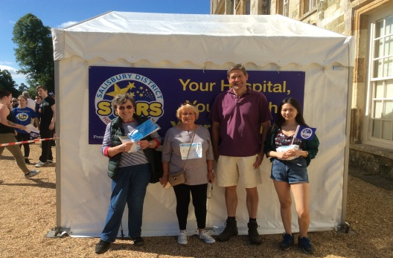
Final thoughts
When introducing a new volunteering initiative into a trust how far up the management chain does it need to go to gain approval?
Any other questions?
Contact: Rubina Thiebaut sft.engage@nhs.net

Slide 10
References
Alzheimer’s Society, 2019. Retrieved from: https://www.alzheimers.org.uk/about-us/news-and-media/facts-media
Briggs, R., Dyer, A., Nabeel, S., Collins, R., Doherty, J., Coughlan, T., & Kennelly, S. P. (2016). Dementia in the acute hospital: the prevalence and clinical outcomes of acutely unwell patients with dementia. QJM: An International Journal of Medicine, 110(1), 33-37.
Oliver, 2016. Why is it more difficult than ever for older people to leave hospital? Retrieved from: https://www.kingsfund.org.uk/blog/2016/05/older-people-leave-hospital?gclid=EAIaIQobChMIm4jJ7cXG5wIVg7HtCh01lQXjEAAYASAAEgKTdfD_BwE

