Slide 1


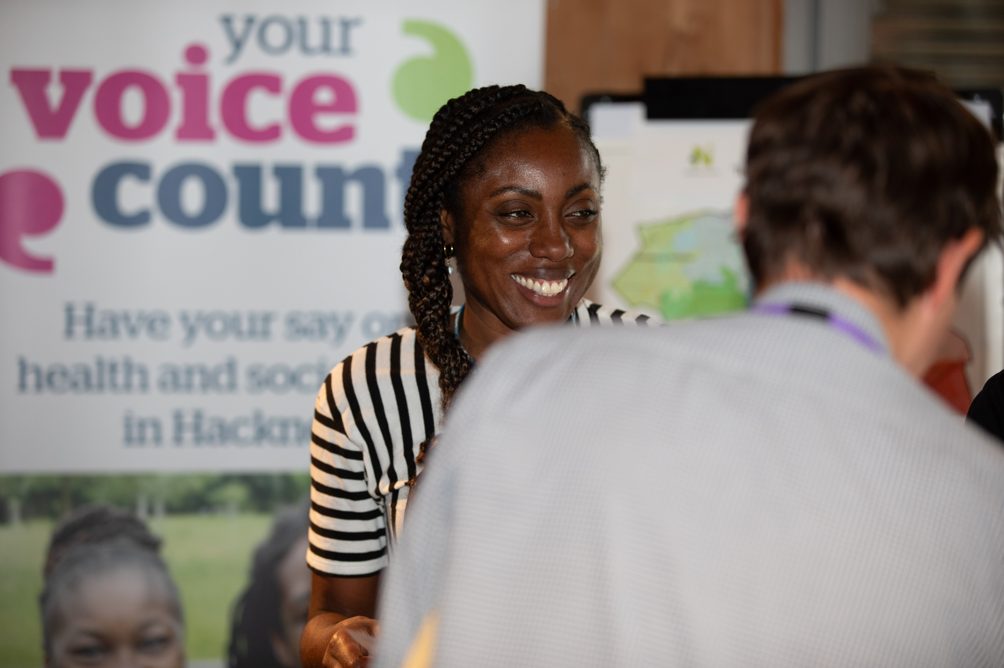
Healthwatch and Volunteering

Slide 2
About Healthwatch
Healthwatch is the health and social care champion. It is for anyone who uses health services or needs care, we want to hear about all experiences.
Healthwatch England works nationally.
Every local authority has a local Healthwatch.
We have the power to ensure that NHS and social care leaders listen to feedback and improve standards of care. We can also help people find reliable and trustworthy information and advice.

Slide 3



Our values
Our vision
To bring closer the day when everyone gets the care they need.
Our mission
To make sure that people's experiences help make health and care better.
Equity: Working in an inclusive and compassionate way, with a strong link to the communities we serve, and empowering them.
Collaboration: We will build relationships, internally and externally, communicating clearly and co-producing with partners to amplify our influence.
Impact: Our agenda will be driven by the public, being a purposeful, critical friend to decision-makers.
Truth: Having integrity and honesty, speaking truth to power
Independence: Being ambitious about creating change for people and communities, being accountable to them and holding others to account

Slide 4

Our people
The Healthwatch network is present in every community.
Nationally
Locally across 153 services
570
Full-time equivalent staff deliver the Healthwatch service for local communities
Volunteers kindly give up their time to understand local people's views, provide advice and help improve services.
3,997
37
staff work with the public, policymakers and partners to improve care
4.08
On average each local Healthwatch has four full-time equivalent staff.

Slide 5

Our reach
Last year one and a half million people with information, or to have their say on care.
Nationally
219,761
People used our service for clear information and advice
13,505
People shared their experiences of care
Locally
929,544
People used our service for clear information and advice
390,049
People shared their experiences of care
4
Notes:
The net

Slide 6
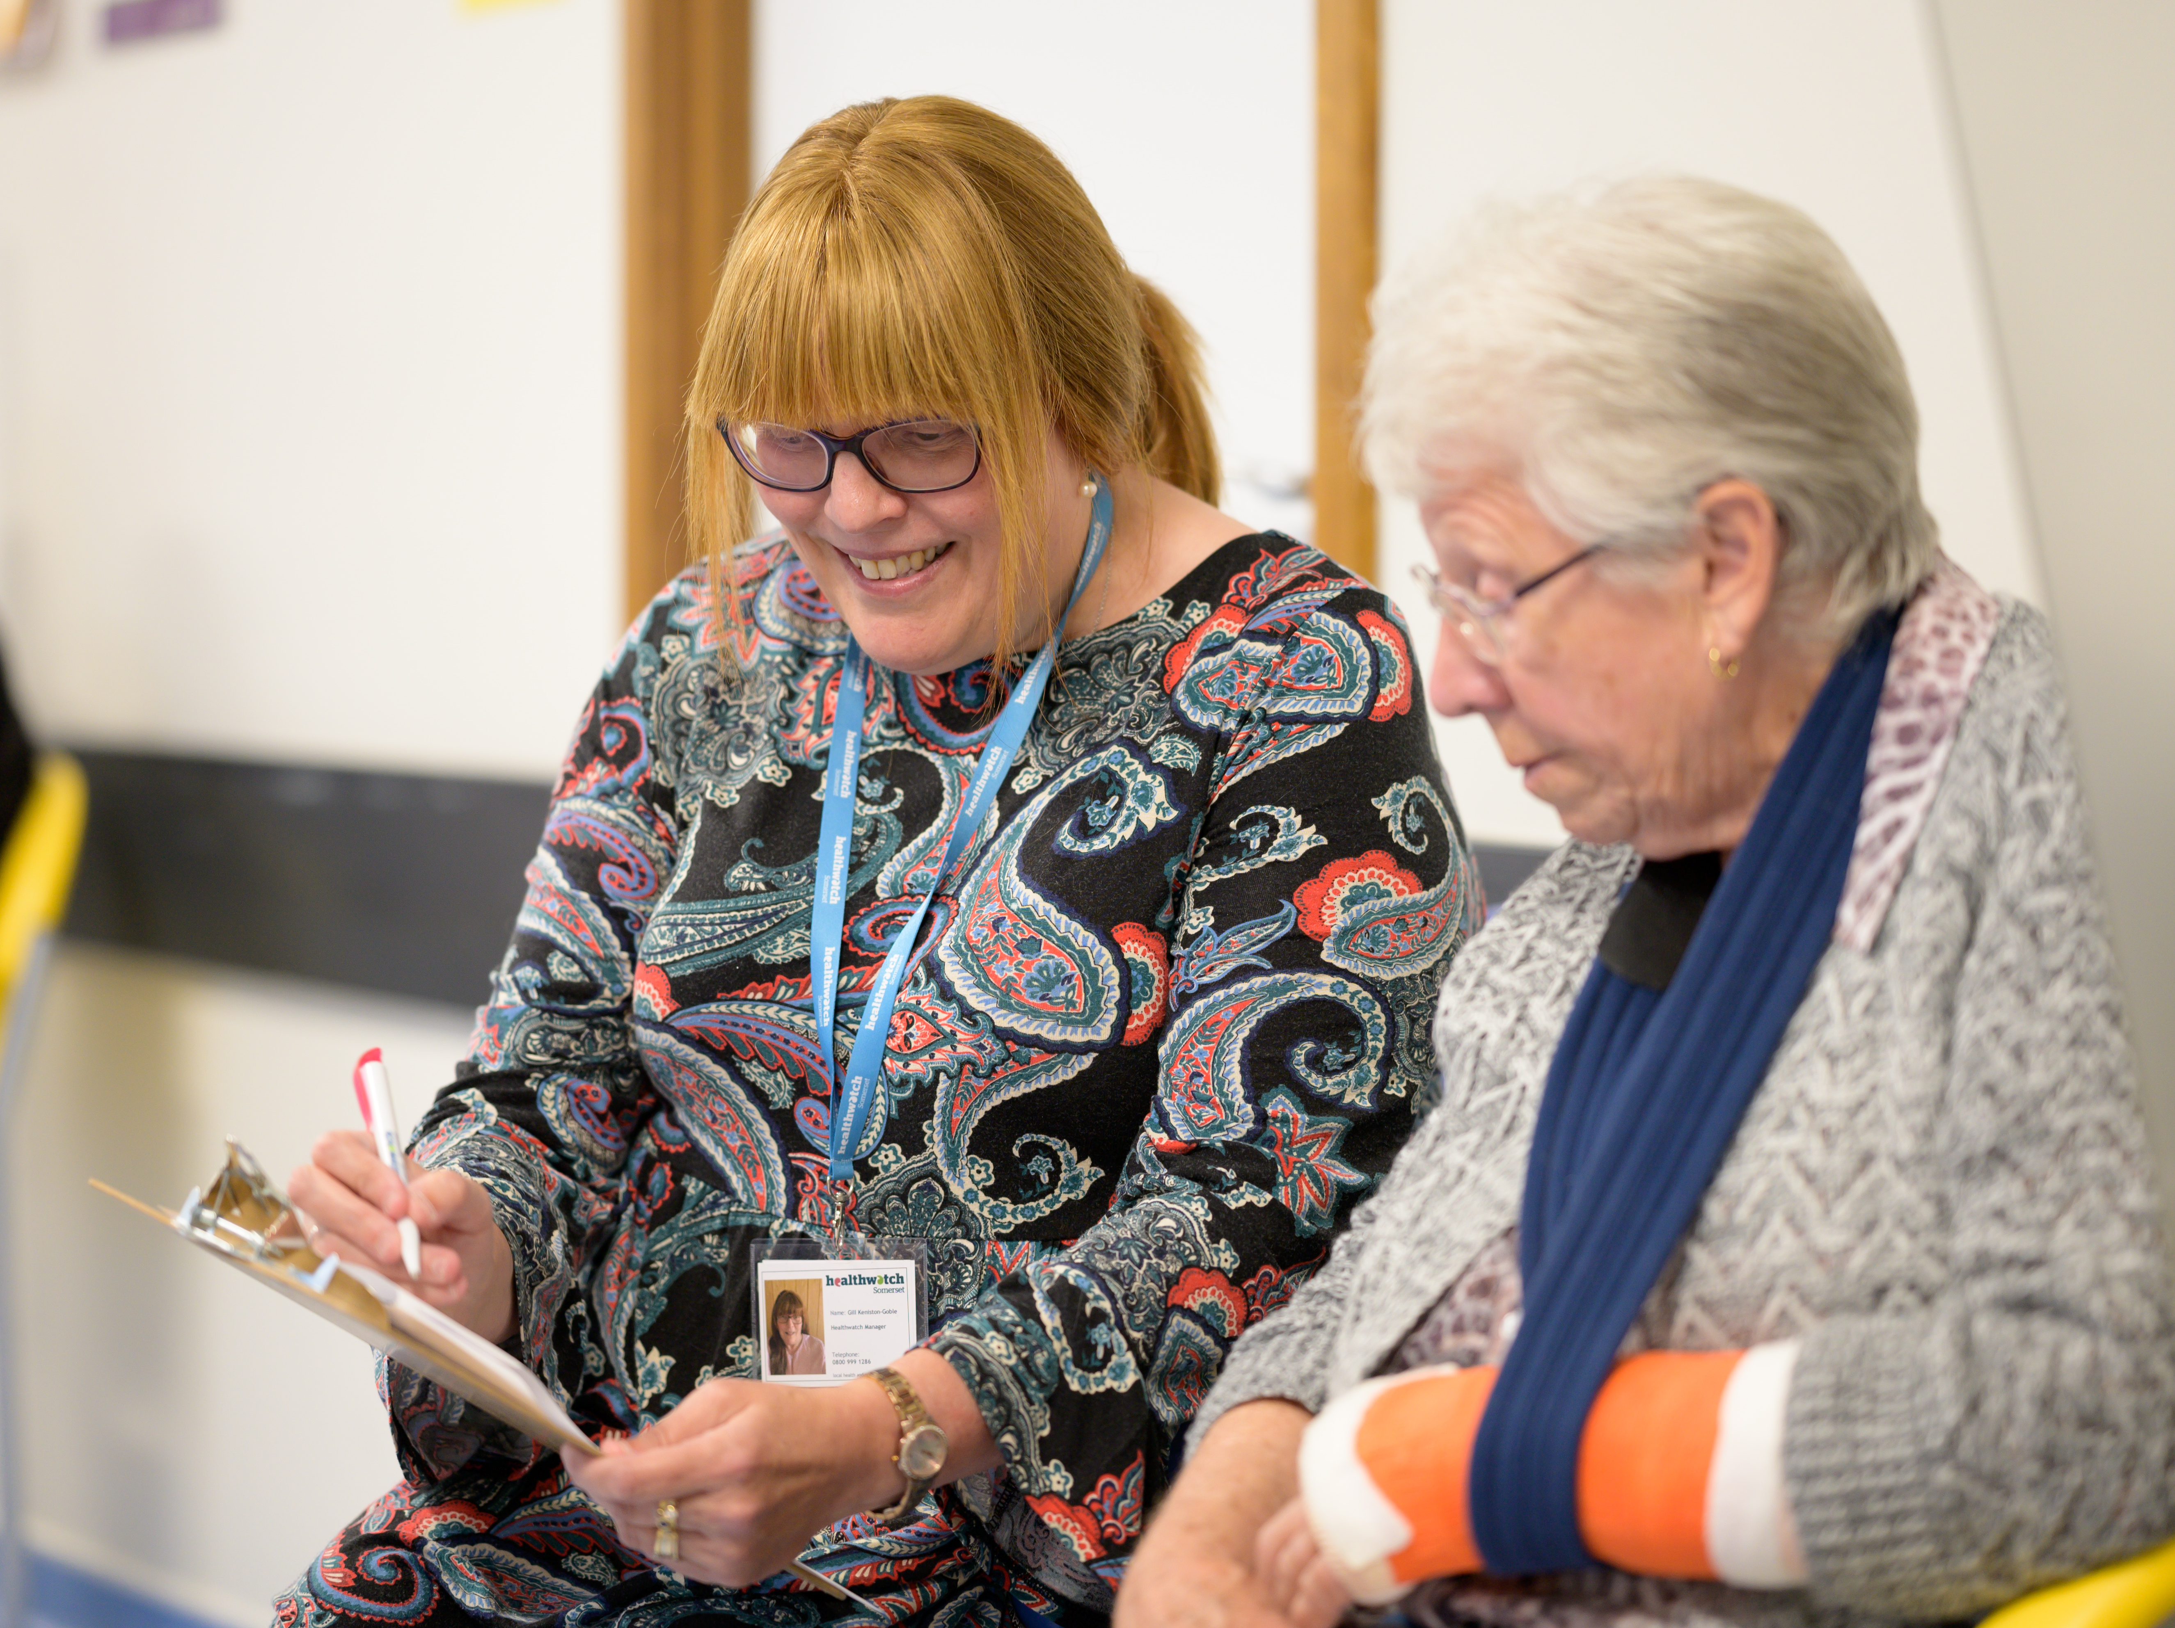
Healthwatch Volunteers - overview

Slide 7



Then and now
The health and social landscape is changing, and so are we.
Staff
2014/15
595
2023/24
570
Volunteers
2014/15
3,700
2023/24
3,997
Funding
2013/14
£33.2m
2023/24
£25.5m

Slide 8
Healthwatch Volunteers
National Support:
Volunteer Lead Network Meetings
Learning and development opportunities
  Recruitment, induction, management, impact reporting
Best practice sharing
Media and communications support
Online engagement platform
Benefits for local volunteers:
Positive contribution – to genuinely help people and communities
Learn new skills
Connections and meet others
Being part of the change to health and social care locally

Slide 9
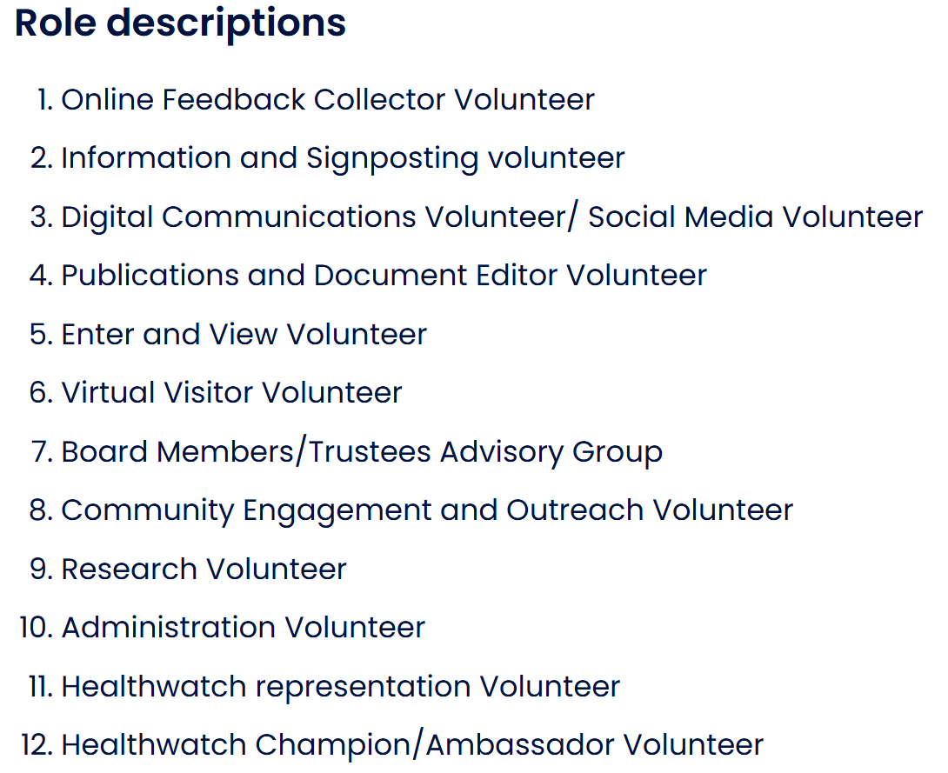
Healthwatch Volunteer Roles
Roles include:

Slide 10

Our Volunteers
Sheila Burridge – Volunteer Officer

Slide 11
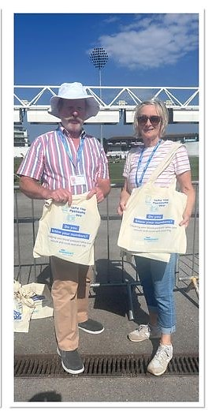
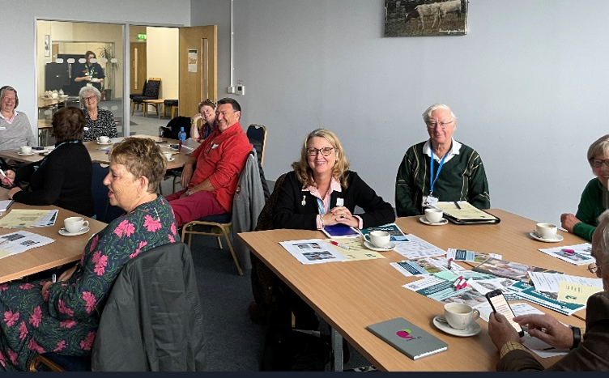
We are fortunate to have a team of volunteers who help us carry out our work

Slide 12
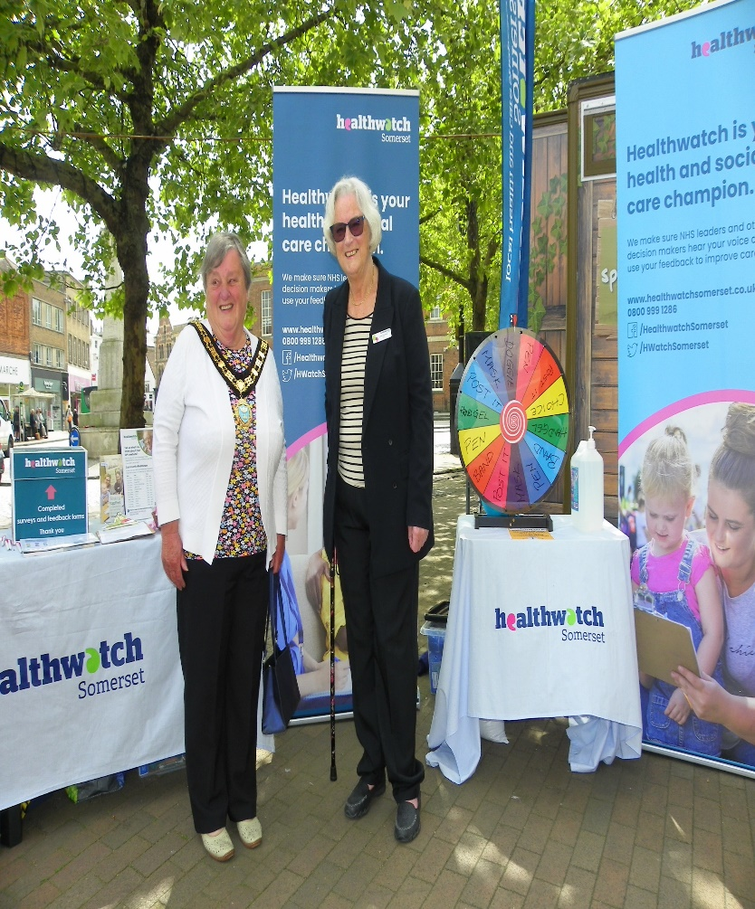
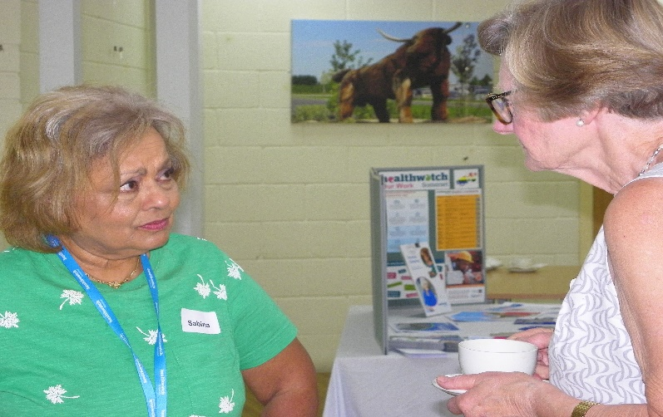
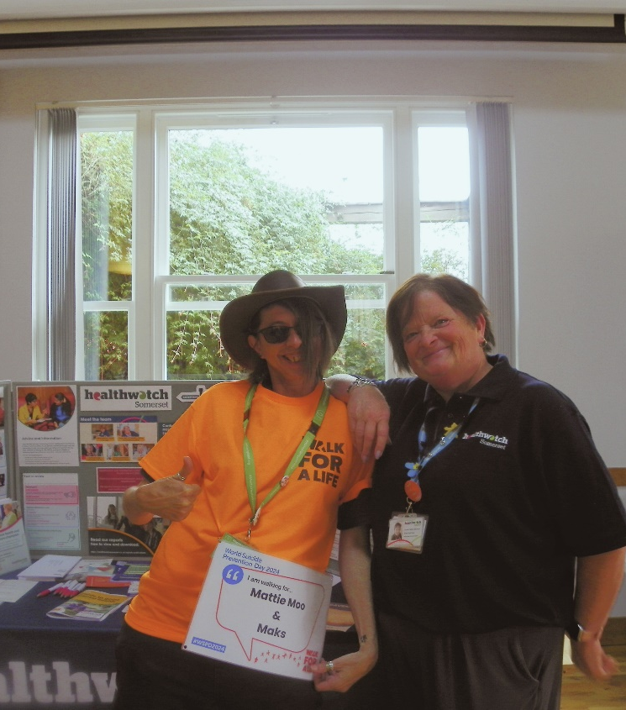
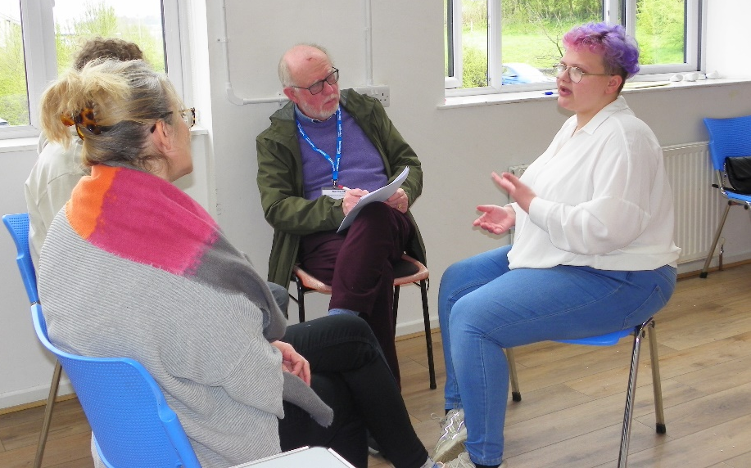
Our volunteers are an integral part of all we do

Slide 13
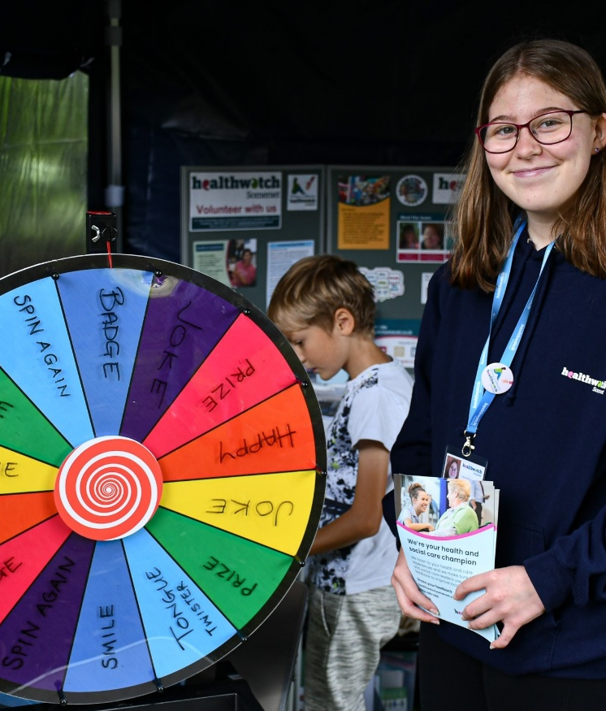
What our volunteers do
Spoke to young people at fetes, fun days, and youth groups
Carried out visits to care homes and hospitals under our Enter and View work.
Took part in surveys
Supported a COPD singing group for people with respiratory issues
Helped to publicise our projects.
Took part in focus workshops e.g. at carers groups

Slide 14
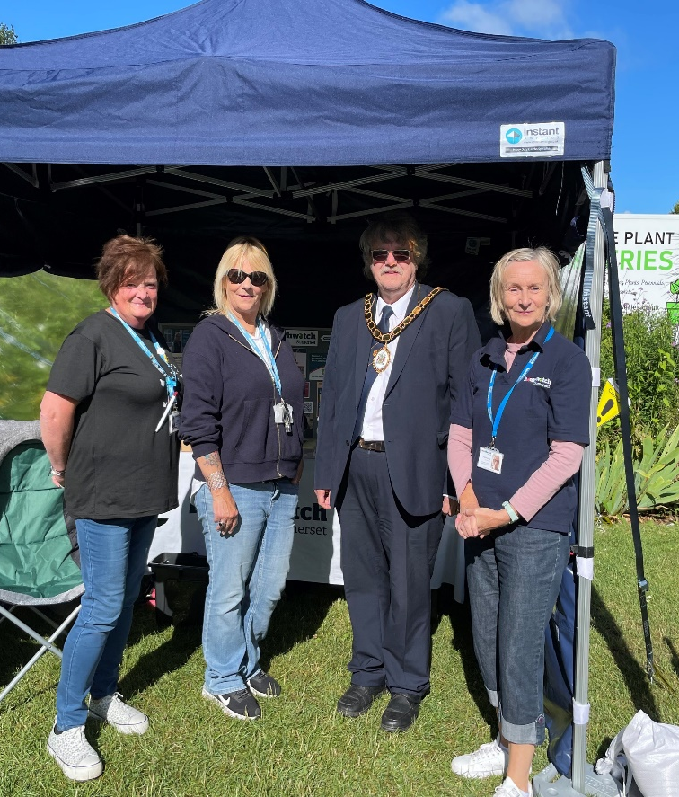
Volunteers are our eyes and ears in their local community
They told us how people were struggling due to pharmacy closures in Glastonbury
We heard about GP access issues in West Somerset
And the difficulty getting ADHD medication in Bridgwater
Volunteers gave us personal case studies for our Dental Access report
And shared their experiences of caring for a family member with social workers at a community training session

Slide 15
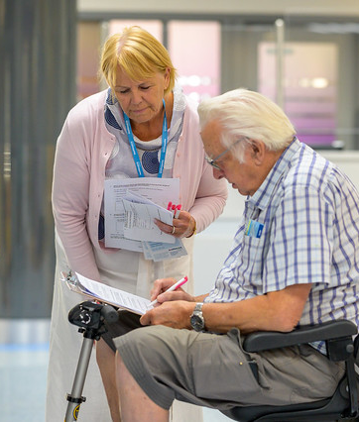
Volunteers feel they can make a difference
By speaking up about issues
Sharing stories from their communities
Encouraging their networks of family and friends to complete our surveys
Taking a lay person perspective when carrying out visits to services
Representing the public or patient voice when attending meetings on behalf of Healthwatch

Slide 16
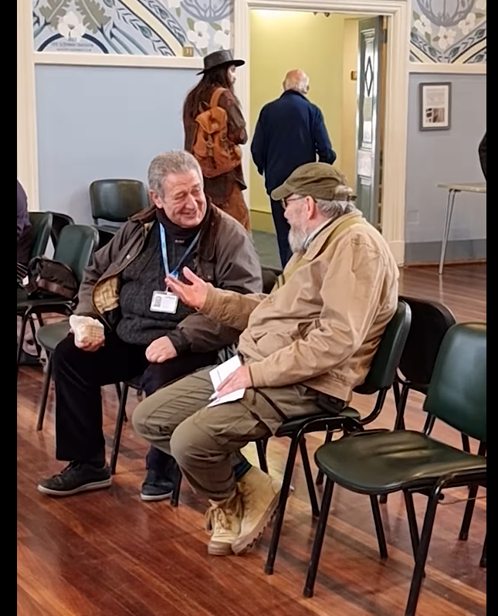
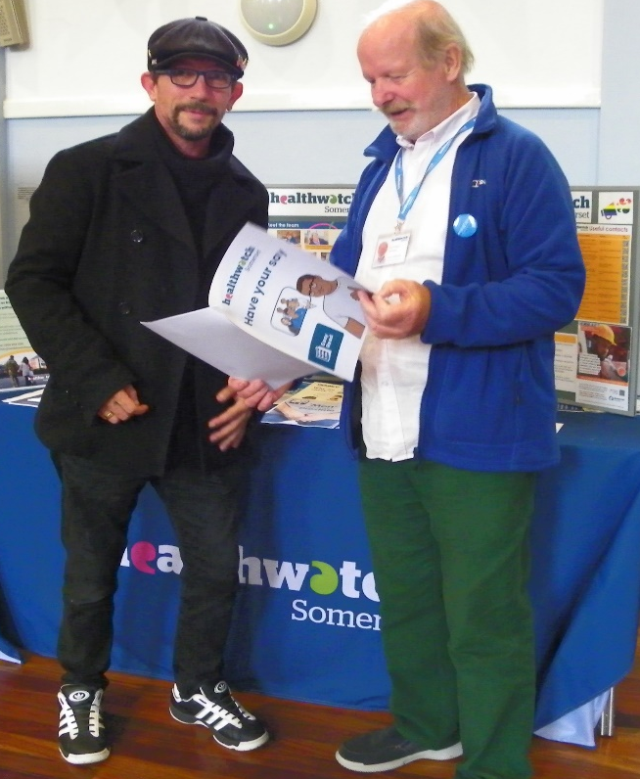
Most recently our volunteers have:
Attended a Men’s Health event in Glastonbury
Talked to carers at a carers assessment day
Carried out a GP surgery visit
Supported us at a Diversity celebration day
Chatted to people at a wellbeing/mental health hub

Slide 17

Thank you
Any questions?

Slide 18
For more information
  Healthwatch England
  National Customer Service Centre
  Citygate
  Gallowgate
  Newcastle upon Tyne
  NE1 4PA
    www.healthwatch.co.uk
    t: 03000 683 000
    e: enquiries@healthwatch.co.uk
    @HealthwatchE
    Facebook.com/HealthwatchE

