Slide 1
Equality, Diversity and Human Rights
volunteer induction
Notes:
By the end of this session you will be able to:
Explain what we mean by equality, diversity, human rights and person-centred support and why they are important
Explain why we need to know about people’s different backgrounds and why it is important not to make assumptions about individuals
Describe what you can do to challenge prejudice and discrimination

Slide 2
Equality, Diversity & Human Rights
Promoting equality and diversity should be at the heart of all organisations. As a volunteer, you can help ensure that we exercise fairness in all that we do to make sure that no individual, community or group is left behind.
Notes:
Promoting equality and diversity should be at the heart of all organisations. As a volunteer, you can help ensure that we exercise fairness in all that we do to make sure that no individual, community or group is left behind.
This session will describe what we mean by equality, diversity and person-centred support what you can do to help create a more inclusive community or organisation. As a volunteer, you can help ensure that we exercise fairness in all that we do to make sure that no individual, community or group is left behind. This session will describe what we mean by equality, diversity and person-centred support what you can do to help create a more inclusive community or organisation.

Slide 3
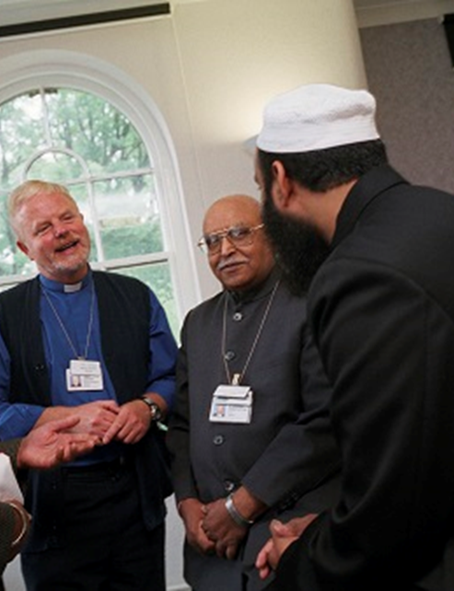
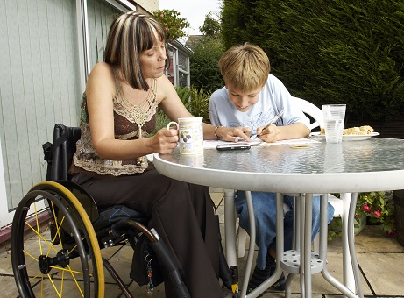
What are the nine protected characteristics referred to in the Equality Act?
Age : A person belonging to a particular age group
Disability: A person is deemed to have a disability if they have a physical or mental impairment, and the impairment has a substantial and long-term adverse effect on the person’s ability to carry out normal day-to-day activities.
Gender Reassignment: Where a person has proposed, started or completed a process to change his or her sex.
Marriage and Civil Partnership: People who are married or in a civil partnership have this protected characteristic.
Pregnancy and Maternity: Maternity refers to the period after the birth and is linked to maternity leave in employment. In the non-work context, protection against maternity discrimination is for 26 weeks after giving birth and includes treating a woman unfavourably because she is breastfeeding.
Race: People who have or share characteristics of colour, nationality or ethnic or national origin can be described as belonging to a particular racial group.
Religion: People who have a religion or religious or philosophical belief, or a lack of religion or belief, share this protected characteristic.
Sex: Under the Equality Act a person is seen as a man or woman, although it should be noted that some individuals see themselves as non-binary rather than exclusively male or female.
Sexual Orientation: A person’s sexual orientation may be towards:
People of the same sex as him or her (in other words the person is a gay man or a lesbian)
People of both sexes (the person is bisexual)
People of the opposite sex from him or her (the person is heterosexual)
Notes:
Age : Means a person belonging to a particular age group
Disability: A person is deemed to have a disability if they have a physical or mental impairment, and the impairment has a substantial and long-term adverse effect on the person’s ability to carry out normal day-to-day activities.
Someone who may have had an impairment or condition such as cancer is also covered by this legal definition of disability
Gender Reassignment: Where a person has proposed, started or completed a process to change his or her sex.
Marriage and Civil Partnership: People who are married or in a civil partnership have this protected characteristic.
Pregnancy and Maternity: Maternity refers to the period after the birth and is linked to maternity leave in employment. In the non-work context, protection against maternity discrimination is for 26 weeks after giving birth and includes treating a woman unfavourably because she is breastfeeding.
Race: People who have or share characteristics of colour, nationality or ethnic or national origin can be described as belonging to a particular racial group.
Religion: People who have a religion or religious or philosophical belief, or a lack of religion or belief, share this protected characteristic.
Sex: Under the Equality Act a person is seen as a man or woman, although it should be noted that some individuals see themselves as non-binary rather than exclusively male or female.
Sexual Orientation: A person’s sexual orientation may be towards:
People of the same sex as him or her (in other words the person is a gay man or a lesbian)
People of both sexes (the person is bisexual)
People of the opposite sex from him or her (the person is heterosexual)

Slide 4
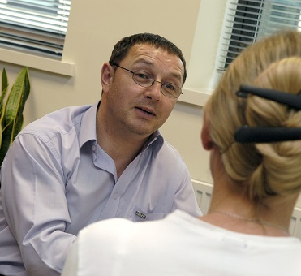
The Equality Act protects everyone.
It is illegal to discriminate against a person because of a protected characteristic.
Peter interviews Hilary for a volunteering role. Peter decides not to offer her the role because Hilary is a lesbian and Peter knows that some people in the team where she would be volunteering have made homophobic remarks in the past. He is worried they will not respect Hilary.
Peter's actions are direct discrimination and he is breaking the law. Peter also should have already challenged his colleagues’ homophobic remarks to help to create an inclusive workplace.

Slide 5
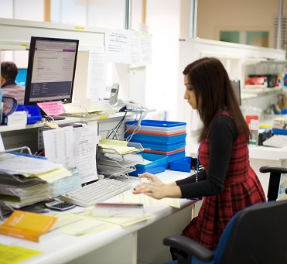
Emma has applied for a role as a volunteer in a large organisation. At interview she discloses that she has recently married and plans to start a family in the future. As a result of this the recruiting officers decide not to offer Emma a role as they fear she will not be able to make a long-term commitment, as she may leave at any time upon falling pregnant.
This is discrimination - pregnancy is a protected characteristic and it is illegal to act in a prejudicial way towards women in this way. If Emma fulfilled all criteria for a role, she should have been offered the opportunity to pursue it regardless of her plans to start a family. Although organisations will often want an expressed commitment to a role by a potential volunteer, it is unlawful to withhold an opportunity on these particular grounds.

Slide 6
How to Make an Inclusive Environment?
Farrah, Robert, Ruth and Sophie are all volunteers.
The team hold regular ‘girls' nights out’. A poster has appeared in the coffee room and several volunteers are discussing their plans for the night. The last night out was a great success, but it was noticed that some volunteers did not attend despite the night being advertised in the coffee room, which everyone knew about. It is agreed that to be more inclusive partners can come next time.
Farrah, Robert ,Ruth and Sophie all feel excluded – why might this be?
It is important to think about how other people may be feeling.
Notes:
Farrah
I love volunteering. I get really good feedback.
Most of the volunteers went on the girls' night out. They asked me to go but I’ve never been on this type of night out; it’s not something I think I would be comfortable with.
My religion is important to me and I don’t drink. I feel a bit left out this morning and everyone is talking about it.
Robert
Why didn’t I go on the girls' night out? Well, it’s obvious, isn't it? Don’t get me wrong I have been invited as a ‘token boy’ but I'm not really comfortable with that. I suppose this is what it’s like volunteering here amongst mostly females. Seriously though, I would like to get to know my team a bit better and have some down time.
Ruth
Well, I was going to go as it sounded like a good night out and an opportunity to get to know my team better. But then I was in the toilet and I heard a couple of the other volunteers talking - they said they thought that I probably would not want to go because of my age. I was really upset - it makes me wonder what else they say about me.
Sophie
Yes, I was invited but I said I couldn’t go.
They were talking about it in the coffee room this morning and decided to make it more inclusive by inviting partners and they know my partner is a woman. They think that’s why I don’t come out, but that’s not it. I’m deaf; everyone is aware and some volunteers have said, 'Don’t worry Sophie, we treat everyone the same even if they have a disability', but for me going on a noisy night out is quite difficult. I don’t want to make a fuss - everyone gets on well.

Slide 7
How to Make an Inclusive Environment?
The volunteering team didn’t deliberately discriminate against any of their colleagues, and they hoped their girls’ night out would help to create a friendly atmosphere and a good team spirit. They’d made sure that they weren’t excluding their lesbian and gay colleagues when they invited partners along.
MAKING ASSUMPTIONS:
The team still assumed that everyone would feel comfortable on a noisy girls’ night out with alcohol, and this wasn’t the case for Farrah, Robert or Sophie. And some colleagues assumed that Ruth was too old to enjoy a noisy girls’ night out.
It’s very easy to make assumptions.
Assumptions like this are part of what leads to inequalities between different groups of people.
FEELING EXCLUDED:
In this case, some volunteers felt excluded, and this is likely to have a negative effect on their health and how well they contribute.
We all need to do our best to make sure that we are including everyone, and not make assumptions linked to someone’s characteristics. We should talk to any colleague that we see doing this.

Slide 8
Volunteering in an Equal and Diverse Environment
Person-centred support also means that a range of environmental factors including lighting, noise, temperature and unpleasant odours can contribute to a negative experience for an individual.
If we are an equal and diverse organisation, we will see the following benefits:
A fair, moral and inclusive society
Better recruitment and retention of volunteers
Fewer complaints
High morale
Fewer bullying and harassment cases
A better reputation as an organisation
Better access to services for everyone and better experiences when using the services.

Slide 9
Volunteering in an Equal and Diverse Environment
It can be difficult to challenge a colleague’s inappropriate behaviour. The following suggestions will help:
Have the conversation in private
Avoid blame and confrontation. Your aim is to help the person you are speaking with to understand why their behaviour/remark is not OK (remember that it may not have been deliberate) and to work out how to behave differently in the future
As in any effective conversation, you should aim to do as much listening as talking. Sometimes we can work out how to do better for ourselves without being told
You can get advice before the conversation from your volunteer coordinator or manager
If you don’t feel able to challenge a colleague, then report the matter to your volunteer coordinator.
If you experience discrimination yourself, you should report your concerns immediately to your volunteer coordinator.
Remember you are entitled to be treated fairly at all times.

Slide 10
Equality and Diversity
While equity and equality are related, there are important distinctions between them. Equity involves trying to understand and give people what they need to enjoy full, healthy lives tailored to the individual.
By contrast, equality delivers the same quality of care in order for people to enjoy full, healthy lives. Like equity, equality aims to promote fairness and justice, but it can only work if everyone starts from the same place and needs the same care
Equality versus Equity - Equality and diversity are not about treating people the same. If we do this, inequalities remain.
Equality versus Equity- Making individual adjustments for individual people makes things fairer and more equal for those people
Equality versus Equity - Removing barriers, or the causes of inequality, is the most effective way to make services and society fairer for everyone now and in the future. Some inequalities have multiple causes so this can take time and effort but in the long run it’s what we should be aiming for.

Slide 11
Equality Vs EQUITY Diversity
There are a number of actions you can do now to ensure you can help promote equality.
DO YOU KNOW WHAT YOUR ORGANISATION’S VALUES ARE?
Equality, diversity and human rights are often at the heart of organisational values. You will be able to find out more about your organisation's values in their Equality and Diversity policy. Your volunteer coordinator will be able to help.
DO YOU KNOW HOW TO RAISE A CONCERN?
As a volunteer, you can report any concerns in confidence to your volunteer coordinator or manager.
Notes:
Key points
Equality, diversity and human rights are important to everyone working and volunteering
We all have a role to make sure that services are accessible and that everyone has a positive and inclusive experience
In the workplace, we also need to think about inclusion and recognise the diversity of those we work and volunteer with, ensuring that they feel valued and respected
Think about what you can do to promote values and behaviours when you are volunteering

Slide 12
Thank you!

Slide 13
The content of this training was developed by NHS England, E-Learning for Healthcare and has been adapted by Bradford Teaching Hospitals NHS Foundation Trust, to provide an accessible format, ensuring that all volunteers have the same basic learning when they start in their role.

