Slide 1
Safeguarding adults
VOLUNTEER iNDUCTION
Notes:
Explain what the term 'adult with care and support needs' means
Describe the process where someone is first alerted to a concern or incident that suggests an adult:
Is experiencing or is at risk of abuse or neglect, and
As a result of their care and support needs, is unable to protect themselves against abuse or neglect, or the risk of it
Define the term ‘adult safeguarding' and underlying statutory principles that underpin adult safeguarding work
Define abuse and neglect, patterns and types and list possible indicators
Identify why some adults are more at risk from abusive behaviour
Explain the role you must play in recognising and reporting and who you need to speak to if you have a safeguarding concern

Slide 2
Adult with Care and Support Needs
Adult safeguarding duties under the Care Act 2014 [1] apply to an adult, aged 18 or over, who:
Has needs for care and support and
Is experiencing, or at risk of, abuse or neglect and
As a result of those care and support needs, is unable to protect themselves from either the risk of, or the experience of, abuse or neglect
We refer to these adults as 'adults with care and support needs'. You may also hear the terms 'adult at risk' or 'vulnerable adult'.
Care and support is the mixture of practical, financial and emotional support for adults who need extra help to manage their lives and be independent, including older people, people with a disability or long-term illness, people with mental health problems and carers.

Slide 3
Adult Safeguarding is Everyone's Business
Adult Safeguarding is Everyone's Business
As a volunteer, you have:
Everybody has the right to be safe no matter who they are or what their circumstances.
Safeguarding is about protecting everyone from harm, abuse or neglect.
A duty of care. It is your duty to identify and report any concerns, not to take action or investigate further
A responsibility to be aware of the Prevent strategy and an obligation to report concerns. As part of your volunteer training you may also be asked to complete the Prevent training session. If in doubt, talk to your volunteer coordinator
Notes:
The safeguarding process starts before volunteers are involved in any activity by making sure the right people are recruited in the first place, and that they receive the necessary support and guidance to carry out their volunteering safely and effectively. Effective safeguarding also looks beyond traditional notions of harm and abuse, taking into consideration health and safety, and other ways to ensure the health and well-being of volunteers and the people they support.

Slide 4
THE AIMS OF ADULT SAFEGUARDING
Prevent harm and reduce risk of abuse or neglect to adults
Stop abuse and neglect wherever possible
Safeguard adults in a way that supports them in making choices about how they want to live
Raise public awareness so that communities, alongside professionals, play a part in preventing, identifying and responding to abuse and neglect
Provide information and support in accessible ways to help people understand the different types of abuse, how to stay safe and what to do to raise a concern about the safety or well-being of an adult
Address what has caused the abuse or neglect

Slide 5
THE UNDERPINNING PRINCIPLES
Prevention: Acting before abuse occurs.
Proportionality: Making sure the level of action taken is equal to the risk.
Protection: support and representation for those in greatest need.
Partnership: Working in partnership to achieve local solutions in communities where we live. Communities have a part to play in preventing, detecting and reporting abuse and neglect..
Accountability: Accountability and transparency in delivering safeguarding.
Empowerment: People being supported and encouraged to make their own decisions and give informed consent
Empowerment: People being supported and encouraged to make their own decisions and give informed consent
Adult safeguarding reflects the six underpinning key principles.

Slide 6
OUTCOMES
What does this mean in practice?
An adult with care and support needs should feel comfortable about the following:
“I am asked and listened to about the support I want to help keep me safe and this directly informs what happens in the safeguarding process
I am provided with easily understood information about what abuse is, how to recognise the signs and what I can do to seek help
I am clear about the roles and responsibilities of all those involved in helping me keep safe and providing good quality care, and so are they”

Slide 7
Supporting an Individual’s Wellbeing
Safeguarding protects an individual's well-being. It should be assumed that individuals are best placed to judge their own well-being. Well-being relates to:
Personal dignity
Exercising control over day-to-day life
Physical, mental health and emotional wellbeing
Domestic, family and personal relationships
Protection from abuse and neglect
Social and economic wellbeing
Suitability of living conditions
Participation in work, education, training or recreation
Contributions to society

Slide 8
What Constitutes Abuse and Neglect?
People are not always aware that adults, as well as children, are at risk and can experience abuse and neglect.
Abuse or neglect in any form needs to be identified and responded to appropriately to make sure harm can be stopped, or managed, and to make sure the likelihood of it recurring is reduced.
Everyone has a duty to respond if they are worried about abuse or neglect of an adult at risk of harm.
There are many types of abuse and these can include the following:

Slide 9
PHYSICAL ABUSE
This is non-accidental harm to the body. It can include hitting, pushing, punching, kicking, nipping, pulling hair, rough handling, spitting, misuse of medication or inappropriate use of restraint.
Indicators of physical abuse might include:
Finger marks
Bruising
Unexplained injuries or falls
Inconsistent explanations for injuries or accidents
Unexplained changes in a person's behaviour
A person being fearful of people around them
Example:
Mr Jones' support worker pinches him to stop him asking for the nurse to come and help him.

Slide 10
PSYCHOLOGICAL ABUSE
This can include name calling, threats of harm or abandonment, deprivation of contact, humiliation, blaming, bullying, radicalisation, treating someone like a child, shouting, verbal abuse, threats, intimidation and coercion.
Coercion, or coercive behaviour, includes acts of assault, threats, humiliation and intimidation or other abuse that is used to harm, punish or frighten their victim.
Indicators of psychological abuse might include:
Lack of confidence and self-esteem
Depression, withdrawal
Changes in behaviour (for example, becoming more aggressive)
Lack of trust in others
Example:
Sarah is told that unless she does what the ward staff tell her, the consultant will stop her family from visiting.

Slide 11
DOMESTIC ABUSE
This is defined as an incident or pattern of incidents of controlling, coercive or threatening behaviour, violence or abuse by someone who is, or has been, an intimate partner or family member regardless of gender or sexuality.
It includes those aged under 18 years, and includes the following types of abuse:
Psychological
Physical
Sexual
Financial
Emotional
So-called honour-based
Female genital mutilation
Forced marriage
Indicators of domestic abuse might include:
Fractures
Bruising
Absence from work
Isolation
Depression
Under 18s should be referred to child safeguarding services.
EXAMPLE:
The last time Debbie went to her activity group, she stated that her husband hits her when he’s drunk. They have a son and daughter in their teens and the son is now mimicking his father’s behaviour.

Slide 12
SELF-NEGLECT
This covers a wide range of behaviours where individuals neglect to attend to their basic needs, such as personal hygiene, health or surroundings.
Indicators of self-neglect might include:
Unkempt appearance
Dirty or untidy surroundings
Hoarding
Non-attendance at health appointments
Lack of engagement with health and social services
Example:
Deidre is a 75-year-old lady with capacity to make her own decisions, but reduced mobility. She drinks a considerable amount of alcohol each day and spends most of her day in bed, refusing to let carers help her wash and shower.

Slide 13
SEXUAL ABUSE
This can include rape, sexual assault, being forced to look at sexual images or any sexual acts to which the adult has not consented to or was pressured into consenting.
Indicators of sexual abuse might include:
Bruising or injuries in intimate areas
Changes in a person's behaviour
Fear, withdrawal, depression, flinching from physical contact
Unusual use of sexual language or sexualised behaviour
Genital and urine infections
Disturbed sleep pattern
Example:
John feels very uncomfortable when the carer visiting him always gives him a kiss and holds him tightly when he arrives at and leaves his home.

Slide 14
ORGANISATIONAL ABUSE
This can include neglect and poor care practices within an institution or specific care setting such as a hospital or care home. Poor professional practice can be the result of the structure, policies, processes and practices within an organisation.
Indicators of organisational abuse may include:
Complaints not being responded to
Inflexible routines
Lack of individualised care
Reluctance of staff to report on progress
Increased withdrawal, apathy or challenging behaviour from residents or individuals
Medication not administered
Example:
The residents of Willow Court are not allowed anything to eat after 7pm because the kitchen is locked once the chef goes home.

Slide 15
DISCRIMINATORY ABUSE
This includes all forms of harassment, bullying or name calling based on a person's disability, ethnic origin, sexuality or gender. In some circumstances, this would be considered a hate crime. It can also include not taking account of a person's religious or cultural needs.
Indicators of discriminatory abuse include:
Using racist or sexist descriptions or innuendos
Victimising somebody because of a disability
Failing to respect religious faiths and practices
Institutional abuse can occur whenever the regimes or routines of an organisation are insensitive to or ignore the unique needs of the service user
Example:
Yousuf is a Muslim man who used to go to mosque by himself until he became disabled. His support staff refuse to take him to mosque because they are not Muslim themselves.

Slide 16
FINANCIAL OR MATERIAL ABUSE
Theft, fraud and internet scamming can include:
Being forced to pay for other people's things
Collecting loyalty points for shopping for others
Not being allowed access or control of your money
Being pressured in connection with your will, possessions or benefits
It can also include coercion in relation to an adult’s financial affairs or arrangements in connection with property, inheritance or financial transactions.
Indicators of financial abuse might include:
Fear of making decisions
Change in living conditions
Sudden changes in finances or constant supervision by the abuser
Lack of basic items
Money or possessions going missing
Unable to account for spending, incorrect receipts
Worrying about money
Insufficient money to provide for basic needs
Example:
Mary uses a wheelchair and is dependent on her sister Sue to take her shopping and help her wash and dress. Because of her care and support needs, Mary feels unable to complain when Sue uses Mary’s money to pay for her own shopping, including clothes, although this leaves Mary very short and unable to afford treats for herself. Sue tells Mary she’d have to ‘go into a home’ without her help.

Slide 17
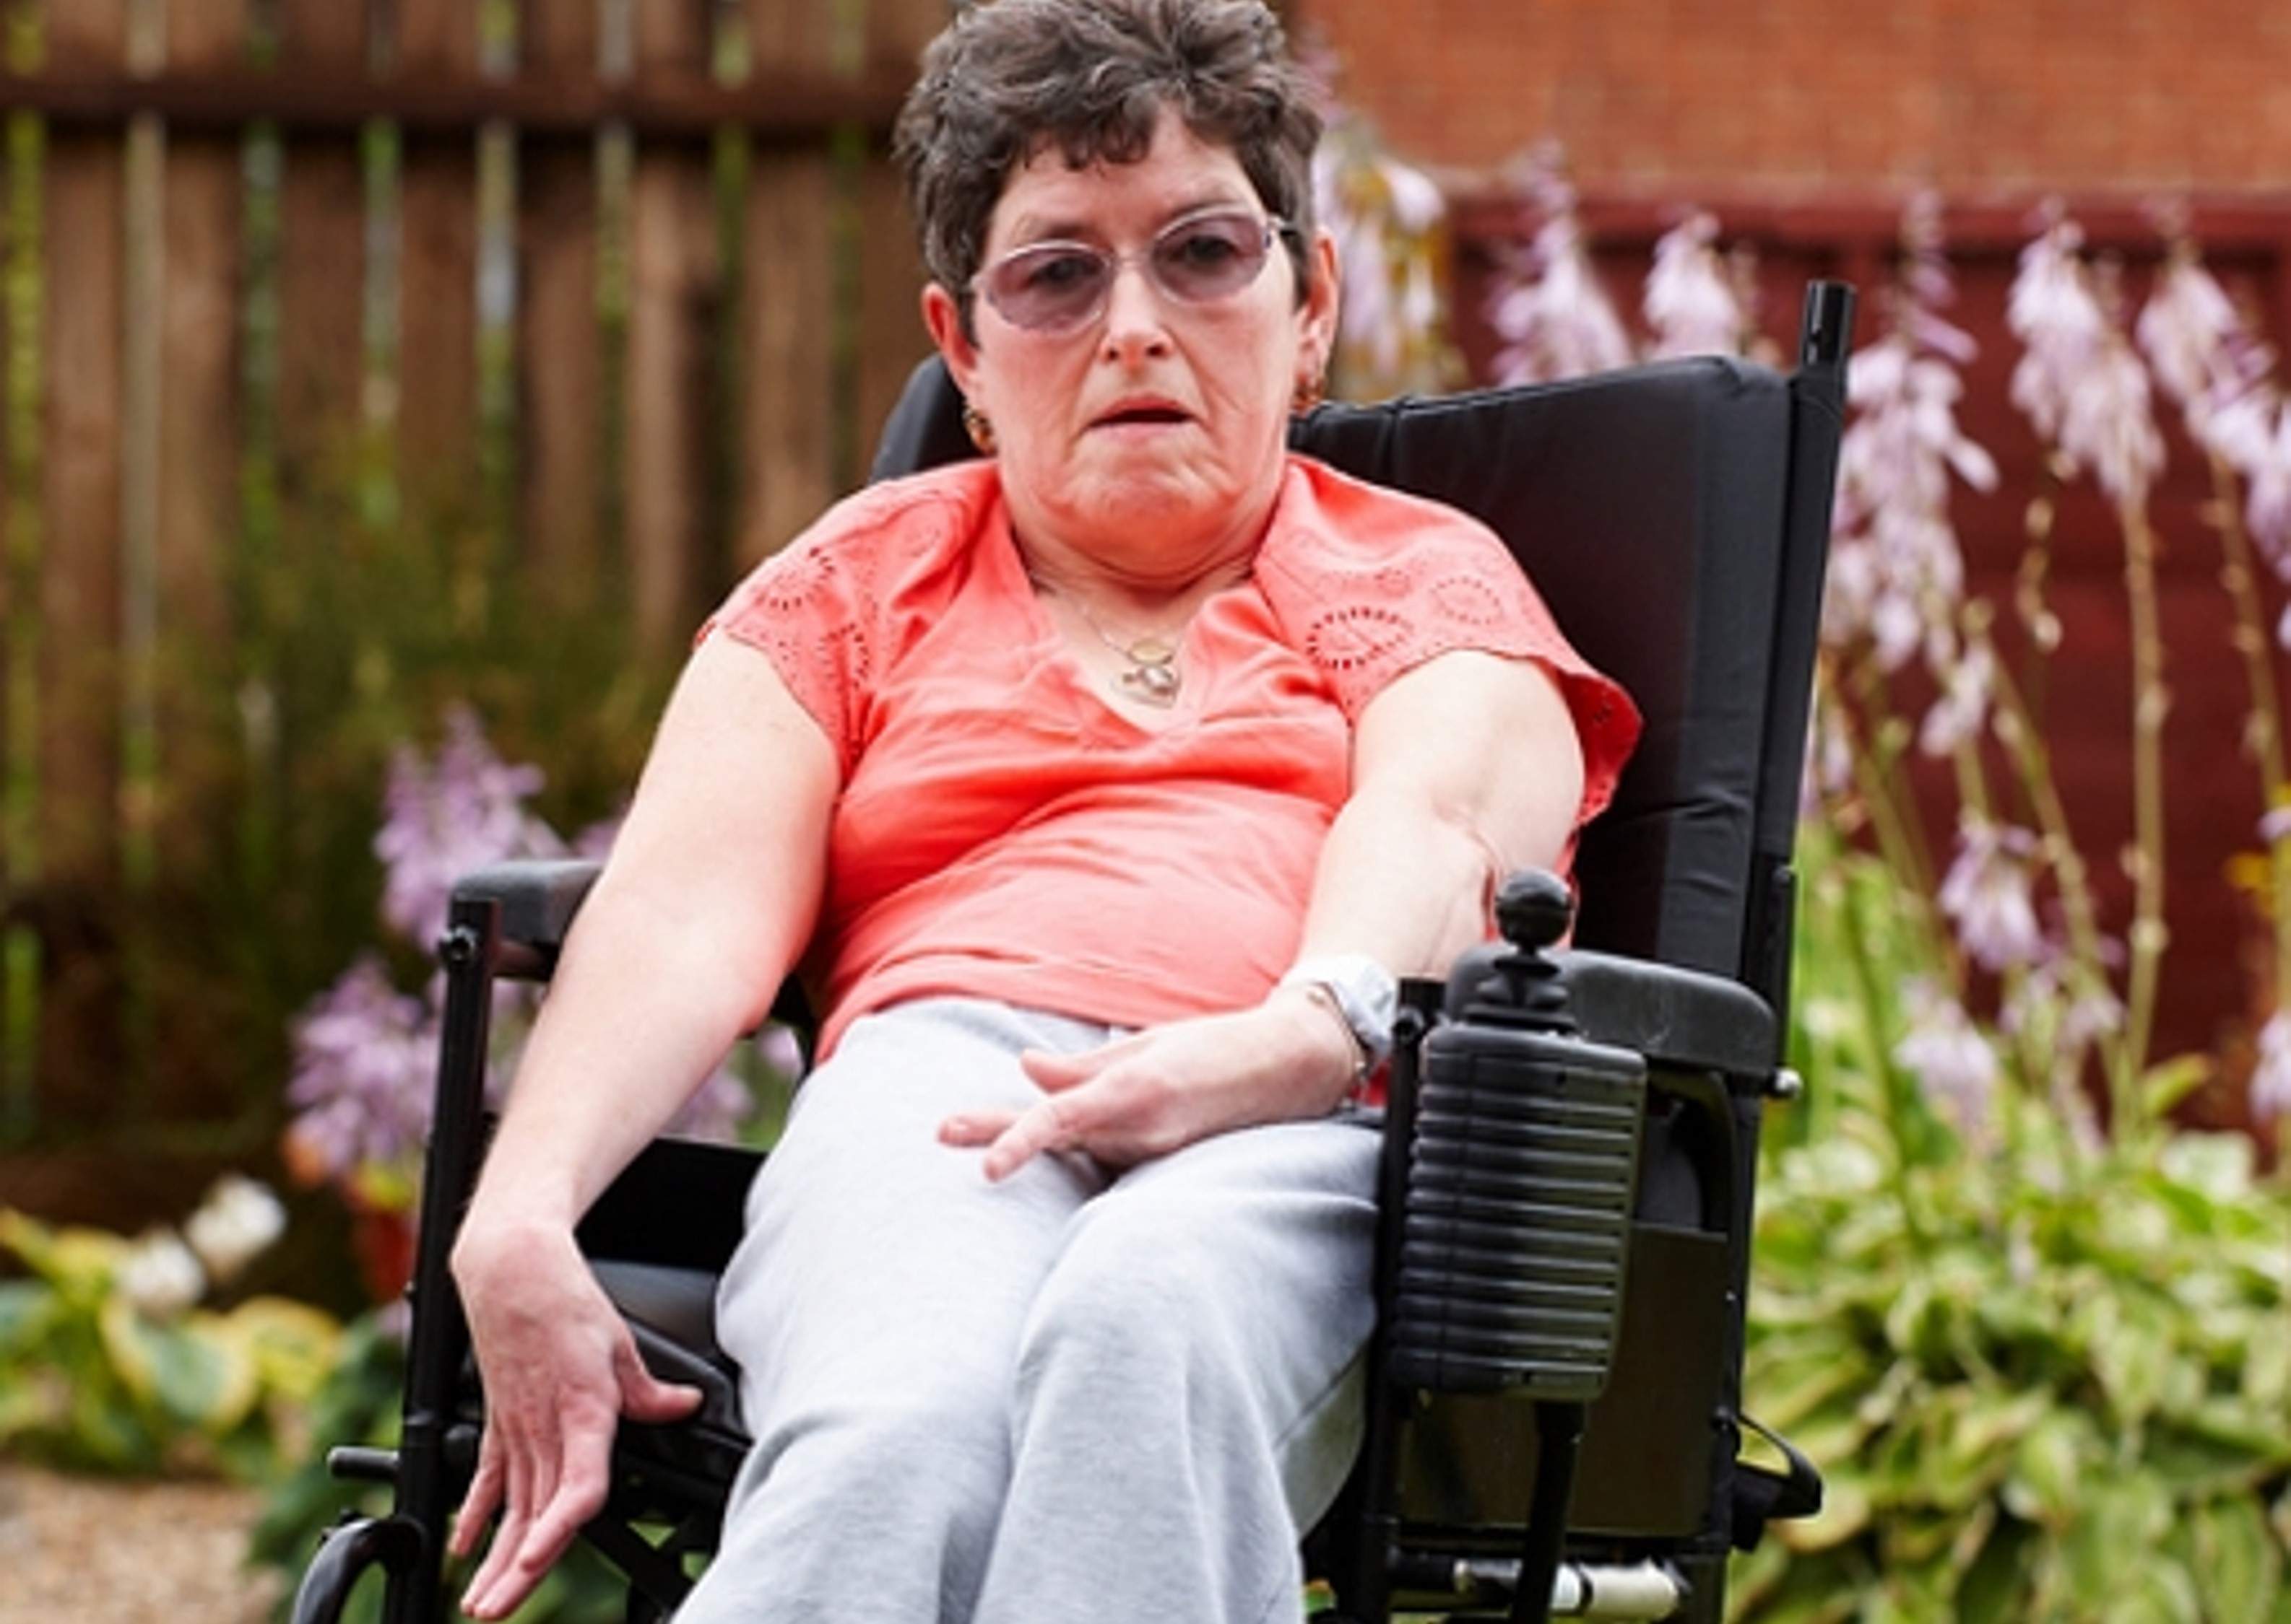
NEGLECT OR ACTS OF OMISSION
This can include ignoring medical needs, not providing personal care or withholding necessities such as food, drink, medication or heating. It can also include not managing or supporting services as agreed. Neglect is not only about not providing services or ignoring an adult with care and support needs. For example, not giving medication can be a form of neglect.
Indicators of neglect might include:
Weight loss
Pressure ulcers
Dehydration
Malnutrition
Complaints of pain or discomfort
Complaints of hunger or thirst
Reduced communication skills or independence
Reluctance by the abuser to report on health or progress
Example:
Alison can't get herself a drink because of her disability. Her mum gives her a drink only three times a day so that she doesn't constantly ask to go to the toilet.

Slide 18
NEGLECT OR ACTS OF OMISSION
Modern slavery includes human trafficking, forced labour and domestic servitude. Traffickers and slave masters use whatever means they have at their disposal to coerce, deceive and force individuals into a life of abuse, servitude and inhumane treatment.
Indicators of modern slavery might include:
Severe weight loss
Poor skin condition
Poor hygiene
Extreme anxiety and fear
Low self-esteem
Suicide and self-harm risk
Example:
Leon is 39 years old and has a severe learning disability. He works on a farm, lives in a leaking caravan, is not allowed to contact his family and is paid £2.50 a week.

Slide 19
REPORTING A SAFEGUARDING CONCERN
As a volunteer you are required to report any concerns immediately to your volunteer coordinator
You are not expected to investigate further. These concerns are confidential and must only be shared with your volunteer coordinator in the first instance.
If an adult confides in you and insists that you don't tell anyone, you must still report it. While it is important to respect someone's wishes, this cannot override their welfare and safety. You should tell them that you have to share this with other people who may be able to help keep them and other adults safe.
Notes:
If you feel your concerns are not being addressed, or you are not comfortable speaking to your volunteer coordinator, then contact another senior member of the team in the organisation.

Slide 20
Reporting a Safeguarding Concern
DoN’T
Do
Panic or allow emotions to become apparent
Share this information with any others at this point until instructed to do so by your volunteer coordinator
Make assumptions about what you’re being told
Give out your personal phone number, email or address
Ask leading questions
Keep yourself safe and, if you do not feel safe, remove yourself from the situation
Speak to your volunteer coordinator immediately if you have any concerns
Keep it confidential, except with your volunteer coordinator
Make notes on what you’ve seen
Be aware of your own limits

Slide 21
As a volunteer, you visit Jakub every week and you have recently become concerned. You have noticed that Jakub is no longer his usual, good-humoured self, and doesn’t even seem interested in tending to his garden anymore. When you spoke to Jakub’s daughter last week, she said that this is natural for someone with dementia, and you should stop poking your nose into family business.
On the last couple of visits, Jakub has been wearing clothes with old food stains on them, his hair is very greasy, and he smells strongly of urine. He also appears to have lost weight, and when you looked through the kitchen cupboards, they were nearly empty.
You asked Jakub if his daughter was helping him and Jakub said yes, she was helping him and obtaining his pension for him. He said he didn’t always receive all this pension.
Jakub could be experiencing abuse.

Slide 22
What type(s) of abuse do you think Jakub is experiencing?
Choose two options -
Physical abuse
Domestic abuse
Psychological abuse
Financial or material abuse
Neglects and acts of omission
Modern Slavery
Organisational Abuse
Sexual abuse

Slide 23
Key points
Prevent harm and reduce risk of abuse or neglect to adults with care and support needs
Stop abuse and neglect wherever possible, and address what has caused the abuse or neglect
The safeguarding principles are:
empowerment, prevention, proportionality, protection, partnership and accountability
It is a volunteer's responsibility to report any safeguarding concerns immediately

Slide 24
Knowledge quiz!
Notes:
Welcome to the Safeguarding Adults Knowledge Quiz. To successfully complete this quiz, you need to achieve a score of at least 75%. There are 4 questions in total.
You should set aside approximately 5 minutes to complete this quiz. Good luck!
Question 1 The aim of safeguarding adults is to: Select two:
Enable all adults to make wise decisions
Ensure that adults with care and support needs do not experience harm or abuse
Support adults with care and support needs to live a life that is free from harm and abuse
Answer - The aim of safeguarding adults is to:
2. ensure adults with care and support needs do not experience harm or abuse.
3. support adults with care and support needs to live a life that is free from harm
Question 2. What are the categories of abuse? Select one:
Physical, Emotional, Financial, Boredom, Discipline, Psychological, Employment, Self-neglect
Financial, Domestic violence, Educational, Sexual, Neglect, Boredom, Physical, Psychological
Emotional, Employment, Financial, Exercise, Self-neglect, Separation, Neglect, Psychological
Physical, Domestic violence, Neglect, Sexual, Psychological, Financial, Modern slavery, Discriminatory, Organisational, Self-neglect
Answer - The 10 categories of abuse are:
4. Physical, Domestic violence, Neglect, Sexual, Emotional/psychological, Financial, Modern slavery, Discriminatory, Organisational, Self-neglect
Question 3. John is a volunteer in a day centre. He is concerned that often there are not enough staff to assist the adults with care and support needs. Yesterday, one man kept asking for help to visit the toilet, but no one could help him for some time. What should John do? Select one:
Look for another place to volunteer
Accept that this is the way things are done and get used to it
Discuss his concerns with his colleagues
Report his concerns to his volunteer coordinator, or the unit manager or to a senior manager
Tell the adults he can't help them all
Answer - John has a duty of care to report his concerns to the volunteer coordinator, or the unit manager or to a senior manager.
Question 4. You raise a safeguarding concern with a manager who advises you that no further action is needed. You are still concerned. What action should you take?
Do nothing as the manager is responsible
Ask for advice from your volunteer coordinator
Call the police
Answer - If you have concerns, it is your responsibility to escalate your concerns by asking for advice from your volunteer coordinator even if another manager dismisses your concerns.

Slide 25
Thank you!

Slide 26
The content of this training was developed by NHS England, E-Learning for Healthcare and has been adapted by Bradford Teaching Hospitals NHS Foundation Trust, to help support the completion of the National Volunteer Certificate in an accessible format, ensuring that all volunteers have the same basic learning when they start in their role.

