Slide 1
Safeguarding children
VOLUNTEER iNDUCTION
Notes:
By the end of this session you will be able to:
Describe the different forms of child abuse (physical, emotional, sexual abuse and neglect)
Describe how common child abuse is and the impact it can have on a child or young person
Indicate what you should do if you do have concerns about child abuse
Describe the risks associated with the internet and online social networking
Describe what the term 'looked-after child' means
Recognise possible signs of child abuse that you might come across in your volunteering role

Slide 2
Why is safeguarding children important
This session explains what is involved in safeguarding children and young people. It looks at:
How you might be able to recognise abuse in a child or young person
What you should do if you are concerned that a child is being abused or neglected
The steps that you need to take in order to protect children from further harm
It is important to note that the term 'children' means children and young people from birth to their 18th birthday
Notes:
The session does not contain any photos or illustrations of injuries. If the session is very upsetting for you (possibly because of experiences in your own or others' lives), you should seek advice from your volunteer coordinator or supervisor.

Slide 3
Why is safeguarding important, even if you do not volunteer with children?
Protecting children from harm is important in everyday life because every child matters. If you only volunteer with adults, you need to be aware that those adults may at some point disclose important information about children or even their own childhood.

Slide 4
Rights of the child
Children have rights whatever their race, religion or abilities, whatever they think or say, and whatever type of family they come from.
All children have the right to:
Children have the right to be protected from being hurt and abused, whether physically or mentally.
Survival
Develop to the fullest
Develop fully in family, cultural and social life
Health and healthcare
Protection from all forms of violence
The law ensures that children are properly cared for and protect them from violence, abuse and neglect by their parents, carers or anyone else who comes into contact with them.

Slide 5
Safeguarding for staff and volunteers
Organisations have a duty in law to ensure that they safeguard and promote the welfare of children and young people.
Unfortunately, many children in the UK do not grow up in satisfactory conditions. Some children and their families need extra help to allow them to reach their full potential.
In order to carry out their duty to safeguarding children, all staff and volunteers need to be able to understand and recognise signs of children being harmed.
As a volunteer you have:
A duty of care, it is your duty to identify and report any concerns, not to act or investigate further
A responsibility to be aware of the Prevent strategy and an obligation to report concerns.
Notes:
Organisations have a duty in law to ensure that they safeguard and promote the welfare of children and young people, and this means that all staff and volunteers have an important role to play. This includes being able to recognise signs of possible child abuse and neglect.
Unfortunately, many children in the UK do not grow up in satisfactory conditions. Some children and their families need extra help to allow them to reach their full potential. Recent high-profile cases have highlighted just how cruelly some children can be treated by others.

Slide 6
CHILD ABUSE
Someone may abuse or neglect a child or young person by inflicting harm, or by failing to act in preventing harm.
This harm may be physical or psychological and will affect the child's or young person’s current and future well-being.
Notes:
Do you think a child is more likely to be abused by a stranger or someone they know?

Slide 7
Do you think a child is more likely to be abused by a stranger or someone they know?
Children and young people may be abused in a family, or in an institutional or wider community setting.
The abuser(s) may be someone known to the child or, more rarely, a stranger. More often than not the person responsible for the abuse has a close relationship with the abused child.
Any child can be at risk of abuse regardless of their age, sex, ethnicity, ability or disability.
Those most at risk are babies and young children, those with learning difficulties and those with physical disabilities.
Young people are also at risk of abuse, and they may respond in ways that put them at further risk of harm, for example, by running away.
Notes:
Children and young people may be abused in a family, or in an institutional or wider community setting. The abuser(s) may be someone known to the child or, more rarely, a stranger. More often than not the person responsible for the abuse has a close relationship with the abused child.
Any child can be at risk of abuse regardless of their age, sex, ethnicity, ability or disability. Those most at risk are babies and young children, those with learning difficulties and those with physical disabilities. Young people are also at risk of abuse, and they may respond in ways that put them at further risk of harm, for example, by running away.

Slide 8
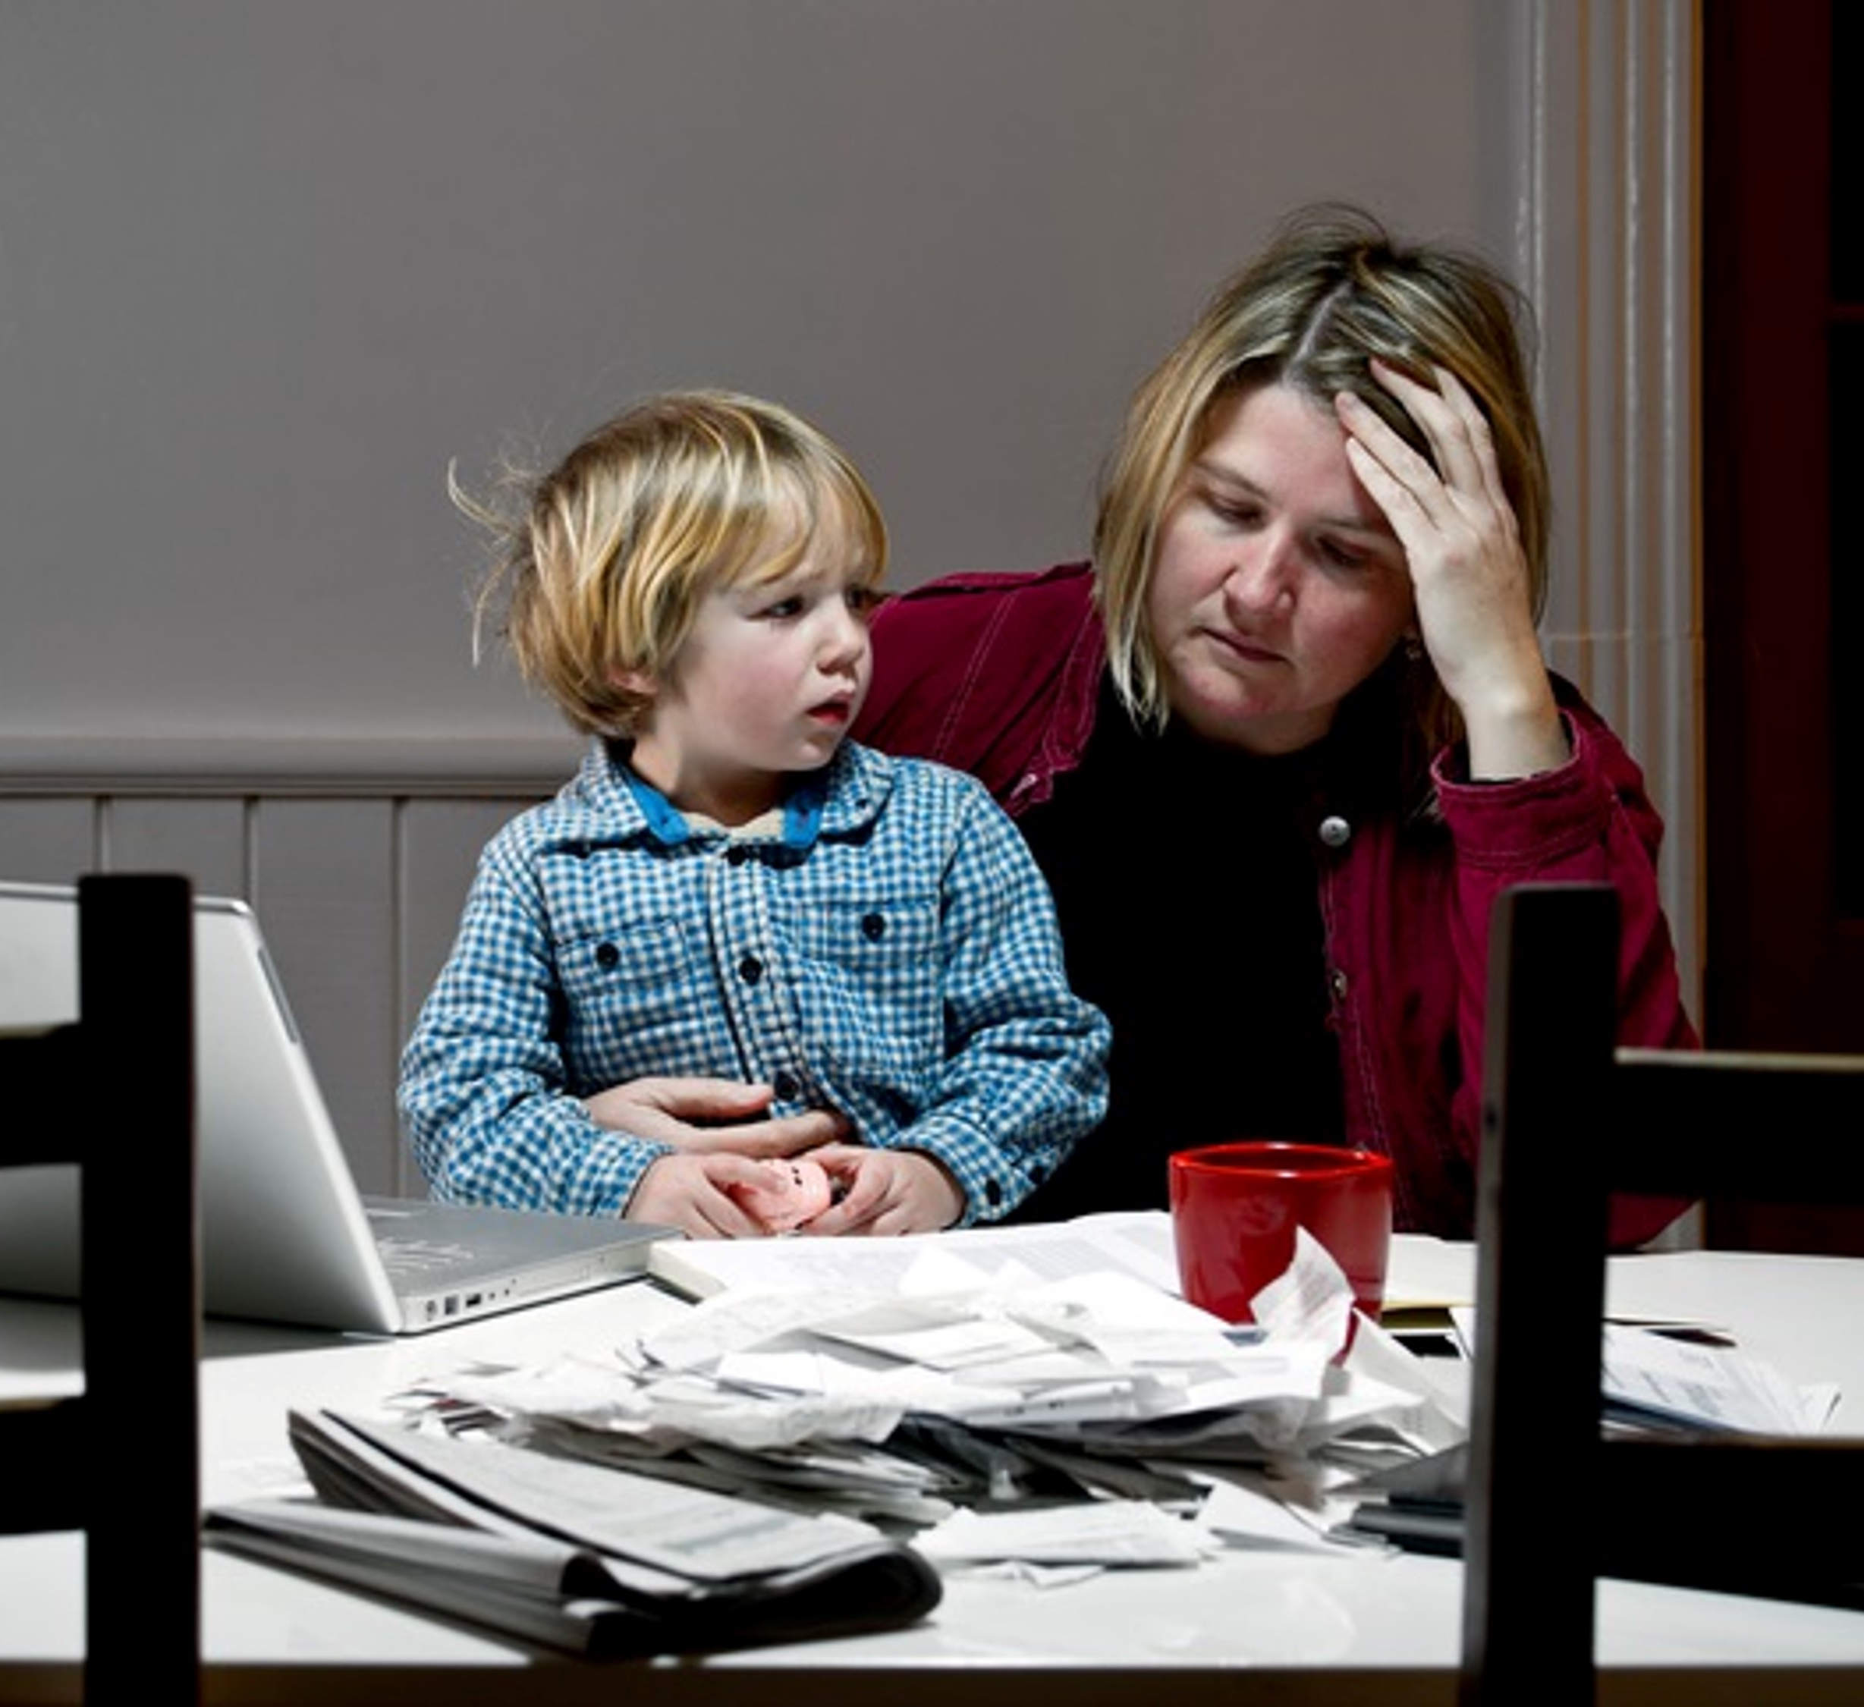
Children are hurt by adults of any age, class, sex, race and sexual orientation. The following factors may increase the likelihood of abuse:
Stress
Possibly caused by financial problems and difficulties in the parents' relationships. This can reduce some adults' ability to control aggressive feelings towards their children or to care for their children properly.
Social disadvantage
For example: living on a low income in inadequate housing or being discriminated against because of ethnicity, religion, disability or sexual orientation. All of these factors could affect the parents' ability to care for their children properly.
Mental illness, substance abuse and domestic abuse
In these circumstances parents can often struggle to take care of their own needs and may find it particularly difficult to meet their children's needs.
Intellectual/physical disability of the child
Children are at increased risk of developmental delay, neglect and abuse.
Notes:
Stress
Possibly caused by financial problems and difficulties in the parents' relationships. This can reduce some adults' ability to control aggressive feelings towards their children or to care for their children properly.
Social disadvantage
For example: living on a low income in inadequate housing or being discriminated against because of ethnicity, religion, disability or sexual orientation. All of these factors could affect the parents' ability to care for their children properly.
Mental illness, substance abuse and domestic abuse
In these circumstances parents can often struggle to take care of their own needs and may find it particularly difficult to meet their children's needs.
Intellectual/
physical disability of the child
Children are at increased risk of developmental delay, neglect and abuse.

Slide 9
Types of child abuse
Physical Abuse
Neglect
Emotional Abuse
Sexual Abuse
Child abuse can be divided into four main categories.
Notes:
Some level of emotional abuse is involved in all types of abuse, although it may also occur alone.
Please remember that categories frequently overlap and should not be seen in isolation.

Slide 10
Other forms of abuse include:
Bullying
Online abuse
Living in a home where there is domestic violence
Being in an abusive relationship (young people)
Female genital mutilation
Radicalisation
There are many other forms of harm inflicted on children and young people:
- Modern slavery
- Trafficking
- Honour-based violence
- Forced marriage
- Child sexual exploitation (CSE).

Slide 11
Physical abuse
Physical abuse may involve hitting, shaking, throwing, poisoning, burning or scalding, drowning, suffocating, or anything else that causes physical harm to a child.
Physical harm may also be caused when a parent or carer makes up the symptoms of, or deliberately causes, illness in a child.
How common is physical abuse?
When asked, 7-8% of young people had experienced some form of physical violence by their parents or guardians during childhood.

Slide 12
How does physical abuse impact on a child?
The child will feel immediate pain and suffering
There may be medical problems caused by the physical injury
The emotional pain will last long after the bruises and wounds have healed
The longer physical abuse of a child occurs, the more serious the impact: chronic physical abuse or a single episode of severe physical abuse can result in long-term physical disabilities, including brain damage, hearing loss or eye damage
In severe instances, children can die from physical abuse

Slide 13
What are the signs of physical abuse?
Some of the common signs can be:
Bruising - especially in areas that are not usually injured
Cuts and scratches - especially in areas that are not usually injured
Bite marks
Burns and scalds
Broken bones - without a good explanation
Shaken babies (abusive head trauma) - causes bleeding into the brain so the baby may be unconscious or fitting
Signs of physical abuse can also be more subtle: a child may be fearful, shy away from touch, be reluctant to change for PE or appear to be afraid to go home

Slide 14
What always needs to be taken in to account?
The child's age and stage of development, for example, a baby who can't sit up yet should not have bruises anywhere unless there is a clear history of trauma such as a car accident. However, a school-aged child will usually have a couple of bruises on their shins caused during normal play.
The child's explanation (where this is possible) and the parent or carer's explanation for the injury. In abuse, the parent's explanation may not fit with the injury seen, seem very vague, or change every time they are asked about the injury. The child may have been 'trained' to echo the parent's explanation

Slide 15
neglect
Neglect is on-going failure to meet a child's basic needs, likely to result in serious harm to the child’s health or development. This may or may not be deliberate.
When might neglect occur?
Neglect may occur during pregnancy as a result of maternal alcohol/substance abuse.
Once a child is born, neglect may involve a parent or carer failing to:
Provide adequate food, clothing and shelter (including exclusion from home or abandonment)
Protect a child from physical and emotional harm or danger
Ensure adequate supervision (including the use of other irresponsible adults)
Ensure access to appropriate medical care or treatment
It may also include neglect of, or not responding to, a child's basic emotional needs.

Slide 16
How common is neglect?
When asked, roughly 15% of young people had been neglected at some point in their childhoods.
What are the signs of neglect?
Physical signs:
Ill-fitting, dirty clothes and shoes
Not dressed warmly enough in cold weather
Appearing very dirty, with matted and unwashed hair or smelling bad
Untreated or delayed treatment for illnesses and physical injuries
Behavioural signs:
Unsupervised young children playing outside
Left alone at home
Frequently late for school
Troublesome, disruptive behaviour, or withdrawn and passive
Running away from home – in the case of adolescents

Slide 17
How does neglect impact on a child or young person?
Examples include:
Always feeling hungry, perhaps not growing properly
Being rejected at school by other children because of their dirty clothes and smell
Living in a filthy house without a clean bed to sleep in, no proper bedtime and therefore always feeling tired
Not getting medical care when needed

Slide 18
Emotional abuse
Emotional abuse is the on-going bad treatment of a child that causes severe and persistent adverse effects on the child’s emotional development.
What does this involve? This can include:
Making children feel they are worthless, unloved, inadequate, or valued only when they meet the needs of another person
Not giving the child opportunities to express their views, silencing them or ‘making fun’ of what they say or how they communicate
Living with domestic abuse in the home
All types of harm to a child involve some level of emotional abuse but emotional abuse may also occur in isolation. Parents from all types of background may emotionally abuse their children.
How does emotional abuse impact on a child?
The child or young person may feel:
That he or she is not worthy of being loved by anyone
A poor sense of well-being, self-image and self-esteem
A poor sense of security, and difficulty in trusting others
That it is hard to feel happy
Responsible for the abusive parent's anger or unhappiness

Slide 19
What are the signs of emotional abuse?
It's not always easy to identify when a child is being emotionally abused. Some of the ways children react to emotional abuse are:
Having low self-confidence and a poor self-image
Being withdrawn, unable to trust others and having difficulty when forming relationships
Being delayed emotionally, socially or academically
Becoming anxious, depressed, demanding, aggressive, destructive or even cruel
Displaying increased risk-taking behaviour
Notes:
What actions of a parent/carer are emotionally abusive?
Parents or carers may:
Say things to the child repeatedly until the child believes he or she is 'no good', 'worthless', 'bad' or 'a mistake'
Speak to the child in a terrifying way such as shouting, swearing, threatening or bullying
Humiliate the child by making sarcastic comments, negative comparisons to others, or shame a child in private or public
Terrorise the child, e.g., threatening to use a knife or other means in order to hurt, torture or kill a pet, a loved one or the child themselves
Force a child to watch violent acts, threaten him or her with abandonment or place the child in dangerous situations
Reject the child, withhold affection or refuse to acknowledge the child's presence and accomplishments
Isolate the child by restricting contact with others
Corrupt the child by encouraging anti-social or delinquent behaviour
Young people may be emotionally abused by peers at school or intimate partners

Slide 20
sexual abuse
What are the signs of sexual abuse?
Often, boys and girls who present with an allegation or a history of sexual abuse do not have any physical signs when examined by a specialist doctor. This is because the abuse may have taken place some time before the examination and injuries to the genital area heal very quickly or because the abuse was non-penetrative (for example, kissing or touching).
The child’s behaviour may suggest sexual abuse if he or she:
Becomes anxious about going to a particular place or seeing a particular person
Suddenly starts having behaviour problems such as being aggressive
Suddenly starts having extreme mood swings such as brooding, crying or fearfulness
Has a sudden deterioration in school results
Displays unexpectedly explicit sexual knowledge for their age, including inappropriate sexualised behaviour
Starts wetting the bed again, having previously been dry by night
Young victims of sexual abuse in the home or with an intimate partner or gang, are more likely to:
Do poorly at school
Abuse alcohol or drugs
Self harm
Have sex with numerous partners
Continue the patterns of violence into future relationships
Many children and young people do not tell anyone about sexual abuse.

Slide 21
What is the impact of sexual abuse on a child or young person?
The commonest reaction that a child feels is shame. They may have tried to tell someone but not have been believed. They may have even been blamed for what has happened. Many sexually abused children wait until they are much older to tell anyone what has happened to them, or they sometimes never tell.
Many young people who are sexually abused by their partner are afraid to tell friends and family.

Slide 22
What are the characteristics of a child sex abuser?
Usually the perpetrator or abuser is a family member, or someone known to the child, such as a family friend. For young people, it is commonly a boyfriend or girlfriend. Child sex abusers can come from any professional, racial or religious background, and can be male or female.
Abusers may act alone or as part of an organised group. After the abuse, they will put the child under great pressure not to tell anyone about it. They will go to great lengths to get close to children and win their trust, such as choosing employment that brings them into contact with children, or by pretending to be children in internet chat rooms intended for children and young people. Child sex abusers are sometimes referred to as 'paedophiles' or 'sex offenders', especially when they are not family members or intimate partners in young people's relationships.

Slide 23
Other forms of abuse - bullying:
May be defined as deliberately hurtful behaviour, usually repeated over a period of time, where it is difficult for those bullied to defend themselves
Can take many forms, but the three main types are:
Physical (hitting, kicking, theft)
Verbal (racist or homophobic remarks, threats, name calling)
Emotional (isolating an individual from the activities and social acceptance of their peer group)
The damage inflicted by bullying can frequently be underestimated. It can cause considerable distress to children to the extent that it affects their health and development or, at the extreme, cause them significant harm (including self-harm). All settings in which children are provided with services or are living away from home should have in place rigorously enforced anti-bullying strategies.

Slide 24
Other forms of abuse - online:
In the past years, the increased use of social networking sites by children has, along with its many benefits, brought with it increased vulnerability to grooming and to the misuse of provocative or sexual images (self-generated or otherwise).
Professionals should be aware that both bullying and child sexual exploitation can be aided by texting, 'sexting', social networking sites and other 'apps'.

Slide 25
Other forms of abuse – female genital mutation (FGM):
The World Health Organization (WHO) defines FGM as:
All procedures that involve partial or total removal of the external female genitalia or other injury to the female genital organs for non-medical reasons.
In practice, the term encompasses a number of different procedures, including any of the following:
Removal of all or part of the clitoris and clitoral hood
Removal of all or part of the clitoris and inner labia
Removal of all or part of the inner and outer labia
Closure of the vagina (also known as infibulation)
There are no health benefits to FGM. It is unknown when, or where, FGM originated. Numerous reasons are given to justify FGM but it is not demanded by any specific religions.

Slide 26
Other forms of abuse – radicalisation:
Prevent is a scheme that is part of the Government's counter terrorism strategy, so that people can go about their lives freely and with confidence.
These forms of terrorism include:
Political extremists
Religious extremists
Environmental extremists
Animal rights extremists
Young people can be particularly vulnerable to getting involved with radical groups through direct contact with members, or increasingly, through the internet. This can put a young person at risk of being drawn into criminal activity and has the potential to cause significant harm.

Slide 27
Other forms of abuse – grooming:
Grooming is when someone builds an emotional connection with a child to gain their trust for the purposes of sexual abuse, sexual exploitation or trafficking.
Children and young people can be groomed online or face to face, by a stranger or by someone they know - for example a family member, friend or professional.
Groomers may be male or female. They could be any age.
Many children and young people don't understand that they have been groomed or that what has happened is abuse.

Slide 28
While you are volunteering, a mother starts talking to you about her 7-year-old daughter. She is worried because her daughter has started ‘acting up’, having mood swings and then sudden bursts of crying and is refusing to go anywhere without her mother. She has also suddenly started wetting the bed.?
While you are volunteering you notice that a child is being made fun of by children in the group for smelling and looking unclean.
Which form of abuse might you suspect? Please choose an option for both scenarios:
Physical abuse
Emotional abuse
Neglect
Sexual abuse

Slide 29
Effects of child abuse
Abuse and neglect can have major effects on all aspects of a child's health, development and well-being. The impact of any abuse will vary from child to child depending on the:
Nature of the abuse
Duration of the abuse
Age of the child
Individual child’s reaction to the abuse
Home/family environment
Impact and speed of any intervention
Consequences of the intervention
Professional response and support

Slide 30
Effects of child abuse
Abuse and neglect during childhood increases the risk of:
Drug and alcohol misuse
Poor physical/mental health
Early and multiple sexual relationships and teen pregnancy
Risk of perpetrating or being a victim of domestic violence
Difficulty with job performance
Relationship problems
Likelihood of going to prison
On the positive side, many children and young people, despite having suffered from abuse, overcome this adversity and go on to enjoy successful and contented lives.

Slide 31
Your role in Safeguarding
As a volunteer you may meet children, young people and their families or carers. You have a responsibility to play your part in keeping children safe. If a child or young person gives you some information that indicates they may be being abused, but then insists you don't tell anyone, what should you do?
Please choose one option:
Nothing – the child’s confidentiality is more important
Report it – the child’s safety is more important
Notes:
Remember that you are not alone if you have concerns about child abuse. Contact your volunteer coordinator or supervisor if you are concerned.
Be aware that the key members in your local child safeguarding team are:
Teachers
Health and social care workers
Police
Staff in voluntary agencies (such as the NSPCC).

Slide 32
Case example
While you are volunteering, a woman and her two young children (a boy aged about 3 and a girl aged about 8 years old) come to visit the woman's elderly father who has a chronic respiratory condition. You notice that the children are scruffily dressed and seem very subdued. The mother asks to take the 8-year-old girl to the toilets. You then happen to visit the toilets yourself, and on opening the door, she hears the mother speak very nastily to her daughter and then hit her on the back. The mother looks embarrassed before bursting into tears.
As a volunteer what should you do?
Comfort the mother and do no more about it
Pretend not to notice; think the mother is probably upset about her own father and do nothing
Accuse the mother of harming her child
Ring the police
Refer the girl to social services
Discuss your concerns with your volunteer coordinator or a senior member of staff
Ring Child Line or the NSPCC

Slide 33
Case example – what happens next?
The line manager contacts a member of the safeguarding team who comes to talk to the mother. The mother reveals that her father's illness is causing her a lot of stress as she is worried that her father is terminally ill and she is a single mother who relies on him for support.
Both the safeguarding team and children's social care must act to help support the mother and protect the children.
The safeguarding team member discusses with the mother the witnessed hitting of her 8-year-old daughter and the concerns about both children seeming very subdued. The safeguarding team member suggests that perhaps the mother is struggling to keep up with things, as she wonders if the children are normally better dressed than this.
The safeguarding team member explains to the mother they are professionally obliged to refer the family to children's social care, but that the main reason for this is to obtain support for the mother and her two children.
Children's social care will assess the circumstances around this family to ascertain whether or not the children are at risk of harm.
This is an investigation carried out over several weeks talking to all agencies involved with the family (school, GP, health visitor) in order to find out what the family's strengths and weaknesses are.
Sharing information in this way is a key part of safeguarding.

Slide 34
Sharing information
By sharing information, agencies can assess the level of risk the child might be exposed to. They can then together decide what the next steps will be - either supporting the child and family or, if there is a greater risk, taking action to protect the child from further harm.
Children’s Social Care: They will take a lead in the investigation and management of child protection cases and will know whether a child and/or family has been previously involved with children's social care.
Police: Police will have knowledge of any previous criminal involvement of the child/parents/carers and records of call-outs to the family house regarding incidents of domestic abuse.
Health Visitor/School Nurse: A health visitor/school nurse will be aware of issues relating to health and development of the child/young person and may be aware of issues affecting other children and/or parents in the family.
School/nursery teacher: A school/nursery teacher will have a good knowledge of the child's day-to-day behaviour.
Paediatrician: A paediatrician will be aware of significant medical issues that may affect the child and have expertise in medical aspects of child abuse.
GP: A GP may well have a knowledge of the whole family, for example, parental mental health or substance abuse issues.
Others: The housing department, mental health team, substance abuse team, midwife, etc. may also provide vital information.

Slide 35
Looked after children
Most children stay with their parents after a child safeguarding enquiry. They are closely monitored for a variable period of time to ensure that the support offered to the children and parents/carers is making a positive difference to the child's life.
Occasionally, the local authority becomes responsible for a child's welfare. This is a legal process and the decision is taken by a judge after all the evidence is presented. These children and young people are called 'looked-after children'. Looked-after children may be taken into care or may still be allowed to stay at home with their parents. In both cases, it is the local authority who makes decisions about their care.

Slide 36
Session summary
All children have the right to grow up in a secure and loving environment that caters for all aspects of their development including physical, intellectual, social, emotional, behavioural and sexual development.
Child abuse is the maltreatment of a child through action or lack of proper care by parents or adult carers
There are four categories of child abuse:
Physical abuse
Emotional abuse
Neglect
Sexual abuse
Domestic abuse damages children and may indicate that there are other types of child abuse occurring
Multiple forms of abuse may be affecting the child - Any type of abuse can cause long-term damage to a child both during childhood and in later life
It is a volunteer's responsibility to immediately raise any safeguarding concerns

Slide 37
Knowledge quiz!
Notes:
Welcome to the Safeguarding Children Knowledge Quiz. To successfully complete this quiz, you need to achieve a score of at least 75%. There are 6 questions in total. You should set aside approximately 5 minutes to complete this quiz. Good luck!
Q1. If a child or young person discloses that they are being abused and neglected but they ask you not to tell anyone, what should you do? Select one:
Respect their wishes
Promise to only tell your volunteer coordinator
Tell them you must share this with other people who may be able to help keep them and other children safe
Answer:
- Tell them you have to share this with other people who may be able to help keep them and other children safe:
While it is important to respect someone's wishes, this cannot override the welfare and safety of a child. It is important to be clear that this information may need to be shared with appropriate people, which may mean sharing more widely than just your volunteer coordinator.
Q2. Which of the following may be signs that a child is being abused or neglected? Select four:
A child who shows great fear of parents and does not want to go home from hospital when ready for discharge
A child whose parents will not allow the child to eat with the rest of the family
A 7-year-old with a broken wrist falling from trampoline during a gymnastic class
A baby with a bruised arm and no explanation given by the parents
Failure to access appropriate medical care or treatment
Answer:
The following may all be signs that a child is being abused:
- A baby with a bruised arm and no explanation given by the parents
- A child whose parents will not allow the child to eat with the rest of the family
- Failure to access appropriate medical care or treatment
A child who shows great fear of parents and does not want to go home from hospital when ready for discharge
Q3. If you are faced with internal barriers and cannot report a case of abuse or neglect through the normal channels, for example your volunteer coordinator may tell you there is nothing to worry about and to keep it to yourself, who can you contact for support? Select two:
A Local authority and/or the Police
Local school
The National Society for the Protection of Cruelty to Children (NSPCC)
Local church
Answer:
If you experience internal barriers to referring a child you should contact:
- The local authority and/or the police
The National Society for the Protection of Cruelty to Children (NSPCC).
Q4. What type(s) of abuse might you be concerned about in the following scenarios? A highly critical parent of a 7-month-old baby describes the child as attention seeking. The child appears apathetic to the examiner and is not gaining weight satisfactorily.
1. Emotional Abuse
2. Neglect
3. Sexual Abuse
4. Physical Abuse
Answer
Emotional Abuse
Q5. What type(s) of abuse might you be concerned about in the following scenarios? An 11-year-old girl, whose mother’s boyfriend insists on bathing with her, provides photos of her genitalia when asked to by someone on an internet chat room 1. Emotional Abuse
2. Neglect
3. Sexual Abuse
4. Physical Abuse
Answer –
Sexual Abuse
Q6. What type(s) of abuse might you be concerned about in the following scenarios? A mother of a male teenager is unconcerned by her 14-year-old son’s repeated absence from home all night and school truancy 1. Emotional Abuse
2. Neglect
3. Sexual Abuse
4. Physical Abuse
Answer –
Neglect
Q7. What type(s) of abuse might you be concerned about in the following scenarios? A parent's explanation for marked bruising on the face of their 5-year-old daughter is that she fell over in the bath. The daughter, when interviewed alone, reveals that she was punched by her father 1. Emotional Abuse
2. Neglect
3. Sexual Abuse
4. Physical Abuse
Answer –
Physical Abuse
Q8. Why is it important to ensure that children grow up safe from significant harm and free from abuse and neglect? Select two: 1. The child's welfare is paramount
2. It gives children a greater chance to achieve their full potential
3. If they are not, the child will always be taken into care
Answers –
The child's welfare is paramount
It gives children a greater chance to achieve their full potential
Q9. What should you do if you have concerns about child abuse or neglect? Select three: 1. Share your concerns with your volunteer coordinator
2. Discuss with your organisation's safeguarding children lead
3. Record what you have seen or heard
4. Nothing as you cannot prove anything
Answers –
Share your concerns with your volunteer coordinator
Discuss with your organisation's safeguarding children lead
Record what you have seen or heard

Slide 38
Thank you!

Slide 39
The content of this training was developed by NHS England, E-Learning for Healthcare and has been adapted by Bradford Teaching Hospitals NHS Foundation Trust, to help support the completion of the National Volunteer Certificate in an accessible format, ensuring that all volunteers have the same basic learning when they start in their role.

