Slide 1
Safeguarding children
VOLUNTEER iNDUCTION
Notes:
By the end of this session you will be able to:
Describe the different forms of child abuse (physical, emotional, sexual abuse and neglect)
Describe how common child abuse is and the impact it can have on a child or young person
Indicate what you should do if you do have concerns about child abuse
Describe the risks associated with the internet and online social networking
Describe what the term 'looked-after child' means
Recognise possible signs of child abuse that you might come across in your volunteering role

Slide 2
Why is safeguarding children important
This session explains what is involved in safeguarding children and young people. It looks at:
How you might be able to recognise abuse in a child or young person
What you should do if you are concerned that a child is being abused or neglected
It is important to note that the term 'children' means children and young people from birth to their 18th birthday
Notes:
The session does not contain any photos or illustrations of injuries. If the session is very upsetting for you (possibly because of experiences in your own or others' lives), you should seek advice from your volunteer coordinator or supervisor.

Slide 3
Why is safeguarding important, even if you do not volunteer with children?
Protecting children from harm is important in everyday life because every child matters. If you only volunteer with adults, you need to be aware that those adults may at some point disclose important information about children or even their own childhood.

Slide 4
Safeguarding for staff and volunteers
Organisations have a duty in law to ensure that they safeguard and promote the welfare of children and young people.
Unfortunately, many children in the UK do not grow up in satisfactory conditions. Some children and their families need extra help to allow them to reach their full potential.
In order to carry out their duty to safeguarding children, all staff and volunteers need to be able to understand and recognise signs of children being harmed.
As a volunteer you have:
A duty of care, it is your duty to identify and report any concerns, not to act or investigate further
A responsibility to be aware of the Prevent strategy and an obligation to report concerns.
Notes:
Organisations have a duty in law to ensure that they safeguard and promote the welfare of children and young people, and this means that all staff and volunteers have an important role to play. This includes being able to recognise signs of possible child abuse and neglect.
Unfortunately, many children in the UK do not grow up in satisfactory conditions. Some children and their families need extra help to allow them to reach their full potential. Recent high-profile cases have highlighted just how cruelly some children can be treated by others.

Slide 5
Do you think a child is more likely to be abused by a stranger or someone they know?
Children and young people may be abused in a family, or in an institutional or wider community setting.
The abuser(s) may be someone known to the child or, more rarely, a stranger. More often than not the person responsible for the abuse has a close relationship with the abused child.
Any child can be at risk of abuse regardless of their age, sex, ethnicity, ability or disability.
Those most at risk are babies and young children, those with learning difficulties and those with physical disabilities.
Young people are also at risk of abuse, and they may respond in ways that put them at further risk of harm, for example, by running away.
Notes:
Children and young people may be abused in a family, or in an institutional or wider community setting. The abuser(s) may be someone known to the child or, more rarely, a stranger. More often than not the person responsible for the abuse has a close relationship with the abused child.
Any child can be at risk of abuse regardless of their age, sex, ethnicity, ability or disability. Those most at risk are babies and young children, those with learning difficulties and those with physical disabilities. Young people are also at risk of abuse, and they may respond in ways that put them at further risk of harm, for example, by running away.

Slide 6
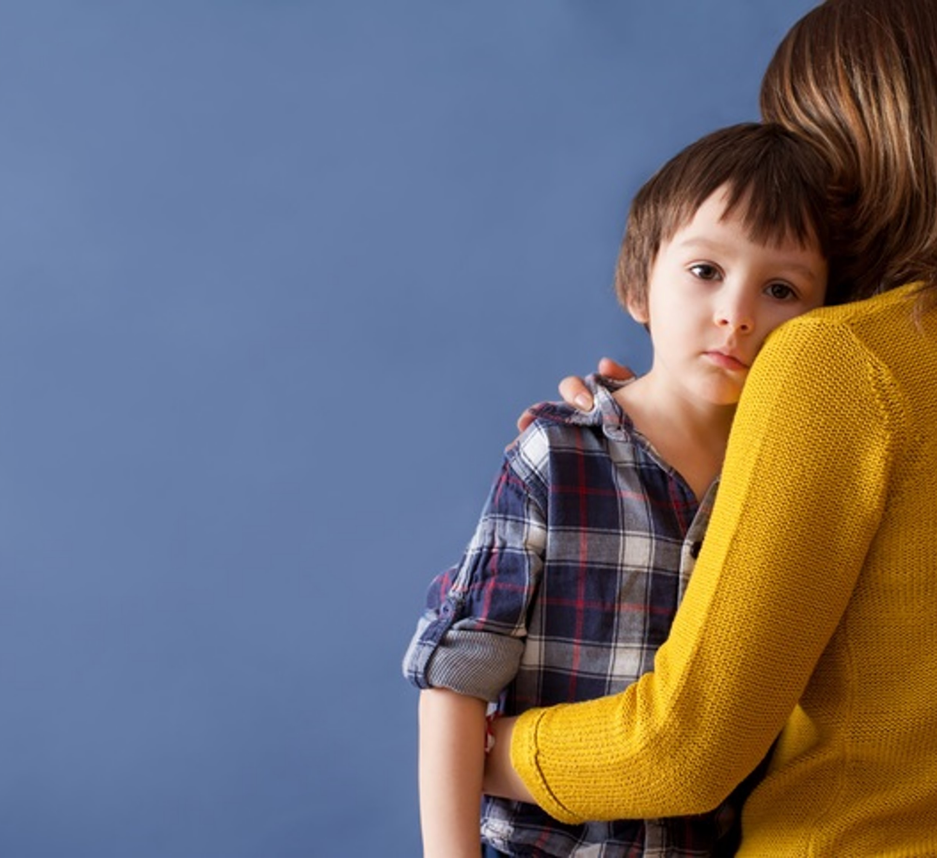
Types of child abuse
Child abuse can be divided into four main categories.
Physical Abuse
Neglect
Emotional Abuse
Sexual Abuse
Notes:
Some level of emotional abuse is involved in all types of abuse, although it may also occur alone.
Please remember that categories frequently overlap and should not be seen in isolation.

Slide 7
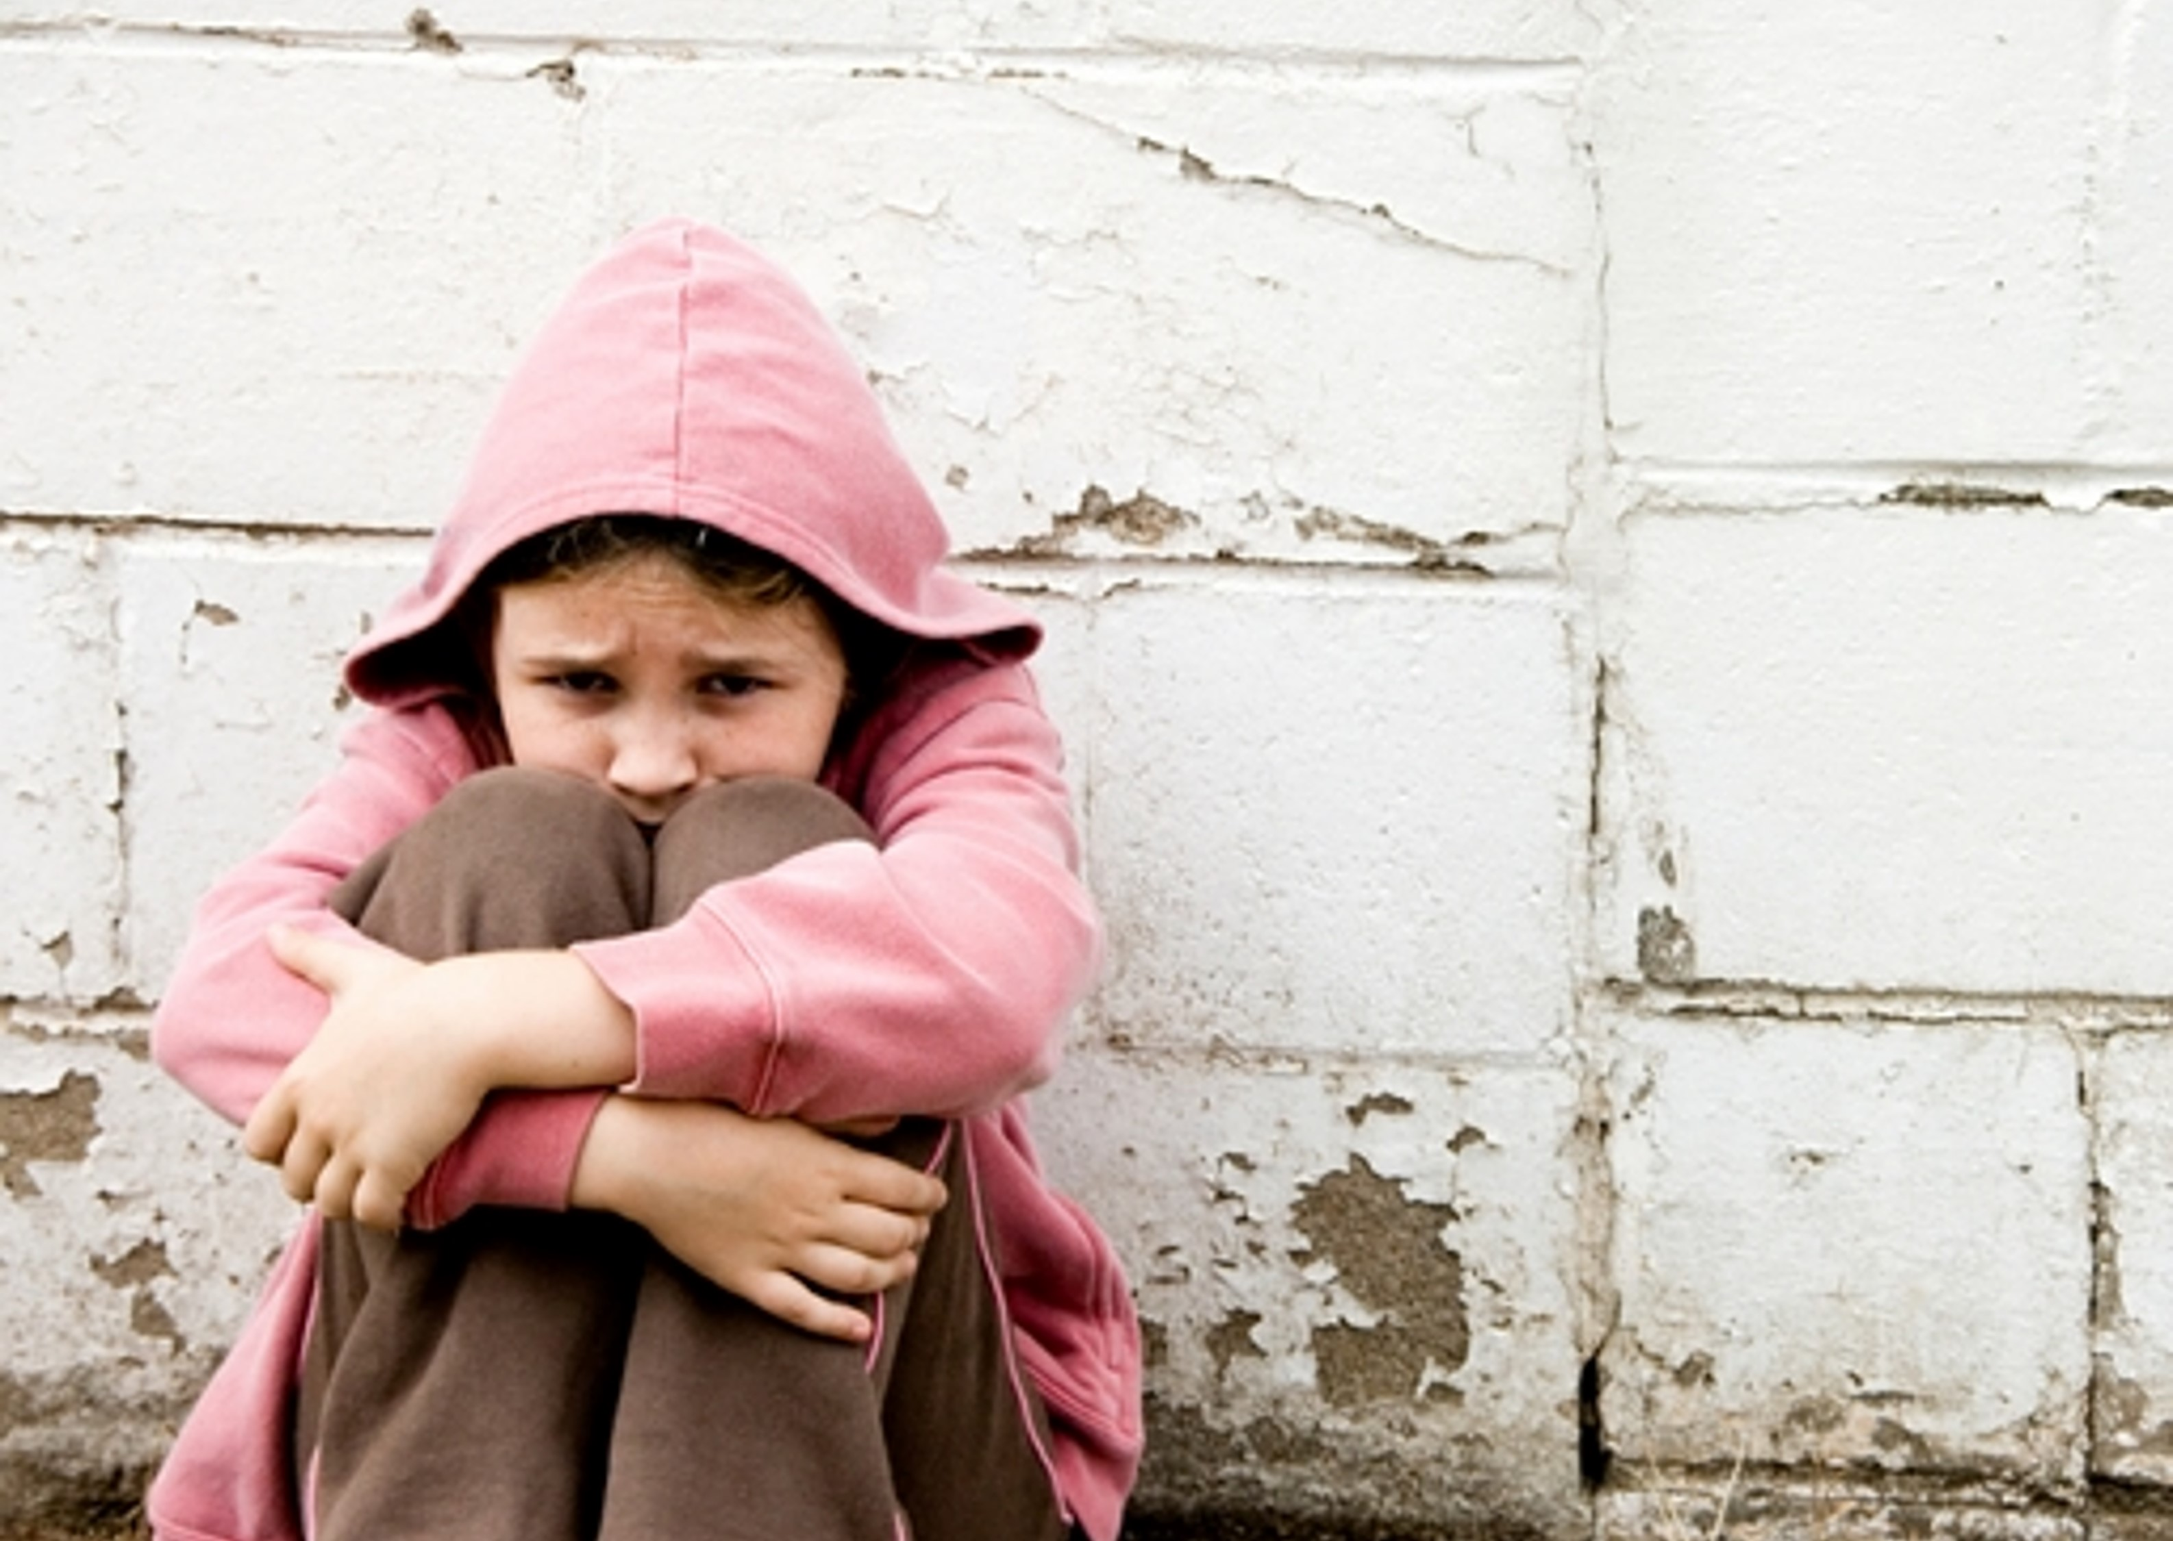
Other forms of abuse include:
Bullying
Online abuse
Living in a home where there is domestic violence
Being in an abusive relationship (young people)
Female genital mutilation
Radicalisation
There are many other forms of harm inflicted on children and young people:
- Modern slavery
- Trafficking
- Honour-based violence
- Forced marriage
- Child sexual exploitation (CSE).

Slide 8
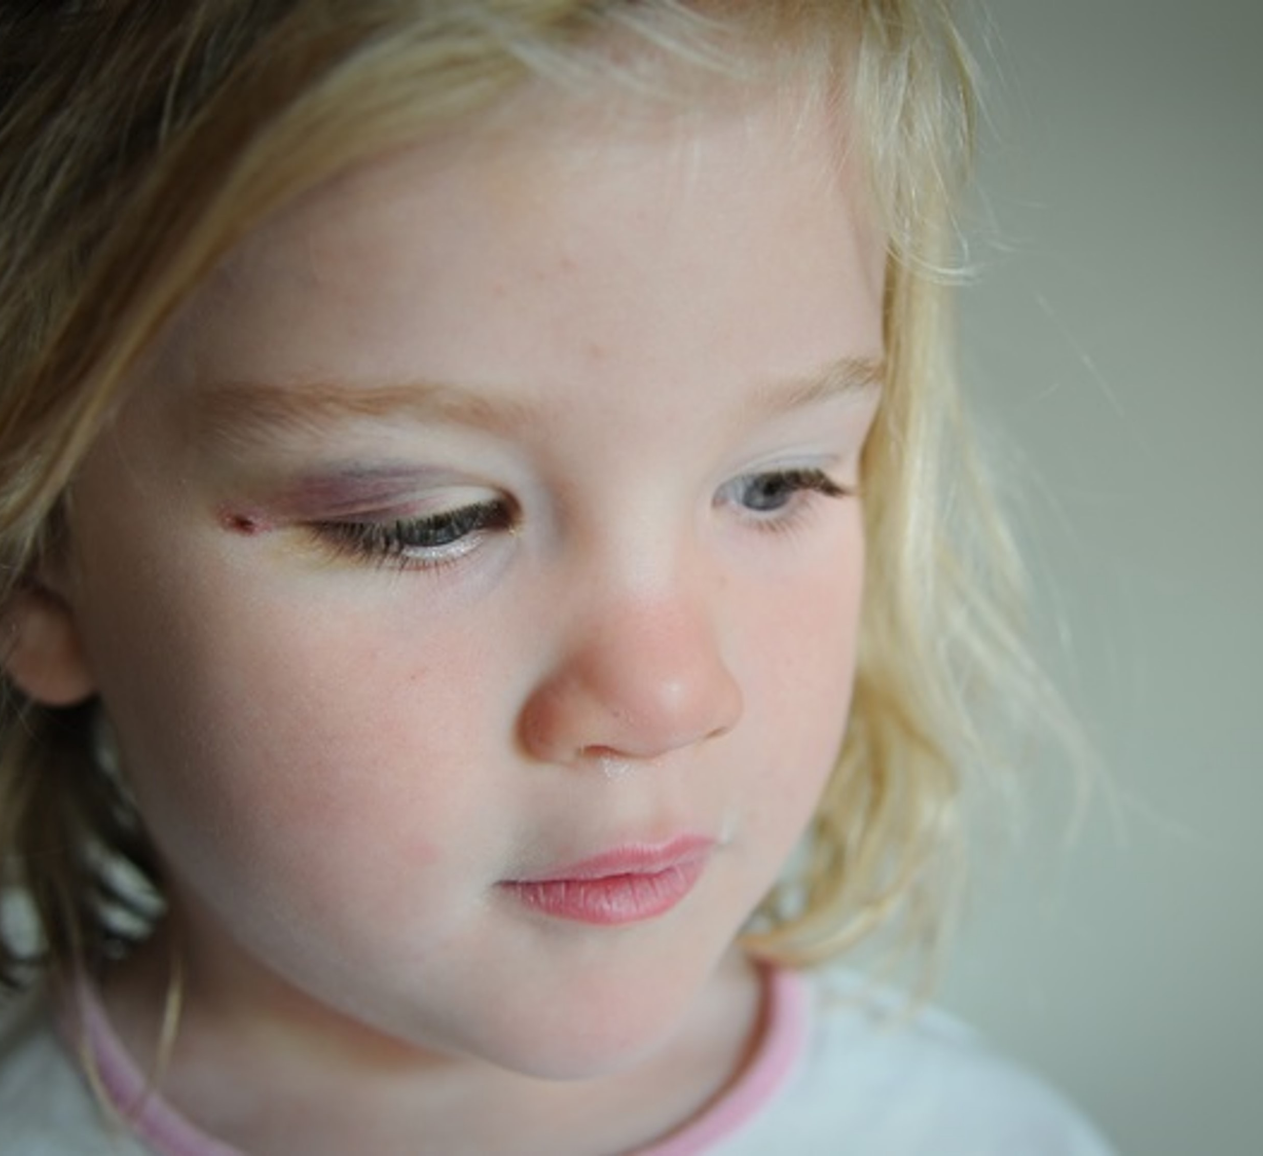
WHAT ARE THE POSSIBLE SIGN OF ABUSE?
Unexplained changes in behaviour or personality
Becoming withdrawn/seeming anxious
Becoming uncharacteristically aggressive
Lacks social skills and has few friends, if any
Poor bond or relationship with a parent
Knowledge of adult issues inappropriate for their age
Running away or going missing
Unexplained bruises/burns or scalds on the body
Any physical injury in a non-mobile baby – ‘what doesn’t cruise doesn’t bruise’
You may also notice some concerning behaviour from adults who you know have children in their care, which makes you concerned for the child/children’s safety & wellbeing
Notes:
The session does not contain any photos or illustrations of injuries. If the session is very upsetting for you (possibly because of experiences in your own or others' lives), you should seek advice from your volunteer coordinator or supervisor.

Slide 9
Which form of abuse might you suspect?
Please choose an option for both scenarios:
While you are volunteering, a mother starts talking to you about her 7-year-old daughter. She is worried because her daughter has started ‘acting up’, having mood swings and then sudden bursts of crying and is refusing to go anywhere without her mother. She has also suddenly started wetting the bed.?
While you are volunteering you notice that a child is being made fun of by children in the group for smelling and looking unclean.
Physical abuse
Emotional abuse
Neglect
Sexual abuse

Slide 10
EFFECTS OF CHILD ABUSE
Abuse and neglect during childhood increases the risk of:
Drug and alcohol misuse
Poor physical/mental health
Early and multiple sexual relationships and teen pregnancy
Risk of perpetrating or being a victim of domestic violence
Difficulty with job performance
Relationship problems
Likelihood of going to prison
On the positive side, many children and young people, despite having suffered from abuse, overcome this adversity and go on to enjoy successful and contented lives.
Notes:
The session does not contain any photos or illustrations of injuries. If the session is very upsetting for you (possibly because of experiences in your own or others' lives), you should seek advice from your volunteer coordinator or supervisor.

Slide 11
VOICE OF A CHILD
Hearing and capturing the voice of the child is really important
You can be the child’s advocate
Listen to them and share information appropriately
Notes:
Do you think a child is more likely to be abused by a stranger or someone they know?

Slide 12
DOMESTIC ABUSE
Domestic abuse is any incident or pattern of incidents of controlling, coercive or threatening behaviour, violence or abuse, between those aged 16 or over, who are or have been intimate partners or family members, regardless of gender or sexuality.
Domestic abuse affects children adversely and if you become aware of potential or witnessed domestic abuse you need to share this with your volunteer Coordinator (or share with Ward Staff).

Slide 13
Your role in Safeguarding – what do you do?
As a volunteer you may meet children, young people and their families or carers. You have a responsibility to play your part in keeping children safe. If a child or young person gives you some information that indicates they may be being abused, but then insists you don't tell anyone, what should you do?
Please choose one option:
Nothing – the child’s confidentiality is more important
Report it – the child’s safety is more important
Notes:
Remember that you are not alone if you have concerns about child abuse. Contact your volunteer coordinator or supervisor if you are concerned.
Be aware that the key members in your local child safeguarding team are:
Teachers
Health and social care workers
Police
Staff in voluntary agencies (such as the NSPCC).

Slide 14
RAISING CONCERNS
Who do I tell?
In the first instance raise any concerns with your Volunteer Coordinator or the person who is responsible for volunteers within your service area.
Children have the right to be protected from being hurt and abused, whether physically or mentally.
The law ensures that children are properly cared for and protect them from violence, abuse and neglect by their parents, carers or anyone else who comes into contact with them.
01274 274884
Safeguarding.children@bthft.nhs.uk

Slide 15
Session summary
All children have the right to grow up in a secure and loving environment that caters for all aspects of their development including physical, intellectual, social, emotional, behavioural and sexual development.
Child abuse is the maltreatment of a child through action or lack of proper care by parents or adult carers
There are four categories of child abuse:
Physical abuse
Emotional abuse
Neglect
Sexual abuse
Domestic abuse damages children and may indicate that there are other types of child abuse occurring
Multiple forms of abuse may be affecting the child - Any type of abuse can cause long-term damage to a child both during childhood and in later life
It is a volunteer's responsibility to immediately raise any safeguarding concerns

Slide 16
Thank you!

Slide 17
The content of this training was developed by NHS England, E-Learning for Healthcare and has been adapted by Bradford Teaching Hospitals NHS Foundation Trust, to provide an accessible format, ensuring that all volunteers have the same basic learning when they start in their role.

