Slide 1
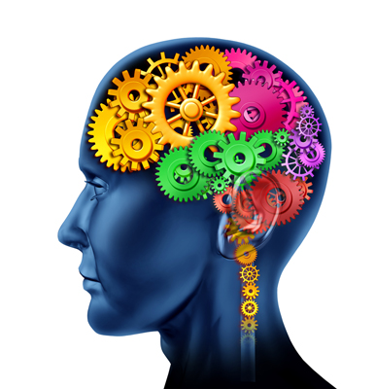
MENTAL HEALTH AWARENESS
VOLUNTEER iNDUCTION
Notes:
Learning Objectives
Explain how common mental illness is in the general population
Describe the breadth (or range) of mental health diagnoses and presentations
Explain why mental health is as important as physical health
Explain what dementia is and how it affects people
Describe different types of learning disability
Identify sources of support for an individual with a mental health diagnosis or learning disability
Explain when volunteers should report concerns if they think an individual's needs are not being met
Describe principles which volunteers can incorporate to improve interactions with individuals with mental health needs

Slide 2

MENTAL HEALTH
Mental health problems can affect anyone of any age - from children to the very old.
Different mental health problems are more likely at different stages of life.
For example, young people are more likely to have worries about their body image, whereas older people are more likely to have memory problems.
Notes:
This introductory session aims to raise awareness of mental health issues with volunteers. It is designed to give a broad overview of what encompasses mental illness whilst highlighting the link between mental and physical health diagnoses. It also provides some simple guidance on how best to support someone with mental health difficulties.
If you are unsure about your role or have any questions or difficulty understanding the content of this session, please contact your volunteer coordinator for support.
You can revisit this session as many times as you need to. Your volunteer coordinator will also be able to help you if you need any technical support.
How many people in the UK do you think will have a mental health problem during their lifetime?
1 in 4 people
1 in 10 people
1 in 20 people
Answer: 1 in 4 people will experience mental illness during their lifetime.
The lifetime risk of mental health problems is higher than the lifetime risk of some common physical illnesses such as breast cancer (1 in 9) or bowel cancer (1 in 14) [1]. Among people under 65 years, nearly half of all ill health is mental illness.

Slide 3
There are lots of different types of mental health problems.
Some people feel very sad and low in mood for more than two weeks. This is called depression
Some people get more worried than is usual. This is called anxiety
Memory loss and difficulties with thinking, problem-solving or language, severe enough to affect daily life. This is called dementia
Other mental health problems include addiction and eating disorders, amongst others.
Some examples of common mental health problems are:

Slide 4
What Causes Mental Health Problems?
Changes in the environment
Substance misuse
Being physically unwell can be associated with a mental health problem
Mental health problems sometimes run in families (this is called genetic association)
Having a learning disability
We do not know exactly what causes all mental health problems; however, we do know that some factors make a mental illness more likely.
Notes:
Changes in the environment (for example, the stress of being homeless or losing a job).
Substance misuse (for example, drinking too much alcohol or taking street drugs).
Being physically unwell can be associated with a mental health problem (for example, someone who has a long-term health condition such as multiple sclerosis).
Mental health problems sometimes run in families (this is called genetic association).
Having a learning disability (for example, trisomy 21, previously known as Down syndrome).

Slide 5

Effects of Mental Health Problems
Mental health problems can affect people in different ways
Some people might:
Have very little energy and sleep a lot
Have more energy and be more active than usual
Stop eating or eat too much
Change their behaviour, for example, they might be more irritable than usual
Worry more than usual, or have unusual thoughts, including wanting to hurt themselves
Some mental health problems may last for a long time, for example, bipolar disorder.
However, about half of people with common mental health problems are no longer unwell after 18 months.

Slide 6
Knowledge Check
A. Not eating because of worries about being fat, when in reality the person’s body weight is very low
Can you match the example symptoms to the illness?
1. Low mood / depression
B. Being scared of spiders
2. Dementia
C. Worrying all the time about what people think of them
3. Phobia
4. Anxiety
D. Forgetfulness and memory problems
5. Anorexia Nervosa
E. Feeling hopeless and worthless
Notes:
Answers: 1E, 2D, 3B, 4C, 5A

Slide 7
Physical and Mental Health
It is widely recognised that physical health and mental health should be treated equally. This is important, as physical and mental health problems are often linked.
People with poor physical health are at higher risk of experiencing mental health problems.
People with poor mental health are more likely to have poor physical health.

Slide 8

Treatments
The choice of treatment varies from individual to individual, here are some examples:
Mental illness is treatable
Removing a trigger factor - reducing stress.
Practical support - receiving help with finding a job.
Self-help - learning breathing exercises to help with relaxation.
Talking therapy - with a trained professional.
Medication - these can help to improve some symptoms, for example an antidepressant may lift someone's mood.

Slide 9

How Volunteers can Support Someone with a Mental Illness
Sometimes volunteers can be unsure how to best support someone with a mental illness. You do not need to be an expert to provide good support to someone with a mental health problem.
Follow these simple principles:
Allow enough time for a conversation where possible
Listen actively and communicate clearly
Ask how you can help
Have a non-judgemental attitude; do not make assumptions
Be aware of the whole person - they are not just a mental health diagnosis
When relevant, seek support from your volunteer coordinator

Slide 10
KNOWLEDGE CHECK
Encourage a healthy diet and regular exercise
Encourage them to seek support from their GP
Allow enough time for a conversation where possible. Ask how you can help them, listen actively and communicate clearly. If the individual is known to a mental health team, try to speak with them to find out what they like and do not like.
The following would be helpful when supporting someone with a mental health problem -
Notes:
Q. What might be helpful when supporting someone with a mental health problem?

Slide 11
Myth Busting
There are a lot of myths about individuals with mental health problems.
Myth: Individuals with mental health problems are always dangerous
Fact: The majority of violent crime is committed by individuals without a mental health problem. Individuals with mental health problems are more likely to be attacked than attack.
Myth: Mental illness is a sign of weakness and failure
Fact: Mental illness is common and can affect anyone, it is not a sign of weakness and failure.
Myth: It is not possible to treat a mental health problem
Fact: There is a wide variety of evidence-based treatments for mental health illnesses.

Slide 12
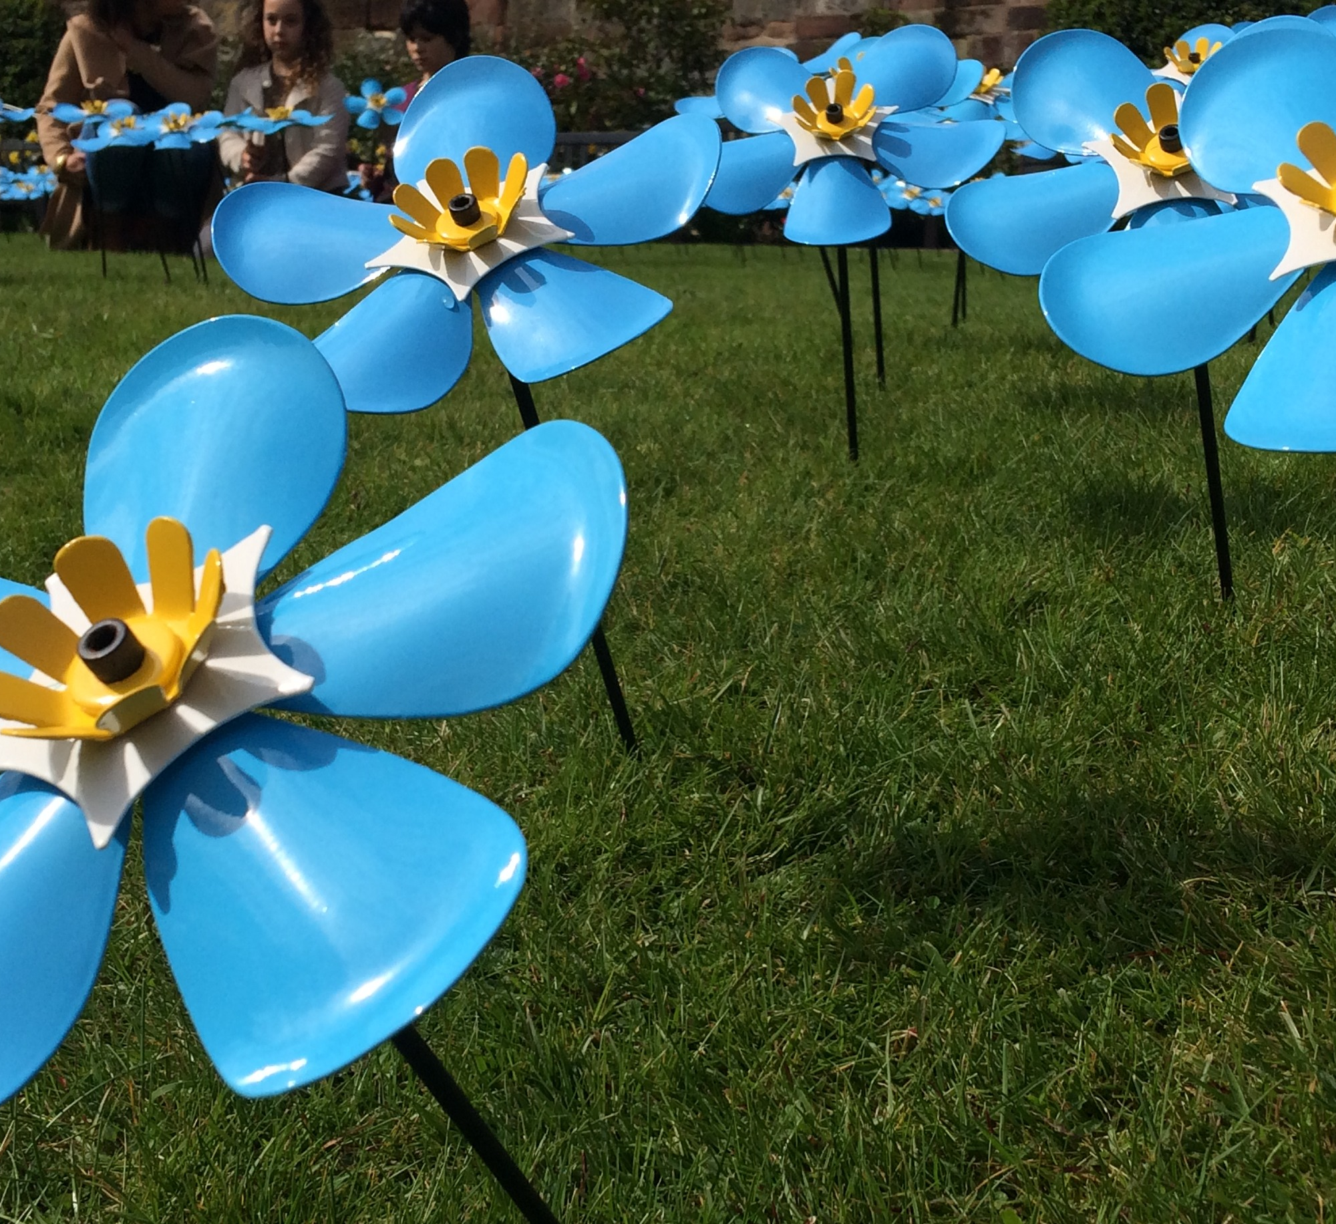
Dementia
The term 'dementia’ is used to cover many different conditions that affect the brain.
Alzheimer's is just one type of dementia.
People suffering with dementia have problems with 'cognitive functions' - this means how they remember things and how to do them. This often means they have problems with their:
Memory
Thinking
Communicating
Decision making

Slide 13
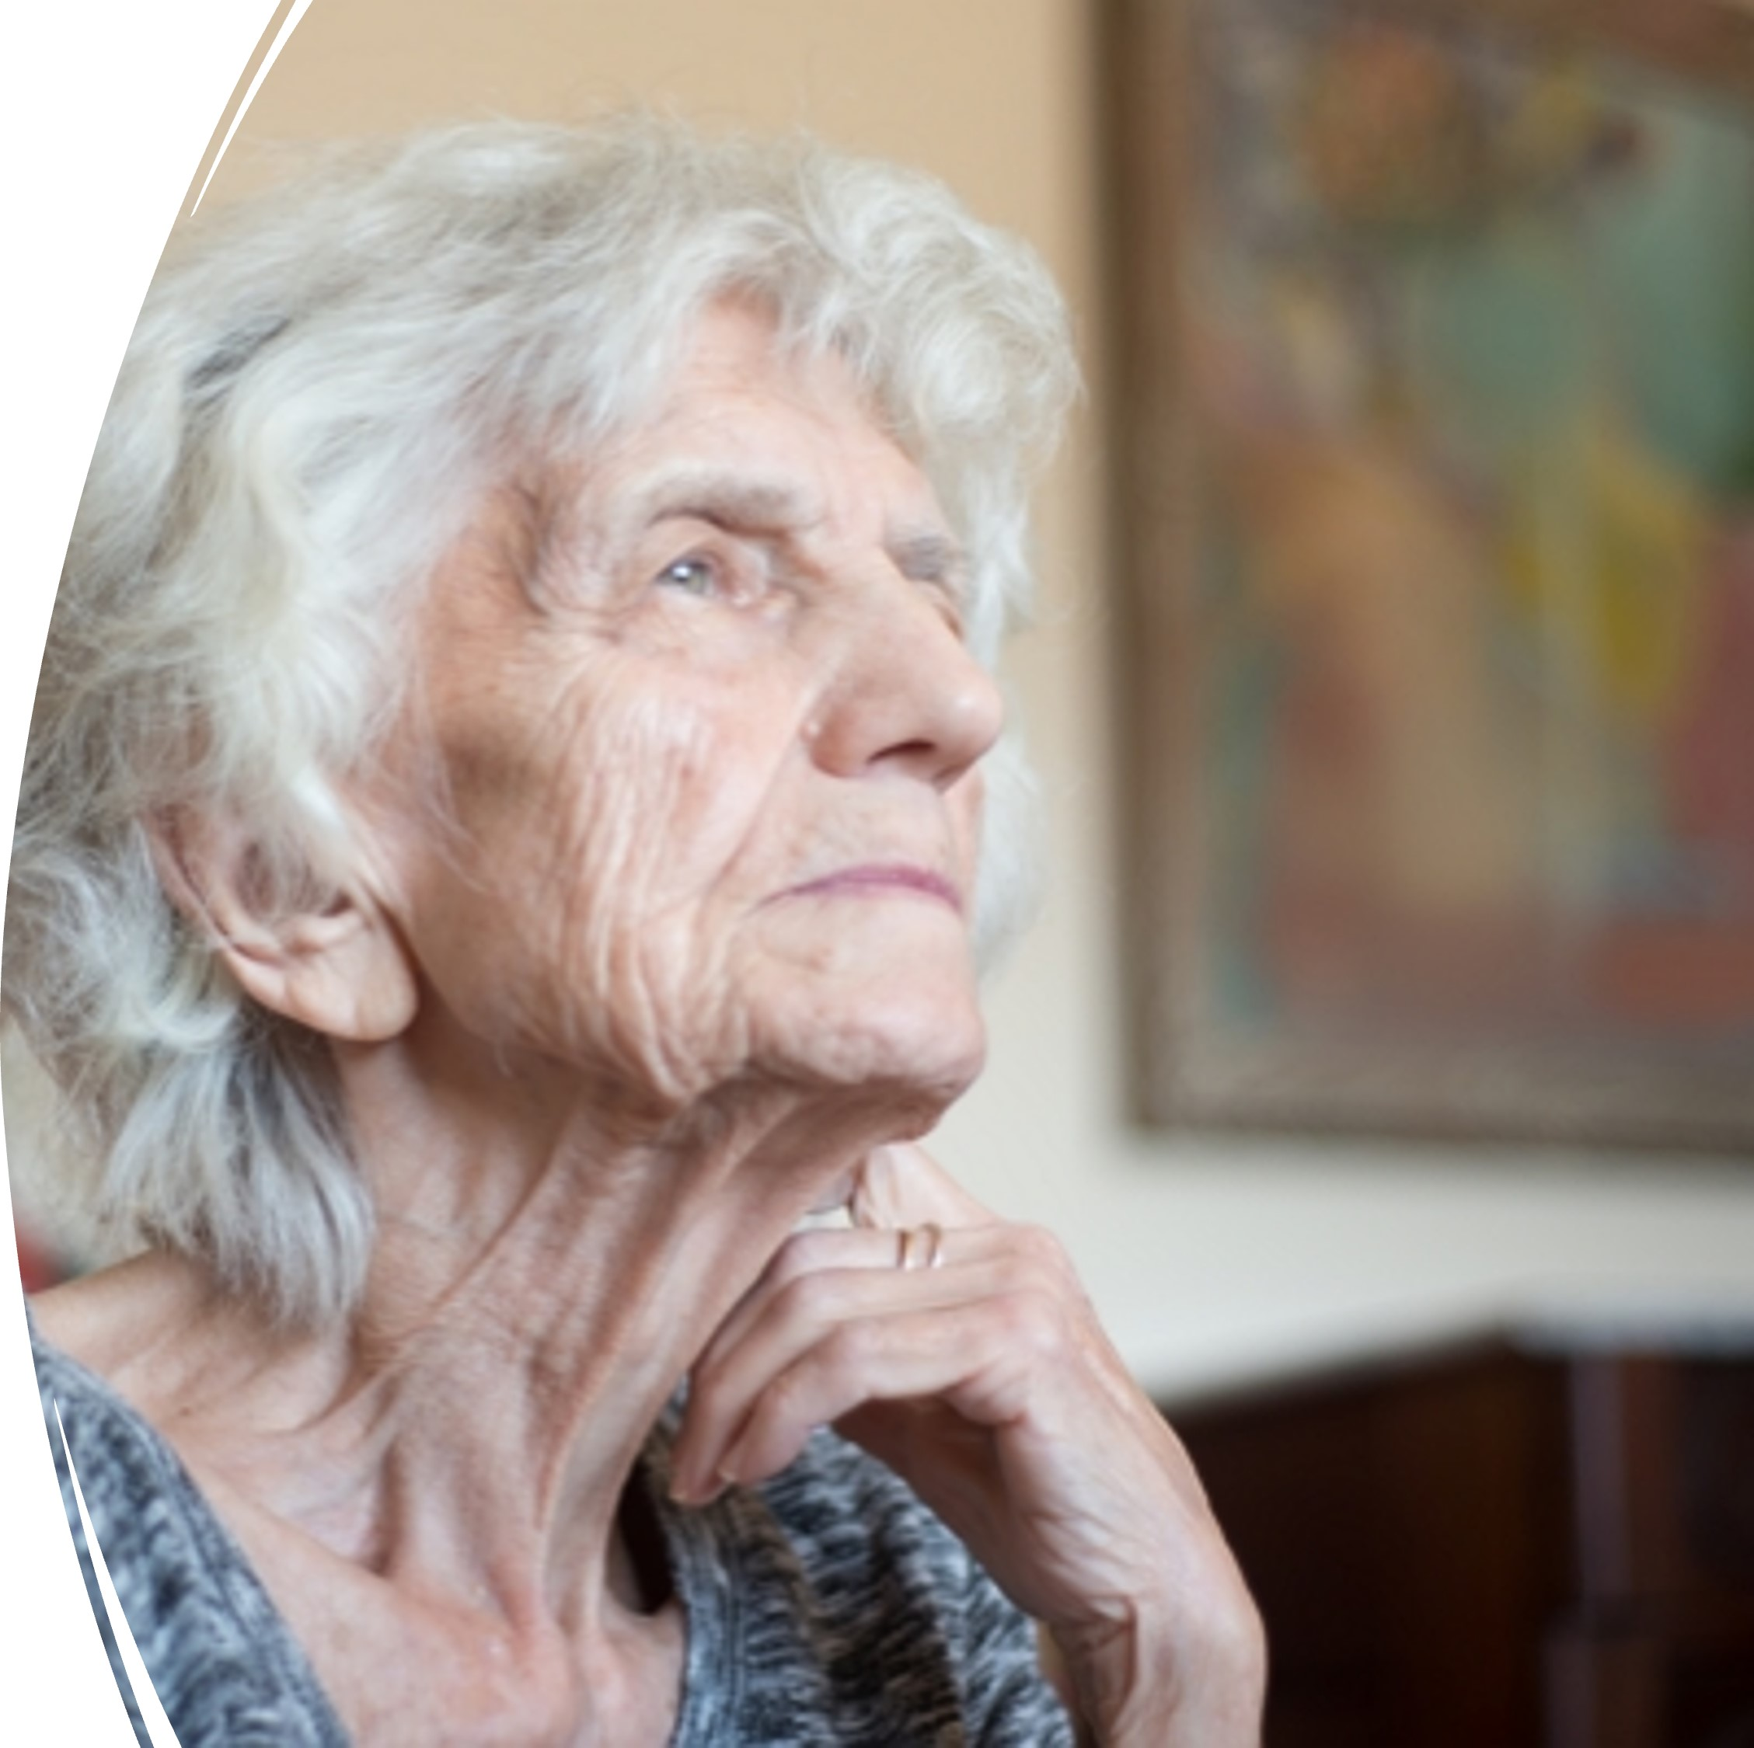
Understanding Dementia
Someone suffering from dementia may sometimes feel confused, frustrated and frightened.
A common symptom is short-term memory loss - the individual finds it difficult to remember recent events or conversations.
This can lead to them repeating stories or asking the same question over and over again.
Notes:
The experience of living with dementia is also affected by other people's attitudes and views. Although a dementia sufferer may have problems remembering things, they still have emotions. They can sense when someone is angry with them and they can feel hurt when this anger is taken out on them.
“If people view living with dementia as a constant loss of abilities... ...that there is nothing that can be done to support that person... then the person living with dementia will most likely experience feelings of ill-being... that can then contribute to a negative experience of living with the condition.”

Slide 14
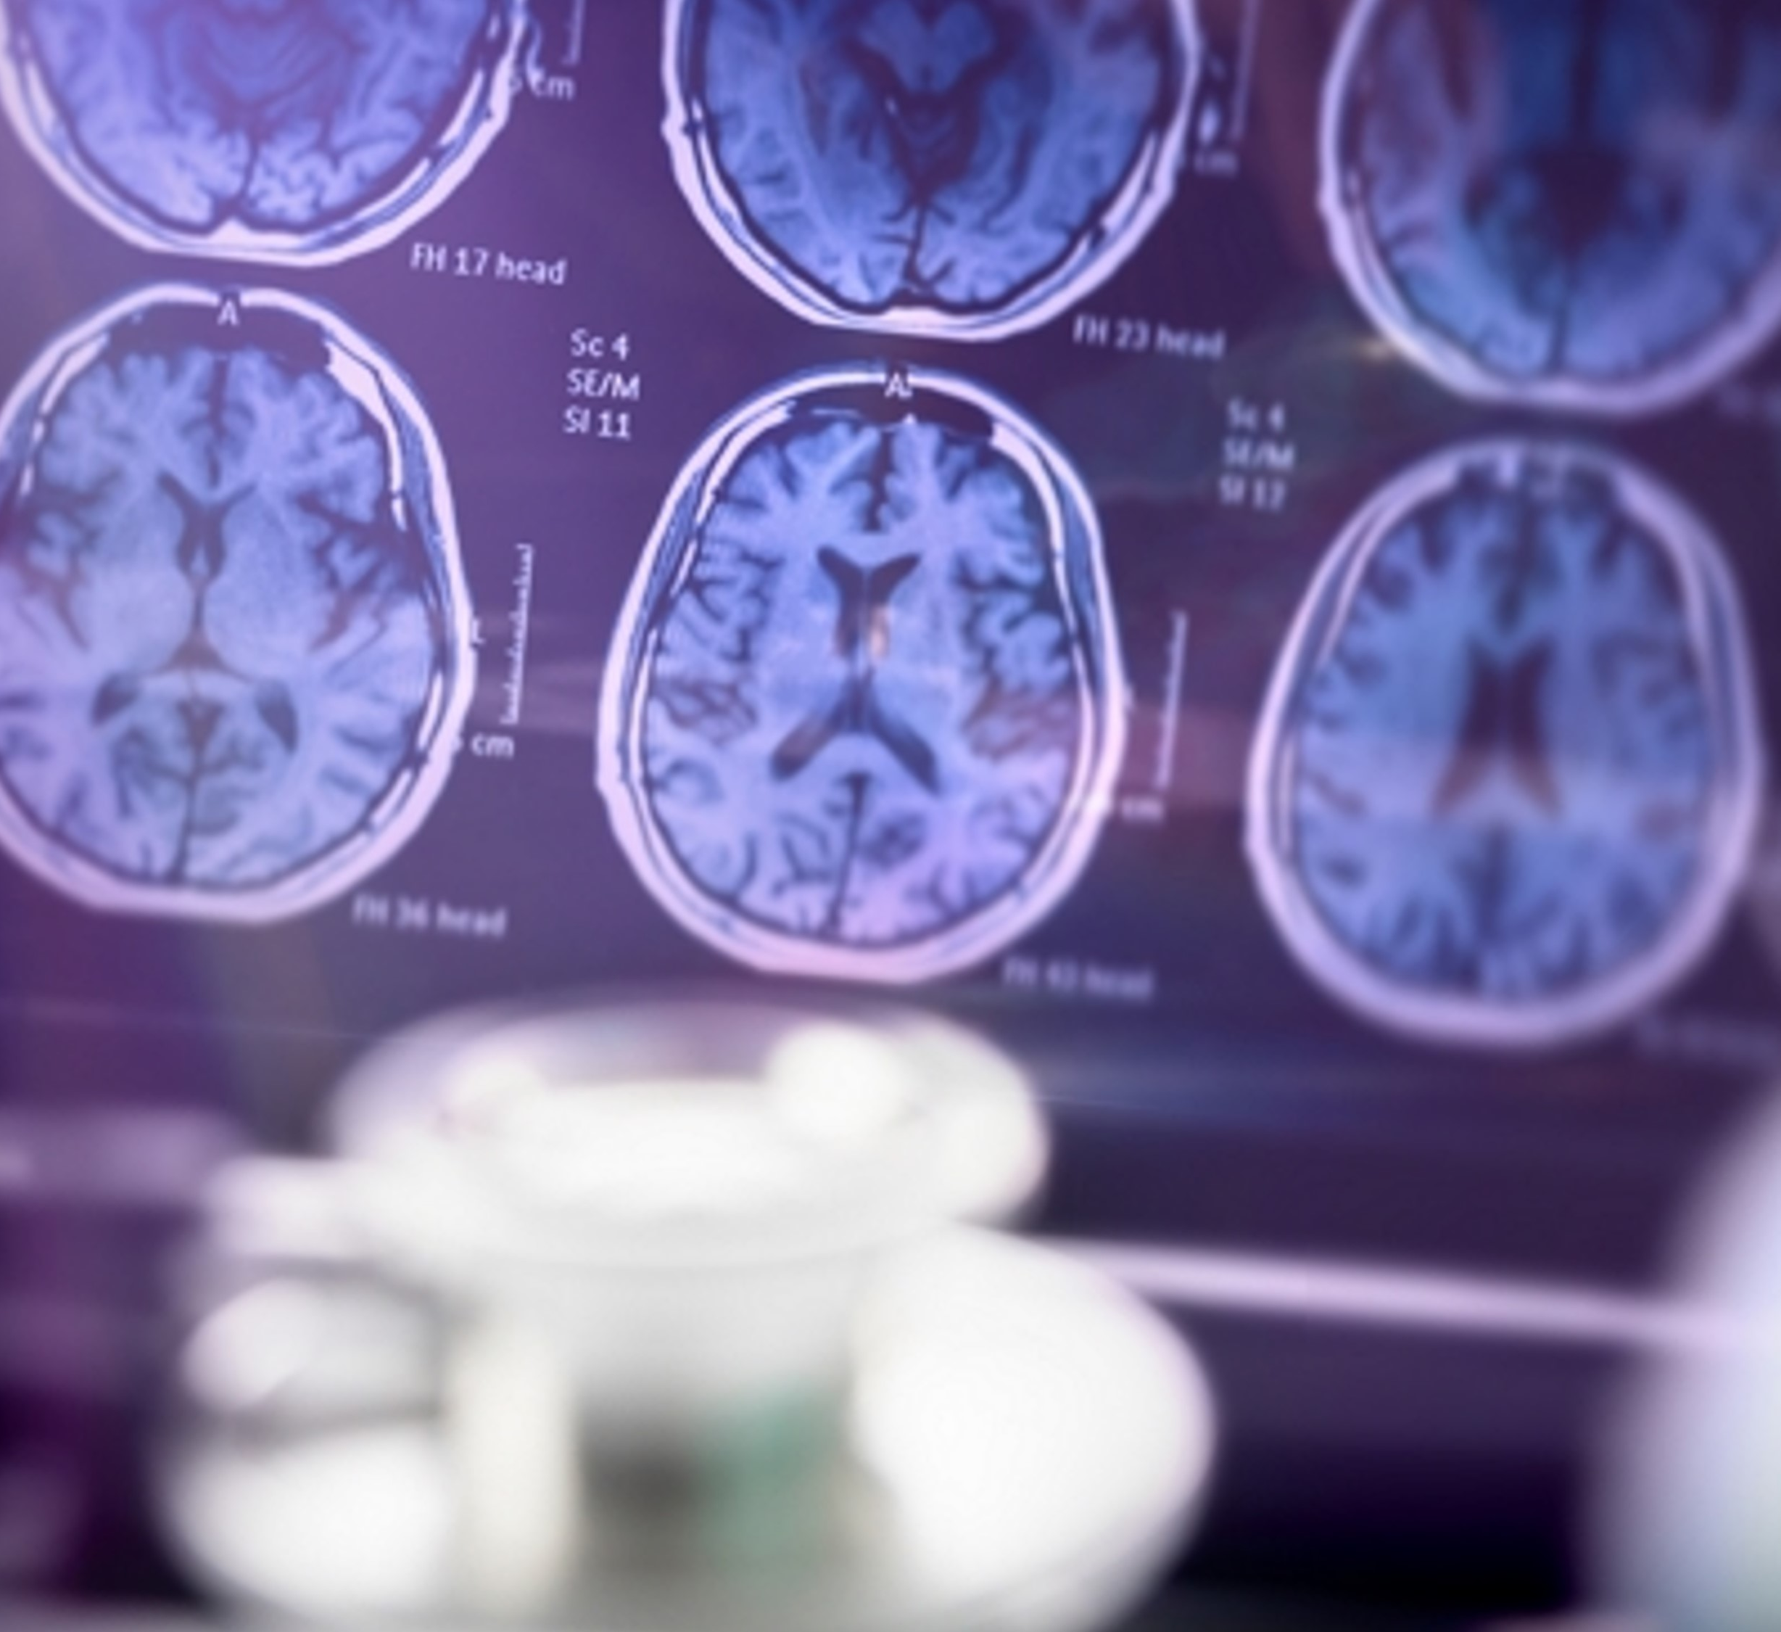
Causes of Dementia
There are many types of dementia and many different causes.
The two most common types are Alzheimer’s disease and vascular dementia.
Alzheimer's is caused by a bad protein developing in the brain. This causes damage to brain cells and their connections. No one yet fully understands why this happens and why it affects some people and not others.
Vascular dementia is caused by oxygen failing to get to the brain cells as a result of problems with the blood supply (the vascular system).

Slide 15
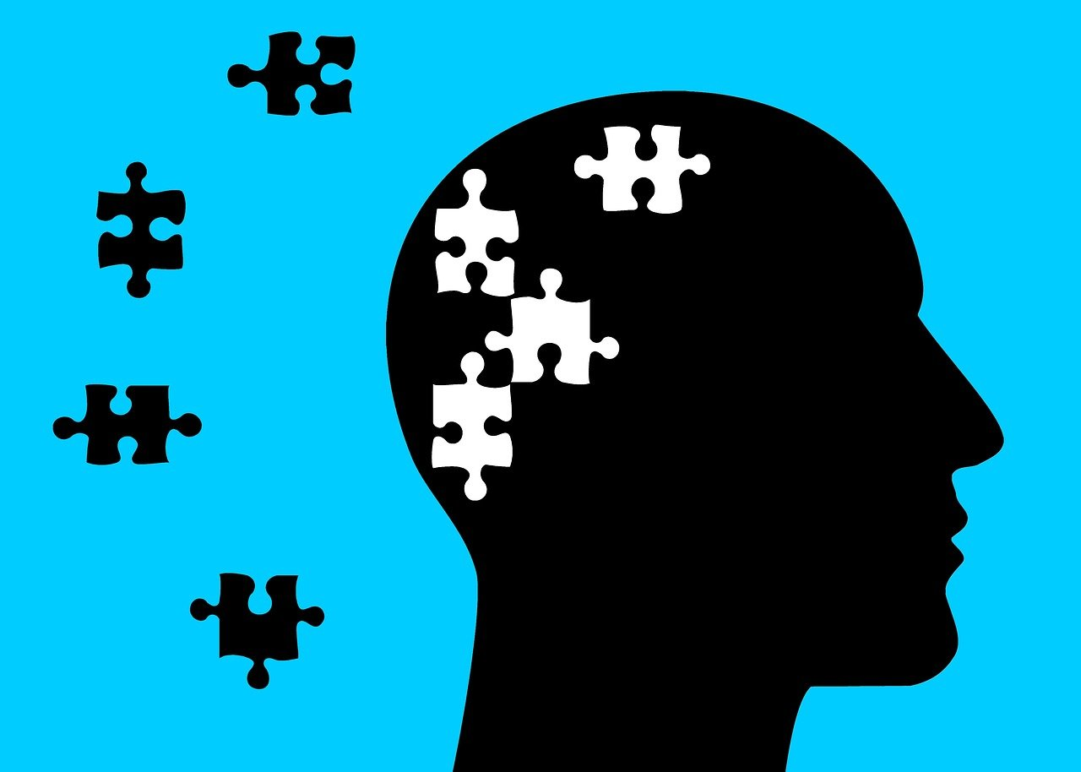
Symptoms
Dementia is often thought to be a condition that only affects older people; however, dementia can affect anyone at any age. Individuals with learning disabilities are more likely to experience dementia at an early age.
Although the symptoms of each type of dementia are different, all types of dementia are progressive.
This means that individuals experience a gradual decline in their thinking, processing and remembering skills.
How gradual and how serious this is varies in each individual and will be affected by the care and support they have.

Slide 16

Learning Disabilities
A learning disability is a result of brain development being affected before birth, during birth or in a person's childhood.
An individual with a learning disability may have difficulty understanding information, learning new skills, communicating and living independently.
The experience of living with a learning disability varies depending on whether it is mild, moderate or severe.
People with a mild learning disability may only need a little support to be independent while someone with a severe learning disability may not be able to communicate verbally and may need constant specialist support.
Individuals may have other physical and sensory conditions alongside their learning disability and may have difficulty responding to feelings and emotions. They may express themselves in ways that others find difficult to understand which can in turn affect how others see and respond to them. In most cases living with a learning disability will have a lifelong impact but this will vary depending on the type of learning disability.
Unlike someone with a physical disability, you cannot always tell who has a learning disability just by looking at them.

Slide 17
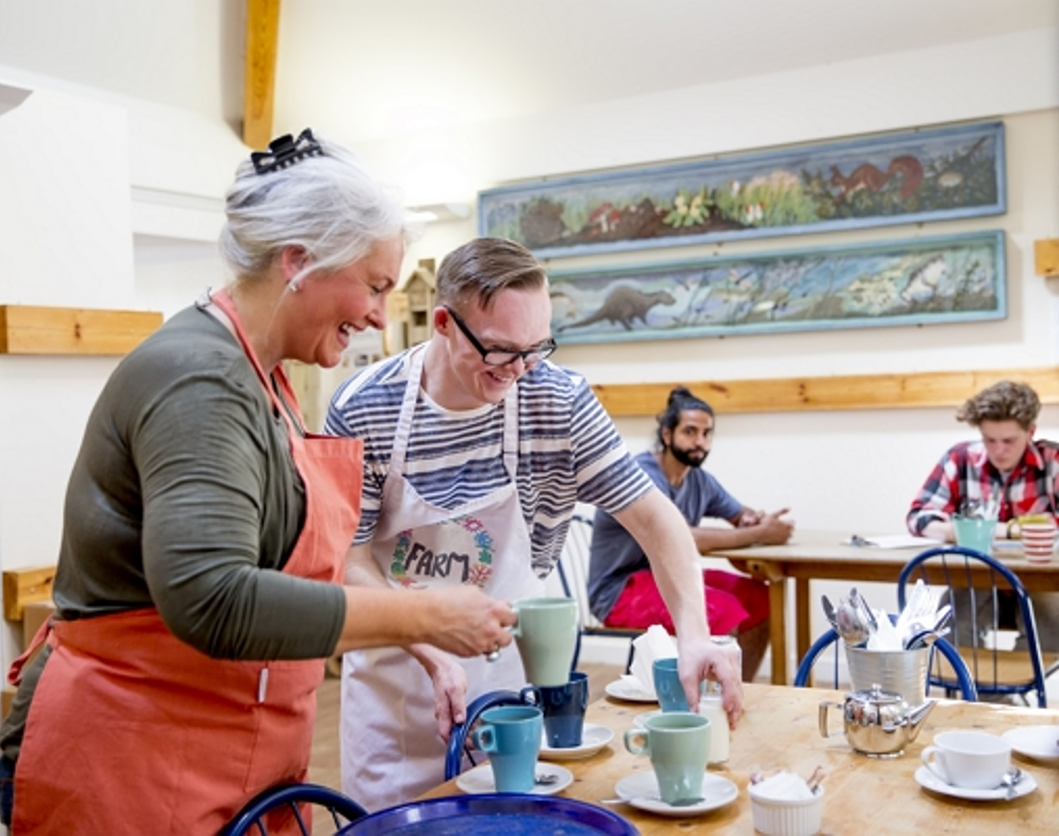
Causes OF Learning Disabilities
Learning disabilities can result from a number of causes, but the particular cause in any given person is not always known. Causes can include:
Genetic conditions such as trisomy 21 which happens as a result of an extra chromosome. This leads to impairments in both cognitive ability and physical growth that range from mild to moderate developmental disabilities
Complications during birth which can lead to lack of oxygen which impedes the baby's development
Illness or injury in childhood which has affected the brain, such as meningitis

Slide 18
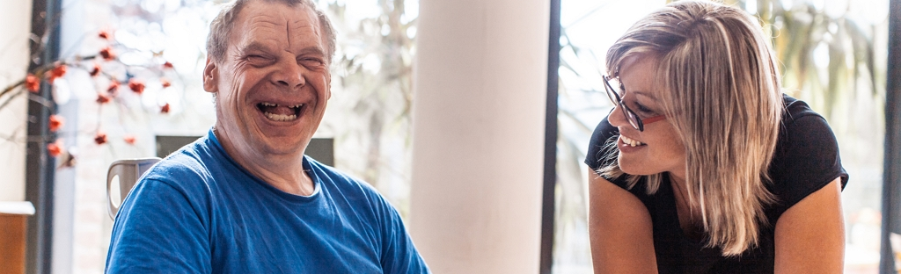
Promoting Positive Attitudes
This can create feelings of loneliness or being left out in society.
It is important that you demonstrate a positive attitude towards all those living with mental health needs, dementia and learning disabilities. You can do this by :
Helping reduce the stigma by making sure individuals are not isolated in social situations
Identifying and building on an individual's skills and abilities
Providing opportunities for individuals to feel empowered and in control
There is a lot of stigma linked to living with a mental health need, dementia or learning disability.
Notes:
However, through focusing on the abilities and skills someone has, living with the condition can be positive and people can be supported to live well.

Slide 19
Reporting Concerns
Case study:
James is a 36-year-old man who has severe anxiety and depression. As a volunteer, you visit James twice a week to spend time with him and you often take him out to visit different places in the local area.
The past month, James has not wanted to leave the house and is refusing to go anywhere with you. When you talk to him, he tells you he no longer feels like he can go outside and prefers to stay in the house where he is safe. He hasn't left the house in 6 weeks.
James' mental health needs have clearly changed, and he may require more support. As a volunteer, you must contact your volunteer coordinator and explain your concerns. Your volunteer coordinator will then raise it with the appropriate authorities.
There may be situations in your role as a volunteer where you feel that an individual's needs are not being met.
As you have a duty of care to this individual, you must report your concerns to your volunteer coordinator.

Slide 20
Session Summary
KEY POINTS
Mental illness is common. One in four people in the United Kingdom is likely to experience a mental illness during their lifetime
Mental health problems include a diverse range of illnesses, symptoms and treatments
Mental illness is treatable. There is a wide variety of treatment options, the choice of which will depend on the type and severity of the illness and person's preference
Mental illness and physical illness are often linked
A wide variety of support services for individuals with mental health problems is available from the NHS, Social Services and the voluntary sector
All volunteers can help to support individuals with a mental health problem by ensuring that they treat the individual with respect, allow sufficient time, communicate clearly and seek help from their volunteer coordinator

Slide 21

Thank you!

Slide 22


The content of this training was developed by NHS England, E-Learning for Healthcare and has been adapted by Bradford Teaching Hospitals NHS Foundation Trust, to provide an accessible format, ensuring that all volunteers have the same basic learning when they start in their role.

