Slide 1
Navigating Change in Healthcare Volunteering
Presented by Maxine Moss-Black

Slide 2
The Healthcare Landscape is Evolving
- NHS England is going
- New NHS 10-Year Plan launching this Spring
- Change is constant in healthcare:
• Policy reforms
• Budget shifts
• Evolving patient needs
What is this going to mean to me, my team and our volunteers?

Slide 3
Why Change Matters for Volunteer Leads
Volunteers are a vital part of healthcare delivery
Change often begins with uncertainty
Navigating change effectively = protecting team wellbeing + ensuring service continuity
How do I acknowledged change with my team/ our volunteers?

Slide 4
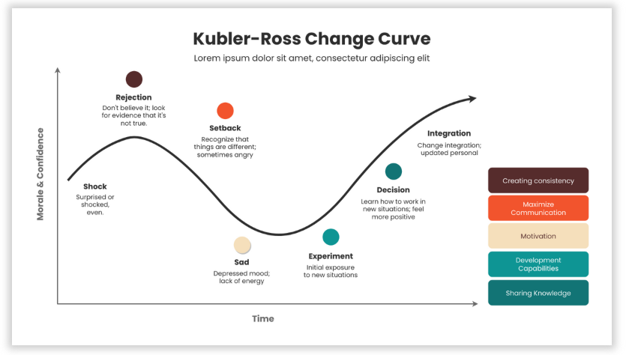
Understanding Change
Recognising and validating these stages is key to leadership!

Slide 5
Top 5 Tips for Managing Change
1. Communicate early, clearly, and honestly
2. Acknowledge emotions and uncertainty
3. Involve the team – get active
4. Provide support and resources – change!
5. Be kind to yourself

Slide 6
Tip 1 – Communicate Clearly and Often
- Be transparent, even when answers aren't clear
- Let staff and volunteers know it's okay to ask questions
- Share updates, even if there's “no update yet”
Key Principles:
- Use multiple channels: email, newsletters, meetings
- Encourage two-way feedback
- Build trust through honesty
What’s previously worked well for your team/ volunteers ?

Slide 7
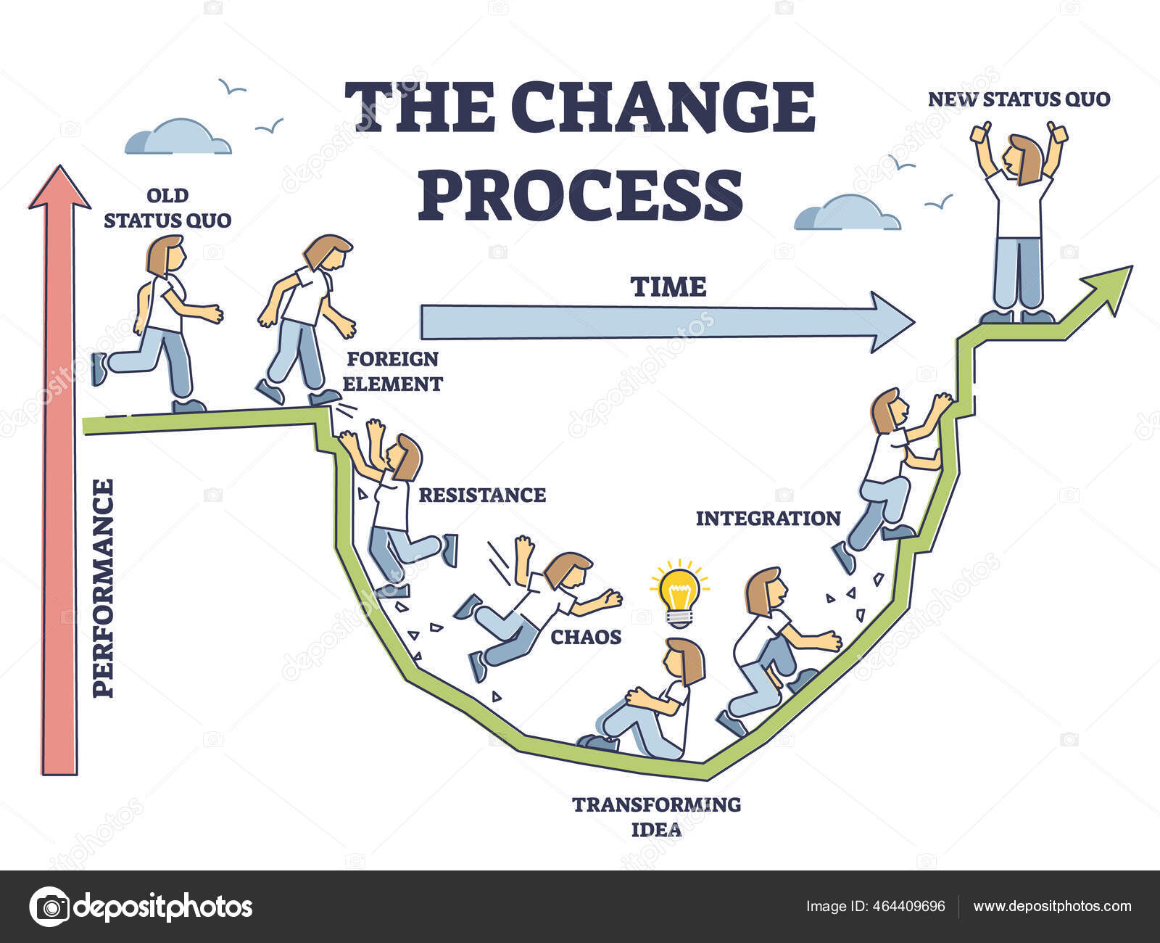
Tip 2 – Acknowledge Emotions
- Uncertainty = anxiety — that’s normal
- Don’t ignore it — address it upfront
- Create safe spaces for expression
- Validate feelings without being derailed by them
How do you make time to do this?

Slide 8
Tip 3 – Involve the Team and get active
- Involvement builds ownership and commitment
- Invite ideas and perspectives from all levels
- Where possible, allow teams to shape solutions
- Trust in your team’s expertise and creativity
What does involvement look like in your team?

Slide 9
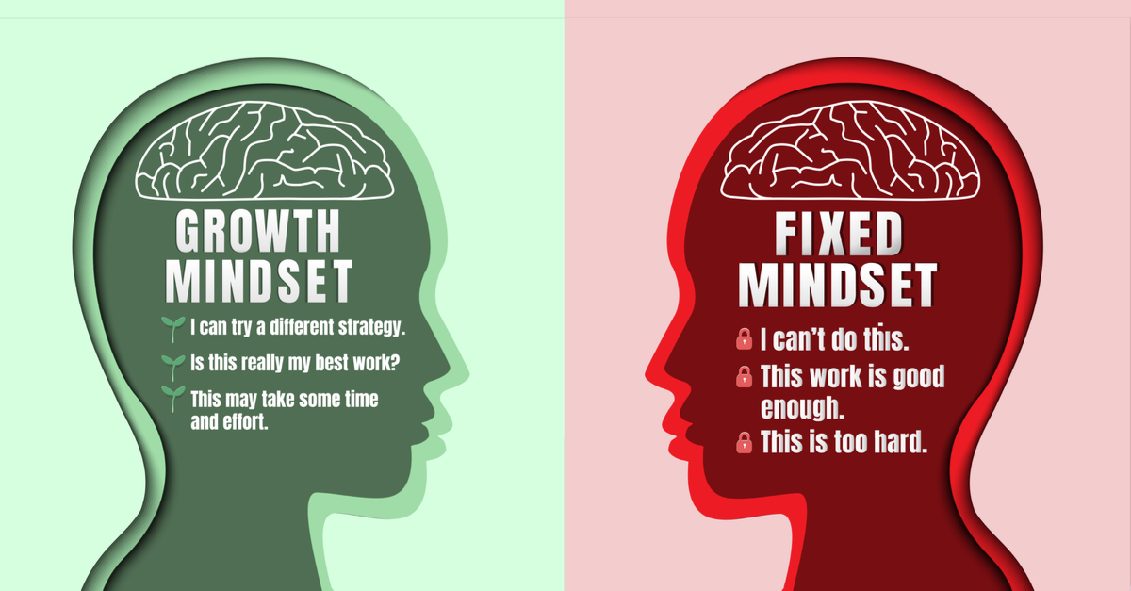
Tip 4 – Provide Support & Resources – change!
- Adopt a growth mindset
- Upskill staff and volunteers for emerging roles
- Offer:
• Coaching
• Mentoring
• Peer support
- Understand: Productivity may dip—and that’s okay
Do you have a fixed or growth mindset?

Slide 10
Tip 5 – Be Kind to Yourself
- Volunteering leads wear many hats
- Don’t forget your emotional wellbeing
- Talk to someone who listens
- Connect with peers who understand
- Helpforce online community: a place for connection and support
What does ‘be kind to yourself’ mean to you?

Slide 11
Conclusion
Lead with Compassion and Confidence
- Change is challenging—but also a chance to grow
- Embrace:
• Open communication
• Empathy
• Flexibility
• Shared purpose
In times of change, what sort of a leader are you ?

Slide 12
Final Thought

