Slide 1
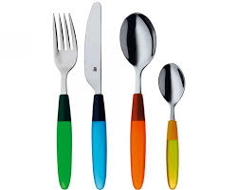
Dining Companions Training
Helen Christmas – Dietitian
Naomi Sirkett – Speech and Language Therapist

Slide 2
Training Process
Presentation
Practical training
Competency assessment form – your responsibility
Ward induction
3 assessments with 3 different patients
Competencies signed off by Registered Nurse
Further assessments can be requested if needed

Slide 3
Structure of Training
What to expect, types of patients, the hospital environment, food and drink facts
On the ward
Preparing the patient
Assisting with the mealtime and feeding
After the mealtime

Slide 4
Hospital wards
Acute Neurology Unit (ANU) - Neurological investigations
Acute Stroke Unit (ASU / B4) - New stroke patients
Hyper Acute Stroke Unit (HASU / B3) - New stroke patients
L3 - Elderly care
L5 - Elderly care / Parkinson’s disease
B6 - Orthopaedic / dementia – e.g. falls leading to fractures
Notes:
Description of the types of patients on each ward – what to expect

Slide 5
Types of Patients - what to expect
Mental difficulties
Thinking skills, memory, planning, paying attention, delayed responses, dementia, confusion, changes to behaviour
Physical difficulties
General body weakness, one-sided weakness, fine motor skills, slow movement,
has to stay in bed, positioning, uncontrolled movements, balance
Communication struggles
Understanding, talking, reading, writing, voice
Reduced senses
Hearing, vision, taste, smell, touch
Notes:
Description of the types of patients on each ward – what to expect

Slide 6
Communication Difficulties
What types of communication difficulties might you find on the wards?
Hearing / vision
Language difficulties
Speech difficulties
Attention and thinking difficulties
Notes:
Description of the types of patients on each ward – what to expect

Slide 7
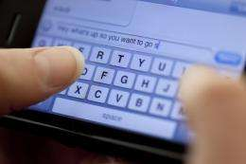
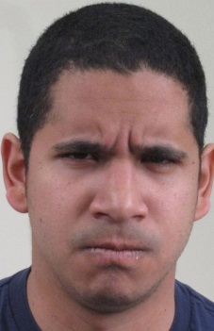
eye contact
body language
talking
gesture
How do we communicate?
social media
typing / texting
facial
expression
reading & writing
understanding
Notes:
How do we communicate
Use many different methods
Diffs can occur at with any one of these methods
IF YOU COULDN’T DO THESE THINGS HOW WOULD IT IMPACT ON YOUR LIFE?
Communication is required for so much in our day to day lives.
Not only do we need communication for work, we need it to maintain relationships and socialise.
For instance, imagine attempting to text or call a friend to meet up for lunch, if you are unable to spell and have difficulties constructing sentences and articulating? What for you and I is something that can take 5 mins with no thought, can e a very traumatic and daunting experience for somebody with communication difficulties.
Being here, listening to us and reading these slides, require excellent communication skills
Campaigning- gesture to emphasis points, eye contact, body language, facial expression for canvasing, access social media using reading and writing to promote self
Less effective at job
Communication difficulties can lead to increased crime, unemployment, mental health issues e.g. depression, increased vulnerability
E.g. More than 60% of young offenders can have difficulties with speech, language or communication.
Bryan K, Freer J, Furlong C. Language and communication difficulties in juvenile offenders. International Journal of Language and Communication Disorders 2007; 42, 505-520.

Slide 8
Talking to Patients
Try and make eye contact
Smile with open body language
Clear speech – possible hearing / understanding difficulties
Introduce yourself / why you are there
Check vision and hearing – glasses / hearing aids
Find out what name they like to be called
Check how they are
Check for a hospital passport / bedside board for ideas for conversation topics
Find a topic interesting to both of you
Notes:
Description of the types of patients on each ward – what to expect

Slide 9
Ideas for Conversations
Visitors?
Where are they from?
Food and drinks?
Books / newspaper
Any family?
Music / TV
Children / grandchildren
Favourite places

Slide 10
Unclear speech – how to help?
Posture – sitting upright
Short sentences
Slow down
Say one word at a time
Break words up
Let them know their speech is unclear
Can they repeat clearer?
Different ways to communicate – writing / pointing / spelling
Consider environmental factors – noise / TV / radio
Notes:
Description of the types of patients on each ward – what to expect

Slide 11
Difficulties talking – how to help?
Can the person use other ways to communicate?
Acknowledge the difficulty
Ask simple yes/no questions,
e.g. do you want help?
Give multiple choices
e.g. do you want tea or coffee?
Notes:
Description of the types of patients on each ward – what to expect

Slide 12
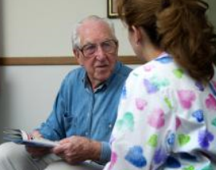
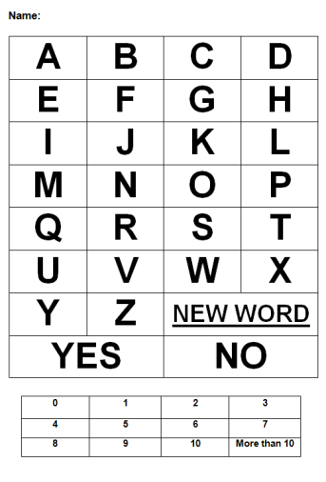
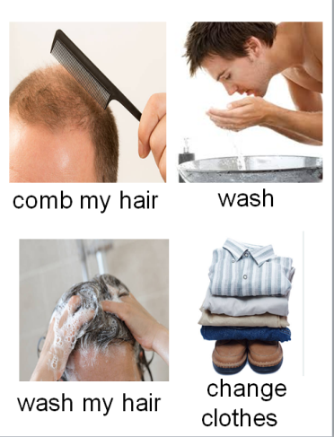
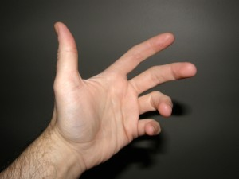
Try other ways to communicate other than talking
speaking
strategies
facial expressions
spelling words
Communication Ideas
pointing to objects or pictures
writing
drawing
Look for personal information in passports
hand gesture
Notes:
Person unable to understand

Slide 13
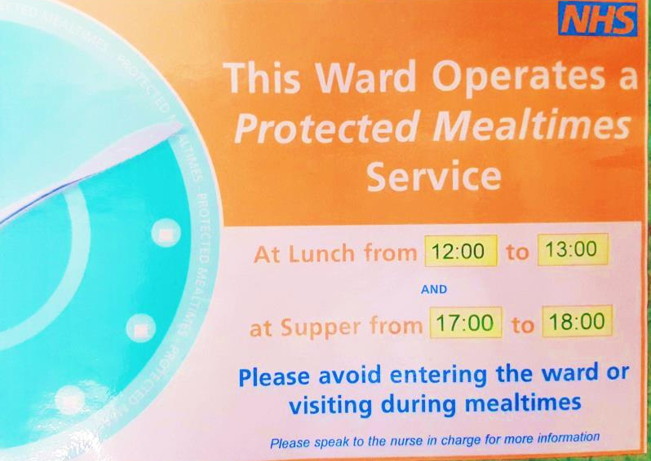
Protected Mealtimes
Ensures patients are able to eat their meals in peace
Staff who are not nurses leave the ward / patients
Times of meals on posters at entrance to ward
Improves the patients' mealtimes
Notes:
Description of the types of patients on each ward – what to expect

Slide 14
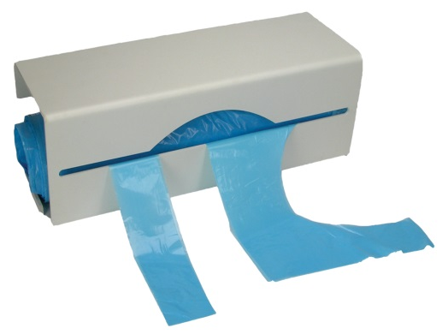
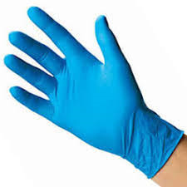
Hygiene Awareness
Hand washing before assisting patients
Bare below the elbows
– remove watches /roll up long sleeves
Long hair tied back
Blue aprons and gloves for assisting patients
Notes:
Description of the types of patients on each ward – what to expect

Slide 15
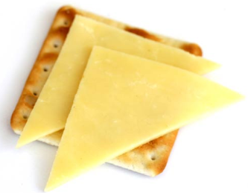
Importance of Nutrition
Poor nutrition in hospital leads to:
Good nutrition whilst unwell looks like:
Medicines and surgery not working so well
Poorer healing
Longer stay in hospital
Feeling low
Less energy
Staying in bed more
Small frequent meals
More high fat/high sugar items
Milky drinks
Snacks between meals
Using nutritional supplements

Slide 16
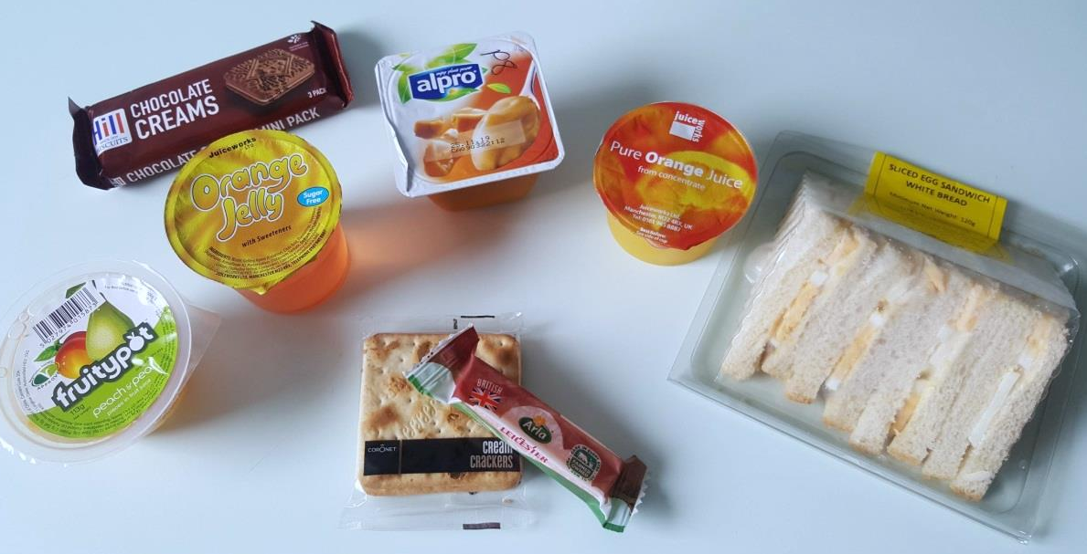
Snacks available

Slide 17
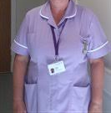
Arriving To The Ward
Nursing staff should be aware you’re volunteering
Find out which patient you’ll be supporting
Introduce self – allocated Nurse / Housekeeper
Sign in – yellow folder
Staff
Nurse
Senior
Nurse
Support
Worker
Trainee Nurse Associate
Housekeeper
Domestic
Staff

Slide 18
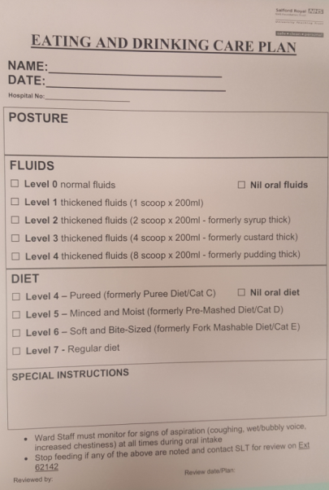
Eating and Drinking – Choice and Restrictions
Check with Nurse, Support Worker or Housekeeper
Level of support needed – red tray, companionship, assisting, feeding
Personal / cultural / dietary choices - Vegetarian, Vegan, Halal, Kosher, cutlery e.g. plastic / teaspoon, likes and dislikes
Fluid restrictions – is there a limit how much the patient should drink?
Dietetic plan - maximise calories, encouraging drinking, snacks,
pudding first
S.A.L.T advice for swallowing difficulties
- Modified diet or fluids, check pink sheet,
bedside magnets, kitchen board

Slide 19
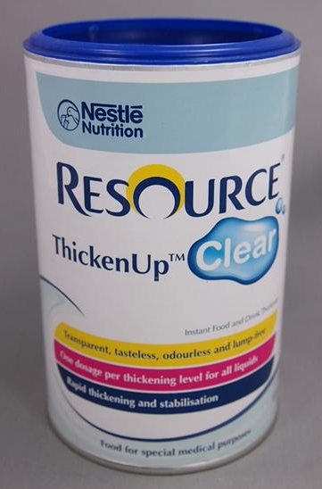
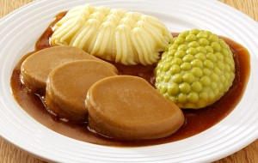
Modified Diet and Fluids
Changes to the consistencies of food and drink
Recommended by Speech and Language Therapists
Can help patients with eating, drinking and swallowing difficulties
Modified fluids - use of thickener in drinks
Modified diet - making food blended, mashed or soft to make it easier to chew and swallow

Slide 20
Does the patient need thickened drinks?
Different consistencies - Levels 1, 2 and 3
Check the pink sheets
Nursing staff will make the drinks
Avoid jelly or ice cream
– can melt to thin liquid
STOP, ASK AND CHECK

Slide 21
STOP, ASK AND CHECK
Puree – smooth and moist
Soft and mashed – small lumps
Check the
Pink Sheets
Level 4
Level 5
Soft – small chopped chunks
Level 6

Slide 22
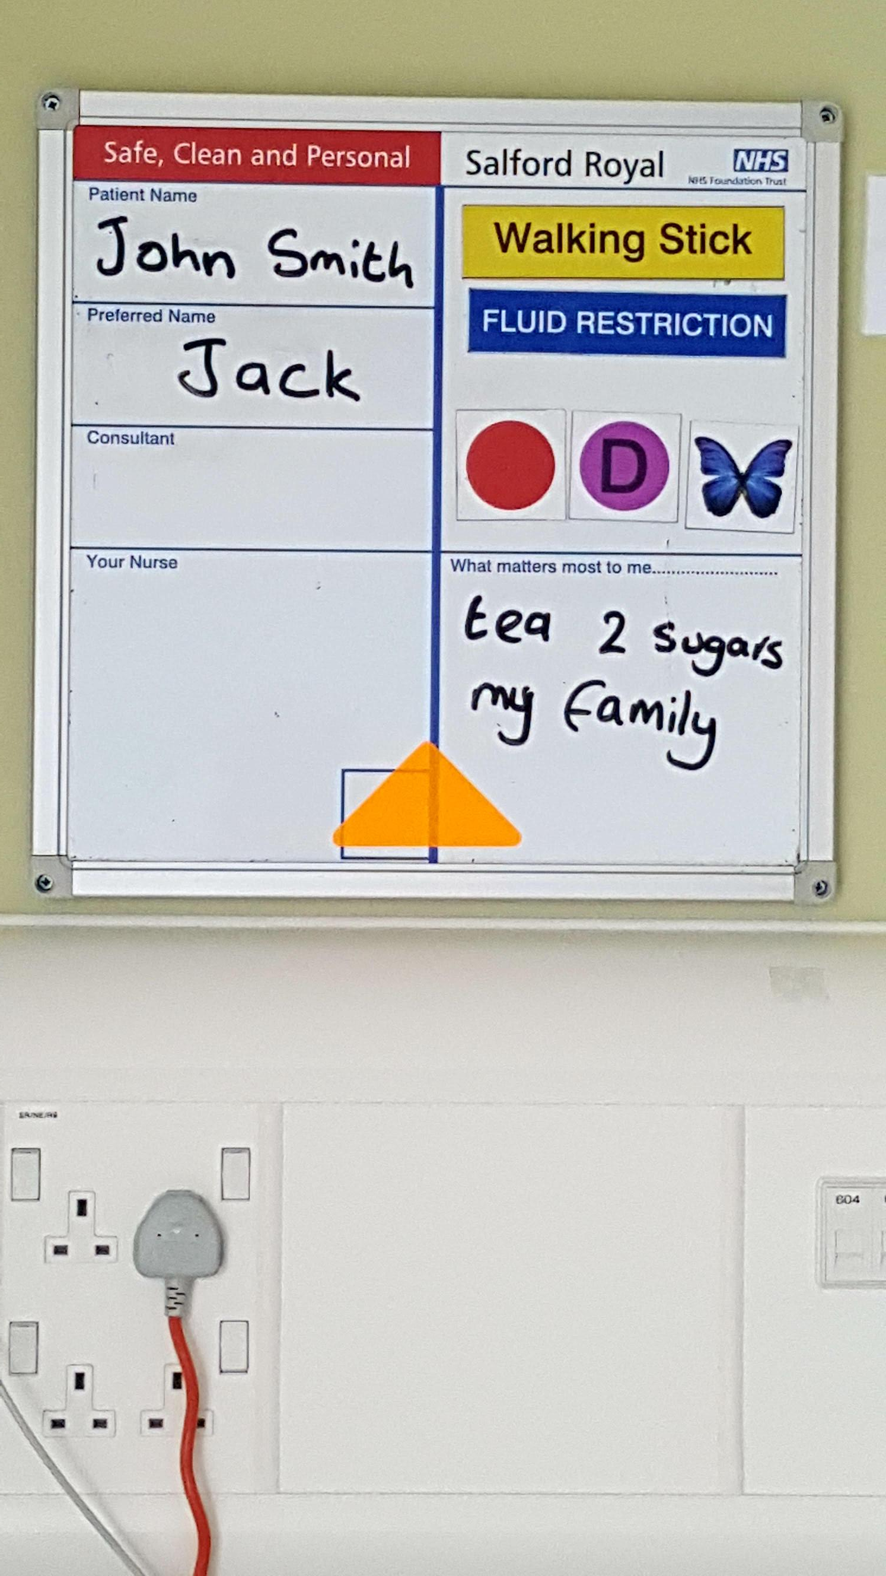
Bedside Boards What to look out for…
preferred name
diabetes
falls risk
Cognitive impairment / dementia
infection
any preferences?
STOP, ASK AND CHECK

Slide 23
Meeting the Patient
Introduce yourself – get consent to support them
Check the following with the patient or nurse:
- alertness
- what the patient would like you to call them
- bedside board and magnets
- hearing aids / glasses / dentures – do they want to wear them?
- communication or swallowing difficulties – do you need to know any advice?
- Position in bed or chair – sat upright facing forward / in chair / able to use arms or hands?
- Are they comfy? - Need the toilet?
- personal hygiene – hands cleaning / wearing an apron / mouth / yourself
- appetite / food and drink preferences – check what you’ve been told
- what they would like assistance with
STOP, ASK AND CHECK
Notes:
Description of the types of patients on each ward – what to expect

Slide 24
Table Set Up
Ensure table is clear and uncluttered
Ensure correct cutlery / condiments available
Table positioning – height / over bed or in front of chair
Drink available – does it need to be thickened?
Notes:
Description of the types of patients on each ward – what to expect

Slide 25
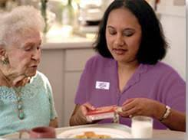
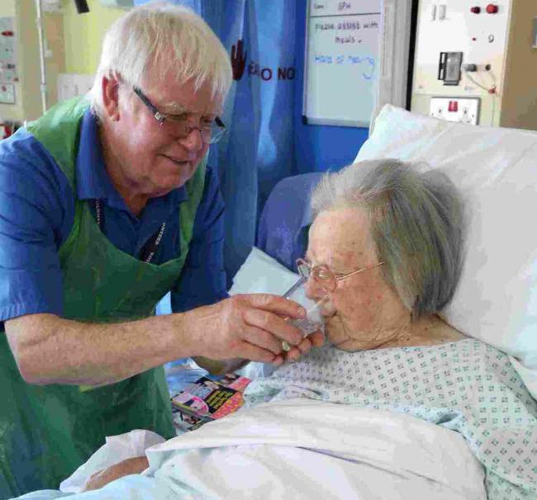
Mealtime Assistance
Different levels of assistance
Companionship
Cutting up food / opening packets
Role modelling
Prompting
Putting food on fork / spoon
Hand or arm guidance
Hand-over-hand
Feeding
Notes:
Description of the types of patients on each ward – what to expect

Slide 26
Mealtime Assistance - Preparation
Sit at the patient’s level – get a chair
Check the food they are given is what they want
Ask for alternatives if needed STOP, ASK AND CHECK
Check how they like to eat their meal
Think about what goes on each fork or spoon – is eating off a teaspoon easier? Order of courses, drinks before, after or in between, do they like to chat?
Show and tell them about the meal
What is it? - remind as needed if the patient has memory difficulties
What is on each fork / spoon?
Describe appearance, smell – be positive and encouraging
Notes:
Description of the types of patients on each ward – what to expect

Slide 27
Mealtime Assistance - Guiding
See how much the patient can do for themselves
Cut up food – bite sized pieces
Tell them about position of food on plate – turn as needed
Putting food on fork - what they would like to have next?
Arm / hand guidance of cup / cutlery to mouth
Prompting, encouraging and focusing attention
Reducing distractions
Helping prevent spillages – helping to wipe up as needed
Notes:
Description of the types of patients on each ward – what to expect

Slide 28
Mealtime Assistance - Feeding
Small amounts on fork / spoon at a time
Let the patient see what you are going to give them
Offer food to lips – is the temperature ok?
Give them enough time as needed to chew and swallow
Ask / check if their mouth is clear before giving more
Prompt to keep chewing if needed – offer an empty spoon to prompt swallow
Offer a drink every few mouthfuls if preferable
Look out for signs of eating, drinking and swallowing difficulties
Holding in mouth / food or drink spilling out mouth / coughing / throat clearing / choking / getting breathless / wet voice STOP, ASK AND CHECK
Notes:
Description of the types of patients on each ward – what to expect

Slide 29
Feeding Practice
Get into pairs
Have a go at feeding your partner and giving them a drink – then swap
2 tasks
Task 1 – the person being fed should slump to the side and close their eyes
Task 2 – try it again sitting upright and eyes open
Think about
- How does it feel being fed?
- Does it feel any different being slumped compared to being upright?
- Is there anything your partner could do to make the experience more pleasant?
Notes:
Description of the types of patients on each ward – what to expect

Slide 30
After the Mealtime
Ensure the patient’s hands and mouths are clean
Check if the patient needs the toilet
Check if the patient needs their mouth cleaning – any food debris?
Tell the nurse or support worker what the patient has eaten / drank
Write on the food / drink
record chart
Leave table clean and tidy
Snack or drink within reach
Notes:
Description of the types of patients on each ward – what to expect

Slide 31
After the Mealtime
Fill in who you assisted on the sign-in sheet in the yellow folder
Initials / bed number / hospital number
If you are able to stay after the mealtime:
Asking for things to do? - Be specific
- Who could I talk to?
- Would anyone like a chat?
Resource box in dayroom – books / memorabilia / soft toys / DVDs
Complete patient experience questionnaire – yellow folder
- Could you swap patients with another volunteer?
- Completed questionnaires in yellow box.
- Fill in form for patients who have had questionnaires / reason couldn’t complete
Notes:
Description of the types of patients on each ward – what to expect

Slide 32
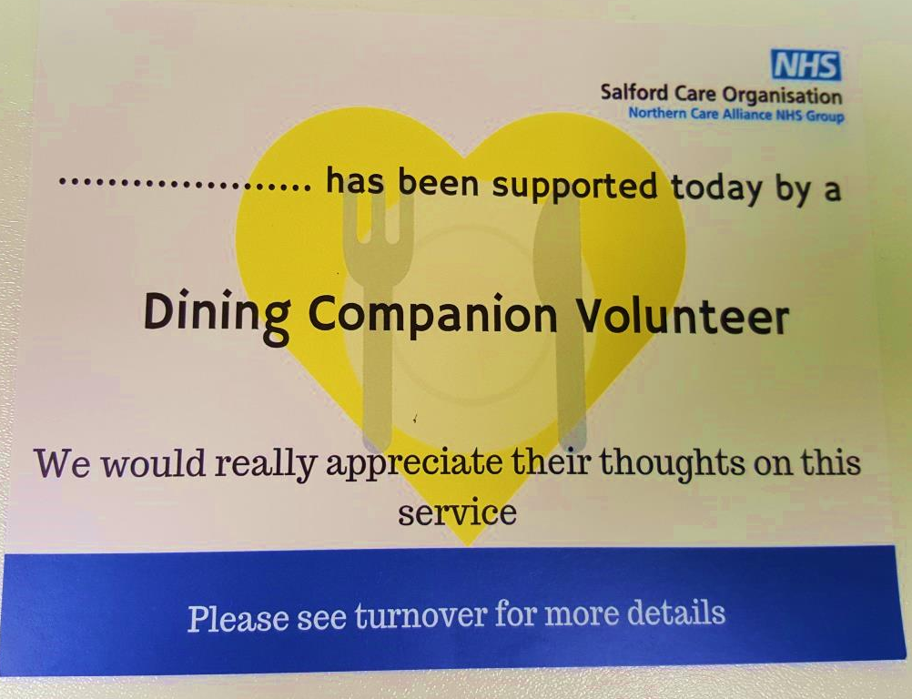
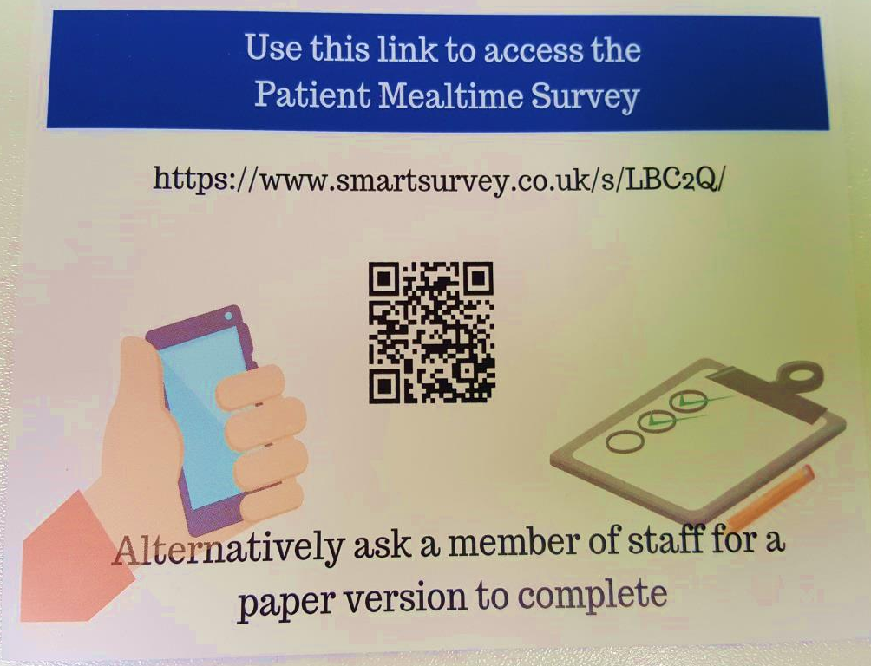
Leave a Calling Card
Notes:
Description of the types of patients on each ward – what to expect

Slide 33
E-Learning
Malnutrition and Swallowing E-Learning
www.paperweightarmband.org.uk/lms

Slide 34
Any Questions?
Contact Numbers:
Speech and Language Therapy: 0161 2065450
Dietetics: 0161 2065197
ANU: 0161 2064586
ASU: 0161 2064788
HASU: 0161 2061903
L3: 0161 2064014 / 2062179
L5: 0161 2061905
B6: 0161 2064574

