Slide 1
NHS Tayside Discharge Support Volunteer Role- Pilot
Notes:
Healthcare Improvement Scotland / Scottish Gov
NHST agreed to test intervention
Helpforce
Delay at outset – clinical pressures……….

Slide 2
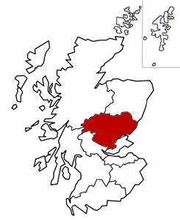
Notes:
Also have patients from North East Fife.
3 third sector areas and Health and Social Care partnerships/ local authorities –
lots of information to gather where people can be referred on to.
Have an information folder – and adding to it all the time
Put together quick reference guide.
Initially referrals for Dundee residents only but expanded that as the pilot progressed.
Were able to research what people needed and called them back.

Slide 3
Evaluation
Networking
Role Description
Safe
Effective
Person-centred
Staff awareness/
engagement
Risk assessment
Process
Local Steering Group
Volunteer Training
Notes:
Central point keep in mind throughout.
Role description was drafted – under review during the setting up process
Risk assessment of the role – identify training and process risks and how to manage them
Local steering group formed – clinical (SCN, discharge team/OT/ VSM/volunteer) – difficult to meet clinical staff
Process – beginning /middle/end also responsibilities and where they sit
Staff Awareness /engagement - could have been more – SCN to lead. Challenge on 2nd ward also – due to number of staff / shifts.
Networking – with local Third Sector Orgs/
Evaluation of the role – Helpforce / patient/staff/volunteers

Slide 4
Criteria for referral
Over 65 years old
Living in Dundee (expanded now)
May be anxious about returning home
May be worried about coping at home
May be at risk of loneliness and social isolation.

Slide 5
The Process
Ward staff tell patients about the service
Ward staff obtain signed consent from the patient
Patient keeps information sheet
Ward Staff complete referral form for Volunteer Team
Volunteers make the calls
Volunteer staff carry out post call evaluation
Notes:
Information sheet was handy tool for the patient to take home.
Reminder of service
Date and time of first call
Type of information the volunteers can provide more information about

Slide 6
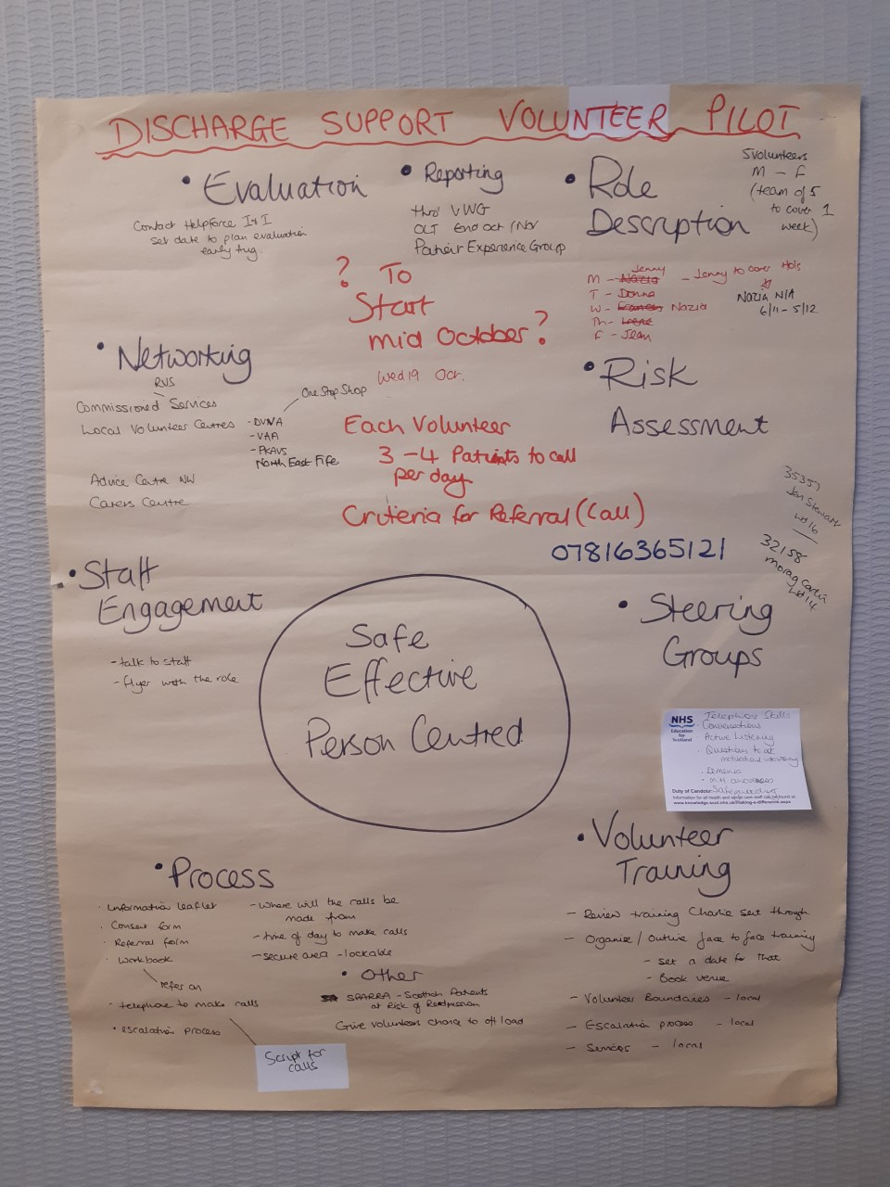
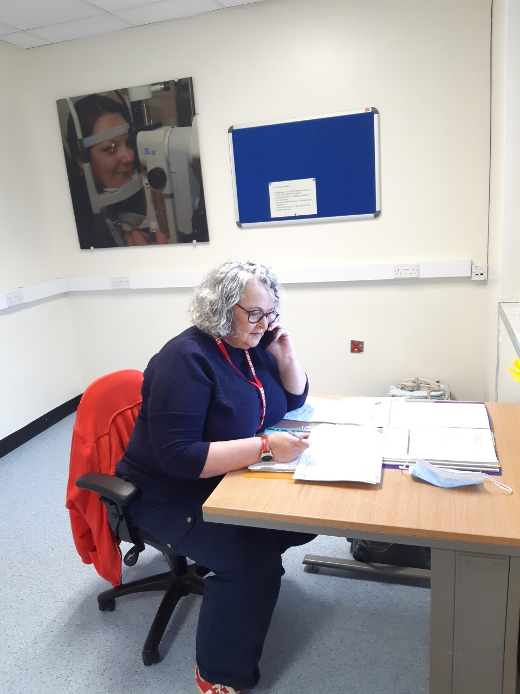
Notes:
Pilot began 19 October – 1 ward –Acute Medicine for the Elderly.
Referrals slow but steady but tailed off just before Christmas.
Break over Christmas and NY – added another ward – Short Stay Medicine.
Younger age group (70’s)- more open to offers of help.

Slide 7
Volunteer makes 5 calls – Monday to Friday. Calls from 10.30am
Key topics for calls
Wellbeing – how is the patient coping at home / do they have support
Practical issues – collecting medicines and
shopping
Any new health concerns – escalating as necessary
Community support – referring to local support services
Notes:
Volunteers record information on log sheet.
Volunteers need handover by volunteer team before shift and will give handover at end.
Volunteer team can suggest any services missed.
Patients encouraged to be independent.
Nok – will be called after 3 attempts to reach patient

Slide 8
116 calls made (as at 14/2/23)
80 days/16 weeks of the pilot
25 referrals for the calls
Calls between 2 min and 40 min
1 referral made x number of suggestions of support
Notes:
Suggestions have also been posted out to people.

Slide 9
Feedback and Observations
Staff see the benefit of the service, hope to see less people back in hospital after discharge.
Staff found time to explain the service and complete the referral a barrier. Its not embedded into the service.
Staff finding it harder to get people home / families want loved ones to stay in hospital for longer
Calls to the younger age group were more receptive to offers of help and support.
Calls to that younger age group were longer.
Patients and carers positive about purpose of the calls.
Notes:
My observations and feedback from staff

Slide 10
It was so reassuring to have contact with the hospital after being discharged.
The volunteers were all so friendly and helpful when they called. Some good advice was shared.
Great referral service – our help with cleaning starts tomorrow
Good to hear you contact the next of kin if you can not contact the patient.
I loved getting the call in the morning and looked forward to the phone ringing. Sometimes it was the only person I spoke to during the day.
Notes:
Client feedback

Slide 11
Evidence of impact
Patients
Staff
90%
of patients agreed that volunteer support increased their confidence that their health concerns were heard and addressed
54%
increase in the number of staff who are confident patients can access community services that can support them
Families/carers
75% of family and carers strongly agreed / agreed that the volunteers increased their confidence in the quality of care provided to their loved ones
Notes:
Client feedback

