Slide 1
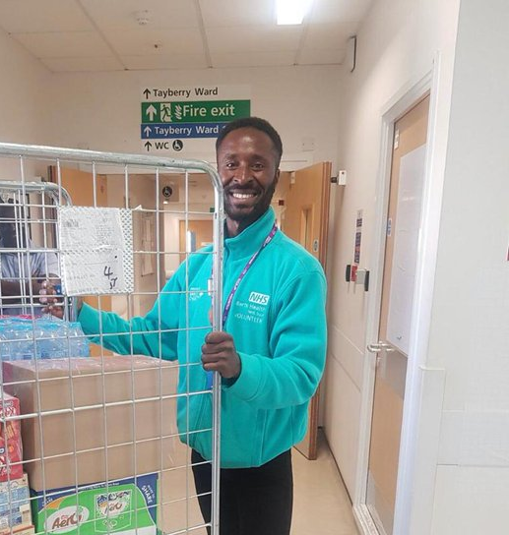
How to adopt a response model

Slide 2
What is Barts Health volunteering?
“Activity undertaken freely that involves spending time, unpaid, doing something that aims to benefit the environment or individuals or groups other than (or in addition to) close relatives”1
“A community of people who give their time to help improve safe and compassionate care across Barts Trust”
Notes:
Mention external drivers

Slide 3
Why do we have volunteers?
Three core aims:
Outcome for the patient
Outcome for the organisation
Outcome for the volunteer
Patient feels more supported or happier, less bored or anxious
Trust is able to provide care we can all be proud of
Volunteer develops skills and sense of achievement
Nursing staff on wards with volunteers are more likely to recommend their ward³
In Jan 2017 137 of 149 patients asked had had help from a volunteer²
Volunteers progress to paid work within Barts Health and wider NHS
“She [volunteer] was a ray of sunshine for me” Patient on ward 14E³
“As always, they have been complete magic!” Sister on Tayberry³
“Helping people while learning – truly fulfilling!” Patient Champion³ 14E

Slide 4
Meet and Greet
Spiritual Support
Support mealtimes
A&E Support
How do volunteers make a difference on the wards?
Collect TTOs
Support Maternity
Support Dementia patients
Support Children
Pets As Therapy
Befriend lonely patients
Charities
Assist with FFT
Museum
Trolley shop

Slide 5
Changing to a response model
The right volunteer in the right place at the right time
Volunteers often went to a ward and didn’t feel utilised
Sometimes the patients had visitors or were sleeping or didn’t want to talk
Clinicians didn’t work with the volunteers
Clinicians weren’t clear about how volunteers could help
Were we making an impact on Trust key agenda? - NO
Where could vols make the most impact?
How do we change the dialogue?
How could we make and improve the volunteering experience?
Training?
Communication?
Evaluation?
The problems
Questions we asked

Slide 6
Theory of Change Volunteer Model
Inputs
Ultimate goals
Intermediate outcomes
Critically examine how we can improve the productivity, impact and experience of volunteers across the Trust and services
Engage with senior manager and stakeholders to support and action the development of and change to a volunteer response model aligned with the Volunteer Strategy key objective –”The right volunteer in the right place at the right time
Patients
Holistic needs met
Reduce length of stay
Patients
Improved patient experience
Prevent discharge delays
Staff
Releasing staff time to care
Improved staff well-being
Happy Patients= Happy Staff and vice versa
Perfect ward improved or achieved
Staff
Staff have a clearer understanding of how volunteers can support them
A clearer way to request and access volunteer resource and help
Supporting staff to provide improved patient care and experience
Volunteers
Utilised more efficiently and impactfully
An improved volunteering experience, training and employment opportunities
Valued more
Activities
Volunteers
Volunteers have a more varied and meaningful role and feel they are more impactful
Are included in the coproduction and development of their role and support for services and patients
Design a flexible role for volunteers based on key internal QI drivers and business intelligence
Create a pathway for staff to contact and request volunteers
Comprehensive flexible training package
Communication plan
Trusts
Improve quality of patient & staff experience
Improved productivity and quality of services e.g reduced discharge delays
Financial savings - ROI
Volunteers embedded in QI
Community engagement
Trusts
Create a flexible volunteer resource in line with business continuity and planning
Volunteer aligned with QI objectives and outcomes

Slide 7
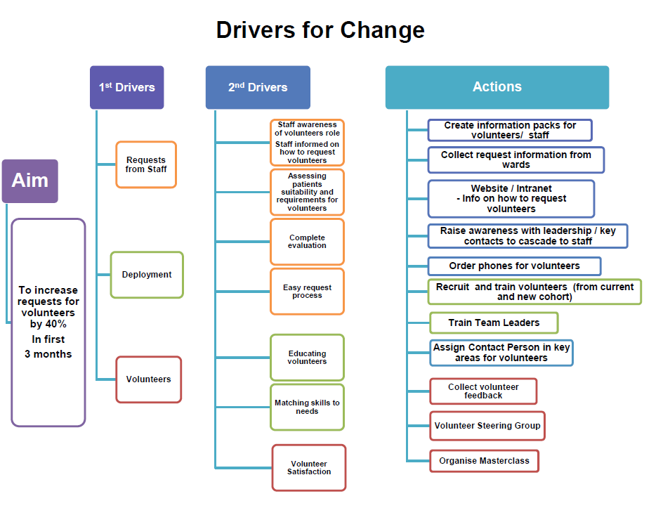
The Process
PDSA

Slide 8
Active Responders
Key areas of “pinch points” and Challenge non-Clinical role creation
Pick up a TTOs
Support during mealtimes
Take patients out for walks
Befriend, chat and listen to lonely patients
Assist patient with smooth running of discharge
Provide emotional support to anxious patients
End of Life Care
Emergency Department

Slide 9
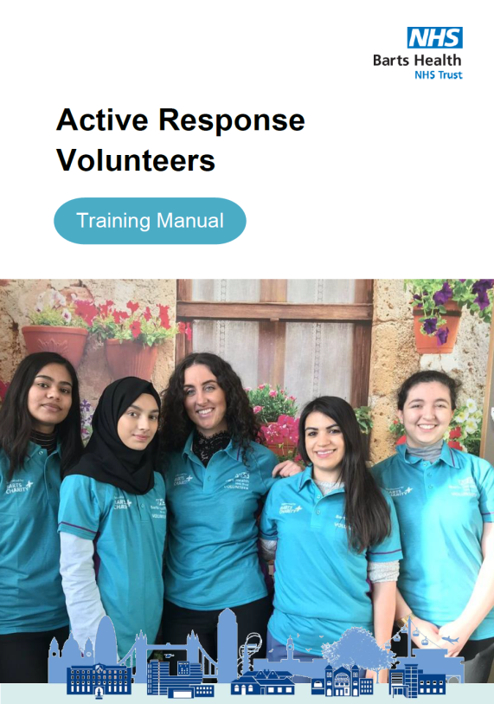
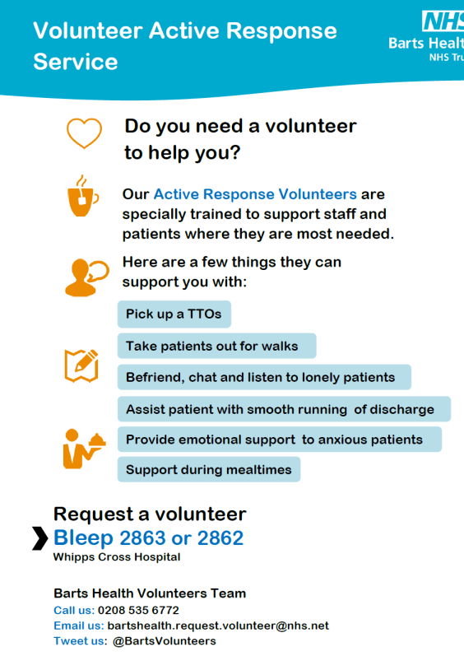
Tools
Volunteer Hubs
Attend huddles, team meetings, Senior Nurses meetings, conversations

Slide 10
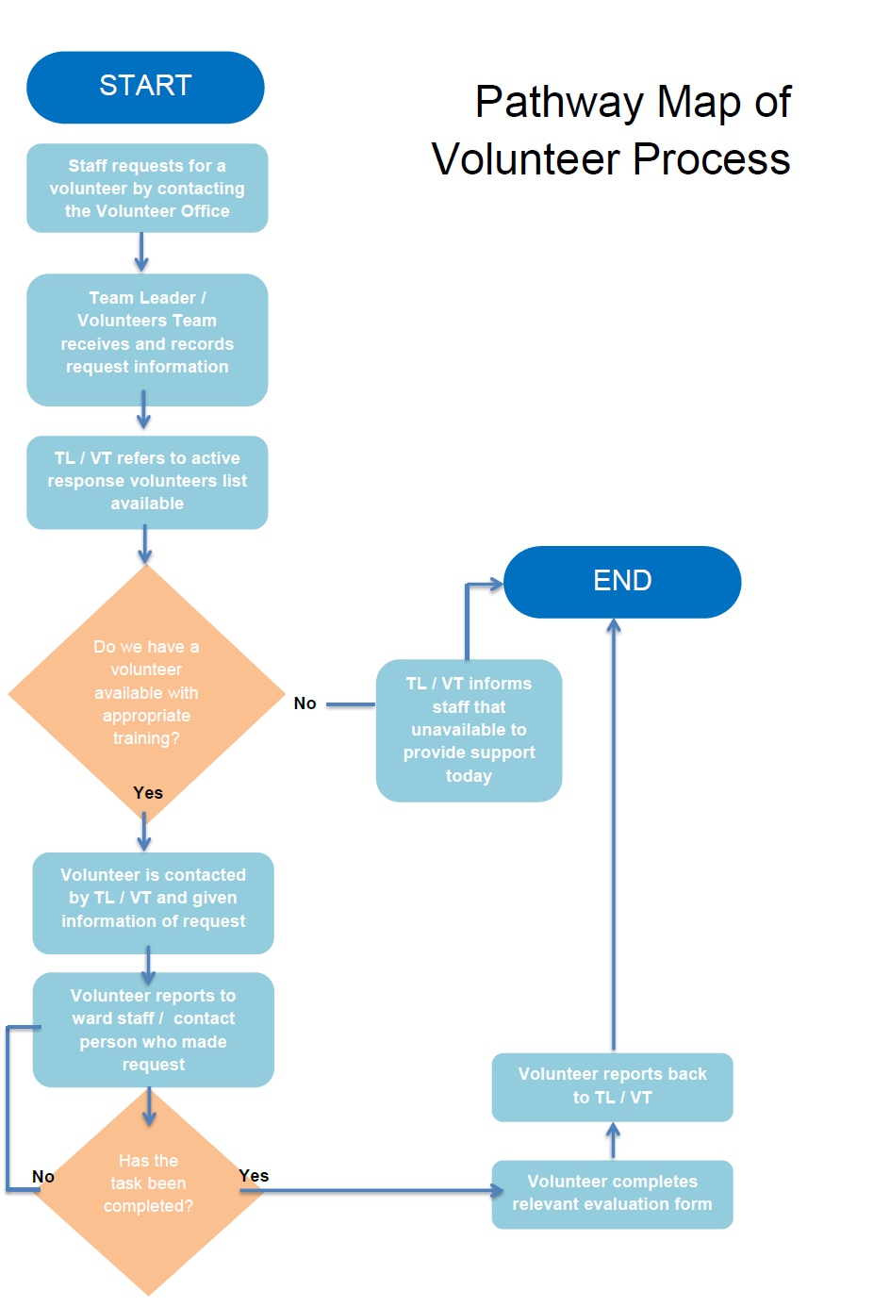

Slide 11
Tips Challenges and Risks
Managing expectations
Really identifying areas where volunteer can most assist
Don’t rely on being bleeped – you have to seek out
Keep reminding people of the service – get the fact sheet
Ensure your governance aligns with the role
Be clear about the role complementing and adding-value
Book lots of training sessions/rooms
Use reliable software e.g. Better Impact
Pilot with a few wards

Slide 12
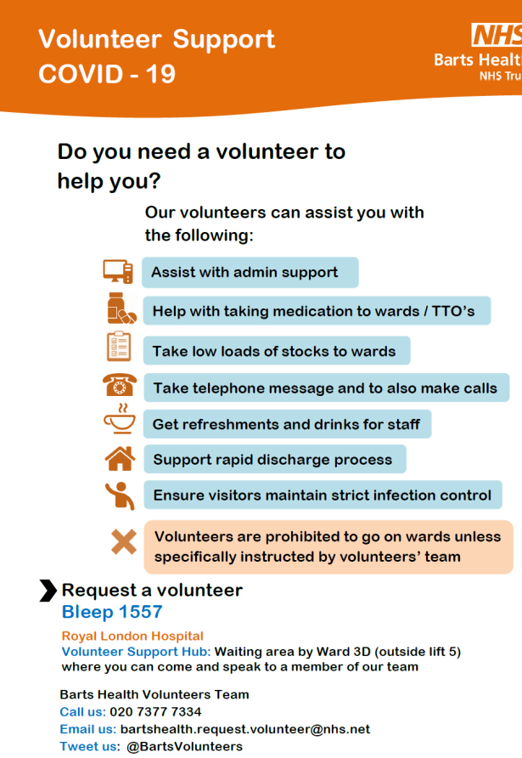
Converting the model during Covid -19
Volunteer hubs
Multi-faceted role linked to how volunteers could best support but not on the wards
Clear about parameters of role and safety etc.
Bleeps and phones
Fact sheets
Being recognised as a resource for business continuity
We didn’t know what the volunteers would be needed for

Slide 13
Converting the model during Covid -19
What did they do?
No ward based volunteers
Taking up visitor packages to the patients
Send a message to a loved one
Food and donations to staff
Staff well being rooms
Fit testing support
Immunity testing support
Front of house including screening
Locating and documenting deceased property and contacting NOK
Moving equipment for the new wards
PPE stock management
Escorting visitors to wards for EoLC
Distributing IPads for video calls
Patient packs
Prepared scrubs (5,000) for Nightingale
Improved staff morale

Slide 14
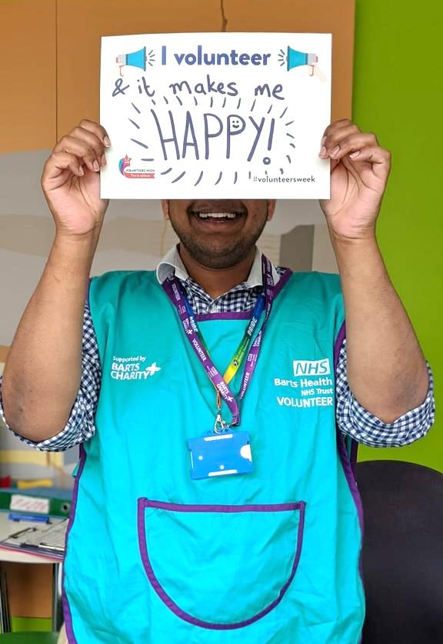
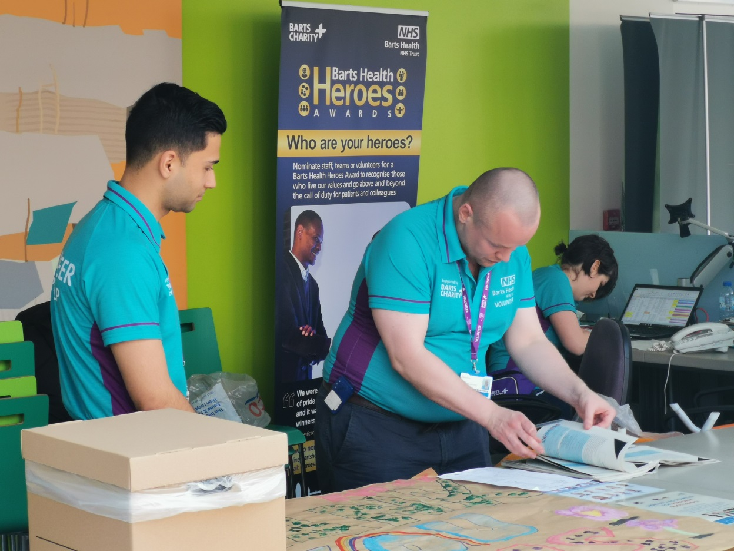
400 no of RIP belongings returned to next of kin
11,000 belongings from visitors drop offs to wards (and counting…)

Slide 15
39,400 meals delivered to staff at Royal London Hospital alone…
grand total of 60,000 meals delivered to staff across the Trust

Slide 16
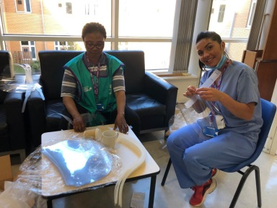
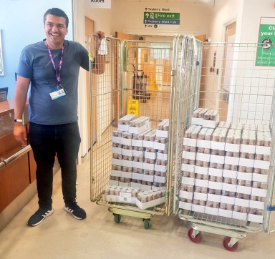
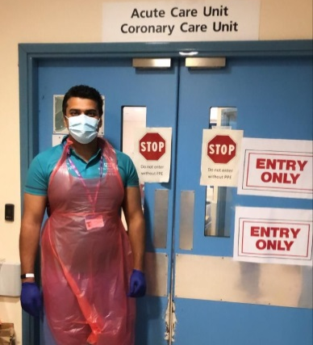
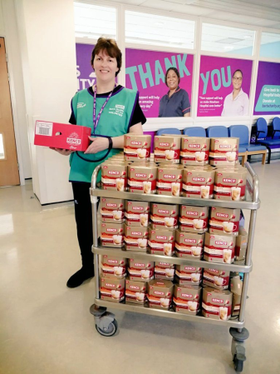
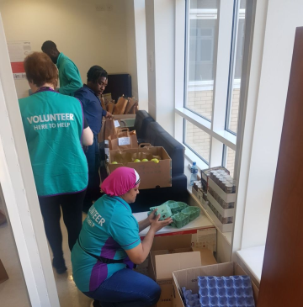
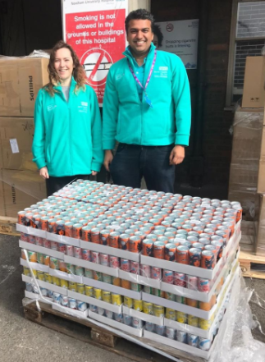
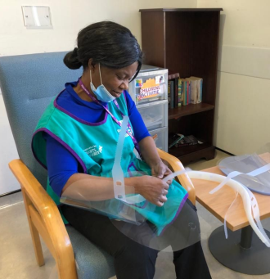
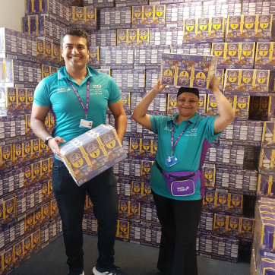
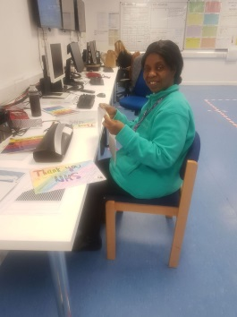
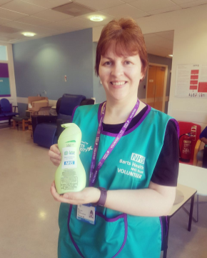
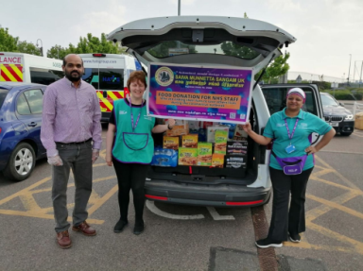
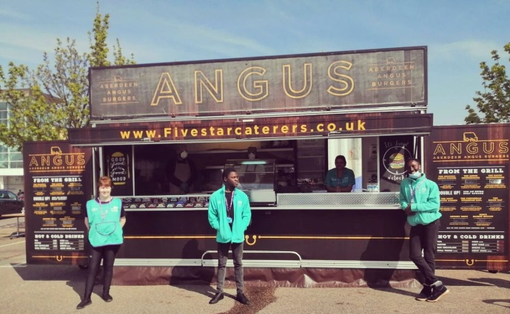
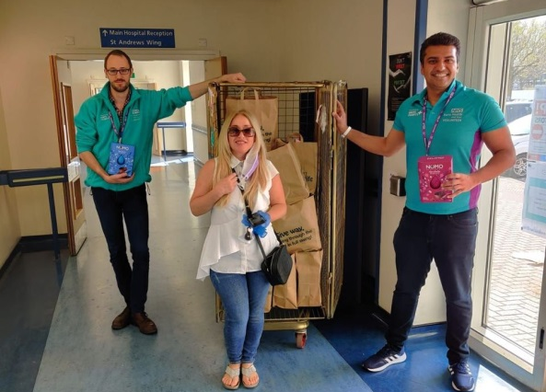
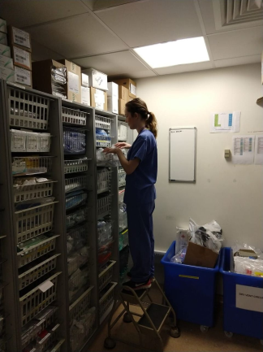

Slide 17
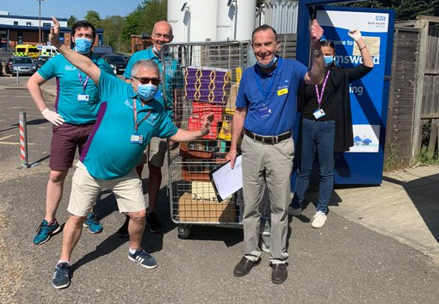
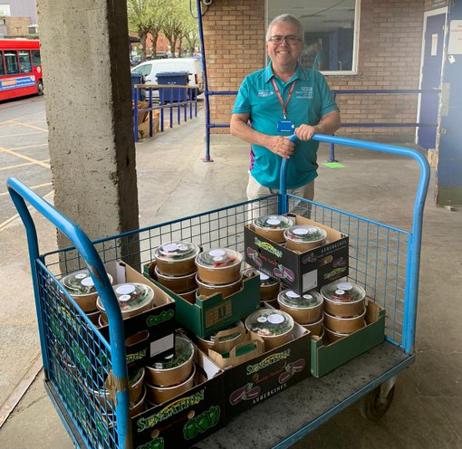
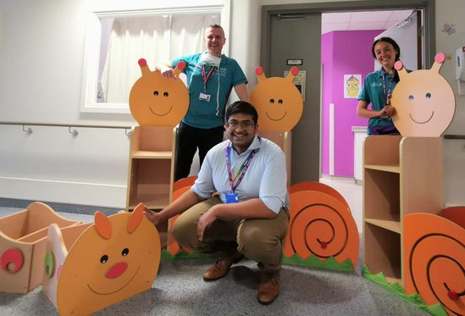
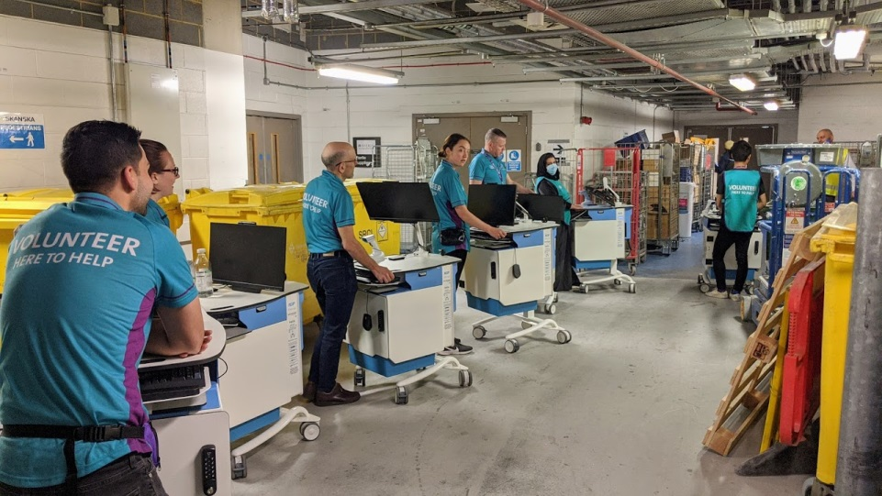
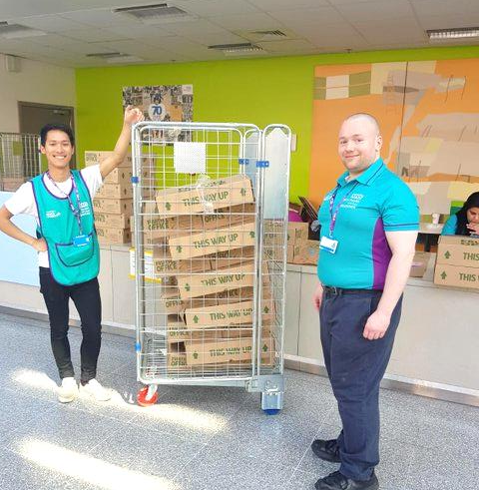
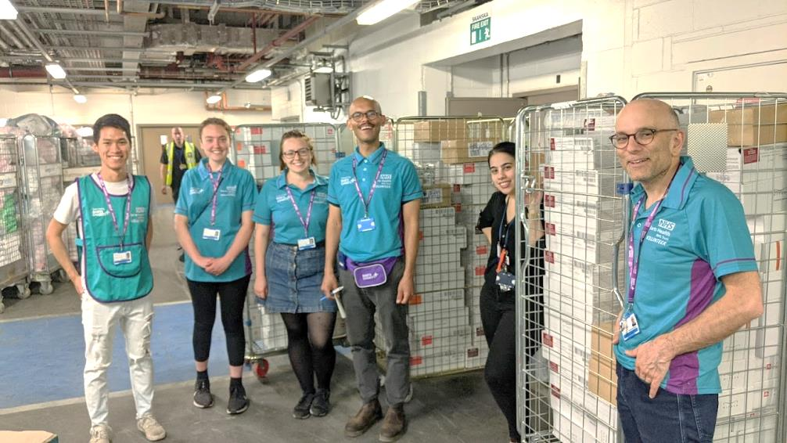
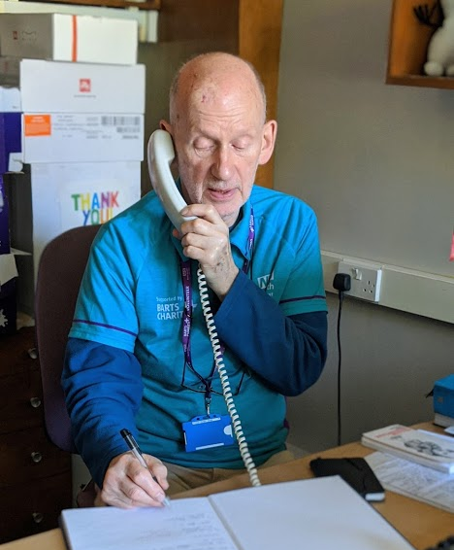

Slide 18
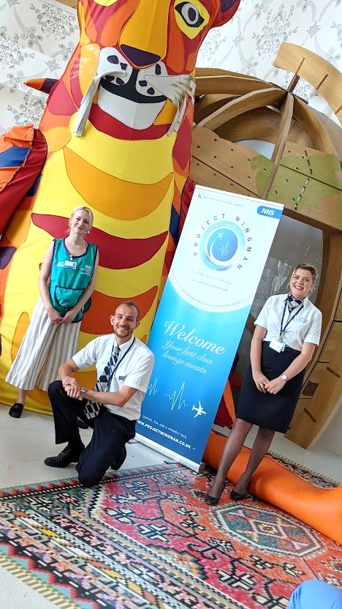
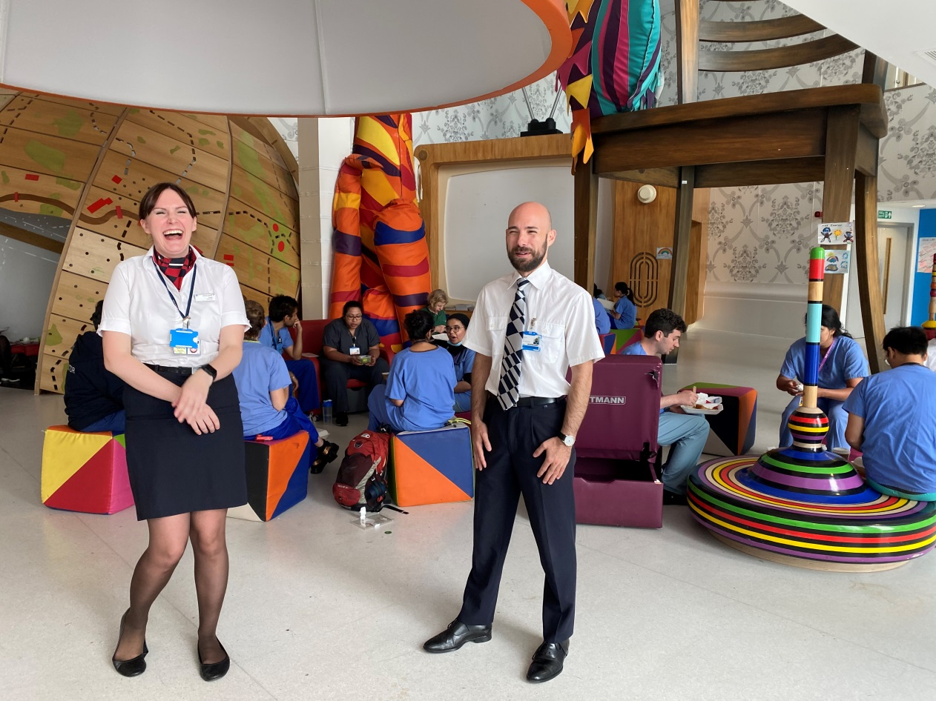
Volunteers are currently supporting the Staff Wellbeing Hub
Providing refreshments and much needed relaxing space for staff to enjoy

Slide 19
Conclusion
Barts Health Trust have completely changed their model of volunteering to a response model.
Although we do keep some specialist roles such as Dementia Buddies, Chaplains, Pets as Therapy.
The response model as the ability to work more to the needs of the hospital whilst ensuring the best experience for volunteers and ensuring that volunteers are getting to where they can make the most impact for patients and the organisation.
Questions?

