Slide 1
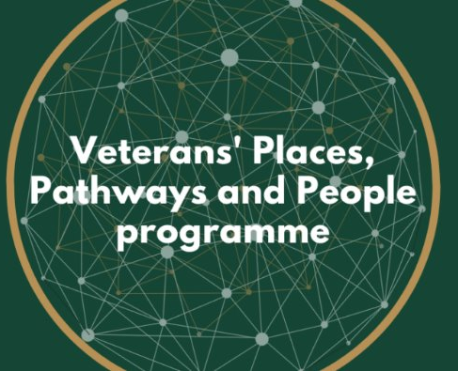
Helpforce's Volunteer to Career for the Armed Forces Community -
Programme overview
27 Feb 2025
Presented by: Mark Burrett, Helpforce Programme Manager
mrb@helpforce.community
Funded by
Working with

Slide 2
About Helpforce
Our mission
Accelerate the growth and impact of volunteering in health and care
What we do
Co-create innovative solutions with health and care organisations
Enable organisations to maximise the potential of volunteering to improve outcomes for people and services
Connect the people leading volunteers together to improve quality together
How we work
Partner with you to grow impactful volunteering opportunities
Capture and share the insight & impact to build the case
Persuade leaders to invest in volunteering

Slide 3
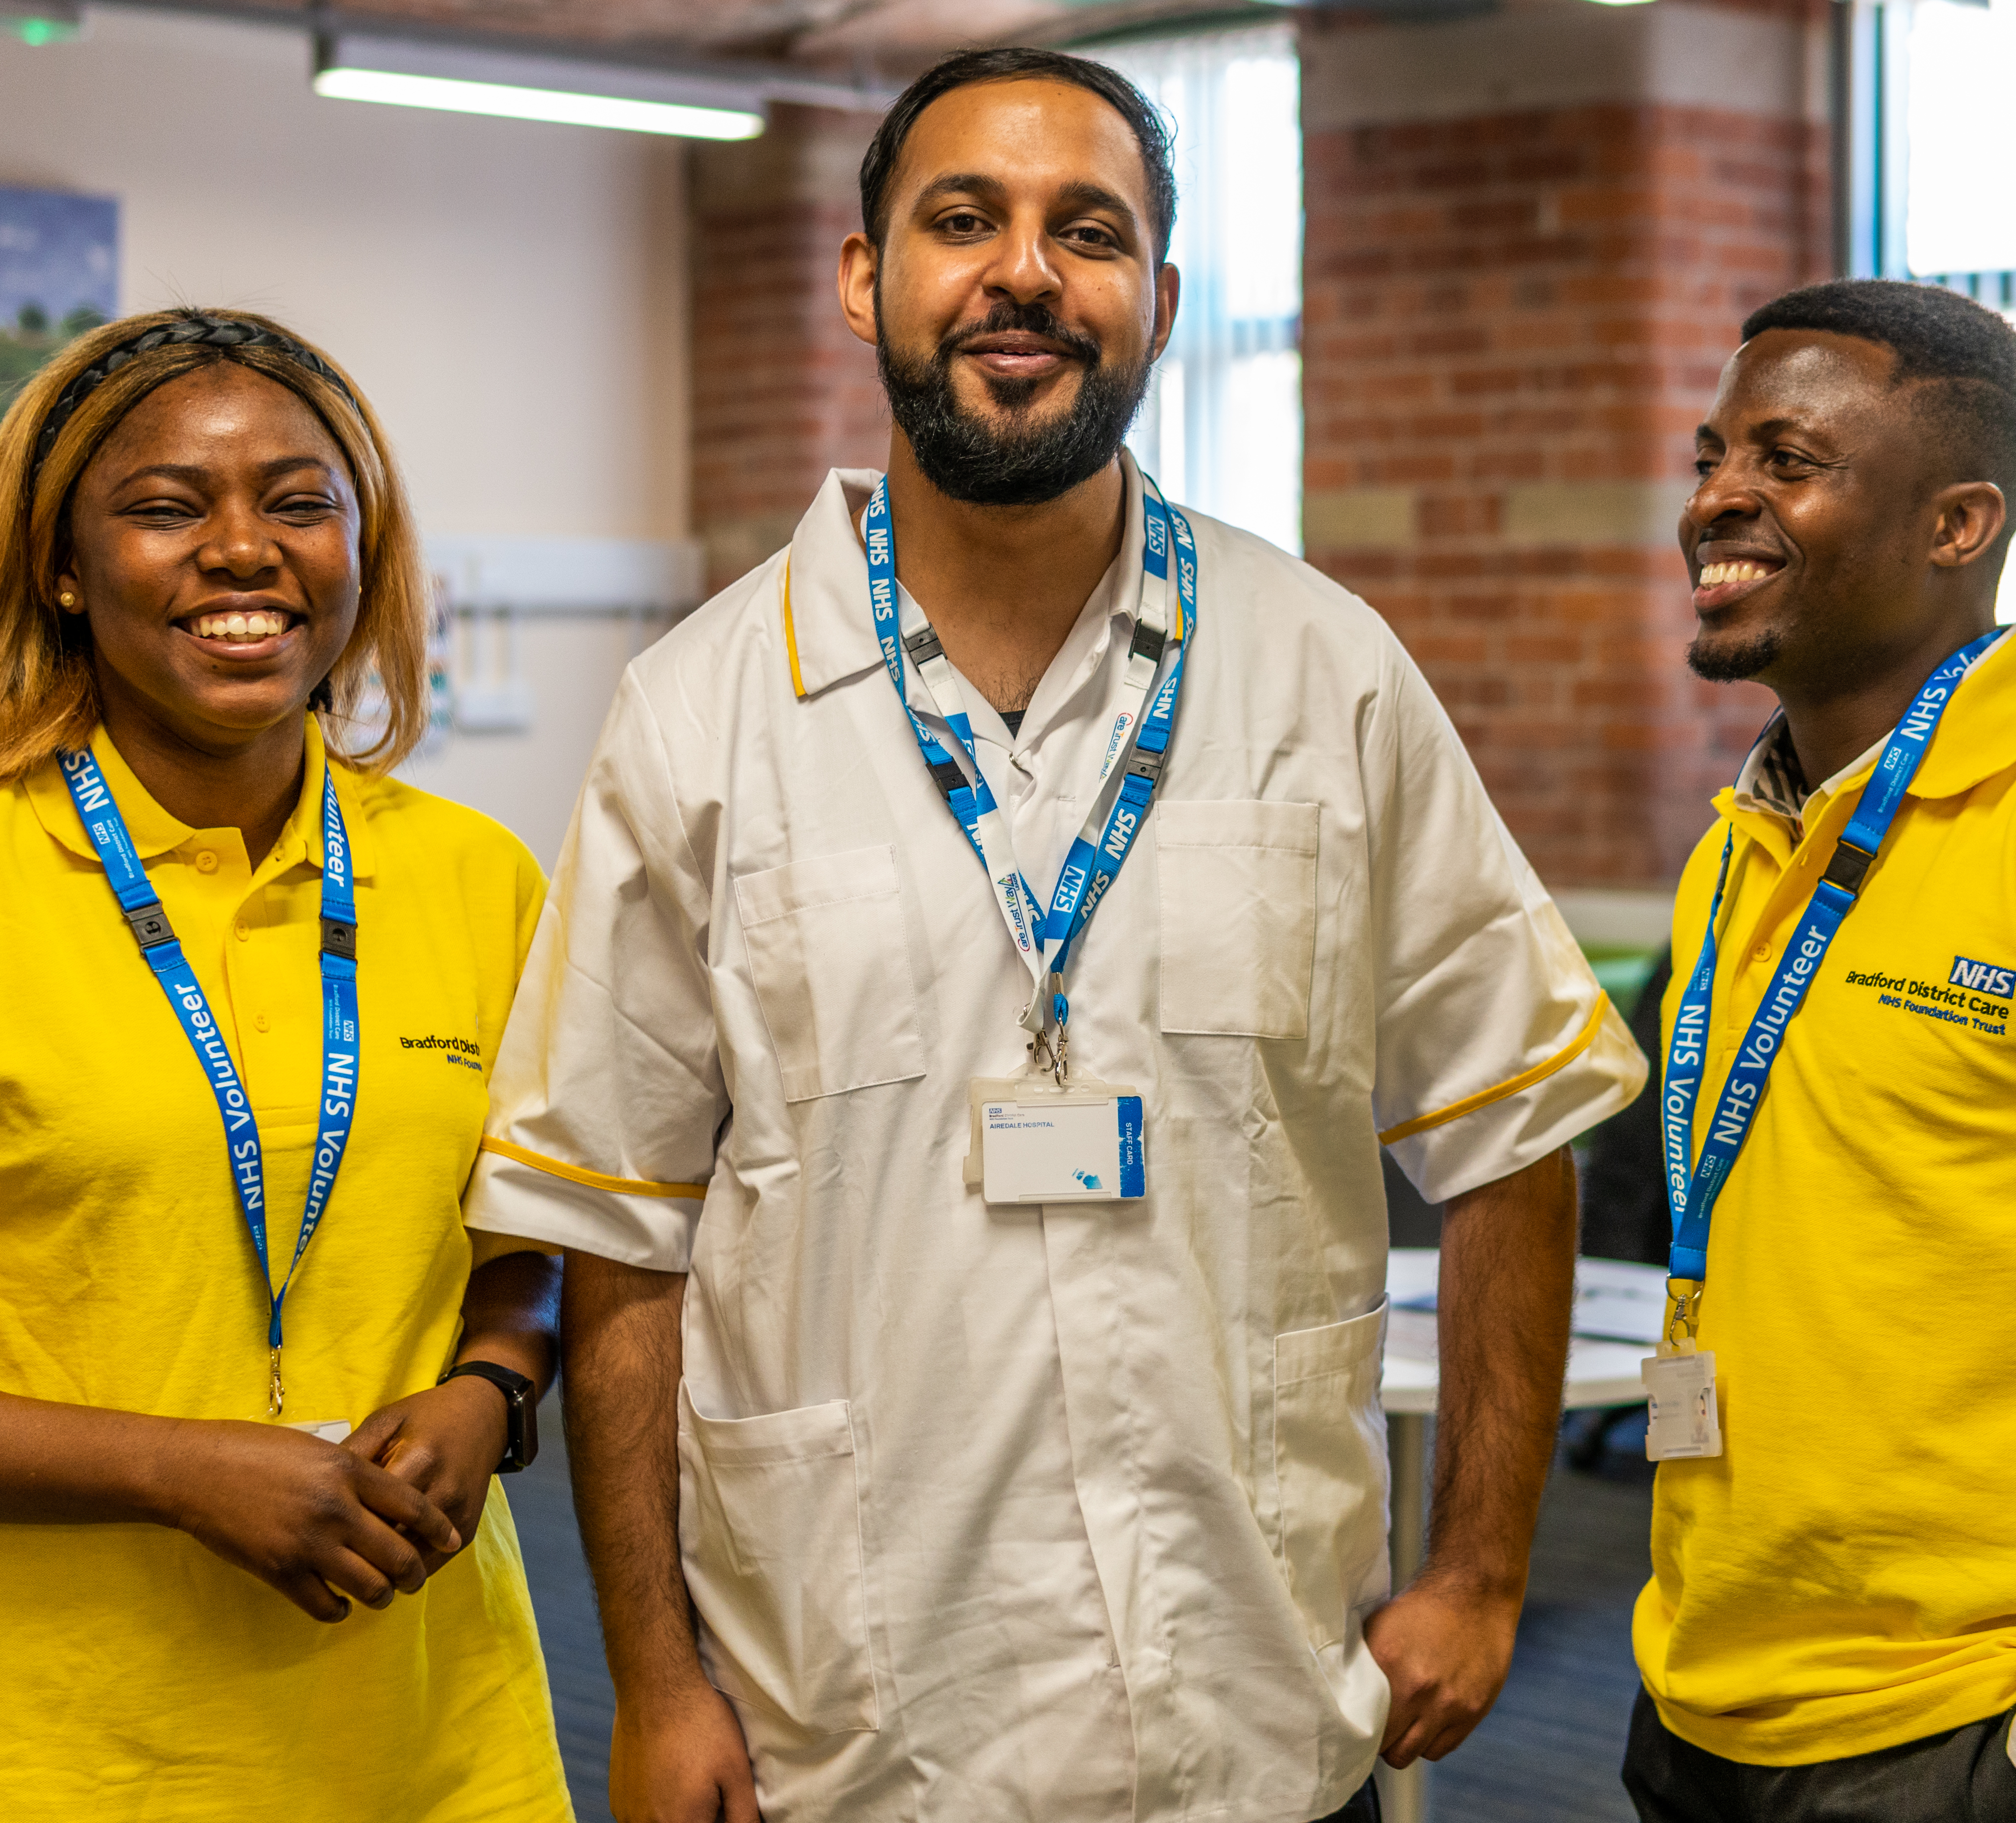
What is Volunteer to Career (VtC)?
The Volunteer to Career programme identifies a pathway for volunteers to develop their careers in health and care.
The pathway is designed around the organisation’s identified workforce needs.
And it sets out how volunteers can make step-by-step progress and an informed decision about applying for employment or starting education or clinical training.

Slide 4
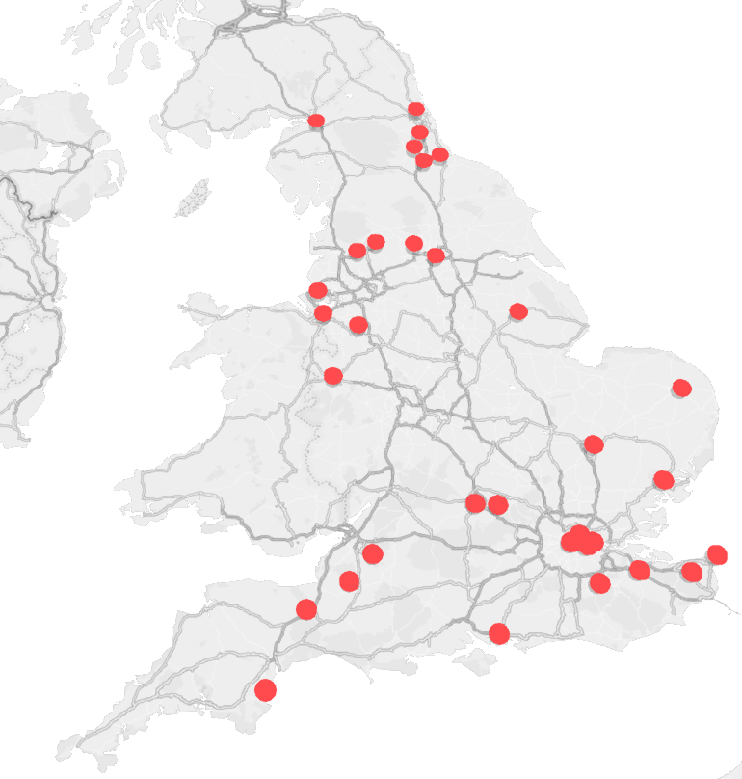
VtC delivery sites
The 28 delivery sites of the NHS England funded Volunteer to Career programme. ​
​
Please note, some organisations are operating a Volunteer to Career programme over multiple sites so will have multiple points on the map.​
​
Bradford District and Craven Health and Care Partnership
Cambridge and Peterborough NHS Foundation Trust
Central London Community Healthcare NHS Trust
Cheshire & Wirral Partnership NHS Foundation Trust
County Durham and Darlington Foundation Trust
East Kent Health & Care Partnership
East Lancashire Hospitals NHS Trust
East of England Ambulance Service NHS Trust
Friends of Moorefields Hospital NHS Foundation Trust
Guy's and St Thomas' NHS Foundation Trust
Lewisham and Greenwich NHS Trust
Lincolnshire Community Health Services NHS Trust
Liverpool Women’s NHS Foundation Trust
Mid Cheshire Hospitals Foundation Trust
Mid Yorkshire Hospitals NHS Trust
Norfolk and Waveney Integated Care Board
North Cumbria Integrated Care NHS Foundation Trust
North Tees and Hartlepool NHS Foundation Trust
Oxford Health NHS Foundation Trust
Portsmouth Hospitals University NHS Trust
Royal United Hospitals Bath NHS Foundation Trust
Shrewsbury & Telford Hospitals NHS Trust
Somerset NHS Foundation Trust
South Central Ambulance Charity
St Oswalds Hospice
Suffolk and North East Essex Integrated Care Board
Torbay and South Devon NHS Foundation Trust
University College London Hospitals NHS Foundation Trust

Slide 5
Volunteer findings: Career outcomes
Volunteer career outcomes were recorded at the point at which an individual completed the VtC programme. As a result of the programme…
Roles have included:
Assistant Physiotherapist
Clinic Administrator
Emergency Care Assistant
Health Care Assistant
Maternity Support Worker
Mental Health Fitness Instructor
Neonatal Assistant
Occupational Therapy Technical Instructor
Patient Pathway Facilitator
Pharmacy Assistant
Therapeutic Activities Coordinator
Training / FE courses have included:
BSc Medicine
Cancer Medicine (MSc)
Dentistry
Nursing and Midwifery Degree
Health and Social Care
Midwifery Degree
Masters in Neurosciences
Orthoptics BMedSci
Paediatric Nursing
Physiotherapy Degree
110
volunteers secured employment in the NHS or health and care
72%
of volunteers who completed the VtC pathway secured employment or further education / training.
12
volunteers secured employment in other sectors
64
volunteers secured places on further education / training courses
*
Overall, over two thirds of volunteers secured employment or education outcome as a result of the programme.
43% of the volunteers who completed the pathway secured employment within a health and care organisation.
Of the 110 jobs secured in the health and care sector, 100 were within the NHS.
n= 257 volunteers who have completed the VtC pathway.
*Individuals might have both secured employment and further education / training so the two are not mutually exclusive.

Slide 6
The Challenge
Veterans
There are over 13,000 people leaving the Armed Forces each year with the majority needing to find employment.
Through stakeholder engagement, we have learned that while many are able to find work, turnover is high.
Less than half (44.5%) feel that they have found the ‘right job’ for them in the longer-term, whilst 42.5% state their current job has not met their expectations in terms of maximising their potential or providing opportunity for career progression (42.4%).
Many have not considered a career in health and care, but a structured public service role could be a very good fit for people leaving the Armed Forces.
Military spouses/partners
A B-Corp explained that on average a UK family in the forces can move up to 16 times whilst in service, making it hard for spouses to find employment.
In a 2018 study, 63% of spouses/partners surveyed said that they had changed career path because of the military lifestyle (only 7% said they wanted to do so).
Additionally, 54% of all spouses/partners who were surveyed were unaware of support for them to find work.
Opportunities to gain transferable skills as well as a potential career in health and care could fit with the need for moving location.
At the same time, the NHS faces a staffing crisis…
1 in 10 job posts are unfilled.
Over £10bn is being spent on bank staff per annum.

Slide 7
Volunteer to Career for the Armed Forces Community programme
Funded by the Swire Charitable Trust (SCT), Helpforce will be running an 18-month pilot ( 1st Oct 24 – 31st March 26 )Volunteer to Career (VtC) programme.
We will develop referral pipelines by partnering with the Veterans Places, Pathways and People programme (Triple PPP), who will promote the programme to members of local Armed Force communities.
We will design, deliver, and evaluate a VtC programme that:
Allows better understanding of the best way to recruit, induct and support veteran and military spouse/partner volunteers.​
Adapts the existing VtC model to take account of the specific needs of veterans and spouses / partners, including the provision of...
a flexible, steppingstone approach into employment within healthcare.
support to build confidence and experience within a healthcare working environment.​
volunteering roles that are aligned with the career goals / needs of Veterans and spouses/partners.

Slide 8
Organisations who are part of the programme
Geography cover | Organisation | Volunteering opportunities that can lead to:
Durham, Darlington, Teeside, York, and North Yorkshire | Tees, Esk and Wear Valleys NHS Foundation Trust County Durham and Darlington NHS Foundation Trust North Tees and Hartlepool NHS Foundation Trust South Tees Hospitals NHS Foundation Trust | Becoming a health care assistant/ward helper Working in estates, portering, catering, domestic, administration and corporate functions
Scarborough also covering North and East Yorkshire | Saint Catherines Hospice | Becoming healthcare assistants Working in: Business support Hospitality
Mid Yorkshire: Wakefield & North Kirklees | Mid Yorkshire Teaching NHS Trust | Working in clinical and non-clinical areas, depending on volunteers’ interests
West Midlands (Shropshire, Telford & Wrenkin, mid-Wales) | Shrewsbury and Telford Hospital NHS Trust | Working in clinical and non-clinical areas, depending on volunteers’ interests
South East London, covering Greenwich,Lewisham and Bexley | Lewisham and Greenwich NHS Trust | Working into healthcare
Somerset | Somerset NHS Foundation Trust | Becoming health care support worker Working in Portering, Emergency Department and Dementia
Dorset, West Dorset, North Dorset, Purbeck, Weymouth and Portland and some joint services with Somerset, and the Bournemouth / Poole area | Dorset County Hospital | Taking up roles centred around Alliance Health Professionals careers: Occupational Therapy, Dietetics, Orthotics, Pathology, Pharmacy Non-clinical roles
Plymouth, Devon | Livewell Southwest CIC | Estates, i.e., electricians, plumbers, maintenance, ground work, pharmacy and HCA

Slide 9
Programme targets
The Armed Forces VtC programme is ambitious, and there are several aims we intend to reach, including…
400
Veterans and military spouses/partners recruited to the VtC programme.
66%
of volunteer's secure employment or education/training related to health & care.
95%
of volunteers increase or maintain their confidence & ambitions for their career.
7
or more delivery partners supported to secure further funding to grow their VtC scheme locally.
Additionally, Helpforce will run the quarterly National Armed Forces Community Steering Group meetings with a view to support: ​
Delivery of the Programme ​
Using the marco report findings, scaling of the VtC across the Healthcare sector and working the OVA (Office for Veteran Affairs) enable VtC as a business-as-usual transitioning service for veterans and spouses/partners.
There are additional outcomes that we have committed to as part of our contract with SCT, all of which are accounted for within the programme and evaluation design.

Slide 10
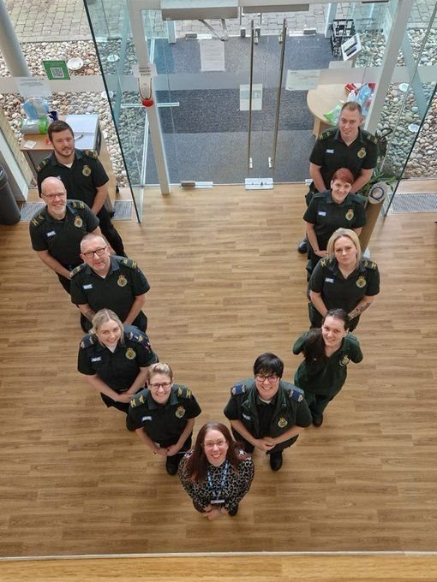
Upcoming opportunities
Our funding allows us to offer our help for free to four more health and care organisations who wish to deliver this programme.
If you are interested in becoming a delivery partner, please email Mark for more information.
mrb@helpforce.community

