Slide 1
South London and Maudsley Volunteer Service Isobel Mdudu

Slide 2
An Overview of the SLaM Volunteer Service

Slide 3
Recruitment
Enquiry – Assemble, telephone or email
Application form
Mandatory Training
Online DBS check and two references
Occupational Health Disclaimer
Informal Interview

Slide 4
Volunteers
We have 400/450 volunteers every year
45% of volunteers have shared with us that they have experienced mental distress
68% are women
32% are men

Slide 5
Demographics

Slide 6
Why we have volunteers
To enhance the service provision and flexibility of this
To gain new ideas, knowledge, specialist skills, enthusiasm and experience
To have service user involvement
To help engage hard to reach clients
To develop a sense of trust in the community
To offer the opportunity for volunteers to gain valuable experience and the development of opportunities for future mental health professionals
To add value (£600,000 per year - economic capital)

Slide 7
Service Users’ Feedback
To have a less formal person to speak with
Another person to share issues with and not being clinically assessed
Volunteers are encouraging and engaging
I would like to volunteer
I have learnt to write poetry and dance

Slide 8
Why people are volunteering
To gain new skills and experience in a mental health setting
To have a career change
To share
To give back
To have a routine to the week
To make friends and meet new people
To get a reference and show commitment
To support a cause
A first step towards employment
To gain confidence

Slide 9
Volunteer Roles
Ward Activities Roles e.g. Art, Music, Poetry
Befriending Community and Ward Roles
Administration
Research
Gardening
Library assistants
Museum and Gallery Volunteers
Discharge Support
Sport and Walking Group Volunteers

Slide 10
What volunteers have gone on to do
Occupational Therapists
Support workers
Project Managers
Nurses
Art Therapists
Police Force
Teaching
Education
and much more!

Slide 11
Challenges and Barriers
Shortage of staff to support volunteers
Protecting the Young Volunteer’s mental well being
Commitment from our Young Volunteers
Occupational Health and length of time for clearance
Change of volunteer expense reimbursement system
Engaging activities
Debriefs
Shortage of young men to support in CAMHS

Slide 12
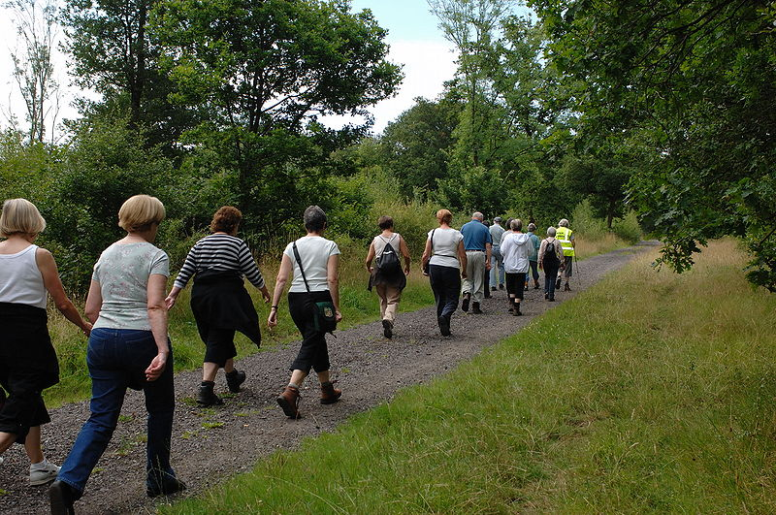
Volunteer Service
Thanks any questions?
Isobel.Mdudu@slam.nhs.uk

