Slide 1

Volunteering at Alder Hey
Supporting Volunteers with Autism, Learning Disabilities/Difficulties

Slide 2
Volunteering with us
We believe that having Autism, a learning disability, learning difficulty or physical disability shouldn’t prevent anyone from volunteering.
Through partnerships with local schools and colleges, we have a an established and inclusive volunteer service to encourage people to actively volunteer (via supported volunteering if necessary) and contribute to their community.

Slide 3
Community Engagement

Slide 4
Recruitment Process
Attending a large recruitment session whether online or as a group can be overwhelming. To really engage and get to know our potential volunteers we offer smaller groups either at Alder Hey, online or we go to local schools or colleges and deliver our presentations there.

Slide 5
Bespoke Training
Accessible Information
There is no one size fits all and you must be prepared to think on your feet and learn to identify and manage the requirements of each individual volunteer. If linked with a college/school this could be part of employability training and delivered there with support. Importantly ask questions, provide information and deliver training in different formats and work with your Learning and Development Teams. Tap into the resources you have – we identified other volunteers with a background in teaching or who had children themselves who required extra support and they took on a training role which was brilliant

Slide 6
Induction and Adjustments
Communication skills – be conscious of using open or closed questions. Consider how a statement can be taken literally. Allow time to process information
Volunteer Buddies – again utilise the talent pot that you have – buddy up with volunteers who understand autism or learning disabilities or difficulties
Reasonable adjustments – shorter sessions build up gradually, more breaks, have a catch up at the end of each shift, quiet area and nominated go to person
Reiterate important messages – reaffirm boundaries, confidentiality, timekeeping and uniform using the same language each time.

Slide 7
David’s Story
I’d like to introduce you all to David, one of our wonderful volunteers
David is going to share with you his volunteer experience

Slide 8
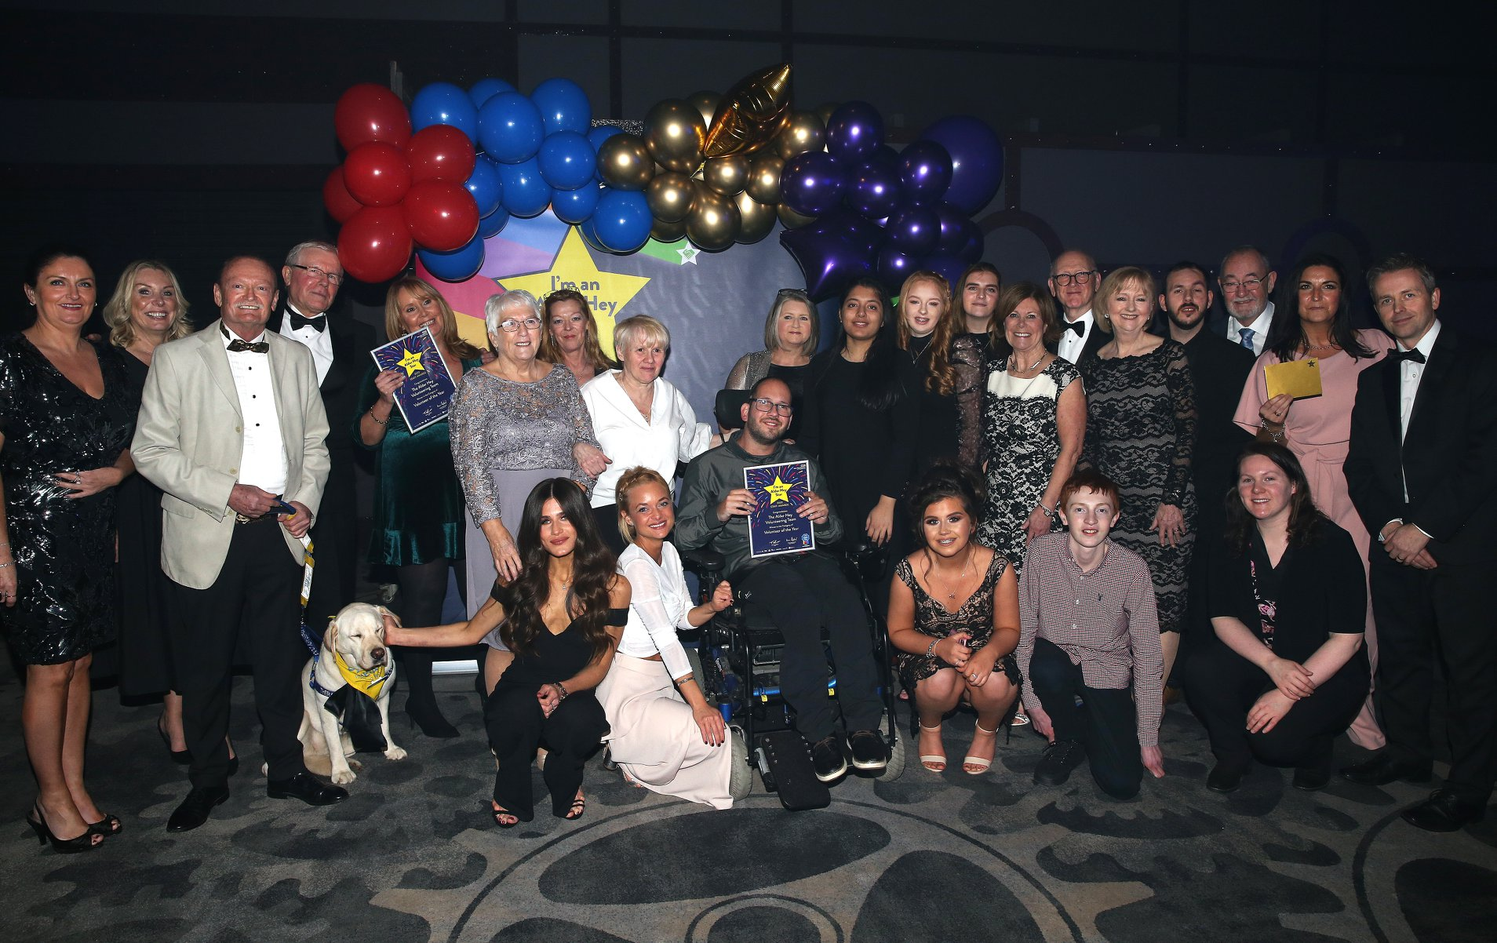
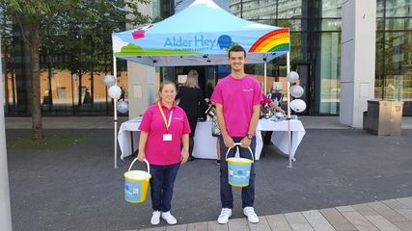
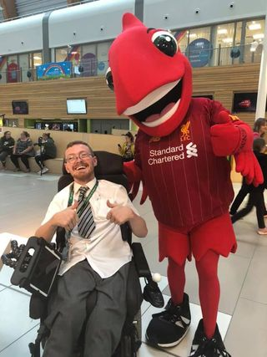
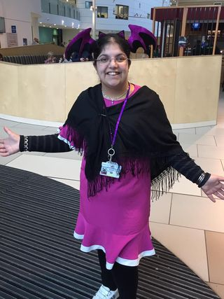
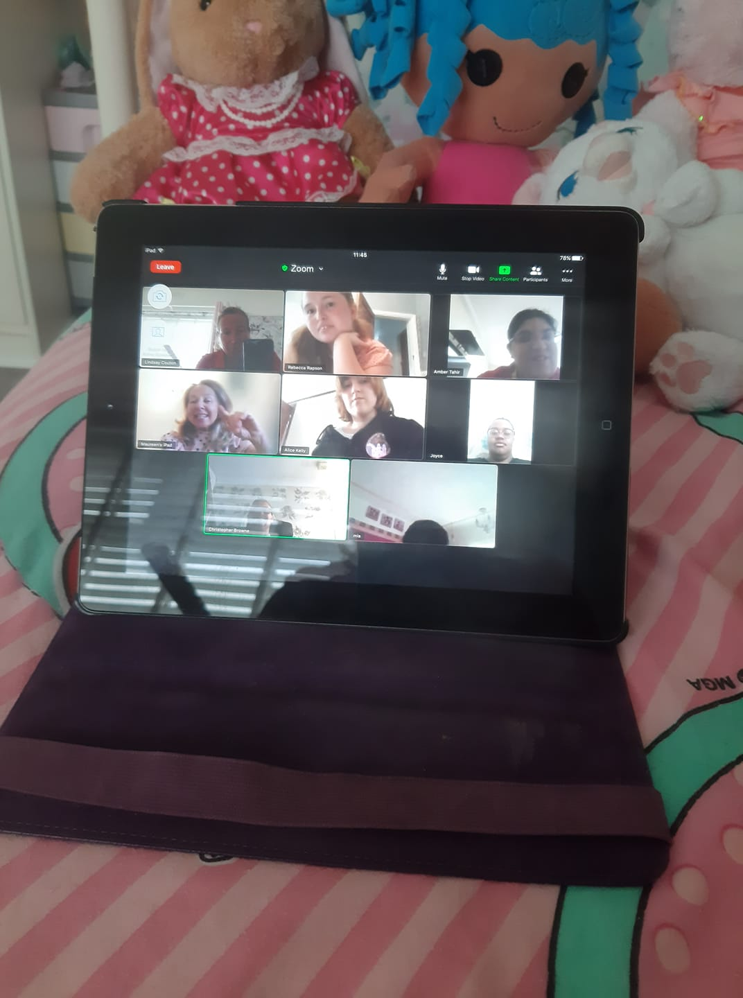

Slide 9
First Steps
Link with your Learning Disability/Autism Liaison Team
Access as much training as you can
Start networking
Join your Trust’s Learning Disability/Autism steering group
Have support in place for your team Team

Slide 10
Highlights Challenges
Joel an amazing volunteer from Greenbank College has gained employment in a Pharmacy
At the moment we are welcoming back volunteers who took time off during Covid - this is a big step for many in restoring confidence and engaging with people face to face after being isolated
Our volunteers receiving the Queens Award for Voluntary Service
Connor one of our volunteers is now a Governor at Alder Hey
Schools and colleges are still conducting many lessons online – hard to engage
Capacity – to provide consistency and the right support we have to limit numbers of volunteers who require more 1-1 support
Varied roles – again due to capacity and the pressure on wards and departments roles are limited
To implement supported internships

Slide 11
Someone like me
We want our children, young people and their families to be welcomed, cared for and supported by volunteers who have lived experience of the very challenges they face – so they see “someone like me”
Our volunteers are role models, they’re inspirational and the potential NHS workforce of the future. By providing an inclusive and accessible volunteer programme now - we invest in future healthcare for everyone

