Slide 1
Extending volunteering from the hospital into the community
How volunteers are helping an NHS Trust to tackle some of the biggest challenges faced by the NHS
Becky Millward
Head of Patient Experience & Volunteering
Jenni Northcote
Chief Strategy, Improvement & Partnerships Officer

Slide 2
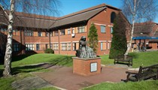
About George Eliot Hospital
District general hospital providing range of services including urgent and emergency care, surgical, medical, women’s and children’s, diagnostic and therapeutic care (358 general and acute beds)
Serves a population of over 300,000 covering North Warwickshire, South West Leicestershire and North Coventry
Provide a range of community services including sexual health, special care dentistry and TB services
2,600+ staff

Slide 3
The Back to Health Pathway An integrated health and care volunteer supported pathway
Volunteers on hospital site
Volunteer contact centre
Responder volunteer team/OOH volunteer drivers
Hospital volunteers
Hospital
Getting well
Community Engagement Officers
Aligns to the NHSE CORE20PLUS5 framework to tackle health inequalities
Supports the prevention and early identification agenda
Strengthen existing volunteering capacity and capability
Help build resilient communities that put less pressure on the health and care system
Community
Waiting well
Recovering well
Living well
Benefits:
Reduce pressure on services and increase flow - Improve patient experience and outcomes - Reduce pressure on staff and support staff wellbeing
reduce DNAs – increase appointment utilisation - reduce unnecessary A&E admissions - reduce length of stay – optimise patients for surgery

Slide 4
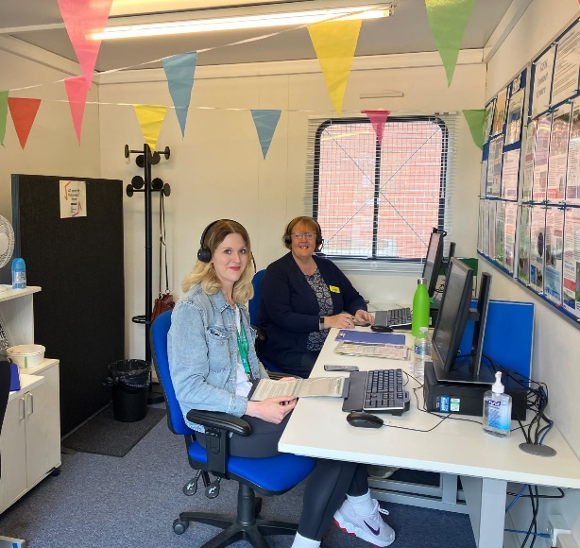
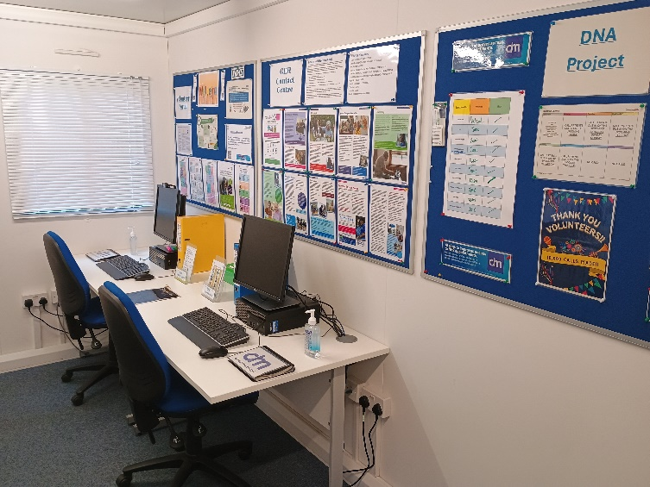
Volunteer Contact Centre (2023/2024)
Making Comfort Calls to patients recently discharged, referring patients to support when needed.
Making appointment/procedure reminder calls to patients to encourage attendance and reduce DNAs. (7531 patient reminder calls across 15 specialties)
Working with Artificial Intelligence firm ‘Deep Medical’ who have developed an algorithm to identify patients most likely to DNA

Slide 5
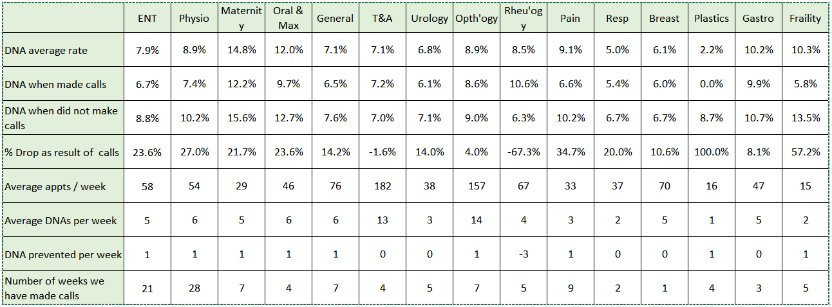
Reducing DNAs by an average of 20 per month

Slide 6
Volunteer Responders (2023/2024)
Responder Team
Out of hours drivers
Supporting Emergency Department
33
Average out of hours medicine deliveries per month
100
Average Responder Hours Per Week
Notes:
Responder Volunteers provide help and support to patients and staff where it’s needed most and average around 100 hours of volunteer support each week. When patients are ready for discharge but waiting for their medications, volunteer drivers will deliver the medications to the patients later at home reducing ‘excess bed days’ freeing up that bed and increasing flow. They run collect TTO’s from pharmacy and take them to the ward, help patients to find their way, locate wheelchairs for patients and answer routine questions and enquiries.

Slide 7
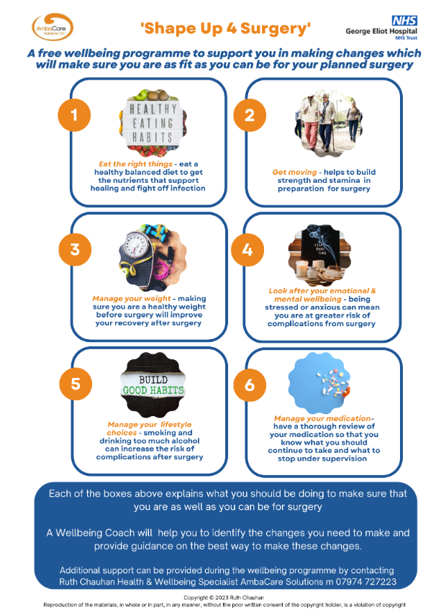
Shape Up For Surgery (2023/2024): Helping patients get fit for surgery, impacting positively on their health outcomes and length of stay
245
Referrals to
Shape up For Surgery
Referrals are being received from Orthopaedics, and General Surgery.
73 patients supported
65% reduced BMI
68% had an improved wellbeing score

Slide 8
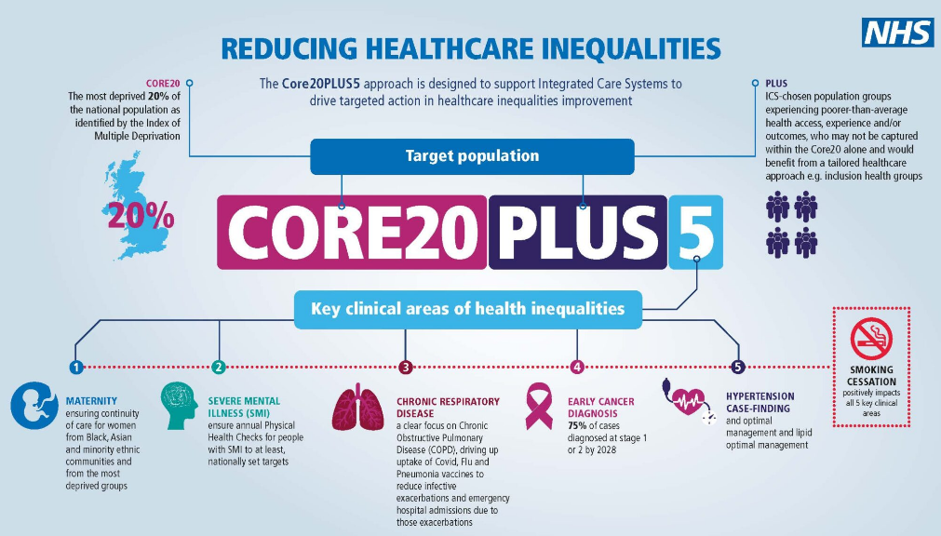
Community Engagement (2023/2024):
In WN this relates to itinerant communities
We track activity against 20% most deprived areas

Slide 9
The Back to Health Team
Voluntary Services Manager
Contact Centre
Co-ordinator
Recruiting, training, managing, overseeing and reporting on contact centre activity. Liaises with directorate operational teams re call lists and escalates patients who wish to cancel or rearrange their appointment so that it can be backfilled
Community Engagement Officers
Engaging with deprived communities, work aligns to CORE20PLUS5 to reduce health inequalities, prevent ill health by encouraging screening, immunisations and vaccinations.
Back to Health Nurse
Develop bespoke roles for clinical settings designed to meet needs of wards/services, carries out risk assessments and develops training. Oversee Contact Centre and driver service, provide clinical escalation, identifies new responder tasks that increase flow and create capacity.
Shape Up For Surgery
Supporting patients to become optimised for surgery aiming to improve patient outcomes and reduce length of hospital stay. Reduced chance of infection because patients are fitter. Readmission risk is lowered.

Slide 10
Securing Funding to Develop The Pathway:
External providers (NHSE, ICB, WN PLACE)
GEH Charity
GEH Hospital Trust (business case)
Important to:
Identify sources of funding
Identify Project Management support
Align to Trust objectives and outline ‘estimated financial benefits/added value/impact on patient experience’
Align to objectives of other organisations (PLACE, ICB)
Think about how to present case
I wish I had…
Carried out more detailed future proofing
Better understood process of developing and submitting business cases

Slide 11
Developing a team of Responder Volunteers:
Important to:
Connect with frontline nursing staff and huddles for tasks
Recruit a Back to Health nurse/clinical champion (clinical connection, by-in and risk management)
Link to command structure
Develop wide variety of tasks across site
Make sure volunteers are visible
Encourage volunteer suggestions (drivers suggested developing OOH service)
I wish I had…
Developed a better system of communication across all wards (including matron and nursing huddles)

Slide 12
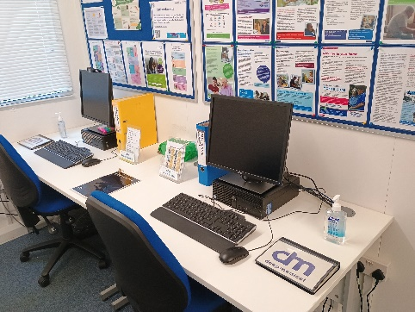
Developing a Volunteer Contact Centre:
Important to:
Understand sources and flow of data
Don’t be scared to make changes
Standardise the process
Commitment from the services to regularly provide us with call lists – needed to keep pushing for these
Need to involve the right people
Dedicated space
I wish I had…
Become part of the Outpatient Utilisation Group (or any improvement group) earlier
Better understood cost saving for new appts versus follow ups
Understood appointment utilisation
Considered bigger accommodation for the centre a lot earlier

Slide 13
Developing Shape Up For Surgery:
Important to:
Be clear where it fits in the elective surgical pathway
Be clear on objectives (optimise patients for surgery to reduce risks)
Develop clear referral criteria
Ensure good communication (posters, emails, discussions etc)
I wish I had…
Increased focus on supporting MH and measuring impact
Had better engagement with doctors from the start
Aligned to new physiotherapy group ‘pre-hab’ sessions
Done more to encourage referrals from GPs

Slide 14
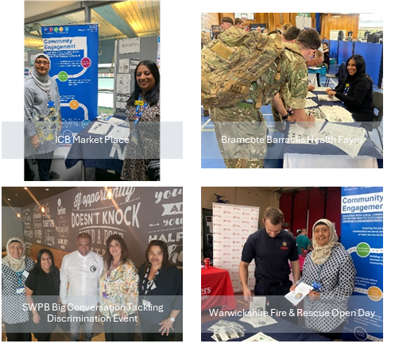
Developing Community Engagement:
Important to:
Align to CORE20PLUS5
Talk to ICB about their additional priorities
Give Officers time to develop networks
Recruit people that know local communities
Link with PCNs
Agree how to evidence impact
Link to interpreting and translation
Be prepared to recruit volunteers to support
I wish I had…
More robust hospital data about hospital pressures linked to postcodes/areas/specialties at the beginning
Better engagement from doctors and medical professionals to help steer community engagement work

Slide 15
Golden threads that run through the pathway:
Health Inequalities
Track patients you are supporting
Many sources of funding available
Priority for all
Align to Patient Experience
Use pat exp data to inform and steer
Use pat exp metrics to measure
Use pat exp platforms to engage
Data and relationship with informatics team
Benchmarking
Measuring
Drive

Slide 16
More golden threads…
Supporting volunteers
Outline benefits to volunteering - what’s in it for them?
Start by talking about what motivates them to volunteer
Training, support and information
Take time to say thank you
Mix and match roles
Retention
Culture – social element
I wish I had…
Understood PHM as a source of data
Linked in with Library and Knowledge services earlier
Walked the wards and engaged with frontline staff more

Slide 17
Help from Helpforce:
Wide range of resources and online discussion forums
Project management advice and resources
Mentoring, coaching and support
Business case development and advice
Particularly helpful financial advice; attributing value to volunteering, help with forecasting costing and benefits realisation
Essential and outstanding support to help measure the impact of volunteering and understanding the insight

Slide 18
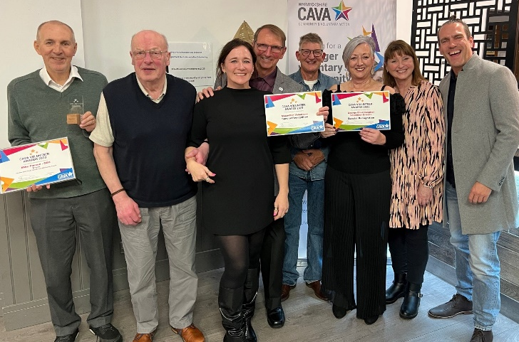
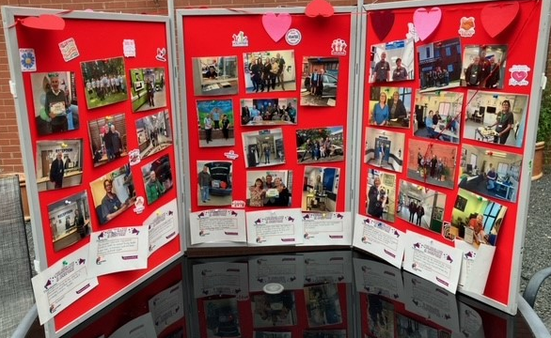
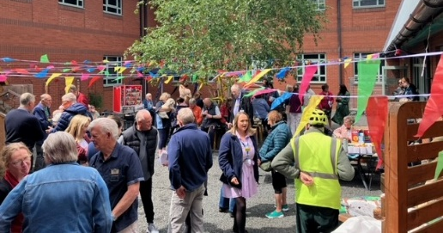
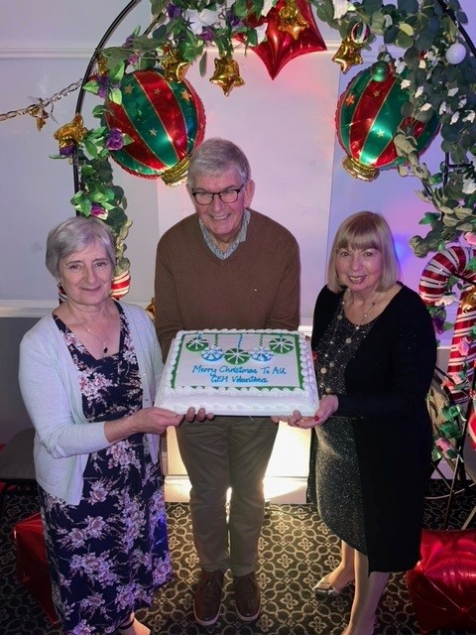
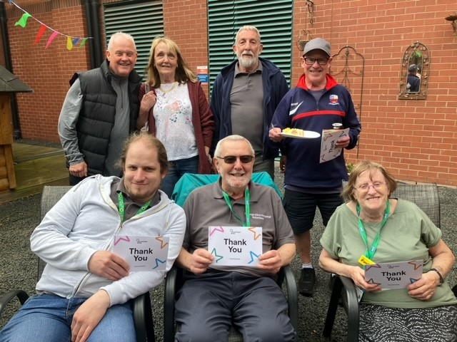
Access Helpforce report on the Back to Health pathway
Contact us for help!

