Slide 1
Health Champions: Volunteers supporting the physical health of people using mental health services
Wednesday 27th September 2023 Helpforce Webinar
Dr Julie Williams
Post Doctoral Researcher, Centre for Implementation Science and
Mind & Body Programme, King’s Health Partners
Julie.Williams@kcl.ac.uk
Notes:
Hi everyone, my name is Julie and in this presentation I am going to tell you about the new intervention that our team developed called Health Champions and describe the study we undertook to evaluate Health Champions focussing on the implementation of the intervention and our learning

Slide 2
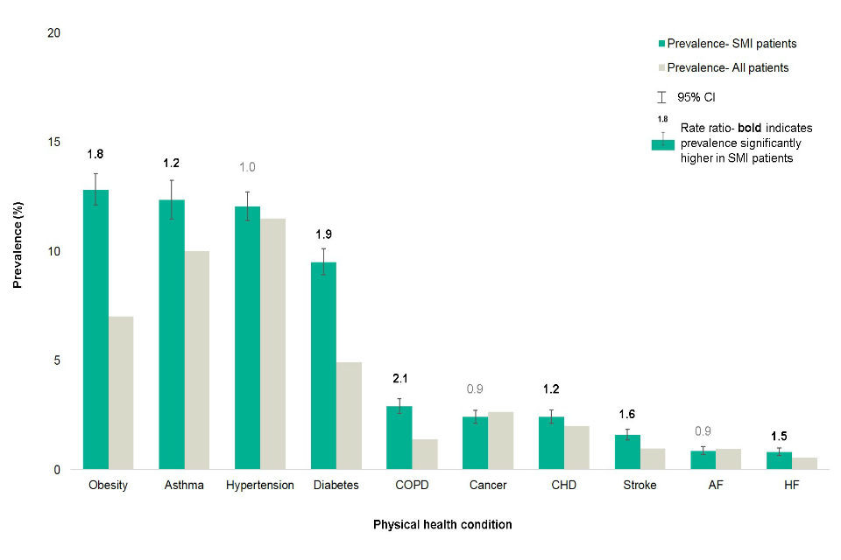
The problem we are addressing
People with severe mental illness have worse physical health and are 5 times more likely to die prematurely
There are many and complex reasons for this
At the individual level people are isolated and dealing with symptoms that can make it difficult to manage their physical health
Prevalence of physical health conditions for severe mental illness (SMI) and all patients aged 15 to 74
The Health Improvement Network (THIN), Active patients in England; data extracted May 2018 in Public Health England (2018). Severe mental illness (SMI) and physical health inequalities: Briefing. https://www.gov.uk/government/publications/severe-mental-illness-smi-physical-health-inequalities/severe-mental-illness-and-physical-health-inequalities-briefing. Accessed 30.01.2023.
Notes:
The intervention was designed for people using mental health services with a diagnosis of severe mental illness such as schizophrenia and bipolar disorder. We know that this group have worse physical health than the general population-as you can see they have higher rates of pretty much all physical health conditions. The reasons for this inequality are complex and can be seen at different levels such as society, health service and individual levels and need to be addressed at all of these levels. The Health Champions intervention is targeting the individual level by matching a volunteer to someone diagnosed with a severe mental illness or SMI to support them with their physical health.

Slide 3
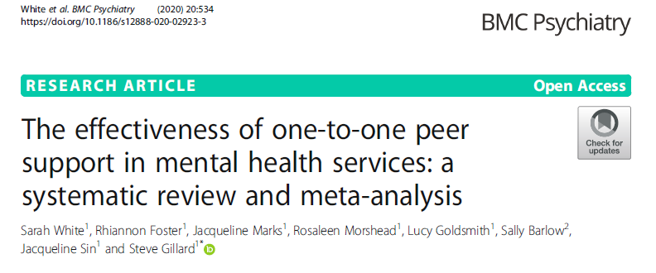
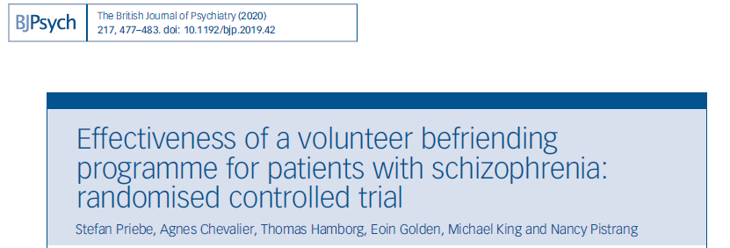
Developing the intervention-
Volunteers supporting people with mental health diagnoses
Notes:
There is evidence that volunteers can offer effecitve support to people with SMI for their mental health but there is little literature about how best to recruit, train and manage volunteers in these roles. As far as we know this is the first intervention to focus on volunteers supporting this group with their physical health and to evaluate the implementation

Slide 4
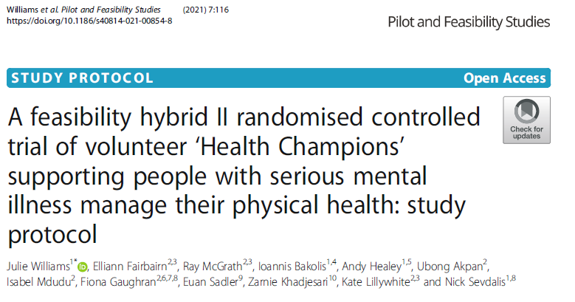
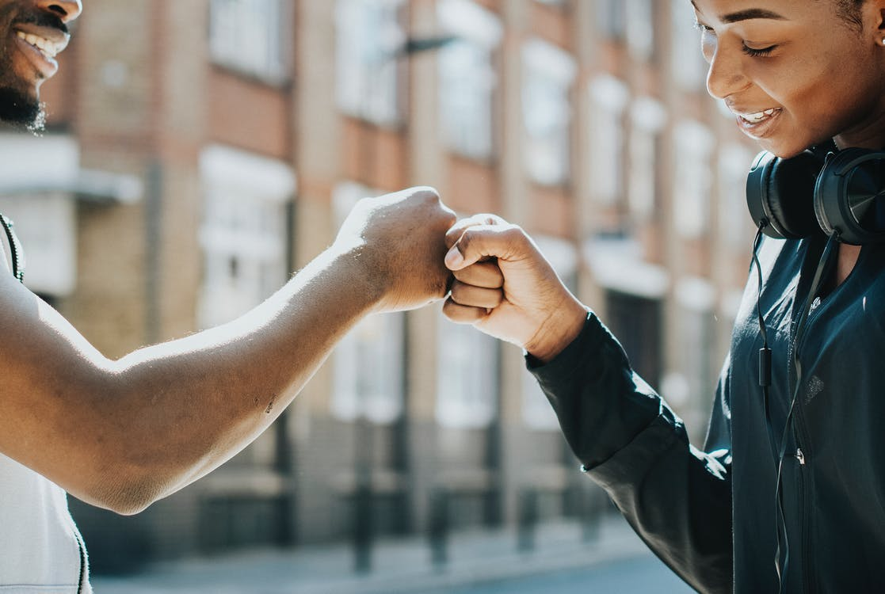
The Health Champions intervention
New intervention developed by the team that included clinicians, academics, volunteer service and people with lived experience
Volunteers called Health Champions would support people with a serious mental illness to manage their physical health over nine months
We evaluated if it could be implemented and the clinical and cost effectiveness
Notes:
Health Champions is a new intervention developed by a multidispilinary team. In the intervention volunteers called HCs work one to one with someone with an SMI to support them to manage their physical health. We used a hybrid design to evaluate implementation, clinical effectiveness and cost effectvieness

Slide 5
Health Champion Role
To support people using mental health services with their own physical health goals
No prescribed way of doing this-depended on what each person wanted
Not expected to be experts
Support for Health Champions
Training
Volunteer coordinator
Monthly supervision
Individual support
Notes:
The Health Champion role was to support people with the physical health goals that were important to them so it would be individual to that person. We did not prescribe what that support should be – it would very much depend on what the person wanted, and Health Champions were not expected to be experts in physical or mental health. We provided support for the Health Champions from a volunteer coordinator that included monthly group supervision, individual support and support from the organisation.

Slide 6
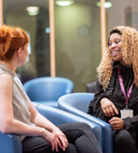
Participants
People using community mental health services with a SMI diagnosis
Wanting to make changes to their physical health
Matched with a Health Champion based on location
Process
Worked together for nine months
Meeting once a week
Met remotely at first then face to face
Notes:
participants were recruited from community mental health teams in slam. They had to have a SMI diagnosis and had to want to make a change to their physical health. They were matched with a Health Champion based on their location-we were not sure how to match people and there is very little written about this-as SLaM is a large Trust this was the most practical way of doing it. The idea was that they would meet once a month for nine months. We had planned the intervention before COVID and were just going to start to recruit in March 2020 when the first UK lockdown happened. We then had to decided whether to wait until we could do it face to face or change the intervention so that it could be done remotely-we decided to do this and had to make changes to our processes so that we could recruit, collect data and implement the intervention remotely and we started recruiting properly in August 2020. This photo is stock slam photo but this lady here is Lorraine, one of our lovely health champions

Slide 7
Results
27 randomised to the intervention group, 21 to control group
21 matched with a Health Champion
14 (58%) completed at least 8 months
Number of sessions ranged from 3 to 32 (mean 20 sessions)
Participant demographics
52% male
44% White, 37% Black
48% lived alone
Median age 41
Notes:
So these were our results. Firstly we recruited 48 participants-obviously not as many as we had planned. We had problems in recruiting particpants and I will discuss this later in the presentation. 21 people were matched with a HC, and 58% completed at least 8 months and the mean number of sessions was 20. and to give you some demographics-you can see that just over half were male, mixed ethnicity, 48% lived alone and the median age was 41

Slide 8
Results-Service users
‘they give good advice, they give practical things that you can do. The one I had was very cheerful, makes you feel good’
‘She helped me with certain things I needed to find out or if I needed to do to any certain things’
‘it’s good to have somebody neutral, so you’re not afraid of saying things to them. Some things you wouldn’t say to your friends, whereas I can say them to my health champion and we can start exploring and looking at things’
Notes:
So these were our results. Firstly we recruited 48 participants-obviously not as many as we had planned. We had problems in recruiting particpants and I will discuss this later in the presentation. 21 people were matched with a HC, and 58% completed at least 8 months and the mean number of sessions was 20. and to give you some demographics-you can see that just over half were male, mixed ethnicity, 48% lived alone and the median age was 41

Slide 9
Results-Health Champions
‘it was a big learning experience. I learnt more about mental health illness...I learnt more about people who are actually going through it and how it’s affected them’
‘Well, being special. You want to make a difference, don’t you? But sometimes, in making a difference, we do it for ourselves. But he made me feel special just by, ‘Are you alright, Jenny?’
‘I definitely felt supported throughout. I knew that, when I did start to think, ‘This is getting a bit too much,’ I felt like I could approach everyone’
Notes:
So these were our results. Firstly we recruited 48 participants-obviously not as many as we had planned. We had problems in recruiting particpants and I will discuss this later in the presentation. 21 people were matched with a HC, and 58% completed at least 8 months and the mean number of sessions was 20. and to give you some demographics-you can see that just over half were male, mixed ethnicity, 48% lived alone and the median age was 41

Slide 10
Thank you for listening
If you want to hear more about this work please get in touch:
Email: mindandbody@slam.nhs.uk
Twitter: @mindandbody_khp
Website: www.kingshealthpartners.org/our-work/mind-and-body
Presenter details:
Dr Julie Williams
Post Doctoral Researcher, Centre for Implementation Science
Evaluation Lead, Mind & Body Programme, King’s Health Partners
julie.williams@kcl.ac.uk

