Slide 1
How volunteers can support NHS Trusts throughout this winter

Slide 2
What you will find in this document:
Challenges that NHS Trusts are now facing
How volunteers could be part of the solutions
What stops Trusts from bringing volunteers back
How some Trusts are overcoming the barriers to bring volunteers back
How Helpforce can help Trusts to maximise the impact of volunteering
List of Trusts that have successfully brought volunteers back
Case study

Slide 3
Challenges currently faced by NHS Trust
Potential shortage of beds for non-covid patients as there is an increasing rate of covid bed occupancy across Trusts
Increased pressure at A&E departments with some Covid patients having to wait up to 40 hours for a bed
Huge backlogs in treatment, with many Trusts cancelling elective surgeries
Detrimental impact on the health and wellbeing of NHS staff because of Covid-19
Delayed patient discharge affecting patient flow
Increased needs to support patients with mental health issues

Slide 4
But volunteers can help by:
Quickly responding to help requests from staff and patients, giving staff the extra time to care for patients so that they can be discharged quicker, potentially reducing bed occupancy
Giving patients the right amount of time and attention, supporting patients’ mental health and wellbeing, which can then contribute to their speed of recovery
Releasing staff from other duties (such as making beds, feeding, escorting patients to appointments, etc.) so staff can use that extra time to recharge or spend the time on patients who need additional care

Slide 5
Yet, some Trusts hesitate to bring volunteers back, because:
If visitors are not allowed to come back, why should volunteers be?
With volunteers on site, there is a higher risk of virus transmission, which could be a health risk for staff, patients and volunteers themselves.
Staff may have to spend an amount of time on training volunteers, potentially taking their time away from caring for patients
Some Trusts haven’t been able to develop specific new roles or don’t have resources to implement new roles (e.g. fast track onboarding process, virtual training programmes, etc.)
Senior leaders are not yet confident about the impact of volunteers and therefore are reluctant to giving their full support to the service

Slide 6
How some Trusts are overcoming those challenges:
Having a thorough risk assessment for volunteers, treating them as if they are staff, so that they can have the right PPE and training to keep themselves, staff and patients safe. (Examples of risk assessments for volunteers can be found here)
Volunteers are considered as a key support to the workforce they have all received mandatory training and have DBS checks.
Setting up a volunteering hub that is visible for staff, volunteers and visitors. The hub can act as a central point to coordinate tasks for volunteers, deliver volunteer training, raise the service’s profile, and engage with staff. (Example of how West Hertfordshire Hospitals NHS Trust set up their volunteering hub can be found here)
Engaging with ward staff and clinicians to identify the needs and how volunteers can step in to help.
Focusing on the middle part of patients’ journey and identifying how volunteers can help, so that patients can quickly move to the discharge phase (At Northampton General Hospital, volunteers support patients with mealtime and therapies, so that patients can get recovered quicker to be safely discharged.)

Slide 7
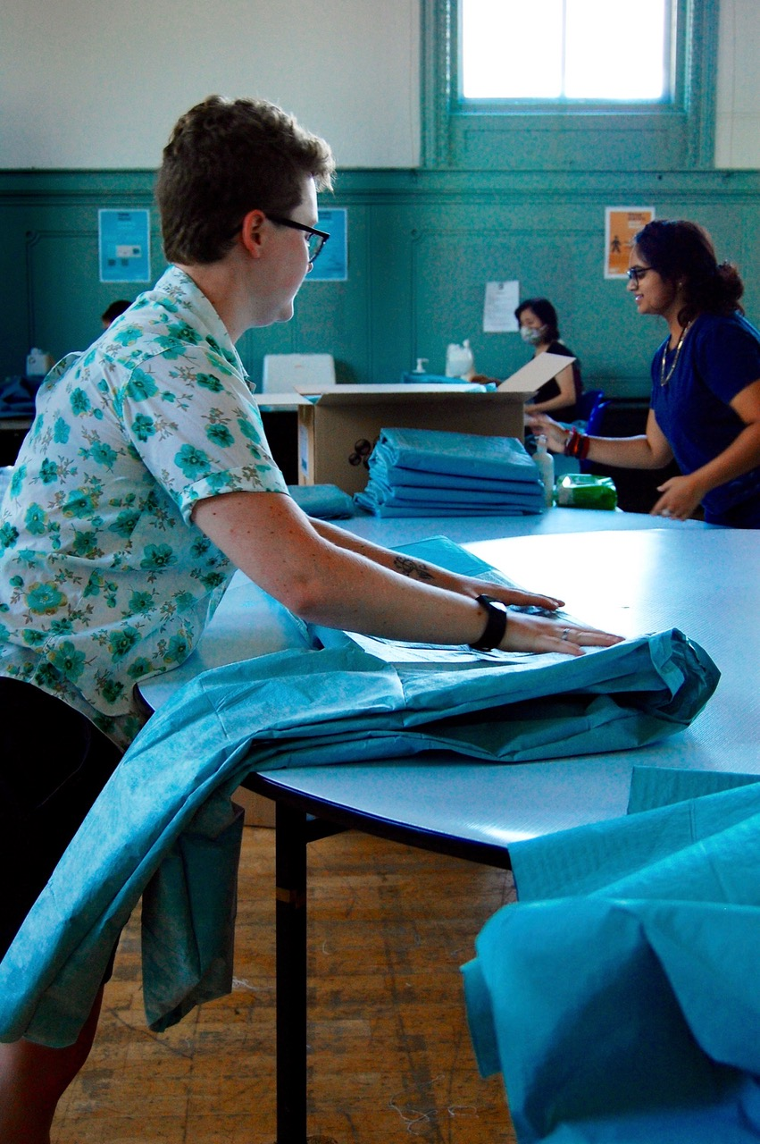
Examples of how volunteers can help in hospital
Delivering medicines and samples
Encouraging patients to fill out patient survey,
Keeping patients flow within the ED department,
Changing beds, keeping the wards tidy, restocking
Distributing donations and face masks,
Encouraging members of the public to wash hands,
Dropping off patients’ belongings
Running staff wellbeing hub: ensuring staff have plenty of refreshments and encouraging staff to take breaks
Keeping patients updated with their clinical appointments
Meeting and greeting patients when they arrive at the hospital, escorting them to clinics
Mealtime assistance: Helping patients with hydration and nutrition needs
Helping patients to stay in touch with their loved ones: Deliver laminated letters from a loved one to patients, helpings patients to use ipads to communicate with their loved ones
Buggy drivers: volunteers use buggies to take patients to their appointments in the hospital
Animation therapy: Volunteers engage patients in meaningful therapy activities to help them rehabilitate
Bereavement support: volunteers make follow up phone calls to support bereaved families
Discharge follow up: Volunteers phone patients to ensure patients are settling in when they are discharged
Virtual volunteering roles: Volunteers deliver storytelling sessions or craft activities over Zoom for patients

Slide 8
How can Helpforce help NHS Trusts to maximise the impact of volunteering during this challenging winter?
Co-design volunteering interventions to enable volunteers to be part of the Trust’s solution for challenges posed by the pandemic
Evidence the impact of the Trust’s volunteer services through a structured impact measurement process
Connect NHS Trusts with others as part of peer learning and support
Contact us at help@helpforce.community

Slide 9
Trusts who have been able to mobilise volunteers in hospital:
Barts Health NHS Trust
Chelsea and Westminster Hospitals NHS Trust
East Sussex Healthcare NHS Trust
Northampton General Hospital NHS Trust
Sandwell and West Birmingham Hospitals NHS Trust
Liverpool University Hospitals NHS Foundation Trust
Leeds Teaching Hospitals NHS Trust
South Tees Hospitals NHS Foundation Trust
West Hertfordshire Hospitals NHS Trust
Sussex Community NHS Foundation Trust

Slide 10
Case study
Active Response Volunteers at Barts Health NHS Trust
Between 2018 - 2020, Helpforce funded and supported the Volunteering service at Barts Health NHS Trust to develop and run the Active Response Volunteering (ARV) model as part of the Volunteering Innovators Programme.
During the Covid-19 pandemic, the Active Response Volunteering (ARV) model has been pivotal in being able to quickly adapt to changing requirements and create a flexible service that could support staff and patients.
The roles of the Covid-19 response volunteers included:
Distributing donation of food to staff
Supporting staff wellbeing hubs
Managing the front hubs for visitor requests including taking items dropped by visitors up to the patients
Laminating and taking up messages from a loved one to patients who have not been allowed to see visitors
Helping to collect deceased patient belongings from wards and organising collection with the next of kin
Volunteers supporting front door assessment of visitors e.g. temperature check and mask wearing
Helping with fit testing
Donning and Doffing area support
Administration tasks
Supporting hospital ward moves
There is strong recognition of the adaptability and flexibility that the ARV model was able to achieve in a short space of time and the resultant support volunteers were able to provide during this difficult time.
Some of the key achievements included:
45,000 meals given to staff not able to leave Covid wards
Staff Well-being hubs entirely run by the volunteers who responded efficiently to staff requirements
Over 1,750 items taken up to patients from visitors
350 Items belonging to deceased patients returned to next of kin
5,000 scrubs organised in preparation for the Nightingale
8 ward moves supported by volunteers including two brand new Covid wards at Royal London Hospital
TTA deliveries
You can also visit this link to learn more about the model and download materials to help you adopt and adapt this service.
If you would like to adapt the Response volunteering model at your Trust, please email us at help@helpforce.community.

