Slide 1
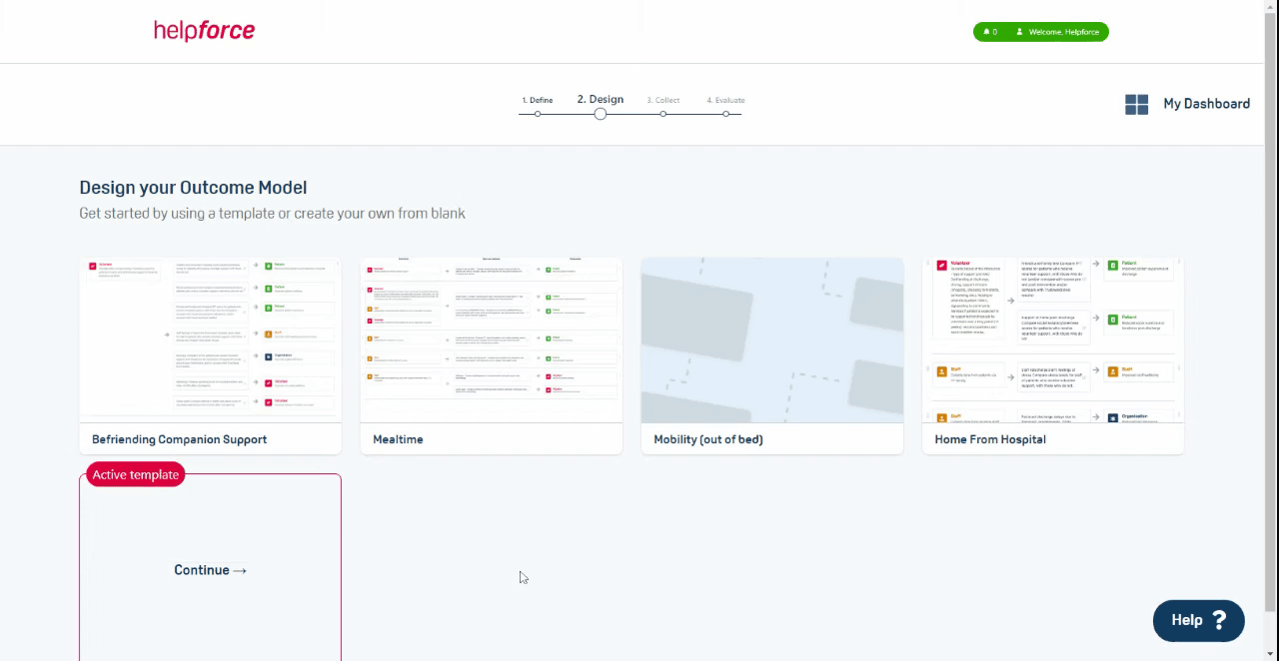
How to improve your volunteering service through Insight & Impact
A series of webinars to help managers of volunteers collect more data, improve their service, and prove its impact
Day 1: Why evaluate?
Day 2: Barriers to evaluation
Day 3: Helpforce I&I service
Thursday May 13th, 2021
Thursday May 20th, 2021
Thursday May 27th, 2021
Notes:
Commentary:
In this series we will hear from different perspectives that will help you all: collect more data, improve your volunteering service, and prove its impact
In today’s session, Nuffield Trust will share highlights from a new guide produced to assist volunteer managers with evaluation
On day 2, next week, we will be joined by PPL to share learning from the Volunteering Innovators Programme, with a focus on some of the typical barriers and how these can be addressed
On day 3 you will hear about Helpforce’s new Insight & Impact service that provides another option for managers of volunteers, which we hope will provide hands-on support for evaluation

Slide 2
The big picture: why evaluate?
More evaluation
More data
More evidence
Greater impact of volunteering
Quant & Qual
Evidence of impact
Service improvements
Quality improvement
Higher profile with NHS leadership (‘mainstream volunteering’)
Increased investment
Create more volunteering opportunities – to help with the NHS recovery
Activity
Impact data
Insights
New & existing roles
Service-wide
Ongoing - not just end of project

Slide 3
New guidance report from Nuffield Trust
https://helpforce.community/enabling/publications

Slide 4
Evaluating the impacts of your volunteering service
A guide for managers of hospital volunteering services
May 2021

Slide 5
Background: how this guide was developed
Introduction: monitoring vs. evaluation
2
This guide was informed by an activity that examined which characteristics made the 12 Trusts involved in Helpforce’s Volunteer Innovators Programme (VIP) good candidates for an ‘impact’ or ‘outcomes’ evaluation.*
The volunteer services were diverse, spanning for example discharge from hospital, nutrition and hydration, and peer debriefing in mental health settings. Each service sought to improve outcomes across four categories: patients, volunteers, staff and the wider system. See the example below and on the following two slides.
Background: Volunteering Innovators Programme
4
Expected outcomes
VIP service description
Before you begin: issues to consider
 | Patients: Improve patients’ experience of care and emotional wellbeing, and an improved confidence around their mobility
 | Volunteers: Increase volunteer employability in healthcare, and improve their wellbeing and experience of volunteering
 | Staff: Save staff time and increase their confidence in the quality of care they provide, improve their perception of volunteers
 | The system: Faster discharge from hospital, reduce (re)admissions to hospital, or reduce complaints received by the hospital
7
Volunteers were trained to support patients to stay mobile during their hospital stay
Volunteers provided basic physiotherapy to patients who were waiting to return home
Four steps of evaluation
8
Pit stop: questions to ask yourself
9
Before we get into the detail, we should be clear that there are numerous ways of evaluating a volunteering service. This guide focuses on conducting a robust outcomes evaluation to measure how much of a difference your service is making for patients, staff, volunteers and the system in the short and longer term.
How to use this guide
* We used an adapted version of Davies (2013) evaluability assessment, see: Davies, R., 2013. Planning Evaluability Assessments:
A Synthesis of the Literature with Recommendations. Report of a Study Commissioned by the Department for International Development.
Available at https://www.gov.uk/government/uploads/system/uploads/attachment_data/file/248656/wp40-planning-eval-assessments.pdf
10
4

Slide 6
Before you begin: four evaluation issues to consider
Introduction: monitoring vs. evaluation
2
Background: Volunteering Innovators Programme
Audience
Resources
4
1
Purpose
2
Audience
3
Resources
4
Goals
Before you begin: issues to consider
What is the purpose of the evaluation?
For example, will it be used to prove the value of your service to Trust executives?
Or will it be used to improve your service?
Who are the key audiences of your evaluation?
What level of evidence do they need?
Which outcomes and/or impacts are they interested in?
What resources (time, money, expertise) will be needed and are these resources available?
Do you have a working / steering group?
What are the goals for the service?
What would you like the service to achieve for patients, staff, volunteers, the hospital?
7
Four steps of evaluation
8
Pit stop: questions to ask yourself
9
Note: The evaluation work should be underpinned by a working group made of up key stakeholders (e.g. patients who use or could potentially use the service, a mix of frontline staff, service managers, and where possible, data analysts, transformation / quality improvement team members, data analysts, and Trust senior leaders / executives). The group should develop processes/tools to help capture and store data in an appropriate way.
How to use this guide
10
7

Slide 7
This guide follows four steps of evaluation
Introduction: monitoring vs. evaluation
2
Reflect on results and report your service achievements
Describe how and why your service works
Background: Volunteering Innovators Programme
Regularly report your findings and consolidate all of your learning into a summary with recommendations
Write down what will change as a result of your service, how and why (in a theory of change)
4
4
1
Issues to consider:
Relevance
Clarity and complexity
Issues to consider:
On-going reporting (e.g. PDSA) vs summative reporting
Before you begin: issues to consider
7
Collect and analyse data
Plan the evaluation with your working group
Collect stories and numbers. Compare and combine these into evidence. Share emerging findings.
3
2
Four steps of evaluation
Build a working group. Think carefully about why you are doing an evaluation – which decisions are you trying to influence?
8
Issues to consider:
Baselines, comparison groups
Data collection and analysis
Issues to consider:
Stakeholder agreement
Plausibility and sustainability
Link between indicators and outcomes
Context
Ethics and governance
Pit stop: questions to ask yourself
9
How to use this guide
In this guide you will be taken through four steps covering a total of 10 points to consider and checklists that will encourage you to ask yourself questions to ensure you’ve understood the concept. We also compare ‘good practice’ and ‘practice that could be improved’ and give you tips to overcome common challenges.
10
8

Slide 8
Questions to help prompt your evaluation planning
Introduction: monitoring vs. evaluation
2
Clarity & complexity
Stakeholder agreement
Plausibility & sustainability
Indicators & outcomes
Relevance
Background: Volunteering Innovators Programme
What is the problem your service is trying to solve?
Is your service relevant to the problem identified?
Is the service clearly described?
Are you clear on the service’s goals?
Have you identified short and long-term outcomes?
Does the target population have boundaries?
Does your working group have wide representation?
To what extent does the working group agree on evaluation plans?
Is there a clear timeline?
Is it likely that the project objectives could be achieved in that timeline?
What are the service’s plans for sustainability?
Could the indicators plausibly reflect the expected outcomes?
Are the expected outcomes realistic?
4
Before you begin: issues to consider
7
Step 1
Step 1
Step 2
Step 2
Step 2
Ethics & governance
Baselines & comparisons
Data collection
& Analysis
Four steps of evaluation
Context
Reporting
8
For the service and its evaluation:
Have internal / external enablers and barriers been identified?
How will you monitor these?
What approvals will you need for your evaluation?
What baseline data will you use?
Who will form your comparison group?
How consistent will data collection be? How frequent?
Will the sample be big enough for quantitative analysis – or would qualitative approaches be better?
Will you report findings throughout (for service change) or at the end?
In what ways can you share your findings with varied audiences?
Pit stop: questions to ask yourself
9
How to use this guide
Step 4
10
Step 2
Step 2
Step 3
Step 3

Slide 9
How to use this guide
Introduction: monitoring vs. evaluation
2
This guide covers ten issues to consider when doing an evaluation. Each issue is described on a single slide or a few slides – depending on the amount of information needed to explain the issue.
In this section of the slide, the issue is introduced and examples are provided.
Sometimes the explanation is brief and summarised in a paragraph or two (e.g. ‘Is your service relevant to the problem identified? ’). Other times, the explanation is more complex and more detail and diagrams are needed and spans a few slides (e.g. ‘Is your service logic clear?’). Each issue compares good practice vs. practice that could be improved, as well as top tips and a check-in question before you move on.
Questions to ask yourself
In this section of the slide we summarise questions that you should ask yourself to see if you have fully considered and addressed the issue in your evaluation.
Top tips
In this section of the slide we provide examples of challenges experienced by the VIP sites and other NHS organisations we have evaluated, as well as top tips to overcome these challenges.
Background: Volunteering Innovators Programme
4
Before you begin: issues to consider
7
Four steps of evaluation
8
Examples of good practice | Practice that could be improved
In this section of the slide, we provide examples of good practice based on what was visible in the VIP programme and also in other NHS organisations that have carried out local evaluation. This list is not exhaustive but gives you a good sense of what to aim for. | In this section of the slide, we provide examples of poor practice. The list suggests what you should avoid doing.
Pit stop: questions to ask yourself
9
How to use this guide
10
10

Slide 10
The four steps of evaluation

Slide 11
Relevance
13
Step 1: Describe how and why your programme works
STEP 1
Clarity & Complexity
14
After this step, you should be able to answer:
What is the problem your service is trying to solve?
Is your service relevant to the problem identified?
Is the service clearly described?
Are you clear on the service’s goals?
Have you identified short and long-term outcomes?
Does the target population have boundaries?
Working group agreement
20
Plausibility & Sustainability
22
Indicators & Outcomes
STEP 2
23
Step 4:
Step 1:
Context
Reflect on results and report your service achievements
Describe how and why your service works
24
Ethics & Governance
25
Baselines & Comparisons
27
Step 3:
Step 2:
3
STEP 3
Collect and analyse data
Plan the evaluation with your working group
Data collection & Analysis
29
35
STEP 4
Reporting

Slide 12
Is your service logic clear? (1/5)
Relevance
13
STEP 1
Clarity & Complexity
14
The first step in an evaluation is describing your volunteering service and justifying how and why it works.
Inputs
Activities
Outputs
Outcomes
Working group agreement
20
the service’s resources (those available and those missing), which can include units of time, staff, money, equipment, know-how, ideas, etc.
For example: volunteers are trained to identify and support patients with mealtime support needs
what volunteers needs to do with/for the target patient group to ensure that the service is successful
For example: volunteers assist patients unable to eat and drink independently during all mealtimes on a daily basis)
what will result from volunteers carrying out the described activities
For example: number of volunteers trained as a proportion of all volunteers, number of patients assisted as proportion of all patients in need in a given week, number of mealtimes where assistance was provided as a proportion of all mealtimes in a given month
the changes, benefits, learning or other effects that happen as a result of services
For example: decrease in the number of patients who were at risk of dehydration and malnutrition
Plausibility & Sustainability
22
Indicators & Outcomes
STEP 2
23
Context
24
Ethics & Governance
25
Create lists in each of the boxes above and once your lists are ready, start linking items: ‘If [input A + activity A], then [outputs A + outcomes A]’ will result. Continue with input B, C, etc. Sometimes it is easier to work backward from your outcomes.
Baselines & Comparisons
27
These ‘if, then’ statements outline your assumptions about how and why your service works. Each statement is called a ‘theory of change’.
You will likely have multiple theories of change for a single service because you want to have an impact on more than just one group of people (e.g. patients AND staff), or because your service has multiple components or steps.
Writing out your theories of change clearly ensures that everyone involved understands what exactly is being evaluated and why you think it works. See an example of the questions our team used to prompt a VIP service to develop their theories of change in slide 17.
STEP 3
Data collection & Analysis
29
35
STEP 4
Reporting
14

Slide 13
What data do you plan to collect? How will you analyse it? (1/5)
Relevance
13
STEP 1
Clarity & Complexity
14
Collecting your own data
Draw on the resources of in-house analysts and other staff/ students/ volunteers who are well-positioned to collect data where possible. The Better Evaluation website provides data collection toolkits on some of the most common forms of data collection, including observation, surveys, focus groups. As the team collects data, save them to a secure database every day – and back this up. Keep GDPR guidance in mind when collecting and storing data and consult the R&D team with any queries. Some of the most common sources of data collected during the Helpforce VIP evaluations included:
Adapted versions of surveys created by Helpforce to measure patient and staff experience. If you want to create your own surveys, you can borrow questions from large scale surveys such as the NHS Staff Survey (you will need to acknowledge the survey you have borrowed questions from in outputs and may need permissions depending on the survey)
‘Bespoke’ metrics that were developed by Trust data teams to measure the service’s impact on the hospital.
A common evaluation challenge is knowing when you have collected enough data. Using a ‘study design’ table (see an example on slide 32) can help you map your evaluation questions, approaches to collecting and examining data on your service, information you think you will obtain based on your planned approaches, and the stage at which you think you will have ‘good enough’ data.
Keep your theory of change in mind
A significant part of the analysis process will require the team trying to understand the causes of outcomes by critically assessing the data collected against the ‘theory of change’.
It can be helpful to undertake some early analysis. This will allow your emerging results and your interpretations of their causes to inform how the service (or evaluation approaches) can be improved. Be careful about publishing early results, as it is possible the data trends could change directions.
Sample size
An important consideration for the evaluation is the possible sample size. For example, it may be that you have 200 volunteers, which would allow you to look at a very common outcome, but not a really rare outcome.
Some VIP Trusts chose to undertake very specific and targeted interventions and as a result had very small numbers of volunteers and patients involved – for example in end of life care or restraint settings in particular wards. These small numbers made it difficult to determine any quantitative metrics that would demonstrate impact.
Working group agreement
20
Plausibility & Sustainability
22
Indicators & Outcomes
STEP 2
23
Context
24
Ethics & Governance
25
Baselines & Comparisons
27
STEP 3
Data collection & Analysis
29
35
STEP 4
Reporting
29

Slide 14
How will you reflect and report on the evaluation findings? (2/2)
Relevance
13
STEP 1
Clarity & Complexity
14
Output type | For whom? | Top tips | Examples
Recommendations | Policymakers Hospital boards | Set out clear recommendations and try to keep them succinct – one page should do! | Transforming Ageing report
Case studies | Volunteers Patients | Case studies can be a nice format to show other volunteers or patients what you are doing and your findings in a digestible way. Make use of different websites: Helpforce, the hospital’s – or create your own ‘stories’ page or send regular newsletters. Be sure to include a clear description of your programme. | Voluteering Matters Voluntary Impact NESTA guidance (see item 28 for a newsletter example) NCVO
Evaluation reports | Policymakers Commissioners Hospital boards Other volunteering services | Evaluation reports are a comprehensive and robust way to demonstrate your findings and make the case that your service has impact. If you find writing a full report a bit daunting, consider pairing up with a research organisation and asking them for support in writing it. Try and keep it concise – and make use of diagrams to make the content more accessible. | Helpforce VIP evaluation Nesta Helping in Hospitals evaluation Corporate Volunteer Programme Valencia King’s Fund evaluation of King’s College Hospital volunteering programme
Academic publications | Academics Policymakers | Writing academic publications can help cement your findings into a wider evidence base. Support from a research organisation might be helpful in targeting the right journals. | Evaluation of a volunteer hospital programme in rural Australia
Working group agreement
20
Plausibility & Sustainability
22
Indicators & Outcomes
STEP 2
23
Context
24
Ethics & Governance
25
Baselines & Comparisons
27
STEP 3
Data collection & Analysis
29
35
STEP 4
Reporting
36

Slide 15
Thank you
www.helpforce.community
help@helpforce.community

