Slide 1
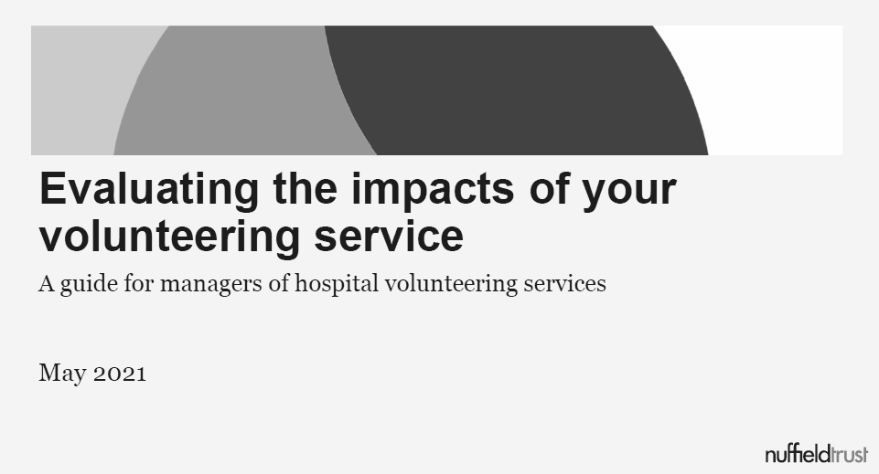
How to improve your volunteering service through Insight & Impact
A series of webinars to help managers of volunteers collect more data, improve their service, and prove its impact
Day 3: Launch of I&I Service
Day 1: Why evaluate?
Day 2: Barriers to evaluation
Thursday May 27th, 2021
Thursday May 13th, 2021
Thursday May 20th, 2021

Slide 2
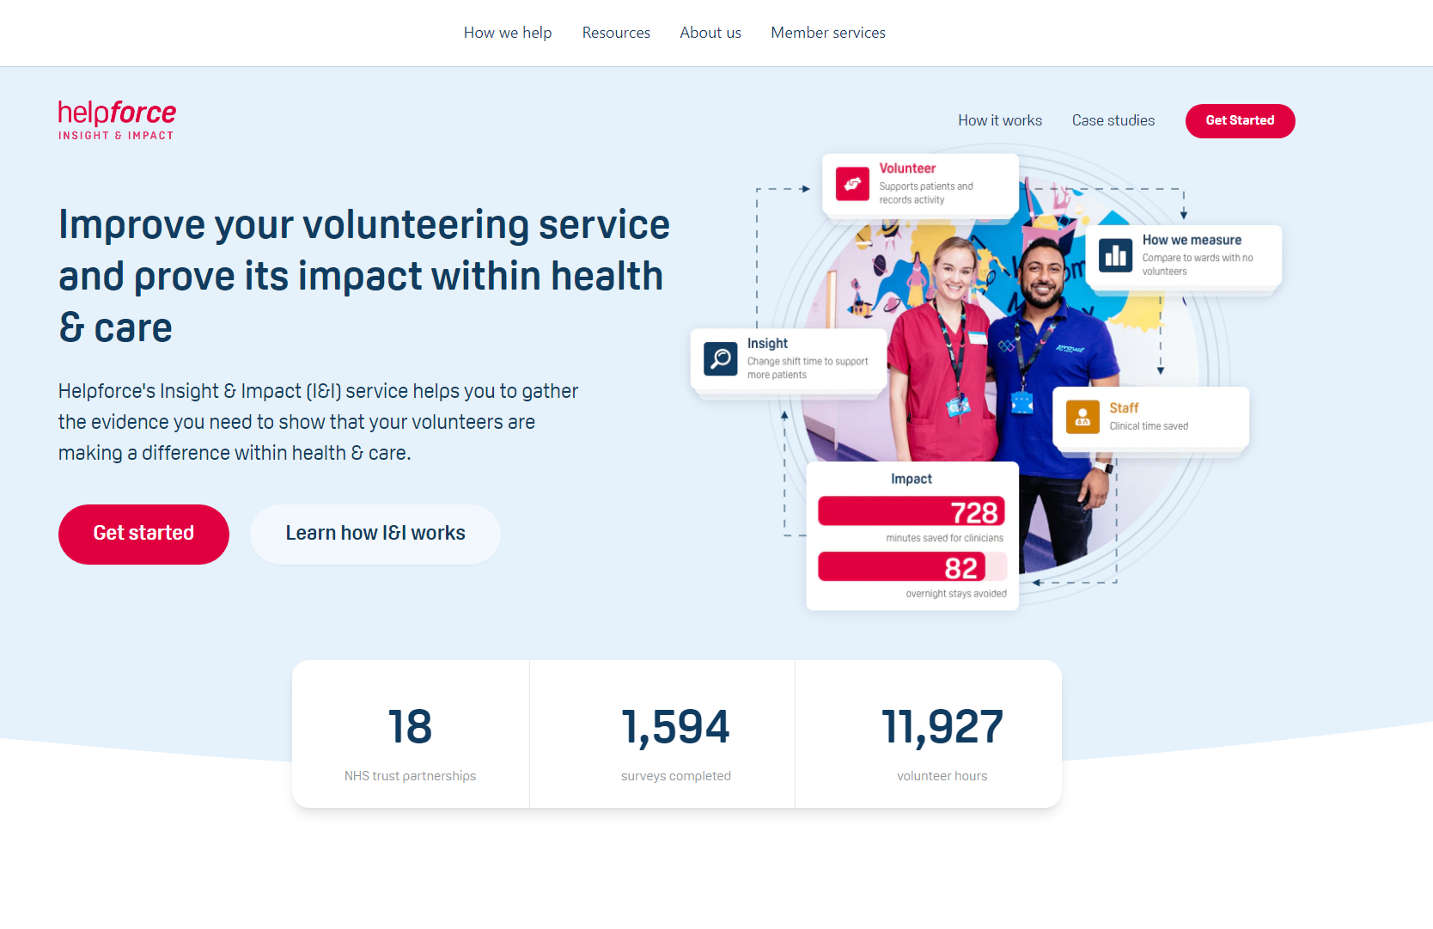
Site live today
https://helpforce.community/iandi/landing-page
OR
https://helpforce.community/ (home page) -> click on ‘Member services’ -> I&I service

Slide 3
What is the Insight & Impact service?
The Helpforce I&I service
A free service to help you measure the difference that volunteering makes to your organisation and beneficiaries
Aims to make data collection and analysis process simpler - no need to be an evaluation expert
We help you collect data that demonstrates:
Insight = how to make continuous improvements to
your volunteering service
Impact = the difference your volunteering service
makes against key health measures
Who is the service for?
Anyone who manage volunteers or volunteering projects
Who wish to prove its value against health measures
Benefits of using the service
Prove to stakeholders how volunteering is making a difference to patients, families, staff, volunteers, services
Show how volunteering supports quality improvement by impacting key measures in your health system
Understand how you can improve your service through data insights
Form evidence that could help underpin a financial case for sustainability or further investment
What’s in the service?
A website guides you through a simple evaluation process, and enables you to save & share the progress you make
Along the way our Helpforce team of evaluation experts offer a helping hand to review & improve your project
We’ll help collect & then analyse your data, and produce evidence findings
Digital / interaction via website
Service model / interaction with our team (and our processes & tools)

Slide 4
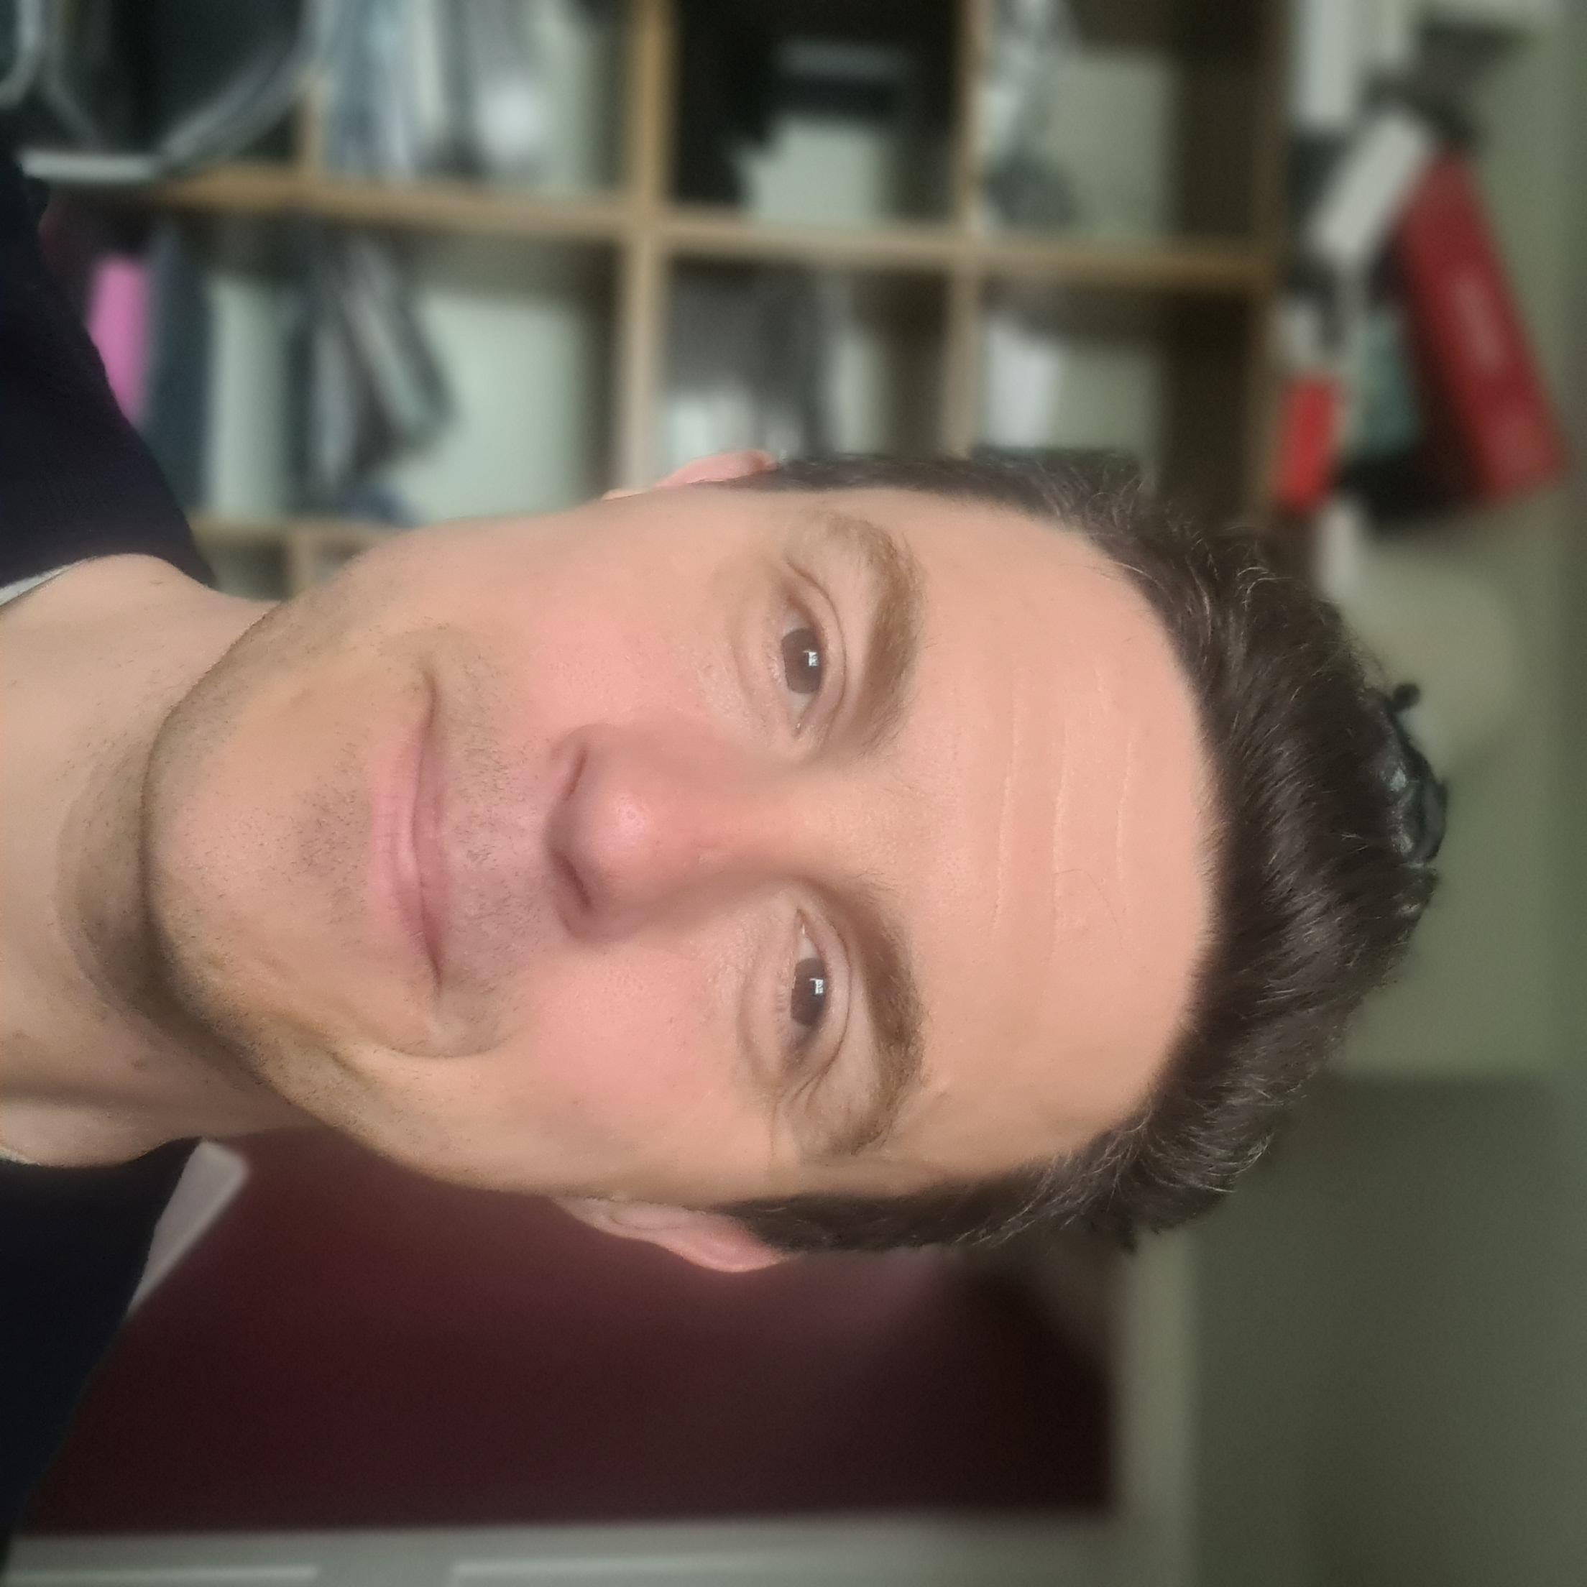
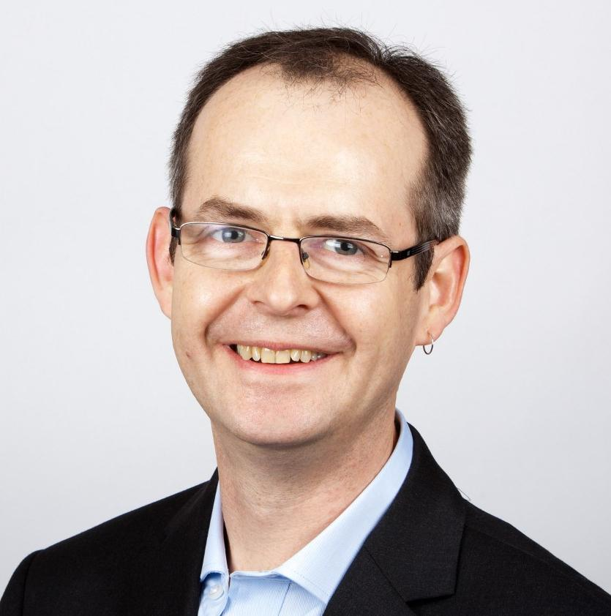
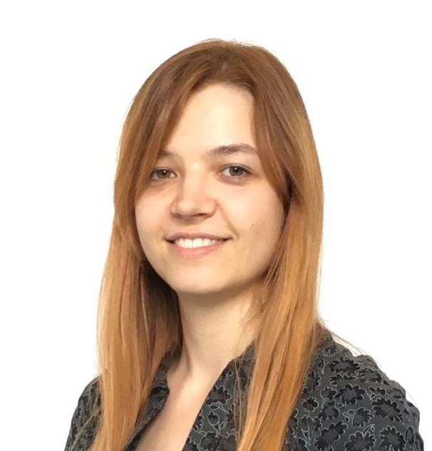
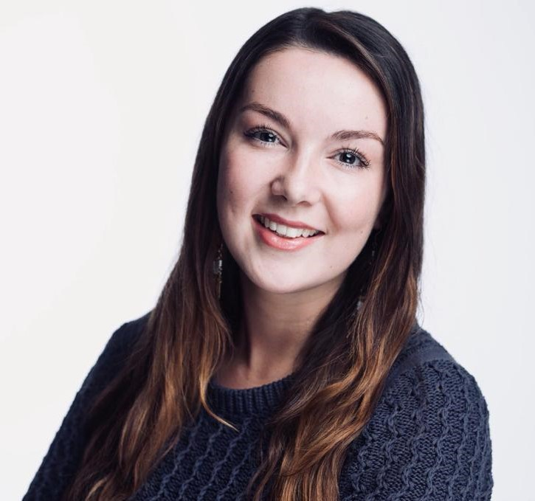
Who will be supporting you?
Helpforce Insight & Impact service team
Paddy Hanrahan
Director who helped set up Helpforce. Designed the I&I process we’ve used to evaluate 18 NHS projects to date.
Role: oversee service and ensure it continues to grow, improve, and deliver evidence to help accelerate volunteering within health & care.
Mark Brooker
Role: Interim I&I Lead
An experienced health evaluation expert on loan from PPL. Mark played a key role in the production of our VIP evidence report, and has a lot of experience of designing and delivering evaluations against key NHS measures.
Rahel Spath
Role: Data Analyst
An independent data analyst who has worked closely with Helpforce for over three years, including the VIP evaluation. Has broad experience with evaluating volunteer services, crunching health data, and creating evidence findings (and lovely graphs).
Mel Griffith
Role: I&I Consultant
Recently joined Helpforce from GE Healthcare. Mel is friendly and approachable, a great problem solver, and broad experience of supporting health clients. Here to help you progress your projects, and help you get the most out of the service.
PPL (additional team members)
Helpforce’s partner for the I&I service, we can reach out for help from PPL’s team, which boasts a broad range of skills in the health & social care evaluation space. Their team works across primary care, community health, and integrated care pathways. And worked on national level programmes such as ‘Realising the Value’

Slide 5
Co-developed with volunteering leaders…
…for volunteering leaders.
We wish to thank the following people who helped with testing the service, and providing ideas & feedback:
Mandy Cleaver, Sussex Community NHS Foundation Trust
Laura Greene, Kingston Hospital NHS Foundation Trust
Lucy Boulter, Salford Royal NHS Foundation Trust
Catherine Jowitt, Bradford District Care NHS Foundation Trust
Antoinette Webber, Barking, Havering and Redbridge University Hospitals NHS Trust
Maria Walker, Royal Berkshire NHS Foundation Trust
Elizabeth Pollard, Plymouth Hospitals NHS Trust
Barry Pridmore, The Royal Marsden NHS Foundation Trust
Emma Wimpress, Northampton General Hospital Trust
Mark Cruise, West Hertfordshire Hospitals NHS Trust
Paul Wharton, North Tees and Hartlepool Hospitals NHS Foundation Trust
Nancy Whiskin, Barts Health NHS Trust

Slide 6
Demo

Slide 7
Q&A
Questions raised by audience:

Slide 8
Thank you
www.helpforce.community
help@helpforce.community

