Slide 1
Volunteer to Career at LGT
VtC Pathways for Veterans and Military Spouses at Lewisham and Greenwich NHS Trust
Helpforce presentation, 27th February 2025

Slide 3
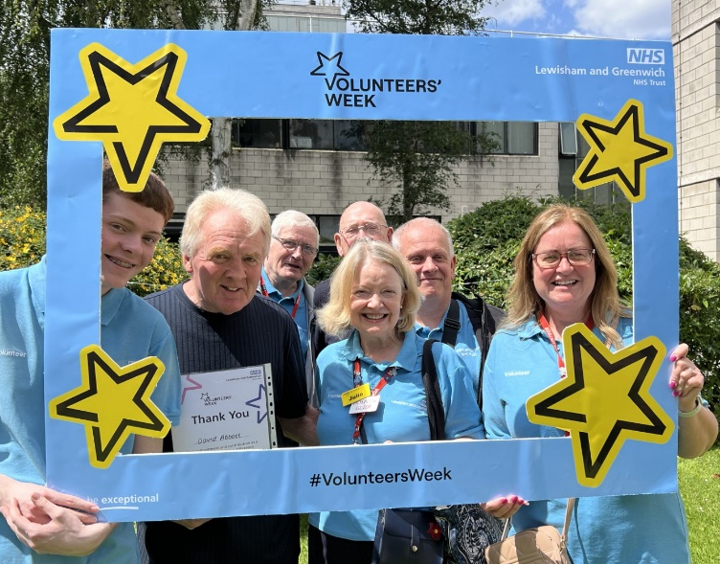
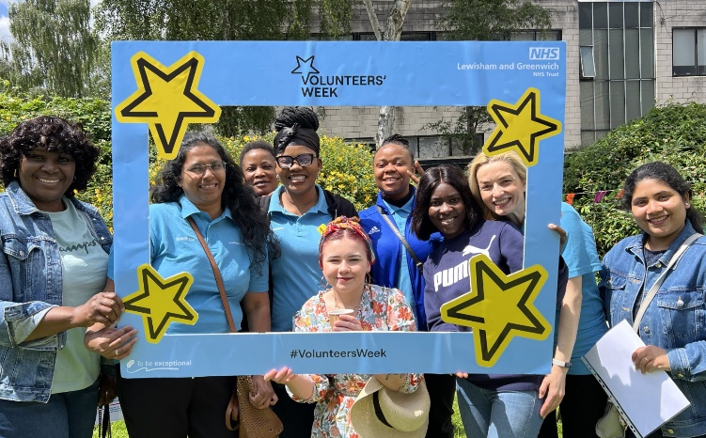
Why choose to be with LGT?
LGT is a community-focused provider of local and acute care, delivering services to over one million people
Employs over 7500 members of staff supported by over 200 volunteers
Year on year improvement in vacancy rates and staff retention
Established successful Volunteer to Career programmes
Recipient of numerous national awards including:
Best Recruitment Experience
Staff Wellbeing
Innovation in Recruitment

Slide 4
Volunteers at LGT
Play an integral role in supporting our Trust vision and values
Volunteer candidates considered from communities our Trust serves: Lewisham, Greenwich and Bexley.
Non-clinical support to enhance patient and staff experience:
Ward Volunteers
Provide non-clinical support to patients and staff
Mealtime support
Company during mealtimes, serve food etc
Admin Volunteers
Assist with general admin i.e data entry, filing,
answering phones
Outpatient support
Befriending, Guiding patients and visitors etc
Children’s Activities support
Interact and socialise, Promotes creativity etc
Guides / meet and greet visitors
First point of contact, direct or accompany visitors etc
Arts volunteers
Supporting with exhibitions and arts activities,
playing musical instruments
Maternity services support
Support to patients, and relatives while visiting the hospital
Garden Volunteers
Assist with gardening at wellbeing garden, UHL
Adult & Paediatric in ED
Supporting staff and patients with non clinical tasks

Slide 5
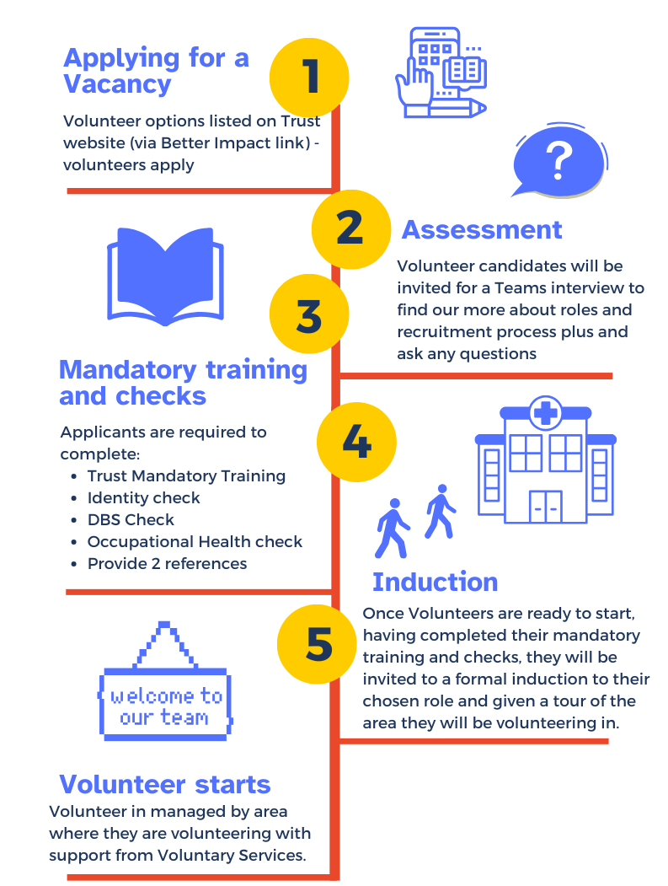
Application and commitment
Complete recruitment process
Commit to min. 2 hours per week, 6 month period
Key personal qualities and skills such as empathy,
listening, communication, observation, reliability,
open to learn, initiative and attention to detail.
Volunteers must comply with policies including:
Record volunteer hours on Volunteer database
Confidentiality and attendance
Dress Code
Non-clinical activities. Not give medical advice/care
Embody Trusts Vision and Values

Slide 6
Launching VtC programme
Previous success launching and delivering VtC maternity programme
Building relationships with Veteran support organisations/key contacts i.e.
Poppy Factory
Local barracks
Engaging and buy-in from LGT Veteran Network/Senior colleagues championing this opportunity
Reaching out to current Veteran on Veteran Spouse colleagues
Reaching out to Trust partners for variety or roles
Targeted Comms for V2C cohort recruitment
Volunteer candidates considered from communities our Trust serves: Lewisham, Greenwich and Bexley

Slide 7
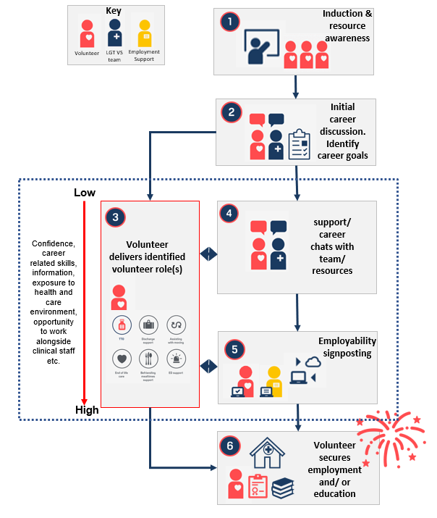
LGT VtC Career Pathway
1. Volunteer induction and awareness
2. Initial career goals discussion/interview
3. Impactful volunteer roles
4. Ongoing support
5. Experience through volunteering
6. Employability support
7. Securing employment or education

Slide 8
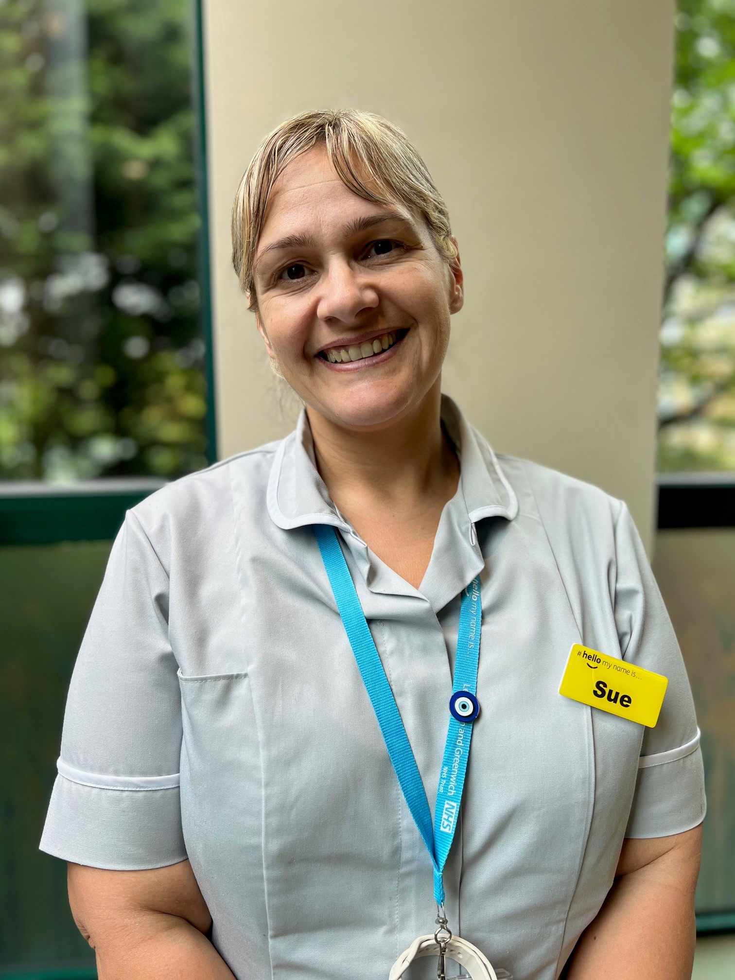
Volunteer to career success - case study
Sue – Joined LGT Volunteer to Career pathway and secured a role at trust in January 2024. Sue is a mum who was made redundant from her office job in July 2023:
‘’Advice is to create an account with Trac and keep looking every day. Also, on Indeed they sometimes advertise open mornings to help progress with a career in the NHS and help you fill out an application.
When doing your shift within a ward keep yourself proactive, talk to staff let yourself be known to them and always keep asking if there is anything they can help with. Ask to shadow them when doing rounds so you gain more knowledge. Ask volunteer services if there any programs coming up in the near future. Being consistent and good time keeping!
As the saying goes "if you don't ask you don't get"

Slide 9
How to access VtC programme
Understanding volunteer roles that may be suitable for veterans/spouses
Maternity volunteers
Ward Volunteers
Guides/Way Finders
Admin/project management Roles
Gardening volunteers
Signpost this opportunity to Veterans/Spouses in community our Trust serves:
Lewisham
Greenwich
Bexley
Invite to apply to become a volunteer through our website and have initial conversation with our team.

Slide 10
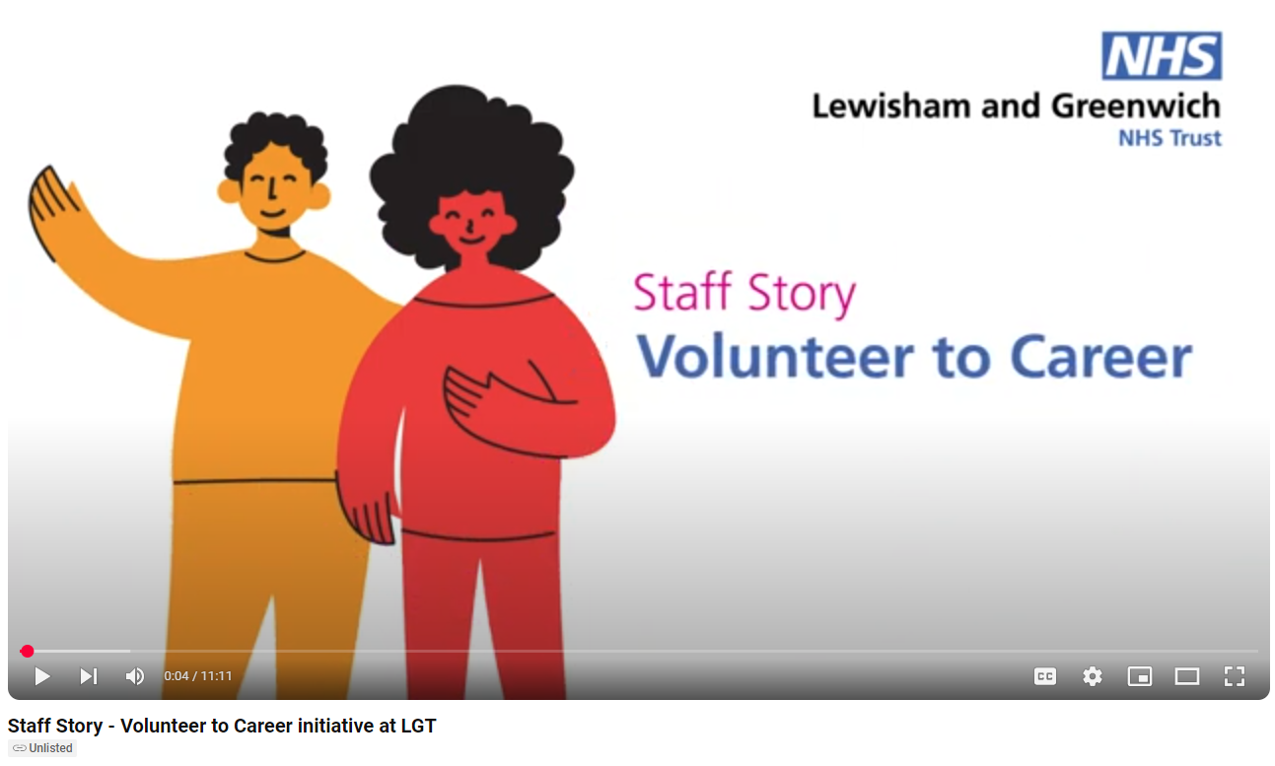
Volunteer to career – Staff Story

Slide 11
Key contacts
To find out more about volunteering at Lewisham and Greenwich NHS Trust and to apply to become a volunteer, visit our website:
Volunteer, volunteering, volunteers | Lewisham and Greenwich
You can also contact our Voluntary Services team on:
Lh.voluntaryservices@nhs.net
Contacts for any questions or queries about VtC:
Margarita Vidiella, Head of Charity and Volunteers - email: margarita.vidiella@nhs.net
Richard Lee, Voluntary Services Lead - email: richard.lee24@nhs.net
Jason Watson, Business Manager to the Chief Nurse and the Chief Medical Office email - jason.watson5@nhs.net

Slide 12
Thank you
Any questions?

