Slide 1
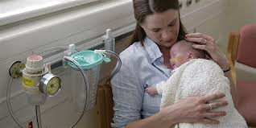
Nurturers Program Parent/carer Information
Why is the Nurturers program important?
Research has shown us that babies and toddlers need sufficient handling and touch for growth and emotional stability.
The nurturing program provides:
Nurturing and support of babies and toddlers by screened and appropriate volunteers when informed consent is given by parents/carers
Assistance for clinical staff in activities which provide a supportive environment for growing babies and toddlers.
Safe companionship for babies in occasional circumstances when parents need to leave the bedside for short periods of time.
Who can have a cuddle?
The Nurturers program volunteers are able to cuddle your baby or toddler with your permission.
These volunteers have undergone induction according to the Hospital’s policy.
They also have undergone additional training to prepare them for cuddling your baby or toddler, infection control measures, safe sleeping practices and settling and positioning techniques.
Nursing staff will still be supervising the care of your baby/toddler, cuddling is the only task that is undertaken by the volunteers.
How does my baby/toddler participate?
Please read this fact sheet and ask nursing staff if you have any questions.
If you decide to be part of the nurturing program a tag is placed over your cot/bed so volunteers know to visit your child.
We will ask you to sign a consent form which will be placed in your child’s folder along with a visit record sheet for the nurturer to complete so you can see when they visited your baby/toddler.
What if I have any questions?
If you have any questions please ask the nursing staff.
Discuss options with your nurse. You can then consent to joining the Nurturing program which offers your baby or toddler the opportunity to be cuddled when you are not here.

