Slide 1
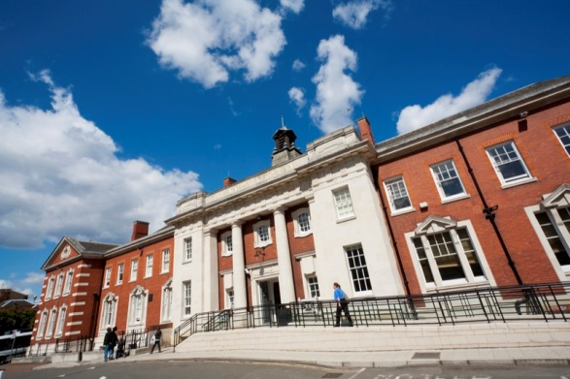
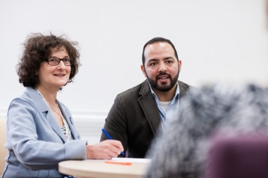
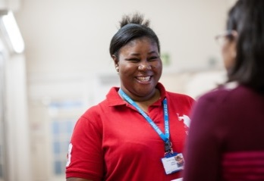
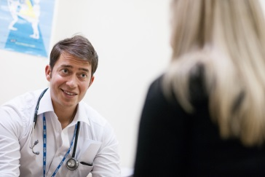
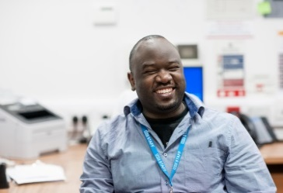
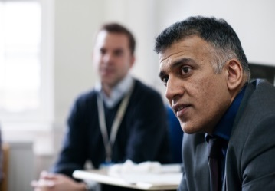
Msaada Personal Perspective from Joseph Kiguwa, BAME Volunteer Coordinator
Notes:
Hello, I am very pleased to be part of this Kings charity volunteer event, thanks for inviting me. I am joseph Kiguwa, a Black & Minority Ethnic , BME volunteer Coordinator.
Can I also say ‘Happy Black inclusion week for this week and the theme this year is
‘Together For A Better Tomorrow’ so I am raising awareness for everybody.
I am giving a personal perspective of a South London & Maudsley Foundation Trust’s , (SLaM ) Volunteering programme.
The volunteering programme is called Msaada, Swahili name meaning giving back and I have been coordinating Msaada since its inception in 2009.
I am not a clinician but have over 20 years experience coordinating various volunteering programmes.

Slide 2
Msaada Presentation Content
Msaada Personal Perspective from Joseph Kiguwa, BME Volunteer Coordinator
What is Msaada? (The need for a SLaM BME volunteer programme)
How Volunteers are Recruited/Trained and Placed
Examples of Volunteering (Inc Maudsley Charity video)
Current need for Volunteering – Activity Volunteer
Volunteer Achievements
Notes:
Msaada Presentation Content
My presentation focuses on:
What is Msaada? (The need for a SLaM BME volunteer programme)
How Volunteers are Recruited/Trained and Placed
Examples of Volunteering (Inc Maudsley Charity video)
Current need for Volunteering – Activity Volunteer
Volunteer Achievements

Slide 3
What is Msaada?
Black & Minority Ethnic (BME)Volunteer Programme
Funded by SLaM & The Maudsley Charity
Coordinated by a BME Volunteer Coordinator
Managed by a BME Service Manager
A Volunteer Service Manager provides governance
Notes:
What is Msaada?
Black & Minority Ethnic (BME)Volunteer Programme one of several SLaM volunteering initiatives
Provides BME volunteer befrienders to patients in acute male and female wards of the Maudsley hospital and to service users in the community- Peckham Befrienders .
Volunteers come from a wide range of backgrounds including those who are employed or not , undergraduates , postgraduates and those with lived experience of mental health , (declared or not).
Funded by SLaM & The Maudsley Charity
This stems from initial funding from Guys and St Thomas for a two year pilot.
Because at the time of the funding application it was noted from the Department of Race and Equality research that there was overrepresentation of BME groups in the mental health system for a host of socio economic reasons. BME volunteers have validated these observations and continue to come forward to address the issues especially tackling stigma and discrimination
Coordinated by a BME Volunteer Coordinator: Joseph Kiguwa
Managed by a BME Service Manager : Wayne Amiel, (also manages Peckham Befrienders)
A Volunteer Service Manager provides governance: Isobel Mdudu

Slide 4
How Volunteers are Recruited/Trained/Placed
Recruitment: Volunteer pack is emailed after enquiries from: SLaM’s Website –Msaada’s webpage:
https://slam.nhs.uk/msaadavarious Various Methods include, Outreach, Presentations, Maudsley Charity, Word of Mouth, Community Southwark
Training: Face to face or Online
Volunteer placements : Arranged By BAME Volunteer Coordinator
Monthly group supervision
Notes:
How volunteers are Recruited/Trained /Placed
Recruitment: Volunteer pack is emailed after enquiries from: SLaM’s Website –
Msaada’s webpage: https://slam.nhs.uk/msaada
Various recruitment methods include, Outreach, Presentations, Maudsley Charity, Word of Mouth, Community Southwark
Training: Face to face or Online, (adapted during Covid restrictions) by coordinator with support from current volunteers and service user involvement
Volunteer placements: Arranged By BME Volunteer Coordinator . Inductions and management takes within placements by designated staff
Monthly group supervision

Slide 5
Examples of Volunteering
Befriending:
Male & Female Acute Wards at the Maudsley Hospital
Community volunteering – Peckham Befrienders
Notes:
Examples of volunteering
Befriending: conversations, participation in engaging and social activities such as playing cards, dominoes, table tennis. These opportunities occur in
Male & Female Acute Wards at the Maudsley Hospital
Community – Peckham Befrienders (Video)
https://wetransfer.com/downloads/1c6e1996f166ac090e25c367de1c21bd20220420141818/662f694cf350600e86d2aebfecaeaff120220420141857/737e45

Slide 6
Current Need for Volunteer
*Befrienders in Peckham Befrienders
Ward volunteers
*Priority
Notes:
Current Need for Volunteers
Peckham Befrienders is proud to announce that it is now reopened after 2 years covid restrictions which affected many community services
Current need is for
*Befrienders in Peckham Befrienders
*Activity Volunteer/s in Peckham Befrienders
Ward volunteers will be considered but at a later stage of recruitment
*Priority
Placements are not guaranteed at the moment as we settle with covid management regulations

Slide 7
Volunteer Achievements
SLaM Volunteer Awards
Southwark Awards
Volunteers move into clinical roles & various roles in Health & Social Care
Patients Service Users and staff feel supported
Notes:
Volunteer Achievements
SLaM Volunteer Awards – Appreciation this year is shown by the presence from our chief executive sir Norman Lamb
Southwark Awards – Two Msaada volunteers are nominated to receive Champion awards at the Tate modern
Volunteers move into clinical roles & various roles in Health & Social Care
Patients, Service Users and staff feel supported

Slide 8
Msaada Thank you for listening !
Joseph.Kiguwa@slam.nhs.uk
Notes:
Thank you for listening!
My contact details are:
Joseph.Kiguwa@slam.nhs.uk
Useful links:
Msaada webpage : https://slam.nhs.uk/msaada
Maudsley Charity webpage promoting Msaada: https://maudsleycharity.org/case-studies/walking-for-recovery-with-lewishams-ladywell-unit/
https://slam.nhs.uk/service-detail/service/peckham-befrienders-238/
Peckham Befrienders Webpage: https://slam.nhs.uk/service-detail/service/peckham-befrienders-238/
Black Inclusion Week: https://www.blackinclusionweek.com/

