Slide 1
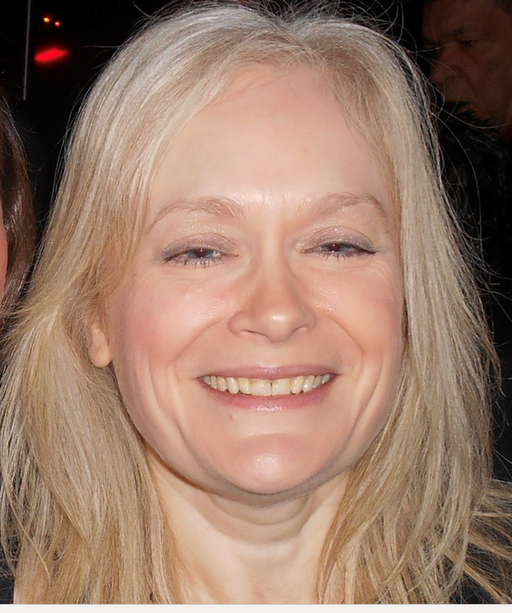
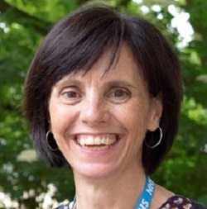
Volunteering Services lhnt.volunteer4LCHS@nhs.net Dawn Kay Volunteering Service Administrator Sally Darley Volunteering Service Manager
Notes:
Intro what I'm going to cover – who we are, what we do, how you can get involved
Comments and questions in the chat box
We’re a small team and our focus is to develop and manage a great quality service that supports both staff and volunteers
Our volunteering service is new and over the last 7 months we’ve been working to get things up and running

Slide 2
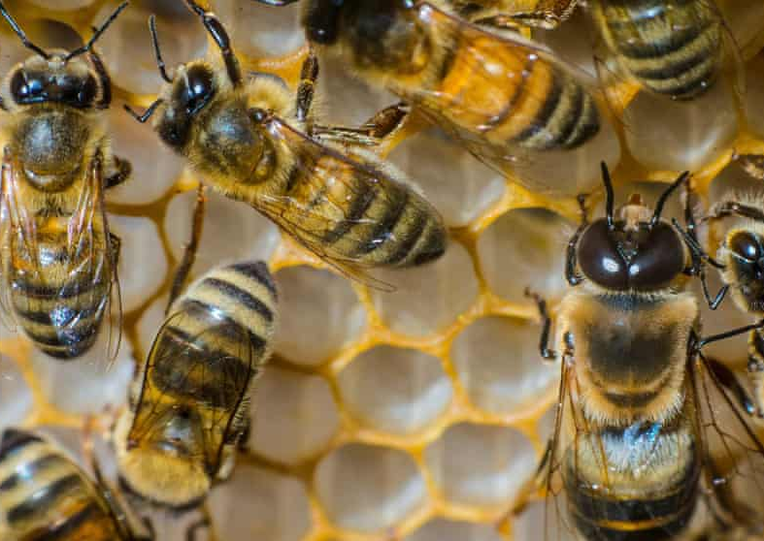
The story so far...
Standardising and updating processes and procedures
Creating resources
Developing new roles
Working with Lincolnshire partners
Connecting with existing volunteers
Notes:
We’ve been buzzing away behind the scene, building structures
- We want to make sure that all volunteers have the same great quality experience and staff understand what that mean
- We want you to be able to find the resources you need to support you to involve volunteers
- We want to offer a variety of interesting roles to our community that have a real impact
- At LCHS we don’t work in isolation, we’ve been building relationships with others who involve volunteers
- We had existing volunteer who have seen a lot of change and disruption over last couple of years. Important to keep them engaged

Slide 3
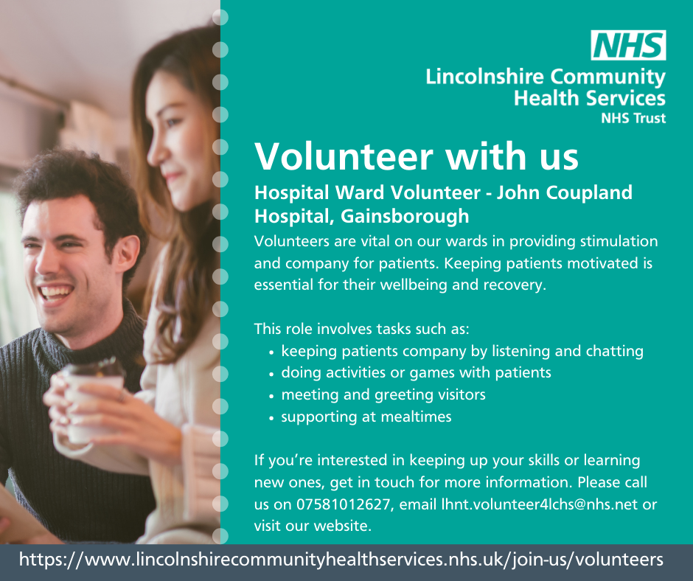
Current roles
Group Supporters – Cardiac and Pulmonary Rehab
Hospital Ward Volunteers – Gainsborough and Skegness
Communication Support – Children’s Therapy
Virtual Group Supporter – Post COVID
Hospital to Community Support Volunteer - Stroke Service
UTC Volunteers – Lincoln/Gainsborough
Administration Support - Ops Centre
Notes:
We’re starting to build a suite of different volunteer roles.
We have quite a bit of variety already. These have been developed with the service teams. Talk to me about your needs and I’ll work it up into a role that you’re happy with.
We’re keen to encourage people to think about non- traditional roles as well such as micro-volunteering, short term projects. They don’t have to be patient facing roles.

Slide 4
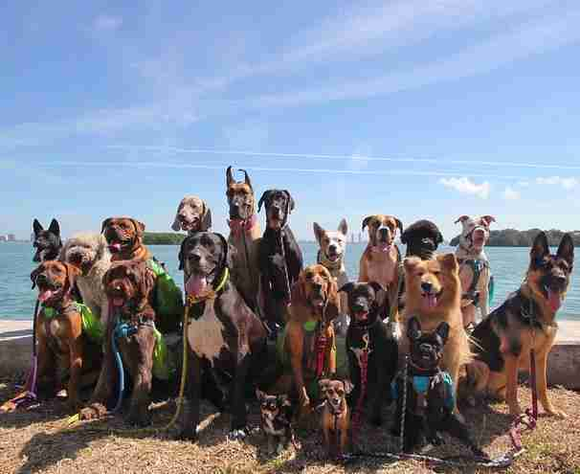
Get involved!
Supporting Staff
Supporting Patients
Lived Experience
Individual wellbeing
Connecting to the community
Future workforce
Notes:
If you need more convincing how about considering the benefits of involving volunteers
Supporting staff – supporting staff to focus on their core work​
Supporting patients – increasing patient contact time and improving patient experience​
Lived experience – volunteers can bring a unique element that staff members can't offer​
Wellbeing – social benefits, confidence, physical and mental wellbeing​
Community – we are a community trust – need to be connected to our patients​
Future workforce – we need more staff in Lincolnshire
If this sounds good to you…

Slide 5
Don’t get left behind
Think about it.
Talk about it.
Let us support you.
Notes:
How can volunteers improve your service?
Discuss it in your teams
Talk to teams that are doing it
Talk to us – call us, invite us to your meetings

Slide 6
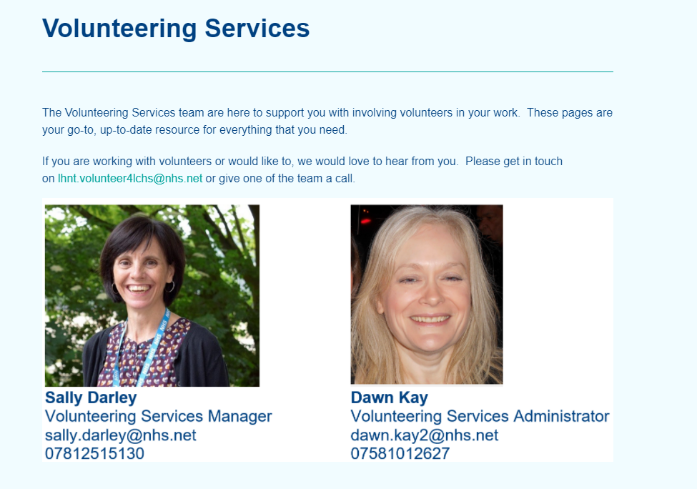
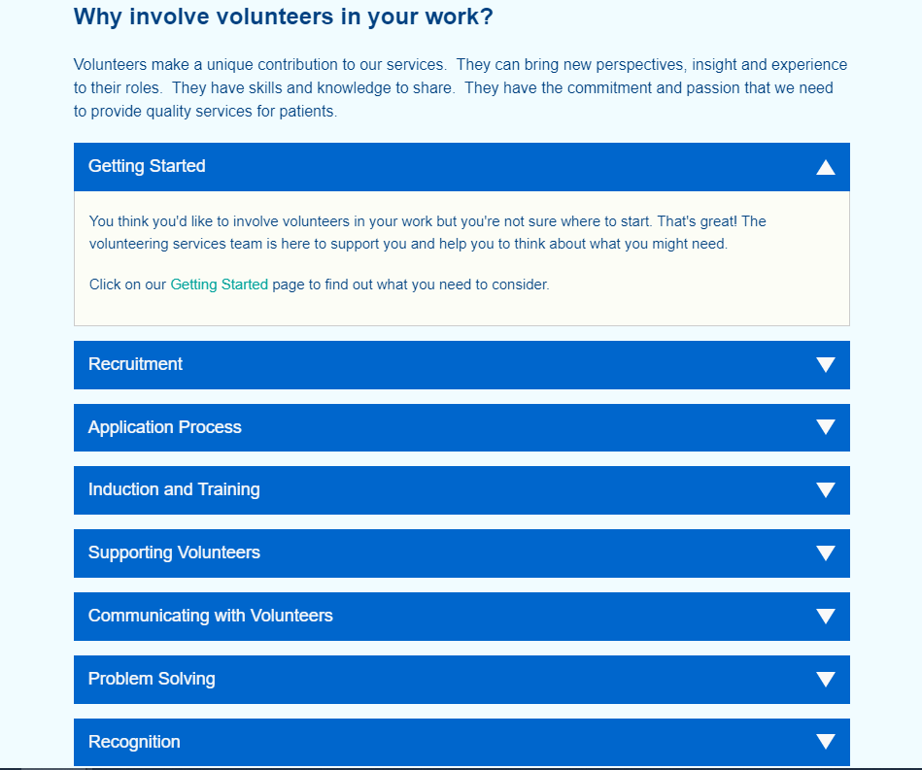
Intranet
Notes:
We’re developing our intranet site for you to refer to
It will have a guidance and resources for each stage of the volunteer journey. Plus quickly accessible videos key points.
We’re still developing this so keep looking back and do give me some feedback about what you want to see.

Slide 7
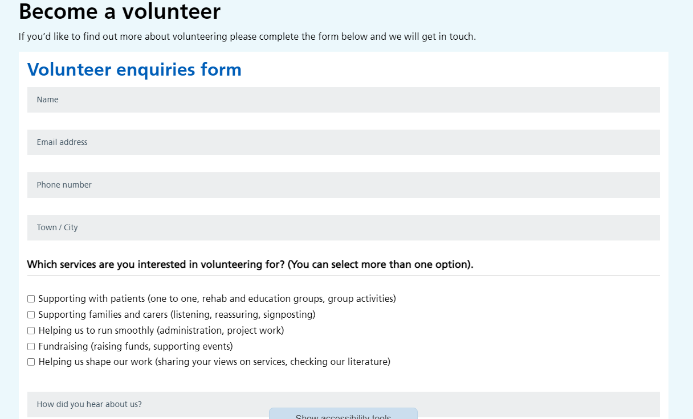
Not ready yet? Support your colleagues.
Talk to patients, family, carers
Website
@LincsCommHealth
Follow, like, share, post, comment
Notes:
Involving volunteers does take time and commitment, they are part of your team.
So your service might not be ready to support volunteers yet, that’s ok.
There’s an easy way to support your colleagues
Share on social media and identify patients/carers who might be interested. Direct to our website or directly to us.
So I hope that give you a flavour of what we’re doing at the Trust. My main message being that we’re here to support you, we’re interested in your ideas and we’d like to help make things happen.

