Slide 1
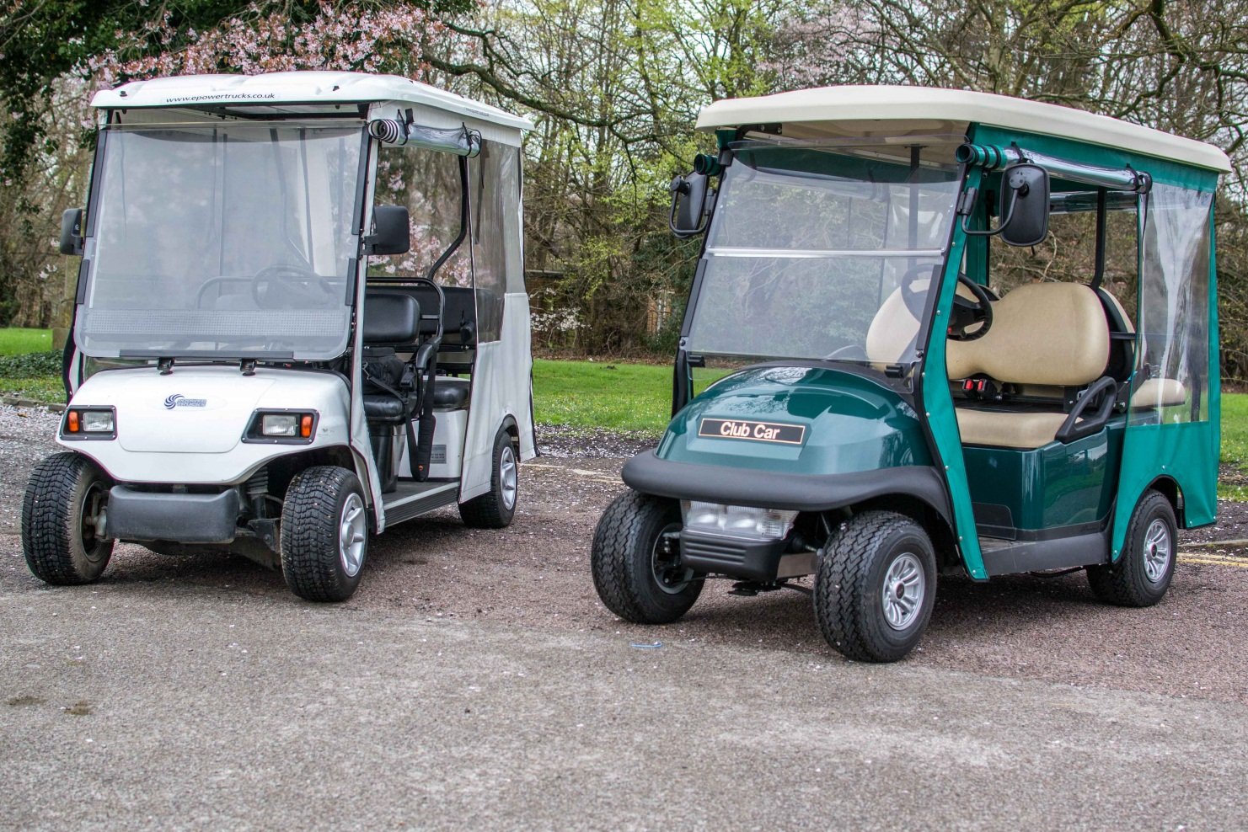
The Buggy Driver Manual

Slide 2
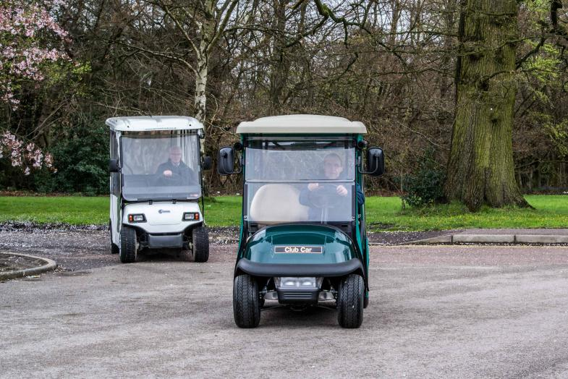
Introduction
Thank you for becoming a buggy driver!
You will be helping our patients and visitors have a much improved experience of visiting the hospital by giving them easier access to the different areas on site.
This manual revisits some of the information covered on your training and assessment day and can be used as a reference resource during your time volunteering with us.
Let’s get started!

Slide 3
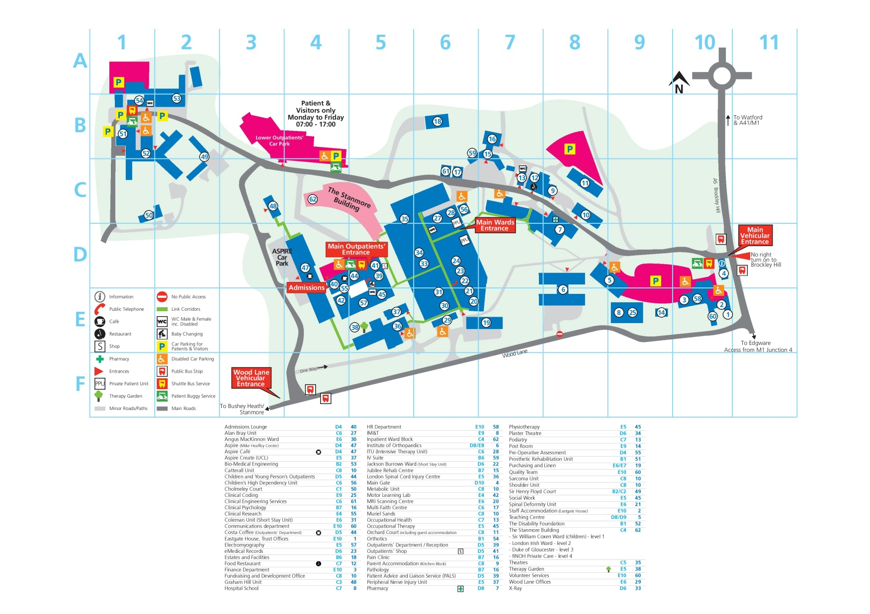
The Site

Slide 4
The Route
The buggy service operates as follows:
9:00am (or first shift of the day) – once the buggy checks are completed the service starts. The driver will distribute the 2-way radios to Orthotics Reception, Outpatients Entrance Volunteer Steward, the Outpatients car park attendant and Main Gate (Enquiries).
The main activity tends to be between the Patients & Visitors Car Park and Outpatients.
However, the buggy may also transport people between Orthotics, Prosthetics, MRI Scanning (top of the “Slope” near the Wood Lane entrance), London Spinal Cord Injury Centre (LSCIC) and the Main Gate. Site maps are on-board the buggy so you can find where things are, and help people to their destinations.
The routes to Prosthetics, Orthotics, MRI Scanning and LSCIC will be on radio or passenger request only. This is both to spare the battery through avoiding longer drives up steep hills unnecessarily and the time it takes to do the trips.
Some routes have barriers to prevent unauthorised access. Each buggy key set has a smartcard which you present to the barrier reader in order for it to open.

Slide 5
Starting your shift
There are two buggy shifts:
9am – 1pm
12:30pm – 4:30pm
The service runs Monday to Friday 9:30am to 4pm, with 30 mins before and after each shift to ensure checks are carried out, a handover takes place and buggies are stored and charged if required
What you must do – each shift
For the first shift of the day, sign keys out from Main Gate. The key numbers are on the key log
Open up garage and carry out the safety check on the buggy you will use. If this is the first shift of the day, you must use the buggy which is not on charge. If coming in at lunchtime, please take over the buggy which is already in service.
Record any problems that might affect the service on the Buggy Shift Log and if major report them immediately to the Volunteer Services Office x 5394 or 020 8909 5394
Ensure you are wearing your ID badge, Volunteer Services polo shirt & Hi-Viz jacket or vest
Test the charged radios (if undertaking first shift of the day, see separate page)
Carefully drive the buggy out of the garage and park
Lock up the garage, drive to Orthotics, Outpatients, the Outpatients car park attendant and Main Gate to drop off radios, giving them to the designated person (if the first shift of the day)
Begin shift. Each buggy has a counter for you to record passenger numbers.

Slide 6
The safety checklist & Buggy Shift Log
What it is
Why you need to complete it
The checklist is a list of things that need to be checked before the start of each buggy shift or use of the buggy.
These include all of the controls, lights, tyres and seatbelts.
This is the best way of identifying any problems or risks in order to protect our passengers and you, our drivers.
If you notice any major problems with the buggy, you must immediately notify Volunteer Services.
You will be transporting patients around the hospital site, often with other traffic moving through.
It is vital the buggies are fully operational to minimise any risk of accident or injury due to faulty parts, damage, or breakdown.
Laminated copies of the checklist are found in the garage. Once the checks are complete, make your entry in the Buggy Shift Log, which is also in the garage.

Slide 7
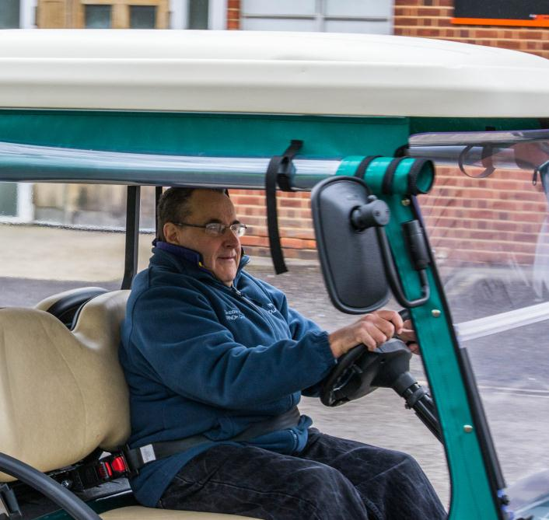
The controls
Main Controls for all buggies are similar
All are left-hand drive
All have accelerator and brake pedals
All have electric horns (sometimes a manual “bulb horn” may be used if there is a fault)
All have forward / reverse switches
All have lights / headlight(s)
All have reversing buzzers
Differences
Club Car (blue) has an electric wiper
Please familiarise yourself with the controls for each buggy, as you may be required to drive any of them during your shift.

Slide 8
2-Way Radio (Walkie-Talkie) Brief User Guide

Slide 9
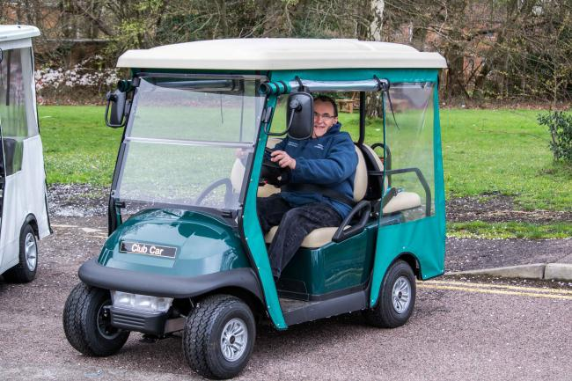
Club Car (green)
Key switch
Turn the “ignition” key to the on position to “start” the buggy. The key can only be removed when set to off.
Forward / reverse switch
The forward / reverse switch is located centrally on the lower seat support panel under your knees. The switch has three settings: forward, reverse and neutral. The reverse setting produces a continuous alarm.
Accelerator pedal
When the key switch is on and the forward / reverse switch is engaged, pressing the accelerator pedal will automatically release the park brake and start the vehicle moving in the direction selected. When the accelerator is released, power will be cut off and the motor will assist in slowing the buggy down.
Brake pedal
The brake pedal has two features. Pressing the main body of the pedal will slow or stop the vehicle. The park brake pedal is the small raised portion in the upper left corner of the brake pedal. To set the park brake, press both the park brake and brake pedal firmly with your foot.
Indicators and lights
There is an amber beacon on the roof which automatically comes on with the ignition. The indicators are located on a column stork as in most cars but do not self cancel! Switch the front and rear lights on via a pull out knob on the dashboard, but use them sparingly to reduce battery drain.
Notes
Ensure the vehicle is stopped before shifting the forward / reverse switch. Failure to do so may damage the vehicle.
The park brake will release automatically when either the accelerator or brake pedal is pressed. The park brake should be firmly engaged and locked to prevent the vehicle rolling.
Lights may be activated during early and late shifts or when visibility is otherwise poor, but drain the batteries faster.
Use the horn sparingly but be aware your movement is virtually silent so people may not hear you coming.

Slide 10
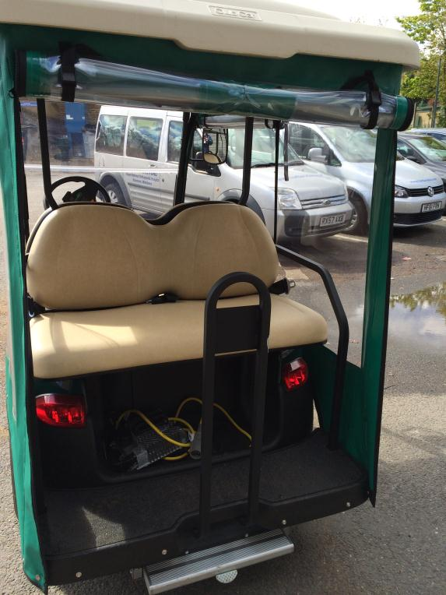
Club Car (green) Extras
Rear semi-automatic access step
The buggy is fitted with an access step that can be used to assist patients boarding the buggy.
Safety
Always ensure that the step is correctly stowed before driving
Be careful if you deploy or stow the step using your hands
The step is prevented from accidental retraction when in use by the small pedal that protrudes from the underside front edge of the step
Safe deployment
With your foot, depress and release the small pedal that protrudes from the front centre of the step. The step will deploy with a slow progressive action and an alarm will sound until the step is retracted.
Step Stowage
With your foot depress the small pedal, and then, whilst keeping the pedal depressed use your toes to push the step fully home. When fully retracted release the pedal, the step will move forward slightly and then be locked into its stowed position. Never drive with the step out.

Slide 11
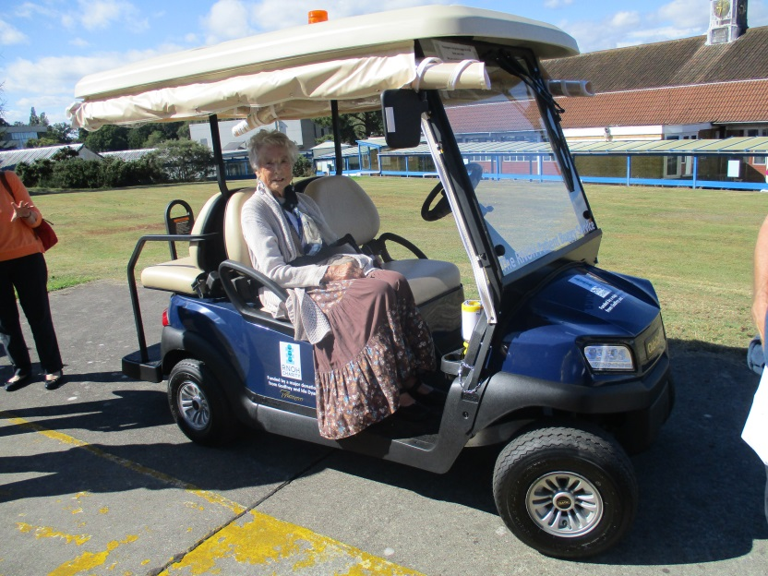
Club Car (blue)
Key switch
Turn the “ignition” key to the on position to “start” the buggy. The key can only be removed when set to off.
Forward / reverse switch
The forward / reverse switch is located centrally on the lower seat support panel under your knees. The switch has three settings: forward, reverse and neutral. The reverse setting produces a continuous alarm.
Accelerator pedal
When the key switch is on and the forward / reverse switch is engaged, pressing the accelerator pedal will automatically release the park brake and start the vehicle moving in the direction selected. When the accelerator is released, power will be cut off and the motor will assist in slowing the buggy down.
Brake pedal
The brake pedal has two features. Pressing the main body of the pedal will slow or stop the vehicle. The park brake pedal is the small raised portion in the upper left corner of the brake pedal. To set the park brake, press both the park brake and brake pedal firmly with your foot.
Indicators and lights
There is an amber beacon on the roof which automatically comes on with the ignition as do the front driving lights. The indicators are located on a column stork as in most cars but do not self cancel! Switch the front and rear lights via a pull out knob on the dashboard, but use them sparingly to reduce battery drain.
Notes
Ensure the vehicle is stopped before shifting the forward / reverse switch. Failure to do so may damage the vehicle.
The park brake will release automatically when either the accelerator or brake pedal is pressed. The park brake should be firmly engaged and locked to prevent the vehicle rolling.
Lights may be activated during early and late shifts or when visibility is otherwise poor, but drain the batteries faster.
Use the horn sparingly but be aware your movement is virtually silent so people may not hear you coming.

Slide 12
Club Car (blue) Extras
Rear sliding access step
The buggy is fitted with a sliding access step that can be used to assist patients boarding the buggy.
Safety
Always ensure that the step is correctly stowed before driving, and never drive with the step out.
Be careful if you deploy or stow the step using your hands
Step deployment
Lift the small retaining bolt up, then using your hand slide the step fully out.
Step stowage
With your foot positioned in the centre of the rear edge, push the step forward until it’s in its stowed position, and engage the bolt to prevent it sliding out.
Never drive the buggy with the step out
Windscreen wiper
The buggy has a single speed single wiper operated by an on/off switch at the top centre of the windscreen. Please only use this for occasional wipes, do not leave it on for long periods.

Slide 13
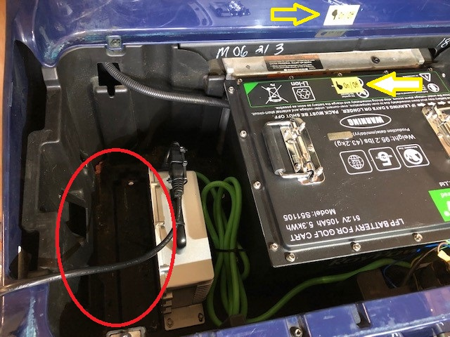
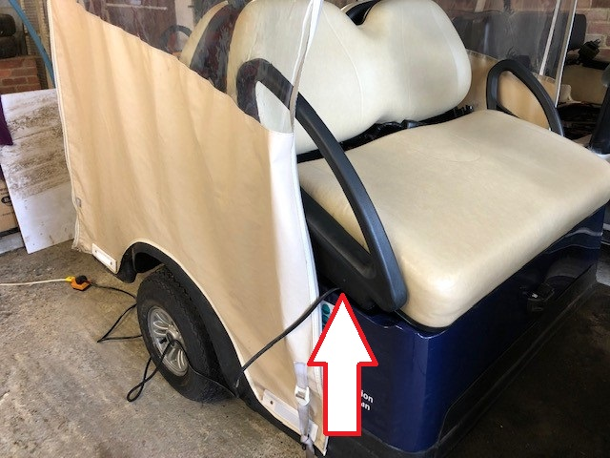
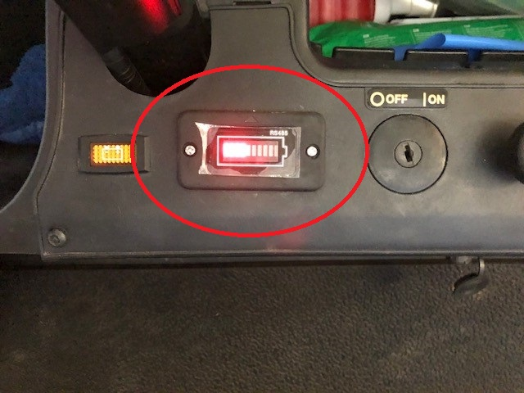
Club Car Charging (green & blue buggy)
Charging information (blue buggy used for photos, but the green buggy is very similar)
These buggies have an on-board charger, installed next to the lithium battery block under the front seat. The mains fly lead is stored next to the battery (blue buggy fly lead is ringed red in the top left photo).
When the fly lead is first plugged in to the mains, the charger goes through some silent self tests, then you will hear the fan kick in which indicates it is working, and the battery charge meter on the dashboard will pulse.
When on charge, please let the seat rest on top of the seat belt harnesses to allow ventilation and to prevent the mains cable being damaged, as indicated in the bottom left photo.
The battery charge meter on the dashboard is permanently on, irrespective of the position of the On/Off switch or charging status, as indicated in the photo below.

Slide 14
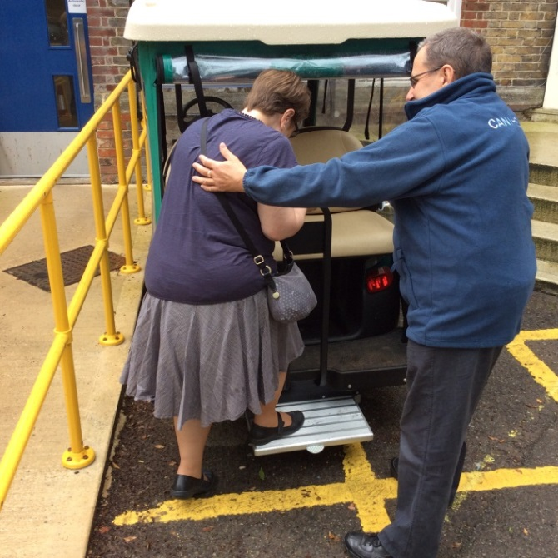
Passenger Eligibility and Handling
Who can use the buggies?
The buggies are for patients and visitors who are able to board and alight the vehicle without assistance. Drivers are not permitted to provide any strenuous assistance to people wishing to use the buggies. The driver may use their judgement to decide if it is safe for a passenger to use the buggy.
Not permitted:
Any persons not able to board and alight without assistance
Staff
Children aged 3 or under, or anyone who cannot be secured with a seatbelt
Unaccompanied children
Children must not sit on the lap of another person
What help can I offer?
Drivers are able to help ‘facilitate’ passengers boarding the buggy. This includes providing a steadying and guiding hand to the patients back, between the shoulder blades. You can also offer an arm to assist the step on or off, or hold a stick or bag.
Folding wheelchairs or other aids may be carried if it is safe to do so, the items can be safely secured with the seatbelts, and the passenger is able to board and alight by themselves.

Slide 15
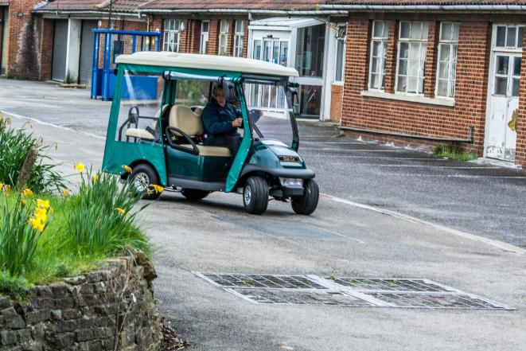
Driving guidelines
Code of practice
No more than three passengers per buggy (one per seat).
You must not carry children aged 3 or under, or anyone who cannot be secured with a seatbelt. See previous page for passenger eligibility. The buggies carry signage to this effect.
Seatbelts must be worn at all times when the vehicle is in motion, including the driver.
Drivers must ensure all passengers are wearing a seatbelt before moving away.
Neither the driver nor passengers are permitted to eat or drink whilst the vehicle is moving.
Passengers must remain seated until the vehicle has stopped and handbrake / park brake is engaged.
Drivers note!
You must never use 2-way radios or mobile phones whilst driving the buggy.
Only use these devices when you have safely pulled over and engaged the park brake.
Drivers violating this rule will have their involvement terminated immediately.

Slide 16
Driving guidelines
Driving requirements (basically similar to the Highway Code)
Drivers should attempt to avoid driving over loose objects, holes, access covers, or large cracks in the road surface where possible. However, drivers should not take evasive action to avoid these which may risk the safety of the passengers or the vehicle. Please always slow down when driving over such surfaces.
If driving through water you must slow down as water can easily come into contact with the electrics which could damage or disable to vehicle.
Vehicles must give way to pedestrians at crossings.
Drivers should not overtake another vehicle whilst both are moving unless the other vehicle has pulled in and given way.
Drivers must use the appropriate entrance and exit points to car parks and other areas where signage exists, and must never travel the wrong way in designated one way areas.
Drivers should not operate in non-designated areas without prior authorisation from the Volunteer Services Department.
All accidents and incidents must be reported immediately following the process described in this manual.
In poor light, drivers should activate the vehicles’ lights.
The horn should be used to alert pedestrians to the buggy, but should be used sparingly. Remember that the buggies are electric vehicles and virtually silent, so pedestrians may not hear you coming as they would with petrol or diesel vehicles. Be attentive to the environment when driving.

Slide 17
Driving guidelines
Practical considerations
To prevent overturning the vehicle, drive slowly & straight (where possible) up and down slopes.
Consider weight distribution of passengers when taking bends and corners; slow down where necessary.
Avoid sudden stops, starts, and abrupt turns. Remember your passengers may not see what you see and may be unprepared. Drive smoothly.
In wet, icy, or adverse weather conditions, make use of weatherproof covers and reduce speed accordingly.
Use brakes to regulate speed going downhill.
Driving through water may affect brakes and electronics. Slow down when passing through water, and always test your brakes after doing so.
Parking
Never hold the vehicle on the accelerator. Use the brake to stop and hold the vehicle.
When picking up and dropping off passengers, ensure the park brake/handbrake is activated.
If you are leaving the vehicle for any period of time, ensure you have parked in an appropriate location and switch off the vehicle. Always take the keys and 2-way radio with you.
Never leave the vehicle unattended with the keys or 2-way radio still in it.
Speed
None of the buggies has a speedometer.
Buggies are capable of speeds that exceed the site limit of 10mph. Ensure that you consider your passengers comfort and safety at all times.

Slide 18
Smartcard operated barriers
Several internal roads have barriers to control vehicle access and movements.
Each buggy keyset has a smartcard attached to operate certain barriers.
Some barriers will automatically open when you approach them from certain directions and without the need for the smartcard.
For barriers which do require smartcard access, you will need to present the smartcard to the reader on the adjacent black post (ringed yellow in right photo). You then have 20 seconds to pass through the barrier before it closes.
Do not tailgate other vehicles through the barriers.
Do not force the barriers to open.
Immediately report the loss of any smartcard or barrier issue to Volunteer Services.

Slide 19
Charging and storage
Volunteer Services have use of a garage (‘The Batcave’) which is located at the far end of site near Orthotics. Here the buggies are maintained and charged.
Key points
To ensure charger plug pins do not get bent, push the plug into the socket straight, without any twisting or rocking.
Ensure all accessories (lights, etc.) are switched off prior to charging and ensure that the off/run or tow/run switch is set to the off/tow position before charging.
Only charge the buggy if the battery is 20% or below.
Do not
Use a charger if any of the following conditions exist:
The plug is too loose or does not make a good connection.
The plug and receptacle feel hotter than normal during charge.
The plug pins or receptacle contacts are bent or corroded
The plug, receptacle or cords are cut, worn, or damaged in any way.
Use of the charger with any of the above symptoms could result in serious injury or death.
Charge procedure
For all buggies, pull out the AC mains fly lead and plug from its on-board storage place under the front seat and insert it into an AC mains power outlet.
Charger will turn on two to five seconds later. Check charger lights or sounds for confirmation.
Leave vehicle to charge.
Failure to follow instructions may result in harm or death

Slide 20
The Batcave
The Batcave is used to store and charge the buggies. The key numbers are 52 for the green Club Car and 107 for the blue Club Car. Each “bunch” has a Batcave door key, a specific buggy key and a smartcard to operate the barriers. All are signed out from Main Gate.
You will find the Shift Checklists in there, which you must complete and make an entry in the Buggy Shift Log when taking a buggy out, or returning it. There is also a calendar sheet to record your passenger numbers.
The Batcave light must be off, and the door bolted & locked once you have taken your buggy out.
Cleaning
Buggies should be cleaned regularly.
Do not use any type of pressure washing or steam cleaning equipment. Water can be obtained from the nearby tap, and car cleaning solution, bucket and sponge are kept in the Batcave.
Storage
Buggies must be returned to the Batcave for storage and charging (if required) when not required.
Once the buggies are parked in the Batcave, ensure the key switch is set to off and the off / run or tow / run isolator switch is set to ‘tow’. This is to prevent battery discharge.
Keeping it tidy
The Batcave must be kept clean and tidy. Put rubbish in the bin bag provided. Report any signs of break in, leaks, or other damage to Volunteer Services immediately.
Personal items
You may leave items in the Batcave, but please remember we cannot be responsible for your personal items. Do not leave valuables unattended.

Slide 21
End Of Shift
If the last shift of the day, you must collect all of the 2-way radios and return them to the Batcave for charging. Turn them off and slot them onto the chargers, ensuring that the base charging light illuminates.
If the last shift of the day you will return the buggy to the Batcave, park and set the isolator switch to tow/off.
If taking over at lunchtime then the early shift will hand over the buggy to you, providing each driver is happy to do so and the buggy has enough charge for the next shift.
If you need to put your buggy on charge you must first set the run/on switch to tow/off. Once you have switched the mains on, check the charger is functioning.
If you have used the roll down canopies and they are wet, please leave them rolled down so they may dry.
Make an entry in the Buggy Shift Log when you return a buggy.
Record your passenger numbers on the calendar provided.
Return your Hi-Viz vest or coat to the locker. If wet leave out to dry on the wall hooks.
Please place any rubbish in the bin bag provided or one of the bins outside.
When leaving the Batcave please turn off the Batcave lights, secure the Batcave and sign the keys back into Main Gate.
Thank you for your time – you are making a valuable contribution to our patients and visitors!

