Slide 1
Leanne Goessen
LAFN PM
East of England Employment Consultant
Notes:
Leanne – LAFN Project Manager – Connects military and non-miltary organisations and charities that support the armed forces community. Currently meet quarterly to share good practise, provide updates and discuss barriers.
- Employment Consultant for the East of England. Working directly with veterans to remove barriers and seek meaningful employment after service.
10 mins

Slide 2
Notes:
TPF started over 100 years ago to provide job opportunities for injured veterans. Not only that, also building housing for their families building community. Recognising the importance of stability to be successful in employment. This is the ethos we still focus on today. They started making poppies for the Royal British Legion’s Poppy Appeal, and to this day our veterans still make millions of poppies each year, including over 100,000 wreaths and organising the Field of Remembrance at Westminster Abbey.
We still have the factory today….

Slide 3
Notes:
Alongside the factory, we have our visitor centre where individuals and groups come to learn about the history of the poppy & factory, as well as admiring the Royal wreaths for Their Majesties King Charles and Queen Camilla.
Varying organisations visit the factory as part of a community/teamwork event. You can also hire the visitor centre for private functions, always good to know that the money from that booking is directly impacting veterans.
So what work are we doing?

Slide 4
Notes:
Northern Ireland supported remotely by a colleague in the Midlands.
Veteran and family services:
Self refer/professional referral – professional preferred for collaborative support.
Holistically – co-ordinating to remove barriers
Develop CVs, interview prep, job searching skills – Job coaching.
Not a recruitment agency – seek meaningful employment.
12 month IWS – employer engagement.
Family Service
Spouses, ex-partners and dependents over 18.
Works closely with The Ripple Pond – support carers of veterans (community, mental health).
Online service.
Navigator Service
Clients who are maybe not ready for employment currently, but want to engage in meaningful activities.
Gold standard – 6 months – to then move to an EC.
Professional referral only – inundated.
Specific areas only.
Other important points, we are not a grant giving organisation – help with funding applications.
At the end of the presentation, the referral links will be shared.
What impact has this service had?

Slide 5
Notes:
Having in mind volunteering, particularly in the healthcare sector:
Range of ages, predominantly 30+. Often the age bracket that a career change is explored due to:
Entered army at a young age, maybe troubled upbringing and looking for stability. Have left with only those military qualifications so are looking for a starting point into something new. This is the structure within the Armed Forces so many are willing to do the same and work their way up.
Found the civilian equivalent of their military role (RLC to HGV driver or SF to security) and that worked for a period of time but maybe PTSD has arisen over this time and they are looking for something less triggering. Or the civilian role didn’t give them the same buzz and job satisfaction as it did in the Army so are looking for a change.
183 clients last year entered some sort of volunteering or training role, this is becoming more popular route as it develops their confidence in their transferrable skills incrementally, without maybe the pressures of a full time role straight away.

Slide 6
Notes:
Families service – Coming up to 2 years in April 2025.
High % are spouses of veterans. Often, they travel with their partners during their military time and are either not working or holding down small local jobs. Once their partner becomes a veteran:
Kids have grown up and maybe moved out so have more time to work on themselves.
May be supporting a partner who was injured or deals with poor mental health following their army career. Along with family responsibilities. Lose their own identity and therefore in search of something new.
90% improve their goals – often linked to confidence, independence.

Slide 7
Notes:
Highlight the Health and wellbeing impact of our service which often involves volunteering roles in different capacities. Time – getting into a routine and finding a purpose to engage again.
With support these veterans are learning to trust others again, over time and starting to see hope in their skills.

Slide 8
Why volunteer to career?
Qualifications
New career pathway
Try before you buy
Transferrable skills
Confidence
Sense of purpose
Notes:
Qualifications – come out the army with many quals but they may not directly transfer. Or they do but they don’t see how and sometimes neither do the employers initially. – Could be a segway into finding out the qualifications that are needed or how theirs can transfer.
New career pathway – The enter the army as they want to deliver a “life of service”, they want meaningful employment. For whatever reason that comes to an end. How can they continue a life of service without being in a military setting? The healthcare sector is one of those. Feel like they are still serving their country.
Try before you buy – Volunteering takes place in parallel with a part time role. Continue to support – volunteers help take some of the strain from full time employees.
Transferrable skills – team work, communication, soft and hard skills. Increase their confidence in the transferrable skills that they have. Gaining new skills or refreshing them.
Confidence – flexibility- getting back into routine – get back into team work.
Sense of purpose – Overall these people want to succeed. Come with determination, respect, good work ethic and adaptable. They are just looking for opportunities to develop this in this new Civilian world.

Slide 9
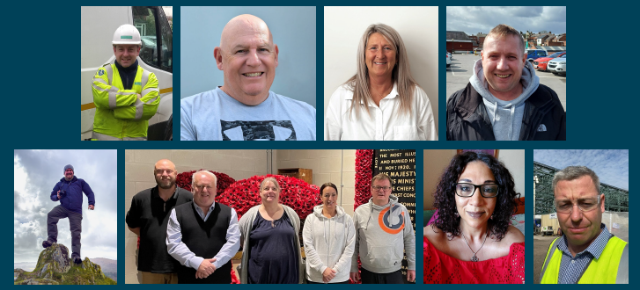
What can the Armed Forces Community do for you?
What is it that you can provide for them?
Notes:
Hopefully I have highlighted, albeit very briefly, how the armed forces community could support your organisations. There are many case studies on our website should you wish to explore that.
But also, what is it that you can provide for them? What opportunities, support and guidance can be put into place to ensure their success?
My advice: Make the process clear, simple and progressive.

Slide 10
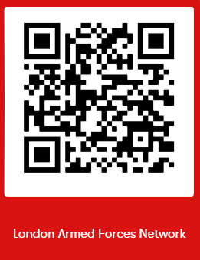
Leanne Goessen
LAFN PM
East of England Employment Consultant
Veteran Service
Families Service
Navigator Service
Professional and Self referrals
Professional and Self referrals
Professional referrals only

