Slide 1
Torbay - a community response to the pandemic
Torbay
Assembly

Slide 2
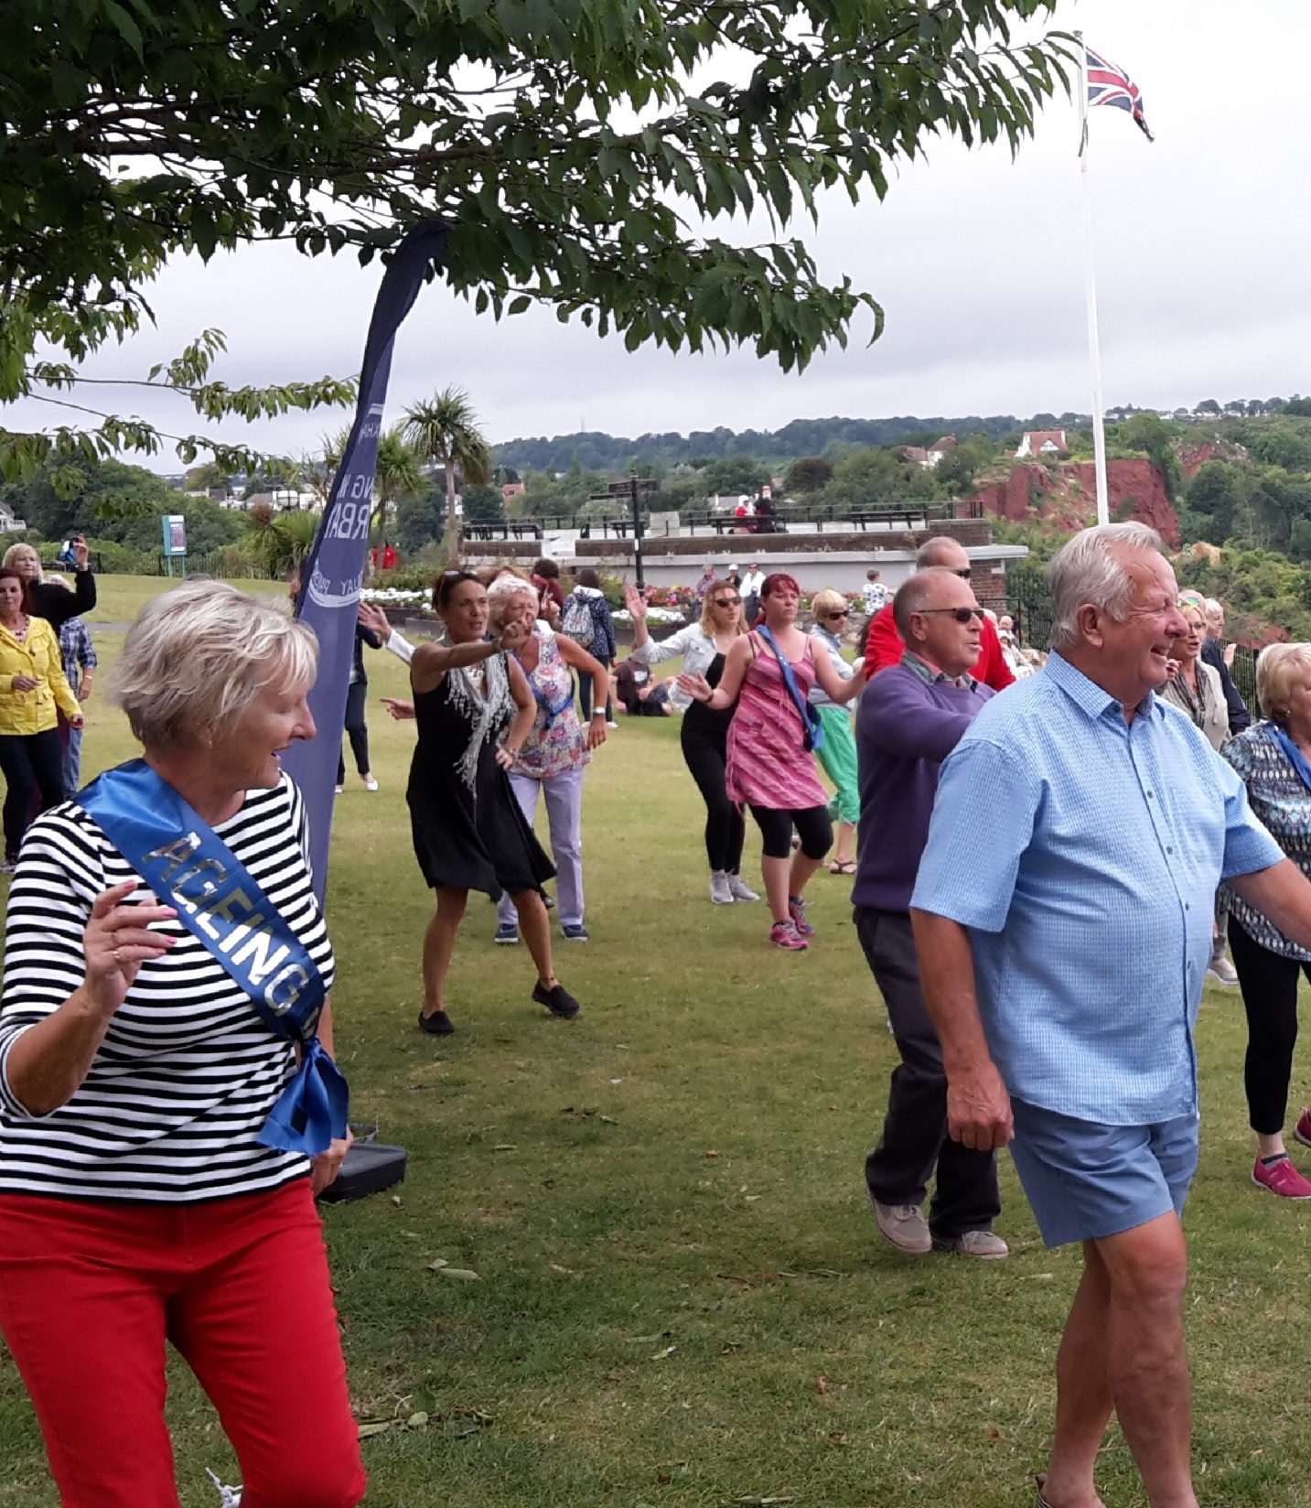
Torbay Community Development Trust
Developing stronger communities across Torbay
Encouraging people to do what they do best
Supporting groups to thrive
Making connections and stimulating co-operation
“Bringing people together”

Slide 3
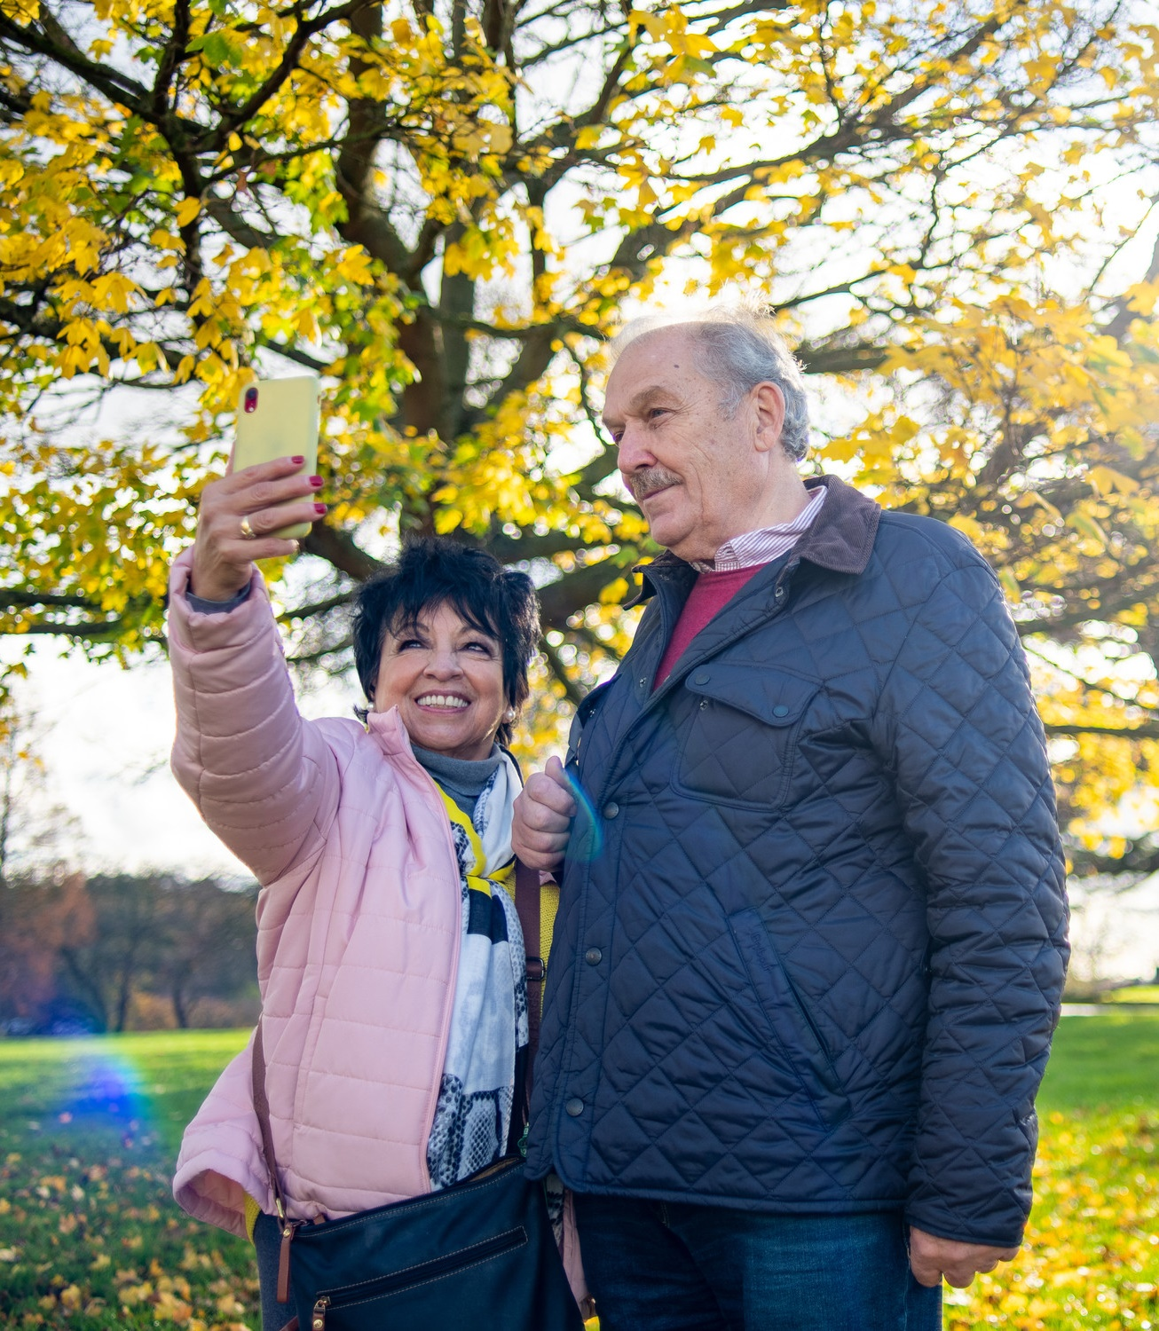
Asset based principles
Person-centred
Holistic
People in the lead
You have what you need when you share what you have
Heart-centred
People build heart-centred relationships with other people – not organisations.
RESOURCE ID 8101, Communities, Age-positive image library, CREDIT Peter Kindersley

Slide 4
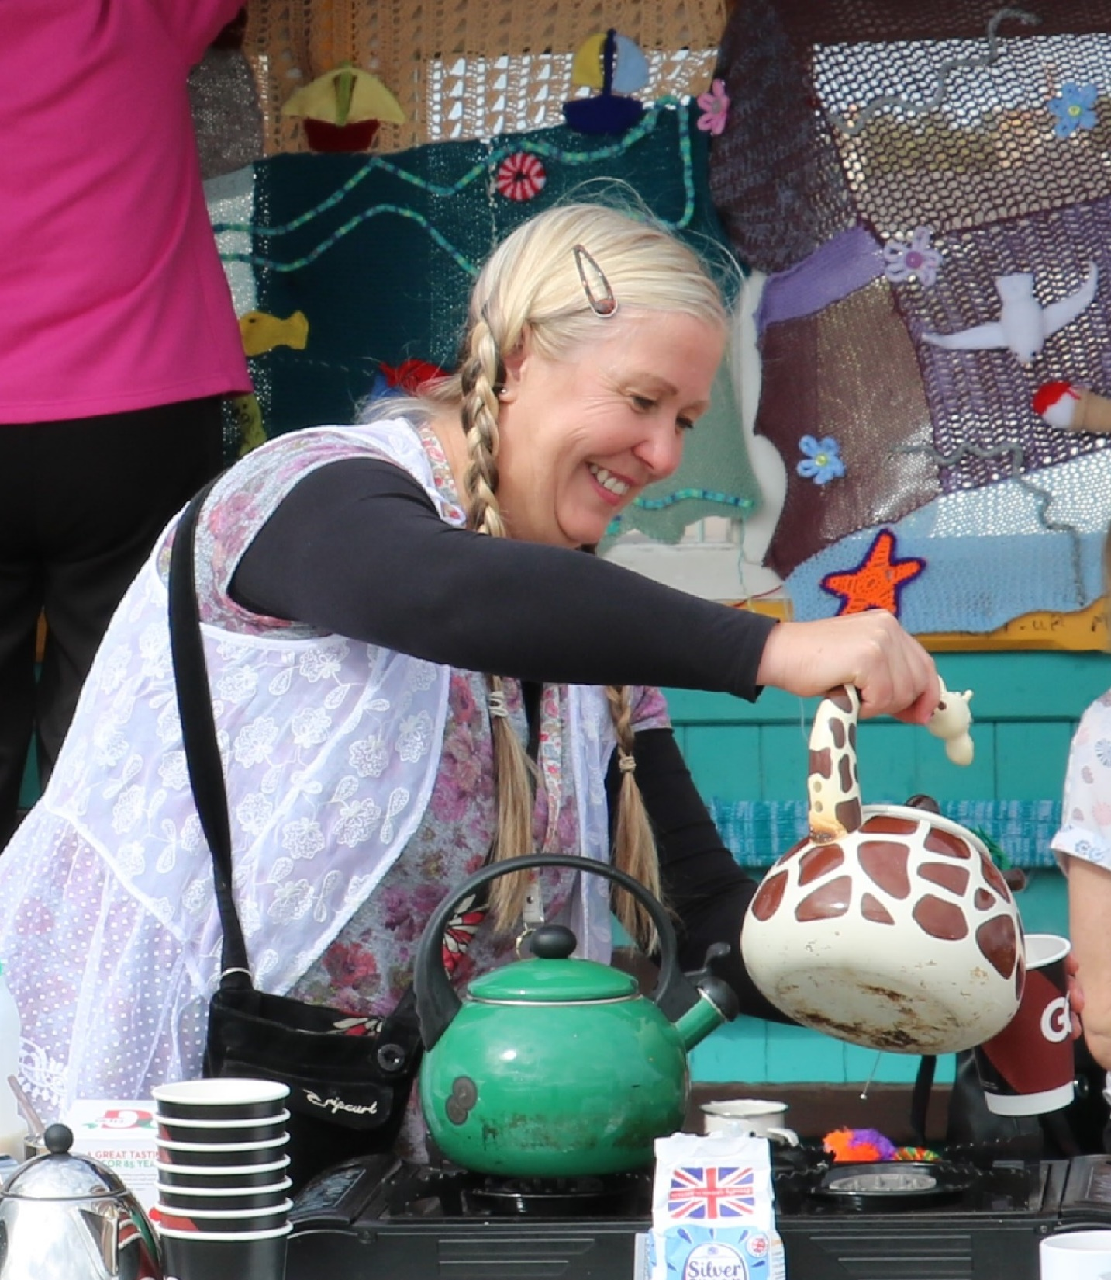
Beautiful Torbay
135,000 people
Unitary authority
50% over 50yrs
Coastal seasonal tourist economy
Ageing Well 7-year Lottery Funded test and learn programme addressing isolation and loneliness.
6000 people over 50 yrs isolated and lonely

Slide 5
Ageing Better – National Lottery
Ageing Better is an £87 million, seven-year, programme funded by TNLCF delivered across 14 areas in the UK. The programme aims to improve the lives of people aged 50 and over by addressing social isolation and loneliness, improving social connections, and enabling people over 50 to be more engaged in the design of services for their communities. It also aims to challenge negative narratives around ageing and promote a positive image of later life.

Slide 6
Torbay Community Helpline
In the first week of Covid lockdown we set up a community-based helpline that continues to grow and develop in response to our community’s needs, links-up the work of VCSE organisations, offers a person-centred approach to people facing complex issues and provides flexible opportunities for people to volunteer to assist people in their local communities.

Slide 7
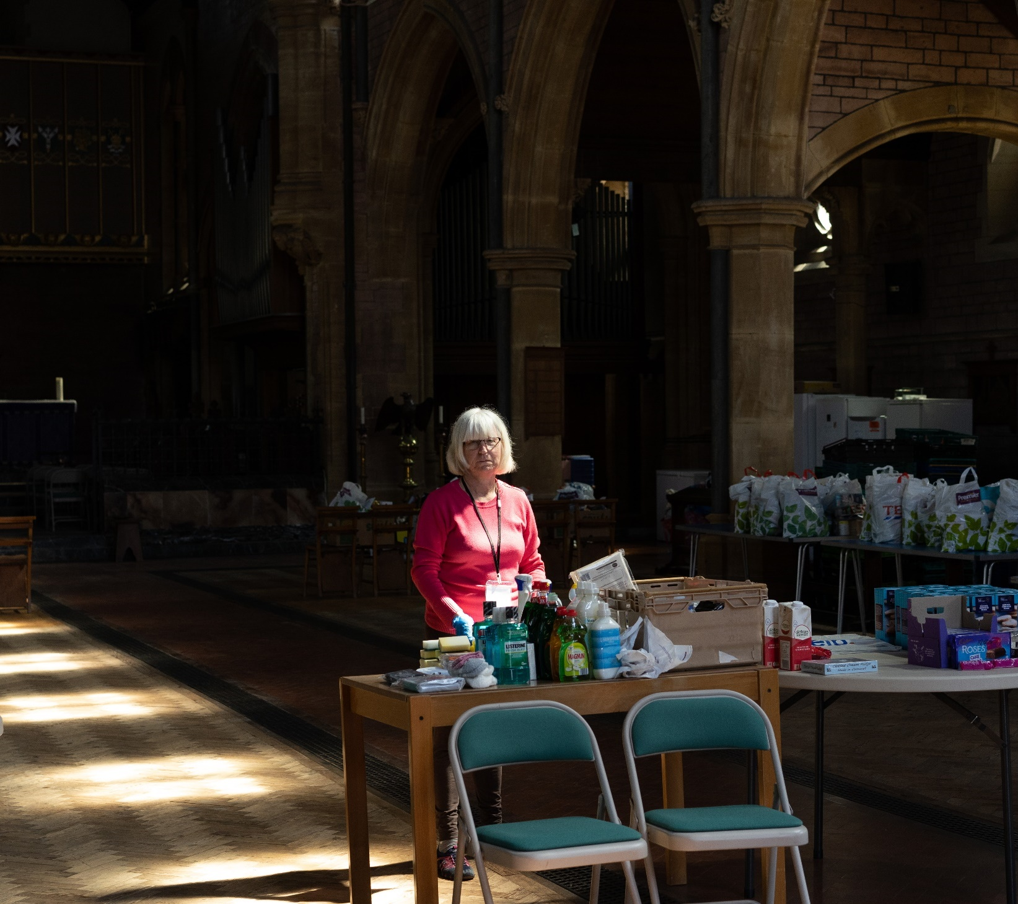

Slide 8
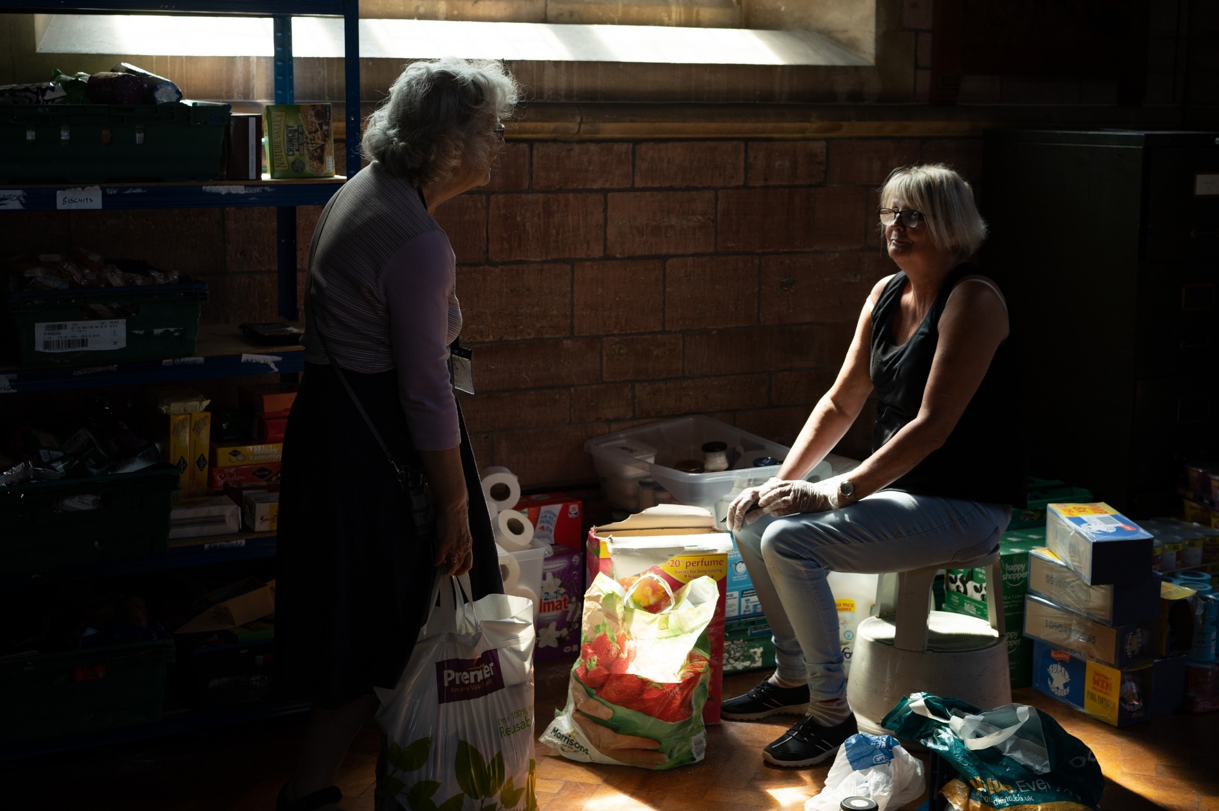

Slide 9
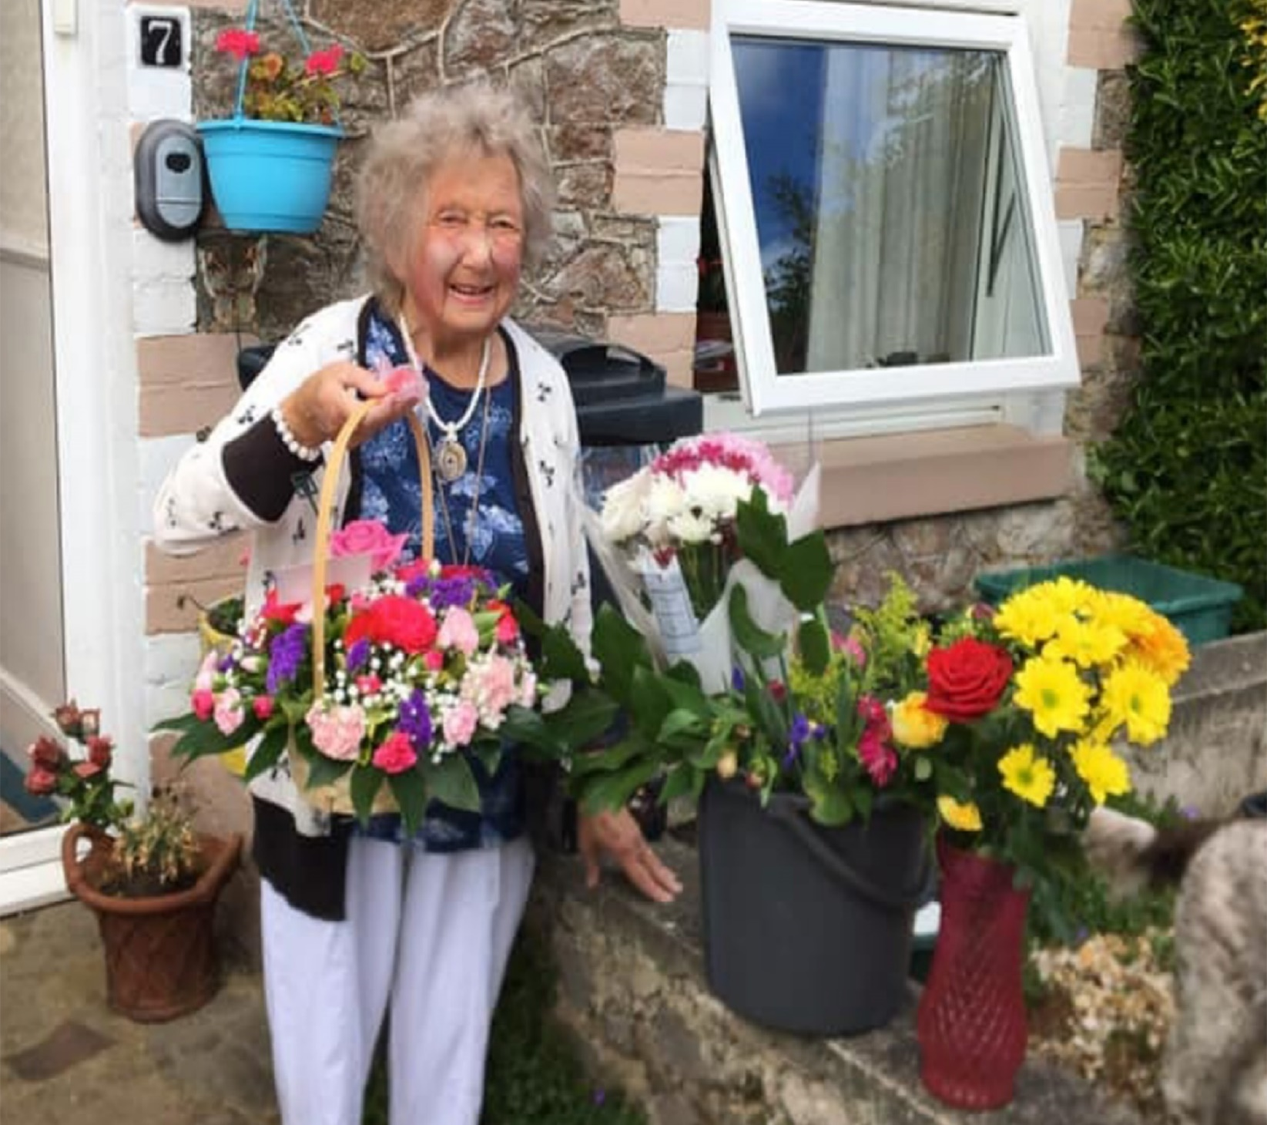

Slide 10
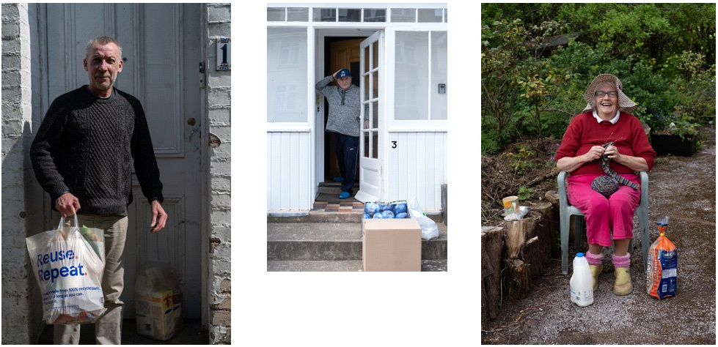
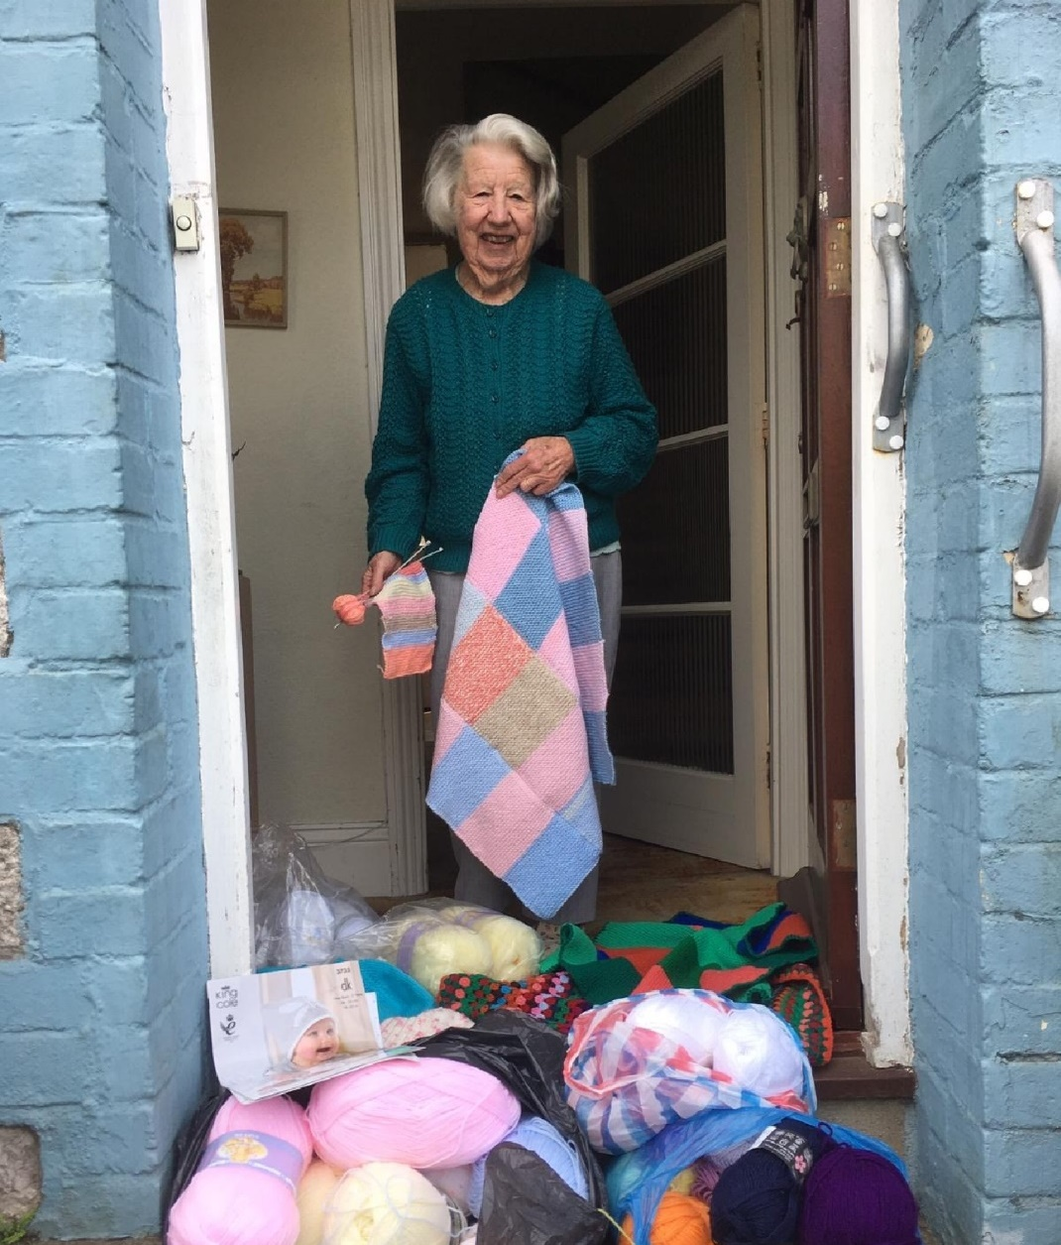

Slide 11
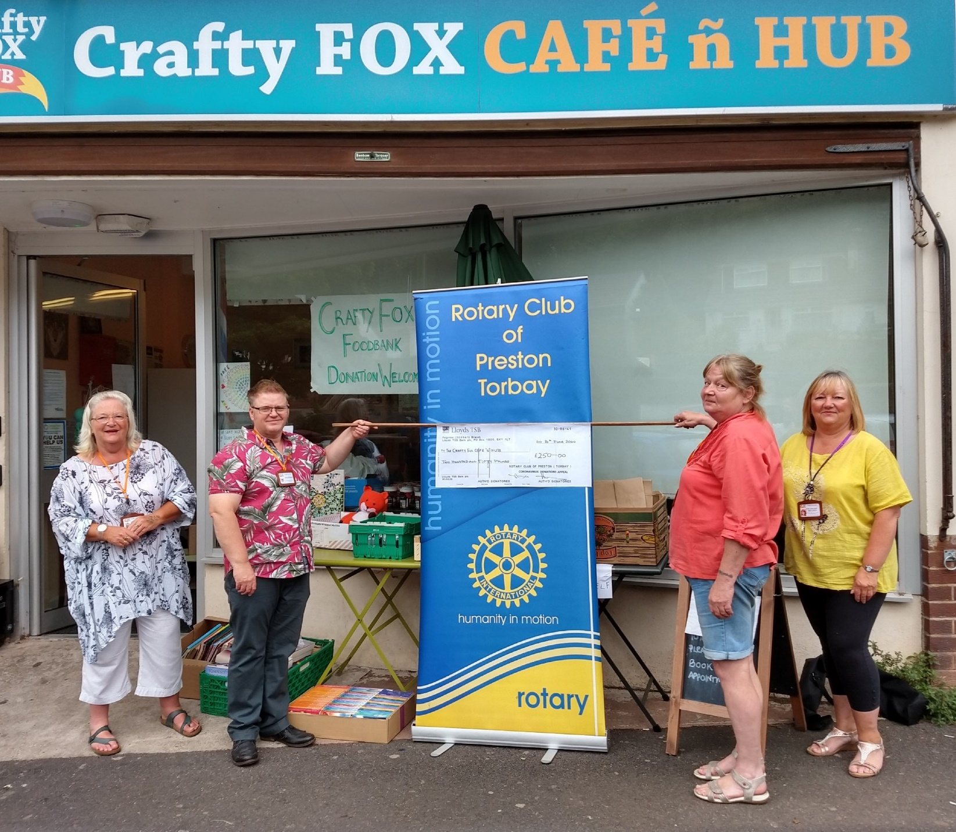

Slide 13
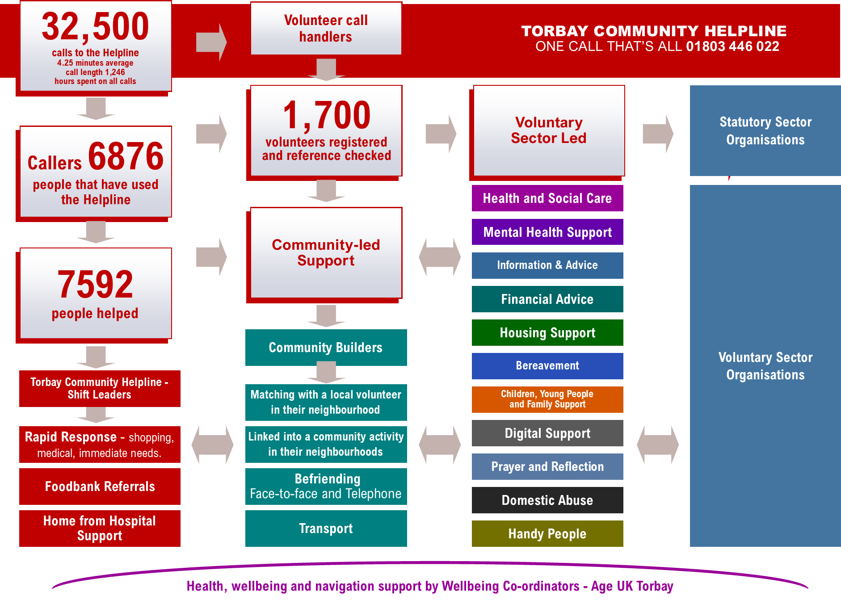

Slide 14
Torbay Voluntary Community and Social Enterprise Sector
Torbay Advice and Information Partnership
18
Torbay Food Alliance
12
Torbay Health and Wellbeing Voluntary Sector Network
250
Torbay Prevent Homelessness Network (under development)
Imagine This -Children, Young People and Families Partnership
44
Local Spark Torbay, Social Enterprise Network
Standing Tall Domestic Abuse
10
Informal Groups, supported by Torbay Community Builders
300+
Torbay Greenspace Forum
24
Torbay Community Partnership Neighbourhood Forums and Community Centres 38

Slide 15
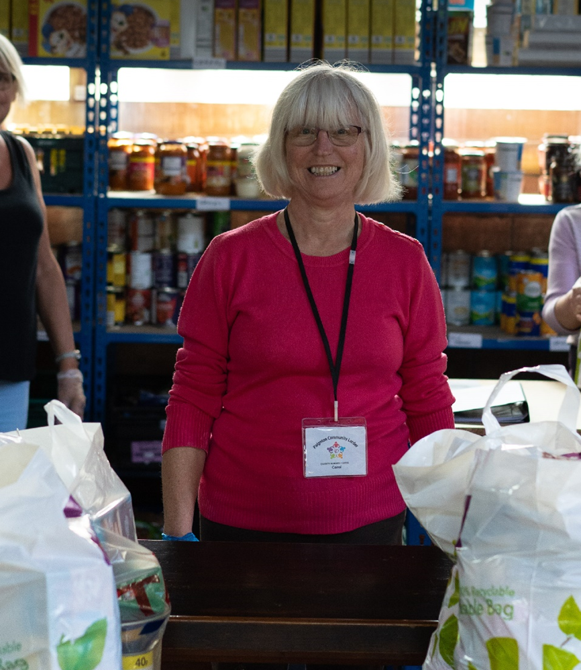
Response
Voluntary Network - 70 charities linking back into the helpline
Mobilising local assistance - Volunteers
Community Builders
Good Neighbours Networks
Triage
Referrals
Matching
Help Hubs - Torbay Together and Timebanking
New partnerships - Food Alliance
Different needs– CRM system - one database

Slide 16
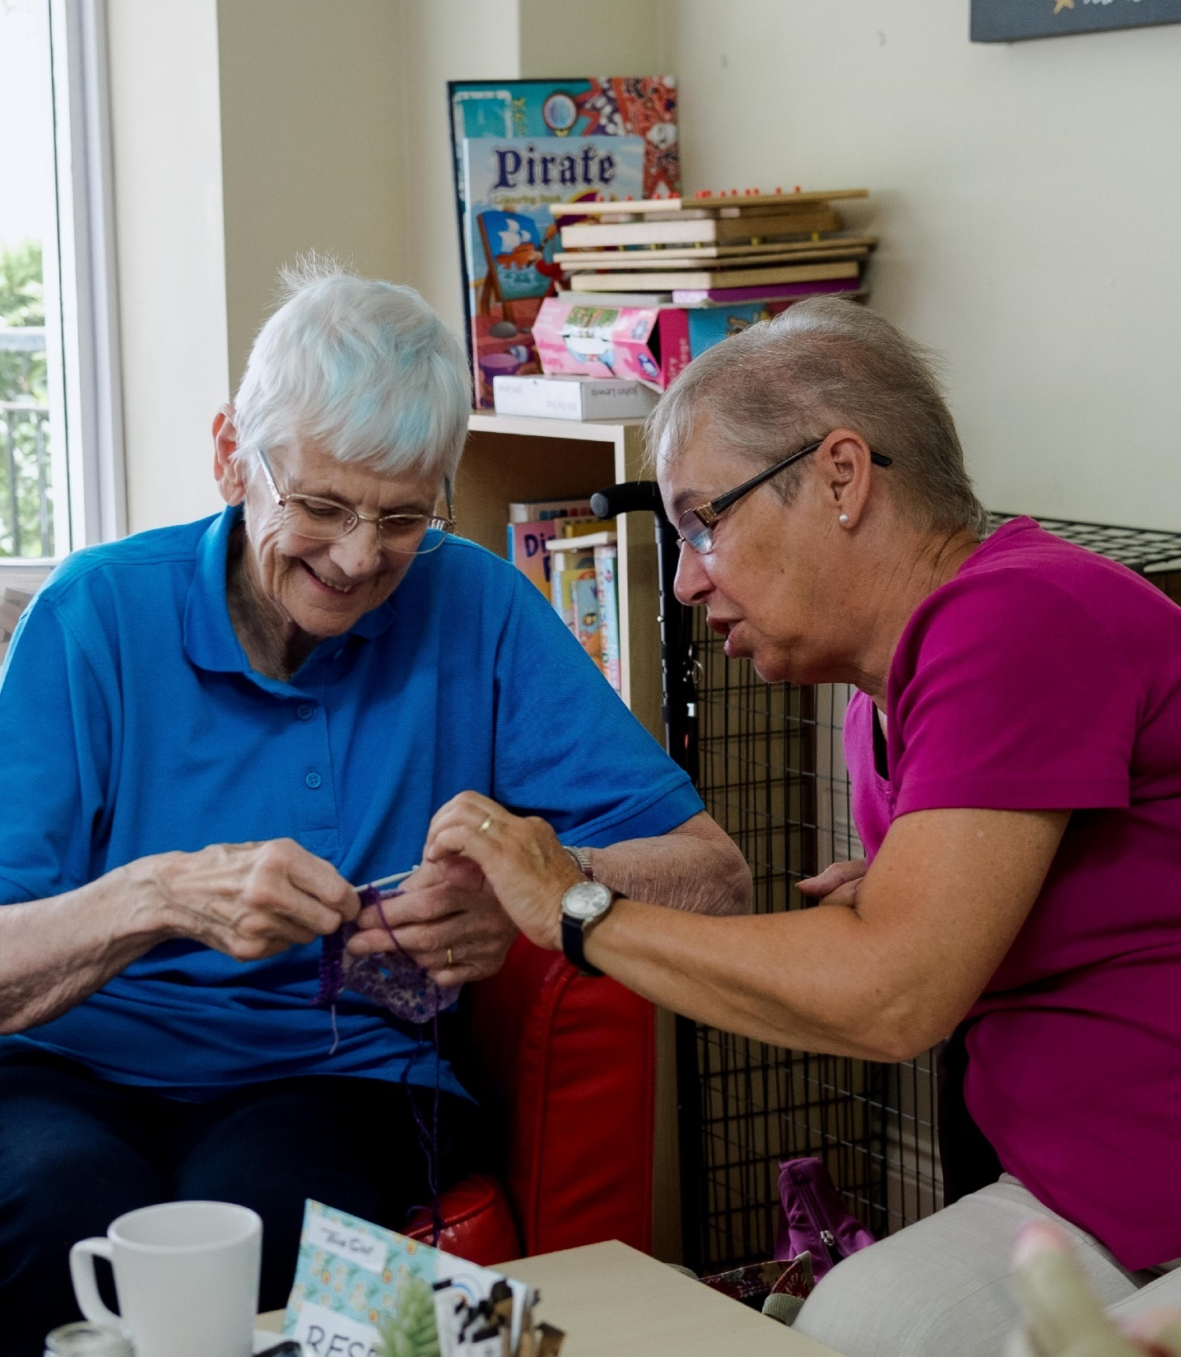
Person-centred
Conversational
Non-judgmental and not seen as an authority
Building trusted relationships
People who have never had to ask for help
Support for complex and multiple needs
Relief for families
Opportunity to give and receive
Network/ecosystem of support

Slide 17
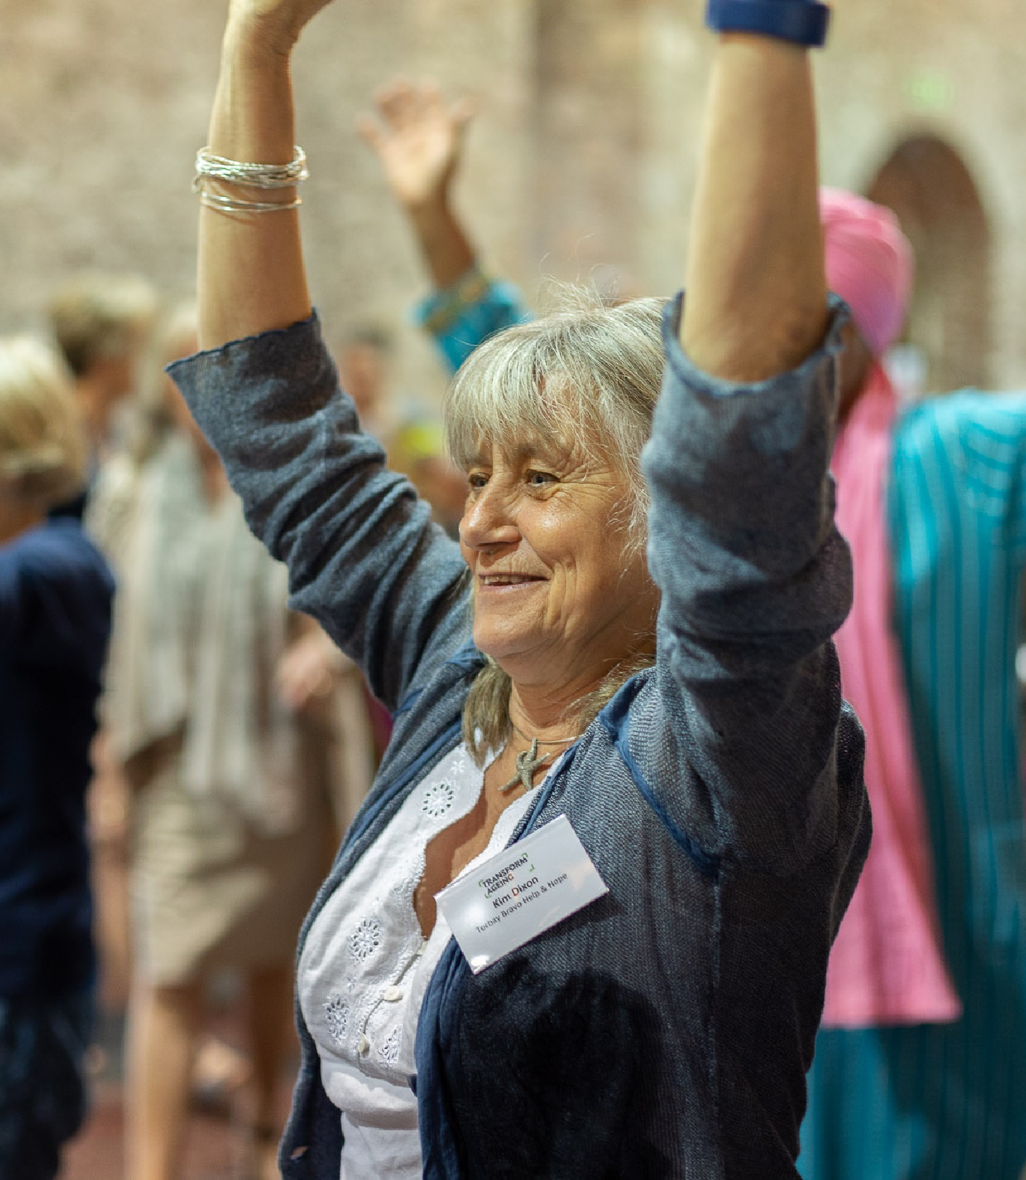
Development
Networking
New collaborations and partnerships – Front Door Project
Training and workshops
Community of practice for asset-based community development
A barometer of community needs - modifying response weekly
Freeing up opportunities and systems
Growing respect for VCSE

Slide 18
Asset-based approaches to volunteering
Themes:
Ageing Better and Ageing Well Torbay programme
Torbay Community Helpline and approaches to volunteering
Community Builders and building a connected community
Good Neighbour Networks
Torbay Together website and Timebanking
Volunteering - collaboration – passporting – and training

Slide 19
Ageing Better and Ageing Well Torbay Programme
John Arcus, Ageing Well Programme Manager, Torbay Community Development Trust
In Torbay we have been involved in developing localised, collaborative and integrated approaches to community development through the Lottery funded Ageing Better Programme addressing isolation and loneliness in people over 50.

Slide 20
John Arcus Ageing Well Torbay Programme Manager Mob: 07548704877 Email: johnarcus@torbaycdt.org.uk Web: www.torbaycdt.org.uk www.ageingwelltorbay.com www.torbaytogether.org.uk

