Slide 1
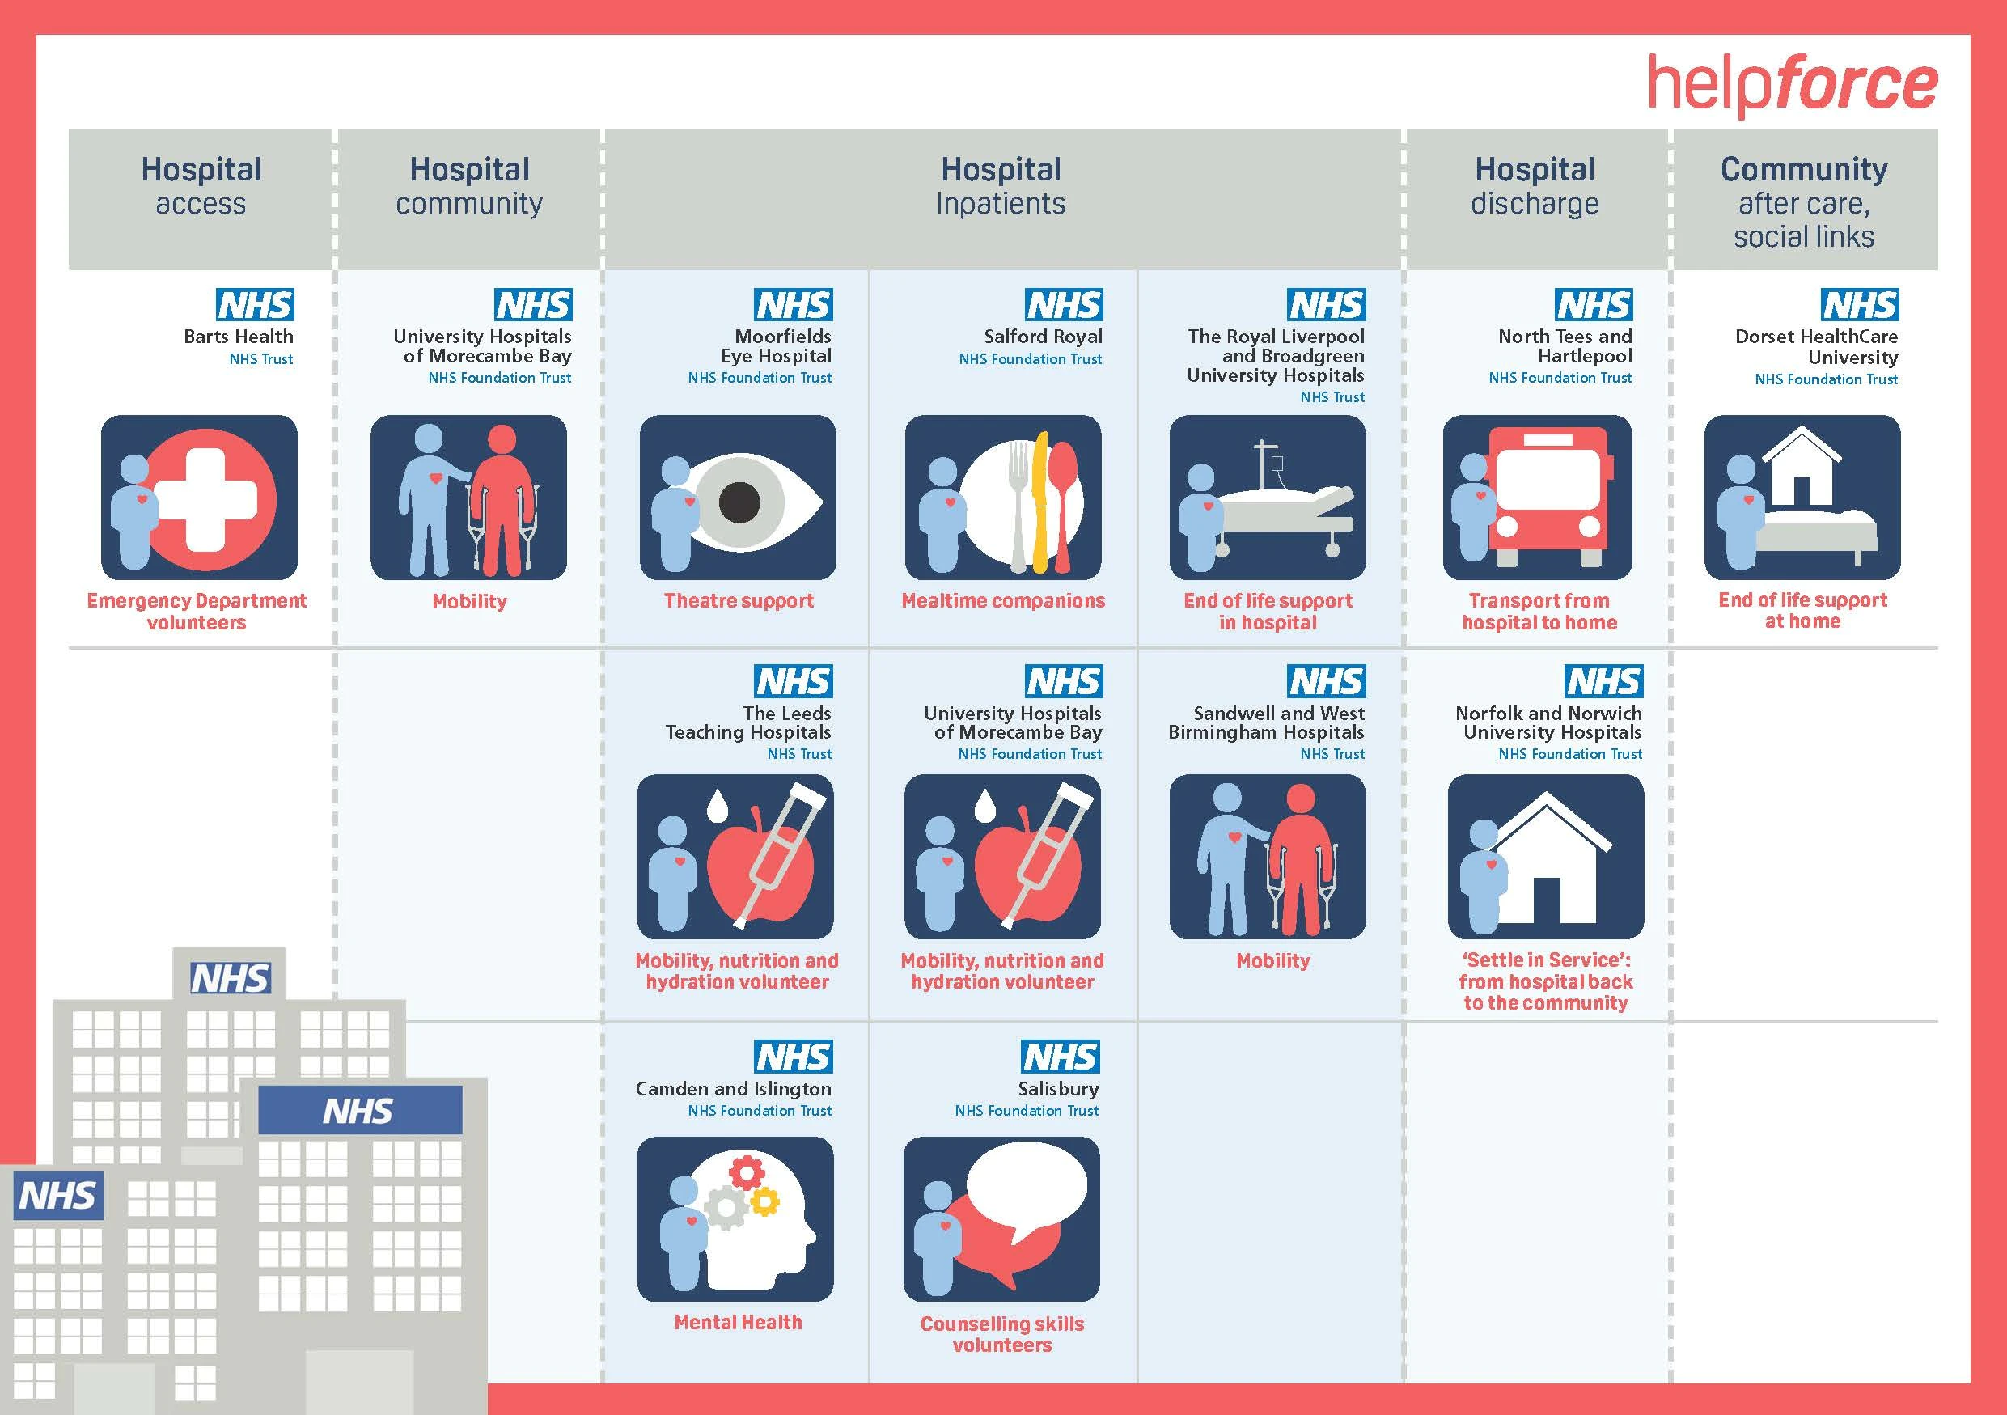
Volunteering Innovators Programme
Impactful volunteering roles across NHS hospital trusts
Key findings and outputs
4th November 2020
Funded by

Slide 2
Agenda & Housekeeping
Welcome & introduction Housekeeping Overview of the Programme | Mark Lever, Helpforce
Key evidence findings | Jullie Tran Graham, Helpforce
The NHS perspective Implications of the findings for the NHS in context of COVID-19 Embedding mobility volunteers in our hospital How our Response Volunteers model has adapted to be effective during the COVID-19 crisis | Dr Neil Churchill OBE, NHS England and NHS Improvement Ruth Wilkin, Sandwell & West Birmingham Hospitals NHS Trust Nancy Whiskin, Barts Health NHS Trust
How Helpforce can support you | Mark Lever
Q&A panel | Chaired by Paddy Hanrahan, Helpforce Joined by colleagues from VIP trusts
Summing up | Mark Lever
www.sli.do #HFVIP

Slide 3
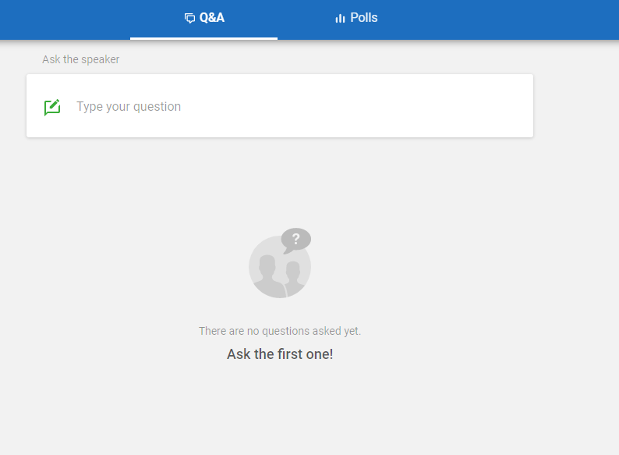
How to use Slido
Visit www.sli.do
Enter the code: #HFVIP
Type in your question

Slide 4
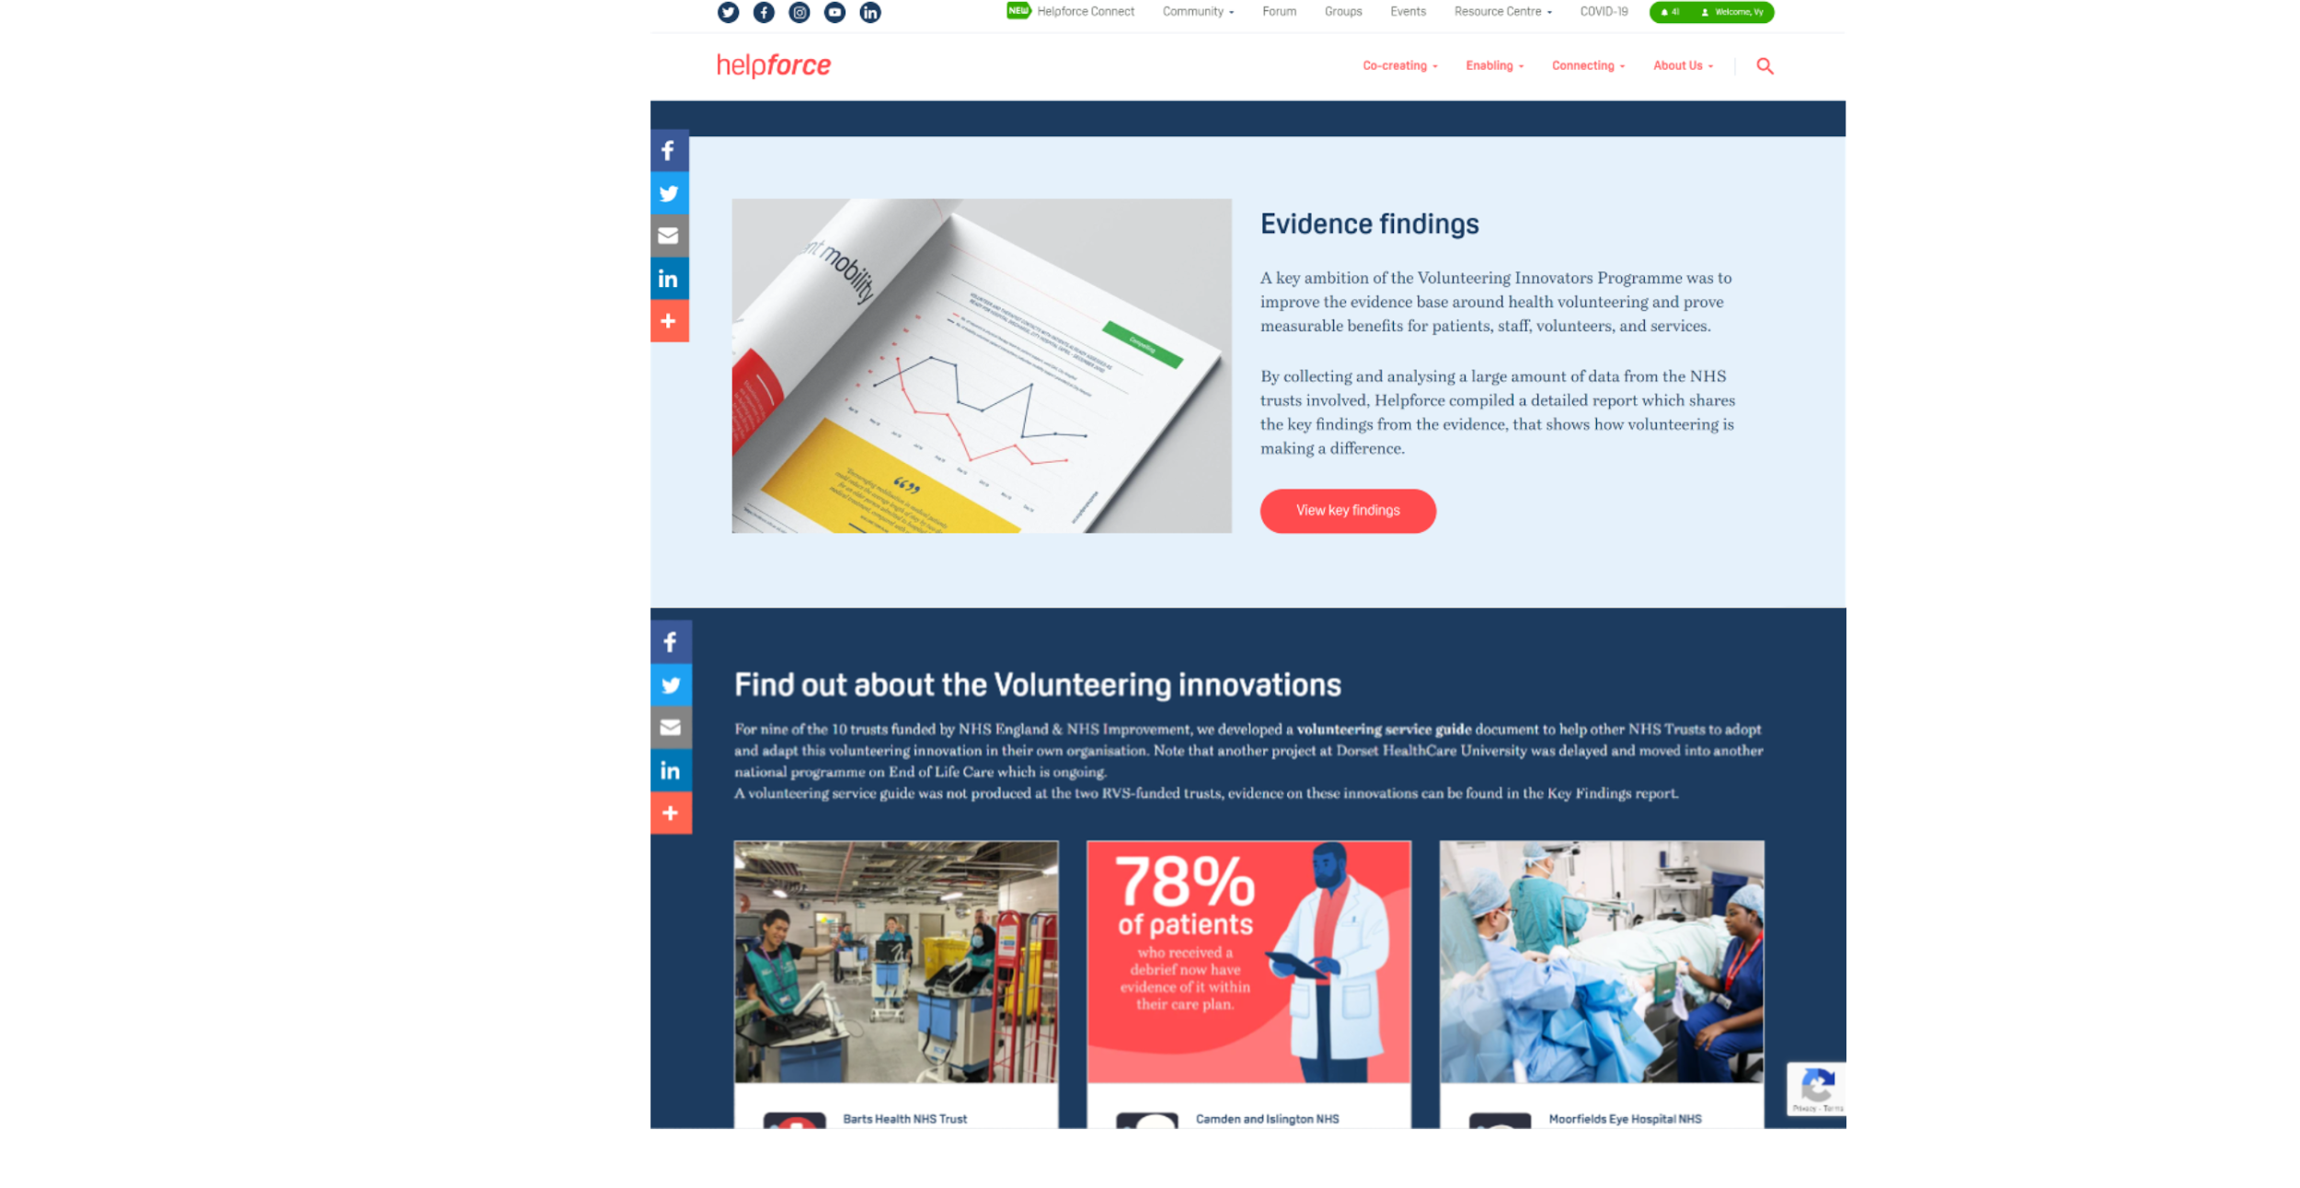
Overview of the Programme
https://helpforce.community/vip/
Ambitions
Develop and spread high-impact innovations
Improve the evidence base for volunteering
Grow the Helpforce network to share the learning
Project work across NHS hospital trusts
Service design, testing, and improvement
Scaling up & ‘packaging’ of innovations
Data collection & analysis
Outputs
Key evidence findings reports
Volunteering service guides x 9
Learning Network of 600+ members
How do we build on this work to accelerate the growth & impact of volunteering?
www.sli.do #HFVIP

Slide 5
Key evidence findings
Introduction
www.sli.do #HFVIP
Notes:
Notes now in a separate Google doc

Slide 6
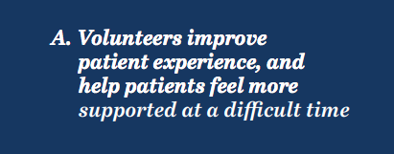
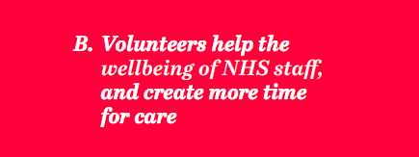
Key evidence findings
Overview: volunteering outcomes that help the NHS
www.sli.do #HFVIP

Slide 7
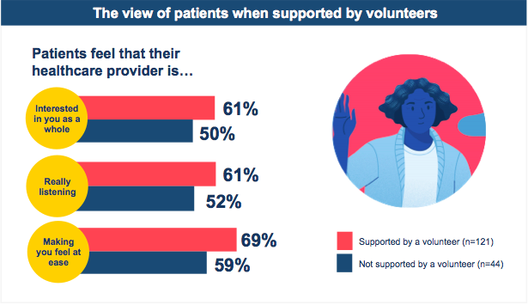
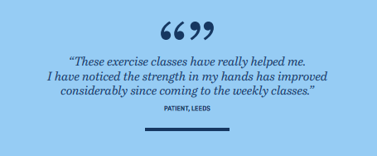
Key evidence findings
Patients
Volunteers improve patient experience and help patients feel more supported at a difficult time
www.sli.do #HFVIP

Slide 8
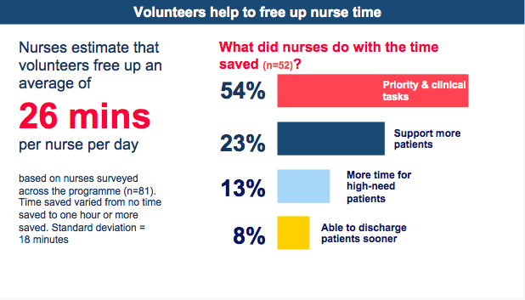
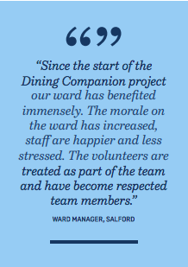
Key evidence findings
Staff
Volunteers help the wellbeing of NHS staff, and create more time for care
www.sli.do #HFVIP

Slide 9
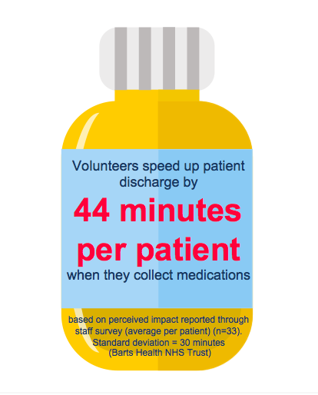
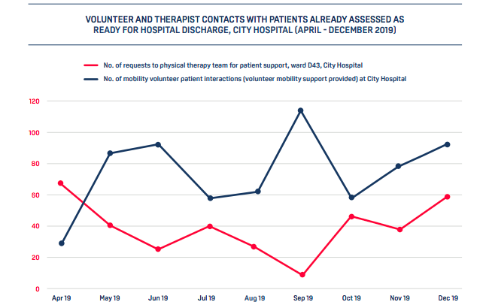
Key evidence findings
Services
Volunteers contribute to the efficiency of a hospital
www.sli.do #HFVIP

Slide 10
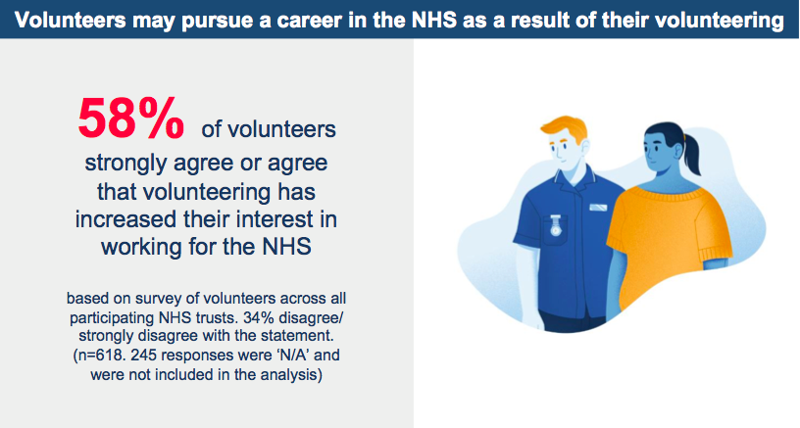
Key evidence findings
Volunteers
Volunteers may pursue a career in the NHS as a result of their volunteering
www.sli.do #HFVIP

Slide 11
Key evidence findings
Full report
Report available at:
https://helpforce.community/vip/
www.sli.do #HFVIP

Slide 12
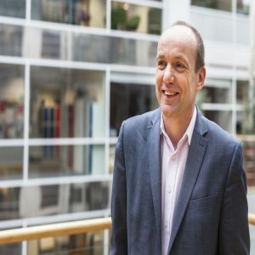
The NHS perspective
Implications of the findings for the NHS in context of Covid-19
Dr Neil Churchill OBE
Director for Experience, Participation & Equalities
NHS England & NHS Improvement
www.sli.do #HFVIP
Notes:
Logistics
Need to keep speakers to 5 mins - perhaps agree beforehand that we send them message at 4 mins “1 min left”?

Slide 13
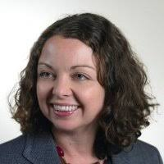
The NHS perspective
Embedding mobility volunteers in our hospital
Ruth Wilkin
Director of Communications
Sandwell & West Birmingham Hospitals NHS Trust
www.sli.do #HFVIP

Slide 14
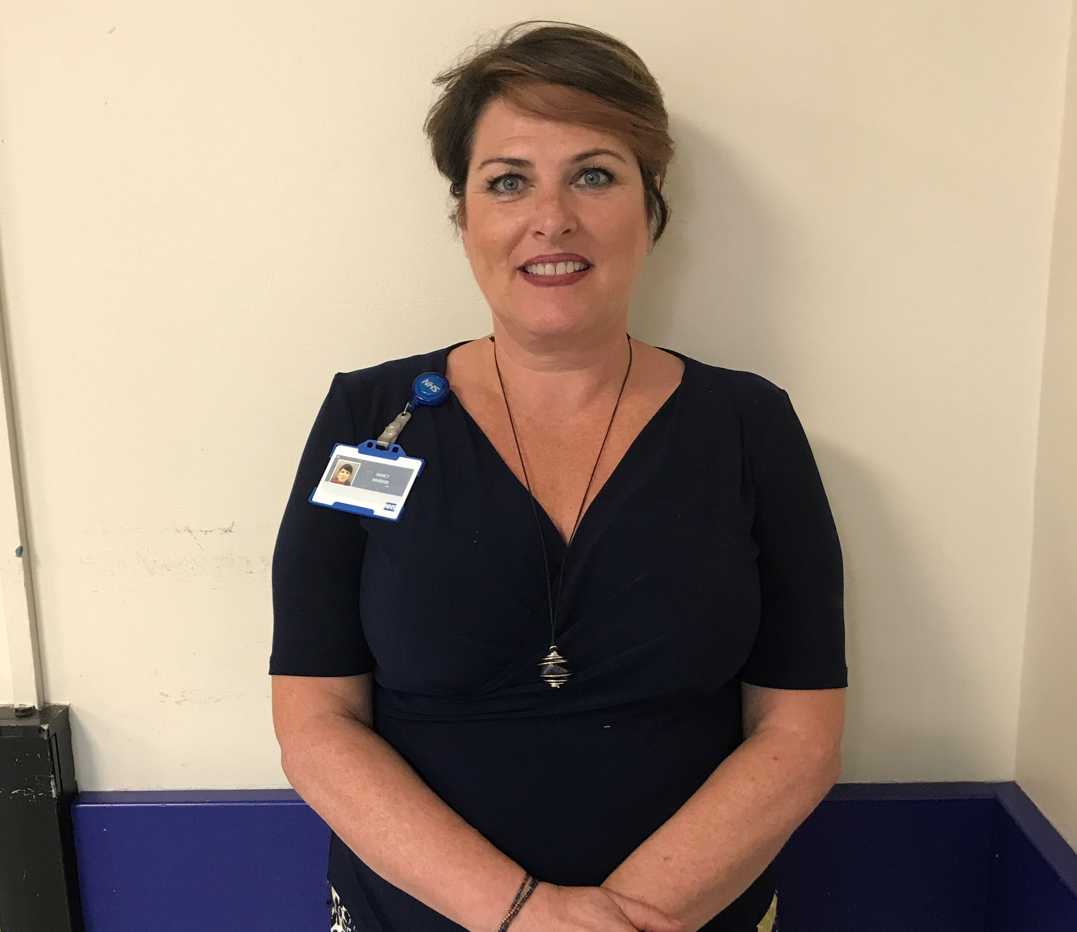
The NHS perspective
How our Response Volunteers model has adapted to be effective during the COVID crisis
Nancy Whiskin
Head of Volunteering,
Barts Health NHS Trust
www.sli.do #HFVIP

Slide 15
How Helpforce can support you
Facilitated support to adopt high-impact innovations relevant to respond to COVID-19
Address barriers to volunteering during COVID-19 through shared insight & solutions
Produce evidence to help make the case for volunteering to leaders
Helpforce Connect - join our network to collaborate with colleagues, and join Groups to share ideas and innovations
Contact us
help@helpforce.community
www.sli.do #HFVIP

Slide 16
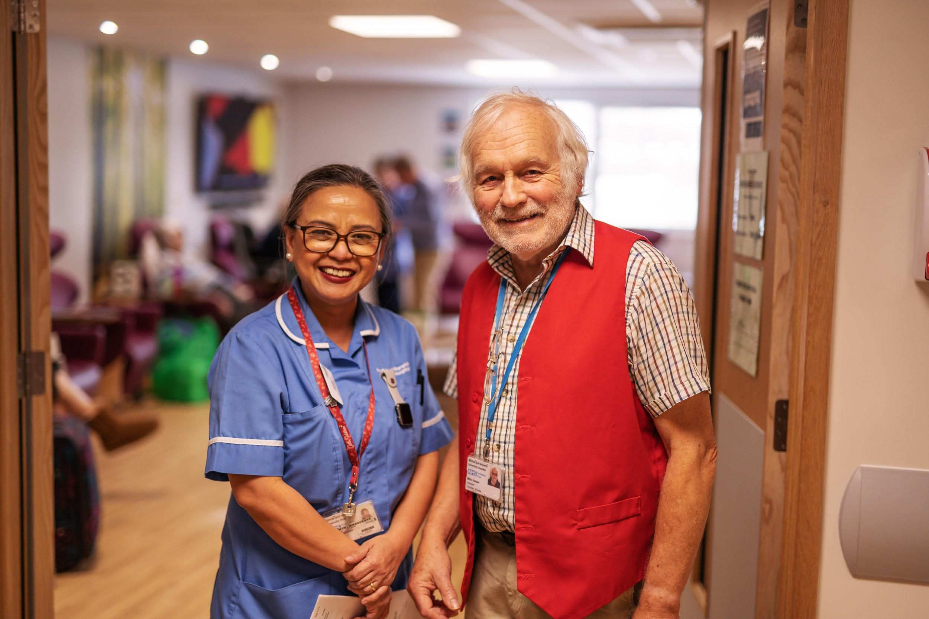
Q&A panel
We will now take questions from attendees.
Panel:
Mark Lever - Chair
Neil Churchill / Jane Fox - NHS England and NHS Improvement
Ruth Wilkin - Sandwell and West Birmingham Hospitals NHS Trust
Patricia Hunt - Sandwell and West Birmingham Hospitals NHS Trust
Nancy Whiskin - Barts Health NHS Trust
Paul Wharton - North Tees and Hartlepool NHS TFT
Charlotte Evans - Norfolk and Norwich University Hospitals NHS Foundation Trust
Jo Scott - Camden and Islington NHS Foundation Trust
Lucy Boulter - Salford Royal NHS Foundation Trust
Natalia Tomashpolskaya - Moorfields Eye Hospital NHS FT
Jullie Tran Graham - Helpforce
www.sli.do #HFVIP

Slide 17
Summary & close
Report available at:
https://helpforce.community/vip/

