Slide 1
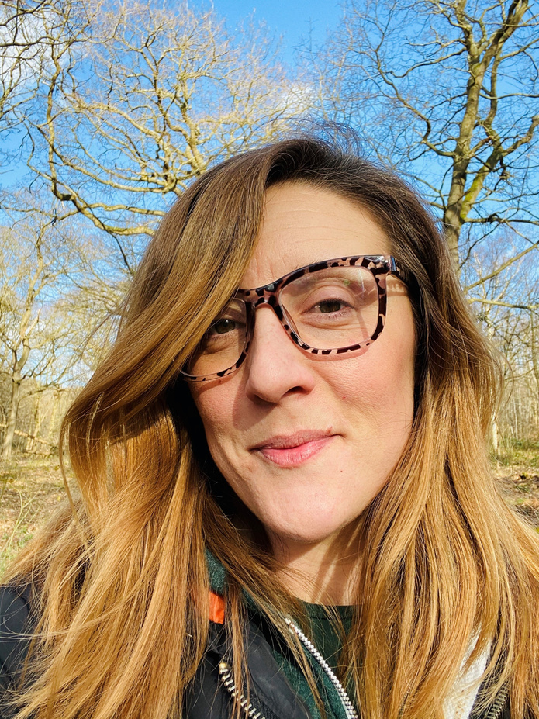



NATASHA HART
Active Citizenship
Supervisor
Notes:
Hi there, my name’s Tasha and I’m the Active Citizenship Supervisor for Ageless Thanet
Today I'll be sharing some of the successes of our Volunteering stream of the Ageless Thanet project.
My aim for this session, is to share our experiences in the hope that people can take what they want, to use or share, so that more people out there can do their best job to enhance our communities”.

Slide 2
Volunteer action at
Ageless Thanet:
Our volunteers are involved across all areas of the project and help us in reducing isolation and loneliness, empowering communities, improving people's mental and physical wellbeing, and ensuring older people's voices are heard.
We want to change people’s perceptions of getting older and our volunteers are vital to us achieving this. We seek volunteers of all age ranges and backgrounds to help us in our goal.
MAKING THANET A GREAT PLACE TO GROW OLDER

Slide 3
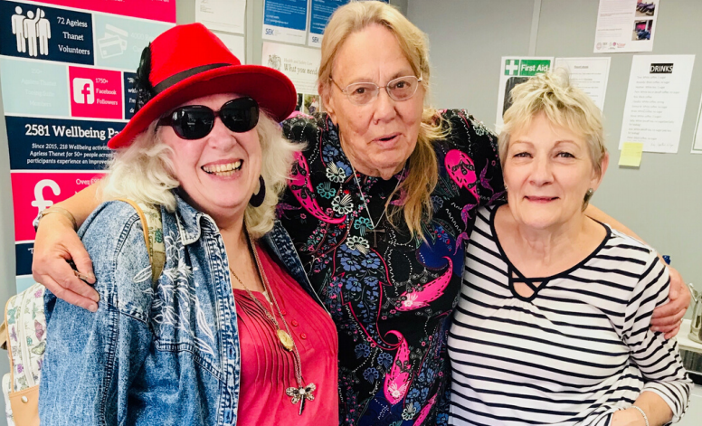
Our unique volunteer
recruitment process:
Anyone 18+ (not just 50+)
Keen to support local 50+ people
Personalised opportunities
Flexible volunteering
Target = Maximising benefit & enjoyment for all!
MAKING THANET A GREAT PLACE TO GROW OLDER
Notes:
Our unique volunteer recruitment process:
Anyone 18+ (not just 50+) – Whilst we started out aiming to primarily recruit volunteers aged 50+ so that they might benefit from community action, we soon learned that many younger people had lots to offer our audience and that we should include them with equal importance if they are able to help us create or maintain social activities for others
However, they DO need to be Keen to support local 50+ people as they are stepping into an environment where the majority of participants would be aged 50 or over.
Personalised or bespoke opportunities, we work to create tailor-made opportunities which bring enjoyment, satisfaction and benefit to both volunteers and participants. Working around the time, skills, confidence of the individual. We steer away from advertising specific volunteering roles, instead encouraging individuals to create their own personalised opportunity.
Flexible volunteering is KEY! Life changes, family changes, work changes health changes and even pandemics happen. If you are ready for this you can plan in advance and all be comfortable and ready for plan B if needed!
Volunteering for all! We strongly believe there is a volunteering opportunity for everyone, regardless of qualifications or experience, it’s just a case of working out what the best action is and some careful planning to make sure the idea works for all.

Slide 4
Recruiting volunteers to host activities
Our top priorities:
1:1 meet (or call) with potential volunteer
Explain project objectives
Take time to understand their skills, hobbies and interests
Offer practical support (venues, marketing etc,)
Empower not just enable
Review and flex
Involve volunteers in every step!
MAKING THANET A GREAT PLACE TO GROW OLDER
Notes:
Volunteering with Ageless Thanet is different to traditional volunteering. Our key objectives are to make the experience as personal and as flexible as possible, to ensure maximum benefit and enjoyment for our volunteers.
We steer away from advertising specific volunteering roles, instead encouraging individuals to create their own personalised opportunity. We always meet with a potential volunteer face to face, to firstly explain the objectives of the project, but also to add that personal and friendly touch that means the individual knows that they will be valued and appreciated.
If a volunteer is unsure of exactly what they want to do, we spend time with them to understand their skill set, hobbies and interests, to help them determine what they might like to offer. This varies from running a class or activity to helping out at events or community engagement days.
Our volunteers bring the passion and enthusiasm for their particular interest, and we assist with the practical side of things such as booking venues and creating marketing material. We involve the volunteers at every step of the way, to build their confidence and to empower them rather than simply enabling them. If there is something they enjoy doing, and would like to share it with others - we make that possible.

Slide 5
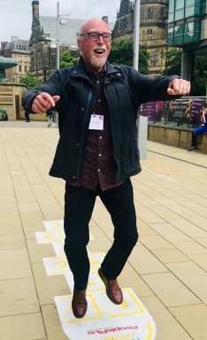
How we work with our
volunteers and community:
As well as being an integral part of our governance panel and various committees, our volunteers lead a huge range of different activities. ..
MAKING THANET A GREAT PLACE TO GROW OLDER
Notes:
Such as… next slide:

Slide 6
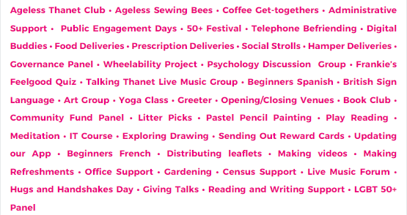
Types of volunteer activities we have supported:
MAKING THANET A GREAT PLACE TO GROW OLDER

Slide 7





  Covid-reactive (new, remote action)
  AGAIN, ALL FREE:
  Helpline
  Interim newsletters
  Social media focus
  Zoom think-tank
  Online drop-ins
  Zoom support for volunteers
  Digital socials and activities
  Telephone Befriending
  Digital Buddies scheme
  Social Prescribing referrals
Notes:
Following the start of the pandemic we ramped up our efforts to be as inclusive as possible and reach people who had effectively ‘disappeared’. We did this via:
A general telephone helpline – providing ongoing support and signposting for all services
We increased the frequency of mail-outs including helpful information re: local services
We also ramped up our social media communications
We hosted Zoom think-tanks with beneficiaries and volunteers (to find out what people wanted, or thought might help themselves and their community)
Online drop-ins – hosted weekly by staff re: all services
We provided zoom support for volunteer group hosts – to get them started
We created a range of brand-new digital socials and activities
We started a digital Buddies scheme – which I will talk more about in a moment
And we also supported referrals to Social Prescribing services regarding accessibility needs for those eligible for assistance

Slide 8

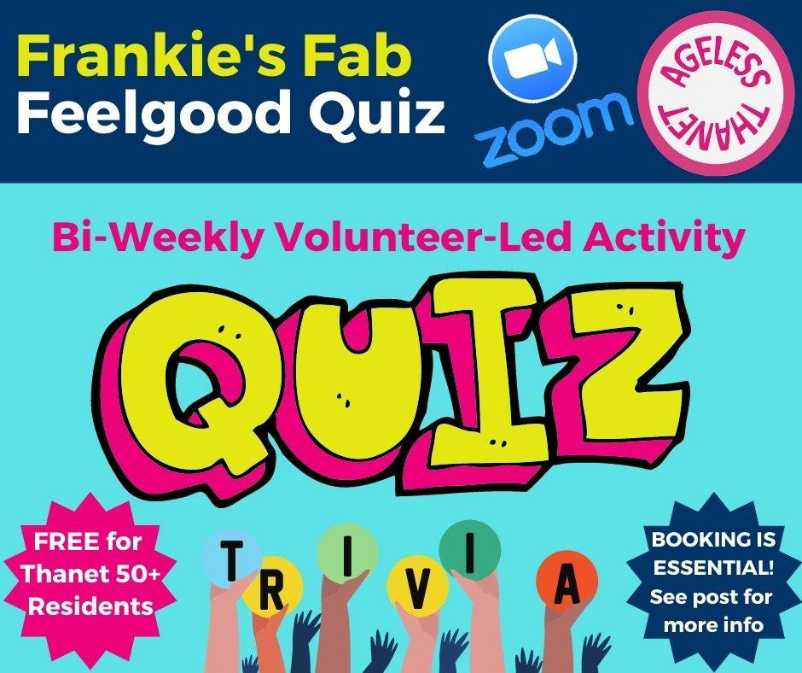
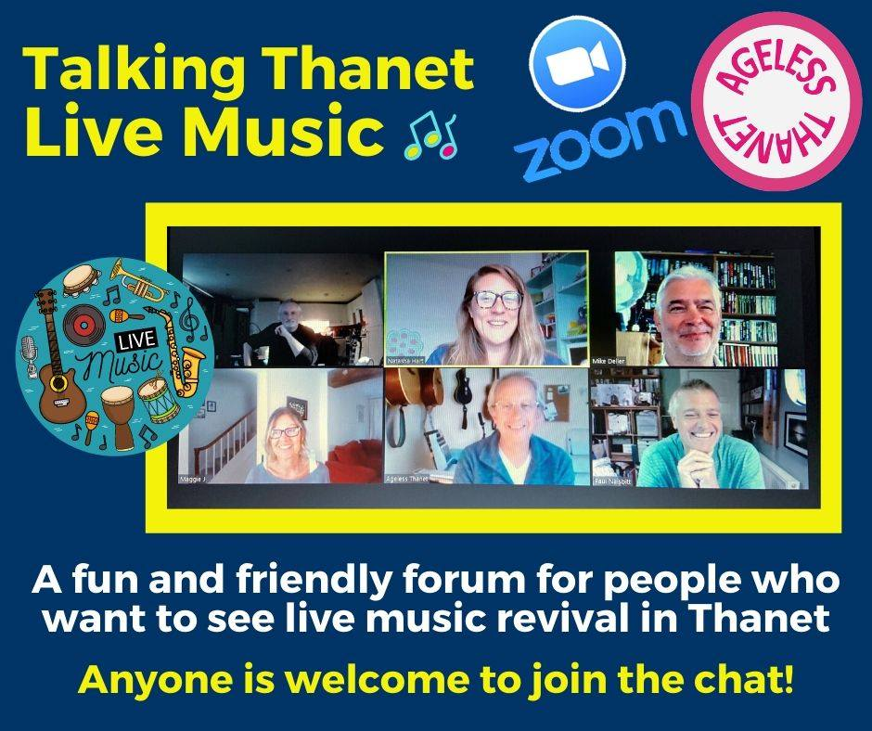
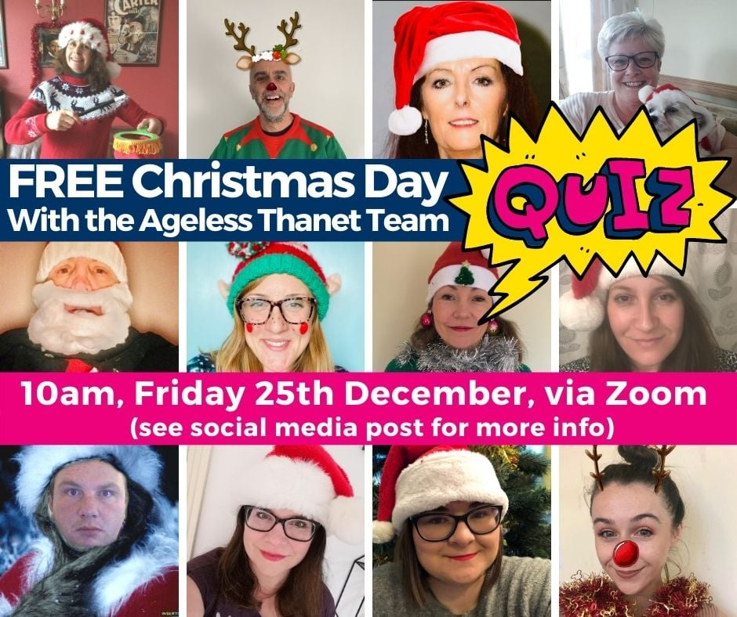

  Digital Socials and Activities:
  Wellbeing activities
  Volunteer Zoom think tank
  Coffee & chats
  Local music lovers' group
  Psychology discussion sessions
  Quiz
  Digital Buddies scheme
  Regular drop-ins
Notes:
In response to restrictions, we worked swiftly to transition our traditionally face to face opportunities online:
We were able to provide a wide selection of digital wellbeing activities, led by professional facilitators and instructors – such as Yoga, keep fit, pilates and photography to name but a few.
Also a good range of volunteer-led socials and activities, such as coffee & chats, a local music lovers’ group was formed, psychology discussions started, plus regular info-drop-ins and quizzes… We even hosted a quiz on Christmas day!
Added to this we also supported our audience to engage with the first ever online Census, over to Will to tell you more about that…

Slide 9
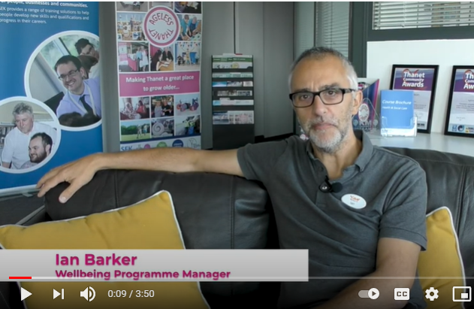
The volunteer-community partners overlap
• Venues, courses & drop-ins
• How we engage our audience
• Learning and development
• Participants as volunteers = the best advocates!
• Flexibility is key
• Fantastic bi-products of a joined-up approach
‘TOP TIPS’ video from Ageless Thanet and leisure partners :
https://youtu.be/CzQio9Z-v7Y
MAKING THANET A GREAT PLACE TO GROW OLDER
Notes:
Venues
We have used a broad range of physical venues such as community centres, sports facilities, church halls, supported living complexes, local businesses, public/green spaces. Volunteer-led aim for FOC or refreshments purchased at business. Sometimes drop-in (if for one-off support), courses or longer term depending on volunteer/s and opportunity.
Communicating with our audience:
Slots in project, wider organization and partner newsletters, sharing on social media, face to face public engagement opportunities, local press, neighbourhood magazines. Must admit that OUR biggest project hook was our own Age Friendly Business reward card (You may have similar in your area? There are lots of postcode/city discount cards or virtual high-street groups across the country)
Learning and development
We work with our partners to the benefit of our shared audience, so we have a broader reach for surveys, to gather data, tp test and learn with
We also believe fully in our approach, learning and achievements, and that produced by other ageing better projects (please see ours and TNLC Ageing Better website for resources and toolkits).
Participants and volunteers are the best advocates!
When promoting activities or recruiting volunteers of participants.
Flexibility is key Because life changes, targets change, the weather changes, and even pandemics happen! Our volunteers are reassured that they can give as much or as little time as they can, when it suits them and have the option to take a break or stop altogether if life gets in the way. All volunteers are welcome to return to volunteering if and when they want to.
Fantastic bi-products of the partnership approach:
MORE opportunities for friendships, new skills, challenging ageing, confidence building, championing older people’s voices, awareness raising – AND SO MUCH MORE!

Slide 10
Our key volunteer statistics:
  65% of volunteers said their confidence increased
  77% of volunteers said they felt they were making a useful contribution
  76% of volunteers said their motivation increased.
  81% of volunteers said they felt they have things to look forward to
Who is
Ageless Thanet?
MAKING THANET A GREAT PLACE TO GROW OLDER

Slide 11
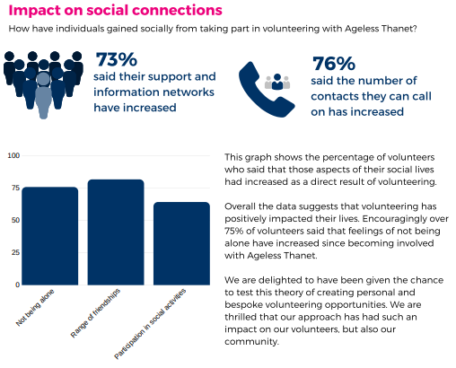
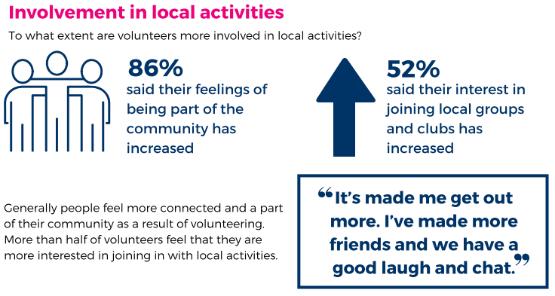
Some additional
Ageless Thanet
Volunteer statistics:

Slide 12

Queens award for volunteering:
This year our volunteers were recognised with this very special award. The MBE for Volunteer groups and the highest recognition volunteers can receive!
The Queen’s Award for Voluntary Service aims to recognise outstanding work by volunteer groups who benefit their local communities.
MAKING THANET A GREAT PLACE TO GROW OLDER

Slide 13

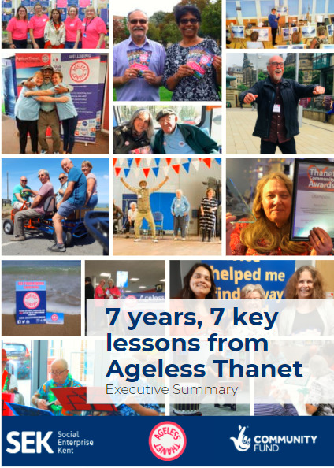
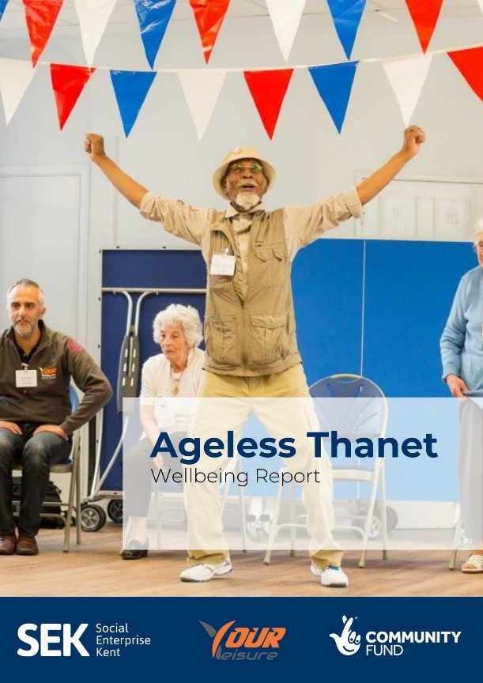
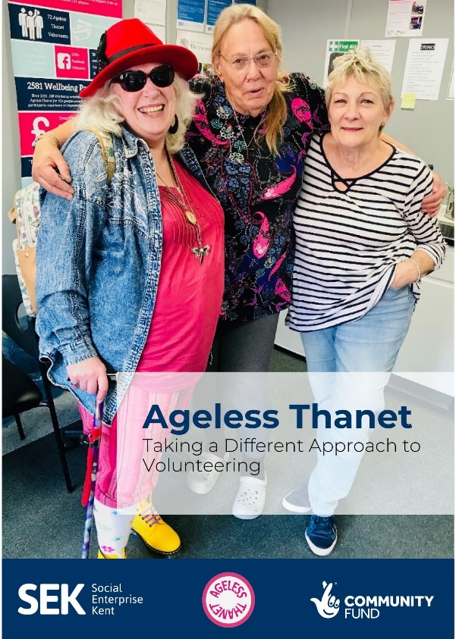
Ageless Thanet Shared Learning:
Who is
Ageless Thanet?
Ageless Thanet Learning Reports:
https://www.agelessthanet.org.uk/learning-reports
Ageless Thanet Videos:
https://www.youtube.com/channel/UCAo6sfAiAcFhs1FY98LlfYw/videos
Notes:
AT & TLCF Website reports and resources

Slide 14
Who is
Ageless Thanet?
Any questions?
  Thank you
Notes:
Does anyone have any questions they’d like to ask or comments they’d like to share?

