Slide 1
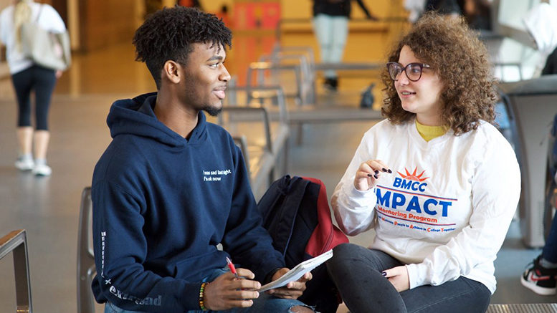
CAMHS Mentoring Project: an overview
Notes:
Hello everyone, thank-you for inviting me today. Its lovely to be here.
My name is Sinéad and I am very proud and delighted to be giving a short presentation on the CAMHS Mentoring Project

Slide 2
The 9-month journey
Notes:
So, this slide will give you a snapshot of the mentoring journey for both the volunteer and the young person accessing CAMHS
As you will see the mentoring journey is split up into three sections: the first few months are really focused on building the relationship, establishing the rapport and gaining trust. These are key tools, necessary to get them set off to a good start.
The second section is very much focused on teaching and exploring goals and skills. Under the guidance of the care-coordinator and clinician; using a comprehensive referral process. I support the Volunteer Mentor through ongoing training and monthly supervisions to work towards for example;
building independence
increasing confidence
working on interpersonal and social skills
such as; practicing how to be assertive, communicating their needs, setting boundaries and conflict resolution.
We work from a strength based approach. We hope to support the young person to achieving their own goals carried out under the guise of the fun activities based around their interests, hobbies and passions.
The final three months are all about:
solidifying the learning goals
developing reflective skills
and winding down.
We spend just as much time ending the relationship and mentoring scheme as we do defining and establishing it.
This ensures the young person is eased off the programme smoothly. We make sure the young person feels ready to end their mentoring sessions and has the tools to continue practicing their skills in their community on their own.
Once the mentoring sessions have stopped: the Volunteer Mentor writes up a summary of intervention to the Care-Coordinator, Clinician or Referrer; outlining the outcomes met and shares any other relevant information that will support the young persons’ treatment in CAMHS.
The final step for the Volunteer Mentor is the exit interview. This vital step in place; gains critical feedback for the Mentoring Programme as we want to hear about the impact of volunteering for them and of course learn ways we can improve it for future volunteers and service users.

Slide 3
Types of Intervention
Enriching community activities
Mediation and family work
Self-Reflective Exercises
Homework Mentors or midweek challenges
Multi-agency work: education, community professionals
Advocacy
Notes:
So moving on. This list should give you an idea of the varying ways the Volunteer Mentor can support the young persons treatment.
The majority of the work carried out enables the child to engage in enriching activities out in the community: this could be bowling, visiting museums and art galleries or attending an art class.
Occasionally where the relationship has broken down at home, it may be the Volunteer Mentor will plan a baking session with the young person and their parent or carer. This promotes healthy communication and is just a nice activity for the child to connect with their caregivers in a fun and accessible way.
Many of the Volunteer Mentors will also use their own skills in music, arts and/or sports as a forum to create a space where they can process difficulties in their lives.
To bridge the weekly sessions, more and more Volunteers are setting their mentees fun homework challenges like: keeping a gratitude journal or performing self-care tasks like putting on a face mask or drinking a glass of water in the morning!
Where the work of a Volunteer becomes really powerful is when they can advocate on behalf of or empower their mentees to get their needs met say for example in school. Mentors might work with teachers and pastoral staff to put in place provisions like ‘communication cards’, so they can discreetly express if they are feeling dysregulated, depressed or anxious.
Usually in the final months, Mentors will source and integrate their mentee into a community provision; like volunteering at a stables or farm; creating something sustainable for the child and their family to access beyond the mentoring scheme.

Slide 4
Training
Overview of SLaM and the NHS
The role of a mentor
Journey
Planning and designing sessions
Monitoring and Evaluation
Communication & THE ART OF Listening
Boundaries
Multi-agency working
Supervisions
Confidentiality
Safeguarding
Child-protection
Lone working
Self-care
PREVENT POLICY
Quiz
Scenarios
CASE-STUDIES
ROLE-PLAYS
The Getting
started
Endings
Notes:
All of our Volunteer mentors are thoroughly vetted and undergo comprehensive training.
We look at the work of the NHS and SLaM.
We explore safeguarding and child protection using real-life case studies.
They learn how to design and facilitate effective session plans that are outcome focused.
And, it is aimed to leave them feeling equipped with the tools to supporting children with complex mental health challenges.

Slide 5
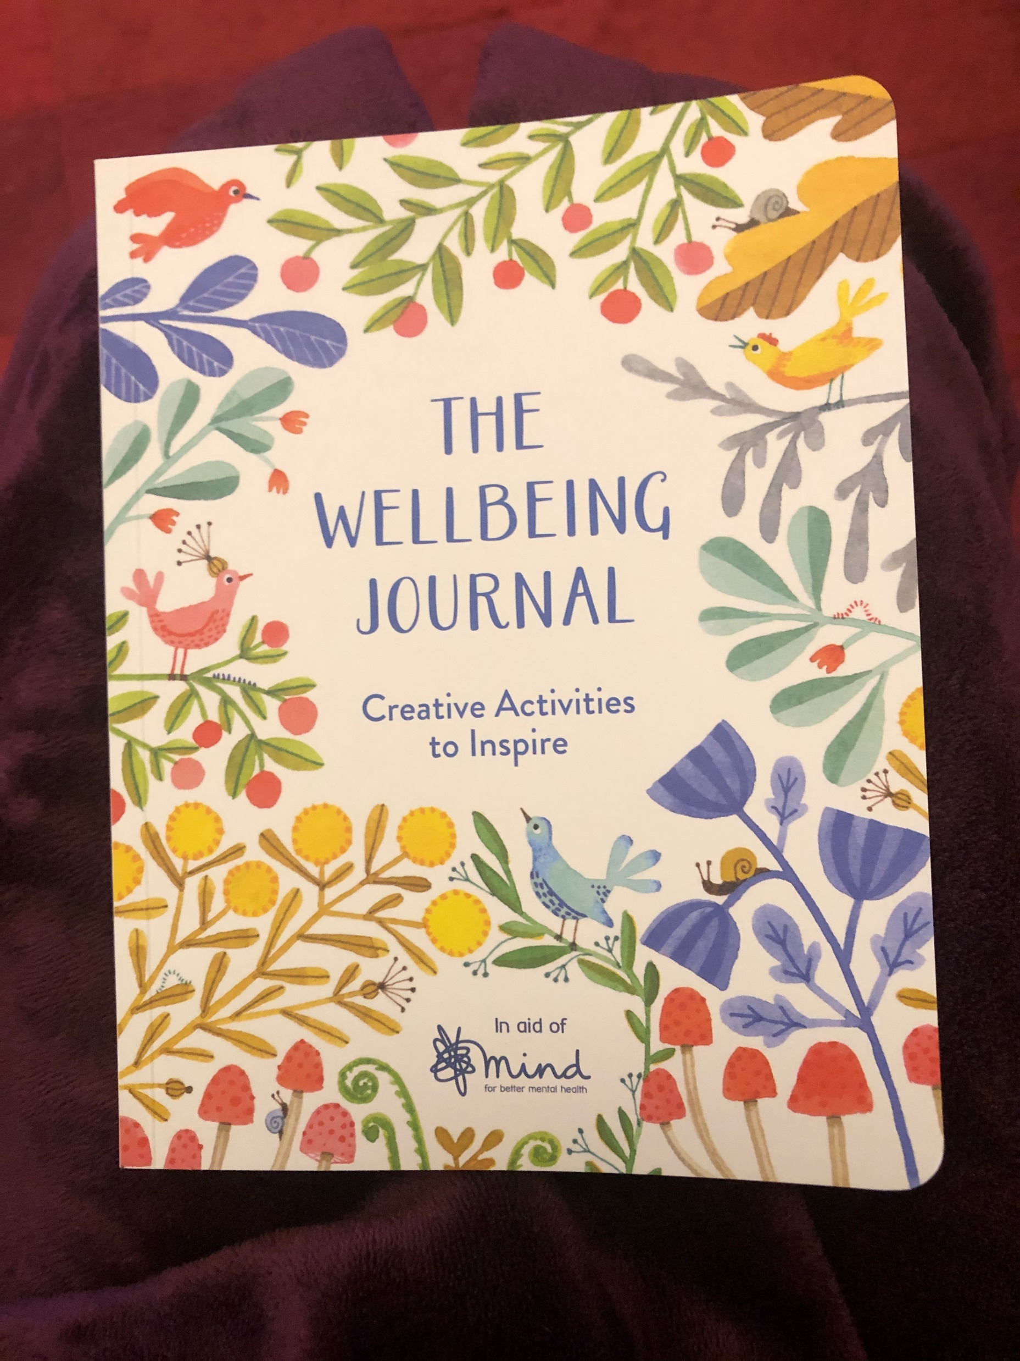
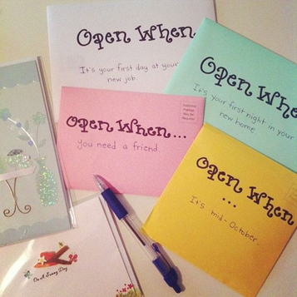
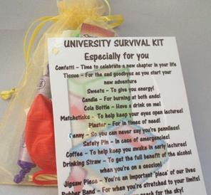
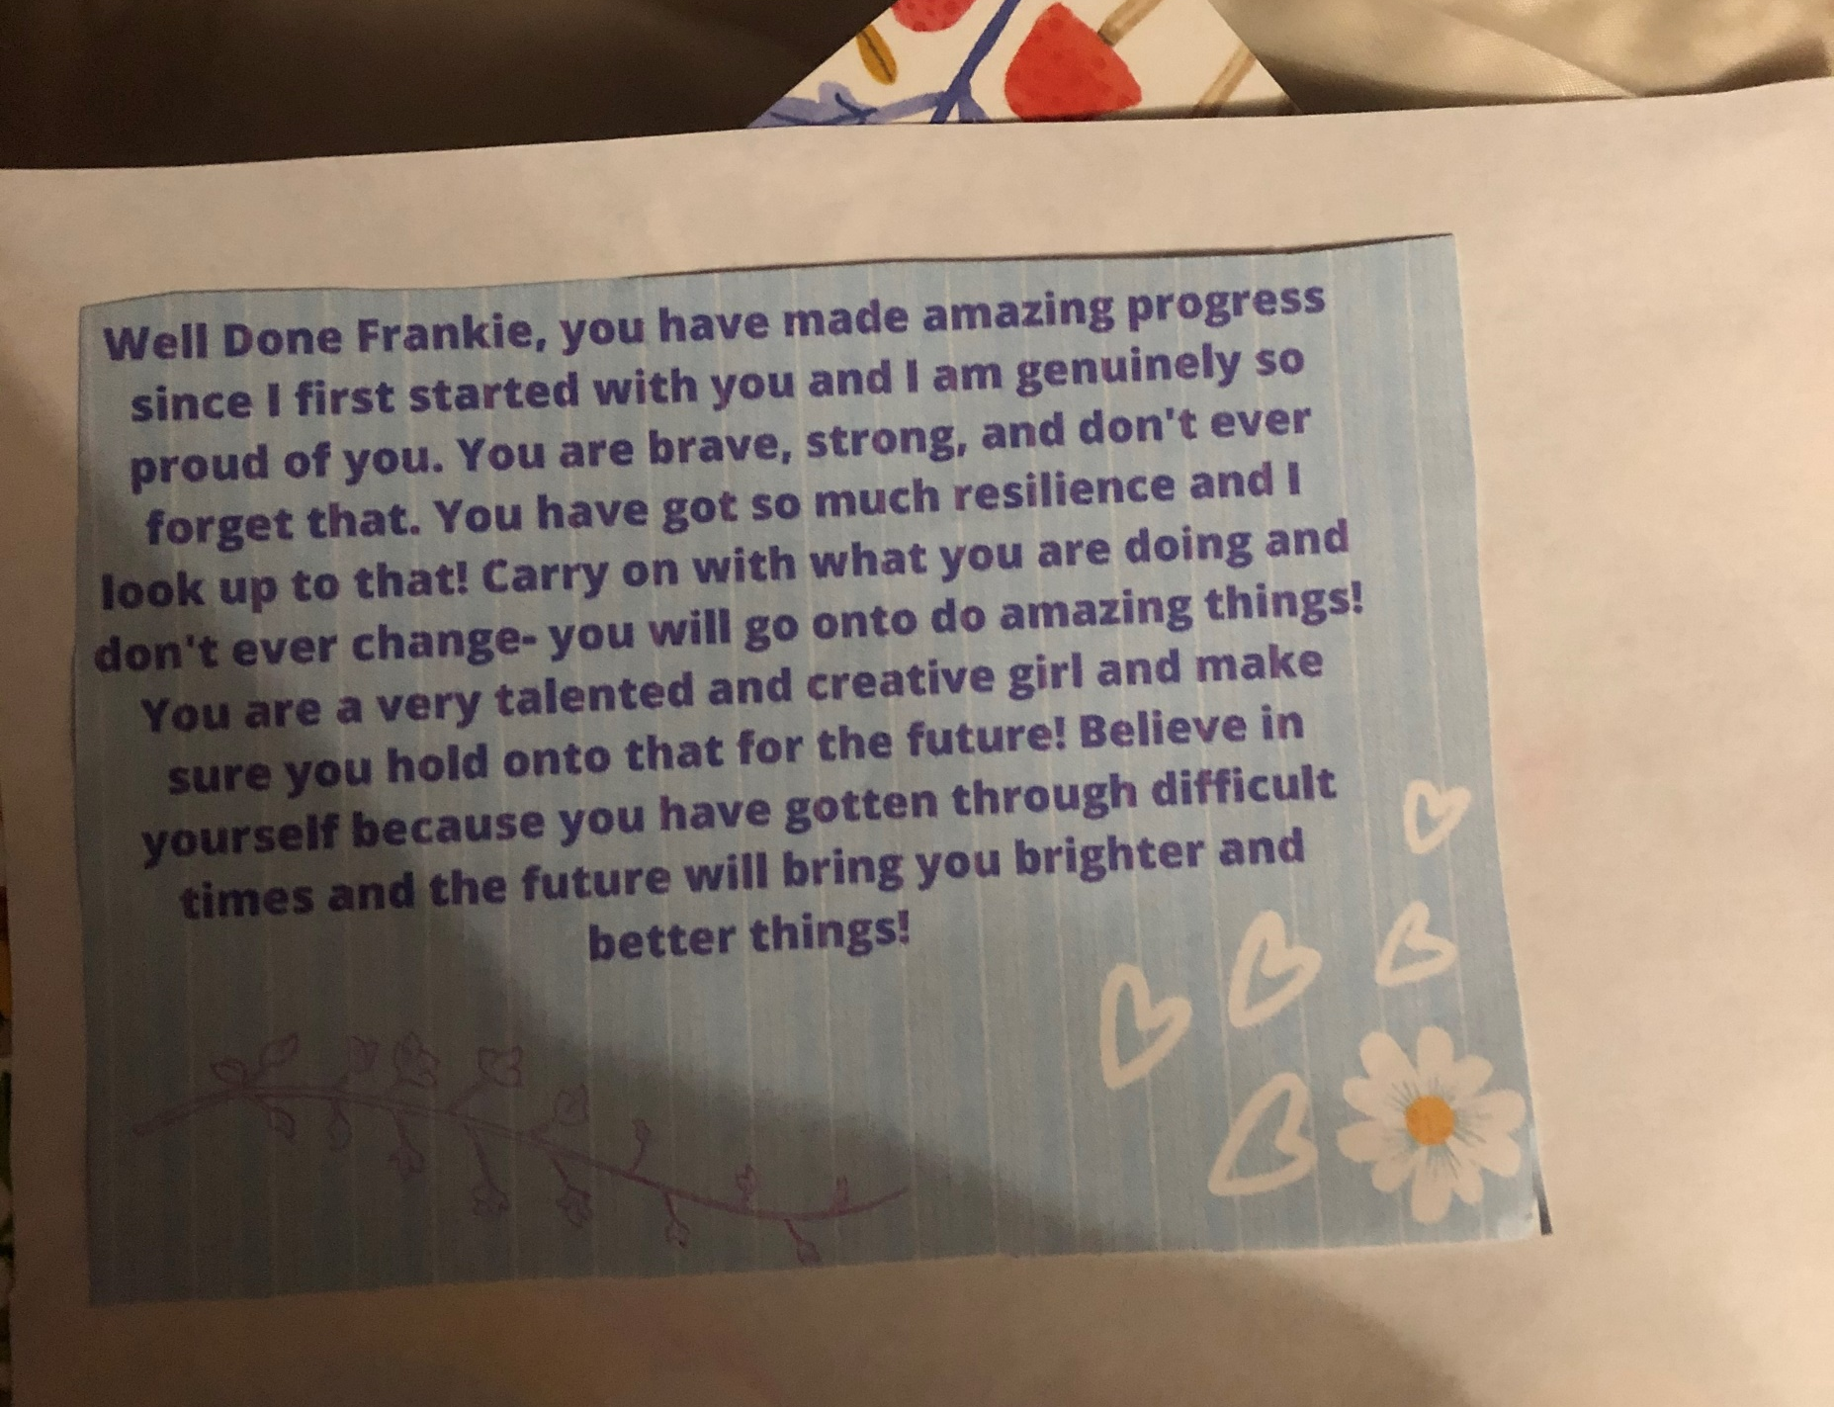
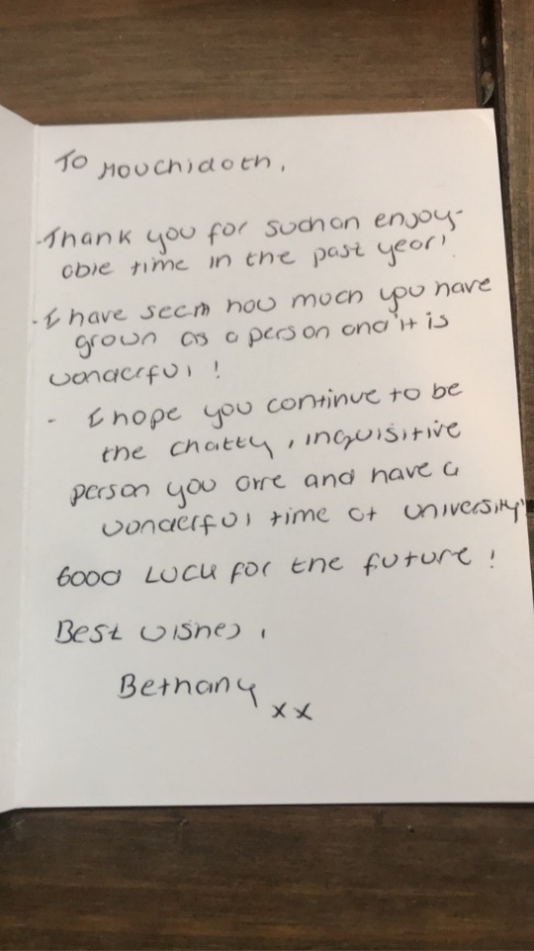
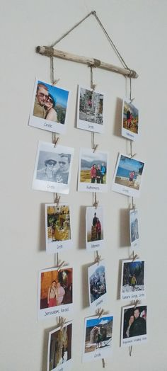
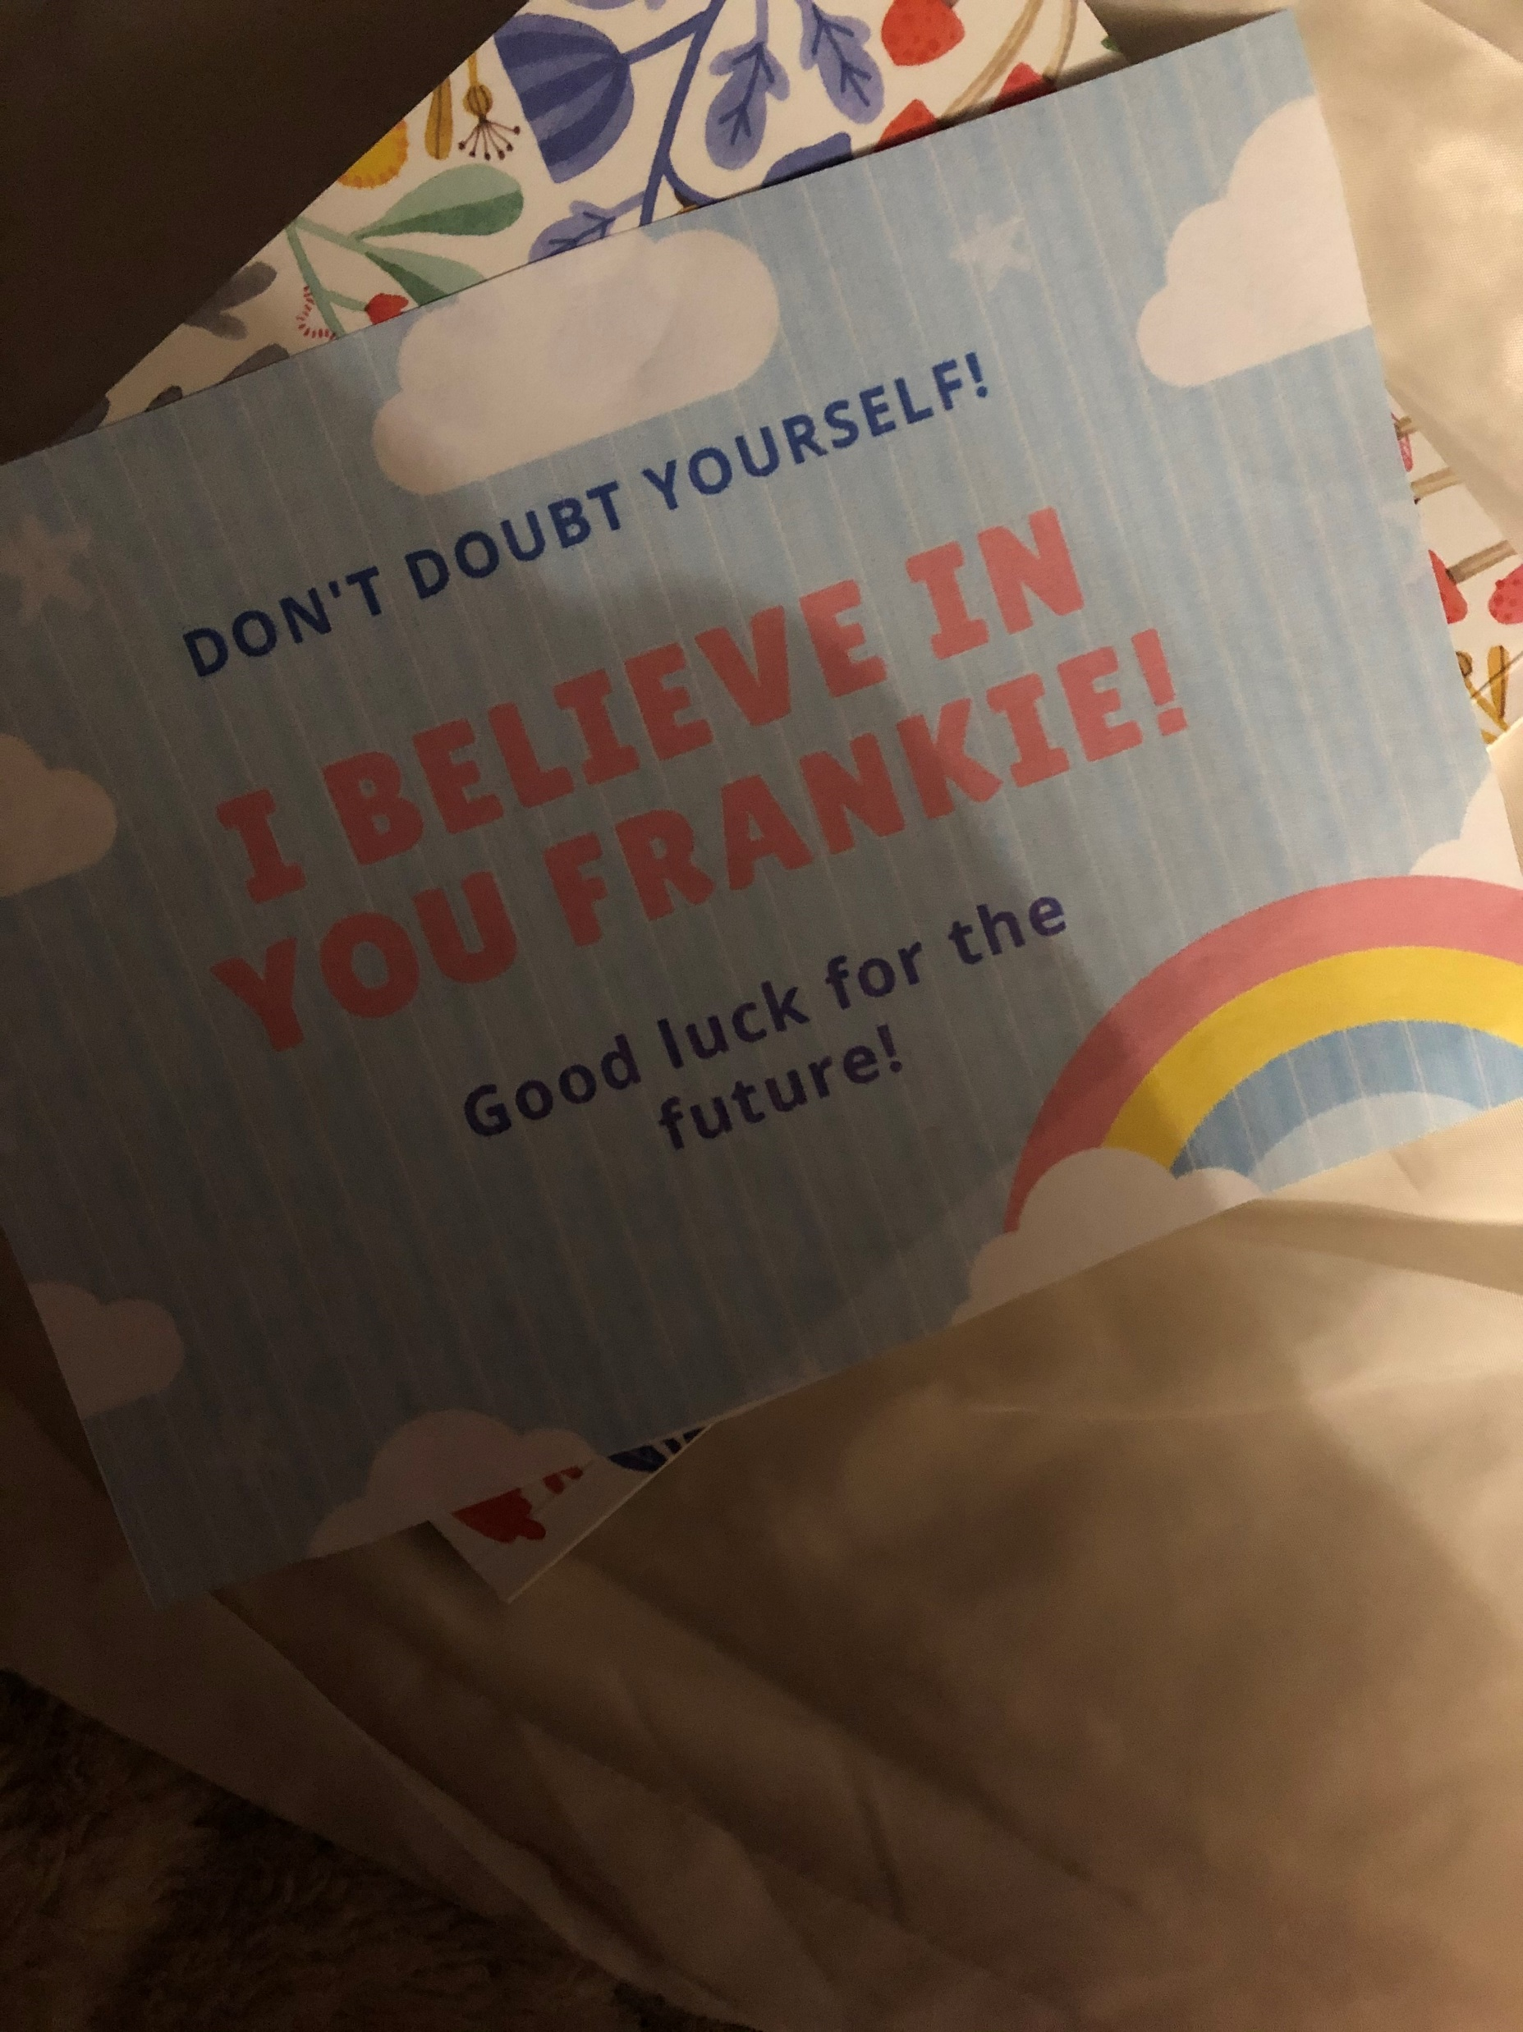
Notes:
Here are just a few examples of the final parting exchanges that Mentors may give to their mentees to capture the wonderful work that’s taken place over the course of the 9 months. These letters, journey books or cool-down kits can offer them support in their absence.

Slide 6
Supervision
PERSONALLY
TOUCH BASE
WHERE ARE YOU NOW?
CONSISTENCY
COMMUNICATION
GOALS
CHALLENGES
STRENGTHS
OPPORTUNITIES
SUPPORT & TRAINING
Notes:
Because we recruit young people - many of whom have lived experience of mental health challenges – it’s really important for us to make sure they feel supported and are able to carry out the work effectively. Our beneficiaries are very much two-fold. We support CAMHS service users but we also supporting the young volunteer mentors .
A thorough supervision with a clear model of support also creates consistency across the programme – this ensures that all of our CAMHS service users are receiving a similar experience.

Slide 7
Lets hear from Joanna…
Notes:
I’d like to pause here for a moment, as I think the best way to get an idea of the great work our Volunteer Mentors are carrying out is by hearing from one of them. Over to you Joanna.

Slide 8
Any questions?
Notes:
I’m happy to take any questions if we have time. And thank-you for having us.

Slide 9
Thank-you

