Slide 2
Volunteering in Primary Care
Integrated Approaches to Volunteering

Slide 3
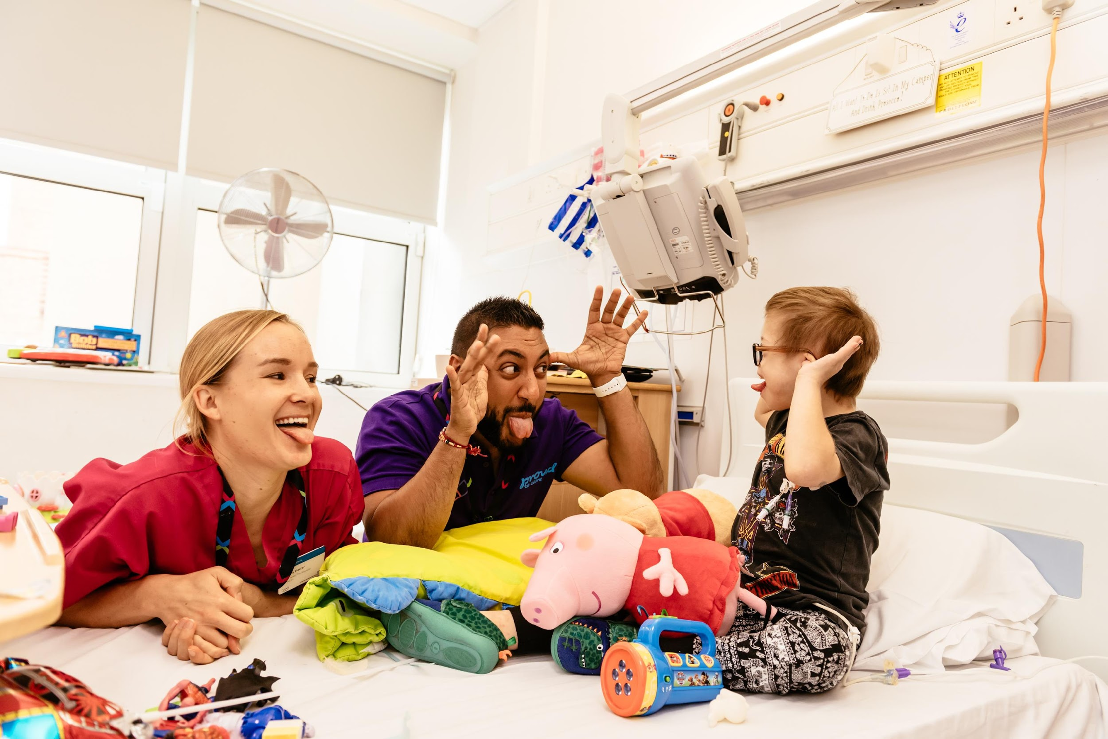
What is this presentation for?
This presentation is a template that people can use to set out the case for encouraging greater volunteering in primary care.
You can take any part of this and use it support your projects

Slide 4
Who might use this presentation?
Anyone that is keen to expand the role of volunteers in support of primary care:
GPs and staff based in Primary Care
CCG staff
Voluntary & Community Sector Organisations
Local Authority staff
Patient Participation Groups (PPGs)
Community Nurses
Hospital Discharge teams

Slide 5
Benefits of Volunteering
Volunteers increase capacity in Primary Care
Volunteers in Primary Care can be representative of the community
Primary Care is looking at ways to support non-medical need

Slide 6
Understanding Primary Care
Primary Care is more than GP Practices.
  PCNs have brought together GP Practices with other local actors in “Neighbourhoods”
Primary Care is made up of a range of multidisciplinary roles
GP Practices also exist in federations
Primary Care Networks (PCNs) have a role in Population Health Management
PCNs must create closer links with their communities

Slide 7
Considerations
Primary Care is currently carrying extremely high vacancy levels
PCNs will have discretionary budgets
Primary Care manages significant non-medical appointments estimate that 35% of GP appointments relate to non biomedical issues

Slide 8
Who might need to be involved in any primary care volunteering project:
PCN staff
Social Prescribing Link Workers
Local infrastructure organisations (CVS)
Local voluntary sector organisations
Local Authority
Local people

Slide 9
How can volunteering help?
Social prescribing has demonstrated the benefits of linking Primary Care to the surrounding community
Volunteers can amplify the impact of social prescriptions
Volunteers can improve the experience of GPs
Volunteers can help co-produce services around local needs

Slide 10
Challenges
Limited volunteer management experience or capacity in Primary Care
Managing volunteers is not free
Setting up a volunteer project takes time
Understanding local assets takes time
Non-medical interventions can be seen as not “core business”
Potential competition with the voluntary sector

Slide 11
Reciprocal benefits
Patients can reduce their own isolation through volunteering
Volunteering provides routes into employment
Volunteer designed services are better for the users

Slide 12
Pitfalls
Developing volunteering projects takes time
Volunteers are not paid staff and their contribution needs to be recognised differently
Volunteering in Primary Care does not exist in isolation
Matching supply and demand is crucial - don’t have people asking for support that you can’t give and don’t have volunteers with nothing to do.

Slide 13
Some examples
Altogether Better - An example of involving volunteers to improve primary care delivery.
Trains primary care leaders to work in collaboration with their local community (through Health Champion volunteers)
Health Champions help codesign services around local needs
Run group classes for activities such as walking, breast feeding, and diabetes management.
These activities help reduce GP visits, secondary care referrals, and help tackle social isolation.

Slide 14
Some examples
Helpforce Companions - Helpforce Companions are recruited, trained and managed by a local third sector organisation that already has experience of working with local volunteers. Helpforce Companions support people by
Picking up medication
Accompanying on a walk or a trip to the shops
Taking to an appointment or community event
Keeping in touch
Helping with simple tasks

Slide 15
Evaluation
The evidence base is emerging and tends to focus on the following areas:
Positive impact on GP staff
Reduction in demand for health services - evidence is emerging - attribution is very hard but impact likely to be felt in
  Reduced GP appts
  Reduced A&E attendance
Impact on patients
  Improvement in physical and mental wellbeing as evidence by improvement in scores such as Patient Activation Measure (PAM) and Warwick Edinburgh Mental Wellbeing Score (WEMWBS)
Impact on volunteers

Slide 16
Need more help?
Helpforce has set up a forum on our website for anyone interested in the role of volunteers in supporting primary care.
Anyone can join this forum it is a place to share best practice and for people to ask others for help and guidance when setting up and running projects aimed at increasing volunteering in Primary Care

