Slide 1
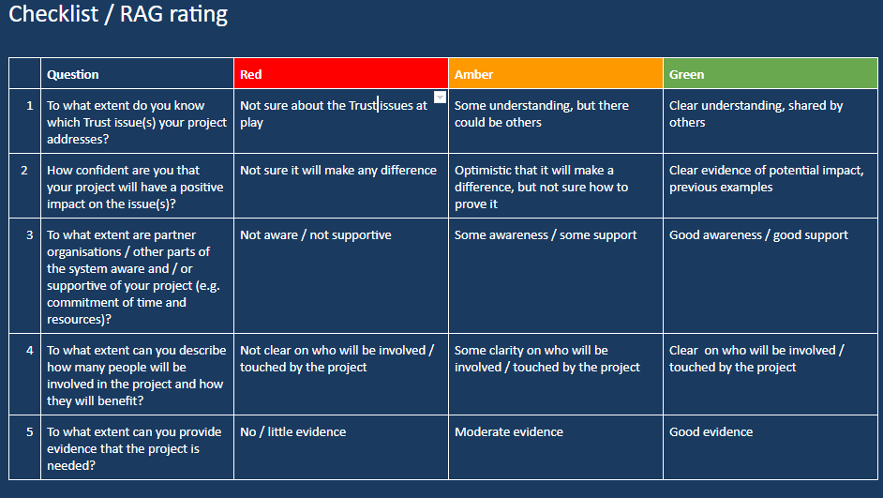
Action plan checklist/ RAG rating tool - Writing and Impactful Business Case
Understand the starting point for writing the business case. For each of the questions on page 1&2 identify which rating best describes your situation. Then use the prompt questions on page 3 to help identify what support/ learning/ knowledge you need to progress to green for each.
1/3
Action planning checklist/ RAG rating tool - Writing and Impactful Business Case

Slide 2
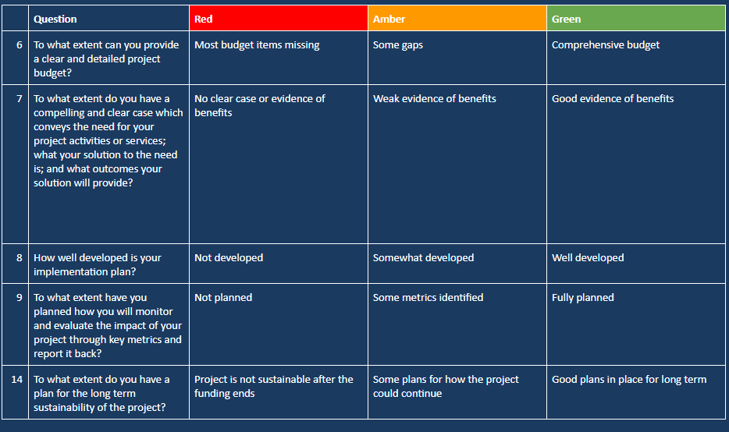
2/3
Action planning checklist/ RAG rating tool - Writing and Impactful Business Case

Slide 3
Develop your action plan
If Red | If Amber | If Green
How can you find our the missing information? How can you plug the gap? What resources do you need? Who will help you? | How can you strengthen your understanding? How can you improve your current position? What resources do you need? Who will help you? | You’re ready to get your business case signed off!
3/3
Action planning checklist/ RAG rating tool - Writing and Impactful Business Case

