Slide 1
Developing and Running
an Effective Project
This session will look at a mix of methods and techniques that will support your overall approach to adopting a new service

Slide 2
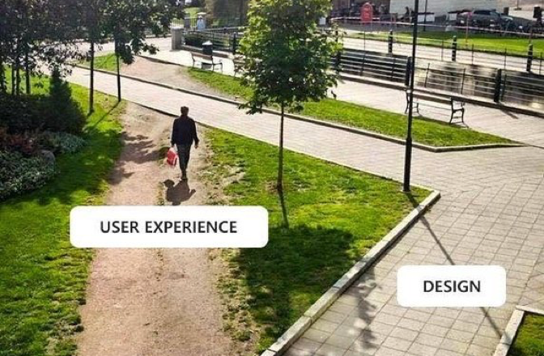
Agenda
Components of a service adoption project
Project management
Service design
Project management, being and feeling in control
Service design, it’s a balancing act
Engagement, it’s key to everything

Slide 3
Components of service adoption project
Understand local context; always important, but more so when adopting an existing model with promised benefits as it will have to be adapted to suit your environment.
Service design; Looks at both:
Front stage (customer experience)
Back stage (staff experience)
Project management; includes the planning, initiation, execution, monitoring, and closing of a project
Local context, considerations and integration
Service Design
Project Management
Front/ Back Stage:
People
Props
Processes
Engagement
Scope
Planning
Budget
Governance
Risk & mitigation

Slide 4
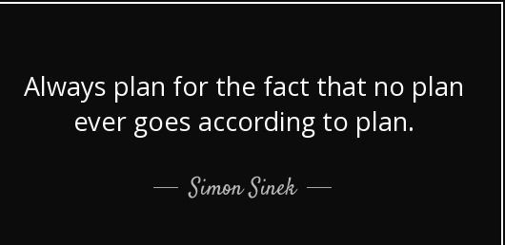
Project management - tips
Feeling and being in control
Scope Doc
Start small, but do start!
Be aware of scope creep
Out of scope list
Challenge yourself on your deadlines
Where are the dates coming from and why?
Query/ Qualify
Backward planning - be realistic about your true capacity
Engagement - be bold, open, capture learning and share good bad and ugly
Clear statements - this what doing these are the benefits

Slide 5
Scope Doc.
The objectives need to be simple to measure and provide you with tangible evidence that will support a case to sustain the service.
Ensure you and you line manager are aligned regarding the existing situation and issues
Exercise - get your line manager to list key issues to identify gaps/ confirm alignment with you
Milestones are what you have done, not what you are going to do, taking time to work these out across you timeline, they will help frame your project plan. They need to be realistic
This is your elevator pitch, making sure you can describe your vision in a succinct way highlighting key benefits. Help people to picture your service and gain buy in.
Knowing what out of scope helps prevent scope creep, gives you the confidence to say No to random additions to the plan by saying - It’s out of scope for phase 1, it’s here in phase 2 etc. Adding in something new either will change the timelines or mean something else moves out of scope.
Understand what data you will need to ensure the service is running effectively (performance data). What are your stakeholders data needs? Ensure you can demonstrate impact related to organisational strategic objectives too.

Slide 6
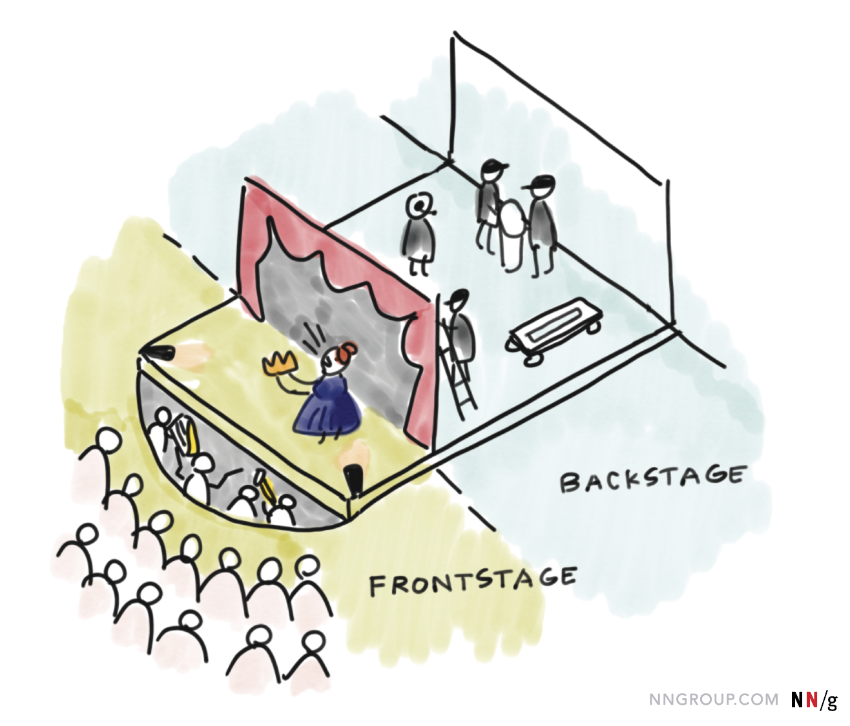
Service design
Service design is the activity of planning and organizing people, infrastructure, communication and material components of a service in order to improve its quality and the interaction between the service provider and its users.
Consider and balance front and backstage activities
Who are your customers?
Understand how your service works and the customer and service providers interaction points.
A quality user experience for both back and front stage is needed in order to grow and in turn sustain a service.
Engagement - be bold, open, capture learning and share good bad and ugly
Clear statements - this what the service is, this is what it isn’t, these are the benefits

Slide 7
Three main components of service design are;
People | 2. Props | 3. Processes
This component includes anyone who creates or uses the service, as well as individuals who may be indirectly affected by the service. | This component refers to the physical or digital artifacts (including products) that are needed to deliver the service successfully. | These are any workflows, procedures, or rituals performed by either the employee or the customer/ user throughout a service.
Examples include: Staff making requests (Customer/ user) Volunteering service staff Volunteers patients (customers encountered throughout the service) Stakeholders | Examples include: Request form Phone Marketing info Training and training materials Hub VMS Case studies Huddles Volunteers uniform Task list | Examples include: How to make a request Completing any governance forms e.g. signatures to confirm receipt of drugs from TTO run Receiving a referral Scheduling volunteers Identifying new tasks

Slide 8
Engagement
Who?
Stakeholders
Enablers
Blockers
Why?
Buy in/ support
Alignment - use your scoping doc
Help (resource or experience)
Influential
Customer
What?
Scope
Planning
Infrastructure
The service
When?
Stage:
Idea
Design
Development
Implementation
Delivery
Evaluation
How?
1:1
Peer Groups
Steering Groups
Workshops
Marketing
Training
Surveys (evaluation)
Needs
Service
Project
Engagement - be bold, open, capture learning and share good bad and ugly

