Slide 1
End of Life Care Project, Pre-project stakeholder survey
Survey results, Feb 2021

Slide 2
End of Life UK Cohort Meeting
17.03.21, 2 - 3.15pm
Agenda
Welcome
Update from Board/Trusts - 3 mins each
Results of the pre-project stakeholder survey
Quantitative data collection progress
Final report - discussion ‘what would you like to see in the final report’
Toolkits - development
What additional information is required to support toolkits and final reports
Questions/answers

Slide 3
Survey results

Slide 4
1. Which trusts/health boards took part in the survey?
The survey had 30 responses. However, 5 responses came from volunteers who did not appear to be part of the relevant steering groups, based on some of their responses. Thus, they were excluded from the analyses.
On ward support:
Aneurin Bevan UHB
West Hertfordshire Hospitals
York Teaching Hospital
Virtual support:
Hywel Dda UHB
NHS Borders
Northern HST
Powys THB

Slide 5
2. Job roles of survey respondents
Just under a third of the survey respondents are volunteer team members or mangers (32%), 28% are clinical staff such as Palliative Care Clinical Nurse Specialists, 16% are quality improvement staff such as Patient Experience or Quality Improvement team members, 12% are third sector liaison and third sector partner staff, and 12% are hospital administration or management staff.

Slide 6
3. How would you rate your level of satisfaction with your previous experience of volunteer support provided within this hospital?
Most survey respondents (88%) are either satisfied or very satisfied with the previous volunteer support provided within their hospital.
Very satisfied quote: “Our volunteers are a super bunch, so kind and supportive, and always ready to help out with whatever is needed! However, they haven't been involved with EOLC.” – West Hertfordshire Hospitals
Unsatisfied quote: “Very limited volunteer offering previously” – Powys THB

Slide 7
4. How has your experience of the design and implementation of the new volunteer service been so far? Do you have any concerns at this stage?
Over half of the respondents (64%) do not have any concerns at this stage. Trusts with virtual support tend to report faster implementation while those with on ward support tend to report delays due to Covid-19.
Positive experiences
No concerns
Well organised, good communication and collaboration
Volunteer recruitment persisted during pandemic
Positive impressions of the running volunteer service
The service has been implemented swiftly (Powys THB / Northern HST)
Concerns
Delays to the service implementation due to Covid-19
Lack of capacity from the volunteer coordinator
The virtual support is not as effective as face-to-face support would be
Risk of losing volunteer engagement

Slide 8
5. In your opinion, what have been the main barriers to successful implementation of the new service?
Covid-19, related restrictions, and adapting to remote working is by far the most named barrier among the survey respondents.
“Due to the pandemic we had to change the project, which actually works well but took longer. Also due to the pandemic staff involved did not have the time needed to implement the project as swiftly as we would have liked.” – Hywel Dda UHB
Other barriers:
Lack of capacity from the volunteer coordinator (Northern HST, NHS Borders)
Having to offer a virtual version of the service, as it affects referrals and volunteer engagement (Powys THB)
Lack of volunteers (West Hertfordshire Hospitals)

Slide 9
6. What have been the key enablers required for implementing the new service?
Good partnership working, teamwork, and stakeholder buy-in
Enthusiastic volunteers
Supportive, dedicated volunteer coordinator and good leadership
Health and safety
Technology training
“The key enablers are that everyone from the outset saw the added value of this initiative and went 'over and above' to get it started. There has been great team working from the outset and a genuine willingness to help and support this.” – Northern HST
“The enthusiasm and commitment of the volunteers has been heart warming.” – Aneurin Bevan UHB
“We have a fab new coordinator who's really getting the service up and running, training vols etc.” – West Hertfordshire Hospitals
“Risk assessments in place to ensure safe return for all our volunteers, additional training in PPE.” – Aneurin Bevan UHB
“Accessing technology and digital training for the staff and volunteers while remaining remotely safe.” – Hywel Dda UHB
Health and safety was relevant only to on ward types of services while technology training was relevant only to virtual types of services.

Slide 10
7. Ratings of EOLC/palliative care/bereavement service performance before volunteers were introduced
Many survey respondents (between 25% and 54% depending on the sub-question) did know how to rate the previous EOLC/palliative care/bereavement service or felt the aspects listed were not relevant to their volunteering project. The four aspects that were rated most poorly are volunteer interest in a health and care career (33% good / very good), family/carer knowledge of support services (38% good / very good), family/carer wellbeing, and staff wellbeing (both 42% good / very good).
Job role differences
Survey respondents from quality improvement teams responded "don't know" to most of the performance aspects.
Third sector liaison / third sector partners and clinical staff provide the highest performance ratings on patient experience, quality of care, family/carer wellbeing and family/carer experience, compared with other job roles.
Clinical staff are also most the positive about family/carer knowledge of support services and staff wellbeing but are also the least positive on volunteer sense of purpose / skills / confidence and volunteer interest in a health and care career.
Volunteer team members / managers were the most positive on staff confidence in the quality of the service that volunteers are helping to deliver and volunteer sense of purpose / skills / confidence.

Slide 11
8. What, if any, do you believe are the primary benefits that will result from the introduction of the new volunteer service?
Additional support to patients’ loved ones, including reassurance that the patient is not alone and signposting to support services
Improved patient care and preventing patient loneliness
Additional support to staff to provide good care, free up time, and improve their wellbeing
Better connection between trust and patients’ loved ones
Improved wellbeing and experience in volunteers
“The ability to reassure next of kin that they were not alone, the signposting to the necessary help, to help start the new grief journey and assure people are being listened to” – Northern HST
“Friendship and to prevent loneliness with the hospital as staff as busy.” – Hywel Dda UHB
“Staff will feel more supported to provide the care they need to patients”
“Families will have a sense that the Trust has remembered about them and they haven't been forgotten.” – Northern HST
“This service provides a meaningful and rewarding volunteering role, benefitting the wellbeing of volunteers who are involved.” – Northern HST
There are no observed differences in responses between on ward types of services and virtual types of services.

Slide 12
9. If you believe that volunteers will deliver service-related benefits, are there any specific hospital performance metrics that you believe should be monitored as part of this project to help demonstrate these benefits?
Only 11 respondents (44%) answered this question. Most of these stated that they did not know of relevant metrics, leaving only 4 meaningful answers (16% of all respondents):
“Cost benefit analysis, ROI or KPI's met.” – West Hertfordshire Hospitals
“Workforce satisfaction with providing end of life care, although this can be difficult to measure”
“Primarily that patients at end of life will have timely access to a companion and that there will be a reduction in the number of people dying alone” – Aneurin Bevan UHB
“Patient and family satisfaction. Hopefully, this service will reduce the number of complaints relating to end of life care.” – Aneurin Bevan UHB

Slide 13
10. How important do you believe that the following will be to the successful implementation of the volunteer service that you are involved with? - (a) Considering the opinions and wishes of stakeholders
The vast majority of the survey respondents feel that the opinions and wishes of all four stakeholder groups (staff, patients, families and carers, and volunteers) are very important to the successful implementation of the volunteer service. The “N/A” responses with regards to patients came from Northern HST (bereavement focus).

Slide 14
10. How important do you believe that the following will be to the successful implementation of the volunteer service that you are involved with? - (b) Implementation of the volunteer role
The vast majority of the survey respondents feel that all of the below listed aspects are very important to the successful implementation of the volunteer service.

Slide 15
10. How important do you believe that the following will be to the successful implementation of the volunteer service that you are involved with? - (c) Other enablers
The vast majority of the survey respondents feel that all of the below listed aspects are very important to the successful implementation of the volunteer service. Only the availability of equipment required by the volunteer service is seen as somewhat less important.

Slide 16
11. Additional comments from survey respondents about their expectations relating to the introduction of the volunteer service
Respondents mainly express their enthusiasm for the volunteer service and their optimism for its impact.
“When it was piloted before, it was such a huge help to patients, families and staff. I am really looking forward to having this again.” – West Hertfordshire Hospitals
“We are so keen to get this service embedded across the Health Board but appreciate that much is dependent on the pandemic, national and organisational risk assessments.” – Aneurin Bevan UHB
Two also offered thoughts around sustainability of the volunteer service.
“I think we have planned how we would like it to develop into a service but we must allow it to make some organic growth too - that is what will help with sustainability in the future.” – Aneurin Bevan UHB
“We would be keen to establish impact to enable the service to continue by finding future funding.” – West Hertfordshire Hospitals
Two also mention the importance of technology skills.
“Technological support for the volunteers, again can be volunteer digital buddies, who can enable the connection to be made if it can’t be face to face. This is important going into the future, technology changes so fast.” – Hywel Dda UHB

Slide 17
Activities
Intermediate outcomes
Ultimate goals
Rose Volunteer Service
Patients
Enhanced patient experience
Support for patients
Patients receive increased emotional and wellbeing support
Volunteers provide a presence and companionship to patients at end of life.
Patients will be less alone in the final days of life.
Enhanced quality of care for patients at end of life
Volunteers refer patients to support services both within WHHT and the wider community.
Volunteers advocate for patients in communications with staff
Carers and loved ones (including family and friends)
Volunteers raise any patient concerns to staff
Improved carer and loved one wellbeing
Carers and loved ones report high satisfaction with the support provided by Rose volunteers.
Support for carers and loved ones
Carers and loved ones report feeling more connected to their loved one through the support provided by the Rose volunteer.
Enhanced carer and loved one experience
Volunteers provide a presence and companionship to carers and loved ones at end of life.
Volunteers advocate for carers and loved ones in communications with staff
Staff
Staff report feeling reassured that patients at end of life have additional support
Staff report increased capacity to focus on acute clinical responsibilities
Volunteers raise any carer and loved one concerns to staff
Linking box
Linking box
Staff have increased confidence in the Rose volunteer service
Linking box
Staff report increased reassurance in the knowledge that patients are receiving enhanced comfort at the end of life
Linking box
Linking box
West Herts
Staff have increased time and support to focus on acute clinical responsibilities
Assumptions:
Staff have confidence in the service being offered
Patients/families/carers are confident in using the service
Volunteers feel confident, supported and sufficiently trained to complete their role
Volunteers
Improved volunteer satisfaction that time spent volunteering is of benefit to staff, patients and their families
Volunteers report they have found their time spent volunteering beneficial to them, to staff and to patients and families
Linking box
Volunteers report feeling adequately prepared and supported to undertake their role in supporting patients and their families at end of life
High quality volunteer knowledge and support

Slide 18
Borders - Theory of Change
Virtual Companionship
Assumptions:
1. Volunteers have the confidence to make the calls
2. Staff are confident enough in the service to refer patients to it
3. Patients/Carers/Families are confident enough in the service to use it
Activities
Intermediate outcomes
Ultimate goals
VIRTUAL COMPANIONSHIP SERVICE
Patients
Volunteer support calls with patients
Patients feel that they are really listened to
Volunteers provide emotional support to patients via phone/online
Enhanced patient experience (end of life and palliative care)
Patients feel less lonely
Volunteers provide mental stimulation and a connection to the outside world for patients via phone/online
Patients feel more connected to the outside world and less isolated
Volunteers log the needs and concerns of patients via phone/online
Enhanced quality of patient care
(end of life and palliative care)
Patients feel more satisfied with the services provided by the hospital
Volunteers signpost patients to other services via phone/online
Carers and loved ones (including family and friends)
Volunteer support calls with families and carers
Carers and loved ones feel more satisfied with the services provided by the hospital
Enhanced experience for carers and loved ones of patients at end of life
Volunteers provide emotional support to families/carers via phone/online
Carers and loved ones feel less lonely
Improved bereavement outcomes for carers and loved ones of patients at end of life
Volunteers signpost families/carers to other services via phone/online
Staff
Staff are alerted to the needs and concerns of patients, carers and loved ones
Increased staff satisfaction with their role
Staff feel more confident about the quality of services offered
Volunteers
(All activities)
Volunteers feel that their volunteering gives them a sense of purpose
Increased volunteer satisfaction with hospital related roles
Volunteers feel that they have gained skills, experiences and opportunities, which could lead to a career in the health or care sector
Increased number of former volunteers in health and social care related careers

Slide 19
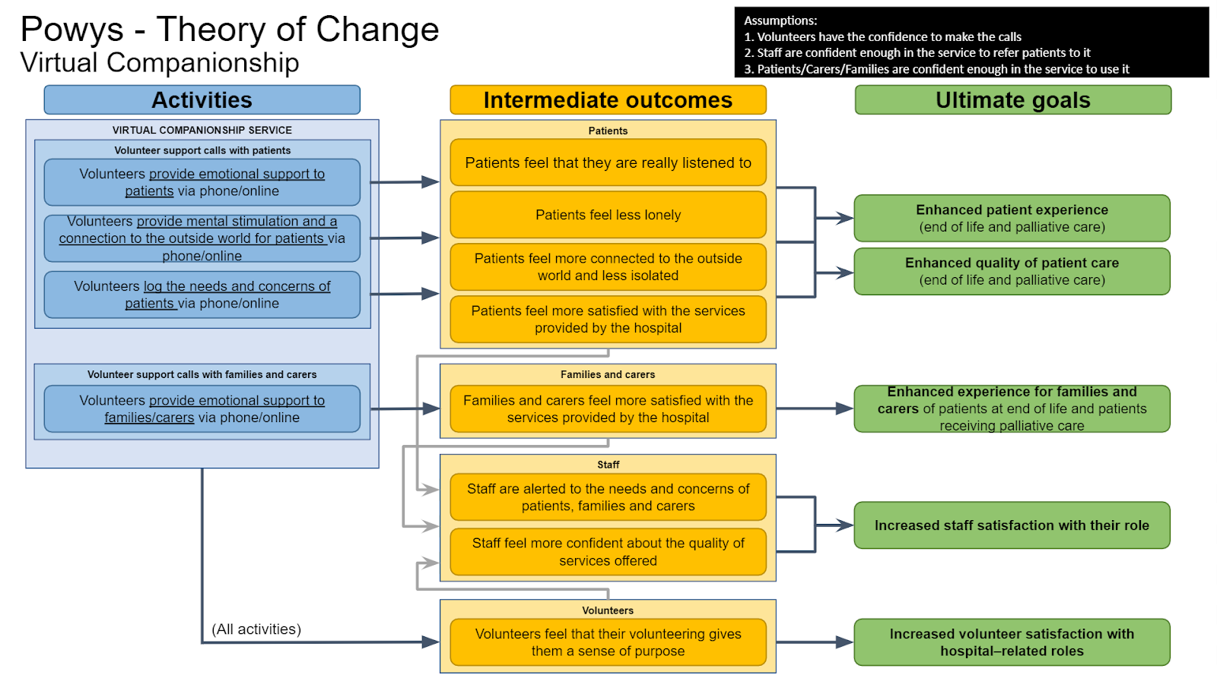

Slide 20
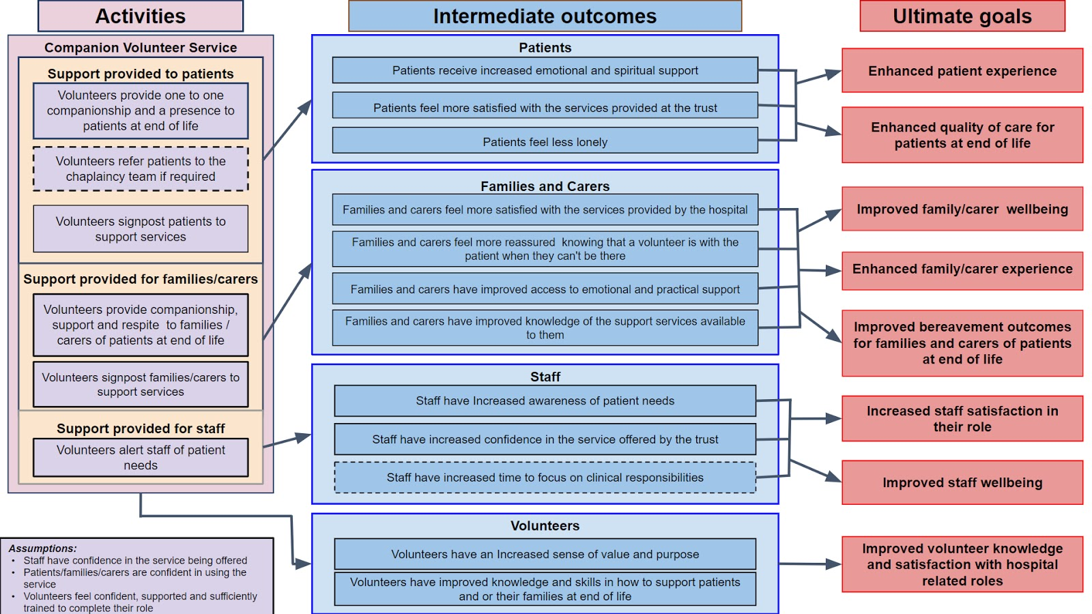
Aneurin Bevan

Slide 22
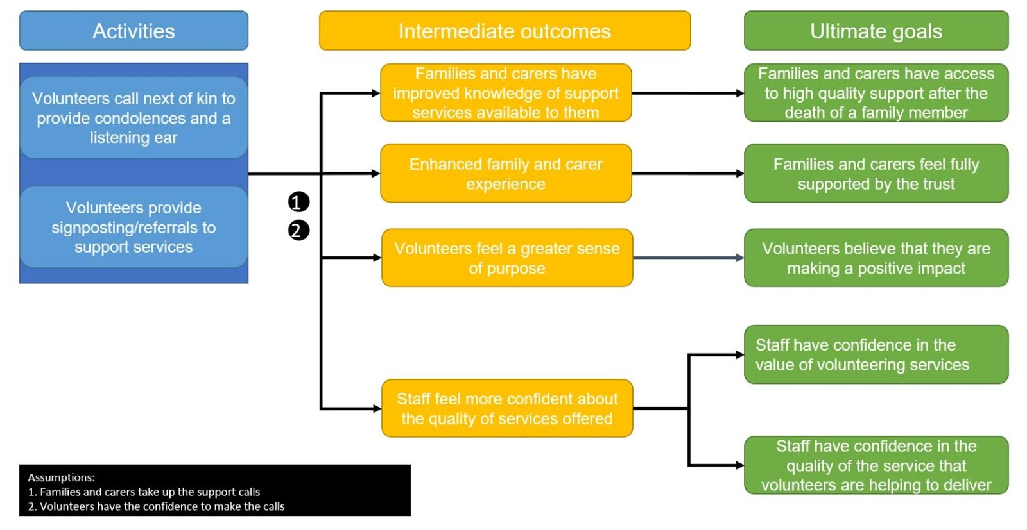
Northern

