Slide 1



Leverage Your Renewable Energy Impact Through Emerging Avoided Emissions PPA Strategies
AASHE 2018

Slide 2
Workshop Facilitators
Boston University
  Dennis Carlberg, Associate VP for University Sustainability carlberg@bu.edu
  Casey Kelly, sustainability@BU Intern caseyk@bu.edu
Carnegie Mellon University, Center for Climate and Energy Decision Making
  Inês Azevedo, Co-Director iazevedo@cmu.edu
Edison Energy (formerly Altenex)
  Christen Blum, christen.blum@edisonenergy.com
  Advisory Renewables Managing Director
WattTime
  Gavin McCormack, Co-Founder and Executive Director gavin@watttime.org
Notes:
Y

Slide 3
Terms
Additionality
Purpose of RECs
Accounting with RECs
Power Purchase Agreements
Avoided Emissions and their Calculations
Marginal Emissions and their Calculations
eGrid Emissions and their Calculations
Scope 2 Accounting
Inventory Based Accounting
Impact Based Accounting
Notes:
??

Slide 4





How does renewable energy help the environment?

Slide 5

How does renewable energy help the environment?
X

Slide 6



But which fossil plants will your renewables replace?

Slide 7
But which fossil plants will your renewables replace?

Slide 8
But which fossil plants will your renewables replace?

Slide 9
CMU’s research makes it possible to know
Projects in
Georgia displace
mostly coal
Projects in
California displace
mostly natural gas

Slide 10
BU decided to multiply their impact
Renewables
in Boston
reduce emissions
a little
Renewables in
some regions reduce
emissions a lot

Slide 11
Edison handled economics and site selection
Solar in CA
can save
~900 kg/kW
Wind in Texas
can, too…
but at a better price

Slide 12
WattTime verified & is raising awareness
BU’s strategy
increased
emissions savings

Slide 13
Themes
Inventory-based Accounting
Impact-based Accounting
Average emissions
All MWh count equally
Priority is ensuring all emissions are “owned” by someone
Cumulative, predictable
Market-based
Marginal emissions
Counts MWh based on actual emissions
Priority is accurately measuring actual effects of actions
Physics-based
1
2
Project Impact
Process
Emissions
Environmental
Financial
Goal setting
Procurement
eGRID and marginal emissions analysis
Marginal emissions data collection
3
4
Notes:
Gavin

Slide 14


Boston University Project Drivers
Climate Action Plan goal
Carbon Impact
Additionality
Credible, Verifiable, Project RECs
Postive Economics
Benefit Student Education and Faculty Research

Slide 15
Process
Project Generation Profile
(Edison)
127
68 Wind & 59 Solar Projects
7 Wind
4 Solar
Projects
Data Analysis (BU)
2 Wind
1 Solar
Projects
South Dakota Wind Project
WattTime Marginal Emissions Validation
Marginal Emissions Profile
(CMU)
Marginal Emissions Screen
Economic & eGrid Screen
Economics & Risk Screen
Criteria Due Diligence
Team Interviews
LOI / Term Sheet
to
REPA Contract

Slide 16
Align Generation with Marginal Emissions
MW Generation
Marginal Emissions (kg/MWh)
Notes:
Casey

Slide 17
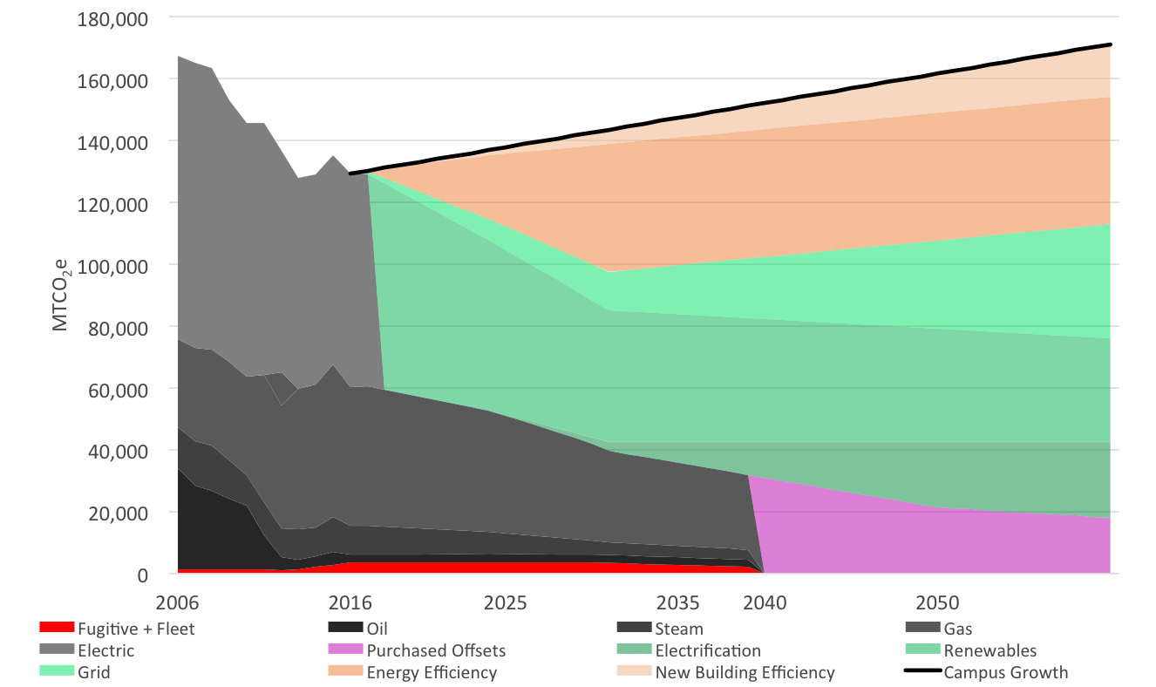
Net Zero Direct Emissions by 2040
25% reduction by 2016
Carbon Free Boston
BU Institute for Sustainable Energy
Leadership
Electricity
Natural Gas
Steam
Oil
2040
2050
CarbonFree
Boston
Notes:
Dennis

Slide 18
Net Zero Direct Emissions by 2040
Net Zero by 2040
Assumptions
Campus Growth
0.75% / year
Electricity
Natural Gas
Steam
Oil
Notes:
Dennis

Slide 19
Net Zero Direct Emissions by 2040
Net Zero by 2040
Strategies
Energy Efficiency
31% by 2032
New Buildings
EUI 90 kBtu/sf
Efficiency
Electricity
Natural Gas
Steam
Oil
Notes:
Dennis

Slide 20
Net Zero Direct Emissions by 2040
Net Zero by 2040
Assumptions
Greener Grid
1.25% / year
Efficiency
Electricity
Grid
Natural Gas
Steam
Oil
Notes:
Dennis

Slide 21
Net Zero Direct Emissions by 2040
Net Zero by 2040
Strategies
Renewable Energy
100% starting in 2019
Efficiency
Electricity
Grid
Renewables
Natural Gas
Steam
Oil
Notes:
Dennis

Slide 22
Net Zero Direct Emissions by 2040
Net Zero by 2040
Strategies
Electrify Heating
End of useful life
Source with Renewables
100%
Efficiency
Electricity
Grid
Renewables
Natural Gas
Steam
Electrification with Renewables
Oil
Notes:
Dennis

Slide 23
Net Zero Direct Emissions by 2040
Net Zero by 2040
Strategies
Offsets
Shortfall to reach 100% starting in 2040
Efficiency
Electricity
Grid
Renewables
Natural Gas
Steam
Electrification with Renewables
Oil
Offsets
Notes:
Dennis

Slide 24
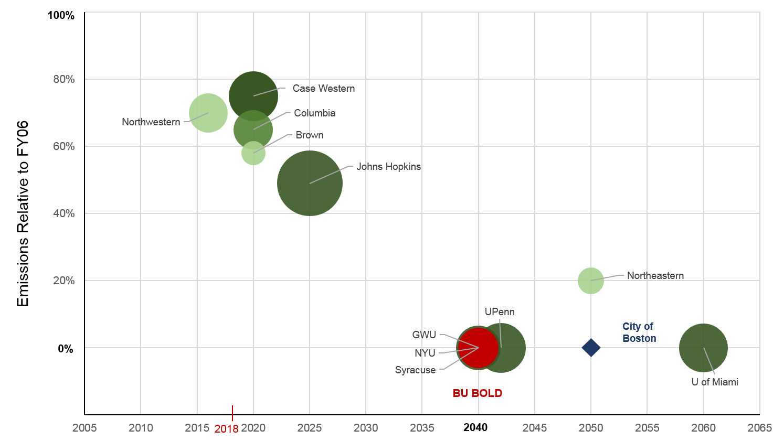
Leadership
Notes:
Dennis

Slide 25
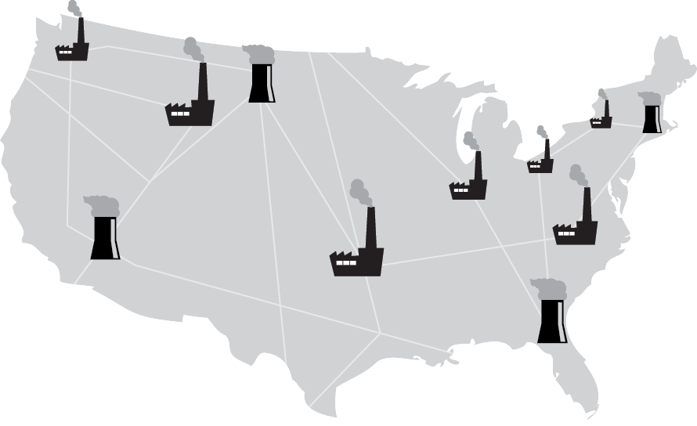
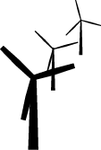


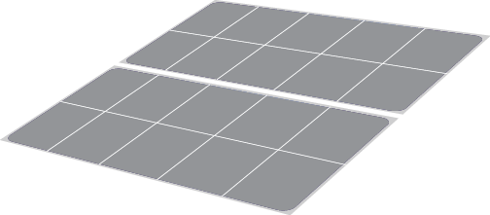
How can we quantify the emissions (GHG and air pollutants) and the respective damages that are avoided as we pursue different interventions in the U.S. electric grid?
Notes:
Ines

Slide 26





Are we helping the environment more by increasing solar in
California or in Pennsylvania?
???

Slide 27




Are we helping the environment more if we choose a battery electric car or an hybrid?

Slide 28




In which states can we have the largest environmental and health benefits from more stringent building codes?

Slide 29

Where can we have the largest environmental and health benefits from increasing wind energy?

Slide 30

Are we helping the environment by increasing storage in our electricity grid?

Slide 31
The US grid is diverse in its carbon intensity
State level CO₂ emissions factors for total electricity generation 2015
metric tCO₂/MWh
Attribution: figure produced by Nathaniel Horner using data from CEMS and EIA.

Slide 32
The US grid is diverse in its carbon intensity
CO₂ marginal emissions factors by U.S. power grid, Sept 12 2018

Slide 33
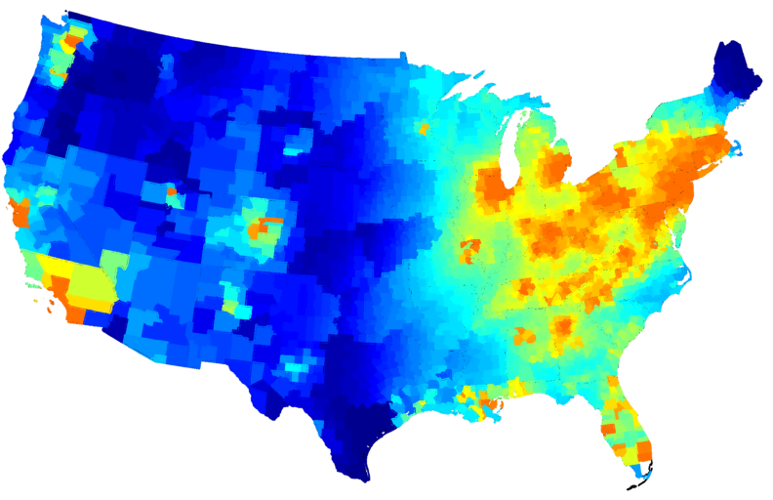
Damages from criteria air pollutants vary tremendously across the country
$1000/ton SO₂
$15,000/ton SO₂
Source: Based on AP2 model from Prof. N. Muller

Slide 34




Fossil fuel generation produces emissions that contribute to
climate change and harm health/environment.
Fossil fuel generation produces emissions that contribute to
climate change and harm health/environment.
Power sector interventions (solar installation, demand response, adding electric vehicles, etc.) change emissions at the margin.
Figures adapted from Azevedo. This is a schematic only; it does not represent a real system.
Notes:
Electricity provides huge benefits to society. 2017: 2/3 of U.S. electricity from fossil fuels
More specifically, at any given time, electricity generators bid some cost at which they're willing to provide electricity (on the y-axis), and we use these generators from least to greatest cost (cumulative generation on x-axis).
Each generator has some emissions intensity (or "emissions factor") associated with it (here shown for CO2) (Make sure to refer to the green arrows.)
The total emissions produced corresponds to the integral under this emissions factor curve.
In this work, we call this power system interventions

Slide 35
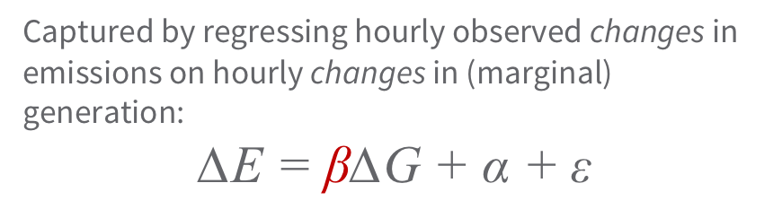
Fossil fuel generation produces emissions that contribute to
climate change and harm health/environment.
Power sector interventions (solar installation, demand response, adding electric vehicles, etc.) change emissions at the margin.
∆generation
Assumptions matter: e.g. annual average emissions factors mask marginal effects.
∆emissions
Captured by regressing hourly observed changes in emissions on hourly changes in (marginal) generation:
$$\text{∆}\text{E}\text{ = }\text{β}\text{∆}\text{G}\text{ + }\text{α} \text{+ }\text{ε}$$
MEF (kg/MWh)
Figures adapted from Azevedo. This is a schematic only; it does not represent a real system.
Notes:
We don't know this curve (dispatch curve), and so the literature has looked at ways to estimate the emissions avoided by an intervention.
Different assumptions matter when evaluating interventions -- for instance, if instead of using marginal emissions factors (those associated with the natural gas plants we knocked out), we used average factors incorporating the dirty coal plants in the middle, we might overestimate the effectiveness of this intervention.
... and this could flip policy decisions

Slide 36
Data
Hourly emissions and hourly generation for fossil fuel power plants larger than 25 MW (2006-17)
  Generation, CO₂, SO₂, NO_{x} from EPA’s Continuous Emissions Monitoring System (CEMS) database
  PM_{2.5} from EPA’s National Emissions Inventory (NEI)
Coupling the emissions with the marginal damages of a ton of pollutant using air quality models (AP2 and EASIUR)
Notes:
"The fuel types of marginal generators in every hour"

Slide 37
Energy: Grid Mix
SPP 2 to 3 > ISO-NE
1,482 lbs. CO₂e/MWh
1,405 lbs. CO₂e/MWh
1,148 lbs. CO₂e/MWh
1,029 lbs. CO₂e/MWh
577 lbs. CO₂e/MWh
Emissions Data based on eGrid 2014 v2 Data by NERC Region: SPP represents average of SPNO, SPSO, MROW, PJM represents average of SRVC, RFCW, RFCE, MISO represents average of RFCM, MROE, MROW, SRMW
Generation Mix based on 2017 ISO Data, by MWh
Notes:
Inês > Dennis
Numbers being made during decision-making mode? > generation mix (2017) > eGRID (were mismatched to what we used) > these were the numbers
All the same scale [

Slide 38
Energy: Criteria for Renewables
Impact: Greenhouse Gas Reduction
1
The projects we select should displace fossil fuel used for generating power on the economic margin for a large majority of operating conditions.
Additionality
2
Chosen projects should generate new renewable power that would not otherwise be generated. Purchasing power through a 1-15 yr. enables developers to obtain financing to get projects built.
Other Environmental Impacts
3
All projects have some environmental impact. We want to choose projects with lower construction and operational environmental impacts.
Education & Research
4
Projects will need to ensure they will benefit BU students and faculty by allowing access to the project sites and real time data and visualization.
Project Economics
5
Obtaining the most favorable project economics will help direct resources to other opportunities for emissions reductions.
Notes:
Dennis

Slide 39
Comparison of Renewable Energy Project Selection Criteria
Criteria | Weight | Solar 2 | Wind 7 | Wind 9 | Criteria Explanation | Notes
 |  | Weighted Rank
Impact New Build | Required | ☑ | ☑ | ☑ | Project will generate new renewable power that would not otherwise have been generated | Project additionality is a prerequisite
Education & Research Opportunities | Required | ☑ | ☑ | ☑ | Project will benefit students and faculty by allowing access to the project sites and real time data | Access to real time data and access to the project site(s) is a prerequisite
Green-e Certified RECs | Required | ☑ | ☑ | ☑ | Third party certified project-based RECs | Project-based Green-e Certified RECs are necessary to validate the claims for the emissions reductions
Project Developer Financial Strength | Required | ☑ | ☑ | ☑ | Long-term owner/operators have resources, experience, & financial strength to manage relationship over term
Bid Size Flexibility | Required | ☑ | ☑ | ☑ | Ability to provide 200,000 MWh/yr or 100,000 MWh/yr capacity to allow flexibility on strategy as determined by BU
Weighted Rank
Notes:
Dennis

Slide 40
Comparison of Renewable Energy Project Selection Criteria
Criteria | Weight | Solar 2 | Wind 7 | Wind 9 | Criteria Explanation | Notes
 |  | Weighted Rank
Impact New Build | Required | ☑ | ☑ | ☑ | Project will generate new renewable power that would not otherwise have been generated | Project additionality is a prerequisite
Education & Research Opportunities | Required | ☑ | ☑ | ☑ | Project will benefit students and faculty by allowing access to the project sites and real time data | Access to real time data and access to the project site(s) is a prerequisite
Green-e Certified RECs | Required | ☑ | ☑ | ☑ | Third party certified project-based RECs | Project-based Green-e Certified RECs are necessary to validate the claims for the emissions reductions
Project Developer Financial Strength | Required | ☑ | ☑ | ☑ | Long-term owner/operators have resources, experience, & financial strength to manage relationship over term
Bid Size Flexibility | Required | ☑ | ☑ | ☑ | Ability to provide 200,000 MWh/yr or 100,000 MWh/yr capacity to allow flexibility on strategy as determined by BU
Project Economics (strong NPV/MWh) | 30% | 3 | 1 | 2 | Financial strength based on risk-adjusted, projected cash flows, and impact on BU financial position and credit rating | The driver in a Contract for Differences is the margin modeled between the PPA price and the grid price/MWh. Favorable project economics are a prerequisite
Weighted Rank
Notes:
Dennis

Slide 41
Comparison of Renewable Energy Project Selection Criteria
Criteria | Weight | Solar 2 | Wind 7 | Wind 9 | Criteria Explanation | Notes
 |  | Weighted Rank
Impact New Build | Required | ☑ | ☑ | ☑ | Project will generate new renewable power that would not otherwise have been generated | Project additionality is a prerequisite
Education & Research Opportunities | Required | ☑ | ☑ | ☑ | Project will benefit students and faculty by allowing access to the project sites and real time data | Access to real time data and access to the project site(s) is a prerequisite
Green-e Certified RECs | Required | ☑ | ☑ | ☑ | Third party certified project-based RECs | Project-based Green-e Certified RECs are necessary to validate the claims for the emissions reductions
Project Developer Financial Strength | Required | ☑ | ☑ | ☑ | Long-term owner/operators have resources, experience, & financial strength to manage relationship over term
Bid Size Flexibility | Required | ☑ | ☑ | ☑ | Ability to provide 200,000 MWh/yr or 100,000 MWh/yr capacity to allow flexibility on strategy as determined by BU
Project Economics (strong NPV/MWh) | 30% | 3 | 1 | 2 | Financial strength based on risk-adjusted, projected cash flows, and impact on BU financial position and credit rating | The driver in a Contract for Differences is the margin modeled between the PPA price and the grid price/MWh. Favorable project economics are a prerequisite
GHG Reduction (CO2e lb/MWh) | 30% | 3 | 1 | 2 | Projected likely marginal GHG savings per MWh over the term of the project; favor projects with highest overall GHG reduction with consideration for higher early reductions | Strong correlation between high grid carbon intensity at time of renewable energy production; the purpose of is to maximize the BU’s impact on GHG reduction
Weighted Rank
Notes:
Dennis

Slide 42
Comparison of Renewable Energy Project Selection Criteria
Criteria | Weight | Solar 2 | Wind 7 | Wind 9 | Criteria Explanation | Notes
 |  | Weighted Rank
Impact New Build | Required | ☑ | ☑ | ☑ | Project will generate new renewable power that would not otherwise have been generated | Project additionality is a prerequisite
Education & Research Opportunities | Required | ☑ | ☑ | ☑ | Project will benefit students and faculty by allowing access to the project sites and real time data | Access to real time data and access to the project site(s) is a prerequisite
Green-e Certified RECs | Required | ☑ | ☑ | ☑ | Third party certified project-based RECs | Project-based Green-e Certified RECs are necessary to validate the claims for the emissions reductions
Project Developer Financial Strength | Required | ☑ | ☑ | ☑ | Long-term owner/operators have resources, experience, & financial strength to manage relationship over term
Bid Size Flexibility | Required | ☑ | ☑ | ☑ | Ability to provide 200,000 MWh/yr or 100,000 MWh/yr capacity to allow flexibility on strategy as determined by BU
Project Economics (strong NPV/MWh) | 30% | 3 | 1 | 2 | Financial strength based on risk-adjusted, projected cash flows, and impact on BU financial position and credit rating | The driver in a Contract for Differences is the margin modeled between the PPA price and the grid price/MWh. Favorable project economics are a prerequisite
GHG Reduction (CO2e lb/MWh) | 30% | 3 | 1 | 2 | Projected likely marginal GHG savings per MWh over the term of the project; favor projects with highest overall GHG reduction with consideration for higher early reductions | Strong correlation between high grid carbon intensity at time of renewable energy production; the purpose of is to maximize the BU’s impact on GHG reduction
Environmental& Health Co-benefits | 20% | 2 | 1 | 2 | Favor projects with lower construction and operational environmental and health impacts
Weighted Rank
Notes:
Dennis

Slide 43
Comparison of Renewable Energy Project Selection Criteria
Criteria | Weight | Solar 2 | Wind 7 | Wind 9 | Criteria Explanation | Notes
 |  | Weighted Rank
Impact New Build | Required | ☑ | ☑ | ☑ | Project will generate new renewable power that would not otherwise have been generated | Project additionality is a prerequisite
Education & Research Opportunities | Required | ☑ | ☑ | ☑ | Project will benefit students and faculty by allowing access to the project sites and real time data | Access to real time data and access to the project site(s) is a prerequisite
Green-e Certified RECs | Required | ☑ | ☑ | ☑ | Third party certified project-based RECs | Project-based Green-e Certified RECs are necessary to validate the claims for the emissions reductions
Project Developer Financial Strength | Required | ☑ | ☑ | ☑ | Long-term owner/operators have resources, experience, & financial strength to manage relationship over term
Bid Size Flexibility | Required | ☑ | ☑ | ☑ | Ability to provide 200,000 MWh/yr or 100,000 MWh/yr capacity to allow flexibility on strategy as determined by BU
Project Economics (strong NPV/MWh) | 30% | 3 | 1 | 2 | Financial strength based on risk-adjusted, projected cash flows, and impact on BU financial position and credit rating | The driver in a Contract for Differences is the margin modeled between the PPA price and the grid price/MWh. Favorable project economics are a prerequisite
GHG Reduction (CO2e lb/MWh) | 30% | 3 | 1 | 2 | Projected likely marginal GHG savings per MWh over the term of the project; favor projects with highest overall GHG reduction with consideration for higher early reductions | Strong correlation between high grid carbon intensity at time of renewable energy production; the purpose of is to maximize the BU’s impact on GHG reduction
Environmental& Health Co-benefits | 20% | 2 | 1 | 2 | Favor projects with lower construction and operational environmental and health impacts
Integration with BU on-site procurement | 10% | 1 | 1 | 1 | Integrate PPA purchases and sales into BU's energy purchasing through hedges or other mechanisms
Weighted Rank
Notes:
Dennis

Slide 44
Comparison of Renewable Energy Project Selection Criteria
Criteria | Weight | Solar 2 | Wind 7 | Wind 9 | Criteria Explanation | Notes
 |  | Weighted Rank
Impact New Build | Required | ☑ | ☑ | ☑ | Project will generate new renewable power that would not otherwise have been generated | Project additionality is a prerequisite
Education & Research Opportunities | Required | ☑ | ☑ | ☑ | Project will benefit students and faculty by allowing access to the project sites and real time data | Access to real time data and access to the project site(s) is a prerequisite
Green-e Certified RECs | Required | ☑ | ☑ | ☑ | Third party certified project-based RECs | Project-based Green-e Certified RECs are necessary to validate the claims for the emissions reductions
Project Developer Financial Strength | Required | ☑ | ☑ | ☑ | Long-term owner/operators have resources, experience, & financial strength to manage relationship over term
Bid Size Flexibility | Required | ☑ | ☑ | ☑ | Ability to provide 200,000 MWh/yr or 100,000 MWh/yr capacity to allow flexibility on strategy as determined by BU
Project Economics (strong NPV/MWh) | 30% | 3 | 1 | 2 | Financial strength based on risk-adjusted, projected cash flows, and impact on BU financial position and credit rating | The driver in a Contract for Differences is the margin modeled between the PPA price and the grid price/MWh. Favorable project economics are a prerequisite
GHG Reduction (CO2e lb/MWh) | 30% | 3 | 1 | 2 | Projected likely marginal GHG savings per MWh over the term of the project; favor projects with highest overall GHG reduction with consideration for higher early reductions | Strong correlation between high grid carbon intensity at time of renewable energy production; the purpose of is to maximize the BU’s impact on GHG reduction
Environmental& Health Co-benefits | 20% | 2 | 1 | 2 | Favor projects with lower construction and operational environmental and health impacts
Integration with BU on-site procurement | 10% | 1 | 1 | 1 | Integrate PPA purchases and sales into BU's energy purchasing through hedges or other mechanisms
Term Length | 10% | 2 | 2 | 1 | Offer 12 vs 15 year term; shorter term length ranks higher
Weighted Rank
2.5 | 1.1 | 1.8
Notes:
Dennis

Slide 45
Comparison of Renewable Energy Project Selection Criteria
Criteria | Weight | Solar 2 | Wind 7 | Wind 9 | Criteria Explanation | Notes
 |  | Weighted Rank
Impact New Build | Required | ☑ | ☑ | ☑ | Project will generate new renewable power that would not otherwise have been generated | Project additionality is a prerequisite
Education & Research Opportunities | Required | ☑ | ☑ | ☑ | Project will benefit students and faculty by allowing access to the project sites and real time data | Access to real time data and access to the project site(s) is a prerequisite
Green-e Certified RECs | Required | ☑ | ☑ | ☑ | Third party certified project-based RECs | Project-based Green-e Certified RECs are necessary to validate the claims for the emissions reductions
Project Developer Financial Strength | Required | ☑ | ☑ | ☑ | Long-term owner/operators have resources, experience, & financial strength to manage relationship over term
Bid Size Flexibility | Required | ☑ | ☑ | ☑ | Ability to provide 200,000 MWh/yr or 100,000 MWh/yr capacity to allow flexibility on strategy as determined by BU
Project Economics (strong NPV/MWh) | 30% | 3 | 1 | 2 | Financial strength based on risk-adjusted, projected cash flows, and impact on BU financial position and credit rating | The driver in a Contract for Differences is the margin modeled between the PPA price and the grid price/MWh. Favorable project economics are a prerequisite
GHG Reduction (CO2e lb/MWh) | 30% | 3 | 1 | 2 | Projected likely marginal GHG savings per MWh over the term of the project; favor projects with highest overall GHG reduction with consideration for higher early reductions | Strong correlation between high grid carbon intensity at time of renewable energy production; the purpose of is to maximize the BU’s impact on GHG reduction
Environmental& Health Co-benefits | 20% | 2 | 1 | 2 | Favor projects with lower construction and operational environmental and health impacts
Integration with BU on-site procurement | 10% | 1 | 1 | 1 | Integrate PPA purchases and sales into BU's energy purchasing through hedges or other mechanisms
Term Length | 10% | 2 | 2 | 1 | Offer 12 vs 15 year term; shorter term length ranks higher
Weighted Rank
2.5 | 1.1 | 1.8
Notes:
Dennis>Christen

Slide 46
eGRID Carbon Emissions Regions Map
In most cases, eGRID Regions do not align directly with wholesale energy markets
Notes:
Christen

Slide 47
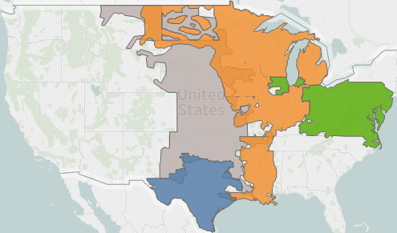
Renewable Energy Project Inventory
Number of Projects
Total | 127
Wind | 68
Solar | 59
MISO
Number of Proposals
538 unique bids
PJM
SPP
Developer Participation
36 companies
ERCOT
Notes:
Christen

Slide 48
Projected Economics & eGRID Impact: All
Economic Rankings represent the expected project margin (PPA Price compared to shape-adjusted power price), under natural gas driven price curve
Carbon Rankings represent the expected marginal carbon emissions reduced (in pounds of CO2 per MWh per year) that would result from each project based on the carbon intensity of the region and the project’s generation profile
ISO-NE
Relative Project Margin (Economic Benefit)
Breakeven
eGrid Carbon Intensity (CO2e lbs/MWh)
Notes:
Christen
Note: ISO-NE project economics would have been below breakeven

Slide 49
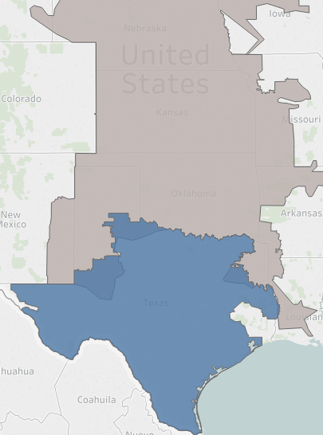
Long-list Selection Summary
Process: From the inventory of over 127 renewable energy projects, 12 were selected based on carbon intensity, economic performance, and qualitative requirements.
All of the recommended projects offer additionality, project specific Renewable Energy Credits, and a strong, credible counterparty.
Economic performance was assessed using electricity market prices derived from natural gas prices near the current Henry Hub price curve. Offers are compared by calculating the Net Present Value per Megawatt Hour of generation (NPV/MWh).
Carbon intensity was assessed by using the eGrid sub-region for each project to estimate the average CO2 lbs/MWh emissions on the grid.
Projects were ranked based on the NPV/MWh and CO2 lbs/MWh. The average of the two rankings was used for long-list selection so that economic and carbon factors were weighed equally.
Project Long-list Overview
SPP:
Solar: 1
Wind: 6
ERCOT:
Solar: 2
Wind: 3
Notes:
Christen

Slide 50
Projected Economics & eGRID Impact: Longlist
Economic Rankings represent the expected project margin (PPA Price compared to shape-adjusted power price), under natural gas driven price curve
Carbon Rankings represent the expected marginal carbon emissions reduced (in pounds of CO2 per MWh per year) that would result from each project based on the carbon intensity of the region and the project’s generation profile
ISO-NE
Relative Project Margin (Economic Benefit)
Breakeven
eGrid Carbon Intensity (CO2e lbs/MWh)
Notes:
Christen
Note: ISO-NE project economics would have been below breakeven

Slide 51
Short-list Selection Summary
Process: From the 12 longlisted projects, 5 were short-listed for final economic and emissions analysis, project due diligence and ultimate selection.
Using the Selection Criteria composed by the Energy Working Group (consisting of economic, environmental, and project / counterparty factors) the long-listed projects were ranked to determine a short-list.
Project due diligence was completed to understand the project benefits, development maturity, & counterparty strength of each offer.
All short-listed developers were notified and project offers were adjusted to reflect the most updated offer and project development status update.
Projects were ranked based on the NPV/MWh and CO2 lbs/MWh. The average of the two rankings was used for long-list selection so that economic and carbon factors were weighed equally.
Project Long-list Overview
SPP:
Wind: 1
ERCOT:
Solar: 2
Wind: 2
Notes:
Casey
Dennis has talked about due diligence and christen has talked about due diligence
Ill talk about emission due diligence

Slide 52

Annual Marginal Reduction in CO₂ Emissions
Notes:
Christen > Casey

Slide 53
Final Selection Summary
Process: From the 5 shortlisted projects reviewed, 3 were identified for final economic and emissions analysis, project due diligence and ultimate selection.
Using the Selection Criteria composed by the Energy Working Group (consisting of economic, environmental, and project/counterparty factors) the long-listed projects were ranked to determine a short-list.
Project due diligence were completed to understand the project benefits, development maturity, and counterparty strength of each offer.
All short-listed developers were notified and project offers were adjusted to reflect the most updated offer and project development status update.
Final economic analysis and marginal emissions analysis are complete; informed the selection of the top projects and demonstrated energy business case for the University.
Project Long-list Overview
SPP:
Wind: 1
ERCOT:
Solar: 1
Wind: 1
Notes:
Casey

Slide 54
Alignment of Generation with Marginal Emissions: Wind 7
MW Generation
Marginal Emissions (kg/MWh)
Notes:
Casey
This projects expected generation aligns well with emissions/demand trends which means it will displace dirtier generators as the marginal supplier. This has the impact of increased the amount of avoided emissions of the project.\\change legens

Slide 55

Alignment of Generation with Marginal Emissions: Wind 9
MW Generation
Marginal Emissions (kg/MWh)
Notes:
Casey
This generation source follows emissions somewhat well but is superseded by demand/emissions at times and has peak generation during a low demand timeframe]focus on marg emissions

Slide 56

Alignment of Generation with Marginal Emissions: Solar 2
MW Generation
Marginal Emissions (kg/MWh)
Notes:
Casey
Generation and demand do not align. This results in the project not displacing emissions from alternative&dirtier generation sources on the grid

Slide 57


Final Selection Summary
Project Details
  Reduce BU emissions by 53%
  15 year PPA to match 100% of BU electricity demand
  Green-e Certified project RECs Agreement
  Additionality – Agreement enabled financing for new wind farm
  Impact South Dakota (SPP) 2 to 3 times greater emissions reduction vs. ISONE
  Educational and internship opportunities for students, research for faculty
1,482 lbs. CO₂e/MWh
Notes:
Casey
b) 205,000 MWh/year starting in 2020 from 48.6 MW generation capacity
e) Accounting for 69,000 MTCO2e/year (of electricity emissions) > Actual impact on SPP marginal emissions 2 – 3 times more than ISO-NE

Slide 58
Market Advantage
  45% lower PPA price than similar deal in 2015
  Contract for Differences economics work with today’s low natural gas prices
  Provides hedge on our natural gas spend
  Declining Production Tax Credit
  Thorough Market Risk Analysis
Market Price
Price $
PPA Price
Time: 15 years
Time: 15 years
Notes:
c) This project provides a ~ 50% hedge on our current natural gas spend. As we complete energy efficiency projects, this will be closer to a 75% hedge at the end of the PPA period
d) We believe the declining PTC value has increased market pressure for developers to get these deals done.
e) There is a strong correlation between HH natural gas prices and electricity prices. Through a very thorough downside risk analysis we believe this project will be cash positive for us in year 1 and over the life of the project. We assume electricity prices will remain fairly flat over the next 10 to 15 years.
Went to market once in 15 and couldt afford project red line is fixed price of electricity over 15 yr period is higher than avergage market price represented by black line (variable price)
Red line has dropped by 45% so project signed will be cash positive in year 1 and over 15 years (although there will be movement over and under black line)
Hedge on nat gas not electricity purchasing
Decling PTC creates pressure in market for projects to get built which drives prices downs

Slide 59
WattTime Third-Party Validation
About WattTime
Environmental nonprofit founded by UC Berkeley researchers
Powered by > 200 expert volunteers from Berkeley, Google, Microsoft, US DOE, PG&E, etc
Spun into the Rocky Mountain Institute in 2017
As renewable energy grows, increasing difference between the emissions consequences of using energy at a particular time and place
Our mission is to research, raise awareness of, and spread common practical tools for optimizing when, where, and whether to use electricity
Our role in this project
Met BU through Boston Green Ribbon Commission collaboration
Neutral third-party nonprofit technical review of the analysis
Notes:
Gavin

Slide 60
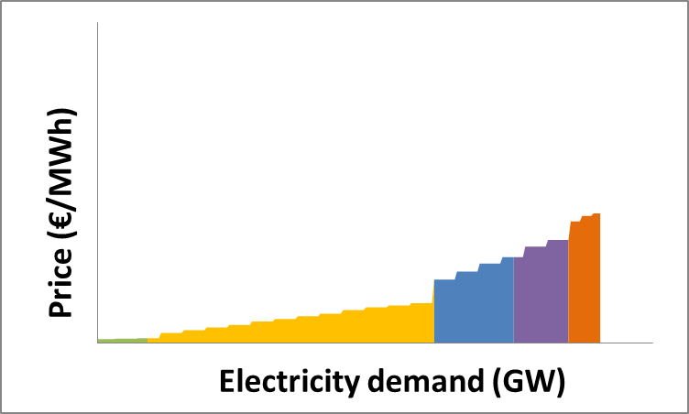
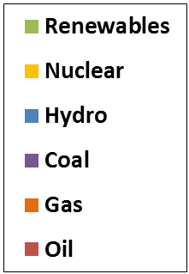
The “marginal” generator

Slide 61
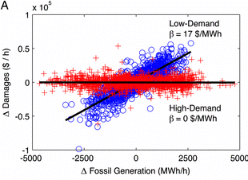
Two ways to measure
Old way: use theory to estimate
New way: use data to measure
Notes:
Gavin

Slide 62
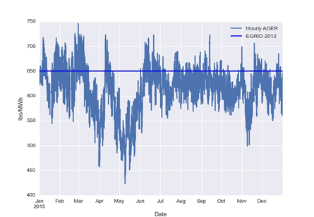
Emissions factors vary over time…

Slide 63
…and space

Slide 64
Greenhouse Gas Protocol
Scope 2 carbon: inventory
All MWh are treated equally
Does not consider variation over time
RE assumed to displace all power plants equally
Accounting abstraction
Applies to all RE regardless of quality
Advantages
  Simple
  Ensures all emissions are “owned” by someone
GHGP says institutions must report
Avoided emissions: impact
Each MWh’s impact is measured
Considers variation over time
Considers which power plants are actually displaced (“marginal” emissions)
Scientific measurement
Only applies to projects with additionality
Advantages
  Measures true emissions impacts
  Makes optimization possible
GHGP says institutions may report

Slide 65
Calculation Methodology
BU
Narrowed project list to short list
Provided geographic locations
CMU
Provided marginal emissions rates by time and region from 2006-2016
Edison
Provided 8760 generation estimates by time and site
Multiplied generation (in MWh), by marginal emissions data (in lbs/MWh) for each time to generate emissions saved in each period and site
Added up and divided by project size to generate common metric of lbs/MWh by site
WattTime
Examined BU’s short list
Generated own marginal emissions factors using a different methodology
  Different underlying statistical algorithm
  Based on real-time, 5-minute rather than historical, hourly
  Based on Blancing Authority rather than NERC region
Examined Edison’s 8760 data
Reproduced all calculations and compared
Notes:
Gavin

Slide 66
Results
Notes:
Gavin

Slide 67
WattTime Validation Conclusion
The approach used to calculate the avoided emissions of the projects under consideration is fundamentally sound.
  Use the latest solid, peer-reviewed science
  Generated from empirically derived techniques validated against real data, not theoretical models
  Accurately reflect the operation of the grid in the defined regions
  Calculations accurately implemented
  Contract clause to remeasure each year
BU’s unique choice accurately identified the best locations and BU’s choices caused significant, real-world emissions reductions.
In fact, WattTime concluded that BU likely understated the true emissions benefits of their choice
This is because more granular analysis found that the particular location within SPP caused ever larger avoided emissions than an average location within SPP
Notes:
Gavin

Slide 68
Not All MWh Are Created Equal
Impact beyond
1 REC = 1 MWh
If BU had bought locally, each MWh = 803 lbs CO₂
At the sites BU picked, each MWh = 1,692 lbs CO₂
This strategy more than doubled real-world emissions impacts
Making BU net negative: if BU ceased to exist, global emissions would increase
Efficiency
Electricity
Grid
Renewables
Natural Gas
Steam
Electrification
with Renewables
Oil
Offsets
Notes:
Gavin

Slide 69
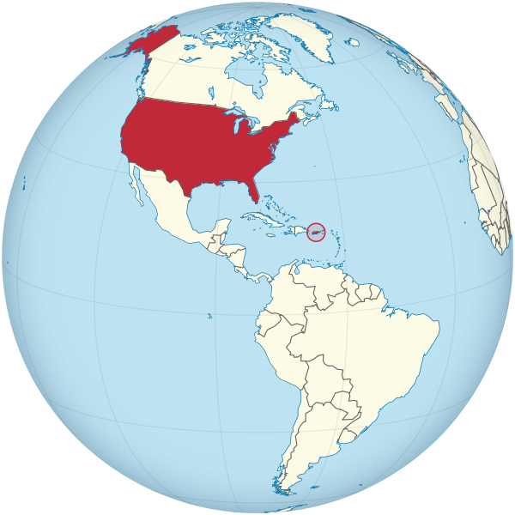
What if all RE purchases optimized for emissions?
WattTime estimated what would happen if everyone adopted this strategy
Obtained new renewable energy build globally, each year, by country (from EIA)
Matched with approximate marginal emissions rates at those locations
Compared with emissions at highest-impact locations
Results were 4.3 gigatons of savings per year
That’s approximately the same impact as converting the entire United States to 100% renewable energy

Slide 70
Thank You
Boston University
  Dennis Carlberg, Associate VP for University Sustainability carlberg@bu.edu
  Casey Kelly, sustainability@BU Intern caseyk@bu.edu
Carnegie Mellon University, Center for Climate and Energy Decision Making
  Inês Azevedo, Co-Director iazevedo@cmu.edu
Edison Energy (formerly Altenex)
  Christen Blum, christen.blum@edisonenergy.com
  Advisory Renewables Managing Director
WattTime
  Gavin McCormack, Co-Founder and Executive Director gavin@watttime.org

Slide 71
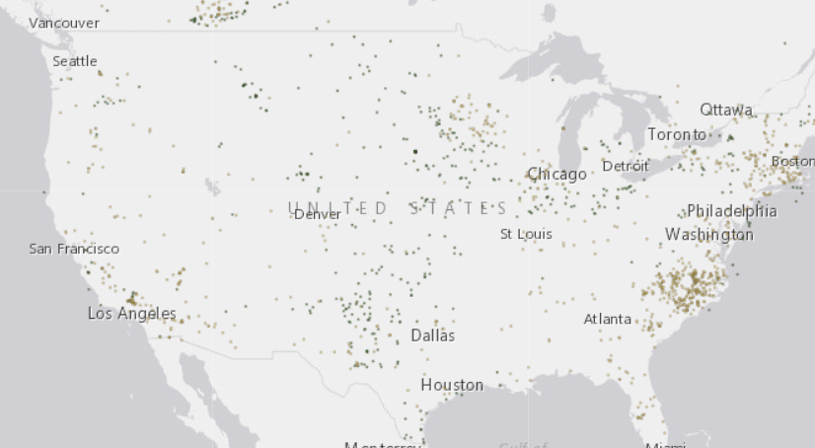
Appendix: Opportunities for further research
More geographic granularity
  Northern SPP vs southern SPP
Align with grid dispatch (balancing authority regions)
Consider renewable energy curtailment
Notes:
Gavin

Slide 72
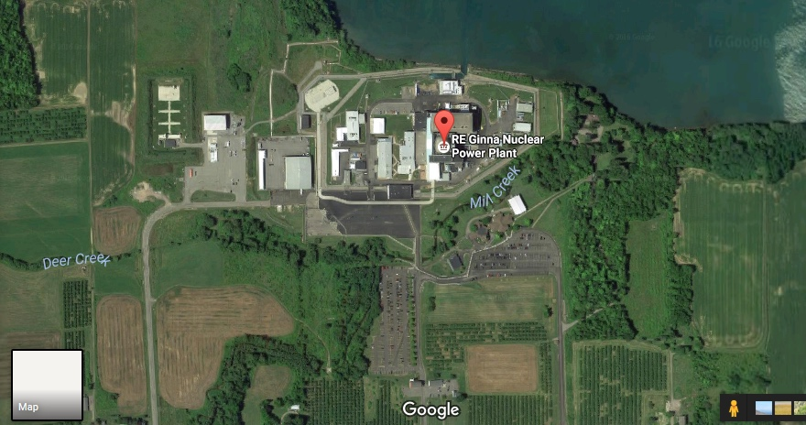
Appendix: the problem with increasing granularity without using the right data
2,115 lbs CO2/MWh
0 lbs CO2/MWh

Slide 73
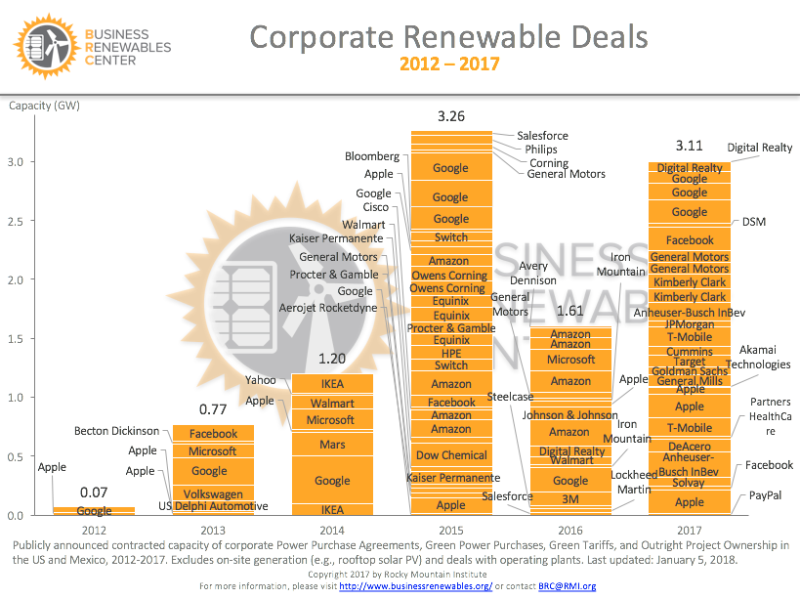
Appendix: what universities do will heavily influence rising corporate RE tide

Slide 74

Appendix: BRC members are doing this to support a diverse set of sustainability goals
Avoiding/triggering mark to market
accounting, or capitalization
Price/total spend/volatility of spend
Locating generation close to load
Meeting sustainability goals
Carbon impact
BUYER
PRIORITIES
The value of the hedge
Clear exit options and costs
Additionality / marketing claims
Wider social good from
renewables development
Minimizing downside risk vs.
maximizing NPV or upside

