Slide 1


Staying Cool Without Warming the Planet:
A New Regulatory Landscape for Refrigerants & the Climate Friendly Cooling Pledge
Kristen N. Taddonio, Senior Climate & Energy Advisor
Institute for Governance & Sustainable Development
Ktaddonio@igsd.org
With thanks to: Johanna Anderson, Director of Learning & Member Engagement
Sustainable Purchasing Leadership Council
2 June 2021

Slide 2


Contents
1. Why are lawmakers focused on energy efficient equipment that uses climate-friendly refrigerants?
2. How can procurement & organizational refrigerant policy help?
3. Where can I find products that use climate-friendly refrigerant? (ClimateFriendlyCooling.com!)
4. How you can take the Climate Friendly Cooling pledge!

Slide 3


Why are Lawmakers Focusing on Efficiency and Climate Friendly Refrigerants?
Climate-friendly refrigerants can avoid 0.5 °C of warming!
Combining energy efficiency can avoid another 0.5 °C of warming!
State and national laws and regulations increasingly mandate climate-friendly refrigerants in the US & worldwide
Efficient, affordable options are now available for many applications (refrigerators, freezers, etc.)

Slide 4

High Efficiency + Climate Friendly Refrigerants = Best Possible Outcome
Asking for products with high energy efficiency AND climate friendly refrigerants provides better outcomes:
  Environmental: minimize direct (refrigerant) and indirect (energy related) emissions
  Financial: minimizes life-cycle ownership costs by minimizing energy cost

Slide 5

The 2016 Kigali Amendment to the Montreal Protocol
Why care about climate-friendly refrigerants?
https://www.youtube.com/watch?v=Ttv-OcvnsaY

Slide 6
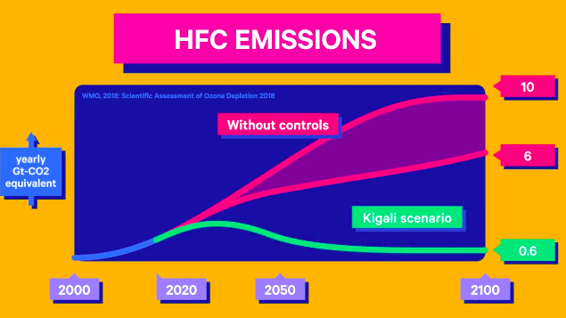
Hydrofluorocarbon (HFC) Phase-down Schedule
Why care about climate-friendly refrigerants?

Slide 7
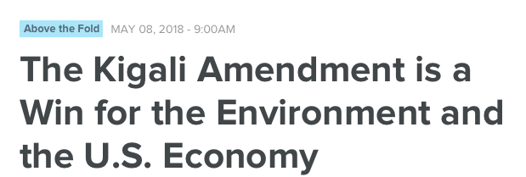
Strong US Industry Support Leads to Passage of the American Innovation and Manufacturing Act in December 2020!
Why care about climate-friendly refrigerants?
https://www.uschamber.com/series/above-the-fold/the-kigali-amendment-win-the-environment-and-the-us-economy
Find the details of the new law & analysis at:
ww.igsd.org/pandemic-relief-bill-mandates-hfc-phasedown-in-compliance-with-montreal-protocols-kigali-amendment/

Slide 8
What does the American Innovation and Manufacturing Act (signed into law Dec 2020) do?
In a nutshell,
It phases down the climate harm of HFC production & consumption on the same schedule as the Kigali Amendment.
It also empowers EPA to set restrictions on the global warming potential (GWP) of HFCs used in products, establish training and certification requirements, and more.
Why care about climate-friendly refrigerants?
Important: The phasedown is GWP-weighted. In other words, we can use the same amount of refrigerant/HFC and still meet the phasedown requirements if we switch to alternatives with lower global warming potentials.

Slide 9
What does this mean for me?
(& How do I prepare?)
If you are a producer or importer of high-global warming potential HFCs, this impacts you directly. You have likely seen this coming for a long time and are likely prepared. (If not, call me and/or talk with your industry association).
If you are consumer of high-global warming potential HFCs, for refrigeration and AC service and/or in other products or equipment, now is the time to make a plan!
  Set an organizational HFC policy.
  Conduct an inventory of your AC and refrigeration equipment. Find out what refrigerants they use & how often you are adding refrigerant. Work with your maintenance team to assure that when products are replaced, your organization purchases energy efficient options that use climate-friendly refrigerants. If equipment is leaky, consider accelerating replacement as soon as low-GWP options are available for your needs.
    In some states, it is illegal to purchase and install an air conditioner or heat pump that has a refrigerant with a global warming potential of over 750 starting 1 January 2025.
    New air conditioning equipment that uses R-32 (meets the GWP requirement) or new refrigerants with similar lower climate impacts were recently approved for the US market; ask your preferred suppliers when they will make climate-friendly equipment available.
    State GWP and refrigerant management requirements are also also in place for supermarket systems & other products that use >50 lbs of refrigerant
    EPA regulations on new products & management of refrigerant in large existing systems likely.
    For most other consumer & business products (domestic refrigerators, freezers, room AC, etc.) efficient, affordable low-GWP options are already available. Find them at ClimateFriendlyCooling.com.
Why care about climate-friendly refrigerants?

Slide 10
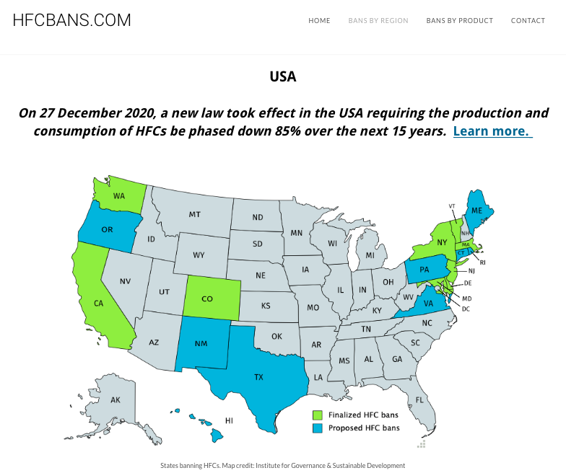
Why care about climate-friendly refrigerants?
HFCbans.com
has information on global adoption of the Kigali Amendment (over 100 countries to date) and US & state restrictions on harmful HFCs

Slide 11
How Can Purchasers Help?
Commit to purchasing low-GWP, energy efficient products
When calculating cost to company of new purchases, include lifetime considerations (disposal, servicing, etc.)
Reduce refrigerant leakage by monitoring system changes
Ensure proper disposal for all products containing refrigerants
Use the Guidance! Visit:
climatefriendlycooling.com/procurement-guidance
Notes:
Today you get a special sneak preview and early invitation to join the campaign.

Slide 12
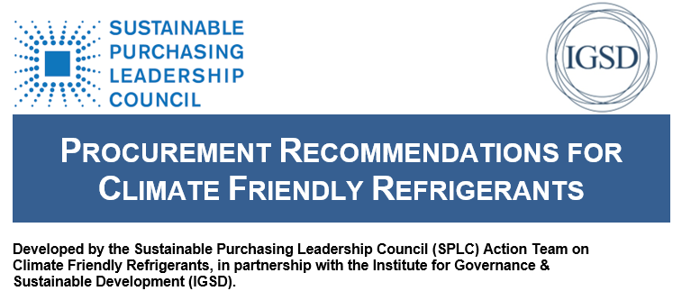
Version 2.0 coming summer 2021!
How can purchasers help?
ClimateFriendlyCooling.com/procurement-guidance
Notes:
This document is the first formal output of the SPLC Climate Friendly Refrigerant Action Team. The Climate Friendly Refrigerant Action Team is dedicated to investigating global regulatory and voluntary programs to avoid and/or reduce emissions from high global warming potential (GWP) HFCs. This document identifies opportunities and specific procurement options to 1) avoid high GWP HFC refrigerants when purchasing new energy efficient refrigeration and air conditioning equipment, and 2) to reduce refrigerant leakage and service emissions

Slide 13

Quick Wins: Energy Efficient Products With Climate Friendly Refrigerants, Available Now
How can purchasers help?
Shop and compare products
@ ClimateFriendlyCooling.com

Slide 14
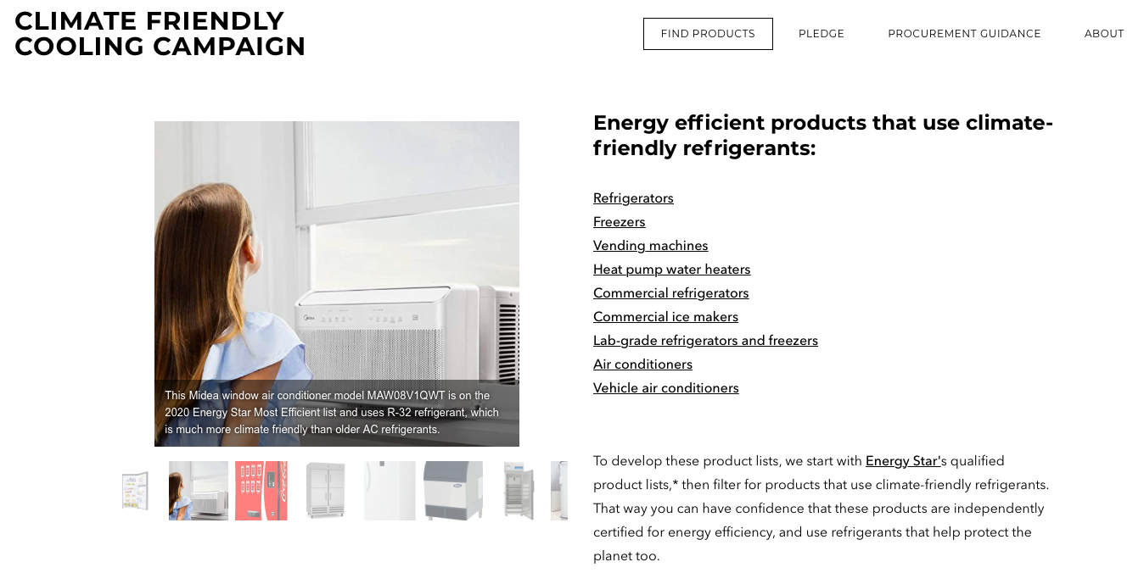
How can purchasers help?

Slide 15
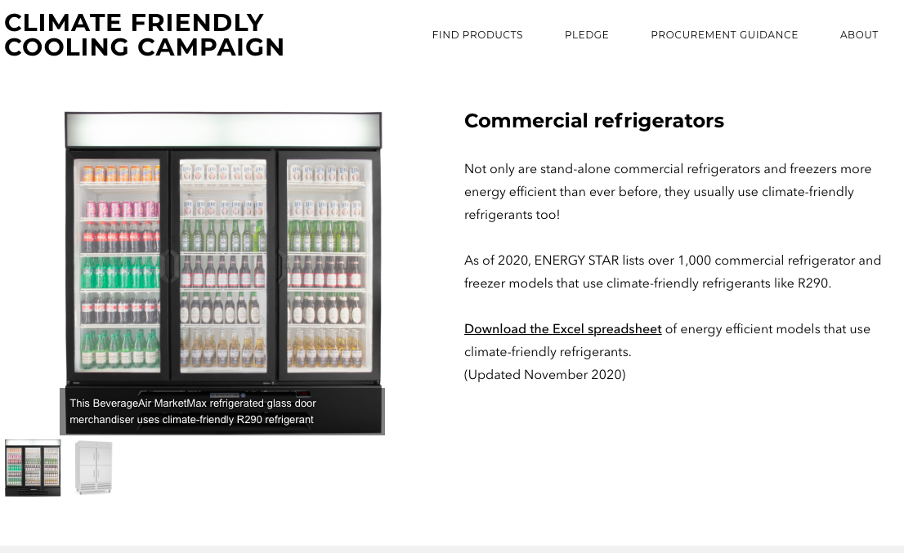
How can purchasers help?

Slide 16
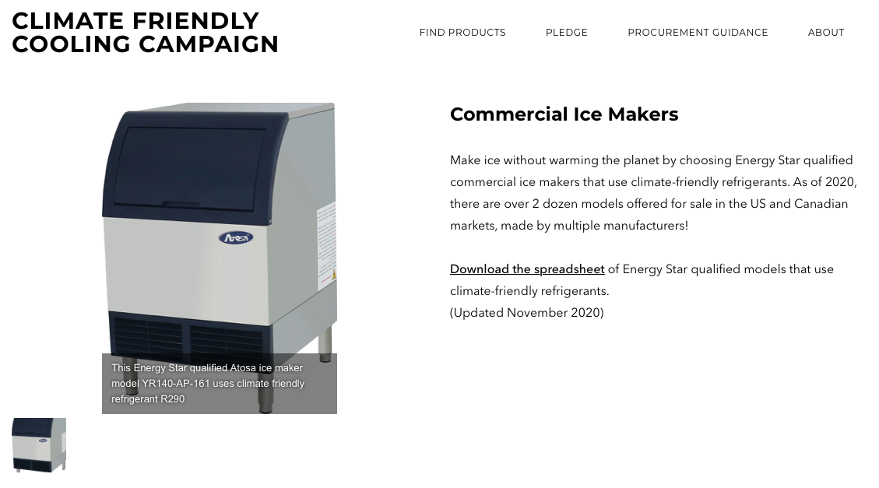
How can purchasers help?

Slide 17
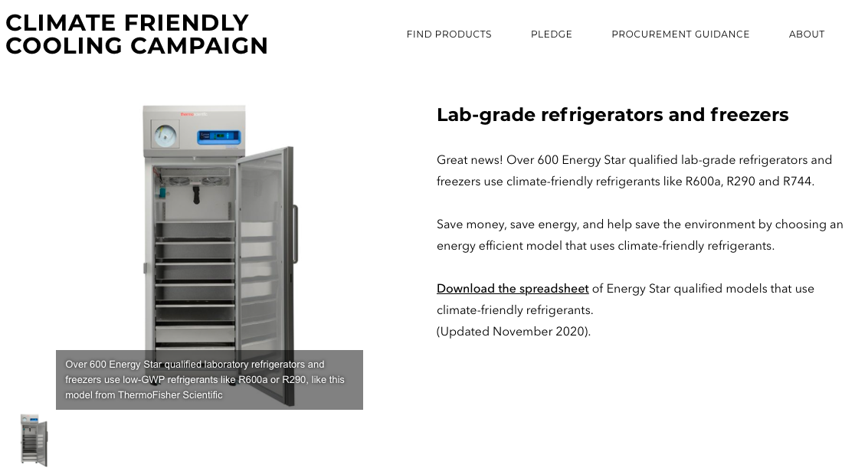
How can purchasers help?
Notes:
The vast majority of qualified models use climate friendly refrigerants such as R-290, R-600a, or R-744 (GWPs = or less than 1).
However, a few still use high-GWP R-404a (GWP=3,943)

Slide 18
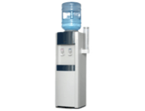
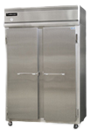
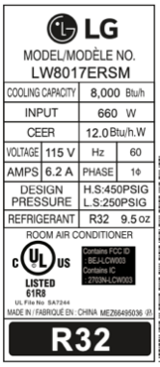
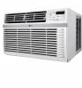
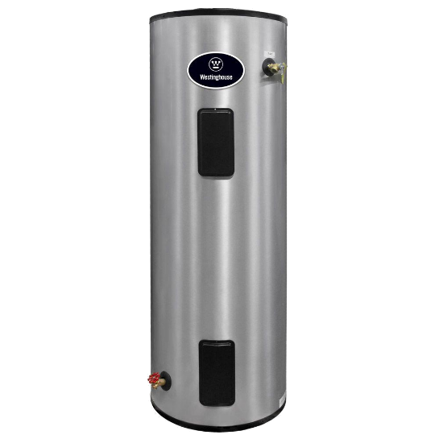
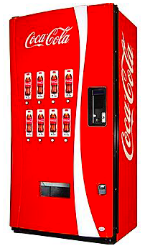

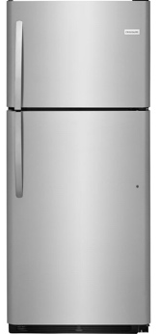
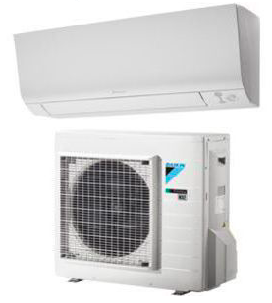
Plus many more product types….
How can purchasers help?
Notes:
Heat pump water heaters, vehicle ac, residential refrigerators and freezers, vending machines

Slide 19
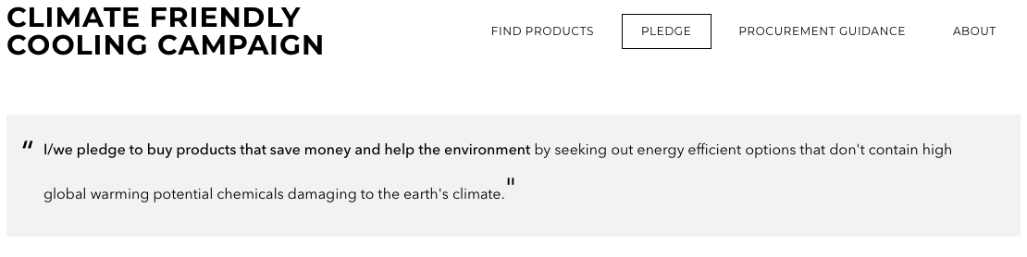
Join IGSD, SPLC & Other Climate
Leaders by Taking the Pledge!
ClimateFriendlyCooling.com/Pledge
Notes:
On the pledge page of the website, company logos of companies that have taken the pledge will appear. Companies can partner with campaign to find other purchasers, and work on content production for external media – ex. Trade magazines, op-eds, social media, etc. Awards for top performers: 1. Climate Hero: Most GWP avoided through purchase, evaluated based on existing stock or typical product on market. 2. World Changer: most people reached with content on low-GWP purchases 3. Value Leader: Companies that update procurement policies to only allow for low-GWP purchases – in stores and corporate offices.

Slide 20
Recap:
Switching to climate-friendly HFC alternatives can avoid half a degree Celsius of warming!
The phase-down has already begun worldwide and in the USA
Your organizational policy & procurement practices are important: it’s time to update them to prioritize climate-friendly options
Toolkit & resources help make smart purchasing decisions easier
Go to ClimateFriendlyCooling.com for guidance & to take the pledge

Slide 21
THANK YOU
Kristen Taddonio, IGSD
Ktaddonio@igsd.org
Johanna Anderson, SPLC
johanna@sustainablepurchasing.org

