Slide 1
YALE University Refrigeration Management A Case Study
Presented to AASHE by James Romanski
Yale University Powerhouse EH&S Manager
June 2nd, 2021

Slide 2
The Ozone Layer

Slide 3
Managing Refrigerant Leaks
Refrigeration Equipment is not Designed to Emit Refrigerants
High Pressures and Demanding Mechanical Duty and Outside Use can lead to Leaks
Leaking Product vs Emitting Air Pollutants
  Combustion Equipment emits by product air pollutants
  Refrigerant is a Product
    Like gasoline evaporative losses at gas stations nobody wants to lose refrigerants
    Leaks = Losses

Slide 4
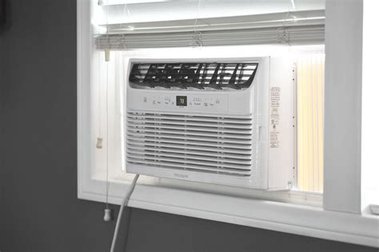
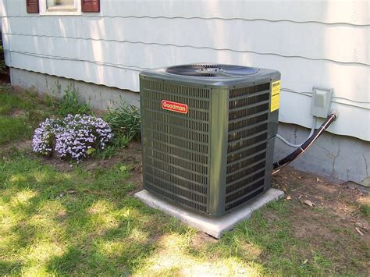
Refrigeration Equipment Residential

Slide 5
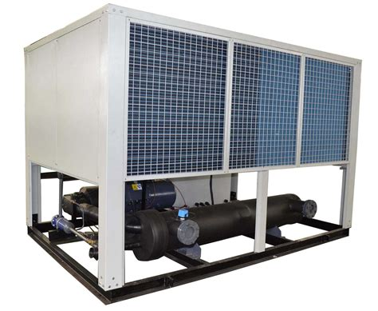
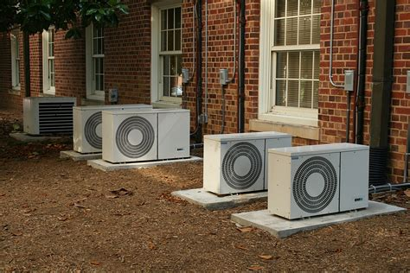
Refrigeration Equipment Commercial

Slide 6
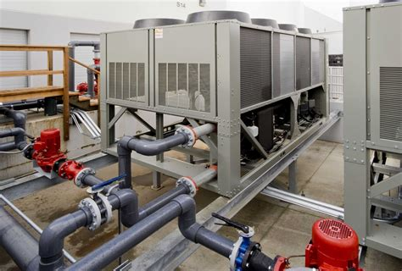
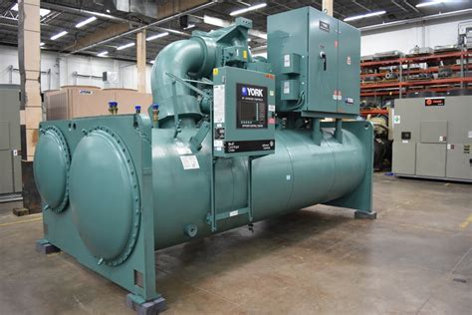
Refrigeration Equipment Industrial

Slide 7
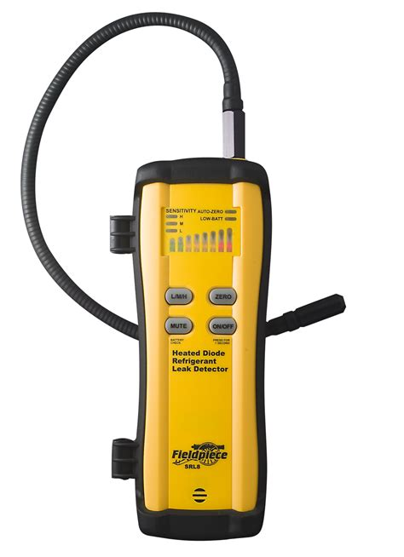
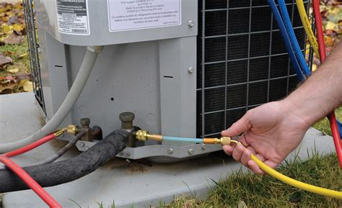
Leak Detection – Sniffers

Slide 8
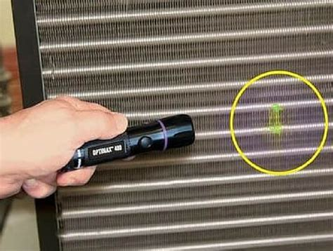
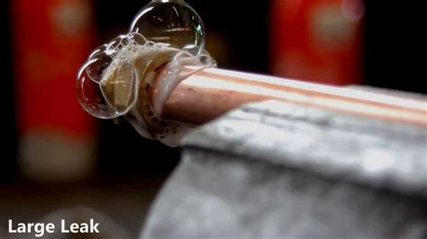
Leak Detection – Dyes and Soap Bubbles

Slide 9
Initial Program – ODS Class I and II
  Development of Inventory
  Identify Refrigeration Technicians
  Review Record Keeping
  Purchase Refrigerant Compliance Management Software

Slide 10
Development of Inventory
Powerplants
  Large Industrial Size Chillers both electrically driven, and steam driven
Large Facilities not Served by Powerplant
  Libraries
  Hospitals/Medical Centers
  Food Services

Slide 11
Identify Refrigeration Technicians
Powerplants Use Equipment Manufacturer’s Contractors
  Carrier
  York
  Trane
Other On Campus Units
  Yale Certified Refrigeration Technicians

Slide 12
Review Record Keeping
Powerplant Equipment Contractors
  Generally, very knowledgeable about EPA requirements
  Record Keeping adequate though not centralized
Yale Refrigeration Technicians
  Mostly servicing <50 lbs charge units
    Record Keeping not required for these units
    We asked them to fill out appliance profiles for units as they service them even if <50 lbs charge
Notes:
Re

Slide 13
Purchased Refrigeration Compliance Software
Refrigeration Compliance Software (RCM)
  For the longest time RCM was the only software package available
  Has been bought out by several software companies over the year
  Currently owned by Sphera along with the original developers and refrigeration experts
  Other software packages now available from other vendors

Slide 14
Using the Software
Provided a template for information required
Included service forms for technicians with information required by EPA to track leak rates
  We require technicians to use the forms for any service done on Class I and II units with >50 lbs charge any time refrigerant is added or removed.
Can also be used to generate service requests
Can also be used for refrigerant inventory management

Slide 15
Old Compliance Program Checklist
Requirements:
Maintain Copies of All Technician Certifications (Contractors maintain their own)
Leak Repair Recordkeeping - Service Records for All “Appliances” with a full charge capacity of >50 pounds of Class I & II ODS including
  Refrigerant Additions
  Leak Tests & Dates of Initial & Follow-up Verification Tests (Only for Industrial units)
  Retrofit or Retirement Plans if any.
Limited Leak Reporting (Only for leak rate calculation exemption)
Proof of Certification by Purchaser.
Records of Class I & II ODS Refrigerant Reclaimed.
Certification of Persons Disposing of Appliances and Records of Disposal (Typically the Recycling Vendor).
One Time Notification of Certified Reclaim Equipment Registrations

Slide 16
Expansion of Program due to Addition of HFC Refrigerants
Expansion of Inventory
New Requirements
Identify Outside Contractor Technicians
Hiring of Full Time Refrigerant Compliance Manager

Slide 17
Expansion of Inventory
Powerplants
Large Facilities not Served by Powerplant
More Libraries
Museums
Hospital
Walk in Coolers
Rooftop Units

Slide 18
Yale University Refrigeration Units Inventory (Excel Spreadsheet)
Active Units
Inactive Units

Slide 19
“New” Compliance Program Checklist
Requirements:
Maintain Copies of All Technician Certifications (Contractors maintain their own
Leak Repair Record Keeping - Service Records for All “Appliances” with a full charge capacity of >50 lbs of ALL Refrigerants with very few exceptions.
  Lower Leak Rate Thresholds
  Refrigerant Additions Additional Details for Service Records
  Leak Rate Calculations and Methods
  Leak Tests & Dates of Initial & Follow-up Verification Tests. For ALL types of Units.
  Retrofit or Retirement Plans if any. Additional Details and Must be Reported to EPA
Leak Inspections – Required if Leak Rate Exceeded and “Chronic Leakers”
Leak Reporting – Expanded to ALL Appliances subject to leak repair provisions.
Proof of Certification by Purchaser.
Records of ALL Refrigerant Reclaimed.
Certification of Persons Disposing of Appliances and Records of Disposal (Typically the Recycling Vendor).
Recordkeeping for disposal of appliances with full charge > 5 lbs and < 50 lbs
One Time Notification of Certified Reclaim Equipment Registrations (No Longer Required)

Slide 20
Purchasing Practices
Plan for Phase out of R-22
Plan for Phase out of HFCs

Slide 21
What about that Class II
Phase Out Schedule
The phaseout schedule, the additional market forces, and
The future cost of purchasing refrigerants.

Slide 22
U.S. Action to Meet the Montreal Protocol Phaseout Class II Schedule
Year to Be Implemented | Implementation of HCFC Phaseout through Clean Air Act Regulations | Year to Be Implemented | Percent Reduction in HCFC Consumption and Production from Baseline
2003 | No production or import of HCFC-141b | 2004 | 35.0%
2010 | No production or import of HCFC-142b and HCFC-22, except for use in equipment manufactured before January 1, 2010 | 2010 | 75.0%
2015 | No production or import of any other HCFCs, except as refrigerants in equipment manufactured before January 1, 2020 | 2015 | 90.0%
2020 | No production or import of HCFC-142b and HCFC-22 | 2020 | 99.5%
2030 | No production or import of any HCFCs | 2030 | 100.0%

Slide 23
Common HCFCs and Their Uses
HCFC-22: (aka R-22) used as a refrigerant in several applications such as unitary air conditioners, cold storage, retail food refrigeration equipment, chillers, and industrial process refrigeration. Also historically used (in smaller quantities) as a blowing agent for certain foam applications and as a propellant in aerosols.
HCFC-141b: used as a blowing agent in rigid polyurethane foams and integral skim foams and in aerosol solvent cleaning applications.
HCFC-142b: used as a blowing agent in extruded polystyrene boardstock. Also used in small quantities in refrigerant blends and as a retrofit refrigerant, such as in motor vehicle air conditioners that previously used chlorofluorocarbon (CFC)-12.
HCFC-123: used in centrifugal chillers and portable fire extinguishers.
HCFC-124: used in some sterilant mixtures and as a component in some CFC-12 retrofit refrigerants. Can be used as a retrofit to replace CFC-114 in some heat pumps and special air conditioning equipment.
HCFC-225ca and HCFC-225cb: used as a solvent and aerosol solvent. Also historically used in small quantities in adhesives, coatings, and inks.
HCFC-21: used as a refrigerant in highly specialized cooling loops.

Slide 24
R-22 Phase Out
EPA’s most recent allocation rule, published in October 2014, calls for a five-year phaseout of R-22 production for 2015–2019.
The rule allocates 13 million pounds of R-22 for 2017. This drops to 9 million in 2018 and 4 million in 2019.
It was estimated that the 13 million pounds of newly produced R-22 for 2017 would only cover ~5% of the estimated R-22 service needs of the United States.
The remaining ~95% of R-22 needed came from existing stockpiles and reclaimed refrigerant.
Meanwhile, the supply gap will get worse as the production allocations drop until 2019, when less <1% of the refrigerant available for service needs will be newly produced.

Slide 25
R-22 Phase Out - 2020
On or after January 1, 2020, no new or imported R-22 will be allowed in the United States.
The only source of R-22 will come from recycle and reclamation, which currently accounts for < 2% of needs.
Existing R-22 stockpiles have experienced an overall decline in recent years.
To compound that problem, when the allocations of R-22 were delegated, there was an overestimate of the rate recycle and reclaim of R-22.
An R-22 Shortage seems certain

Slide 26

Questions?

