Slide 1
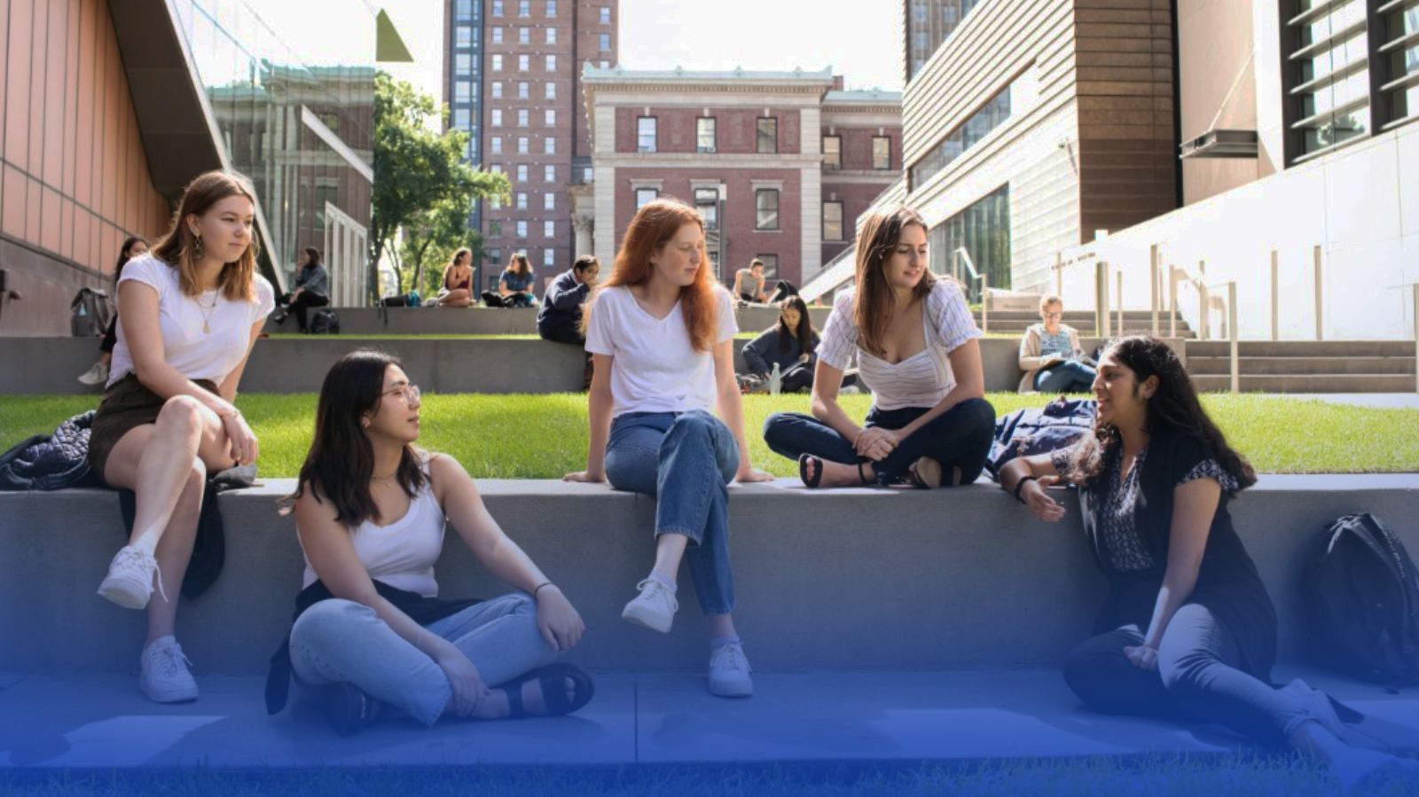
CIRCULAR CAMPUS AT BARNARD
Notes:
Thank you for having us, SG intro BC Sust and Climate School (background in theatre, repair shops, Fixation), here to tell you about the work we are doing around circularity at Barnard.
Big question is - HOW do you actually DO this??

Slide 2
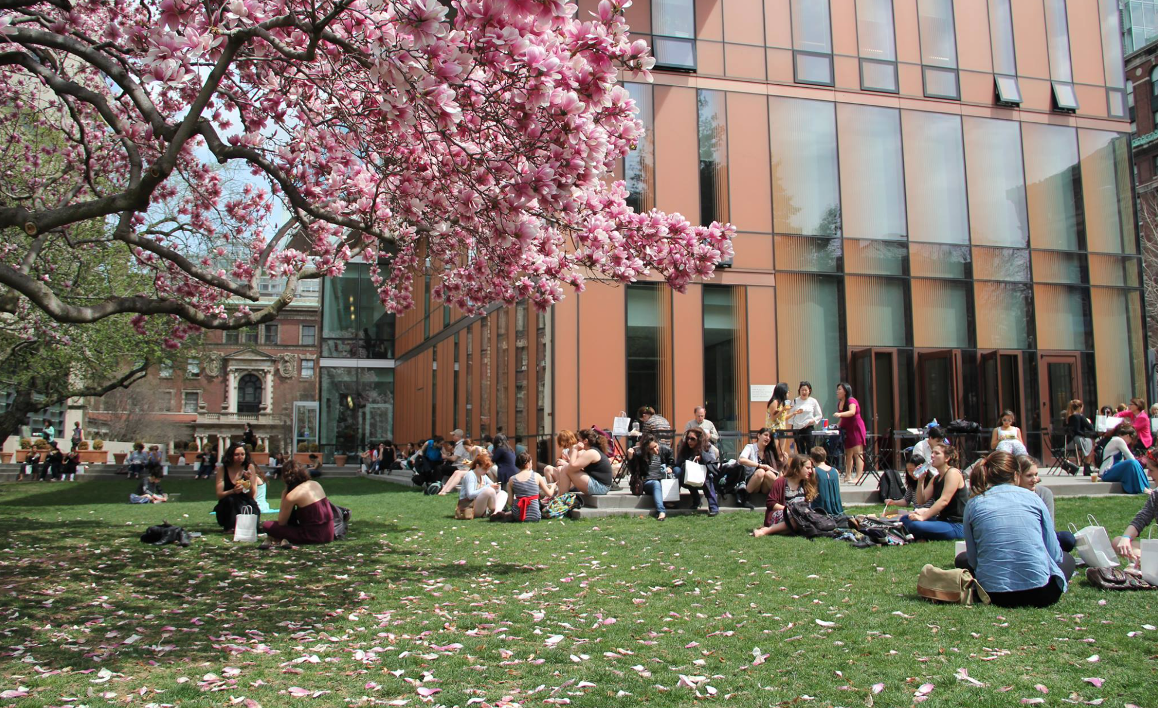
Notes:
Barnard intro:
Small liberal arts College for women in UWS of Manhattan, affiliated with Columbia.
2700 students, 16 buildings, 4 acres,
Part of a potentially much larger network - CU, Manhattan School of Music, Union Theological, Morningside Heights and Harlem, NYC schools.
This is just one of the reasons we are so interested in circularity:

Slide 3
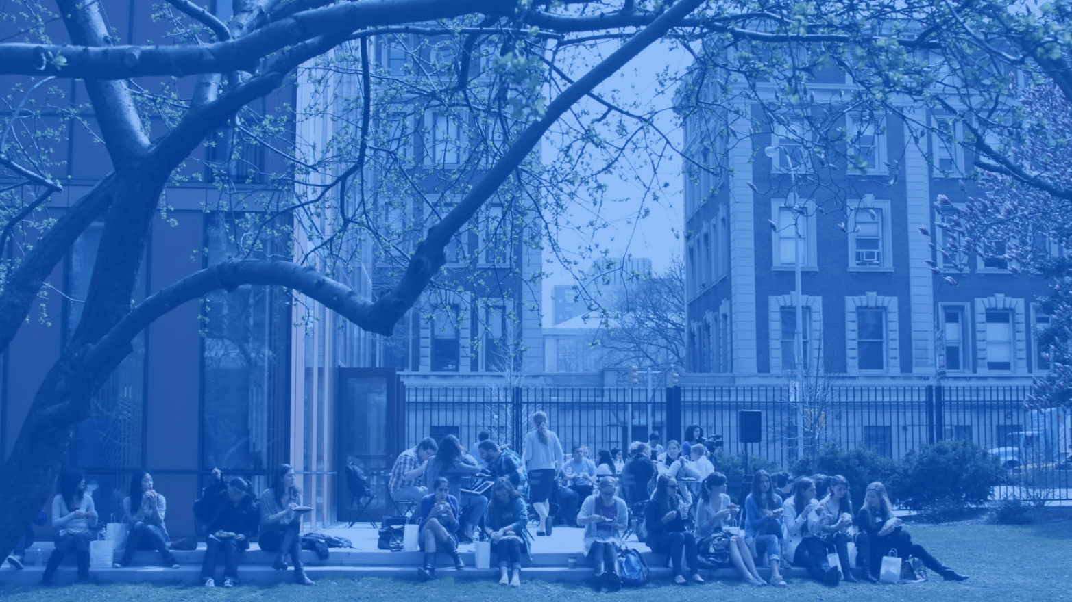
Circular Campus
Framework
Waste Diversion
Food & Dining
Design, Construction & Deconstruction
Green Spaces
Reuse &
Sustainable Purchasing
Notes:
Practically, a way to tie together a lot of seemingly disparate workflows.
5 major areas, we are starting with 3 to begin (ones in the middle)
Major impact of Scope 3 emissions (2015 and 2021 studies) show as much as 60%.
Not just reduce emissions, but also impact behavior. These Scope 3 behaviors touch on everything we do - not hidden.
Intersect with access, affordability, environmental justice, community engagement

Slide 4
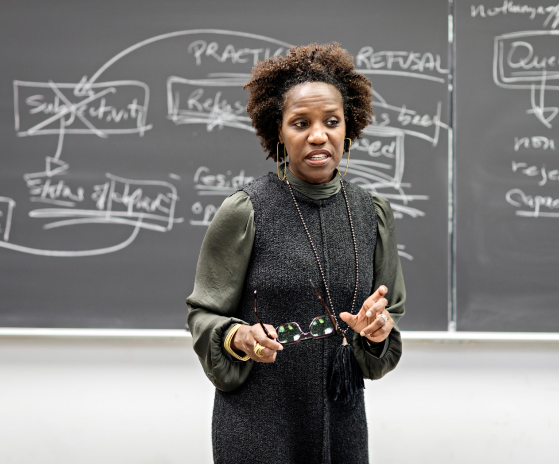
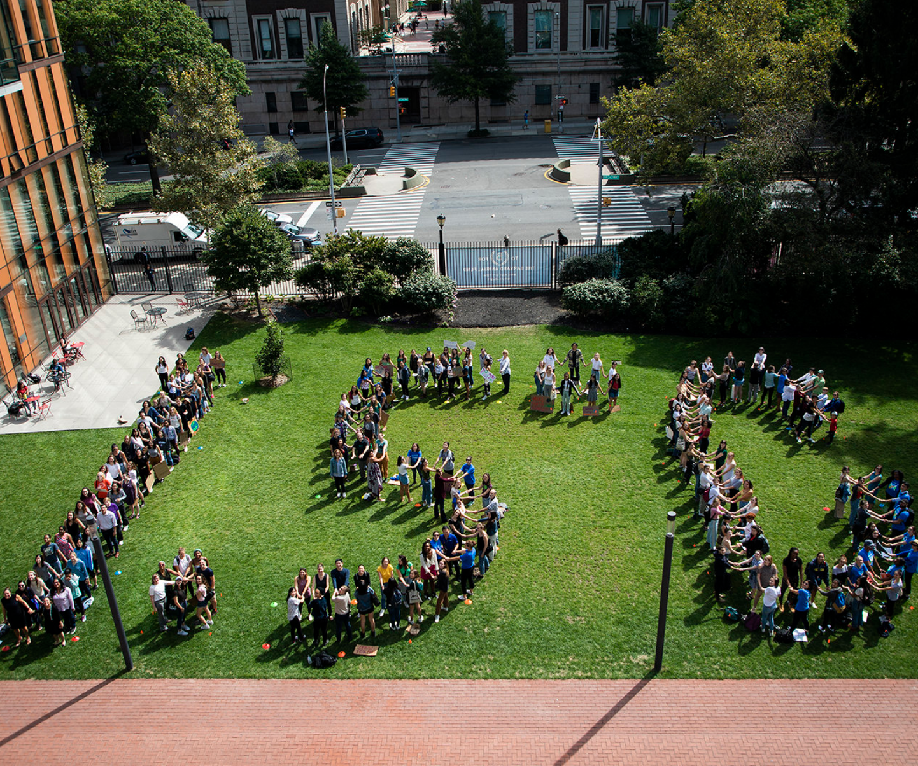
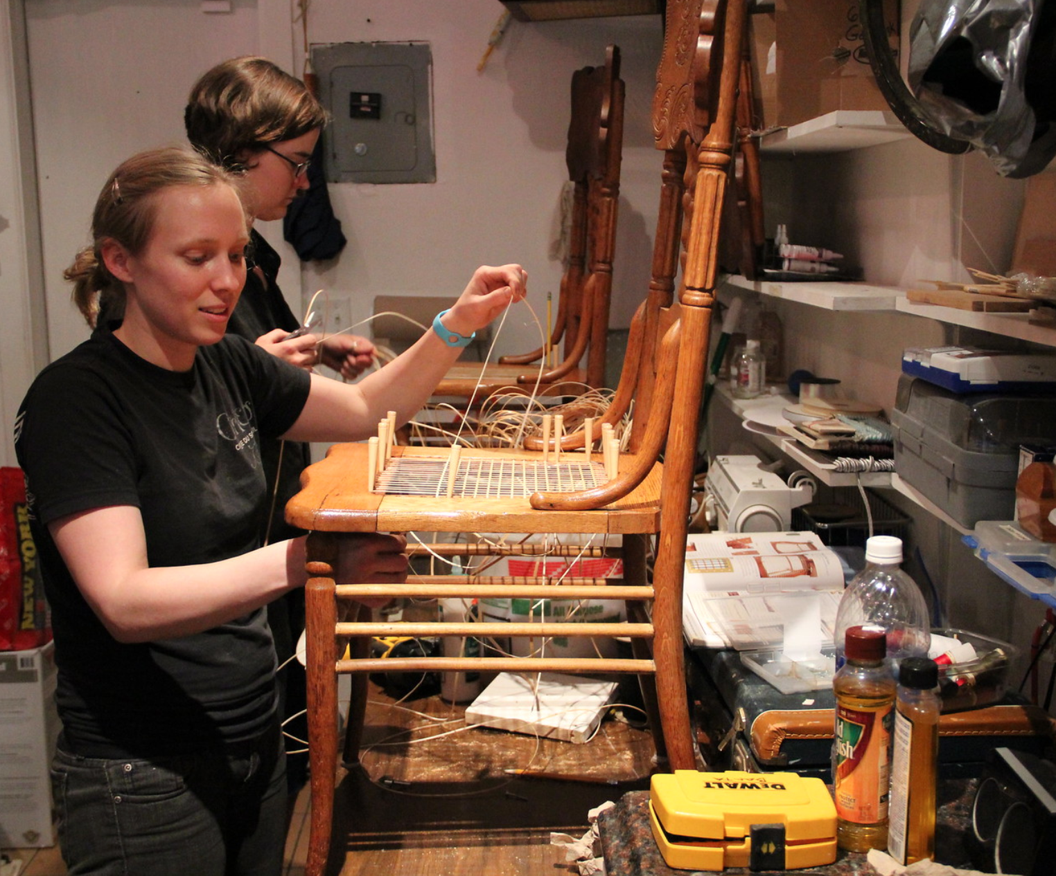
Notes:
Because of this, our Scope 3 emissions and our Circular Campus approach are a key factor in our overall approach to Net Zero, and climate action on campus - operationally, in classroom, and co-curricular.

Slide 5
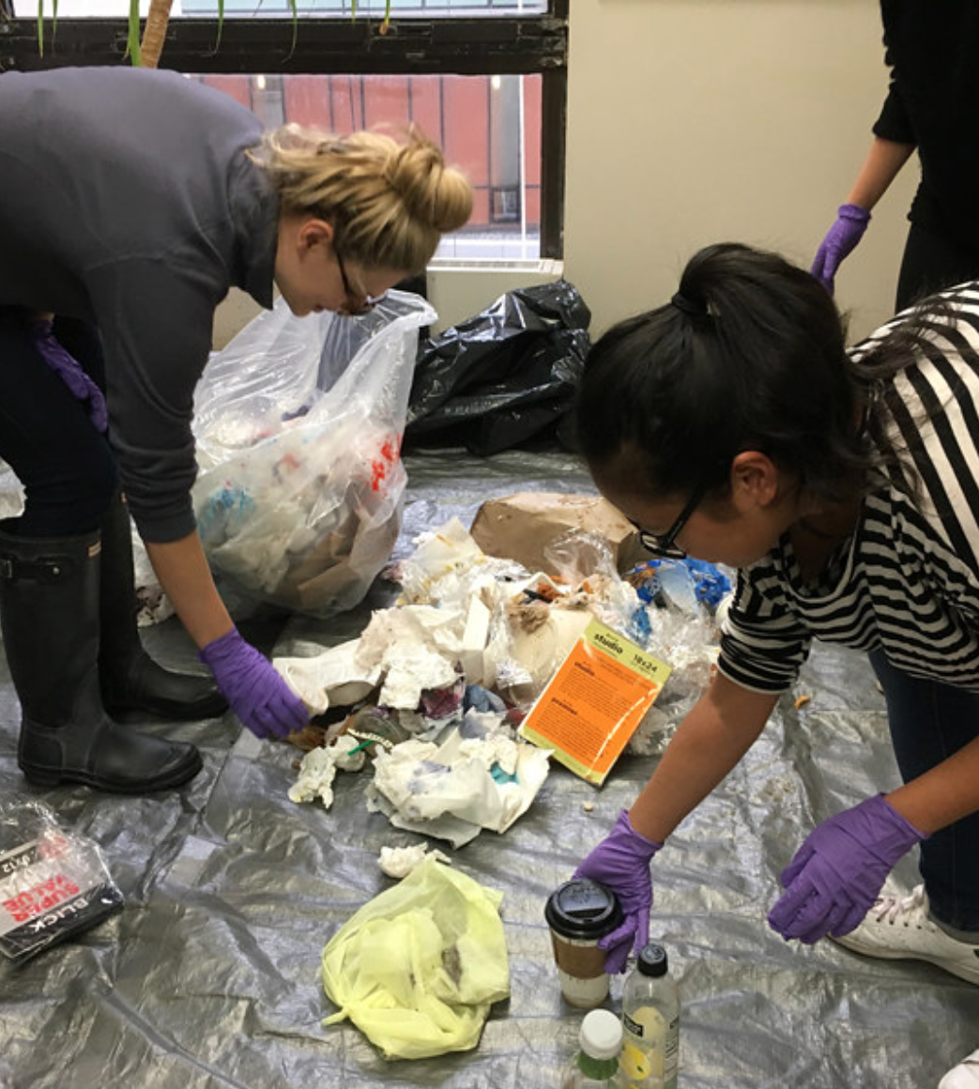
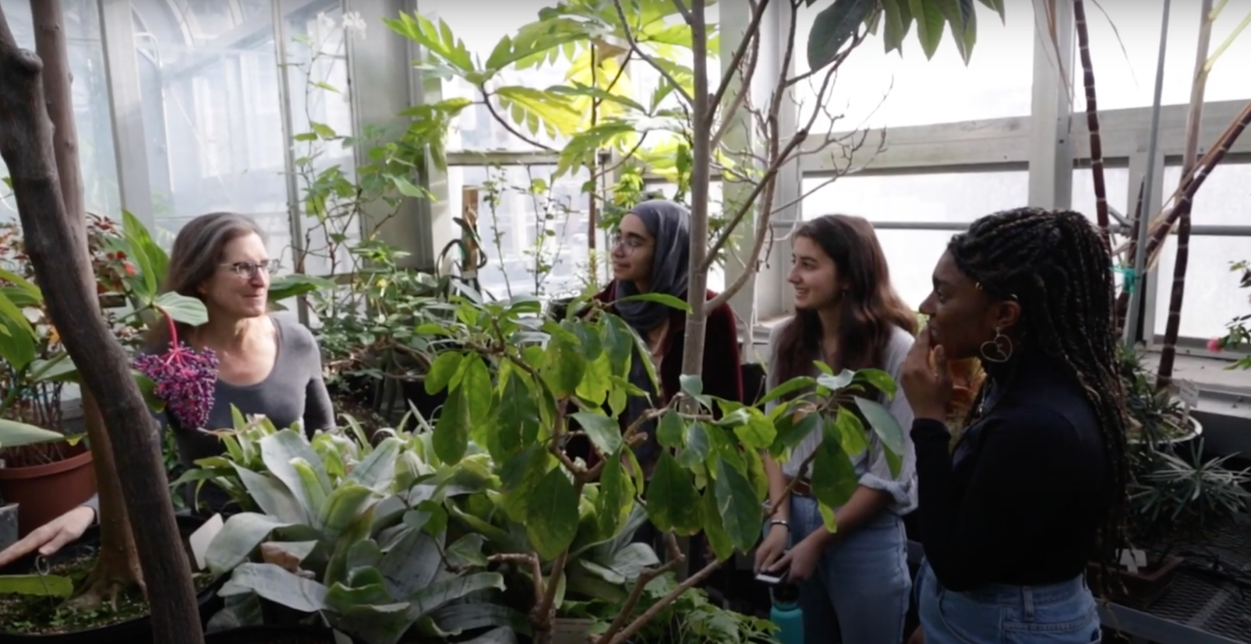
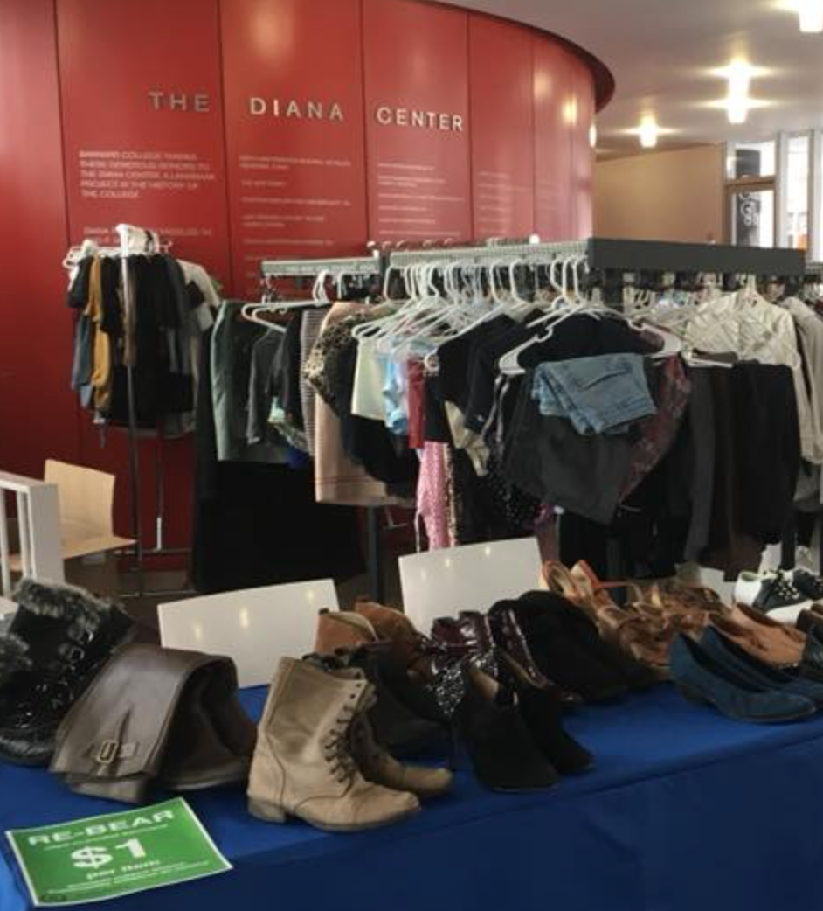
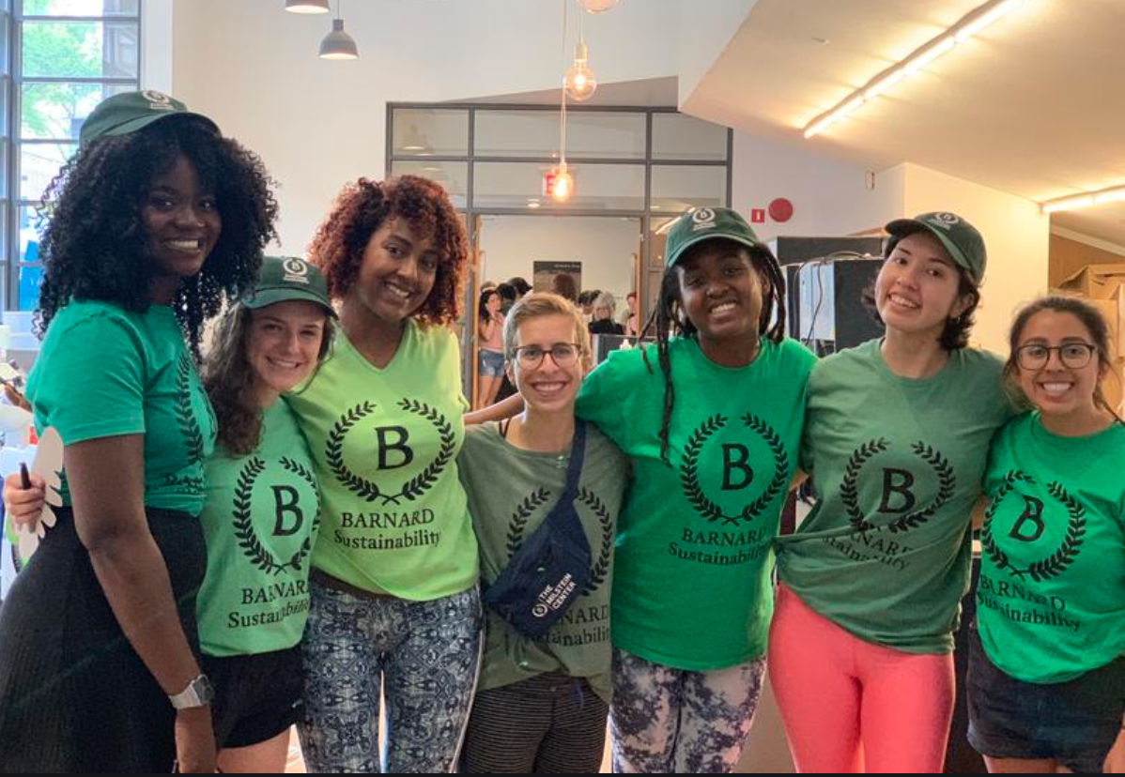
Notes:
In addition to big scale planning - like net zero and major construction projects - we are very conscious of grass roots elements of this work.
Students and faculty, efforts like move-in move out, Waste Management course, Rebear clothing swaps and sales.

Slide 6
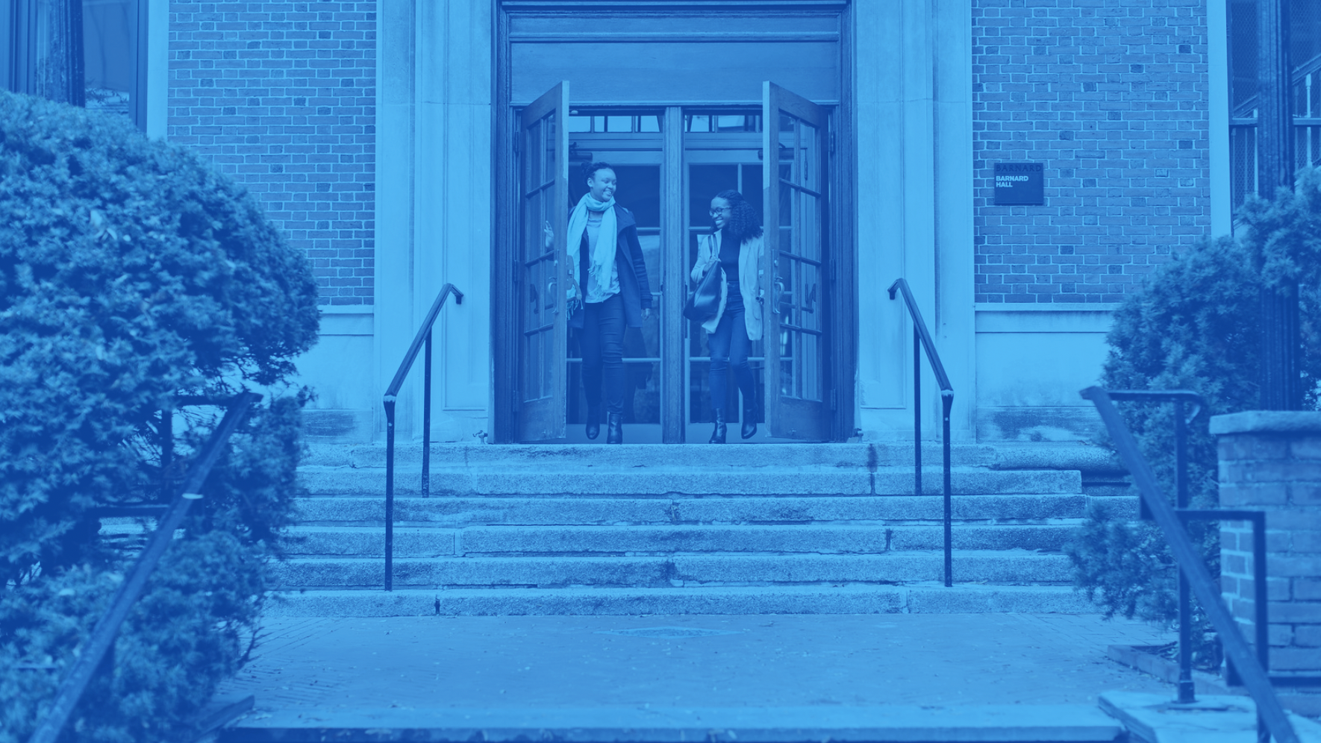
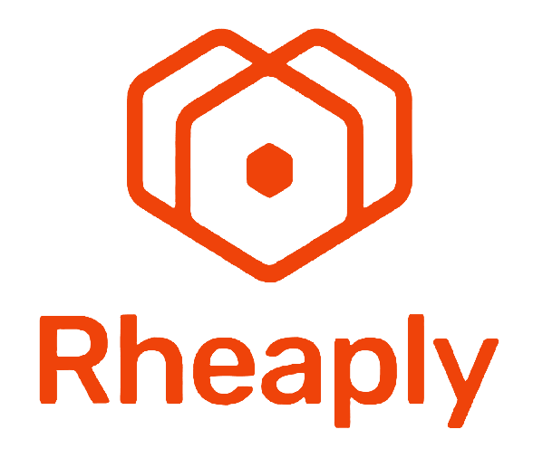
Notes:
Bringing together internal and external partners:
DEI, Access Barnard, Business Services, Facilities & Capital Planning, Faculty, students.
External partners like BLOXHUB, Rheaply, Ellen MacArthur Foundation
Bloxhub workshop this spring - Guiding principles and next steps in 3 buckets: Design Construction & Deconstruction, Green Spaces, Internal Reuse and Sustainable Purchasing.
Holistic, regenerative approach that supports our commitment to social justice, access and affordability.
Supports top-down initiatives, and grass roots projects.

Slide 7
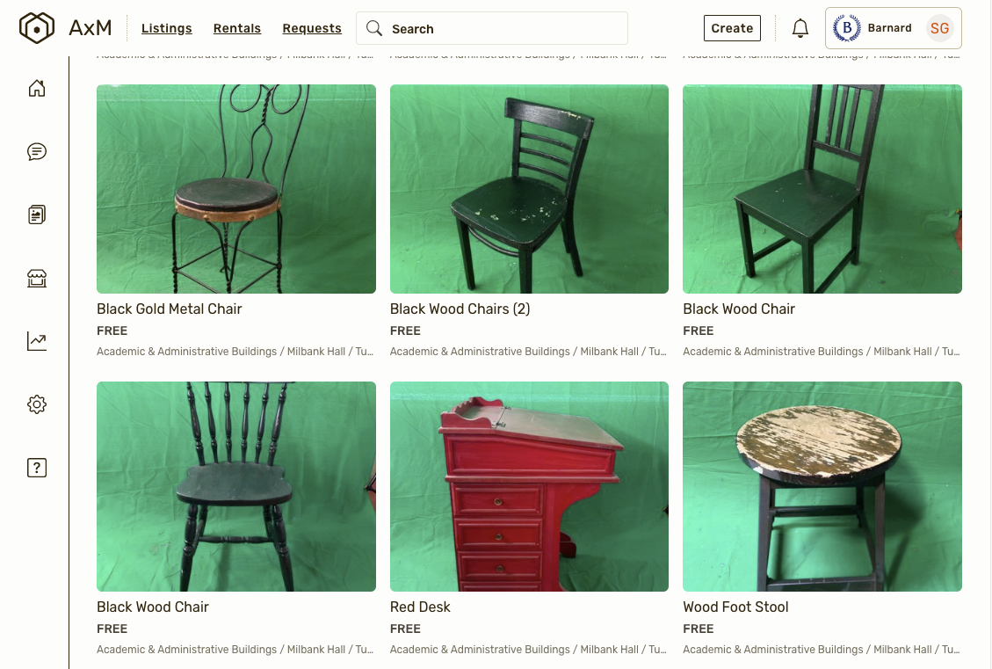
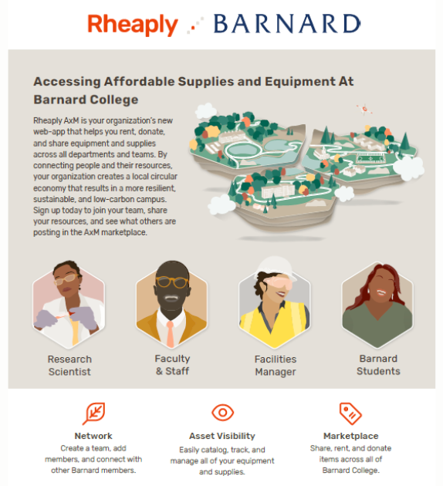
Notes:
We are extremely excited about Rheaply, core element to our approach to Sust purchasing and reuse, and a great example of a way to tap into BOTH top down and community level, and really make reuse the FIRST STOP in terms of purchasing.
Piloting with several departments to start, especially arts, theatre, architecture, design center.
And Access barnard
You see here some of our theatre props - one example of how we’re using Rheaply - to digitize our stock and make our departmental materials available to student groups and eventually other schools and theatres.
I’ll pass it off to Garr now to talk more about Rheaply, and look forward to discussion.

