Slide 1
Faculty Student Association (FSA)

Slide 2
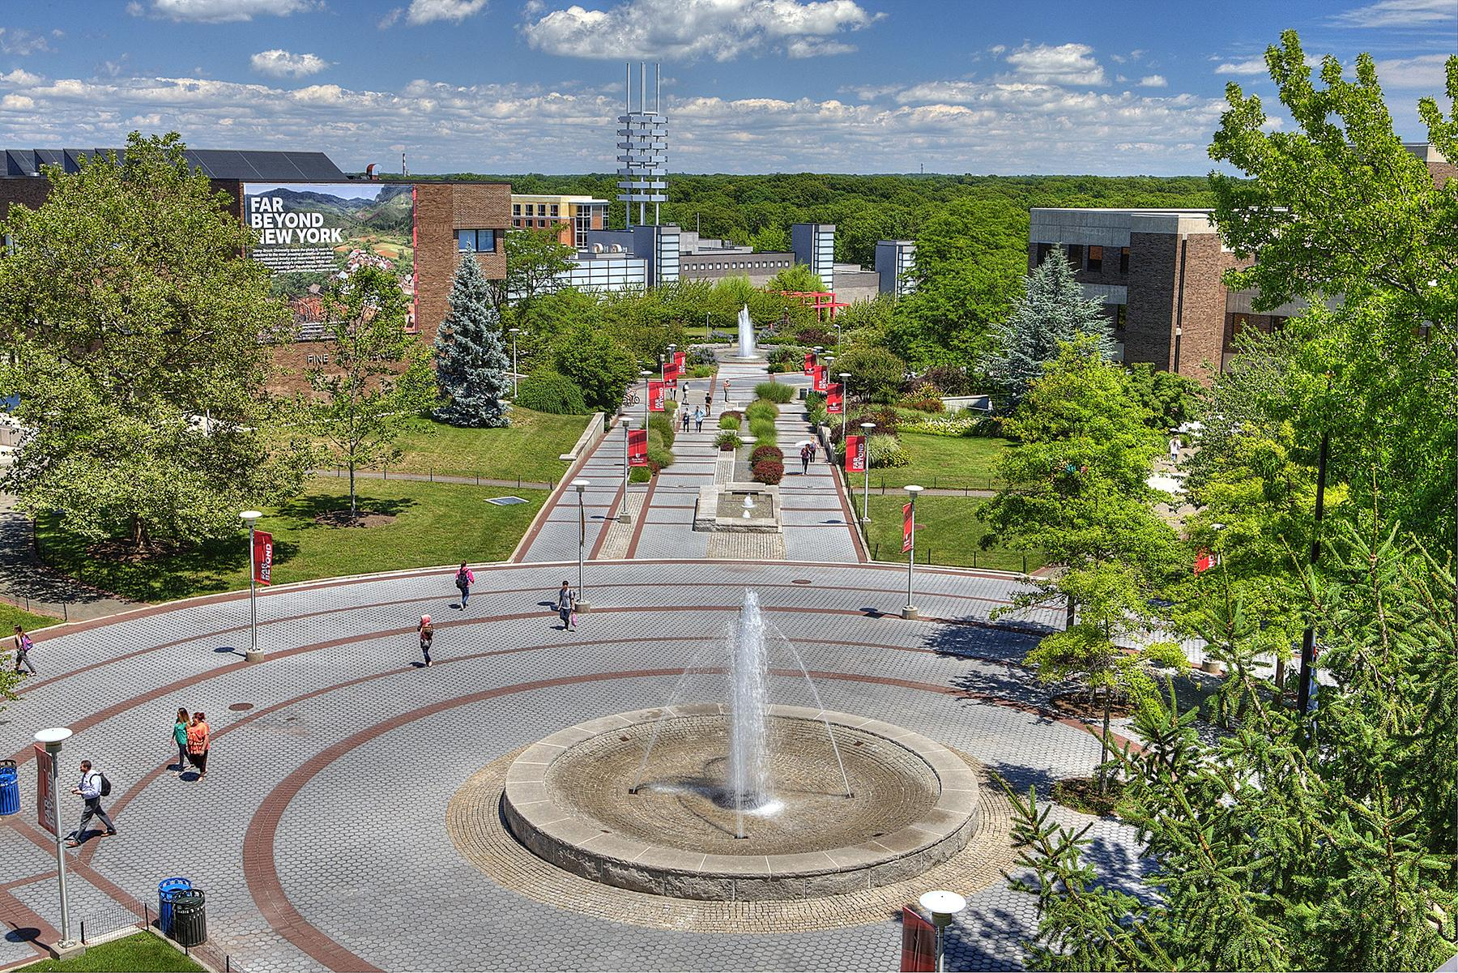
Who We Are
FOUNDED
1957
Long Island, New York
140+
graduate
programs
TOP
100
universities in the nation*
Member of the Association of
American
Universities
200+
undergraduate
programs
25K+
undergraduate
and graduate students
Students
from nearly
ALL 50 STATES
and more than
150
COUNTRIES
TOP
50
public
universities*
14K+
Faculty and staff
*U.S.News & World Report

Slide 3

Southampton
4 Core
Academic Programs and growing
400+
Undergraduate and graduate students, faculty and staff
84 Acre
Campus in
Eastern Long Island
Supports major
conferences:
FOOD LAB
&
SUMMER
WRITERS
SOMAS
Famed School of Marine & Atmospheric Sciences

Slide 4
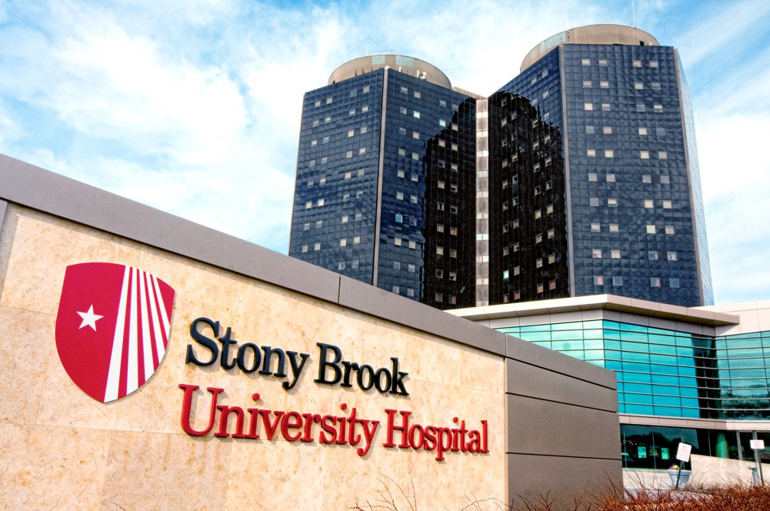
Stony Brook Hospital
BEDS
603
TOP RANKED
institution for scientific research and training.
WORLD-CLASS INSTITUTION
outstanding, compassionate patient care, biomedical research, and healthcare education
BROOKHAVEN
NATIONAL LAB
World-class
Research facility

Slide 5
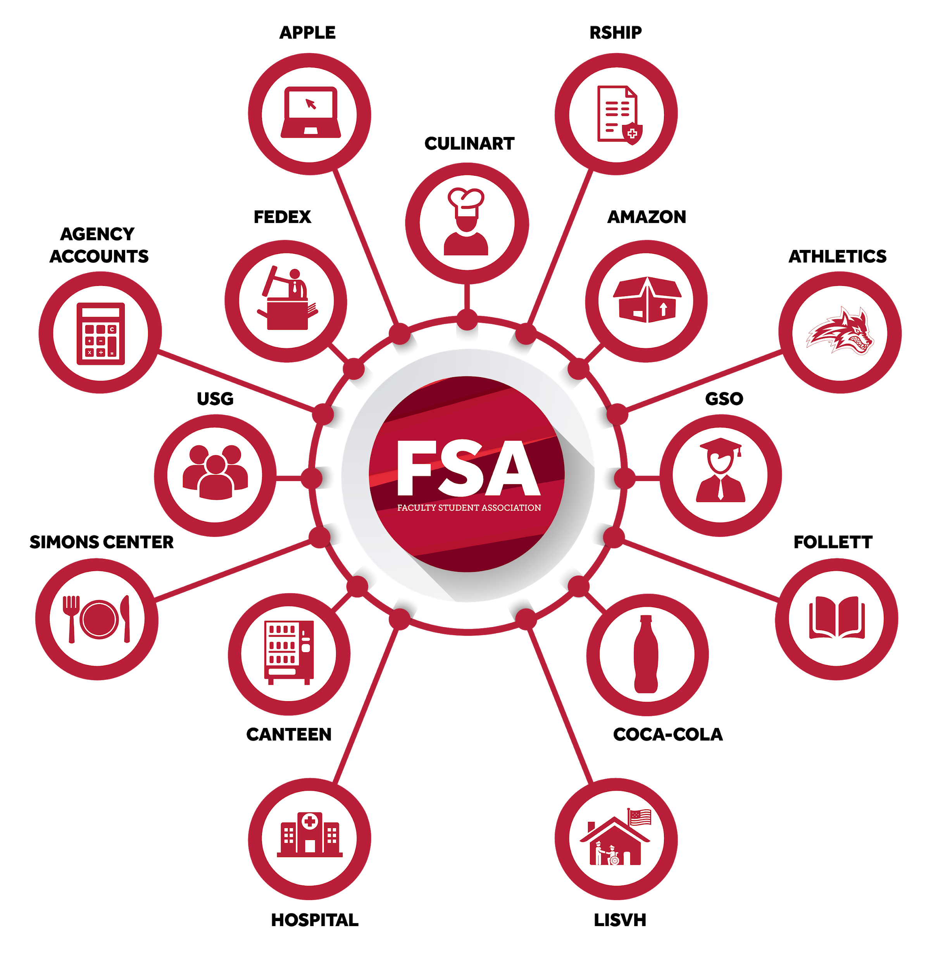
What services does FSA provide?
The Faculty Student Association (FSA) is a
not-for-profit auxiliary services corporation that
operates many of the non-academic services
on the Stony Brook campus.

Slide 6
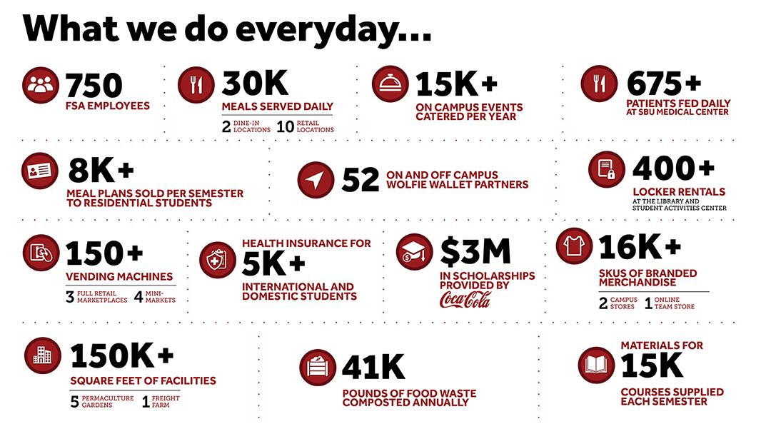

Slide 7
Pre COVID-19
We make your day better!

Slide 8

FSA earns National Award
for Sustainability
Over 25 articles published showing our leadership role in creating and implementing campus dining sustainable efforts.
Hosted webinars for the College and University Recycling Coalition (CURC) and the Association for the Advancement of Sustainability in Higher Education (ASSHE) offering advice to other colleges and universities across the nation.
Recognized for reducing plastic waste, food waste reduction, Freight Farm tours, behind-the-scenes farm and fair trade coffee roasting tours, pop up events, permaculture gardens
Notes:
2nd year in a row!

Slide 9
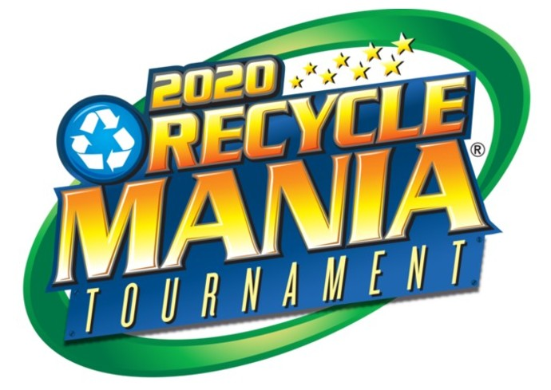
SBU Placed No. 1 for E-waste
National First Place Winner!
Collected over 112,506 lbs. of e-waste: trash generated from surplus, broken, and obsolete electronic devices such as cellphones and computers.
SBU was a leader in other areas of the competition - top 15% of colleges and universities nationwide for both the Food Organics and Per Capita Classic categories.

Slide 10
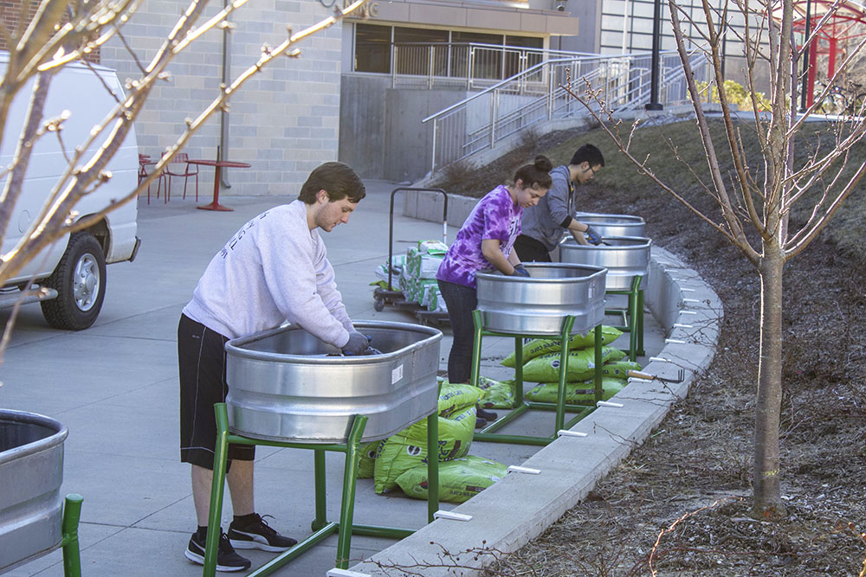
SBU’s Sustainable Impact Rated High in Times Higher Education Ranking
For the 2020 THE rankings, Stony Brook University ranked among the top 100 institutions out of a total 806 worldwide in four areas:
No. 27 in Reduced Inequalities
No. 59 in Industry, Innovation & Infrastructure
No. 95 in Quality Education
No. 99 in Climate Action

Slide 11
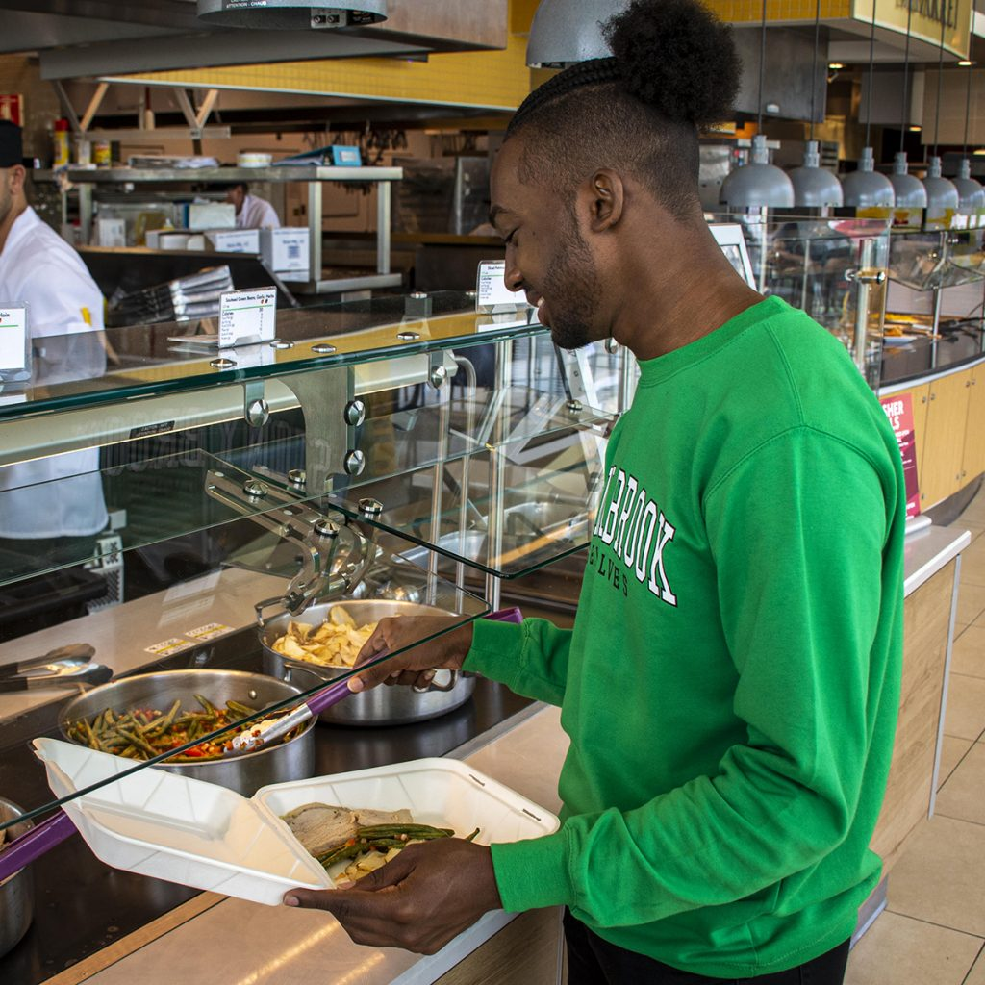
FSA Launches Major Plastic Waste
Reduction in Dining Services
Dining locations transitioned away from disposable plastics. Now use compostable containers made from sugarcane, paper products and Greenware, drink cups and containers made entirely from annually renewable plants – not petroleum.
The reusable takeout container program offered at three dining locations.
Plastic straws have been eliminated from dining locations, corn straws are only available upon request at the cashier.
Convenience stores no longer offer plastic bags for purchase and instead sell reusable tote bags.

Slide 12
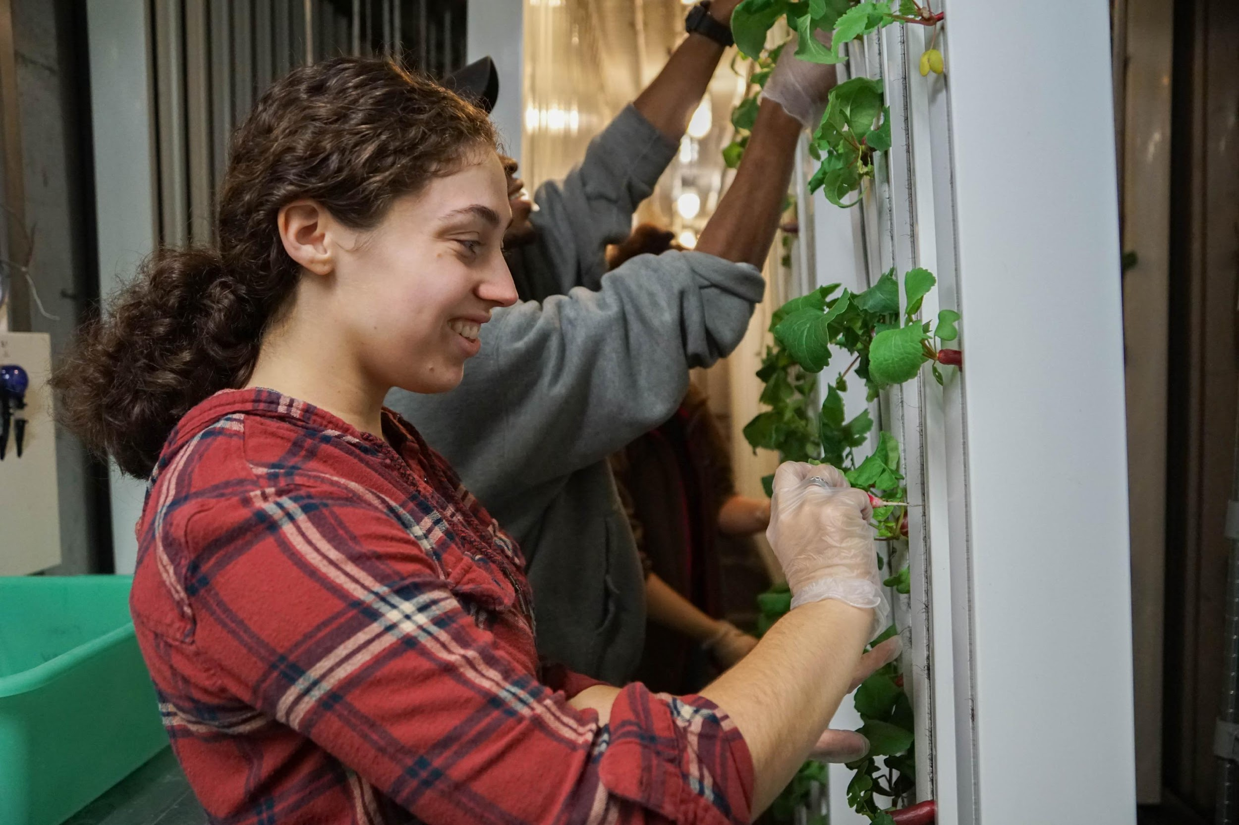
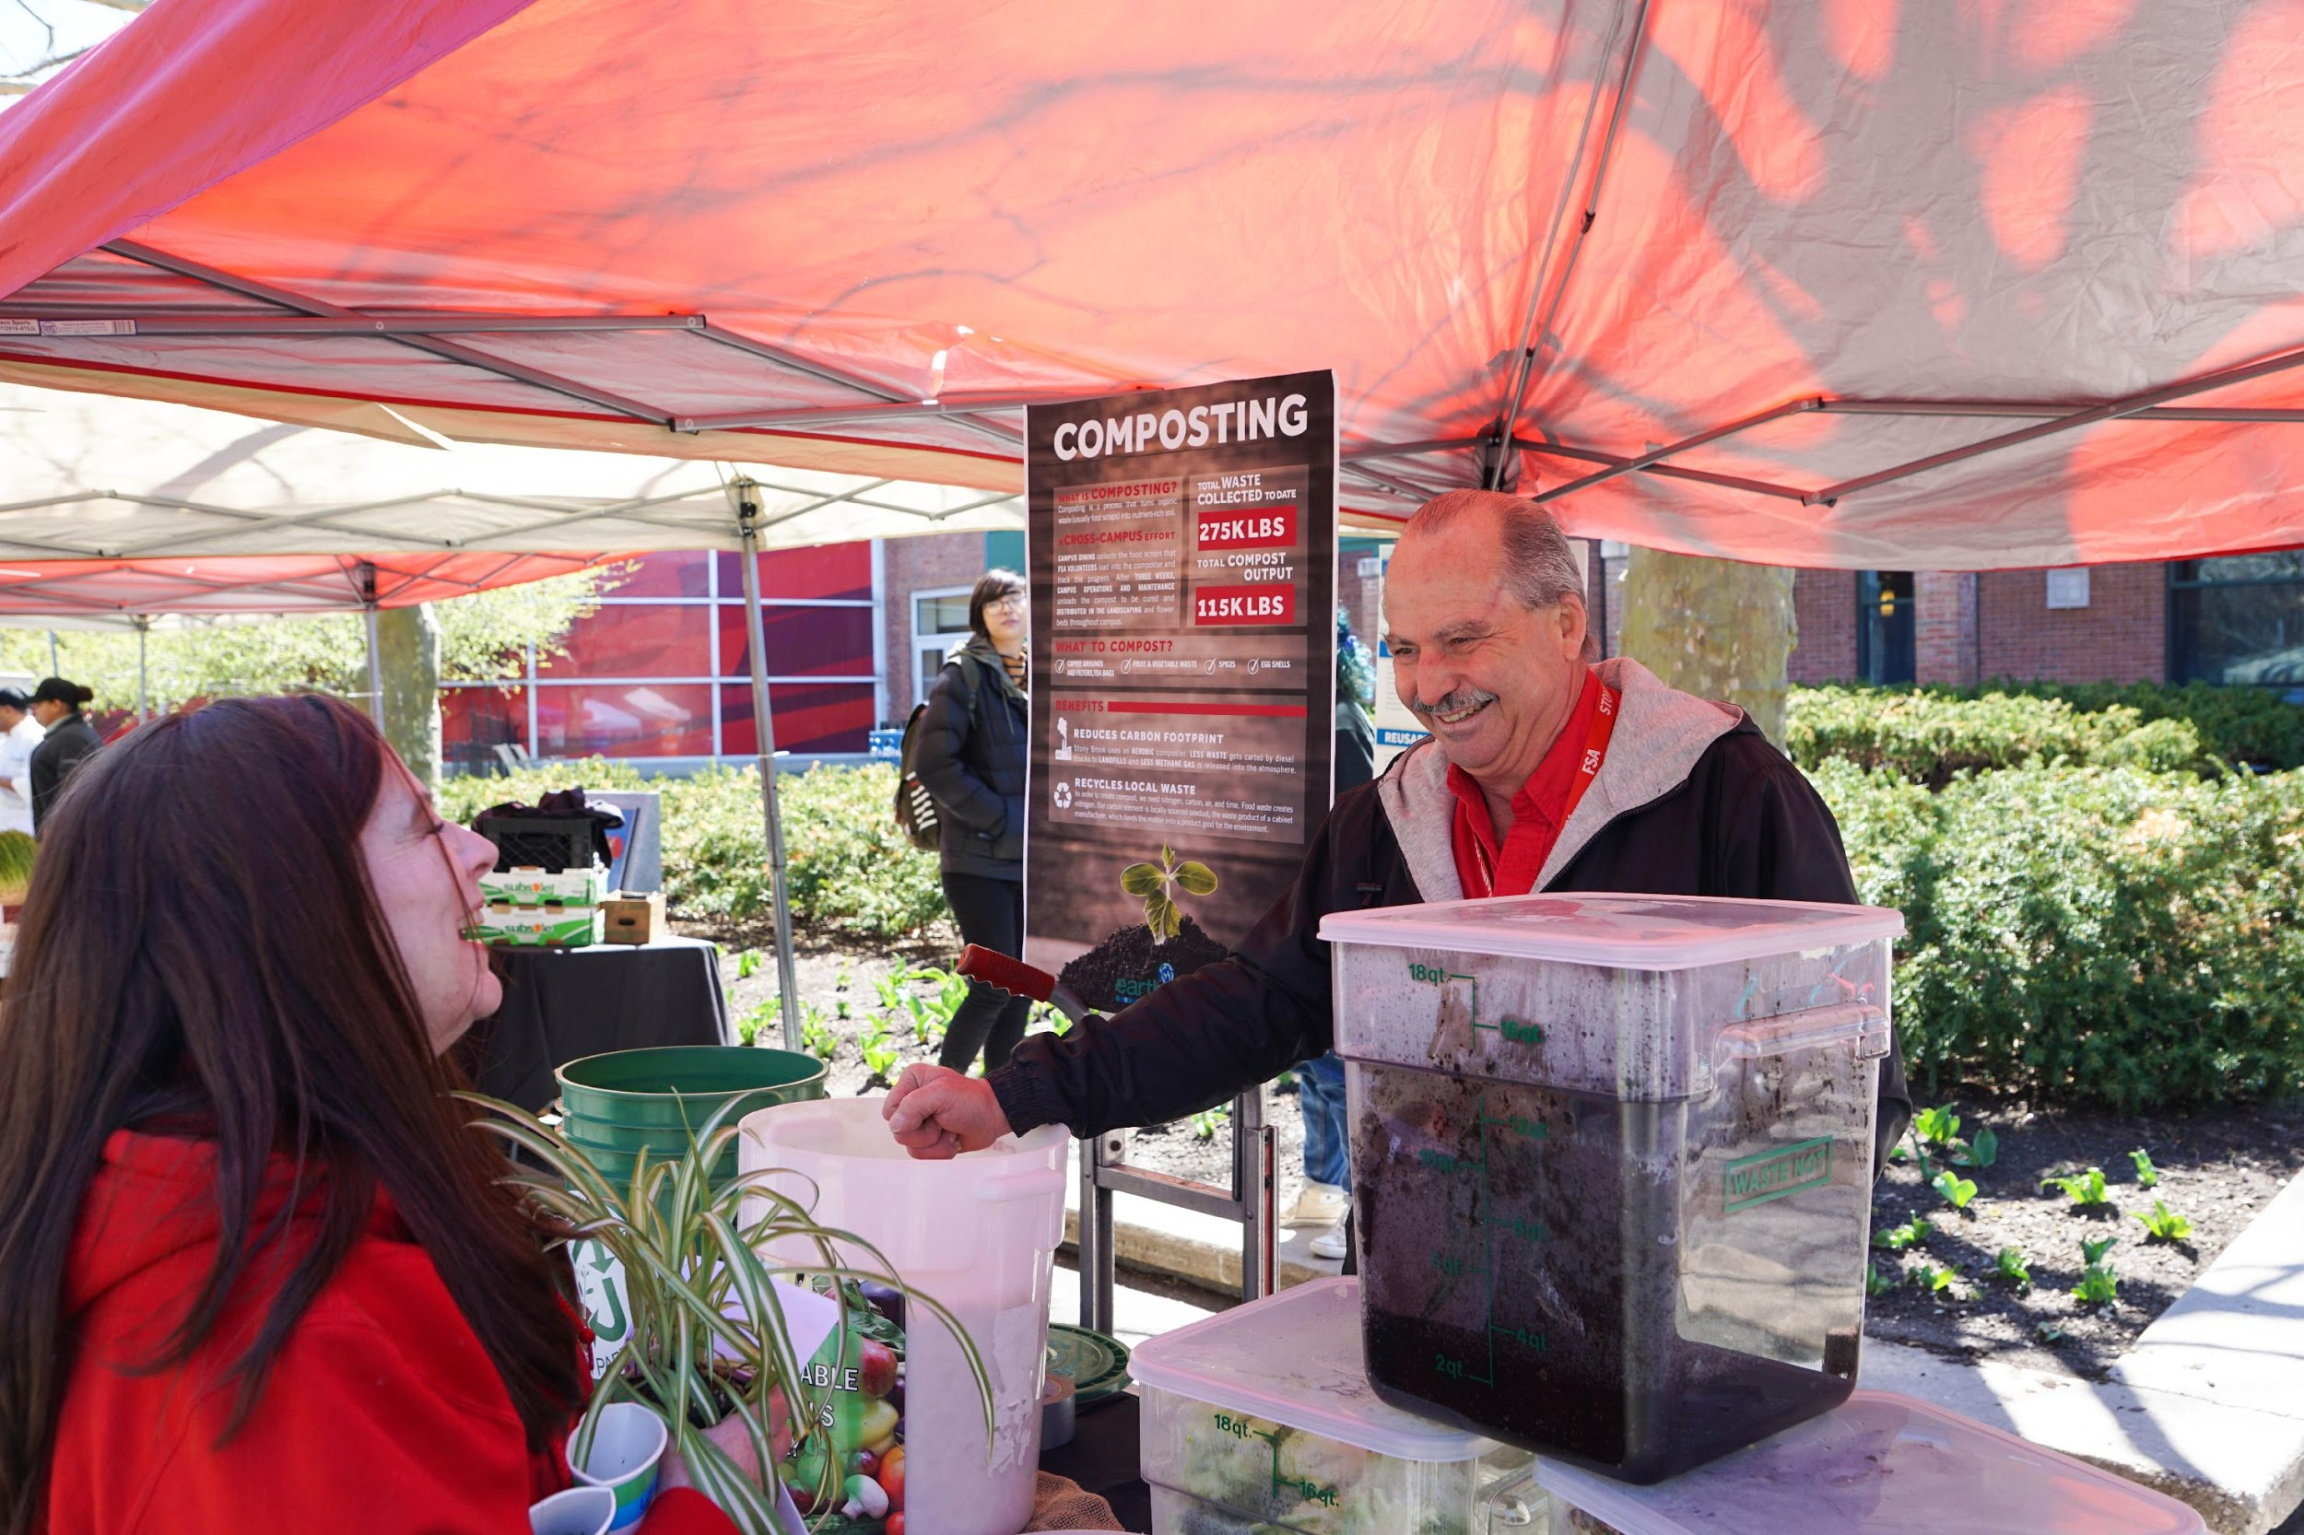
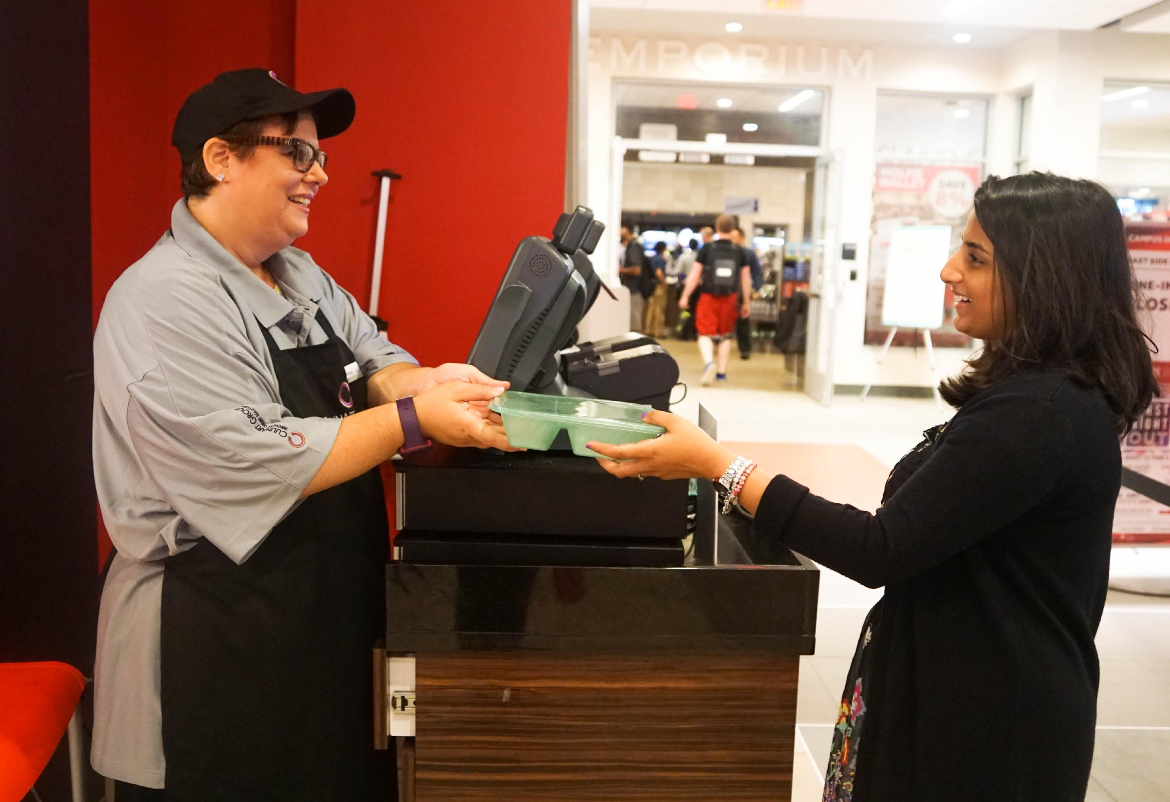
Sustainability Initiatives
Freight Farm grows lettuce hydroponically in a recycled shipping container! Radishes too!
Composting is a process that turns organic waste into nutrient-rich soil and diverts pre-consumer food waste from the landfills each week.
Reusable takeout containers
at East Side, West Side and
Roth Food Court.
Notes:
Students can eat the food they grow while enhancing their knowledge of sustainable agriculture.
Hands-on learning opportunity outside the classroom.
Inspires students to be more sustainable in their lives.
Just like a library card, you’ll use your ID card to check out your reusable takeout container. If you are not exchanging it for a clean container, return it to a cashier to swipe it back onto your card.

Slide 13
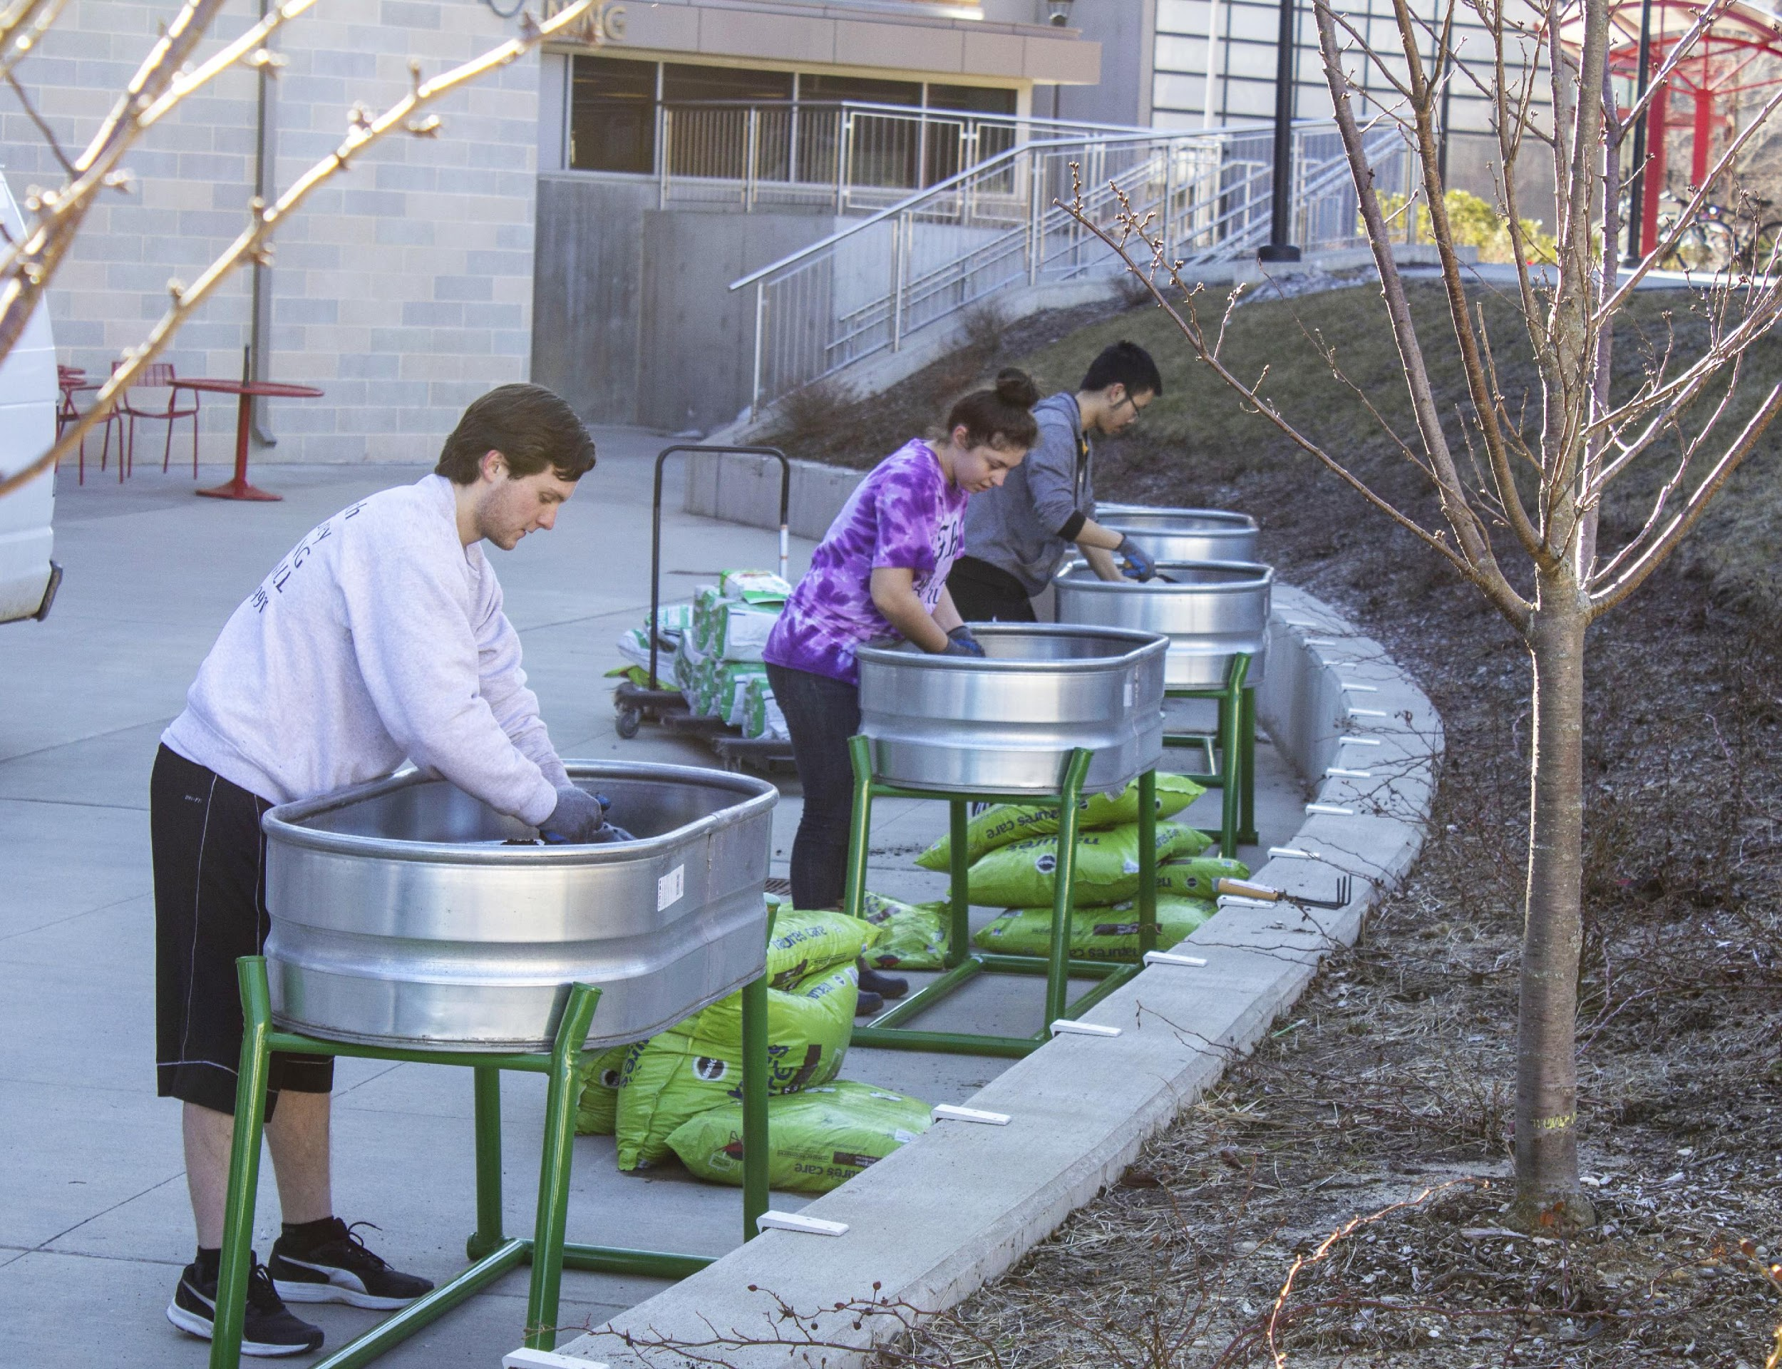
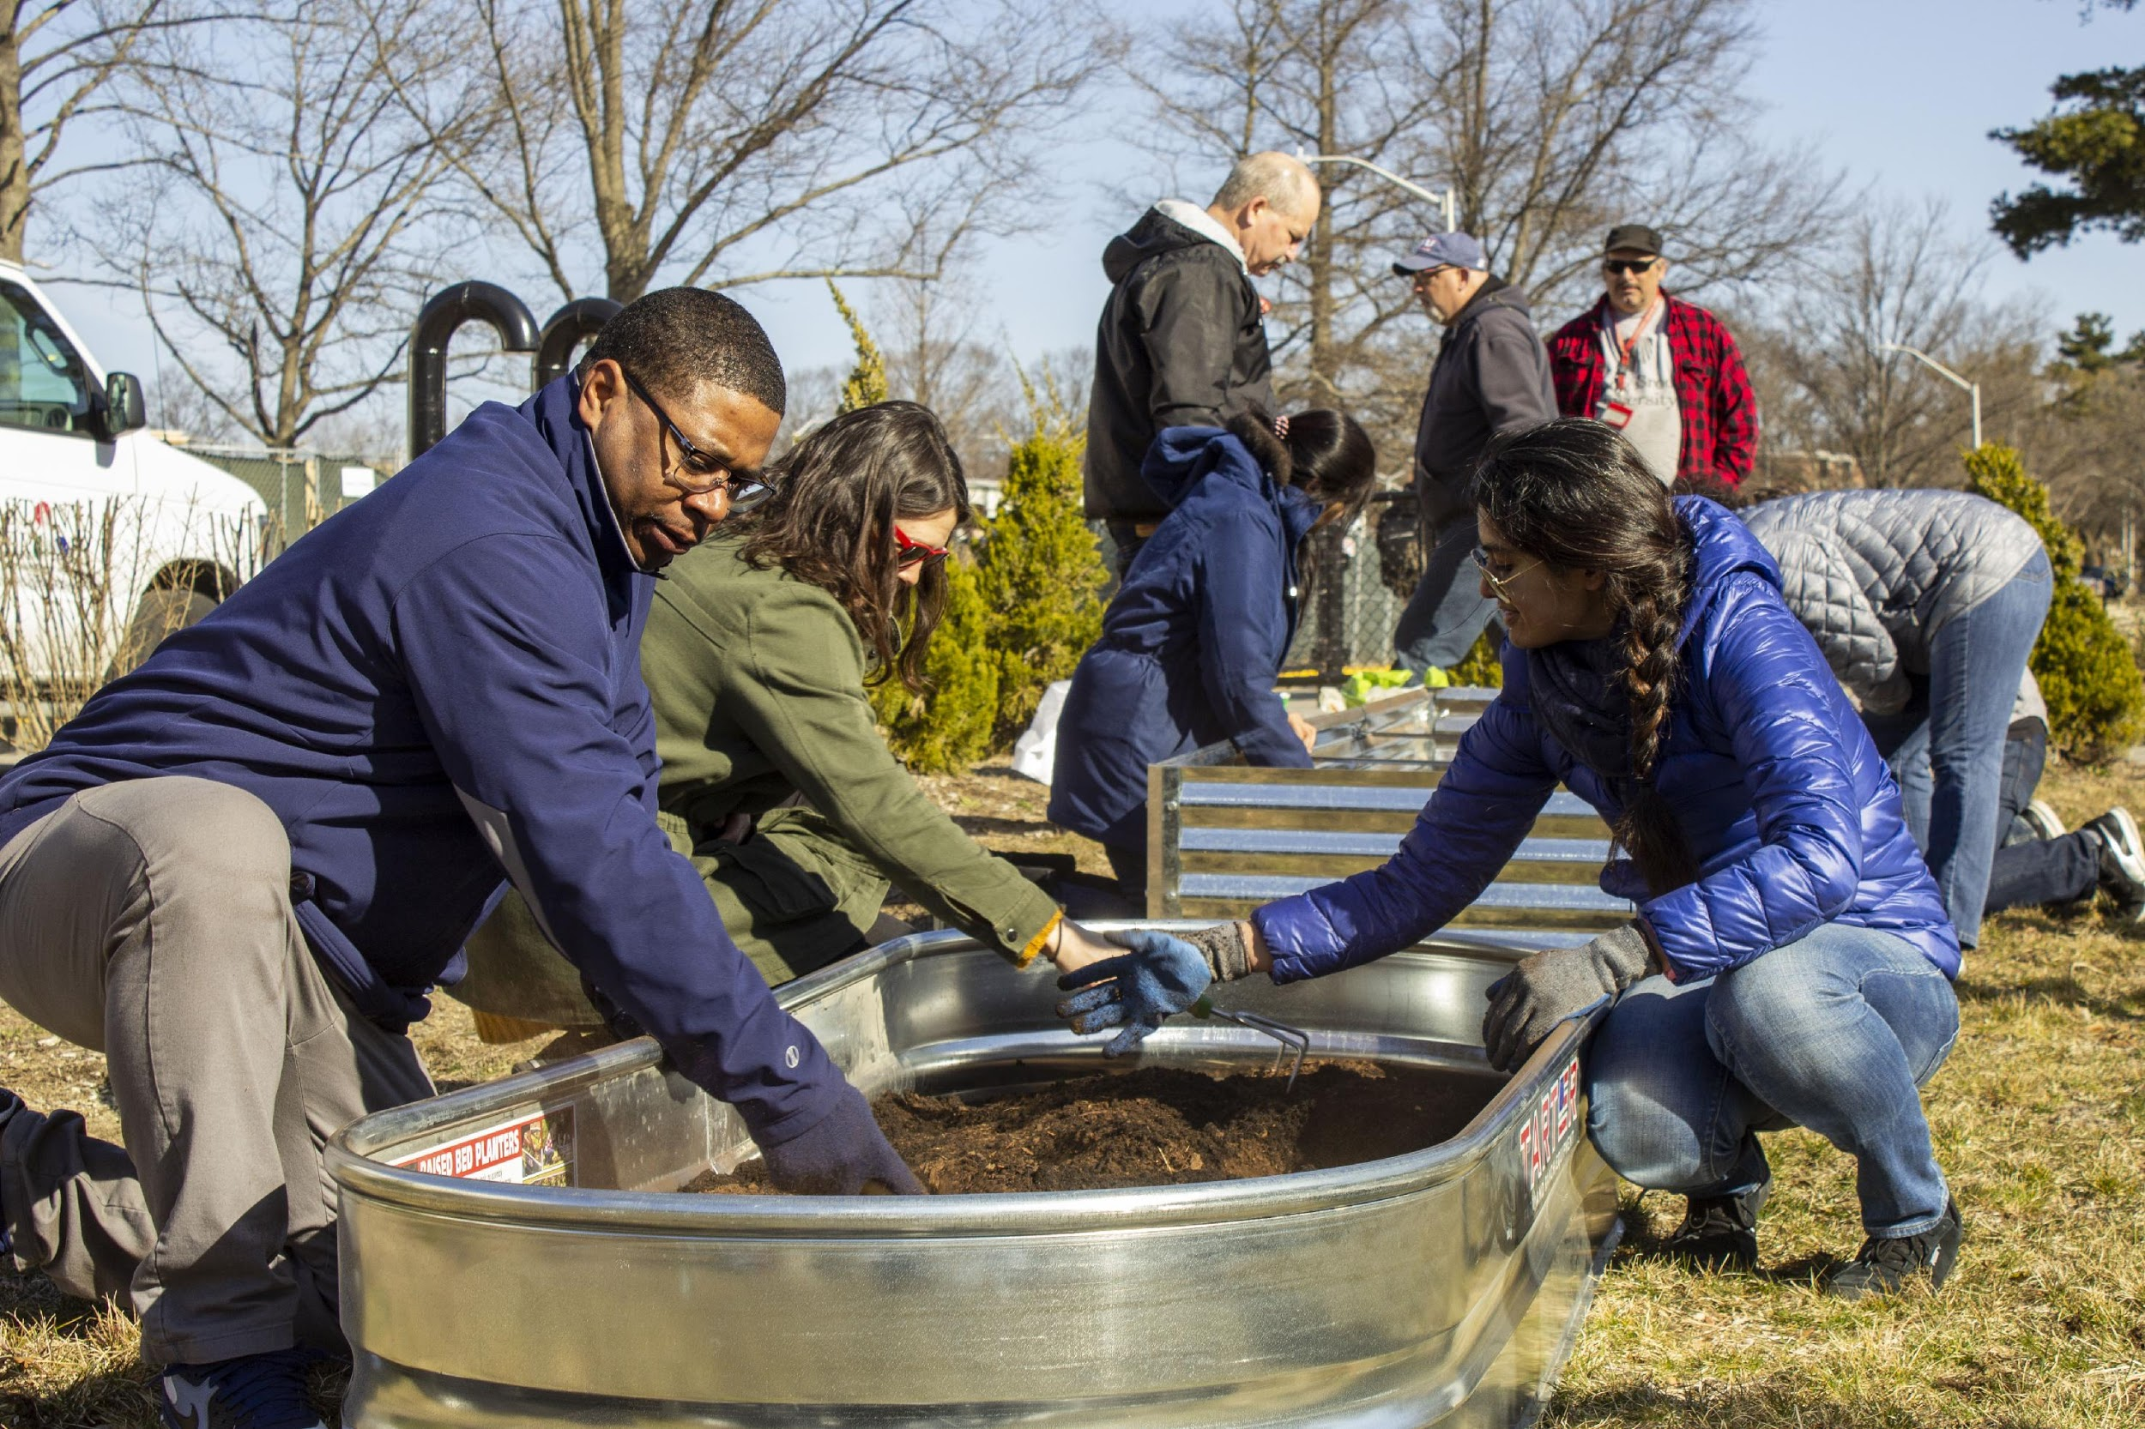
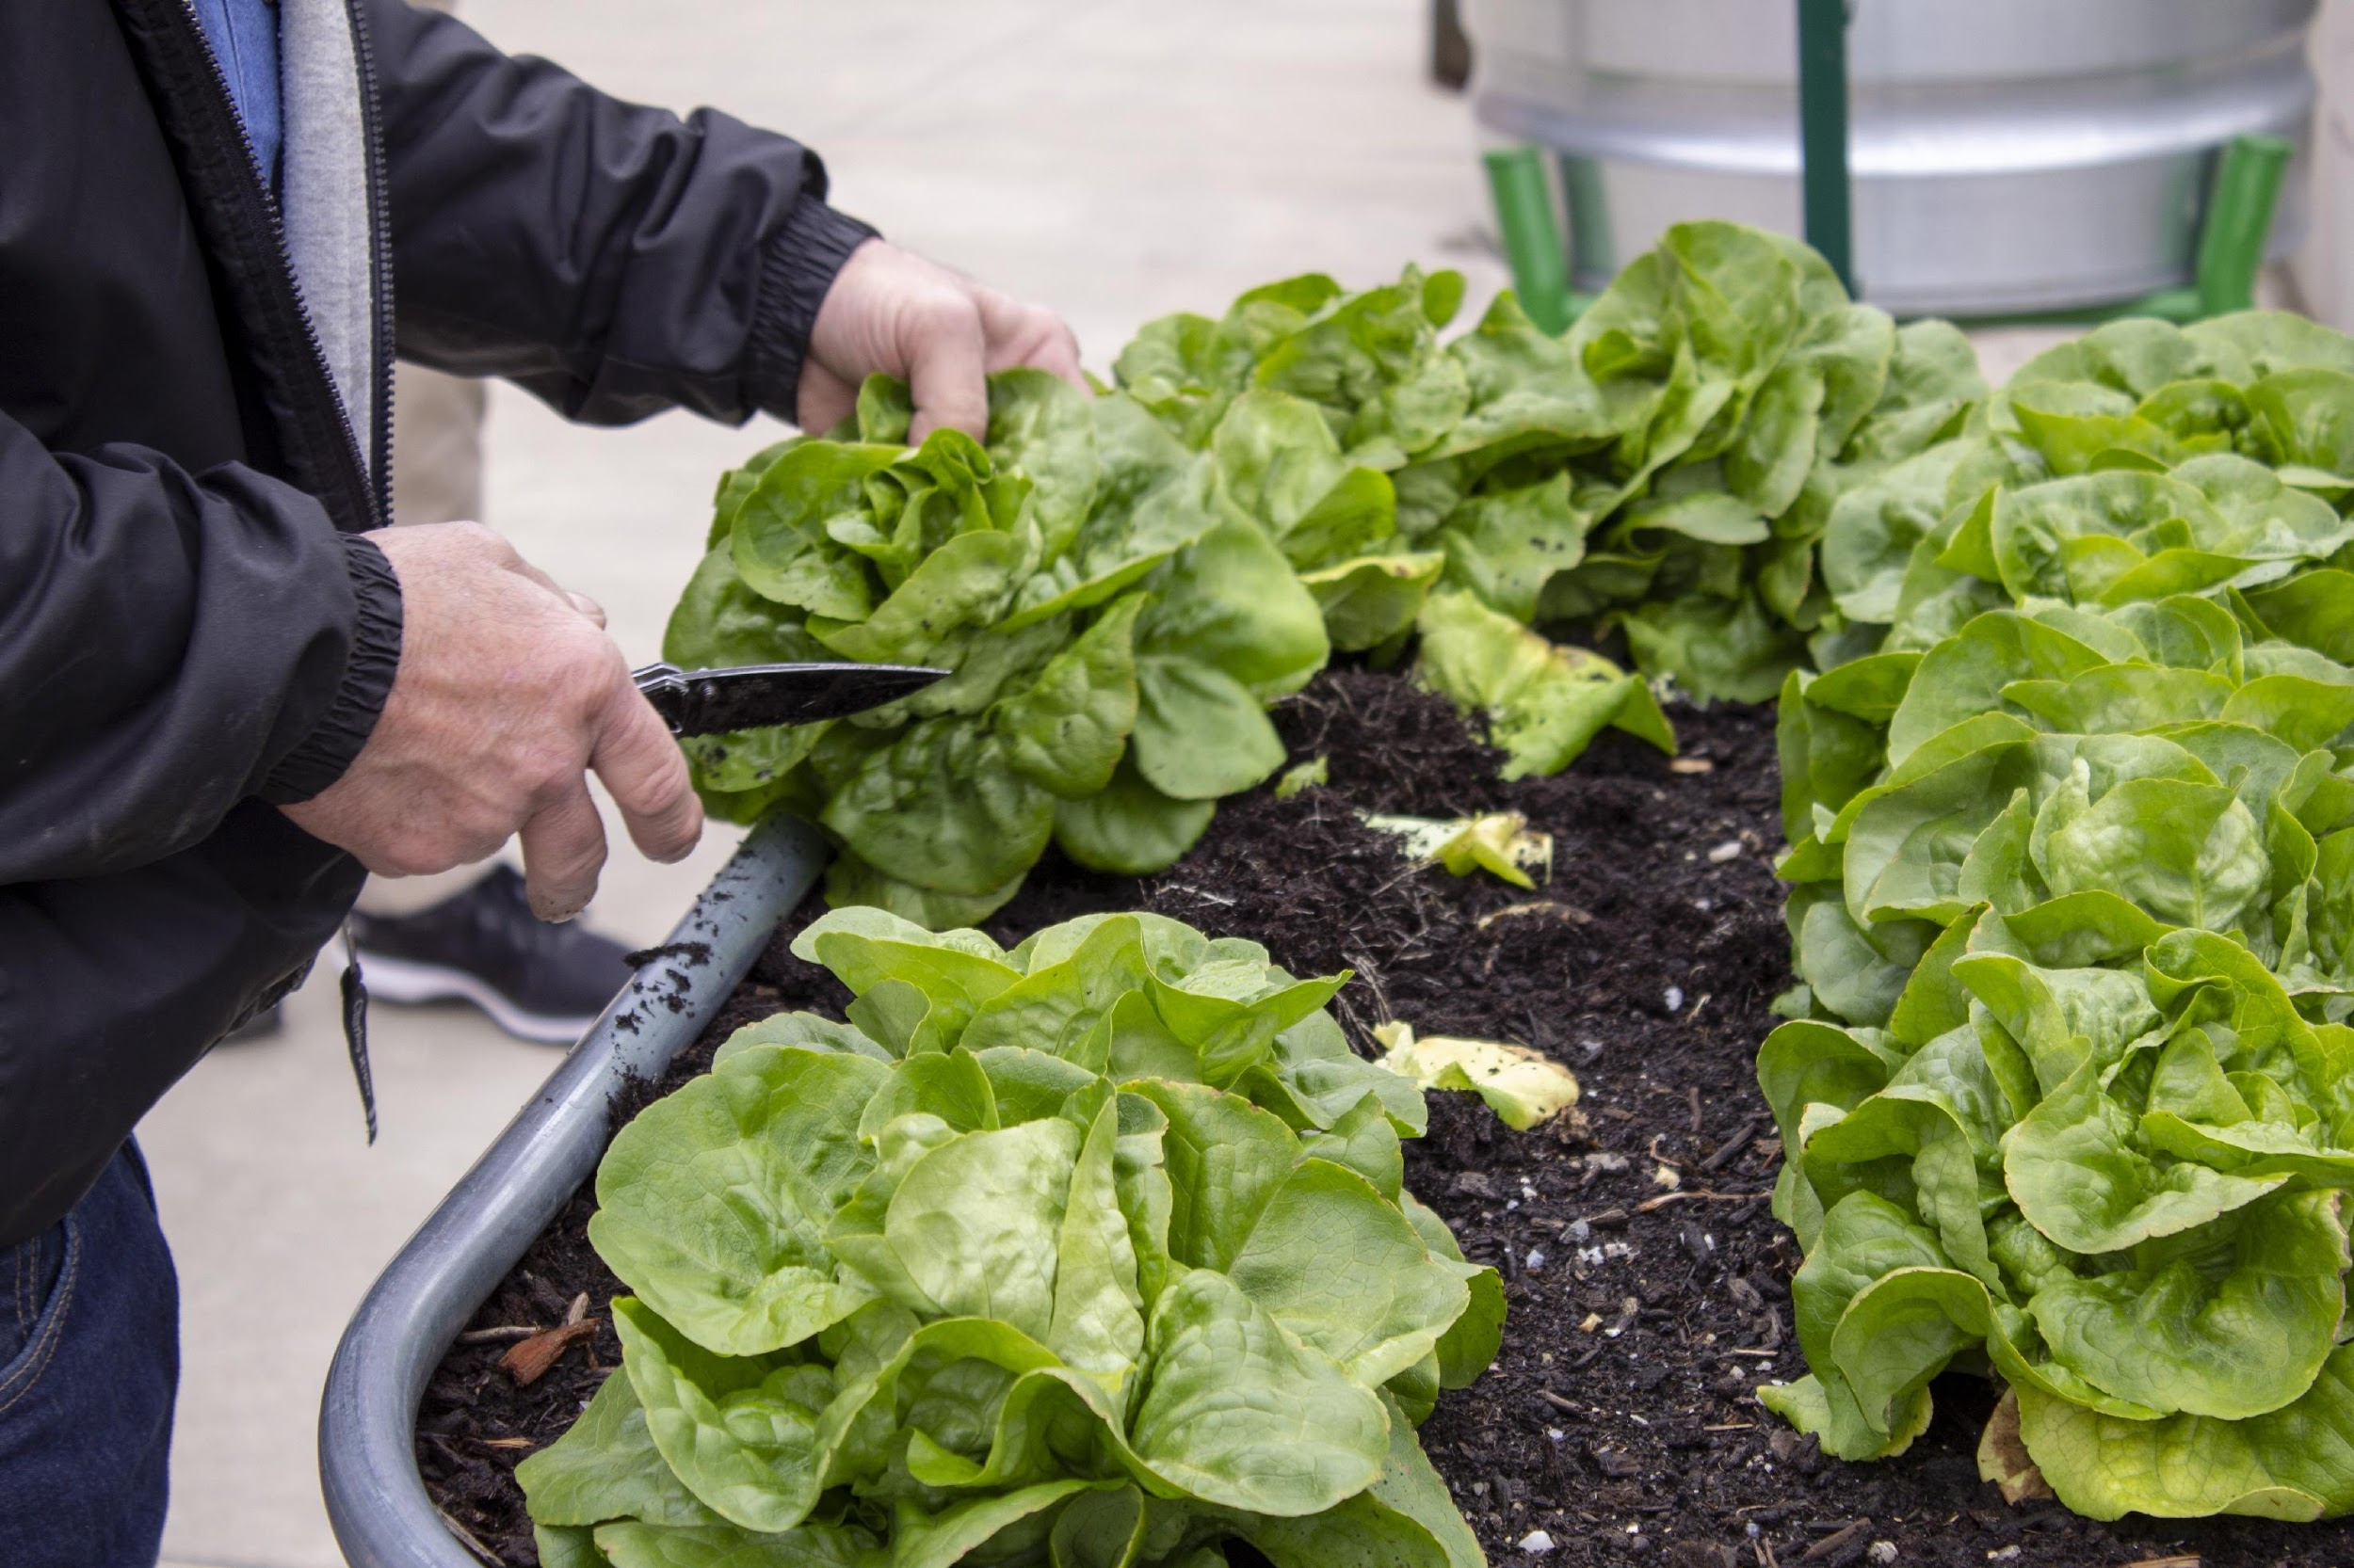
Residential Dining
Gardens
Provides healthy ingredients and learning opportunities.

Slide 14
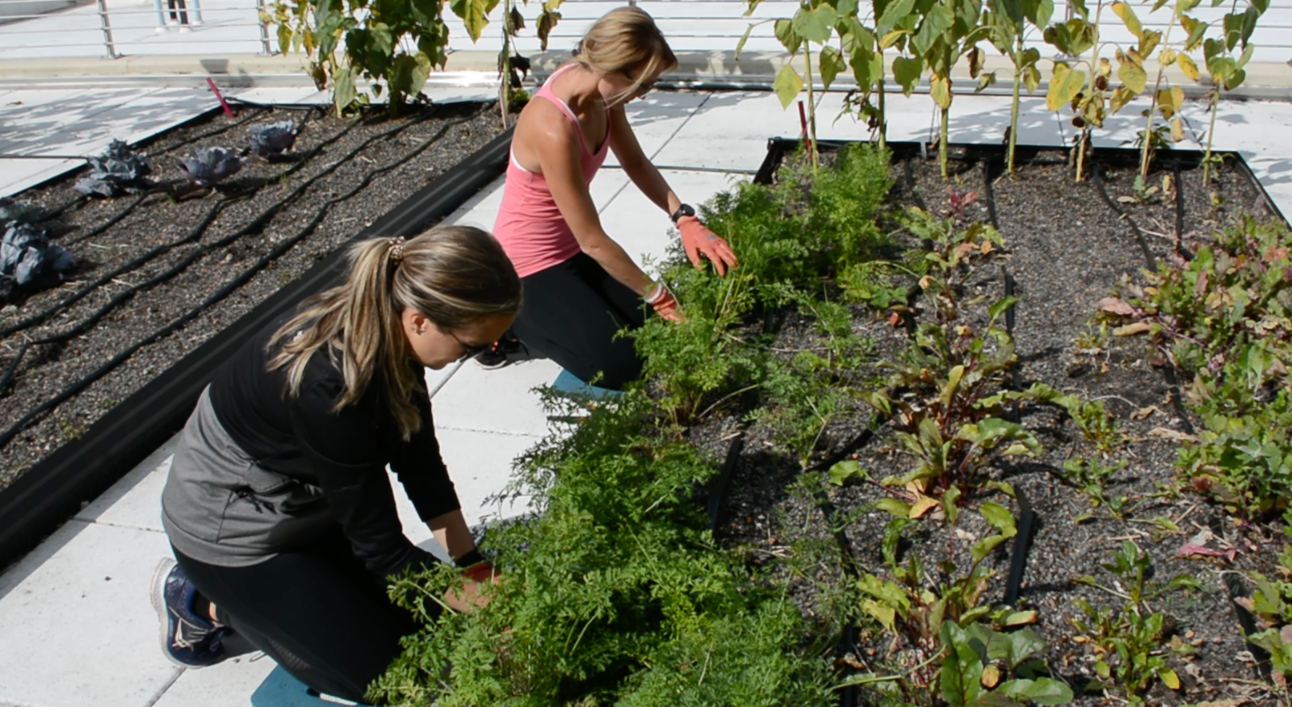
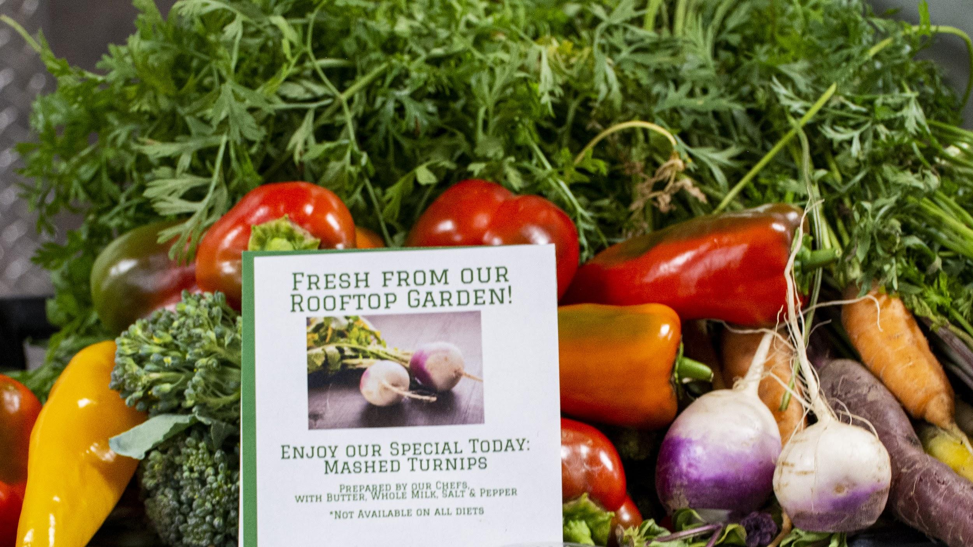
Rooftop Farm at University Hospital

Slide 15
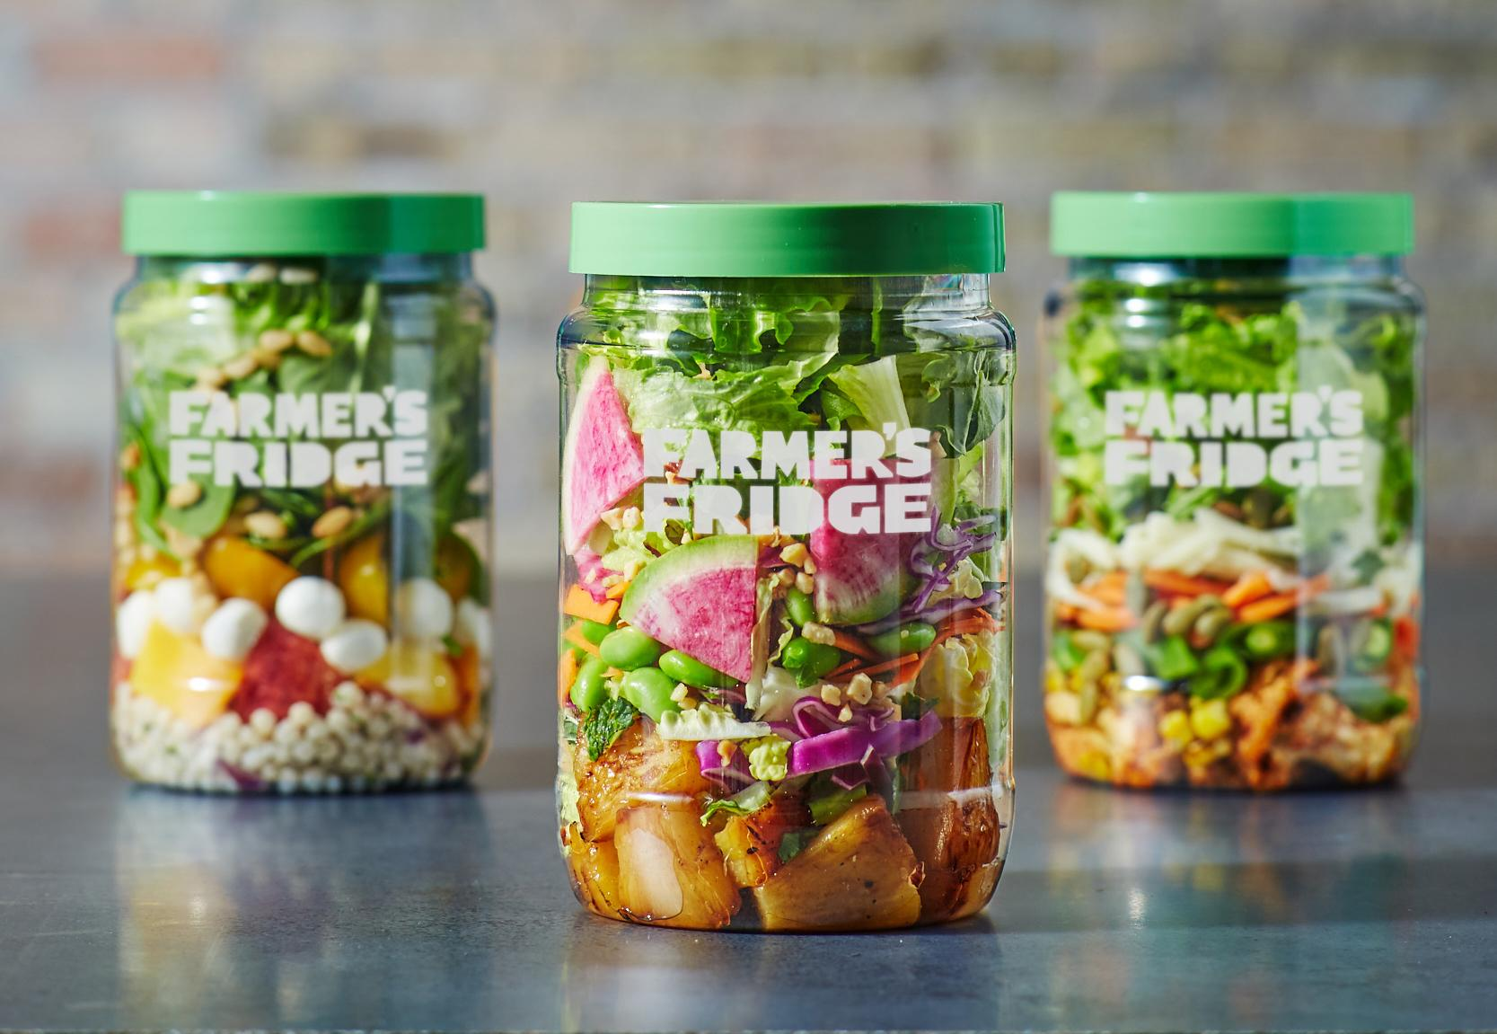
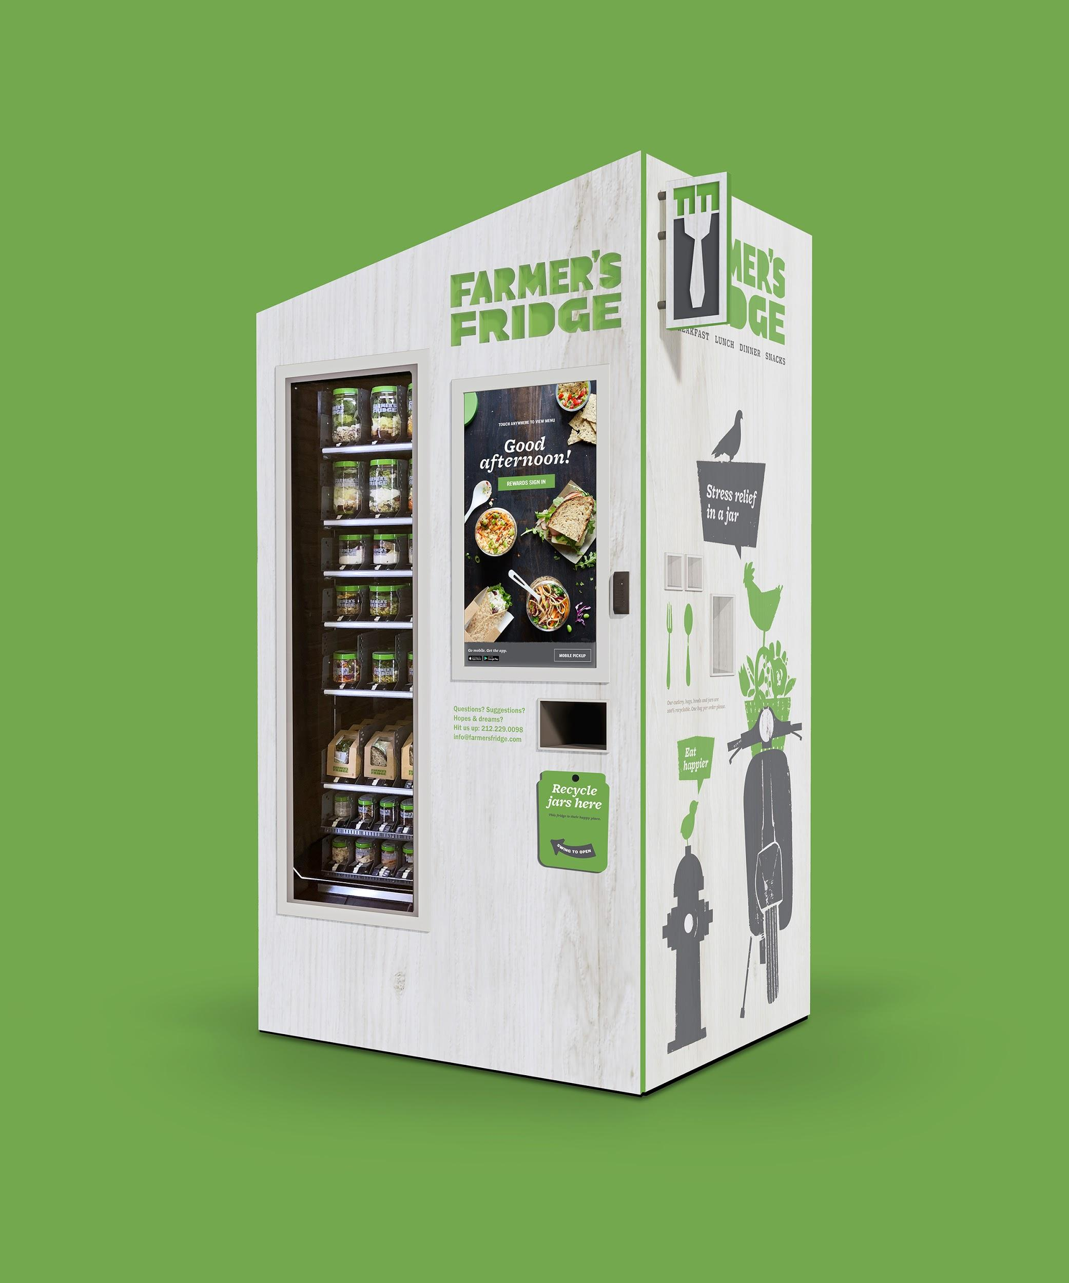
Farmers Fridge
New Vending Options
High quality and seasonal ingredients
Salads, sandwiches, bowls, and trail mix
Javits, Physics, SBS buildings and Tabler Market
Prices range from $4 to $9
Notes:
Working with Farmers Fridge so that unpurchased meals are donated to the SB Food Pantry.

Slide 16
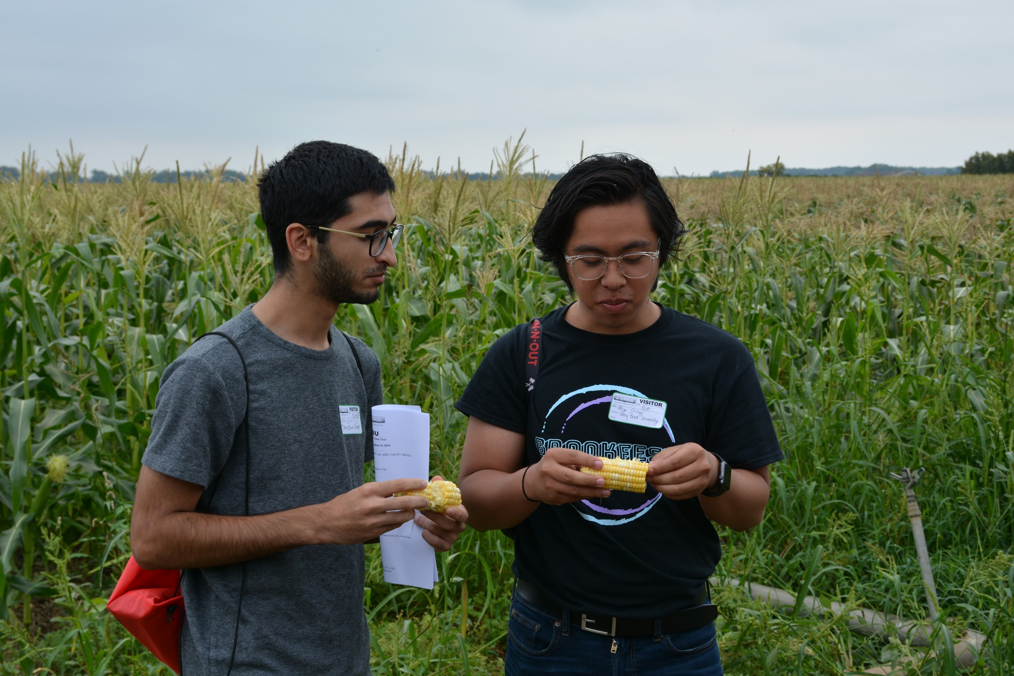
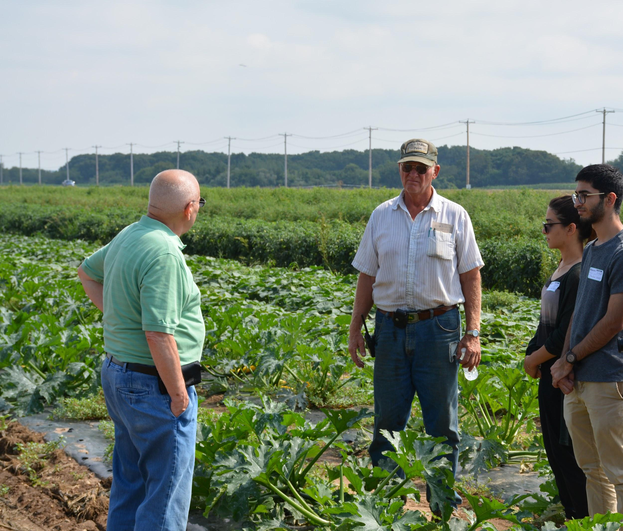
Long Island Farm Tour

Slide 17
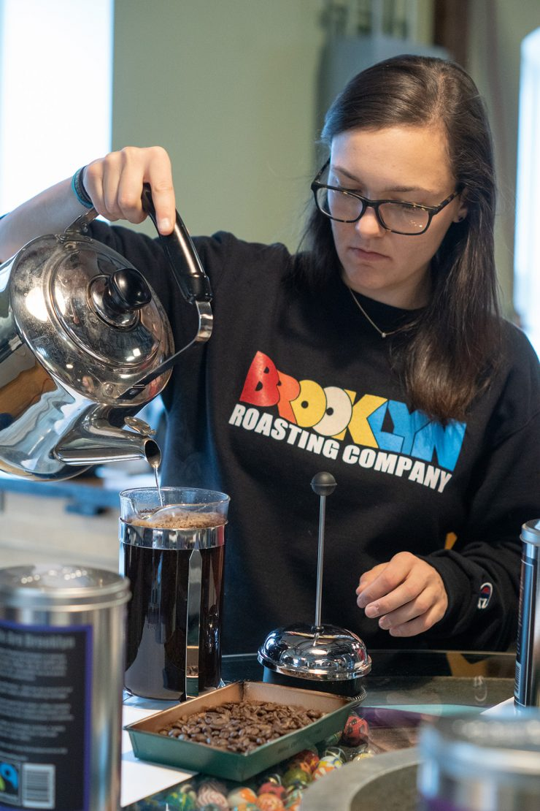
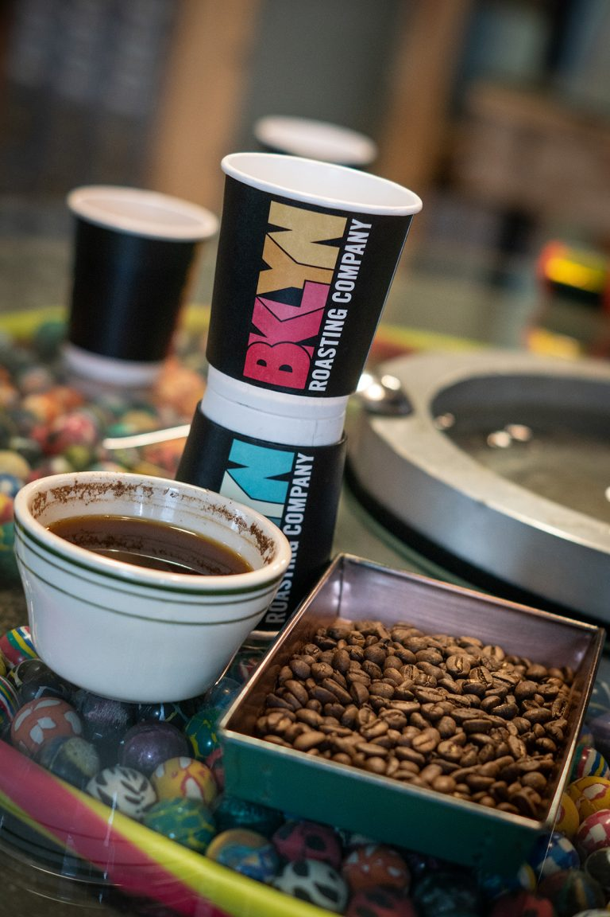
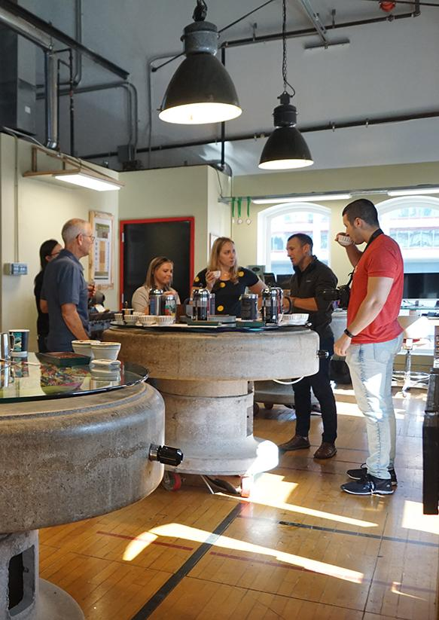
Brooklyn Coffee Roasting Tour
Notes:
Brooklyn Roasting Company Reduces Your Environmental Impact One Cup at a Time

Slide 18
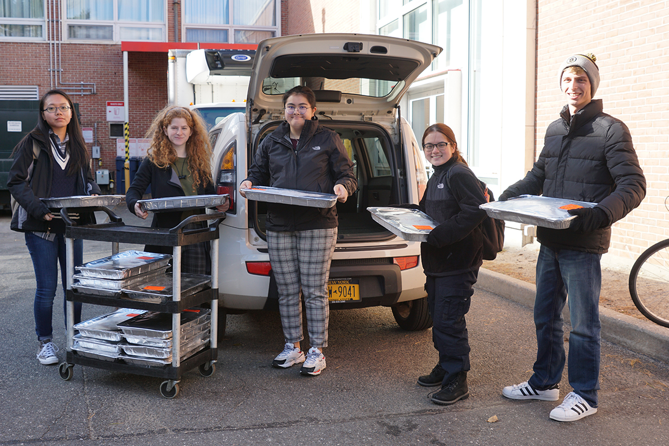
Food Recovery Network
Notes:
A national nonprofit that helps fight food waste and hunger by recovering perishable food that would otherwise go to waste from campus dining and donates it to those in need.
Student volunteers recover surplus food from CulinArt and transport it to organizations from our hunger fighting partner agency, Island Harvest.
Delivered 280 lbs. food to Hands Across Long Island (HALI) in Central Islip in a 2 week period.
Up next … recover grab and go products from our convenience stores prior to expiring and bring them to the Ronald McDonald Room at Stony Brook Children’s Hospital.

Slide 19
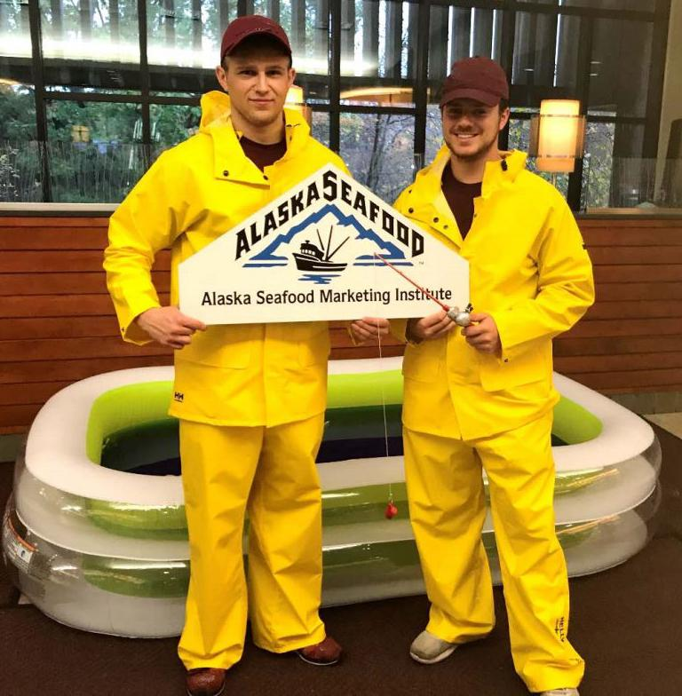

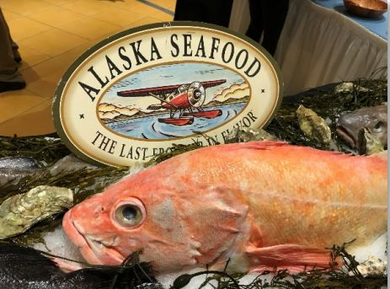
Sustainable Seafood
Notes:
Pop up at dine-in and ASMI will be at the Barton Seaver dinner event.

Slide 20
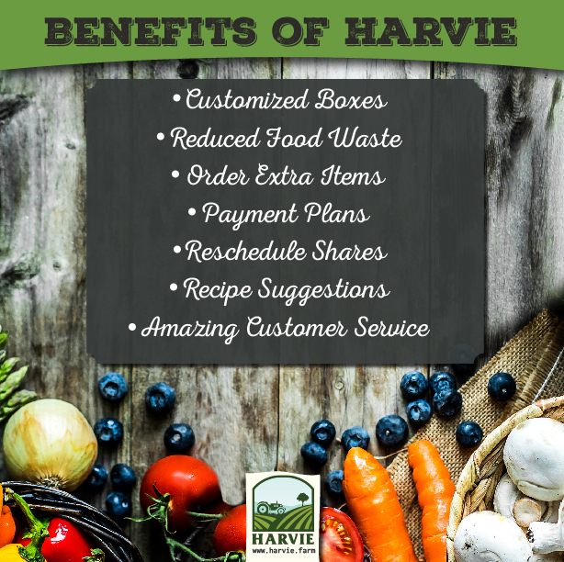
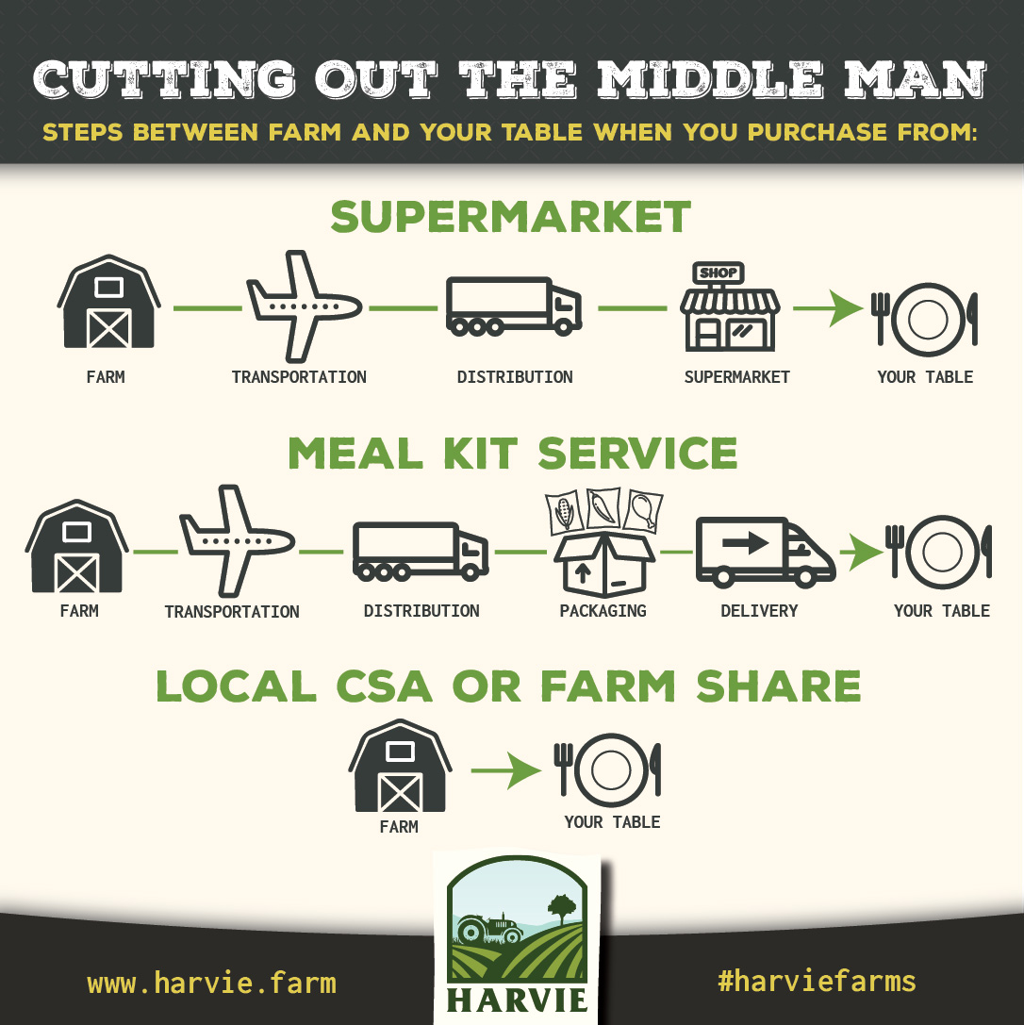
New CSA farm share program
Notes:
Partnership with Healthier U, launching this summer into fall

Slide 21
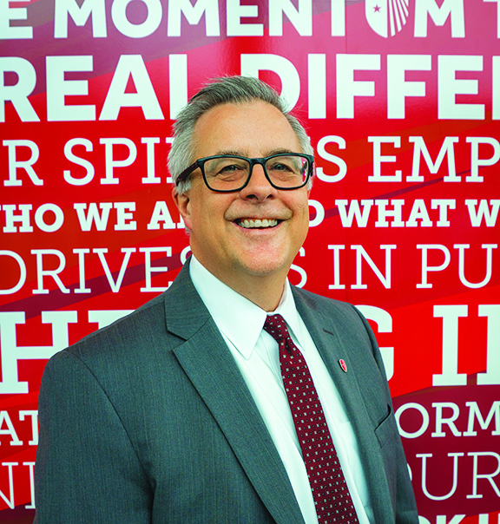
You can do this!
Partnership and consensus with Campus Community
  Bridge narrative between various constituencies
  Construct the narrative
  Frequent communication
  Ubiquity of Auxiliary Services
Calculate costs and plan into budgets going forward
  It’s just math!
  Retail pricing periods
  Cost savings offsets
  Labor analyses
Upstream considerations
Contract partners
  National programs and marketing
  Contractual obligations

Slide 22
Moving Forward
We make your day better!

Slide 23
Changes to Sustainability Efforts
Analyze your sustainability efforts for items that may need to be taken off line or delayed during the COVID crisis, either for safety or financial reasons
Defer new initiative funding if necessary
New Realities are also New Opportunities
    More points of service are more points of contact
    Good conversations, i.e. pumps vs. pc. for condiments
    Disposables and reusables are a focus
    Cost savings are crucial
    Dining will be a major part of the campus narrative
    Promote responsible sourcing and fair living wages as part of the story when serving restaurant quality meals

