Slide 2
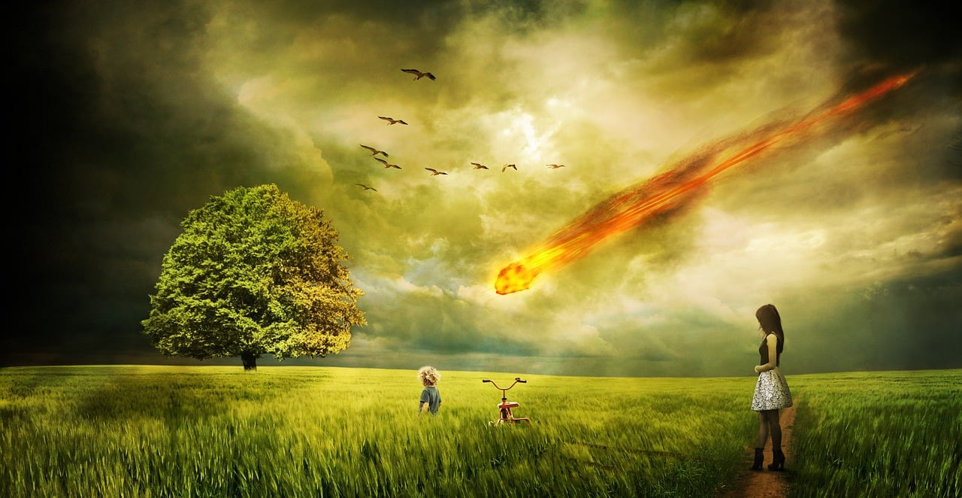
Cli Fi, Sci Fi, and the Culture of Sustainability
AASHE’s 2023 Ultimate Cli Fi Book Club for Sustainability in Higher Education
Hosted by: Krista Hiser, Ph.D.

Slide 3
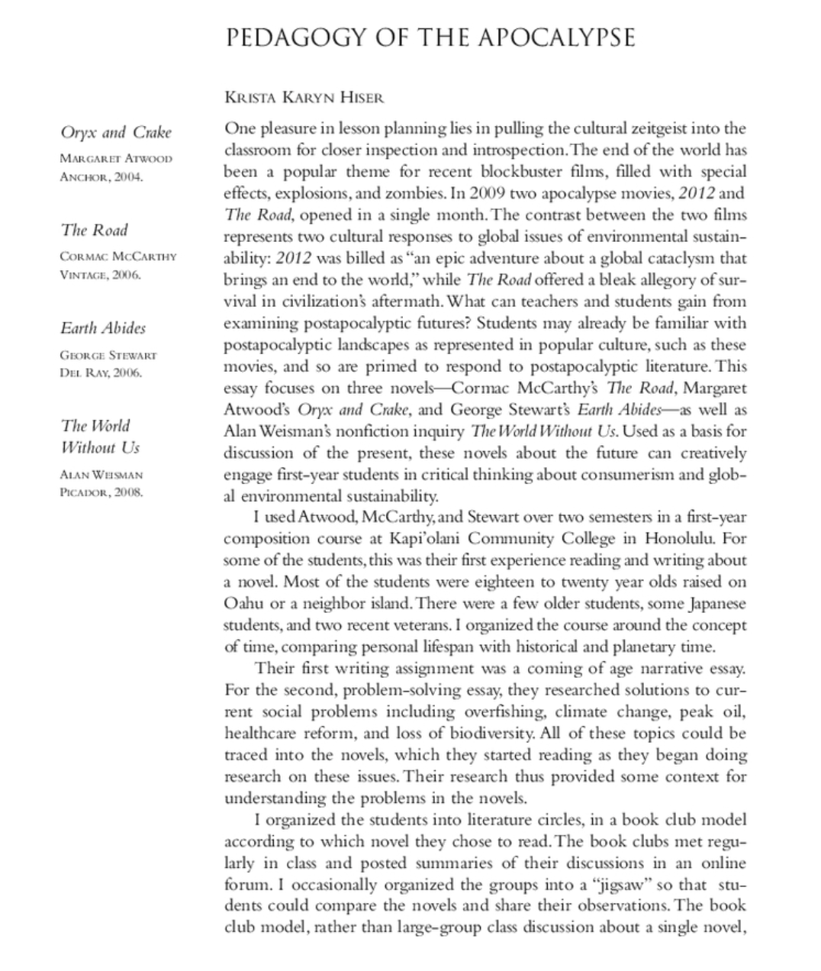

Hiser, K. (2010). Pedagogy of the apocalypse. Transformations: The Journal of Inclusive Scholarship and Pedagogy, (21.1),154-162.

Slide 4

"In Western culture, we often seek truth through confrontation. But our headstrong ways of charging at truth scare the shy soul away. If soul truth is to be spoken and heard, it must be approached 'on the slant.' I do not mean we should be coy, speaking evasively about subjects that make us uncomfortable, which weakens us and our relationships. But soul truth is so powerful that we must allow ourselves to approach it, and it to approach us, indirectly. We must invite, not command, the soul to speak. We must allow, not force, ourselves to listen.
"We achieve intentionality in a circle of trust by focusing on an important topic. We achieve indirection by exploring that topic metaphorically, via a poem, a story, a piece of music, or a work of art that embodies it. I call these embodiments 'third things' because they represent neither the voice of the facilitator nor the voice of a participant. They have voices of their own, voices that tell the truth about a topic but, in the manner of metaphors, tell it on the slant. Mediated by a third thing, truth can emerge from, and return to, our awareness at whatever pace and depth we are able to handle — sometimes inwardly in silence, sometimes aloud in community — giving the shy soul the protective cover it needs.

Slide 5
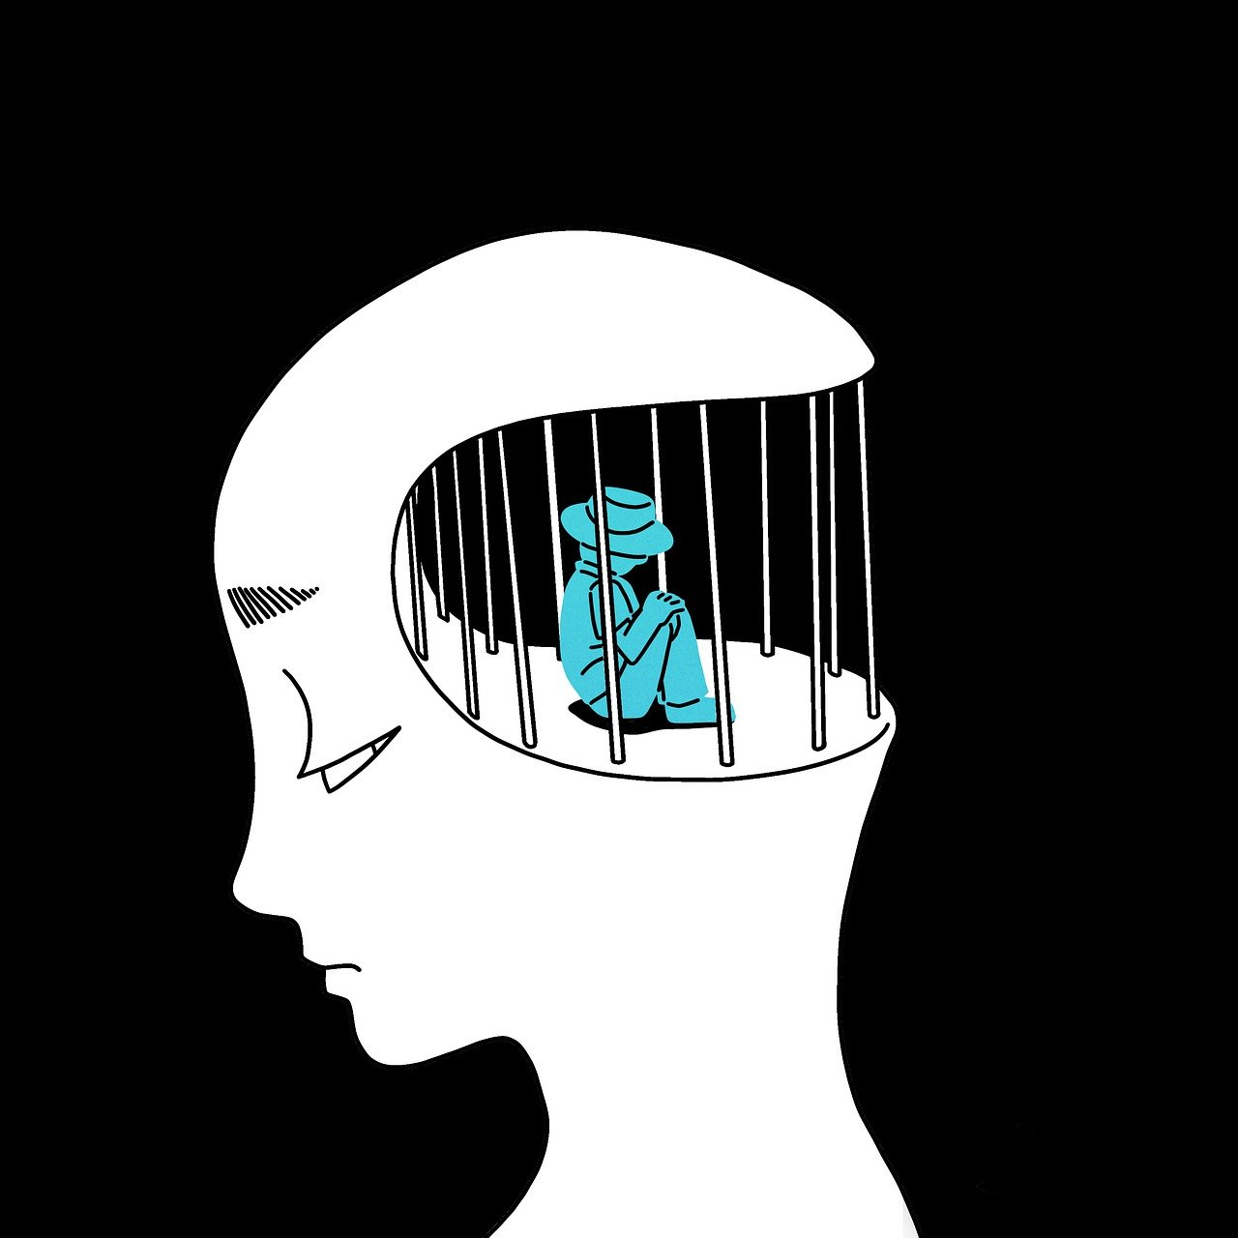
Reading, Attention, and your Brain
Reading penetrates the mind’s defenses against climate change.
Reading slows us down.
Reading transcends time.
Reading engages the sensory world and the emotional world.

Slide 6
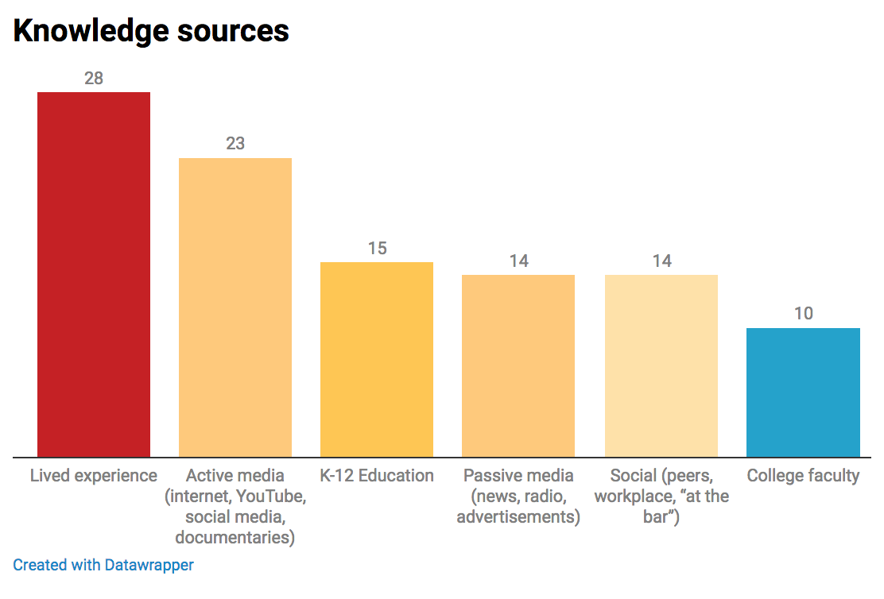
Hiser, K. and Lynch, M. (March, 2021). Worry & Hope: What students know, think, feel, and do about
sustainability and climate change. in Journal of Community Engaged Scholarship (JCES).

Slide 7
What brings you here today? (chat)
Notes:
Mike and mark

Slide 8

UCFBC Criteria & Literature Circles Pedagogy
No aliens, no zombies. (cli fi vs. sci fi)
No silver bullet technology.
An identifiable time and place.
Direct description of some aspect of climate change: SLR, soil depletion, warming, drought, migration, pandemic. Climate change can be the setting, the plot, or a character.
Fine Sentences, Literature
Teachability

Slide 9
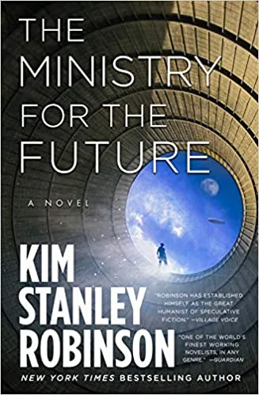
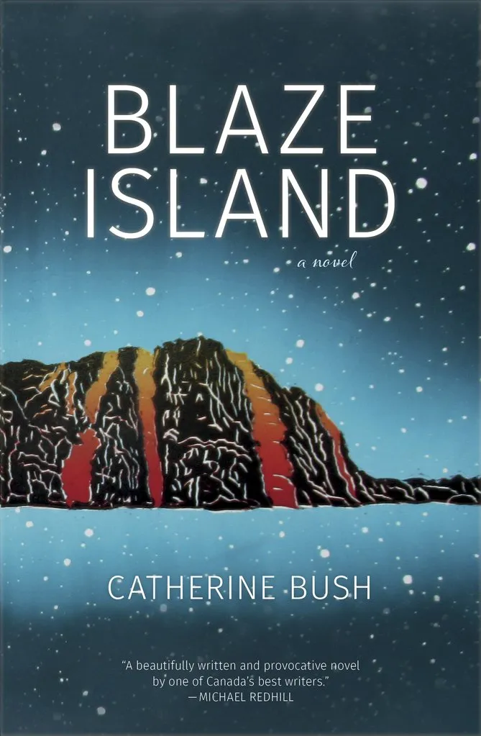
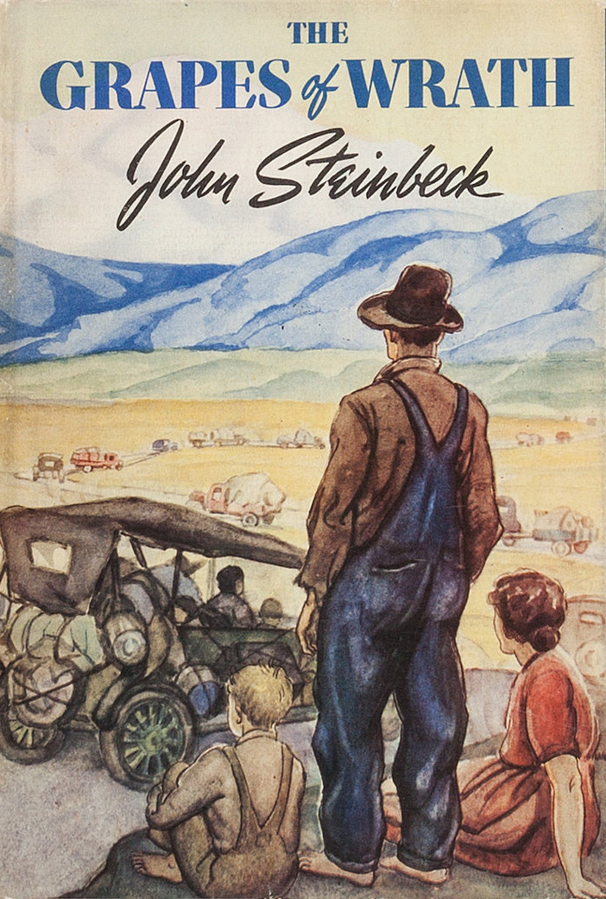
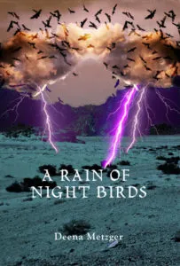



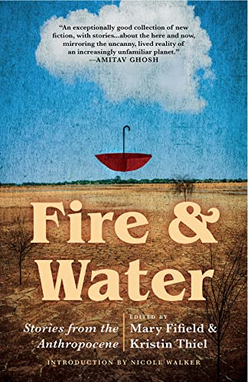
2021
AASHE’s Ultimate Cli Fi Book Club
2022
AASHE’s Ultimate Cli Fi Book Club

Slide 10



2023
Literature of Resoration
with Special Guest
author Sharon English
Short stories, short novels, and poems on the theme of Water
Water is Life
Existential threat of nuclear annihilation…and climate crisis
Using Literature Circles pedaogy in higher education
Interdisciplinary Solutions Thinking

Slide 11
Details
Course participants will meet virtually on the first Thursday of the month from 2:45–4:00 p.m. ET starting on August 3 and continuing through December 7.
August 3: How to Save the Planet using Every Academic Discipline
Ministry for the Future by Kim Stanley Robinson: Engineering, Economics, Environment
September 7: What’s (Nuclear) War Got to Do with It?
Canticle for Leibowitz: Purpose of the University, Ethics, Future Thinking
October 5: Night in the World by Sharon English,
The Literature of Restoration, Urban ecology, Place-based literature
November 2: Water is Life!
Memory of Water by Emmi Itaranha AND participant recommendations for short stories about water.

Slide 12
Future, Earth, Life –
You, promise of our days.
You, ground of our existence.
You, source of our being.
We come to you, broken.
Maybe not broken, merely unfinished.
And yet, with broken hearts:
We nearly broke you.
“If It’s Life We Want: A Prayer for the Future (of the) University.”
Susanne Moser and Ioan Fazey

