Slide 1

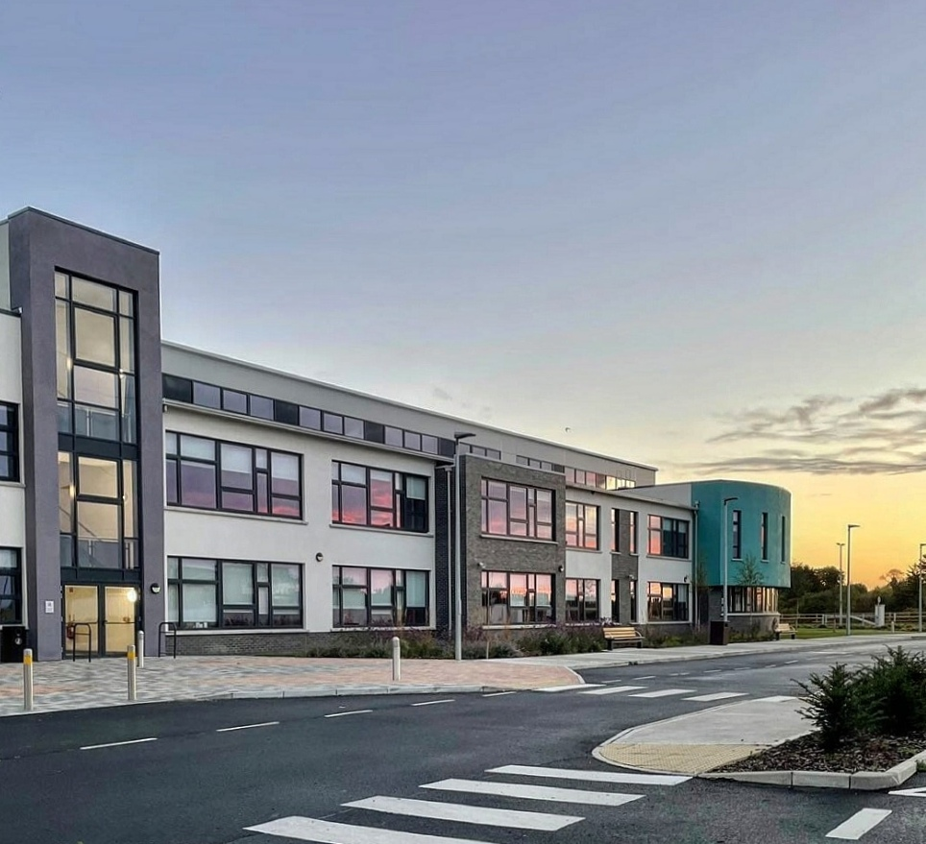
First Year 2026
Information Evening May 2026

Slide 2





Maynooth Community College
Oct 25
Nov 25 – April 26
Assessment Day
Subject choice
Information Meeting
Start in 1st Year
Applied to Maynooth Community College
Offered and Accepted a place in MCC
CAT 4
Cognitive abilities test
Picked a language and two other options
Overview of transition to secondary school
Start on
Friday 28th August 8:48AM-12:30PM

Slide 3

KWETB / MCC Ethos

Slide 4
Our Mission Statement
  Maynooth Community College is a
  community of students, staff and parents.
  We aim to create a warm and caring learning environment in which
  all students can achieve their full potential.
  We value the unique contribution of each individual in an atmosphere of tolerance, partnership and shared respect.

Slide 5

Secondary School
New friends
New subjects & teachers
New building
New day to day routine
New Lockers and a Canteen

Slide 6
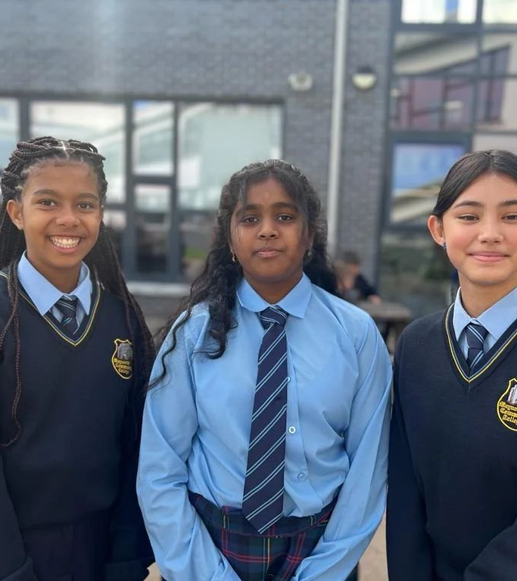
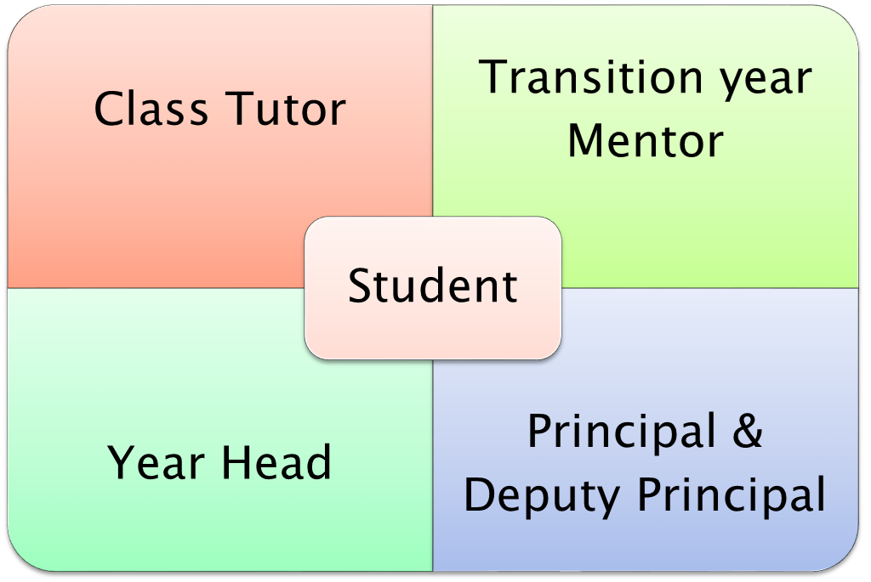

Slide 7
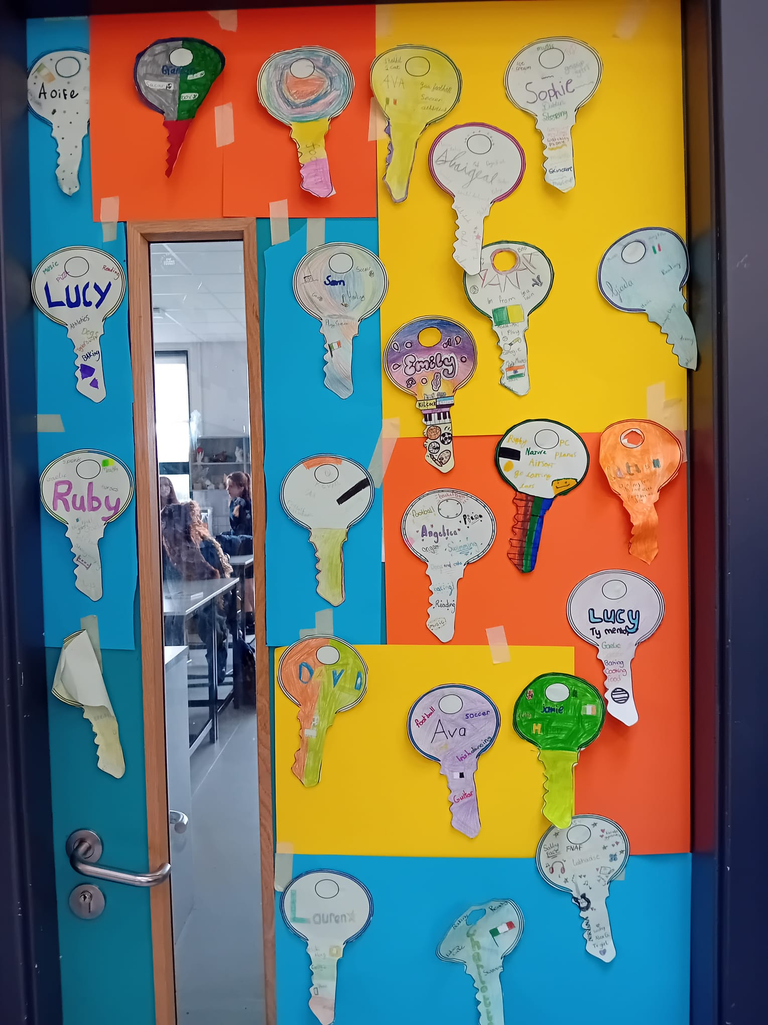

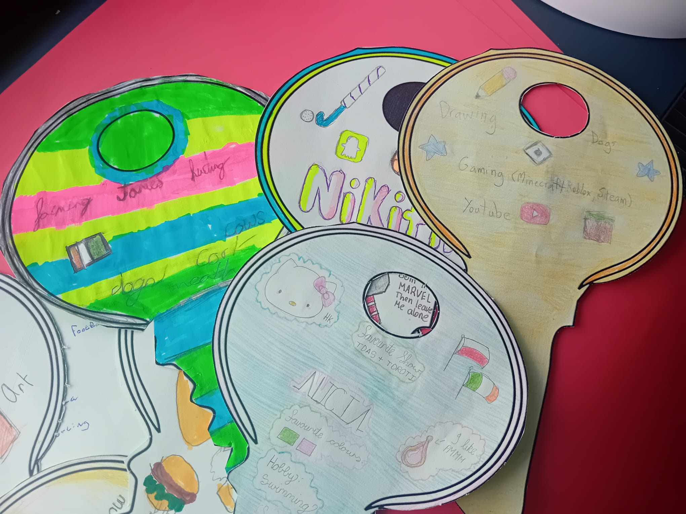
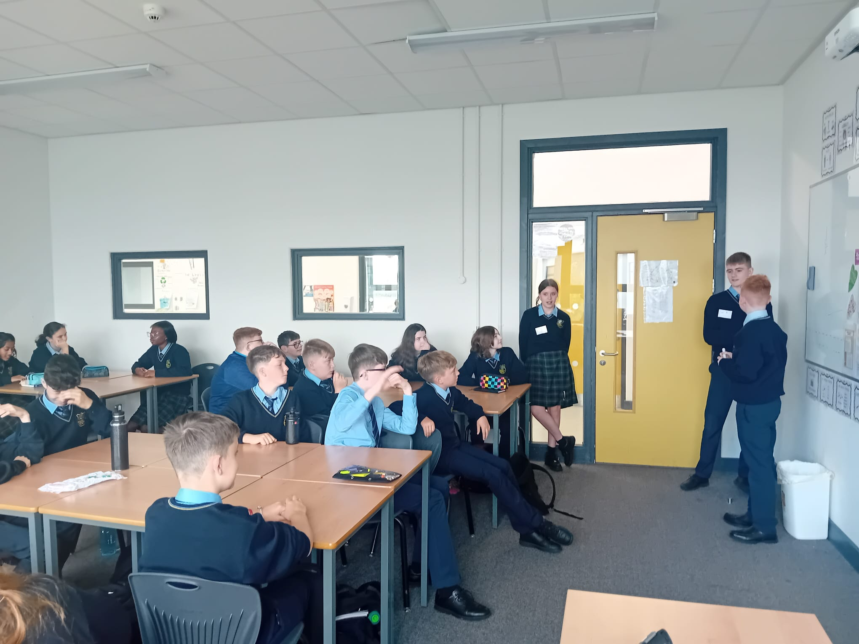


Slide 8
7 First year classes – 200 students
All classes are mixed ability groupings , with a common level taught to all.
Educational Structure
Dedicated Lunch rooms, Toilets, Locker areas
Each first year will do 11 core subjects and 3 optional subjects.
28 hour working week

Slide 9
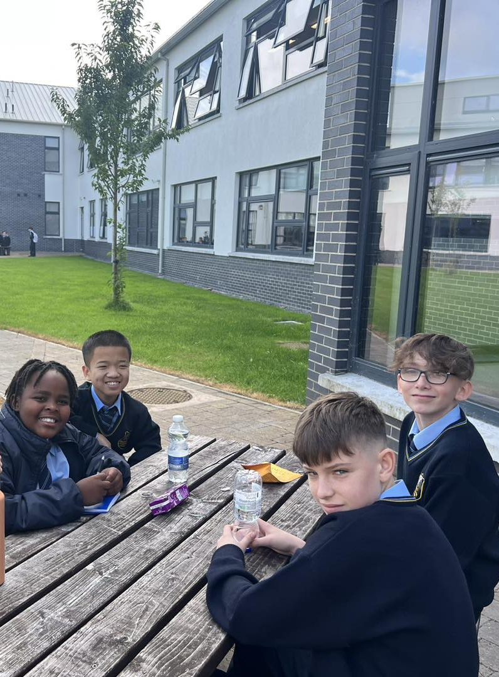

Core Subjects

Slide 10
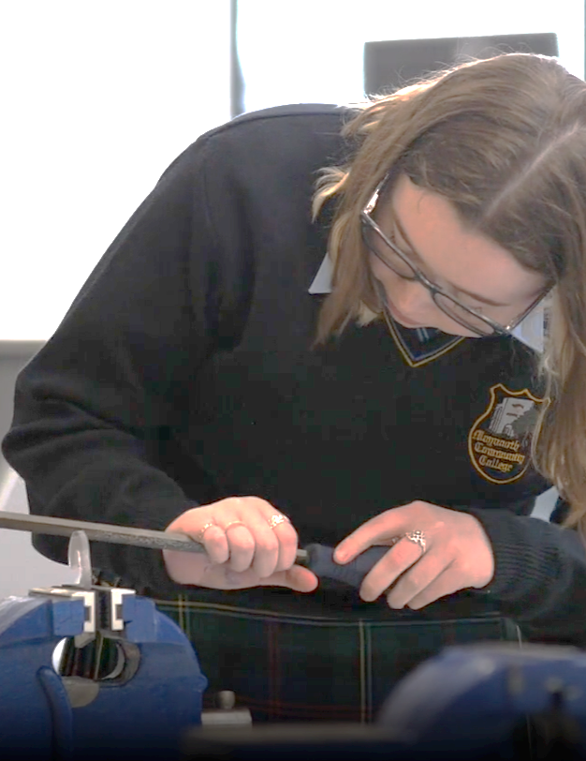
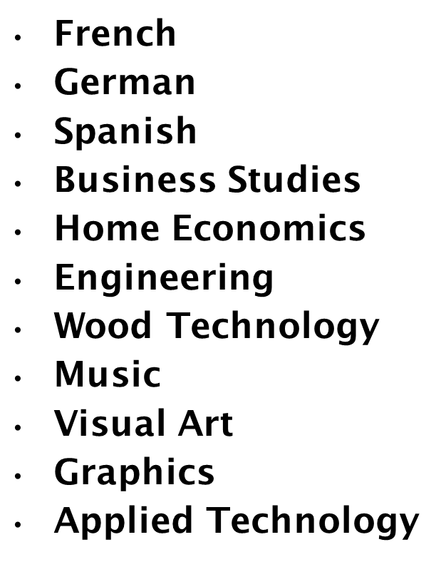
Optional Subjects

Slide 11


Additional Educational Needs
School support for all
Additional support for some
An Cuan (special classes)

Slide 12
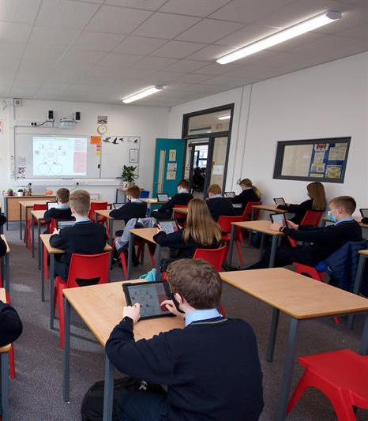
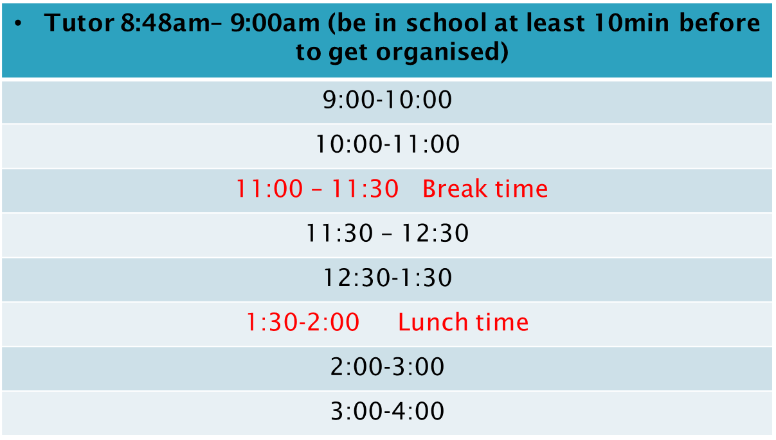
Classes finish at 12:30 on a Friday.

Slide 13
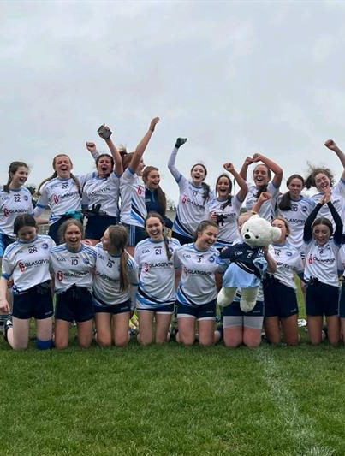
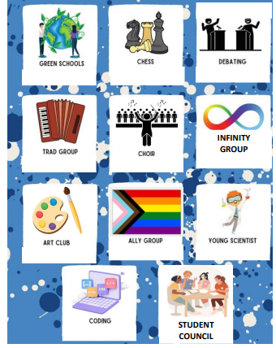
Extra Curricular Activities

Slide 14
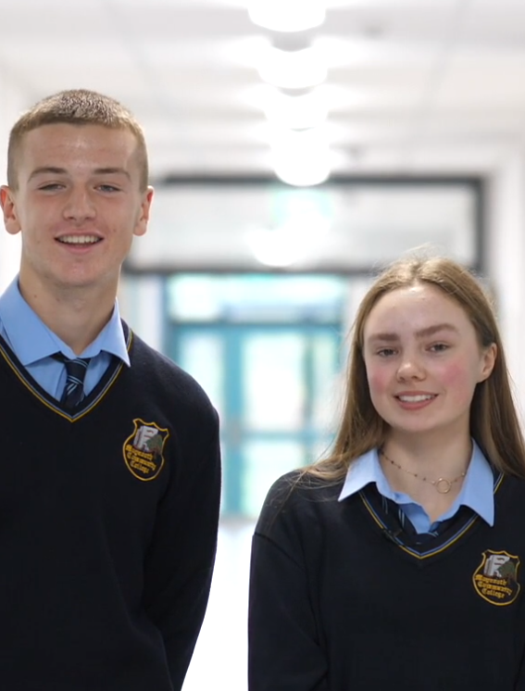
Student Leadership
Teams

Slide 15



What we need to know
Any relevant medical information
Educational Reports etc
Any change in circumstances or relevant information

Slide 16
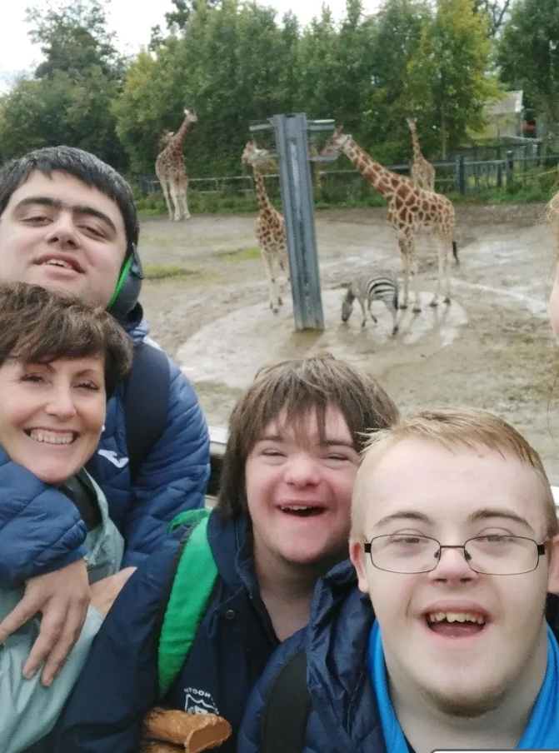

Code of Behaviour
Bí Cineálta Policy
School Policies
Working together –
Our Community Vision

Slide 17
Parents & Guardians as Partners
Open and welcoming policy
Tyro App
Parent Teacher Association
Board of Management representation
Parent/Teacher Meetings
Social Media: Facebook / Instagram
School Reports
Online year group meetings
School Events
Information Evenings
Pastoral Care
School Website
Guest Speakers
Mobile phone policy

Slide 18
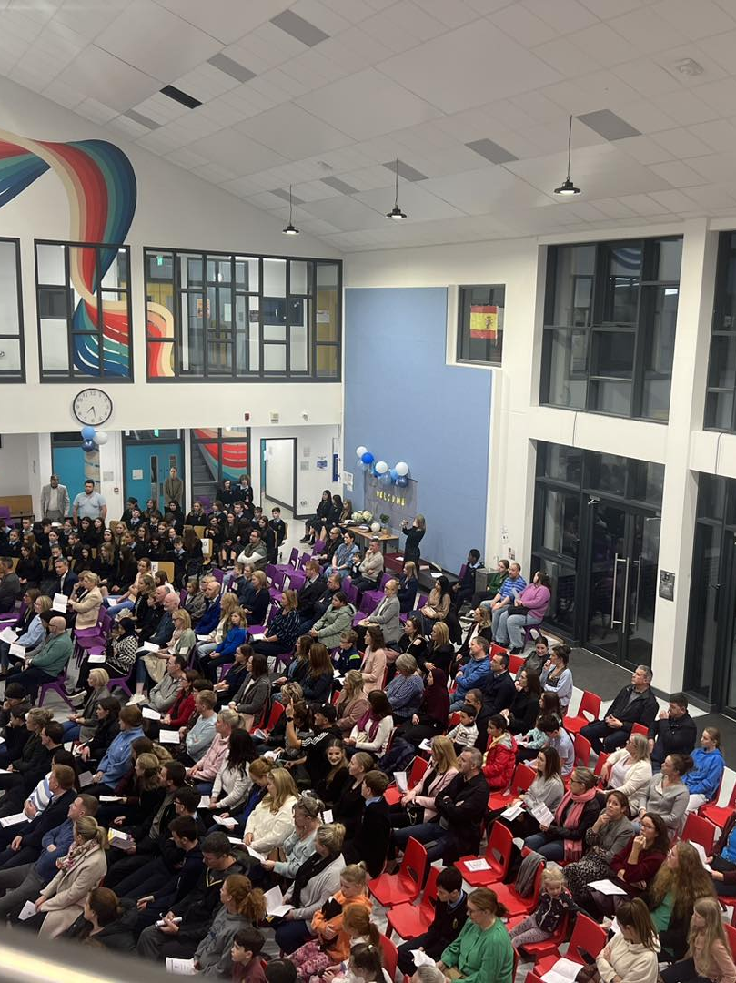
How can you support
the transition to
Secondary School.

Slide 19

School Communication App
Reception: reception@mcc.edu.ie
Principal: principal@mcc.edu.ie
Year Head: n.hynes@mcc.edu.ie

Slide 20


We are a Microsoft school using teams as our online platform.
All students will receive a school email address and password in September.
Students will get all the training they need to allow them to use these tools with confidence. ​
All students will be required to download the teams app onto a device .
1:1 Laptop devices from 2nd year ​

Slide 21
School Book Scheme
Textbooks & copies
Journal
Calculator

Slide 22
What will you need to provide:
School bag
Pencil case
Pens / Pencils
Rulers / Rubber / Pencil sharpener
Highlighters
Home Economics ingredients and we may require a contribution to practical subjects

Slide 23
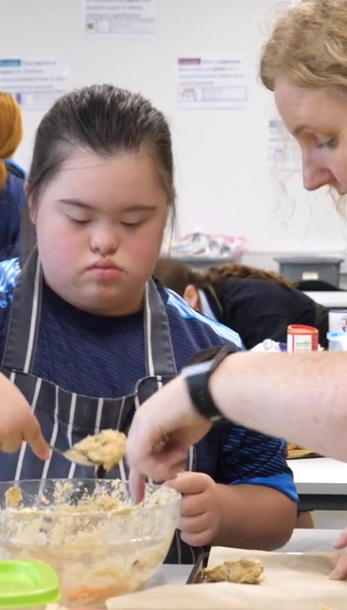
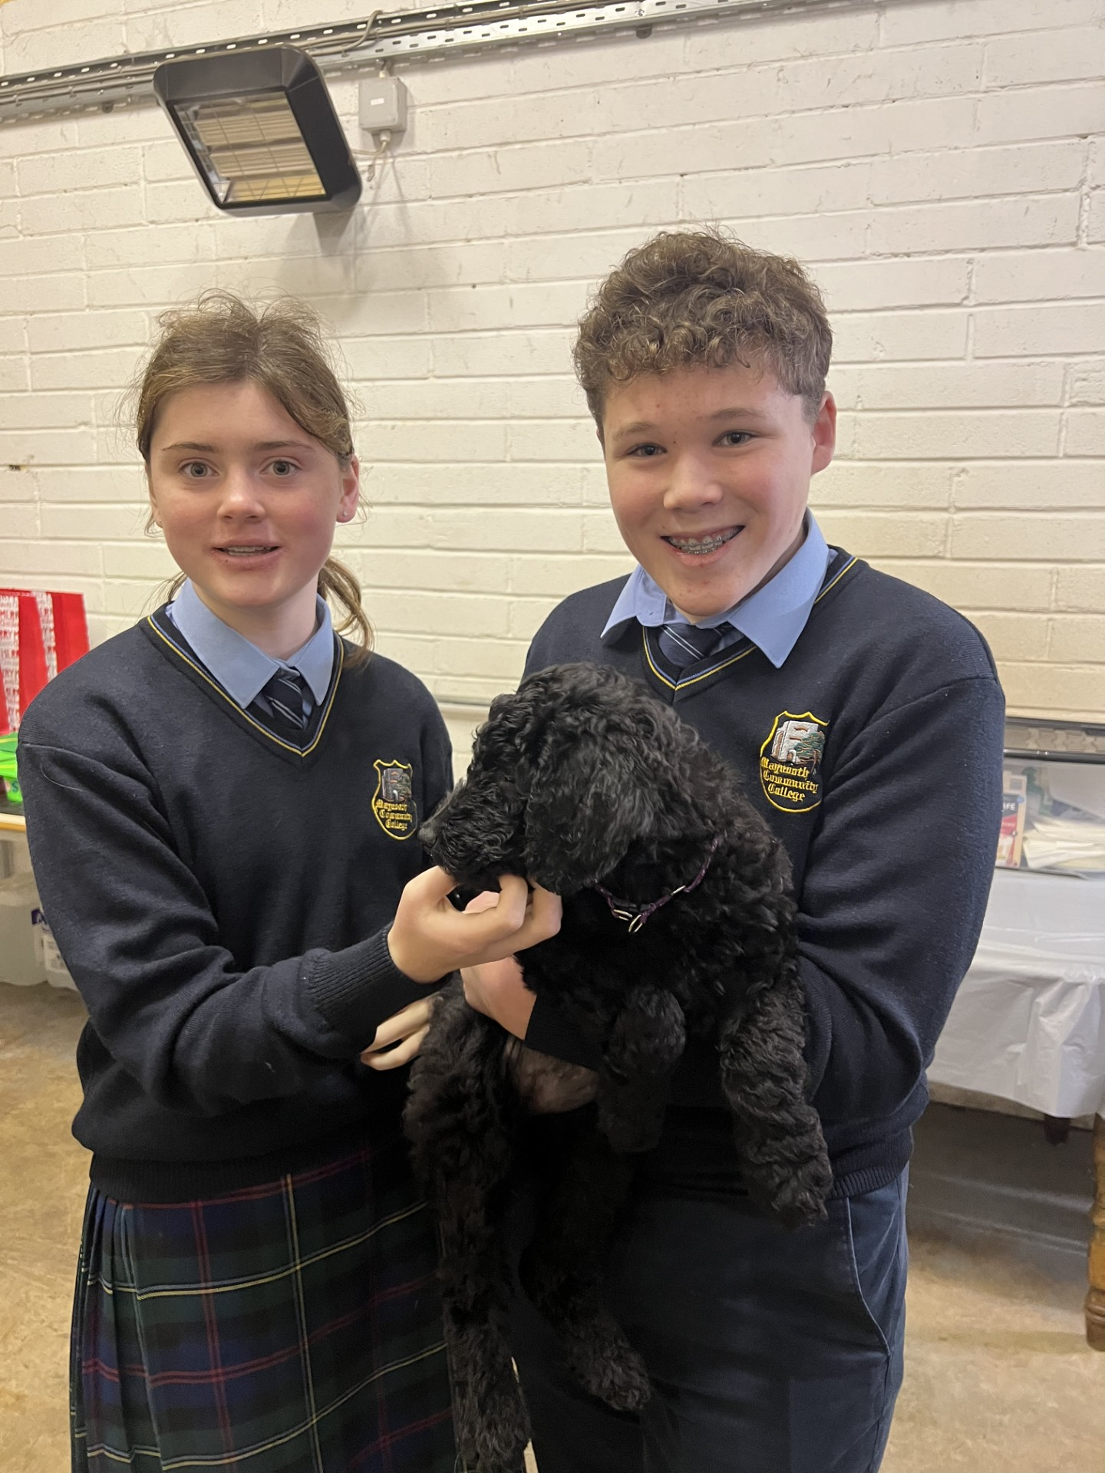

School Uniform
www.schoolwear.ie
School Coat
School Shoes
PE Uniform https://schoolsportsuniforms.ie/collections/maynooth-education-campus
Fitting days 3:15pm-6:00pm in the sports hall .
- Mon 25th May (A-G)
    Tue 26th May (H-M)
    Wed 27th May (N-Z)

Slide 24
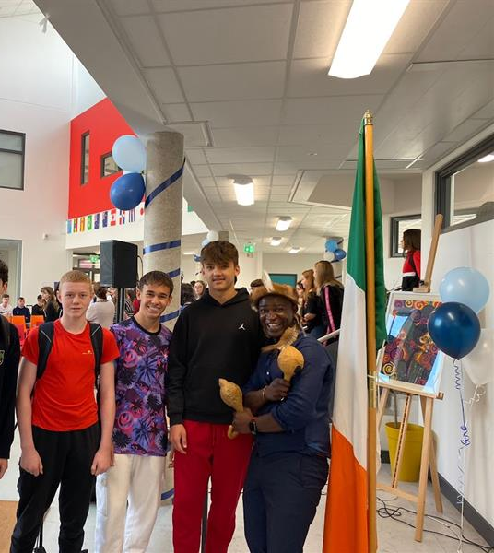
Summer Pack:
1st Year Equipment List 2026/2027 *
School Calendar 2026/2027
Uniform Letter
tyro Information Guide
Social Media Information Letter
School Map
A Parent’s Guide to Child Protection Guidelines
Junior Cycle Information Leaflet
Junior Cycle Reporting and Assessment Leaflet
Junior Cycle Wellbeing
SPHE and RSE Information Leaflet

Slide 25
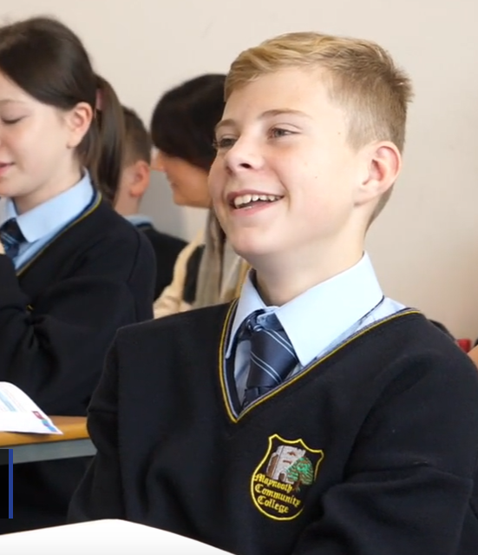
Start in 1st Year in MCC
on
Friday 28th August 8:48am – 12:30 pm

