Slide 1
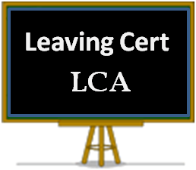


Leaving Certificate Applied Maynooth Post Primary School

Slide 2
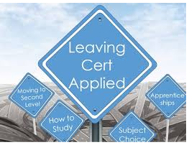
What is the Leaving Certificate Applied?
It is a distinct, self-contained two-year Leaving Certificate programme aimed at preparing learners for adult and working life.
It emphasises forms of achievement and excellence which the established Leaving Certificate has not recognised in the past.
It offers learners specific opportunities to prepare for and progress to further education and training.

Slide 3

Who would benefit most from the Leaving Certificate Applied?
Learners who are not adequately catered for by traditional Leaving Certificate.
Students who enjoy doing project work and independent research.
Students who like to gain credits (marks) for classwork / assignments rather than focusing solely on a full set of exams at the end of the 2 year period.

Slide 4
Key Underlying Principles
student centred curriculum
team work
active teaching /learning methodologies
personal and social development
community links
integration and cross curricular links
literacy & numeracy development
reflection

Slide 5

Structure of Leaving Certificate Applied
2 year programme
4 sessions, September to January and February to June
LCA made up of courses
Courses are made up of modules
Over the 2 years, students will complete 44 modules
****Work Experience every Friday
There is a cost of €200 per year for LCA to cover workshops and trips.

Slide 6
Maynooth Post Primary School - LCA
Music
VPG
Art
Social Education
Mathematical
Applications
Irish
Foreign Language
ICT
English & Communication
Leisure & Rec
HCT

Slide 7


Assessment
Satisfactory completion of Modules 62 credits (31%)
3 Modes
7 Student tasks 70 credits (35%)
Final examinations 68 credits (34%)
Total 200 credits (100%)
3 levels
Pass (60-69 %) (120 - 139 credits)
Merit (70-84 %) (140 - 169 credits)
Distinction (85-100 %) (170 - 200 credits)

Slide 8

Assessment Modules
Requirements:
Evidence of completion of 4 key assignments for each module
90% attendance

Slide 9


Leaving Certificate Applied Route Map
Leaving
Certificate
Applied
Vocational Preparation
Vocational Education
Post Leaving
Certificate
Course
Further & Higher Education
Careers
SOLAS
Apprenticeships

Slide 10
The Difference in the End
Leaving Cert Applied
Leaving Cert.
1. Well prepared for work
2.Will be experienced in interviews
3. Good at working in a team
4. Have good self – knowledge
5. Good critical / reflective thinkers
1. Well prepared for further education
2. Good at dealing with pressure
3. Will have learned more from books
4. Be competent academically

Slide 11

Thank You Questions
j.byrnes@mpps.ie

