Slide 1

Transition Year in Maynooth Post Primary School
A space to grow

Slide 2
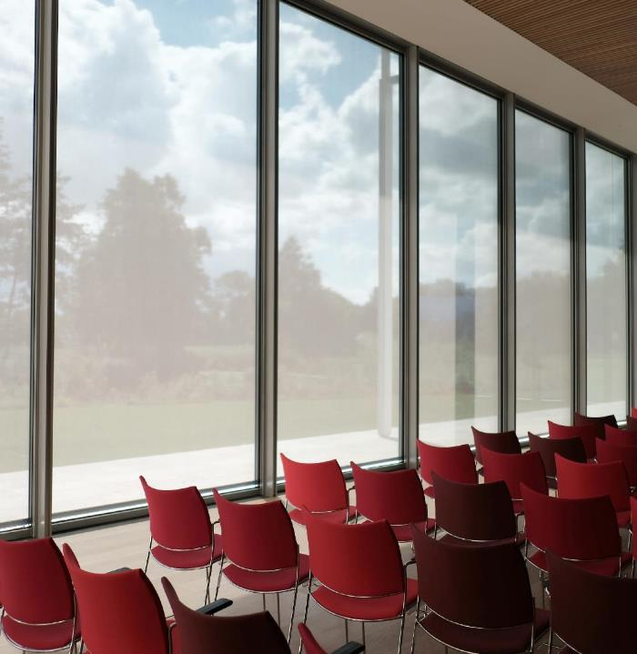
Aims of TY
A chance to find and develop individual strengths
To become more independent
To become more responsible for study & self-directed work

Slide 3

The space and opportunity to mature and grow To develop greater self-confidence To become better at making decisions Become more skilled at getting on with other students & those in authority To develop clearer goals & aspirations for life To prepare for personal, leisure & working life
Our vision for TY

Slide 4

The TY Team Programme Coordinator: Ms. J. Byrnes Year Head: Mr. Winders Tutors: To be confirmed
 | Year Head
Tutors | To be confirmed

Slide 5


Core Subjects
Modular Subjects
Irish
English
Mathematics
French/Spanish/German
World of Science
Religious Education
PE
Computer Applications
Career Guidance
Work Organisation/VPG
History
Geography
SPHE
Leadership
Cookery
Crafts (Woodwork)
Art
Chinese
Japanese
Polish
Horticulture
Media Studies
Economics / Business
Road Safety
Community Studies
Annual School Musical
These are the core and modular subjects for 2025/ 2026. There may be changes next year due to number of class groups and timetabling constraints.
5

Slide 6
TY ACTIVITIES 2025 - 2026
Nutrition / Fitness
Sexual Consent
Law Workshop
Christmas Panto
Driving
Hospitality
Barista Workshop
Trip to Causey Farm
Sniffer Squad
Personal Safety
Visit from National Reptile Zoo
Just 1 Life
Acting Workshop
EiSHT Mental Health Workshop
Forensic Fun
Kairos TV Production Workshop
Redhills
Christmas Boxes
Christmas Appeal in aid of the Homeless
SIPTU
Presentations by Credit Union & Irish Army Science Quiz
Genetics at Dublin Zoo Magic & Stage Confidence
An advance payment of €400 is required to cover the cost of activities. Please forward to the school by Thursday 30th April 2026.
6

Slide 7
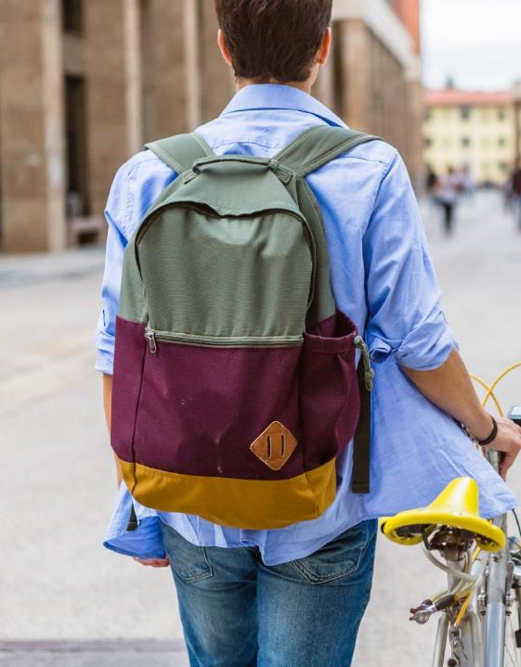
Optional Extras
Mentor Programme The Rubbish Film Festival (Kildare County Council & Createschool)
Organising GAA blitzes for 1st Year Students
Bakesales in aid of Charity Science Club
ISTA Photograph Competition RCSI (Royal College of Surgeons Ireland) TY Programme
Junk Kouture Fashion Competition Fáilte Ireland TourismCareers.ie
An Garda Síochána One-Week TY Programme
EPAS (European Parliament Ambassador School) Programme
Houses of the Oireachtas TY Work Experience National Gallery of Ireland TY Work Experience
Helping with School Library
Gaisce
TY Defence Forces One-Week Programme Career Fair
National Short Story Competition
Maynooth University Short Film Competition
STEPS Engineer Your Future Programme
Christmas Shoebox Appeal Team Hope Law Ed Tik Tok Competition
ASLFL Leadership Conference Maynooth University July 2026
Glenveagh Construction Placement
DNG Placement Gas Networks Ireland Placement
7

Slide 8



Key Elements
TY Portfolio
After each activity, students must write a reflective report and put it in their digital portfolio
Credit System
This is in place to monitor participation, attendance & behaviour.
Certification at the end of the year will be based on the Credit System. Each student will be given credits at the beginning of the year. It will be the student’s responsibility to keep them
Work experience takes place one day per week.
Session 1: From the first or second week in September 2026 until the week before the Christmas holidays.
Session 2: From after February midterm break until May 2027.
Students on work placement are covered by school insurance.
8
Notes:
Each student will receive a Work Experience Journal, with each Wednesday’s date printed.
The employer must sign and stamp the relevant spot.
Tutor follows up in VPG class once a week to check that each student is engaged in a work experience placement every Wednesday. Block weeks are permitted if some students wish to avail of that opportunity but attendance at a work experience placement every Wednesday is compulsory for every single student.
One block week does not equal 5 Wednesdays spent at home.

Slide 9


Work Experience
In addition to the compulsory one day per week work placements students may avail of block week-long placements. However, students MUST be at work on the chosen work experience day.
Each student will receive a Work Experience Journal with each work experience day date printed. The employer should stamp and sign the relevant spots. Tutor follows up every week in VPG class
9

Slide 10



Communication Methods
0fwjah3
0fwjah3
Microsoft teams is our information/communications forum
A new group will be set up and the code provided to students and parents.
Students must join.
Information for parents will be sent via Vsware / TYRO
10

Slide 11





THANK YOU
Ms J. Byrnes
01-6286060
j.byrnes@mpps.ie
www.mpps.ie

